Slide 1
Body Fluids
Dr. Maha Saja
Physiology department,
Level 2,
Office 89,
Email: msaja@ksu.edu.sa

Slide 2
Objectives
• State the water content of the body.
• Describe the physiologic factors that determine the body’s water
content.
• Discuss water balance in the body with regards to intake and output.
• Describe the physiologic mechanisms involved in water balance (the
role of ADH hormone and thirst mechanism).
• Enumerate the different body fluid compartments and state their
normal volume.
• Describe the composition of the different body fluid compartments.
• Define osmolarity and state the normal osmolarity of body fluids.
• Explain the effects of placing a cell in solutions with varying tonicity
on the cell volume.
• Enumerate fluids used in clinical practice and state their tonicity
compared to that of normal body fluids.
• Describe the effects of infusing IV fluids with different tonicities on
the volume and osmolarity of the different body compartments.
Study source for this lecture:
(Guyton & Hall Textbook of Medical Physiology, 13th ed, Chapter 25)

Slide 3
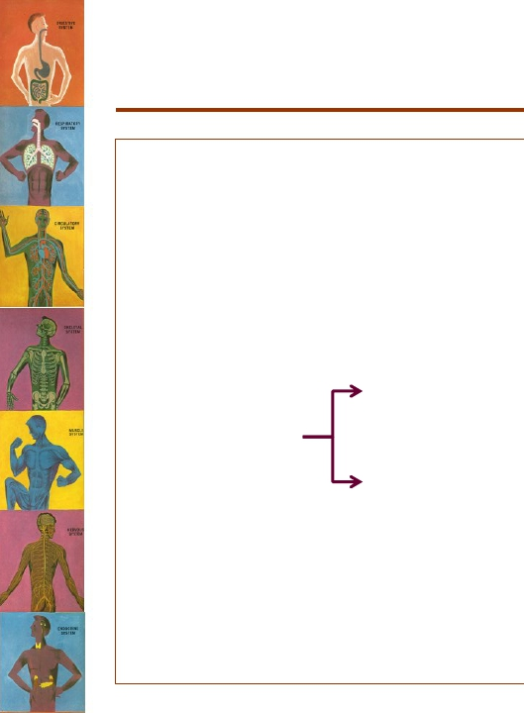
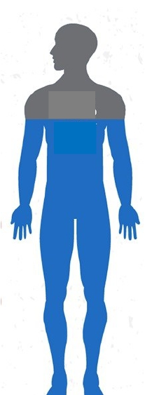
Body Fluid Content
• Total body fluids ≈ 60% (50-70%)
of total body weight (TBW).
• Body fluids = water + dissolved
solutes.
60%
Water
Electrolytes
(Na+, K+, Cl-, HCO3-
, Mg+2, Ca+2)
▪ Solutes
Non-electrolytes
(glucose, urea, creatinine)
• Total body water ≈ 60% of TBW.
(Guyton and Hall Textbook of Medical Physiology. 13th ed. Ch-25)

Slide 4
Calculate the total body water content
of a 30-year-old 70kg man?

Slide 5
Physiologic factors affecting
body water content
• Is body fluid/water
content similar
between;
➢ Child & adult?
➢
➢
Young & old?
Male & female?

Slide 6
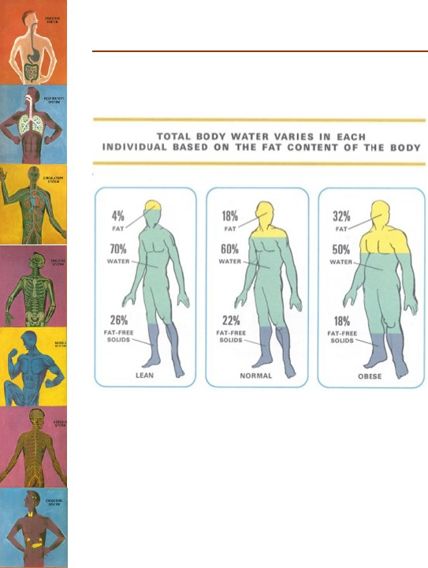
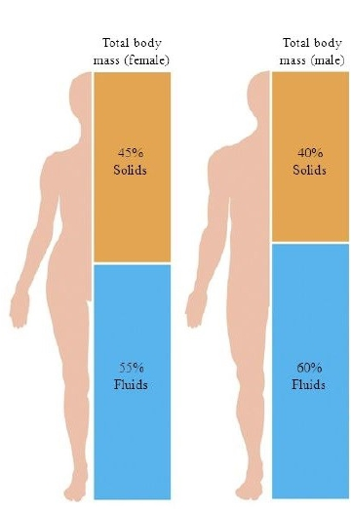
Continue.. Physiologic Factors Affecting Body Fluid Content

Slide 7
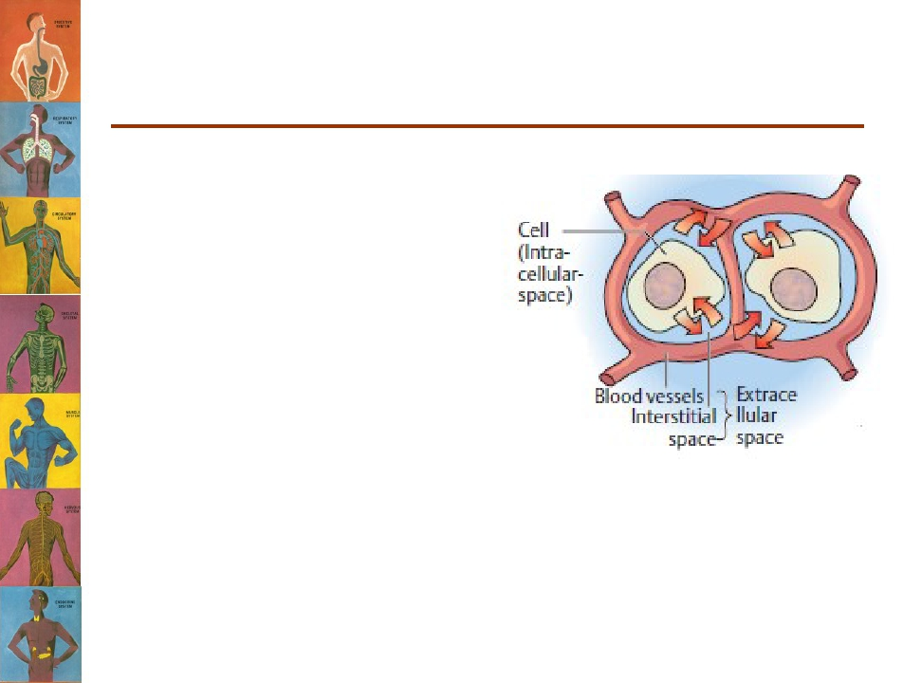
Water Balance
• Cells are largely made of
water and are surrounded
by a “sea” of water.
• Water is constantly being
exchanged between the
cells and surrounding
environment.
• Keeping a constant
volume of water is
essential for homeostasis.

Slide 8
Maintenance of Fluid Balance
Daily loss:
• Insensible loss (700 ml).
• Sweat (100 ml).
• Feces (100 ml).
• Urine (1400 ml).
Total loss = 2300 ml
Water intake:
• Fluids ingested (2100 ml).
• From metabolism (200ml)
Total intake = 2300 ml

Slide 9
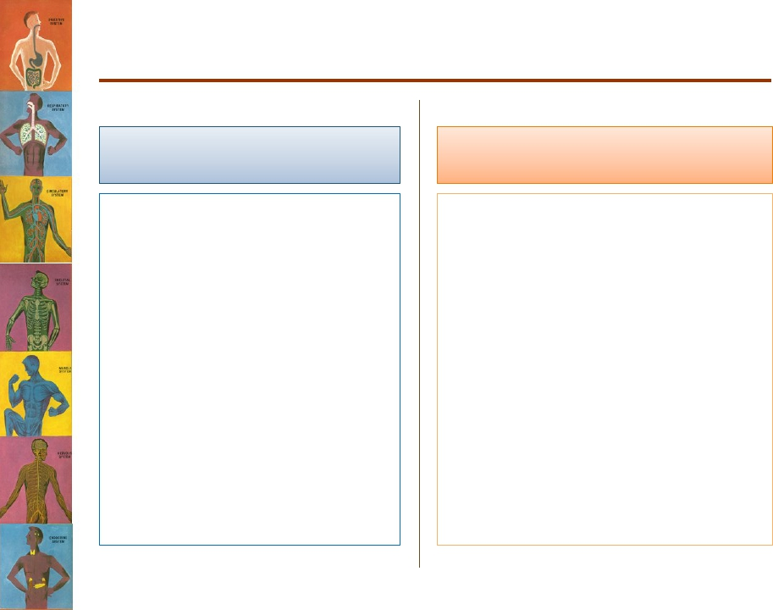
Disturbances in Fluid Balance
Water/fluid intake
• Intake is variable.
• Depends on:
– Climate.
– Habits.
– Physical activity.
Water/fluid output
Burns
Exercise
Hot weather.
Diarrhea
Vomiting
Blood loss
Diabetes
•
•
•
•
•
•
•

Slide 10
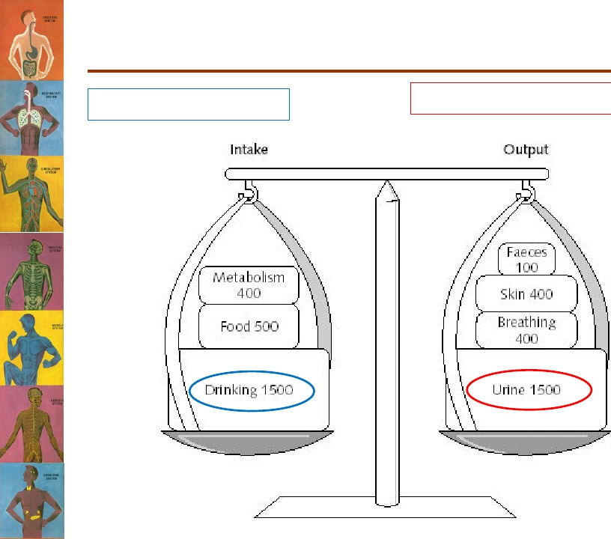
Regulation of Fluid Balance
Modify intake → thirst
Modify output→ Kidney excretion
Major ouput
Major input

Slide 11
Regulation of Fluid Balance
Water deficit
• Input < output.
• Leads to:
– Hypovolemia
– Dehydration
Water excess
• Input > output
• Leads to:
– Hypervolemia.
– Edema.
•
Physiologic regulation:
1. Activates hypothalamic thirst
centre → ↑fluid intake
• The hypothalamic thirst centre
is activated by:
• Physiologic regulation:
1. ↓ ADH secretion → ↓
– ↓ ECF volume (10-15%)
– ↑ ECF osmolarity (1-2%)
↑ ADH secretion by posterior
pituitary → ↑ water
reabsorption by the kidney.
water reabsorption →
↑ water excretion by
kidney.
2. Decrease thirst
2.

Slide 12
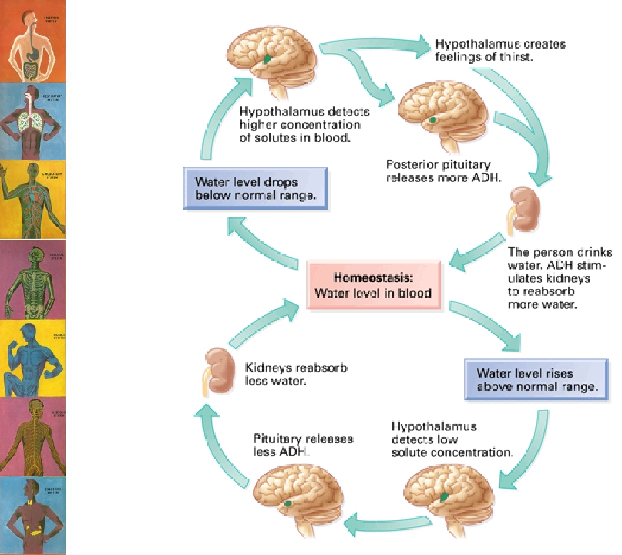

Slide 13
DISTRIBUTION OF BODY
FLUID CONTENT

Slide 14
How is this water/fluid
distributed in the body?
Where is this 60% of fluid/water located in the body?
Plasma

Slide 15
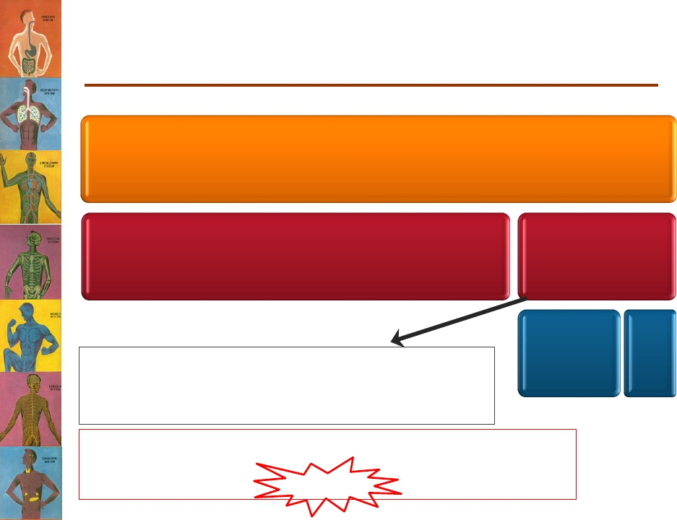
B ody Fluid Compartments
Total body water = 60% TBW
*2/3 (40% of TBW)
Intracellular
1/3 (20% of TBW)
Extracellular
¾ (15%)
Interstitial Fluid
¼ (5%)
Plasma
Transcellular fluid (specialised type of ECF e.g.
synovial, CSF, ocular, pericardial, pleural, peritoneal
fluids)= 1-2L
N. B. the fractions refer to its relation with the preceding
compartment. While the percentage refers to its relation to Total
Body Weight)
(Guyton and Hall Textbook of Medical Physiology. 13th ed. Ch-25)

Slide 16
Let’s go back to our 30-year-old man
Calculate the total body water content
of a 40-year-old 70kg man?
• TBW = 42 litres
• How many litres lie intracellularly?
➢
42 X ⅔ = 28L OR 70 X 40/100 = 28L.
• How many litres lie extracellularly?
➢
42 X ⅓ = 14L OR 70 X 20/100 = 14L.
• How many litres constitute the interstitial
fluid?
• How many litres are plasma?

Slide 17
COMPOSITION OF BODY
FLUIDS

Slide 18
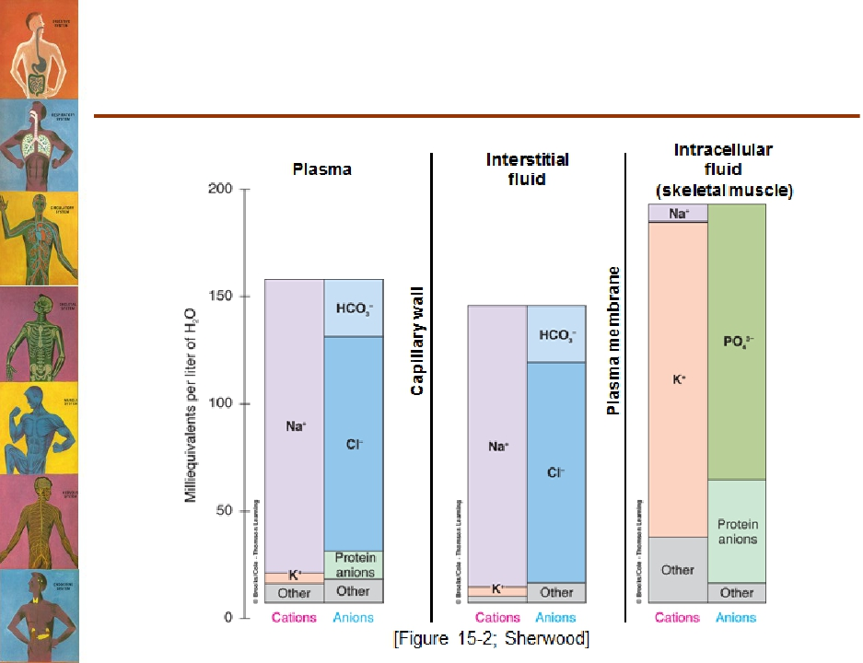
Does the composition of the different body
fluid compartments differ?

Slide 19
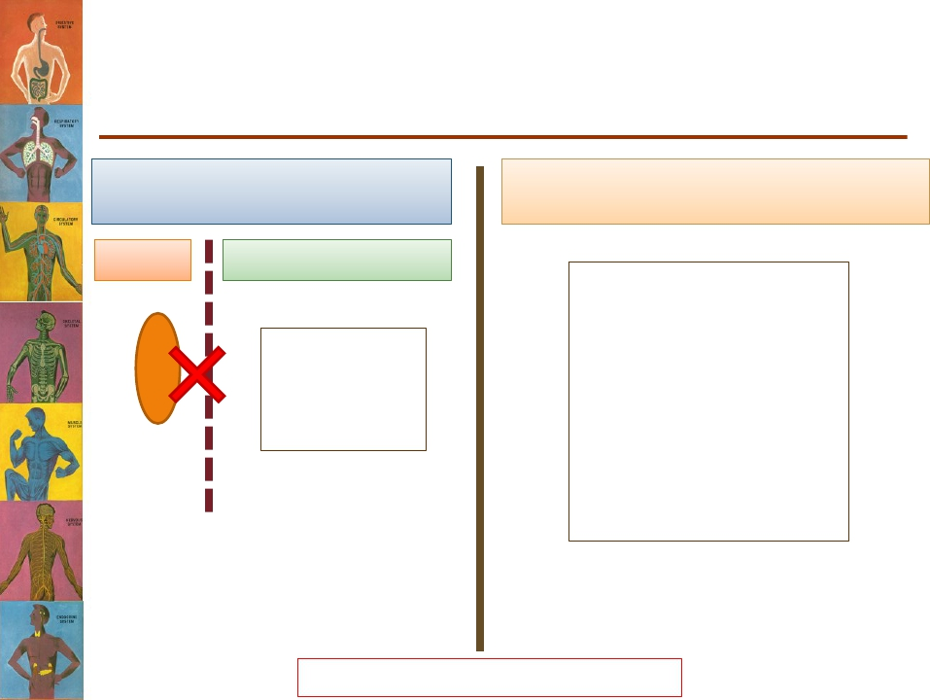
Constituents of the Different
Body Fluid Compartments
Extracellular compartment
Intracellular compartment
Plasma
Interstitial fluid
↑↑ Na+
↑↑ Cl-, HCO3-
↓↓ K+
Cations = anions
↑↑ K+
↑↑ Phosphate (PO4-3)
↑ Proteins
↓↓Na+
↓↓ Cl-
Proteins
Capillary wall
Cell membrane
ECFs are constantly mixing and
have the same composition except
Cations = anions
for proteins.
Osmolarity is the same ≈300 mOsm/L

Slide 20
What is Osmolarity?
• A unit of concentration.
• It measures how concentrated or diluted a
solution is.
• Defined as = the number of osmoles of a solute
per litre of solution.
• The normal osmolarity of body fluids is ≈ 300
mOsm/L

Slide 21
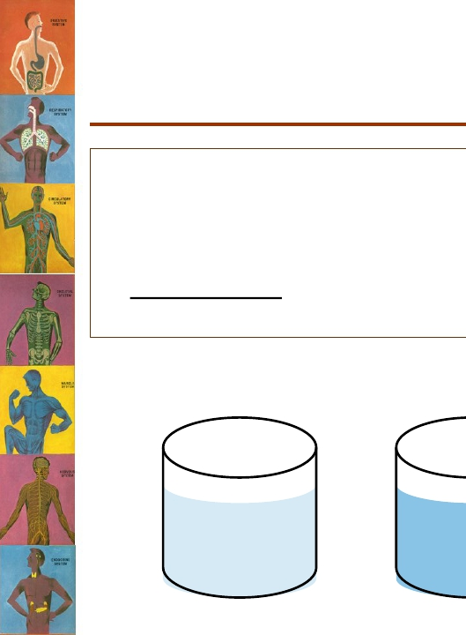
What is Tonicity?
• Osmolarity describes the concentration of one solution.
• Tonicity is used to compare between the osmolarities of
two or more solutions separated by a semi-permeable
membrane.
Which solution is hypertonic to B?
100 mosm/L
A
200 mosm/L
B
400 mosm/L
C

Slide 22
Why is it important?
The difference in tonicity between two different
solutions separated by a semi-permeable membrane
determines the movement of water.

Slide 23
Osmosis
• It is the movement of water across a semi-
permeable membrane from a region of low
solute concentration to a region of high
solute concentration.

Slide 24
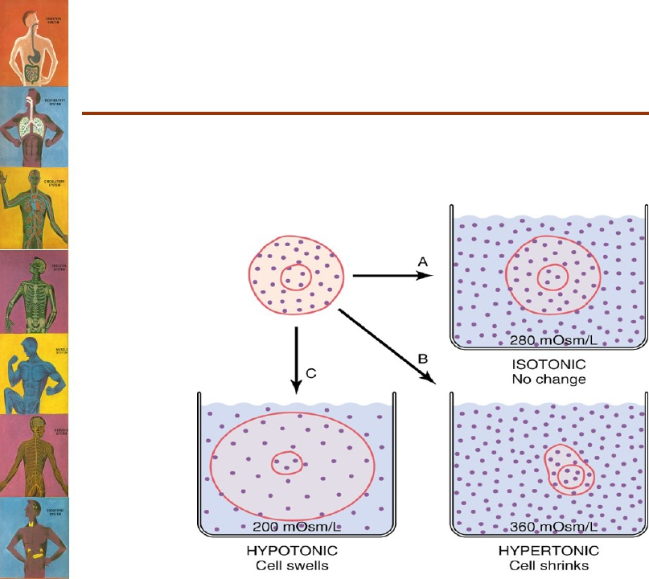
How does it apply to
physiology?
The cell membrane is a semi-permeable membrane
(Allows only water to move freely across it)

Slide 25
How is it related to patient
care?
1. Physicians administer fluids to patients for
various reasons that may change the
osmolarity of ECF.
2. Abnormalities in electrolytes can change the
osmolarity of ECF and can affect the cells
a. Hypernatremia (↑ Na conc. In ECF)
b. Hyponatremia (↓ Na conc. In ECF)
• There are many types of IV fluids with different
tonicities.

Slide 26
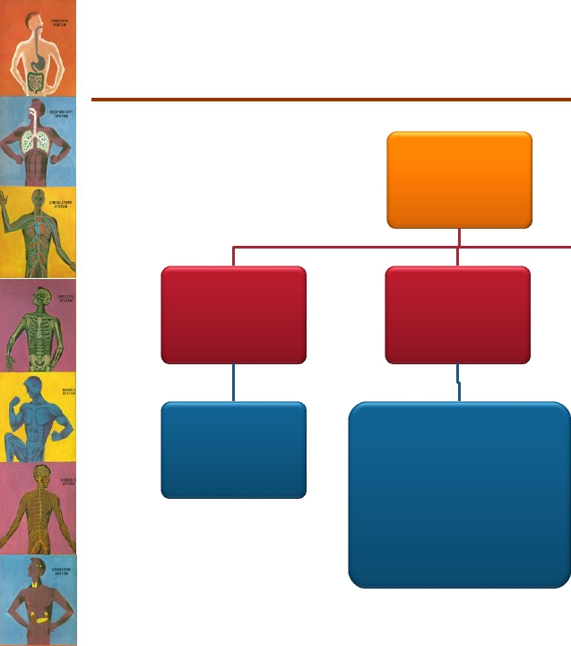
Types of IV Fluids
IV Fluids
Hypotonic
0.45%
Saline
Isotonic
0.9% Saline (NaCl in
water)
Dextrose (5%
glucose)
Hypertonic
Dextrose in
0.9% saline

Slide 27
What happens to the different
compartments with the administration of
IV fluids?

Slide 28
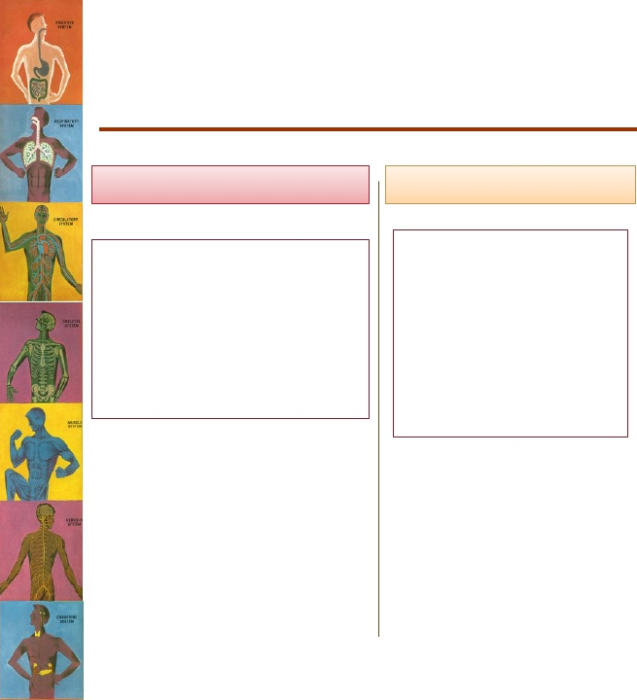
What happens to the different
compartments with the administration of
IV fluids?
Adding hypertonic solution
• ↑ ECF osmolarity
• Water moves out of
cells into ECF.
• ICF volume decreases.
• ECF volume increases.
• ↑ ICF osmolarity
Adding isotonic solution
• No change in ECF
osmolarity.
• No osmosis occurs
through cell
membrane.
• ECF volume
increases.
Adding hypotonic solution
?
Activity

Slide 29
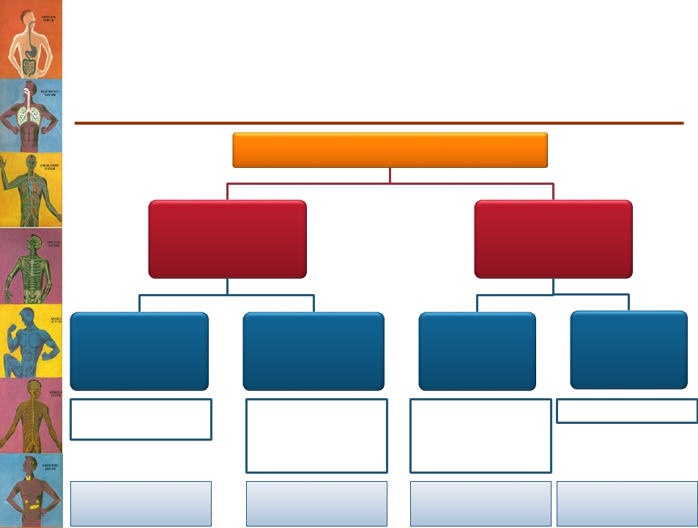
Clinical Abnormalities of Fluid
Volume Regulation
(Hypo- & Hypernatremia)
Plasma Na+ concentration
↑ [Na+]
“Hypernatremia”
↓ [Na+]
“Hyponatremia”
Excess Na+ in
ECF
Excess aldosterone
hormone
Hypernatremia +
overhydration
Loss of water
from ECF
ADH deficiency
Water intake less than
water loss (excessive
sweating)
Hypernatremia +
dehydration
Loss of Na+
from ECF
Decreasealdosterone
secretion
Overuse of diuretics
Vomiting & diarrhea
Hyponatremia +
dehydration
Excess
water in ECF
Excess ADH (SIADH)
Hyponatremia +
overhydration

Slide 30
Clinical Manifestations of Hypo- &
Hypernatremia
Hyponatremia
• ↓↓ Plasma [Na+] →
↓↓ECF osmolarity
causing cells to swell.
• Brain cell edema leads to
neurologic symptoms;
– Headache.
– Nausea.
– Lethargy & disorientation.
• [Na+] < 115-120mmol/L
→ seizures, coma,
permanent brain damage
& death.
Hypernatremia
• ↑↑ Plasma [Na+] → ↑↑
ECF osmolarity causing
cells to shrink.

Slide 31
What happens to body fluid compartments in
different clinical situations?

Slide 32
What are the feedback mechanisms
operating in fluid balance control?

Slide 33
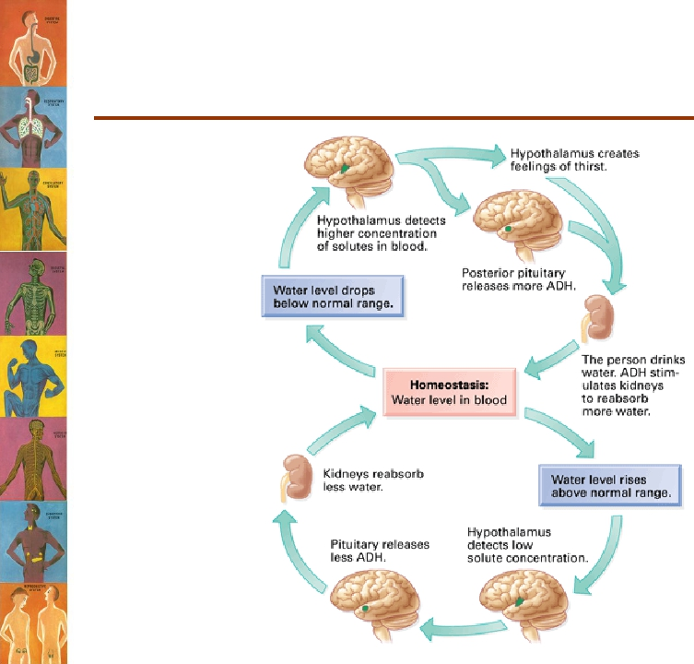
Feedback Mechanisms
Controlling Fluid Balance

Slide 34
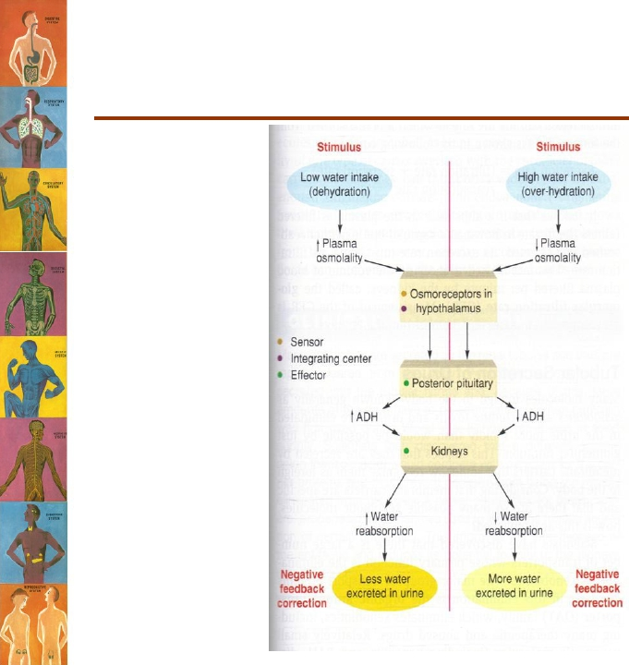
Feedback Mechanisms
Controlling Fluid Balance

Slide 35
Water distribution in the body
An exercise
• After learning about water content of the human body, a
60kg medical student was curious to calculate her own
body water content. What would you expect the total
volume of her body water to be?
• And what is the volume of the following compartments?
–
–
–
–
ICF
ECF
IF
Plasma

Slide 36
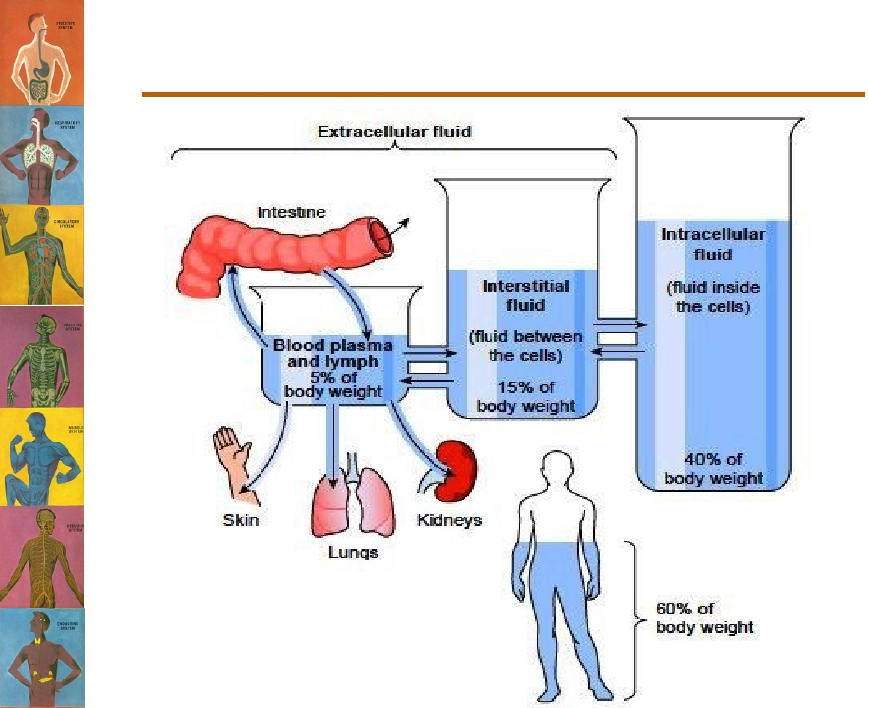
In summary

Slide 37
Thank you

