Slide 1
Edema
Dr. Maha Saja
Physiology department,
Level 2,
Office 89,
Email: msaja@ksu.edu.sa

Slide 2
Objectives
Define edema and describe its different types.
Discuss and describe the Starling forces governing fluid exchange across capillary walls.
Link changes in hydrostatic and osmotic pressures to the pathogenesis of edema.
Study source for this lecture:
(Guyton & Hall Textbook of Medical Physiology, 13th ed, pages: 316-320 & 191-201)

Slide 3
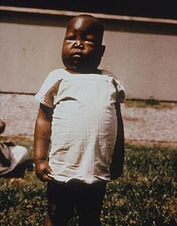
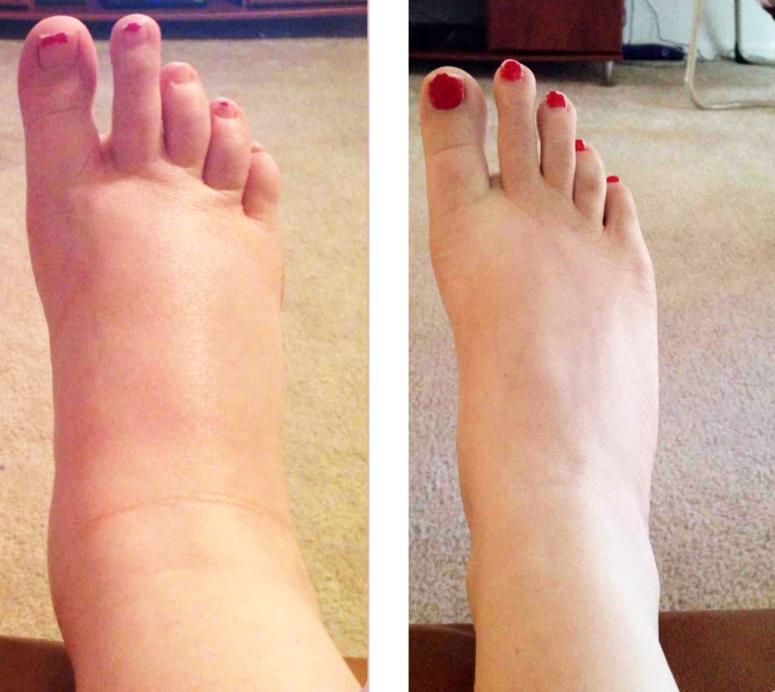
Edema
What is “edema”?
Edema = swelling
The presence of abnormally large amounts of fluid in the intercellular tissue spaces of the body.
(Dorland’s illustrated medical dictionary, 28th ed)

Slide 4
Types of Edema
Edema occurs mainly in the ECF compartment, but it can involve the ICF compartment as well.
Edema
Intracellular
Extracellular
Due to intracellular swelling.
Caused by:
Hyponatremia.
Depressed metabolism
Lack of nutrition to the cells.
Inflammation.
More common clinically
Due to accumulation of fluid in the extracellular space.
Can be caused by many conditions.
(Guyton & Hall Textbook of Medical Physiology; 13th ed, Chapter 25)

Slide 5
Extracellular Edema
Extracellular edema = the abnormal accumulation of fluid in intercellular tissue space (i.e. interstitial space).
Normally, fluid is constantly moving in & out of the interstitial space to allow ECF to distribute between plasma and IF.
This process happens without fluid accumulating between the cells.
What happens to cause fluid to accumulate between the cells leading to edema?
To understand EC edema one must first understand how fluid exchange occurs between capillaries and tissue cells.

Slide 6
Fluid Exchange Between Blood & Interstitial Fluid

Slide 7
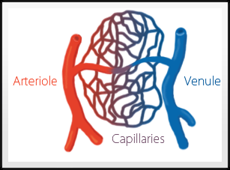
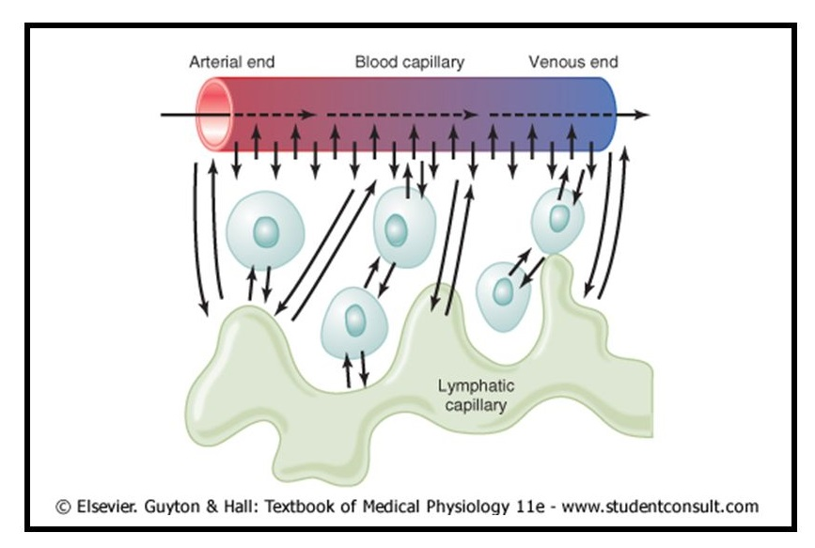
Fluid Exchange Between Blood & Interstitial Fluid
Fluid exchange between blood and tissue cells occurs at the level of the capillaries.
The capillaries are the smallest blood vessels in our vascular tree.
These vessels are very small and have a very thin wall allowing easy exchange of fluid across the walls.

Slide 8
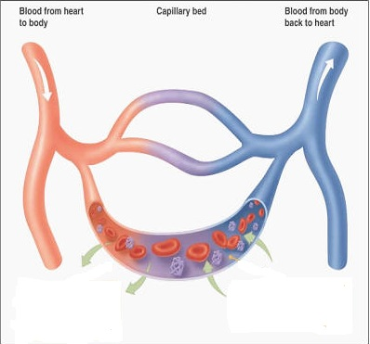
Fluid Filtration Across Capillaries
In simple words!
As blood passes through capillaries
How does this process happen?
OR
What are the mechanisms controlling fluid exchange across capillaries?
Fluid filters from plasma to interstitium
Fluid is reabsorbed from interstitium into plasma

Slide 9
Factors Controlling Fluid Filtration Across Capillary Walls
Movement of fluids across capillary walls depends on the balance of starling forces acting across the capillary wall.
What are starling forces?

Slide 10
Starling Forces
Starling Forces
Forces that control movement of fluid in/out of a capillary
Hydrostatic pressure (P)
Colloid osmotic (oncotic) pressure ()
The pressure exerted by blood (water) on the walls of the blood vessel
The osmotic pressure created by the non-diffusible plasma proteins inside the blood vessel
Pushes fluid OUTSIDE
Pulls fluid INSIDE

Slide 11
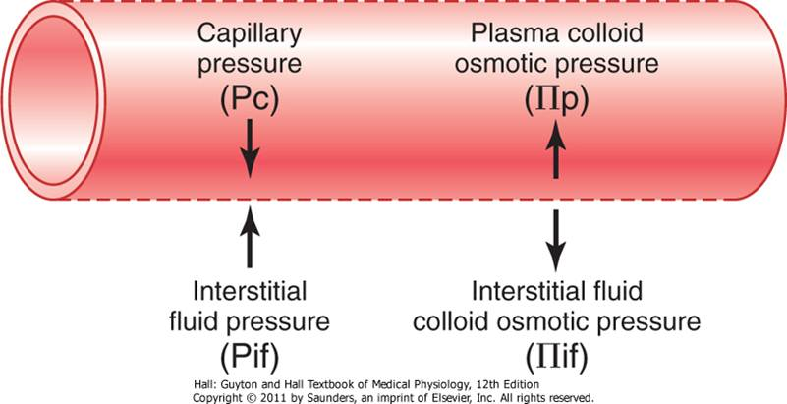
Starling Forces Acting Across Capillary Membrane
Four primary forces determine whether fluid moves in or out of blood “Starling forces”:
Capillary “hydrostatic” pressure → out of blood.
IF “hydrostatic” pressure → into blood if +ve and out of blood if -ve.
Plasma colloid osmotic pressure → into blood.
IF colloid osmotic pressure → out of blood.

Slide 12
Starling Forces Acting Across Capillary Membrane
Capillary hydrostatic pressure (Pc):
Arterial end = 30 mmHg
Venous end = 10 mmHg (usually 15-25 mmHg less than arterial end).
IF hydrostatic pressure (Pif) is usually subatmospheric in loose connective tissue (≈ -3 mmHg). Because Pif is negative it will actually favour filtration rather than oppose it.
Plasma colloid osmotic pressure (πp) = 28 mmHg.
IF colloid osmotic pressure (πif) = 8 mmHg.

Slide 13
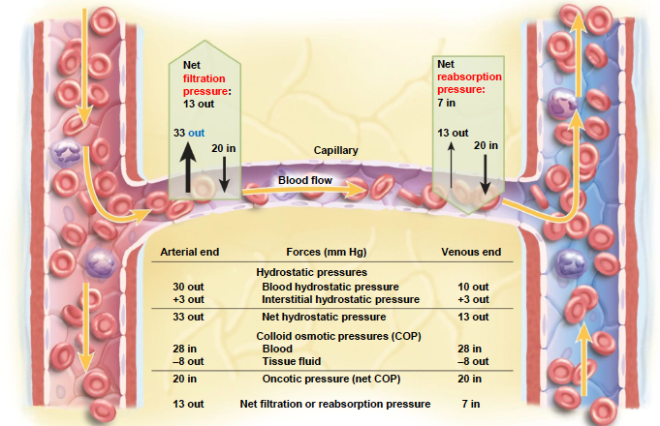
Forces that Determine Fluid Movement through Capillary Membrane

Slide 14
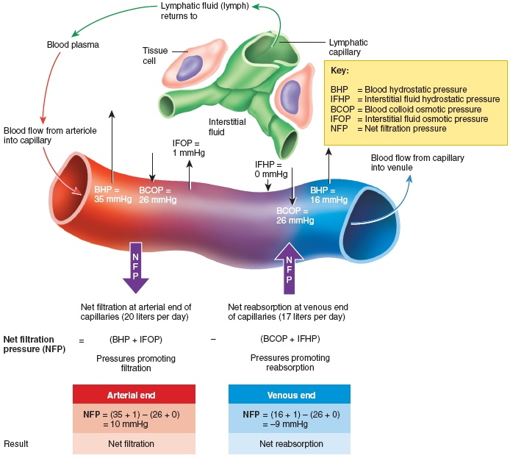
The Lymphatic System
The reabsorption pressure causes 9/10 of the filtered fluid to be reabsorbed while 1/10th remains in the IF.. What happens to this 1/10th?
The total quantity of lymph ≈ 2-3L/day.

Slide 15
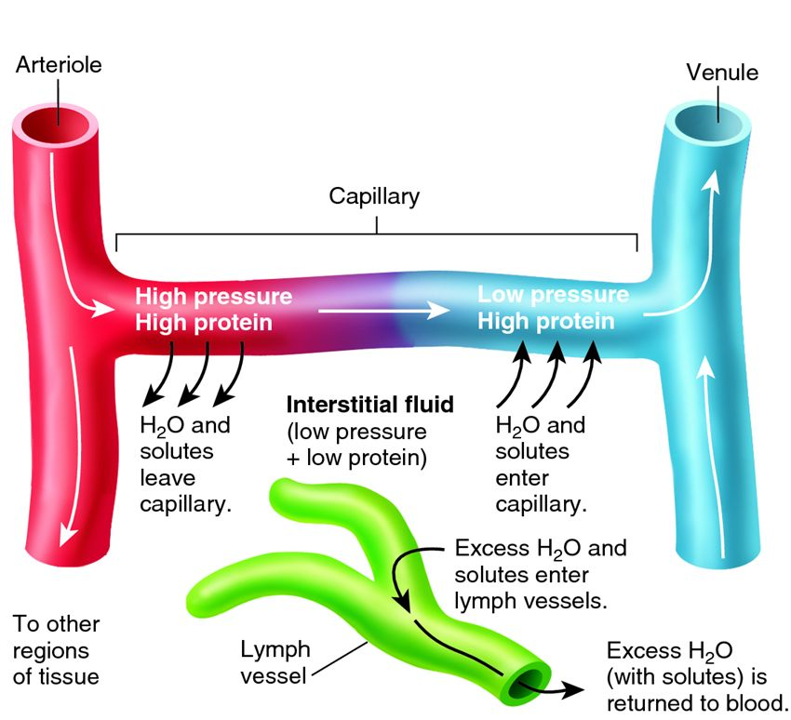
Summary

Slide 16
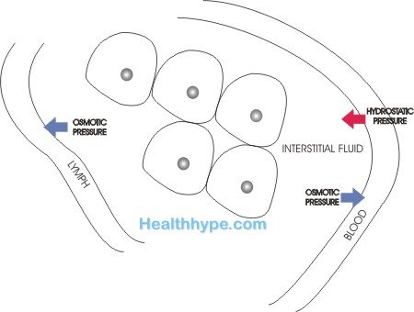
Edema
Edema = excessive accumulation of fluids in the EC space.
Two main reasons:
Abnormal leakage of fluid from plasma to interstitial space.
Failure of lymphatic uptake.
↑↑ fluid
↓↓ uptake
Edema
↑↑ filtration

Slide 17
Edema
Increase capillary filtration
Decrease lymph uptake
Increased capillary pressure
Kidney failure
Heart failure.
Venous obstruction
Decreased plasma oncotic pressure
Loss of proteins (nephrotic syndrome, burns).
Inability to synthesize proteins (liver failure, malnutrition).
Increased capillary permeability
Inflammation
Infection.
Immune reactions.
Lymphatic obstruction
Infection (filaria).
Surgery.
Congenital absence.
Cancer.

Slide 18
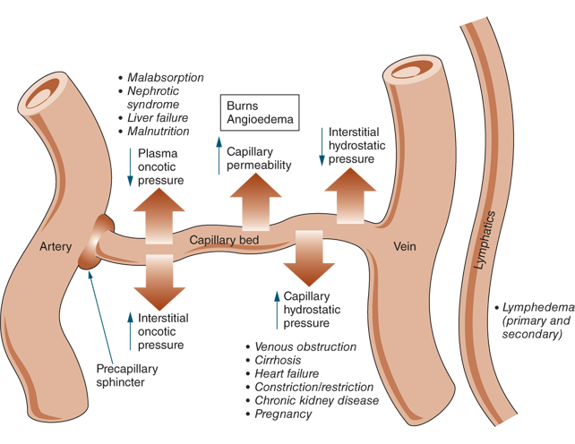
Edema

Slide 19
Thank you

