Slide 1
BLOOD PHYSIOLOGY
White Blood Cells
(WBC)
Dr Nervana Mostafa

Slide 2
Lecture content
.1 Eosinophils and Basophilophils formation,
maturation and function
Monocytes and macrophage formation, maturation and function Reticuloendothelial system component and function
Lymphocytes formation, maturation and
function
Leucocytosis, leucopenia and leukemia
.2
.3
.4
.5

Slide 3
White Blood Cells
EOSINOPHILLS &
BASOPHILS

Slide 4
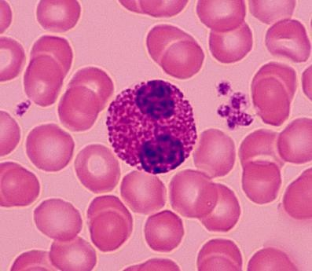
Formation and Maturation of Eosinophils
Formed in Bone Marrow:
Stem cells → Myeloblast→ Promyelocytes →
Eosinophil myelocytes →
Eosinophil metamyelocytes →
polymorphnuclear eosinophil (Mature Eosinophil released to blood)

Slide 5
Eosinophil Function
•
•
Phagocytosis
High eosinophil count:
Parasitic (hook worm, ascaris, bilharzia) Allergic (asthma, rhinitis, drug reaction)
–
–
•
Eosinophil attach themselves to parasites _{and}
releases substances (hydrolytic anzymes,
superoxide) to kill it

Slide 6
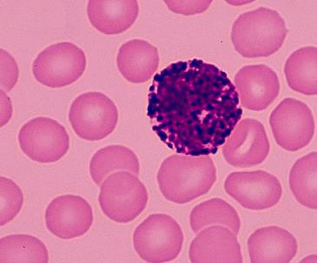
Formation and Maturation of Basophils
Formed in Bone Marrow
Stem cells → Myeloblast→ Promyelocytes →
Basophil myelocytes →
Polymorphnuclear Basophil (Mature Basophils
released to blood)
.1
.2
.3

Slide 7
Basophils
Similar to mast cells both secrets:
Heparin to prevent clotting,
Histamine , bradykinin & serotinin contribute
to inflammation response
The release of those substances cause local and vascular reactions characteristic of allergic manifestation

Slide 8
White Blood Cells
MONOCYTES & MACROPHAGES

Slide 9
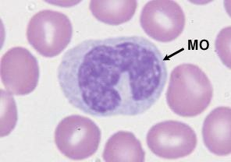
Monocytes and Macrophages
Formed in Bone Marrow
.1
Stem cell → monoblast → promonocyte → mature monocytes released into blood
Stay for 10-20 hours in circulation
Then leave blood to tissues transforming into larger cells macrophage,
.4 Macrophage life span is longer upto few months
.2
.3

Slide 10
Function of Monocytes and Macrophages
Macrophages are a powerful phagocytic cells; first line of defense
– Ingest up to 100 bacteria,
–
–
Ingest larger particles as old RBC
Get rid of waste and survive
Functions: anti-inflamatory
Directly: phygocytosis of bacteria, dead cells
Indirectly cooperating with lymphocytes by recognizing foreign body (take in foreign body process it and present it to lymphocytes)

Slide 11
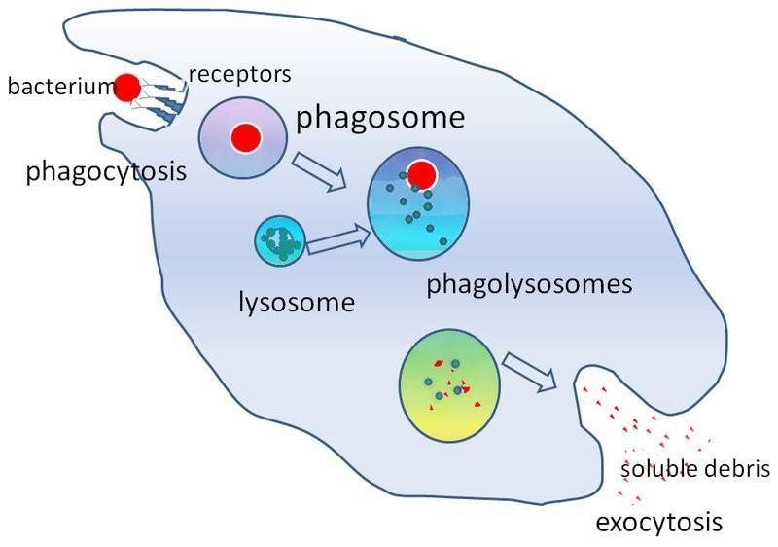
Direct anti Inflammatory

Slide 12
Indirect anti-inflammatory
Dr Sitelbanat 2011

Slide 13
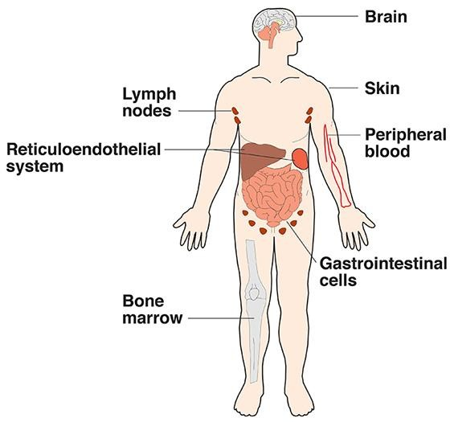
Reticuloendothelial ^{system}
Consist of:
Monocytes
Macrophage
Endothelial cells (bone marrow,
spleen, lymph node)
•
Located in all tissues especially: skin
(histocytes), liver (kupffer), spleen, bone
marrow, lymph nodes, lung

Slide 14
Functions of Reticuloendothelial system
Phagocytosis: Bacterial, dead cells,
foreign particles
Breakdown of Hb
Immune function: processing antigen and antibodies production (indirect)
Storage of iron

Slide 15
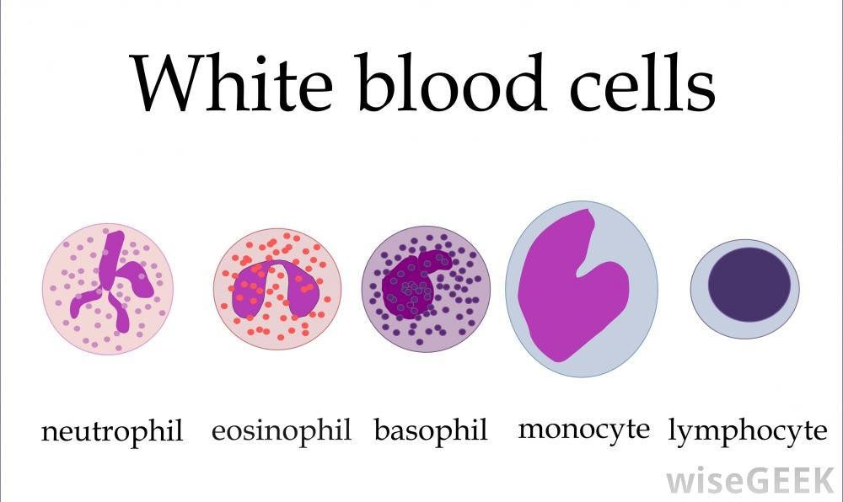
White Blood Cells
LYMPHOCYTES

Slide 16
Lymphocytes Formation and Maturation
.1 Formed in bone marrow, thymus, lymphoid tissues
Stem cell (thymus, lymphoid tissue & bone marrow) → lymphoblast → intermediate pyronophilic blast cell → lymphocytes
.3 Life Span Of Lymphocytes range from weeks
to months according to its type
.2

Slide 17
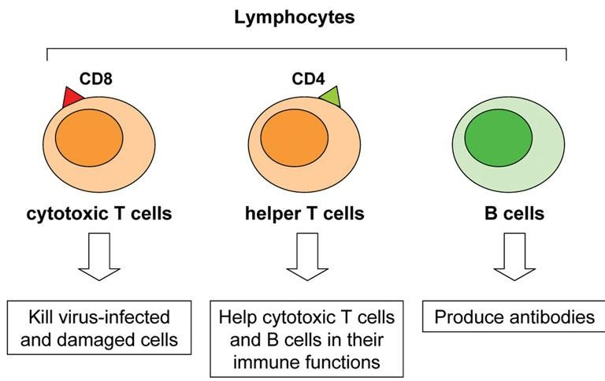
LYMPHOCYTES Function and types
Function:
Types:
.1 Thymus dependent (T-lymphocytes)
.2 Thymus (B-lymphocytes)
independent

Slide 18
T-Lymphocytes
(Thymus dependent)
•
Formed in bone marrow or lymphoid tissue migrate to thymus for maturation
Life spans 100-130 days.
Circulate between blood, tissues, lymph.
Types of T-lymphocytes
•
•
•
–
–
–
T-helper
T-cytotoxic Natural killer
Functions
–
Cellular immunity (graft rejection delyed hypersensitivity.)
– Role in antibody secretion.

Slide 19
B- Lymphocytes
(thymus-independents)
•
•
First discovered in Bird Bursa Formed in: Bone marrow, germinal
layer of lymph node, red pulp of spleen
Life span 2-7 days
•
It transforms into large plasma cell (produce
antibody)
Function: Humoral immunity.
•
Stimulated by antigen transforming

Slide 20
Leucocytosis
Increased WBC
•
•
Physiological
Diurnal ↓ morning ↑ evening
After physical exercise
Stress or Adrenaline injection Disease
Bacterial infection (tonsillitis,
Appendicitis)
Worm infection
•

Slide 21
Leucopenia
↓ WBC
Causes;
2- typhoid fever.
4- B12 & folic acid↓
1- malnutrition.
3- drugs.
5- radiation

Slide 22
Leukaemia
•
Cancer of white cells due to chromosomal abnormality caused by chemicals, radiation, and viruses.
WBC more than 50x10³
Types of leukaemia
– Myeloblast leukaemia → myeloid cells
– Lymphoblast leukaemia →
lymphocytic cells Acute or chronic onset
•
•
•
•
Accompanied with anaemia, bleeding

Slide 23
Objectives
At the end of this lecture student
should be able to:
Describe Esinophils formation and functions
Describe Basophils formation and
functions
Describe Monocytes and macrophage formation and functions.
Describe Reticuloendothelial componants
and functions
.3
.4
23

Slide 24
Objectives
At the end of this lecture student should be
able to:
Describe lymphocytes formation and
maturation.
Describe the functions of the different
types of lymphocytes.
Recognise leucocytosis and leucopenia.
Recognize type of leukaemia
24

