Slide 1
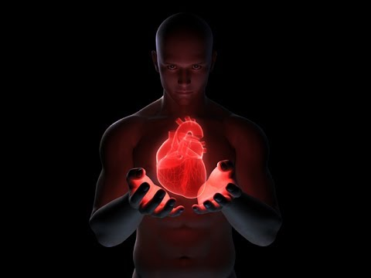
CARDIOVASCULAR
SYSTEM
Khaleel Alyahya, PhD, MEd
King Saud University
School of Medicine
@khaleelya

Slide 2
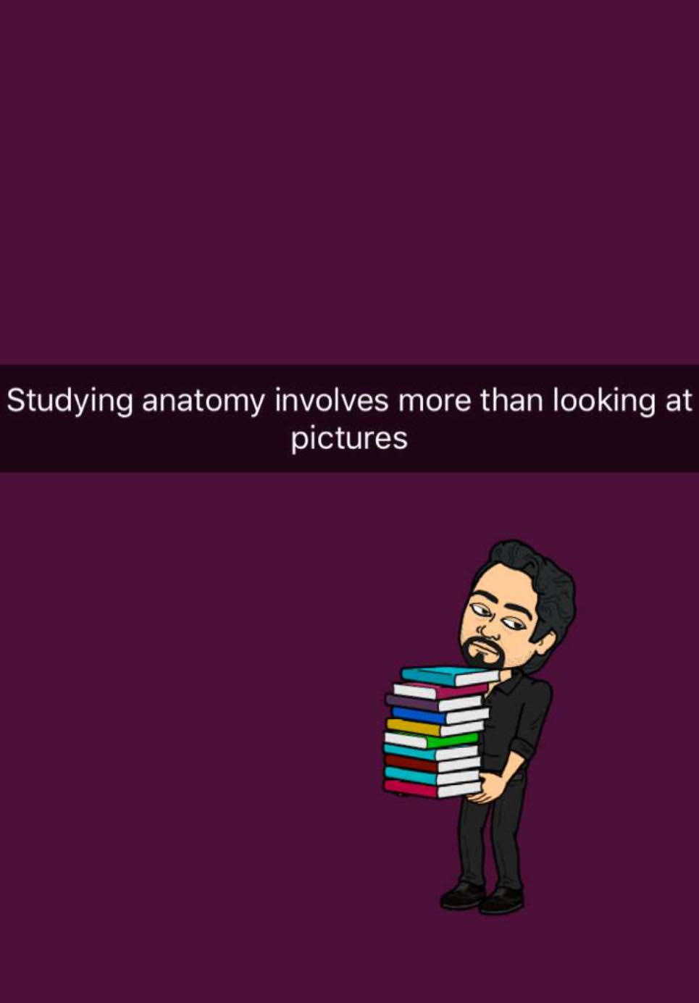

Slide 3
OBJECTIVES
At the end of the lecture, students should be able to:
Identify the components of the cardiovascular system.
Describe the Heart in regard to (position, chambers and valves).
Describe the Blood vessels (Arteries, Veins and Capillaries).
Describe the Portal System.
Describe the Functional and Anatomical end arteries.
Describe the Arteriovenous Anastomosis.
Describe the component of the blood and its function.

Slide 4
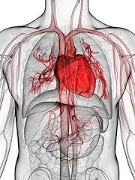
CONTENT
Pump: HEART
Network of Tubes: BLOOD VESSELS
Vehicle: BLOOD

Slide 5
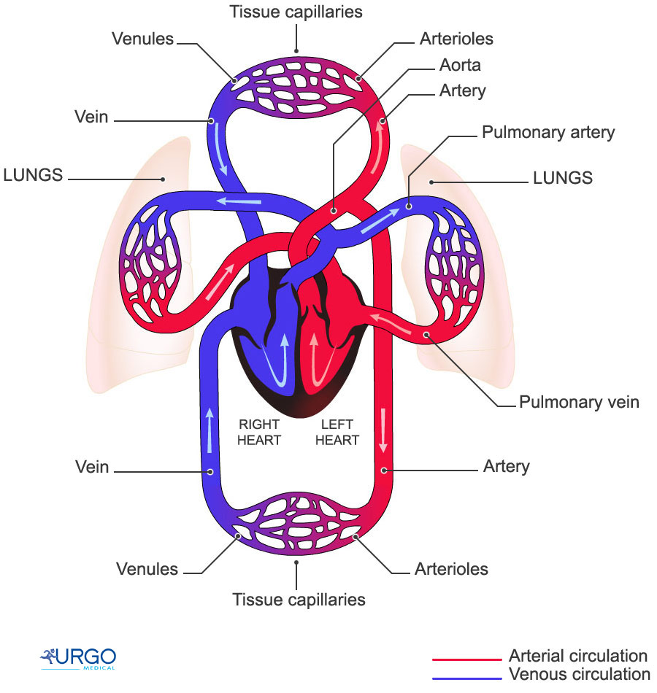
FUNCTIONS
It is a transportation system which uses the blood as the transport vehicle.
It carries oxygen, nutrients, cell wastes, hormones and many other substances vital for body homeostasis.
It provides forces to move the blood around the body by the beating Heart.

Slide 6
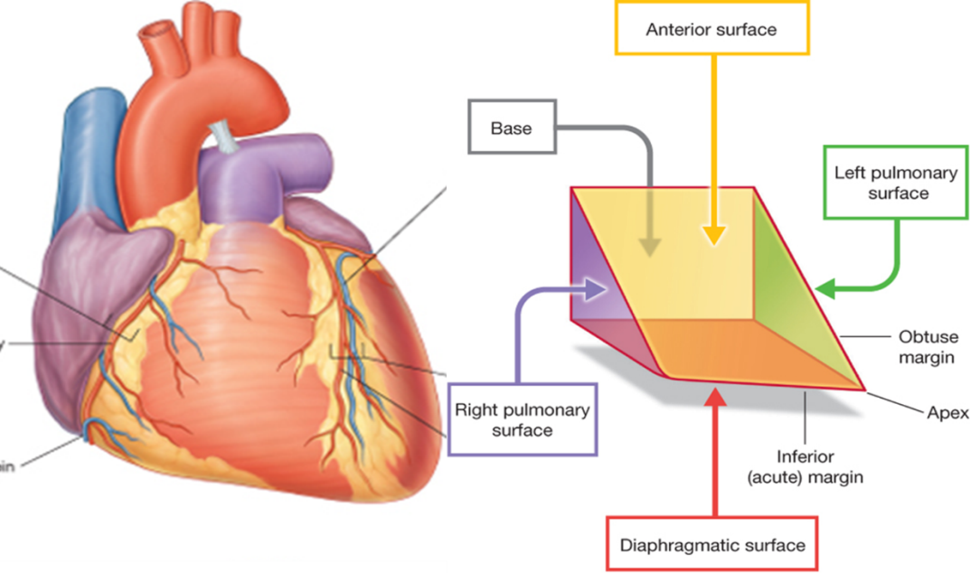
THE HEART
It is a hollow, cone shaped muscular pump that keeps circulation going on.
It is the size of hand’s fist of the same person.
It has:
Apex
Base
Surfaces:
Diaphragmatic & Sternocostal
Borders:
Right, Left, Inferior.

Slide 7
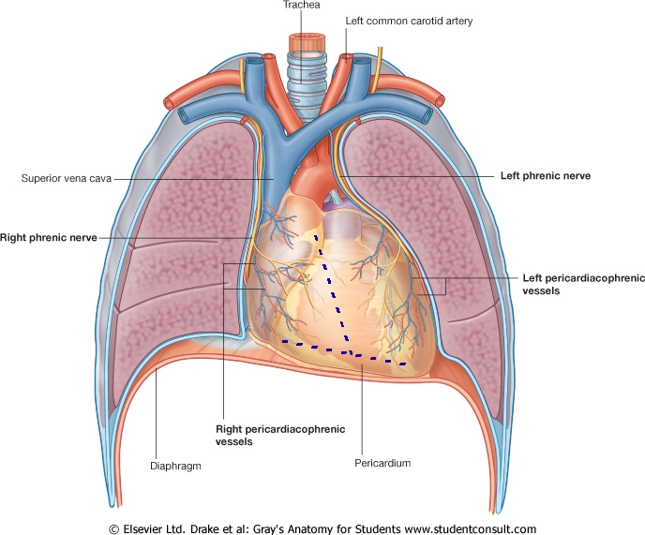
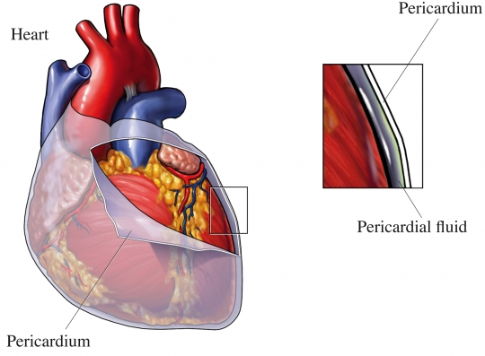
LOCATION OF THE HEART
It is located in the thoracic cavity in a place known as the Middle Mediastinum between the two pleural sacs.
Enclosed by a double sac of serous membrane (Pericardium).
2/3 of the heart lies to the left of median plane.
The outer wall of the heart is made up of three layers:
Epicardium.
Myocardium (muscle of the heart).
Endocardium.

Slide 8
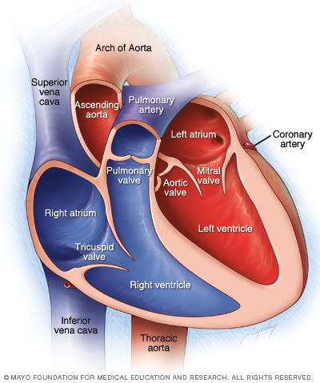
CHAMBERS OF THE HEART
ATRIA:
They are two (Right & Left).
Superior in position.
They are the receiving chambers.
They have thin walls.
The upper part of each atrium is the Auricle.
The Right Atrium receives the venous blood coming to the heart.
Left Atrium receives arterial blood coming from the lungs.

Slide 9
CHAMBERS OF THE HEART
VENTRICLES:
The inferior chambers.
They are two (right & left).
They have thick walls.
They are the discharging chambers (actual pumps).
Their contraction propels blood out of the heart into the circulation.

Slide 10
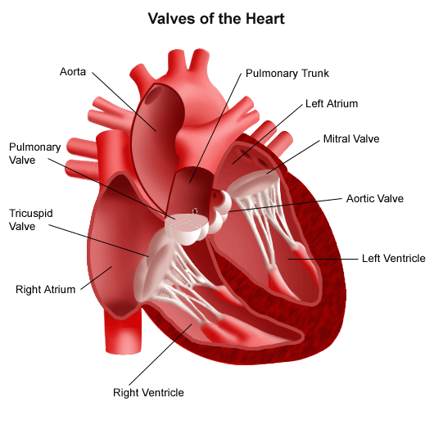
VALVES OF THE HEART
The heart has FOUR VALVES:
Two Atrio-Ventricular valves.
One Aortic Semilunar valve.
One Pulmonary Semilunar valve.

Slide 11
VALVES OF THE HEART
ATRIOVENTRICULAR VALVES:
Valves between atria & ventricles.
They allow the blood to flow in one direction from the atria to the ventricles.
Right AVV (Tricuspid).
Left AVV (Bicuspid).

Slide 12
VALVES OF THE HEART
SEMILUNAR VALVES
(AORTIC & PULMONARY):
Between the right and left ventricles and the great arteries leaving the heart.
Aortic Semilunar Valve
Pulmonary Semilunar Valve
They allow the flow of blood from the ventricles to these arteries.

Slide 13
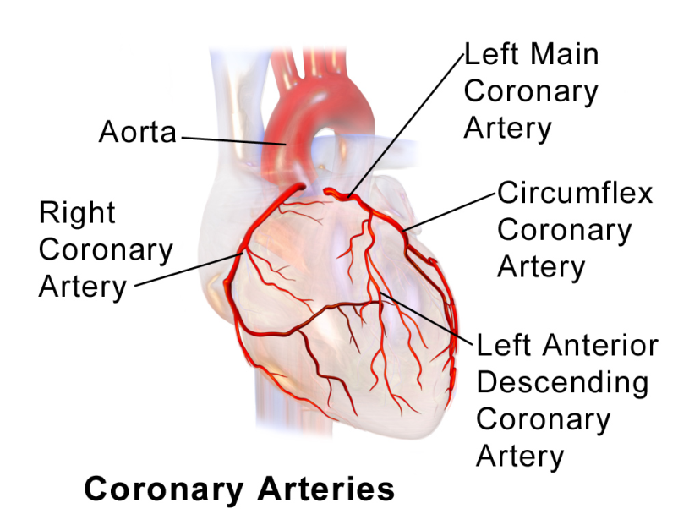
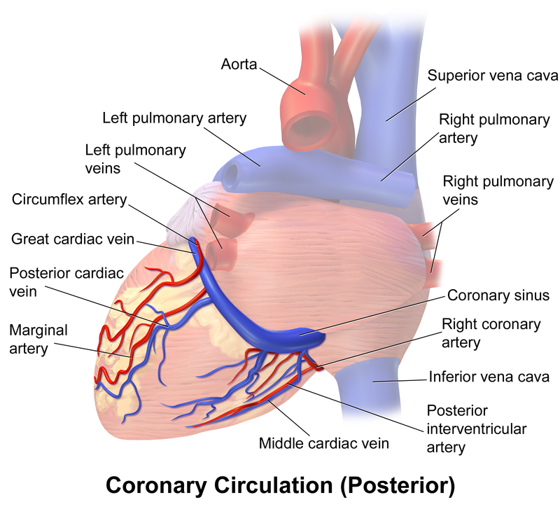
BLOOD CIRCULATION OF THE HEART
CORONARY CIRCULATION
The heart has its own blood vessels that provide the myocardium with the oxygen and nutrients necessary to be able to pump blood to the body.
The left and right coronary arteries branch off from the aorta and provide blood to the left and right sides of the heart.
The coronary sinus is a vein on the posterior side of the heart that returns deoxygenated blood from the myocardium to the vena cava.
Great, middle and small coronary veins drain into coronary sinus.
Coronary sinus drains into right atrium.

Slide 14
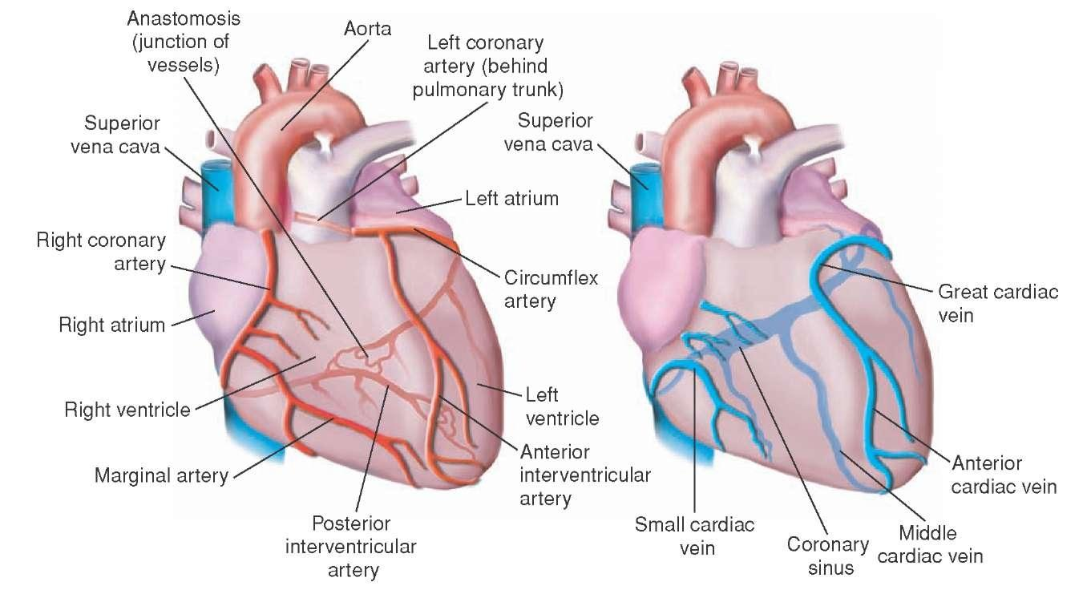
BLOOD CIRCULATION OF THE HEART

Slide 15
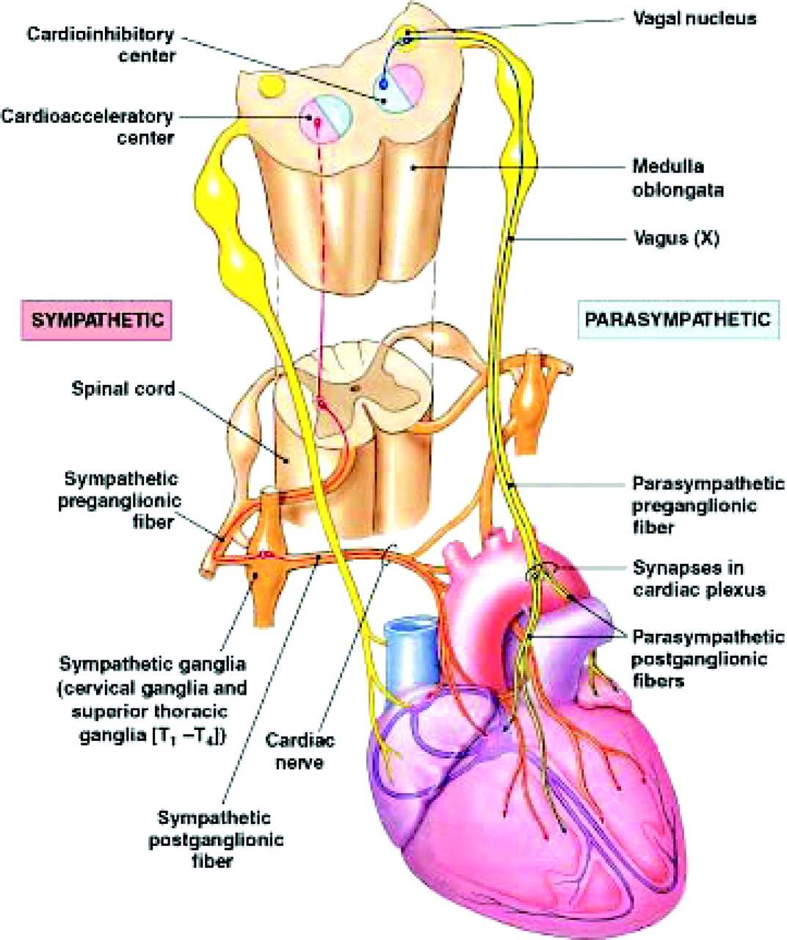
INNERVATION OF THE HEART
VISCERAL MOTOR INNERVATION
The heart receives visceral motor innervations, by:
Sympathetic (speeds up)
Parasympathetic (slows down)

Slide 16
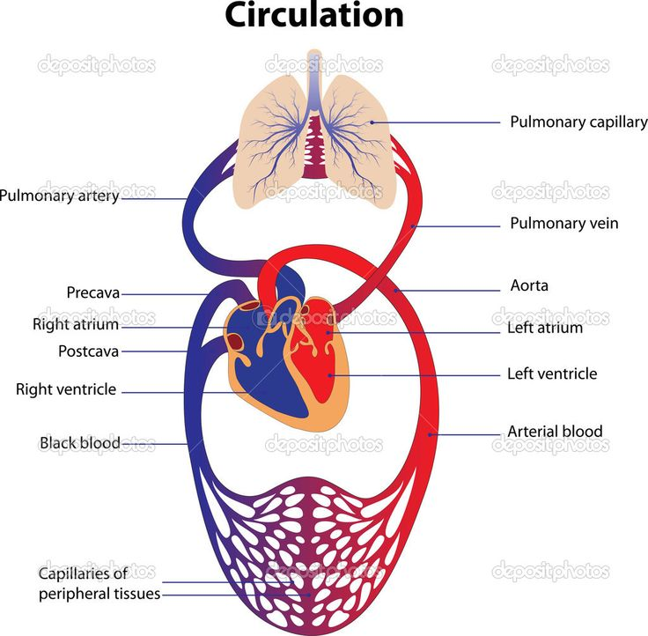
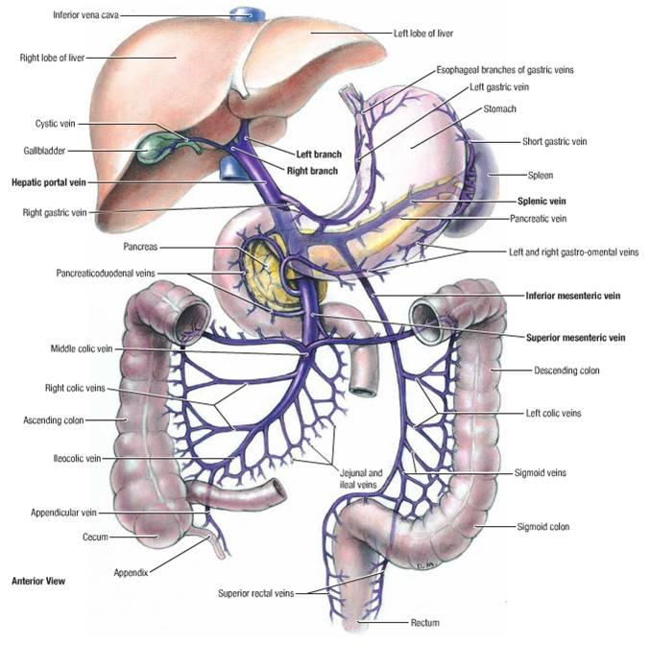
BLOOD CIRCULATION
Systemic Circulation; the flow of blood between the heart and the cells of the body.
Pulmonary Circulation; the flow of blood between the heart and lungs.
Hepatic Portal Circulation; blood flows from GIT to the liver via portal vein then to systemic circulation via IVC

Slide 17
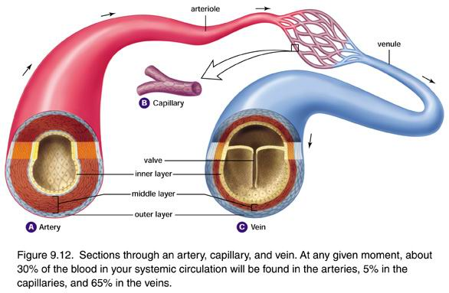
BLOOD VESSELS
ARTERIES:
Thick walls.
Do not have valves.
The smallest arteries are arterioles.
VEINS:
Thin walls.
Many of them possess valves.
The smallest veins are venules.
CAPILLARIES
Connect arterioles and venules.
Help to enable the exchange of water, oxygen and other nutrients between blood and the tissues.

Slide 18
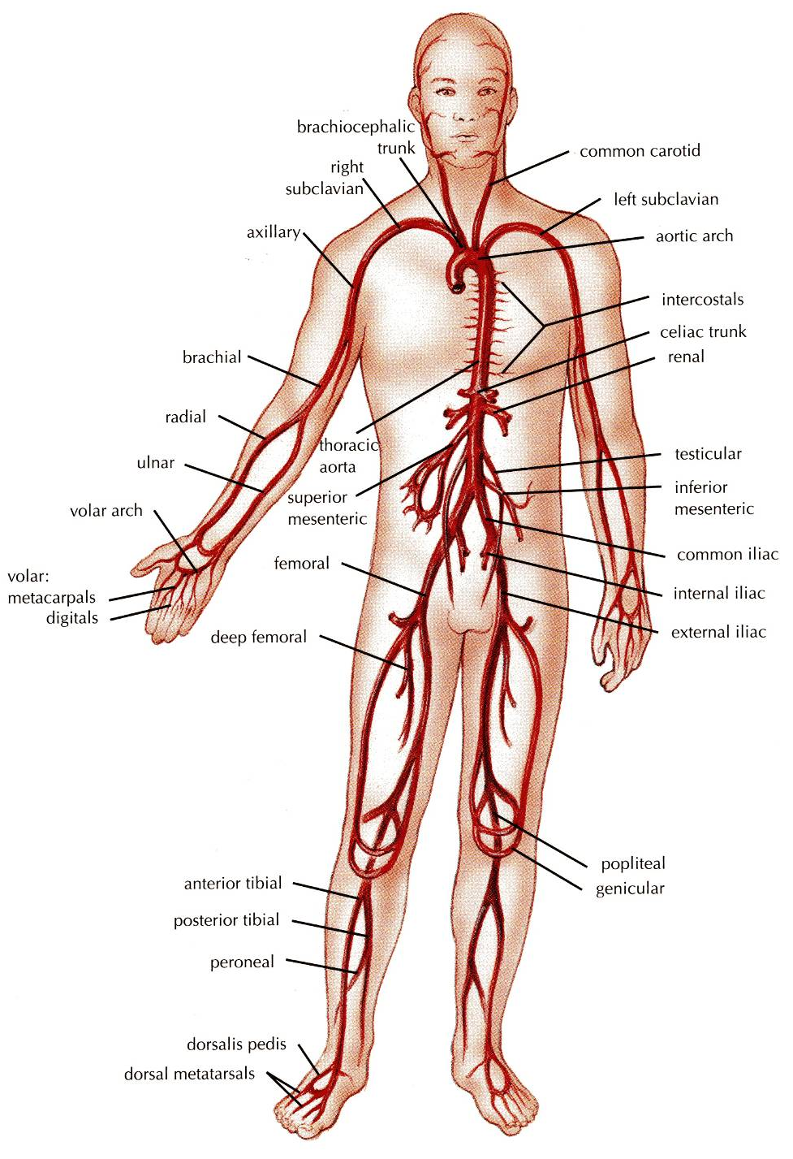
ARTERIES
They transport blood from the heart and distribute it to the various tissues of the body through their branches.
Carry oxygenated blood away from the heart.
TWO EXCEPTIONS:
The pulmonary arteries.
Carries deoxygenated blood from the heart to the lungs.
The umbilical arteries.
Supplies deoxygenated blood from the fetus to the placenta in the umbilical cord.

Slide 19
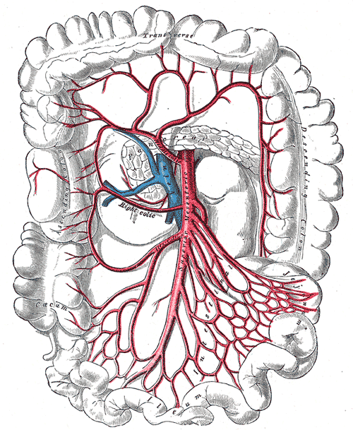
ANASTOMOSIS
It is the connection of two structures.
It is the joining of terminal branches of the arteries.

Slide 20
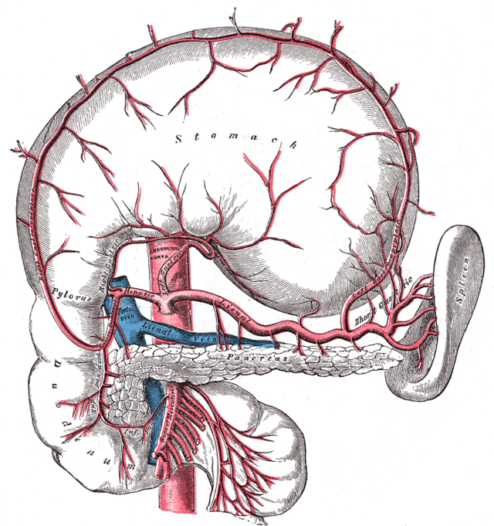
END ARTERIES
It is the artery that is the only supply of oxygenated blood to a portion of tissue.
Arteries which do not anastomose with their neighbors are called end arteries.
Examples:
Splenic artery.
Renal artery.

Slide 21
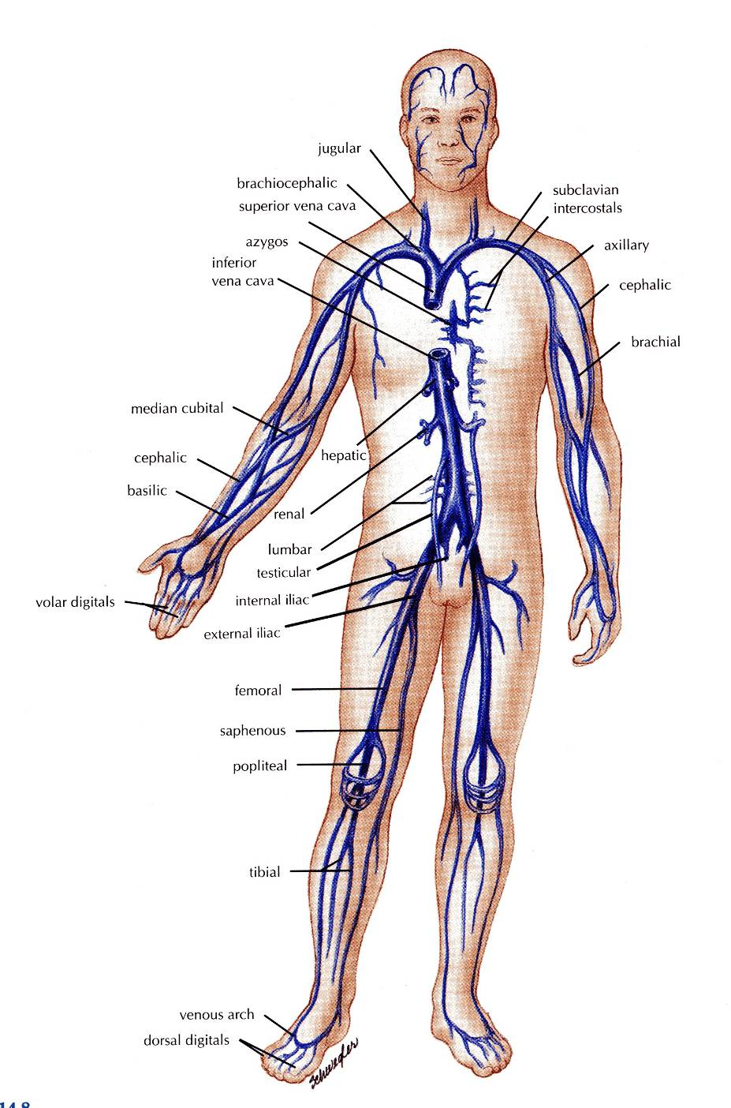
VEINS
They transport blood back to the heart.
The smaller veins (Tributries) unite to form larger veins which commonly join with one another to form Venous Plexuses.
Carry deoxygenated blood toward the heart.
Two Exceptions:
the pulmonary veins.
receive oxygenated blood from the lungs and drain into the left atrium of the heart.
the umbilical veins.
carry oxygenated blood from the placenta to the growing fetus.

Slide 22
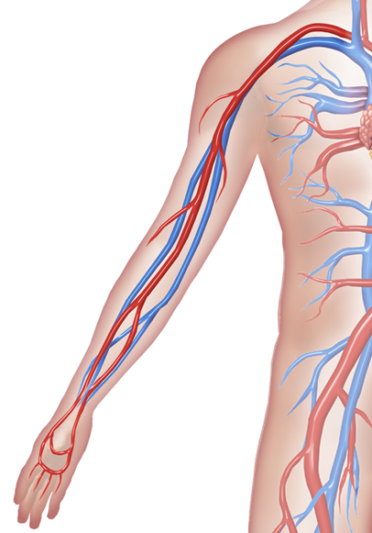
DEEP VEINS (VENAE COMITANTES)
Two veins that accompany medium sized deep arteries
Vena comitans is Latin for accompanying vein.
They are found in close to arteries so that the pulsations of the artery aid venous return.
Venae comitantes are usually found with smaller arteries, especially those in the limbs.
Larger arteries do not have venae comitantes. They usually have a single, similarly sized vein.

Slide 23
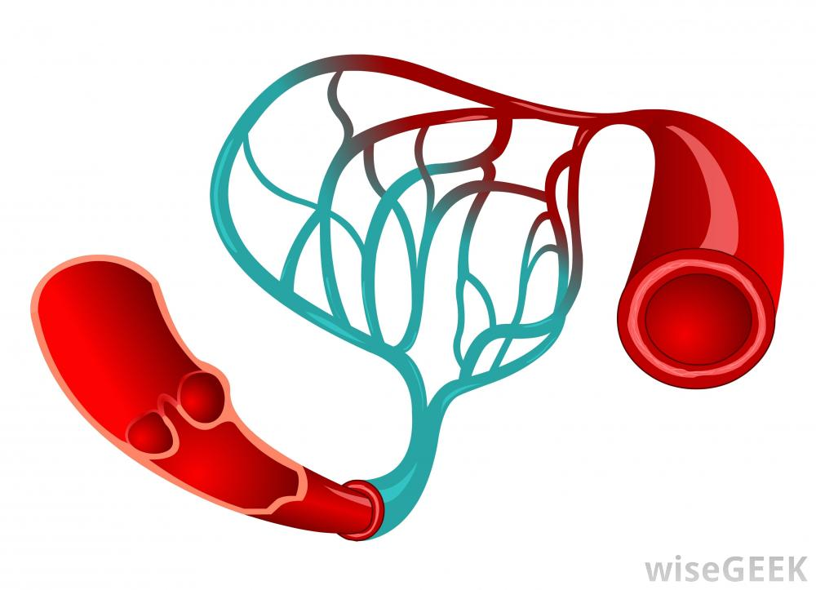
CAPILLARIES
Microscopic vessels in the form of a network.
They connect the Arterioles to the Venules.
They help to enable the exchange of water, oxygen and many. other nutrients between blood and the tissues.

Slide 24
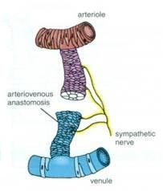
ARTERIOVENOUS ANASTOMOSIS
Direct connections between the arteries and veins without the intervention of capillaries.
Found in tips of the fingers and toes.

Slide 25
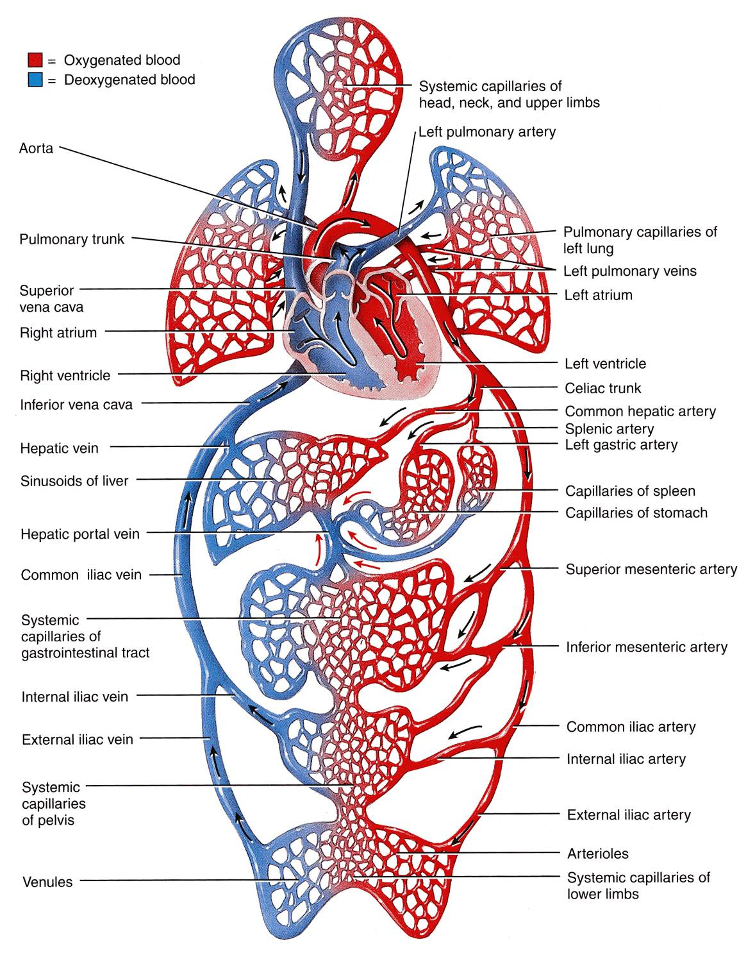
PORTAL CIRCULATION SYSTEM
Portal Venous System occurs when a capillary bed pools into another capillary bed through veins, without first going through the heart.
Veins leaving the gastrointestinal tract do not go direct to the heart.
They pass to the Portal Vein.
This vein enters the liver and breaks up again into veins of diminishing size which ultimately join capillary like vessels (Sinusoids).

Slide 26
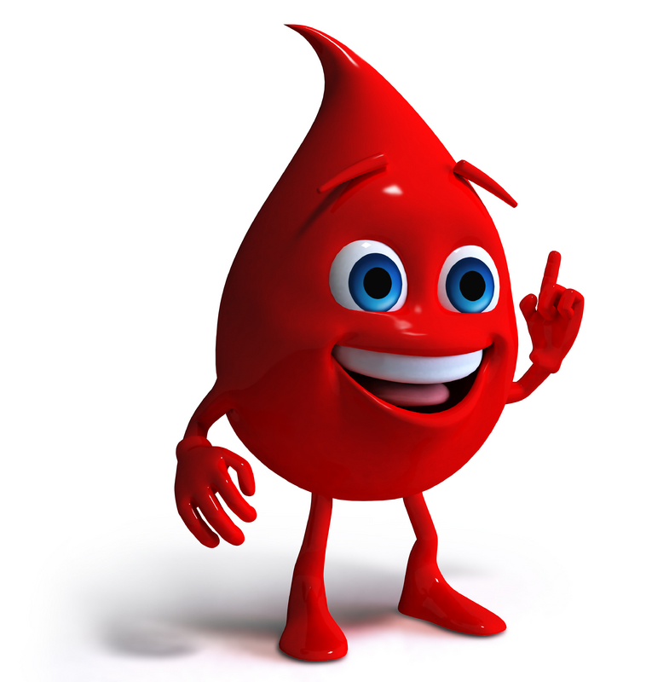
BLOOD
Blood is the actual carrier of the oxygen and nutrients into arteries.
Blood is made mostly of plasma, which is a yellowish liquid that is 90% water.
Plasma contains also salts, glucose and other substances.
Most important, plasma contains proteins that carry important nutrients to the body’s cells and strengthen the body’s immune system.
Blood has main 3 types of blood cells that circulate with the plasma.

Slide 27
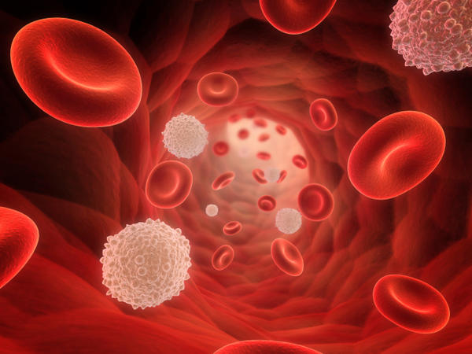
TYPES OF BLOOD CELLS
PLATELETS:
Helping the blood to clot. Clotting stops the blood from flowing out of the body when a vein or artery is broken. Platelets are also called thrombocytes.
RED BLOOD CELLS
Carry oxygen. A healthy adult has about 35 trillion of them. Red blood cells are also callederythrocytes.
WHITE BLOOD CELLS
These cells, which come in many shapes and sizes, are vital to the immune system against infections. When the body is fighting off infection, they increase. White blood cells are also called leukocytes.

Slide 28
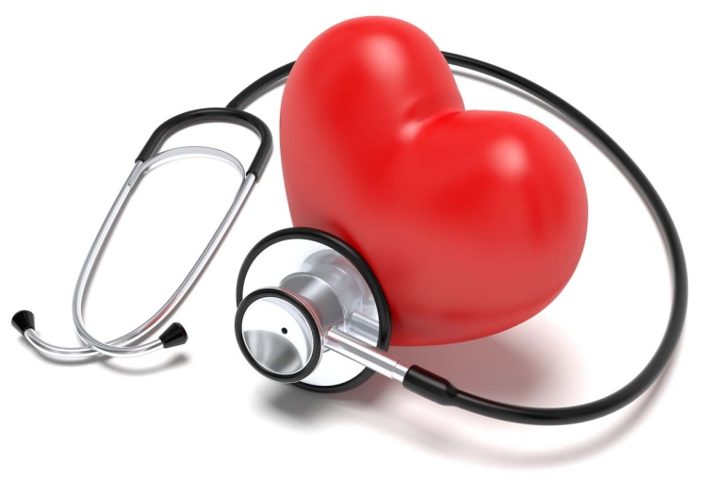
CARDIOVASCULAR DISEASES
HEART ATTACK
Occurs when blood flow to a part of the heart is blocked by a blood clot. If this clot cuts off the blood flow completely, the part of the heart muscle supplied by that artery begins to die. Most people survive their first heart attack and return to their normal lives to enjoy many more years of productive activity.
ISCHEMIC STROKE
Happens when a blood vessel that feeds the brain gets blocked, usually from a blood clot. When the blood supply to a part of the brain is shut off, brain cells will die.

Slide 29
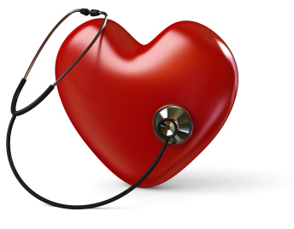
CARDIOVASCULAR DISEASES
HEMORRHAGIC STROKE
Occurs when a blood vessel within the brain bursts. The most likely cause is uncontrolled hypertension.
HEART FAILURE
It means the heart isn't pumping blood as well as it should. The heart keeps working, but the body's need for blood and oxygen isn't being met.
ARRHYTHMIA
This is an abnormal rhythm of the heart. The heart can beat too slow, too fast or irregularly.
HEART VALVE PROBLEMS
When heart valves don't open enough to allow the blood to flow through as it should.

Slide 30
SUMMARY
The cardiovascular system is a transporting system.
It is composed of the heart and blood vessels.
The heart is cone shaped, covered by pericardium and composed of four chambers.
The blood vessels are the arteries, veins and capillaries.
Arteries transport the blood from the heart.
The terminal branches of the arteries can anastomose with each other freely or be anatomic or functional end arteries.
Veins transport blood back to the heart.
Capillaries connect the arteries to the veins.
The portal system is composed of two sets of capillaries.
The veins from the GIT go first to the liver through the portal vein.
Blood is the actual carrier of the oxygen and nutrients into arteries.

Slide 31
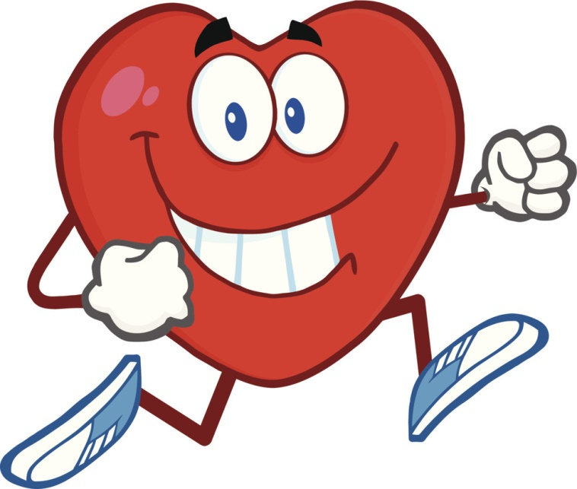
HAPPY HEART
Change life style ..
Eat well and healthy ..
Go to gym ..

Slide 32
LYMPHATIC SYSTEM

Slide 33
LYMPHATIC SYSTEM
It is the system that is responsible for collecting excess tissue fluid at arteriolar end and returning leaked blood proteins to blood stream .

Slide 34
LYMPHATIC SYSTEM COMPONENTS
Lymph- clear fluid from CT around capillaries
Lymphatic capillaries (near blood capillaries) →
Lymph collecting vessels. →
Lymph nodes (sit along collecting vessels).
Lymphatic trunks →(convergence large collecting vessels)
Lumbar, intestinal, bronchomediastinal, subclavian, jugular
Lymphatic (thoracic) ducts → empty into veins of neck

Slide 35
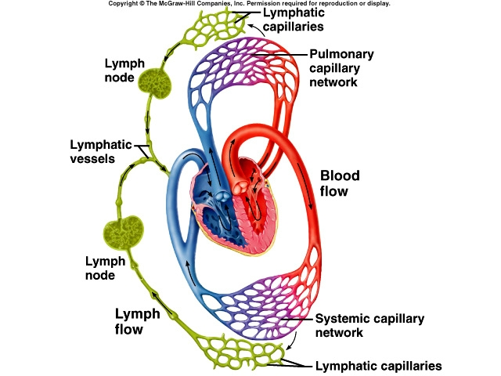
LYMPHATIC SYSTEM CIRCULATION

Slide 36
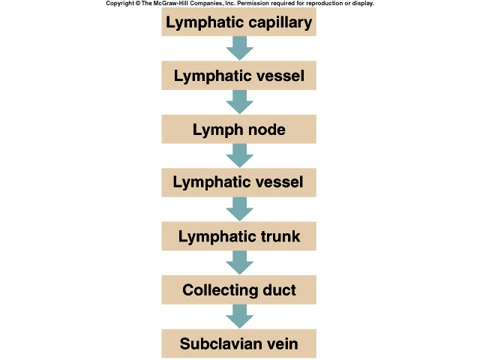
LYMPHATIC SYSTEM CIRCULATION

Slide 37
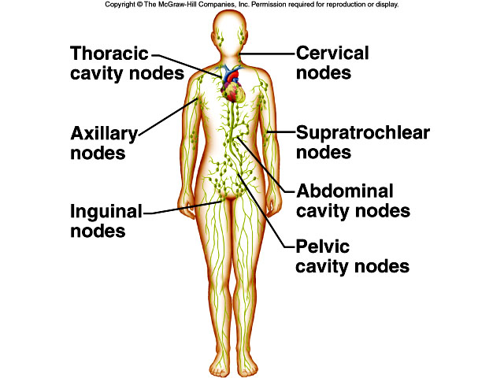
LYMPHNODES

Slide 38
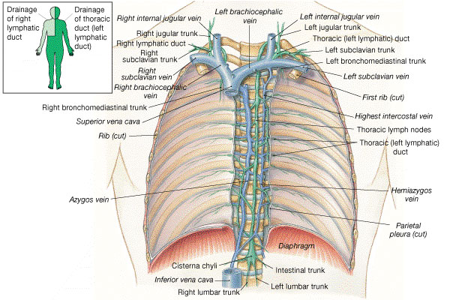
LYMPHATIC SYSTEM

Slide 39
Review Question # 1
WHICH ONE OF THE FOLLOWING IS NOT TRUE?
Right atria receive blood from the body.
The valve between right atrium and right ventricle called “Bicuspid”.
Left ventricle discharging blood to the body.
Right ventricle receives blood from right atrium.
Valves allow blood to move one way only.

Slide 40
Review Question # 2
WHICH STATEMENT OF THE FOLLOWING IS TRUE?
Arteries transport blood from the heart to the body.
Arteriovanous anastomosis found in tips of the fingers and toes.
Capillaries connect the Arterioles to the Venules.
Anastomosis is the joining of terminal branches of the arteries.
Veins leaving the gastrointestinal tract do not go direct to the heart.

Slide 41
QUESTIONS!

