Slide 1
Cell Signaling
and
Regulation of Metabolism

Slide 2
Objectives
By the end of this lecture, students are expected to:
Differentiate different steps in signaling pathways
Describe the second messenger systems
Recognize the function of signaling pathways for
Signal transmission
Amplification
Discuss the role of signaling pathways in regulation and integration of metabolism

Slide 3
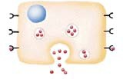
No cell lives in isolation
Cells communicate with each other
Cells send and receive information (signals)
Information is relayed within cell to produce a response

Slide 4
Signaling Process
Recognition of signal
Receptors
Transduction
Change of external signal into intracellular message with amplification and formation of second messenger
Effect
Modification of cell metabolism and function

Slide 5
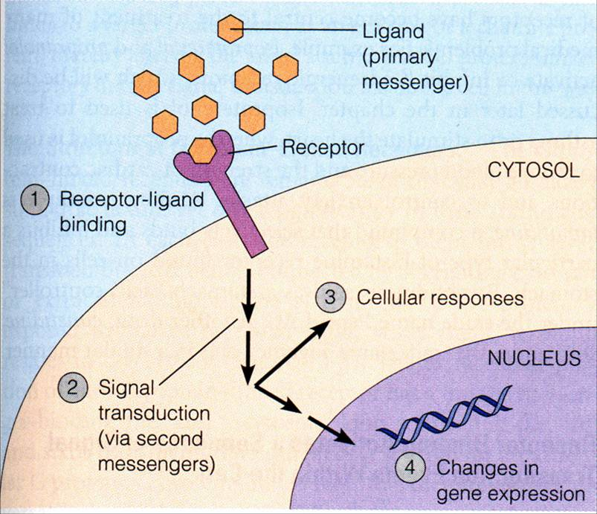
General Signaling Pathway

Slide 6
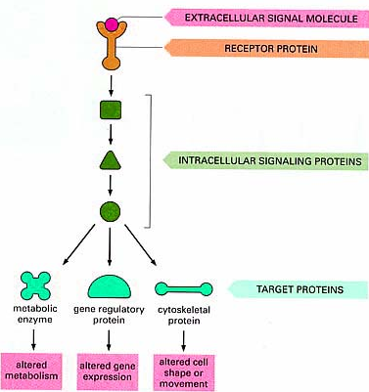
Signaling Cascades

Slide 7
Recognition
Performed by receptors
Ligand will produce response only in cells that have receptors for this particular ligand
Each cell has a specific set of receptors

Slide 8
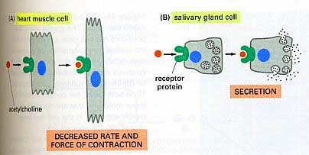
Different Responses to the Same Signaling Molecule. (A) Different Cells

Slide 9
Different Responses to the Same Signaling Molecule. (B) One Cell but, Different Pathways
Hypoglycemia
Glucagon secretion
Hepatocyte: Glucagon/receptor binding
Second messenger: cAMP
Response: Enzyme phosphorylation
P
P
Glycogen synthase
(Inactive form)
Inhibition of glycogenesis
Glycogen phosphorylase
(Active form)
Stimulation of glycogenolysis

Slide 10
GTP-Dependant Regulatory Proteins (G-Proteins)
G-Proteins: Trimeric membrane proteins (αβγ) G-stimulatory
(G_{s}) and G-inhibitory (G_{i}) binds to GTP/GDP
Forms of G-Proteins
Inactive form
Trimeric –bound GDP
(αβγ/GDP)
Active form
α-bound GTP
(α/GTP)
The α-subunit has intrinsic GTPase activity, resulting in hydrolysis of GTP into GDP and inactivation of G-proteins

Slide 11
Signaling Pathways for Regulation of Metabolism
Two important second messenger systems:
Adenylyl cyclase system
Calcium/phosphatidylinositol system

Slide 12
Adenylyl Cyclase System
Adenylyl cyclase: Membrane-bound enzyme, Converts ATP to cAMP
Activation/Inhibition:
Signal: Hormones or neurotransmitters (e.g., Glucagon and epinephrine)
or Toxins (e.g., Cholera and pertussis toxins)
Receptor: G-protein coupled receptor
Response: Activation/inhibition of protein kinase A (cAMP-dependent
protein kinase)

Slide 13
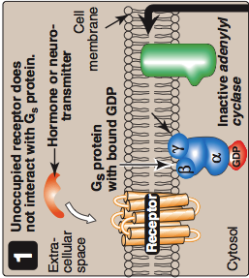
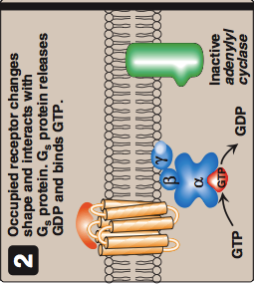
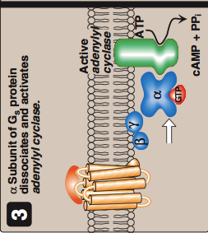
Signal Transduction: Adenylyl Cyclase System
Resting state: No Signal
Ligand/Receptor Binding
Activation of G_{s}-protein
Activation of adenylyl cyclase

Slide 14
Actions of cAMP
*
AMP
*Phosphodiesterase

Slide 15
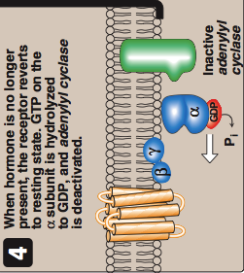
Signal Termination
Protein phosphatase
Phosphodiesterase → ↓cAMP → Inactive protein kinase
*
AMP
*Phosphodiesterase

Slide 16
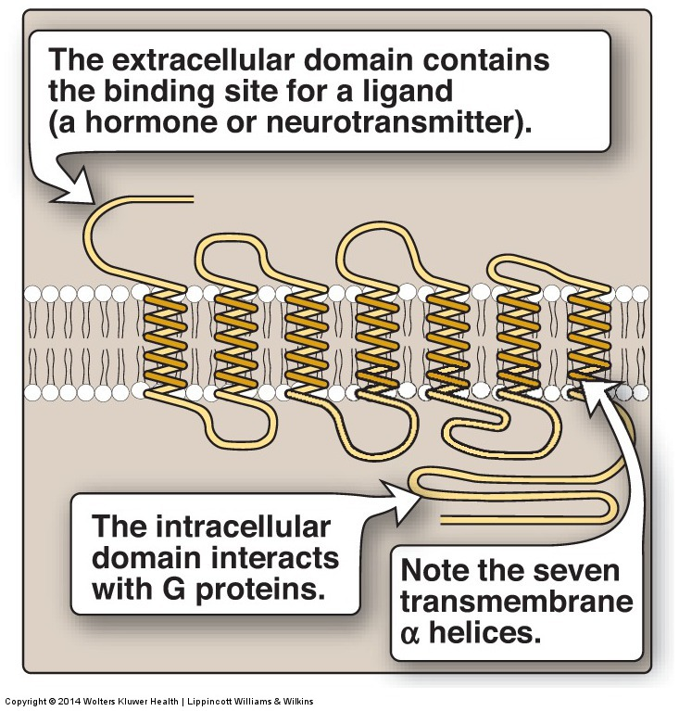
G-Protein Coupled Membrane Receptor

Slide 17
Regulation of Glycogen Metabolism by Glucagon: Effects on Glycogen Synthase and Phosphorylase
Hypoglycemia
Glucagon secretion
Hepatocyte: Glucagon/receptor binding
Second messenger: cAMP
Response: Enzyme phosphorylation
P
P
Glycogen synthase
(Inactive form)
Inhibition of glycogenesis
Glycogen phosphorylase
(Active form)
Stimulation of glycogenolysis

Slide 18
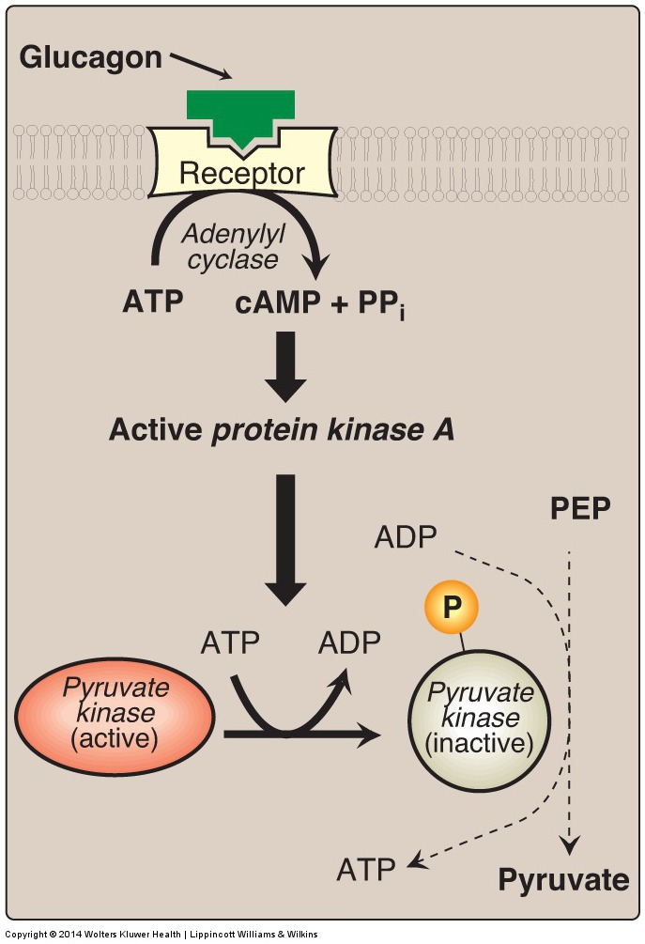
Pyruvate Kinase Regulation: Covalent Modification

Slide 19
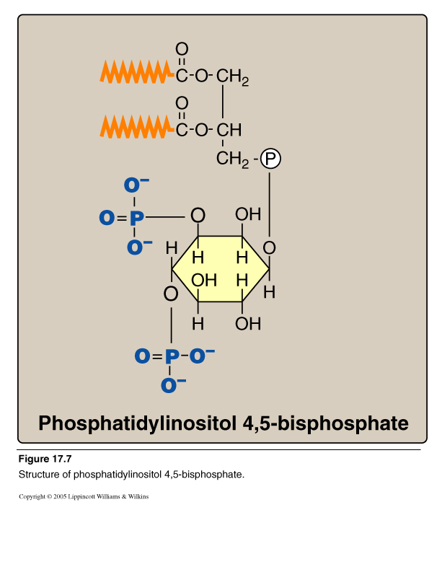
Calcium/Phosphatidylinositol System
Diacylglycerol
(DAG)
Inositol Trisphosphate
(IP₃)
Phospholipase C

Slide 20
Intracellular Signaling by Inositol trisphosphate
e.g., Antidiuretic hormone (ADH), Acetylcholine

Slide 21
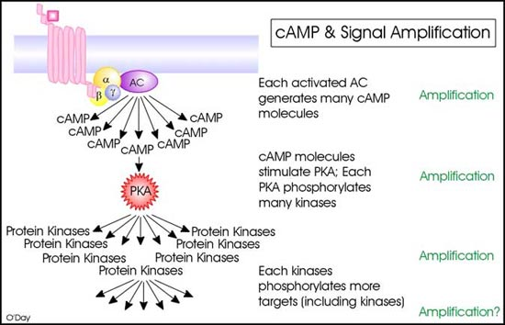
Signal Amplification

Slide 22
Take home messages
Cell signaling allows
Signal transmission and amplification
Regulation of metabolism
Intercellular communications & coordination of complex biologic functions

Slide 23
Reference
Lippincott’s Illustrated reviews: Biochemistry 6th edition, Unit 2, Chapter 8, Pages 91-107; and Chapter 17, Pages 204-205.

