Slide 1
Protein structure
(Foundation Block)

Slide 2
Objectives
By the end of this lecture, the students should be able to:
Understand the peptide bonding between amino acids.
Explain the different levels of protein structure and the forces stabilizing these structures and what happens when the protein is denatured.
Define the α-helix and β-sheet as the most commonly encountered secondary structures in a protein molecule.
Correlate the protein structure with function with hemoglobin as an example.
Understand how the misfolding of proteins may lead to diseases like Alzheimer’s or prion disease.

Slide 3
What are proteins?
Proteins are large, complex molecules that play many critical roles in the body.
They do most of the work in cells and are required for the structure, function, and regulation of the body’s tissues and organs.
Proteins are made up of hundreds or thousands of smaller units called amino acids, which are attached to one another in long chains.

Slide 4
What are proteins?
There are mainly 20 different types of amino acids that can be combined to make a protein.
The sequence of amino acids determines each protein’s unique three-dimensional (3D) structure and its specific function.
Proteins can be described according to their large range of functions in the body e.g. antibody, enzyme, messenger, structural component and transport/storage.

Slide 5
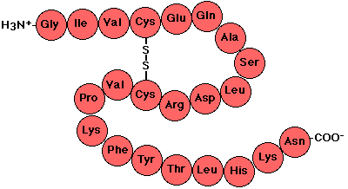
Primary structure
It is the linear sequence of amino acids.
Covalent bonds in the primary structure of protein:
  Peptide bond.
  Disulfide bond (if any).

Slide 6
Peptide Bond (amide bond)

Slide 7
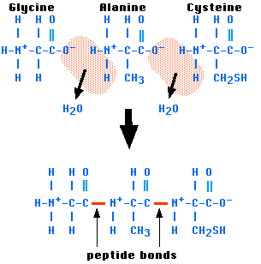
Each amino acid in a chain makes two peptide bonds.
The amino acids at the two ends of a chain make only one peptide bond.
The amino acid with a free amino group is called amino terminus or NH₂-terminus.
The amino acid with a free carboxylic group is called carboxyl terminus or COOH-terminus.

Slide 8
Peptides
Amino acids can be polymerized to form chains:
  Two amino acids ➔ dipeptide ➔ one peptide bond.
  Three amino acids ➔ tripeptide ➔ two peptide bonds.
  Four amino acids ➔ tetrapeptide ➔ three peptide bonds.
  Few (2-20 amino acids) ➔ oligopeptide.
  More (>20 amino acids) ➔ polypeptide.

Slide 9
DNA sequencing.
Direct amino acids sequencing.
How to determine the primary structure sequence?

Slide 10
Secondary structure
It is regular arrangements of amino acids that are located near to each other in the linear sequence.
Excluding the conformations (3D arrangements) of its side chains.
α-helix, β-sheet and β-bend are examples of secondary structures frequently found in proteins.

Slide 11
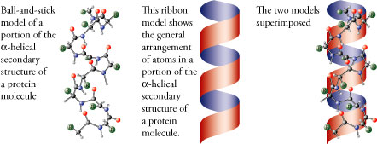

Slide 12
Secondary structure
α-helix:
  It is a right-handed spiral, in which side chains of amino acids extended outward.
  Hydrogen bonds: Stabilize the α-helix.
  form between the peptide bond carbonyl oxygen and amide hydrogen.
  Amino acids per turn: Each turn contains 3.6 amino acids.
  Amino acids that disrupt an α-helix:
    Proline ➔ imino group, interferes with the smooth helical structure.
    Glutamate, aspartate, histidine, lysine or arginine ➔ form ionic bonds.
    Bulky side chain, such as tryptophan.
    Branched amino acids at the β-carbon, such as valine or isoleucine.

Slide 13
Secondary structure
β-sheet (Composition of a β-sheet)
    Two or more polypeptide chains make hydrogen bonding with each other.
    Also called pleated sheets because they appear as folded structures with edges.

Slide 14
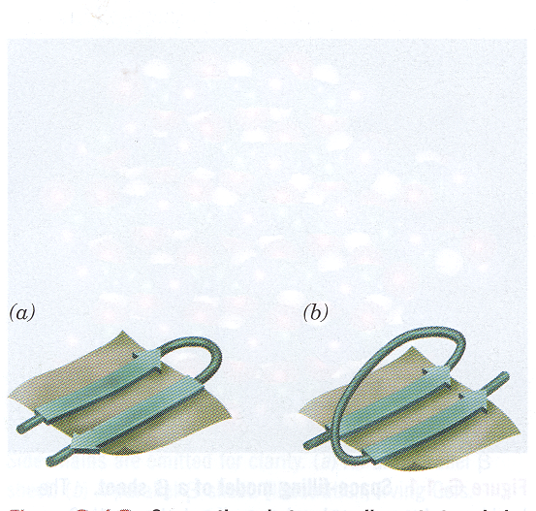
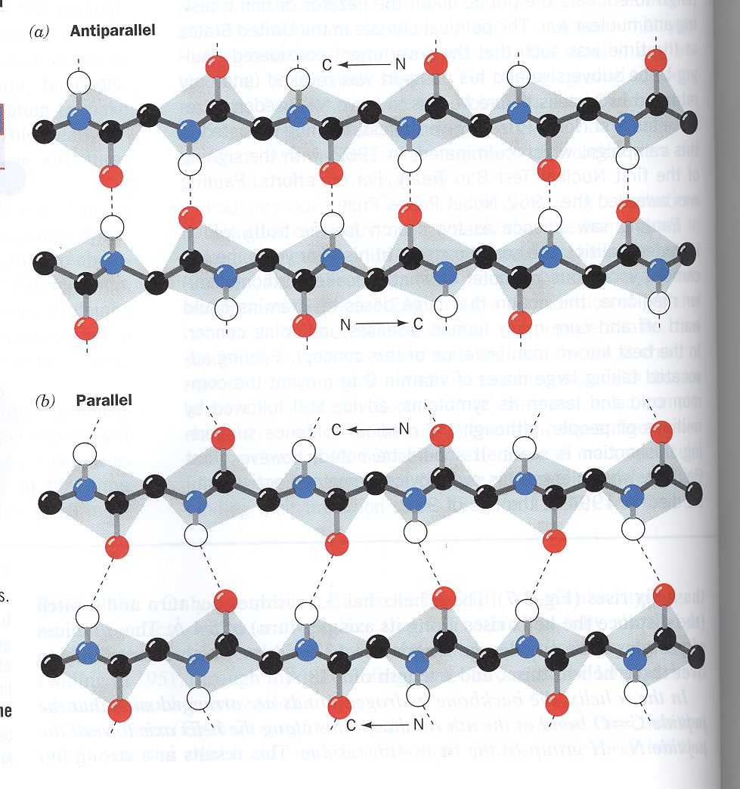
Secondary structure
β-sheet (Antiparallel and parallel sheets)
  Hydrogen bonds in parallel direction is less stable than in antiparallel direction

Slide 15
Secondary structure
Other secondary structure examples:
  β-bends (reverse turns):
    Reverse the direction of a polypeptide chain.
    Usually found on the surface of the molecule and often include charged residues.
    The name comes because they often connect successive strands of antiparallel β-sheets.
    β-bends are generally composed of four amino acid residues, proline or glycine are frequently found in β-bends.
  Nonrepetitive secondary structure:
  e.g. loop or coil conformation.

Slide 16
Secondary structure
Other secondary structure examples:
  Supersecondary structures (motifs):
    A combination of secondary structural elements.
α α motif: two α helices together
β α β motif: a helix connects two β sheets
β hairpin: reverse turns connect antiparallel β sheets
β barrels: rolls of β sheets

Slide 17
Tertiary structure
It is the three-dimensional (3D) structure of an entire polypeptide chain including side chains.
The fundamental functional and 3D structural units of a polypeptide known as domains, >200 amino acids fold into two or more clusters.
The core of a domain is built from combinations of supersecondary structural elements (motifs) and their side chains.
Domains can be combined to form tertiary structure.

Slide 18
Tertiary structure
Interactions stabilizing tertiary structure:
  Disulfide bonds.
  Hydrophobic interactions.
  Hydrogen bonds.
  Ionic interactions.

Slide 19
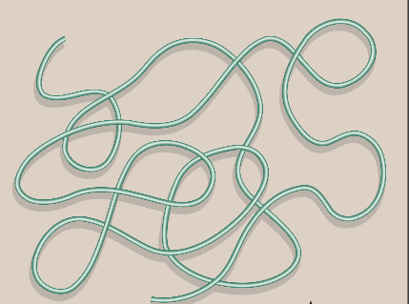
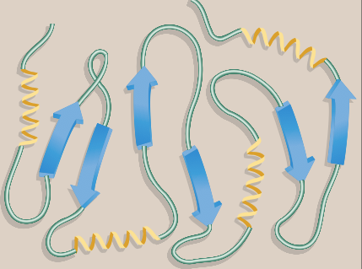
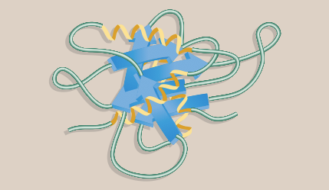
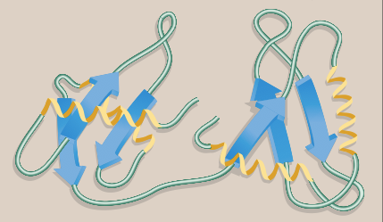
Tertiary structure
Protein folding:

Slide 20
Tertiary structure
Role of chaperons in protein folding:
  Chaperons are a specialized group of proteins, required for the proper folding of many species of proteins.
  They also known as “heat chock” proteins.
  The interact with polypeptide at various stages during the folding process.

Slide 21
Quaternary structure
Some proteins contain two or more polypeptide chains that may be structurally identical or totally unrelated.
Each chain forms a 3D structure called subunit.
According to the number of subunits: dimeric, trimeric, … or multimeric.
Subunits may either function independently of each other, or work cooperatively, e.g. hemoglobin.

Slide 22
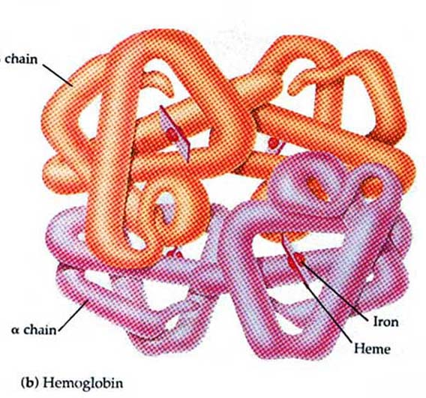
Hemoglobin
Hemoglobin is a globular protein.
A multisubunit protein is called oligomer.
Composed of α ₂ β ₂ subunits (4 subunits).
Two same subunits are called protomers.

Slide 23
Denaturation of proteins
It results in the unfolding and disorganization of the protein’s secondary and tertiary structures.
Denaturating agents include:
  Heat.
  Organic solvents.
  Mechanical mixing.
  Strong acids or bases.
  Detergents.
  Ions of heavy metals (e.g. lead and mercury).
Most proteins, once denatured, remain permanently disordered.
Denatured proteins are often insoluble and, therefore, precipitate from solution.

Slide 24
Protein misfolding
Every protein must fold to achieve its normal conformation and function.
Abnormal folding of proteins leads to a number of diseases in humans.

Slide 25
Protein misfolding
Alzheimer’s disease:
  β amyloid protein is a misfolded protein.
  It forms fibrous deposits or plaques in the brains of Alzheimer’s patients.
Creutzfeldt-Jacob or prion disease:
  Prion protein is present in normal brain tissue.
  In diseased brains, the same protein is misfolded.
  It, therefore, forms insoluble fibrous aggregates that damage brain cells.

Slide 26
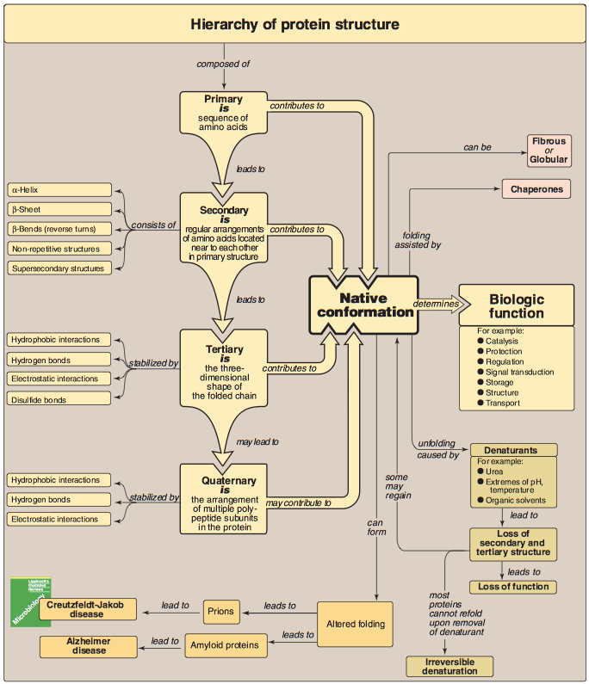

Slide 27
Take home messages
Native conformation of the protein is the functional, fully folded protein structure
The unique 3D structure of the native conformation is determined by its primary structure, i.e. the amino acid sequence
Interactions of between the amino acid side chains guide the folding of the polypeptide chain to form secondary, tertiary and sometimes quaternary structures that cooperate in stabilizing the native conformation of the protein.
Protein denaturation results in unfolding and disorganization of of the protein’s structure, which are not accompanied by hydrolysis of peptide bonds.
Disease can occur when an apparently normal protein assumes a conformation that is cytotoxic, as in the case of Alzheimer disease and Prion disease.

Slide 28
Reference
Lippincott’s Illustrated reviews: Biochemistry 6th edition, Unit 2, Chapter 2, Pages 13-24.

