Slide 1
Introduction to metabolism

Slide 2
objectives
By the end of this lecture the First Year students will be able to:
Understand the concept of metabolic pathways
Identify types and characteristics of metabolic pathways (anabolic and catabolic)
Identify ATP as the energy source for cells

Slide 3
Metabolism
All the chemical reactions taking place inside a cell are collectively known as METABOLISM
Metabolism consists of:
Energy consuming (anabolic) pathways
Energy producing (catabolic) pathways

Slide 4
Pathway vs Chemical Reaction
Metabolic Pathway
A multi-step sequence of chemical reactions
Product of first reaction becomes a substrate for second reaction
Integrated pathways: Metabolism

Slide 5
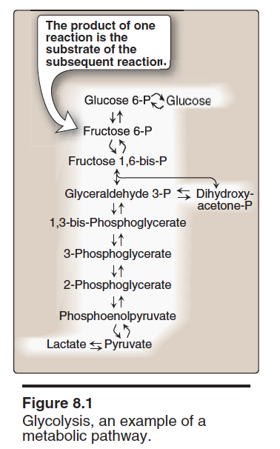
Glycolysis is a metabolic pathway

Slide 6
Metabolic Map
Different pathways can intersect to form an integrated and purposeful network of chemical reactions called ”The Metabolic Map”

Slide 7
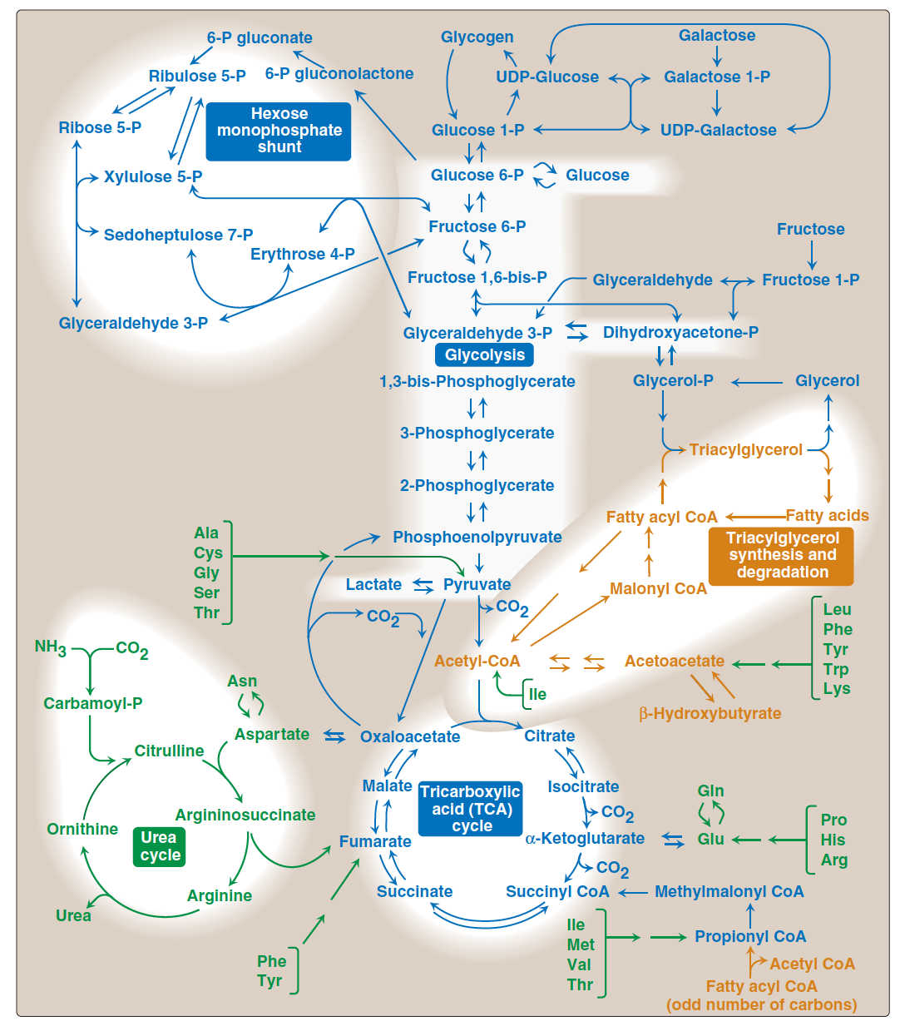

Slide 8
Classification
Most pathways can be classified as:
Catabolic
Anabolic
Pathways that regenerate a component are called cycles

Slide 9
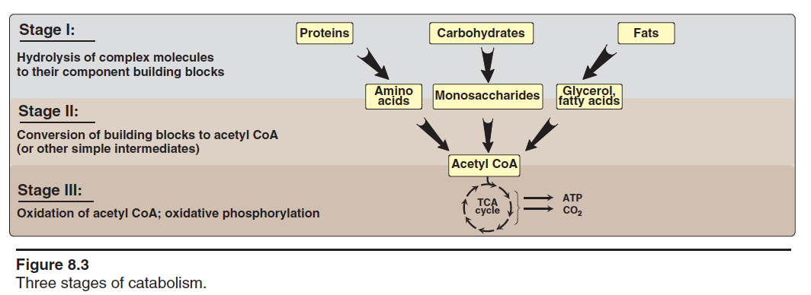
Catabolic Pathways

Slide 10
Anabolic Pathways
Formation of precursor molecules into complex molecules
Endergonic reactions (require ATP)
A divergent process (few precursors form more complex products)

Slide 11
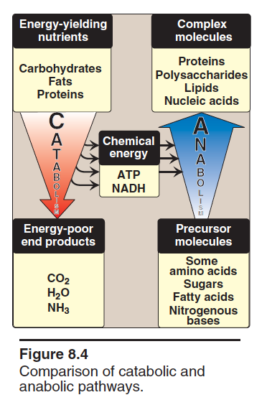
Catabolism Vs Anabolism

Slide 12
Comparison of catabolic and anabolic pathways
Anabolic
Catabolic
Simple to complex molecules
Endergonic
Involves reduction
Require NADPH
Divergent process
Complex to simple molecules
Exergonic
Involves oxidation
Require NAD⁺
Convergent process
Notes:
Eplain what

Slide 13
Amphibolic Pathways
Amphi means dual
Amphibolic: Both catabolic and anabolic
Example:
Krebs cycle is mainly a catabolic cycle but with some anabolic features
Krebs cycle is used for the synthesis of glucose from amino acids
It is amphibolic

Slide 14
Energy Currency: ATP
ATP + H₂O ADP +P_{i}
The free energy liberated by the hydrolysis of ATP is used to drive the endergonic reactions
ATP is formed from ADP and P_{i} when fuel molecules are oxidized
This ATP-ADP cycle is the fundamental mode of energy exchange in biological systems

Slide 15
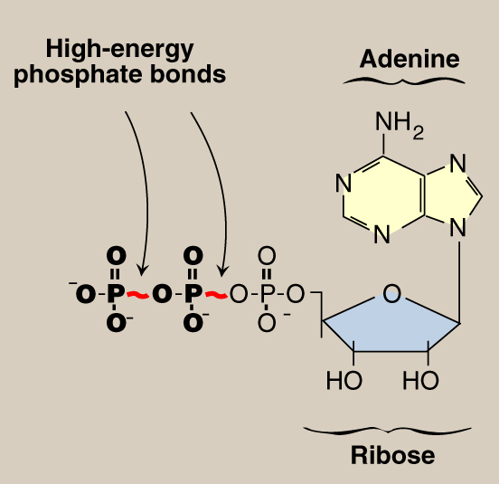
Adenosine Triphosphate (ATP)
Δ Gº -7.3 kcal/mol/bond

Slide 16
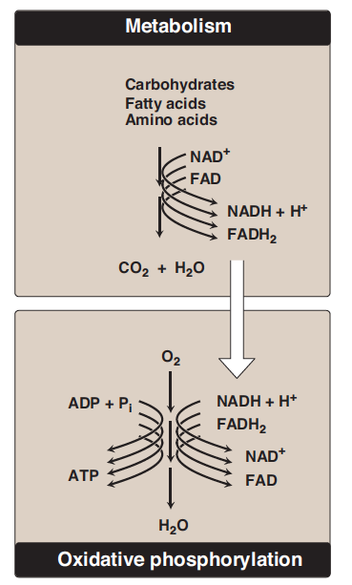
Energy rich
compounds
Transfer of electrons
Energy-rich
Reduced
coenzymes
Oxidation-Reduction in Metabolism
Oxidized
coenzymes

Slide 17
Oxidation / Reduction
Oxidation:
Loss of hydrogen
Loss of electrons
Reduction:
Gain of hydrogen
Gain of electrons

Slide 18
NAD⁺ / NADH

Slide 19
Regulation of Metabolism
Intracellular signals:
Substrate availability
Product inhibition
Allosteric activators or inhibitors
Intercellular communications:
Chemical signaling (hormones):
Second messenger
cAMP, cGMP
Ca⁺⁺/phosphatidylinositol

Slide 20
Metabolic Fuel
Carbohydrates and lipids (mainly) and proteins (little extent) are used for energy production
Glucose and fatty acids are a major source of energy
Amino acids are a minor source of energy
Glucose is the major metabolic fuel of most tissues

Slide 21
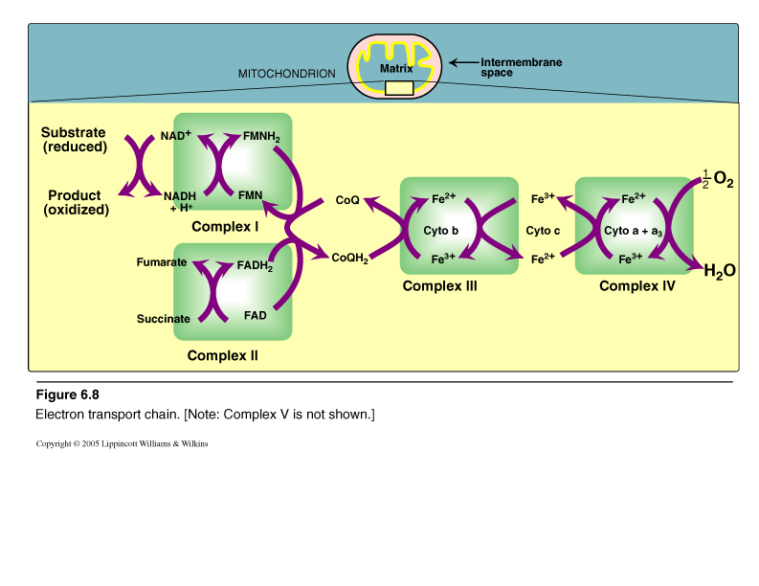
Electron Transport Chain (ETC)
Figure For Illustration only
Non-protein mobile carrier
Sites for ATP Synthesis
Electron transport and ATP synthesis are tightly coupled processes

Slide 22
Take home message
Metabolism is the sum of all biochemical pathways that occur inside the cells
A metabolic pathway is a multistep sequences of enzyme-catalyzed reactions
Catabolism is a convergent process that provides energy to cells in the form of ATP
Anabolism is a divergent process that consumes energy for the synthesis of complex molecules
Metabolic pathways are tightly regulated and highly integrated
ATP is the energy currency of the cells

Slide 23
references
Lippincott’s Illustrated Reviews, Biochemistry, 5th edition, Denise R. Ferrier, Lippincott Williams & Wilkins, USA, pp 91-94.

