Slide 1
GRAM POSITIVE & GRAM NEGATIVE BACTERIA
(Foundation Block, Microbiology)
Lecturer name: Prof . AM Kambal & Dr. Fawzia Alotaibi
Department of Pathology, Microbiology Unit
‹#›

Slide 2
Objectives:
By the end of this lecture, the student should able to:
Know the general basic characteristics of bacteria
Differentiate between gram positive and gram negative bacteria characteristics.
Know the classes and groups of gram positive bacteria, cocci and bacilli (rods)
Know the common identification characteristic of these groups
‹#›

Slide 3
Know the common infections and diseases caused by these organisms and the antibiotics used for their treatment
Know the classes and groups of gram negative bacteria, cocci and bacilli (rods)
Know the common identification methods for These organisms
Know the commonest infectious and diseases caused by these bacteria and the antibiotics used for their treatment
‹#›

Slide 4
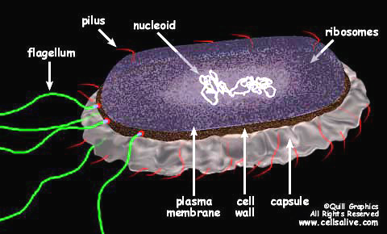
Bacterial cells
‹#›

Slide 5
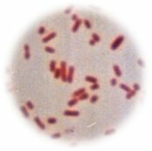
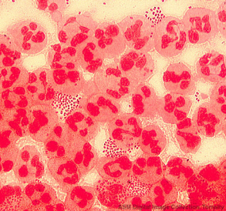
GRAM STAIN
Developed in 1884 by the Danish physician Hans Christian Gram
An important tool in bacterial taxonomy, distinguishing so-called Gram-positive bacteria, which remain coloured after the staining procedure, from Gram-negative bacteria, which do not retain dye and need to be counter-stained.
Can be applied to pure cultures of bacteria or to clinical specimens
Top: Pure culture of E. coli
(Gram-negative rods)
Bottom: Neisseria gonorrhoeae in a smear of urethral pus
(Gram-negative cocci, with pus cells)
‹#›

Slide 6
CELL WALL
Gram positive cell wall
Gram negative cell wall
Consists of
a thick, homogenous sheath of peptidoglycan 20-80 nm thick
tightly bound acidic polysaccharides, including teichoic acid and lipoteichoic acid
cell membrane
Retain crystal violet and stain purple
Consists of
an outer membrane containing lipopolysaccharide (LPS)
thin shell of peptidoglycan
periplasmic space
inner membrane
Lose crystal violet and stain pink from safranin counterstain
‹#›

Slide 7
Gram Positive
Gram Negative
‹#›

Slide 8
The Gram Stain
Gram's
Crystal
iodine
violet
Decolorise with
acetone
Gram-positives
appear purple
Counterstain with
e.g. methyl red
Gram-negatives
‹#›
appear pink

Slide 9
‹#›

Slide 10
Gram-positive cocci
Gram-positive rods
Gram-negative cocci
Gram-negative rods
‹#›

Slide 11
Gram positive bacteria
Cocci Bacilli
Aerobic /facltative Anaerobe
Anaerobe Peptostreptococci
Staphylococci
Streptococci
Enterococcci
Aerobic/facultative anaerobe Anaerobic
Cornybacterium
Listeria Clostridium
Nocardia
Latobacillus ,Bacillus
‹#›

Slide 12
Gram | O2 | Arrangment | Example | Diseases
Gram Positive Cocci |  | Gram + coccis in chains Catalase negative | Strep.Pneumoniae Alpha hemolysis | Pneumonia meningitis
 |  |  | Group A strept Beta hemolysis | Sore throat Rheumatic fever
 | Aerobic |  | Group B strept Beta hemolysis | Neonatal infection
 |  |  | Enterococcus Non hemolysis | Urine, blood infection
 |  | Gram + cocci in clusters Catalase + | Staph Aureus | Soft tissue bone joint blood and heart
 |  |  | Coagulase – staph Staph epidermidis | Catheters
 | Anaerobic | Gram + coccis in chains | Peptostreptococcus | Brain abscess
Gram Negative cocci | Aerobic | Gram – cocci in pairs | Neisseria and Moraxella | Genital , Meninges and respiratory
 | Anaerobic | Gram – cocci | Veillonella | Rare cause infection
‹#›

Slide 13
Gram | O2 | Characteristics | Examples
Gram Positive Bacilli | Aerobic | Spore forming | Bacillus antherasis
 |  | Non-Spore forming | Listeria Actinomyces
 | Anaerobic | Spore forming | Clostridia
 |  | Non-Spore forming | Eubacterium
Gram negative Bacilli | Aerobic | Sugar fermenter Enteric Bacteria Oxidase - | E. coli
 |  | Sugar fermenter Oxidase + | Vibrio cholerae
 |  | Non fermenter Oxidase + | Pseudomonas
 |  | Non fermenter Oxidase - | Acinetobacter
 |  | fastidious | Haemophilus influenzae
 | Anaerobic |  | Bacteroides
Non Gram Stainable |  |  | Spirochetes
 |  |  | Mycoplasma
 |  |  | Chlamydia
‹#›

Slide 14
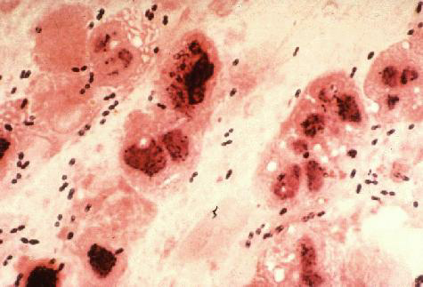
Gram-positive Cocci
Staphylococci
Catalase-positive
Gram-positive cocci in clusters
Staphylococcus aureus
coagulase-positive most important
pathogen
Staph. epidermidis
and other coagulase negative staphylococci egS saprophiticus
Streptococci
Catalase-negative
Gram-positive cocci in chains or pairs
Strep. pyogenes
Strep. pneumoniae
Viridans-type streps
Enterococcus faecalis
‹#›

Slide 15
Streptococcus
S. viridans-oral flora -infective endocarditis
S. pyogenes dividedby type of haemolysis
Group A, beta hemolytic strep
pharyngitis, cellulitis
rheumatic fever
fever
migrating polyarthritis
carditis
immunologic cross reactivity
acute glomerulonephritis
edema, hypertension, hematuria
antigen-antibody complex deposition
‹#›

Slide 16
S. pneumoniae
‹#›

Slide 17
GRAM POSITIVE BACILLI
A-Spore forming
B-Non spore forming
Spore forming are divided into:-
Aerobic spore forming most important is Bacillus anthracis,that causes anthracis
‹#›

Slide 18
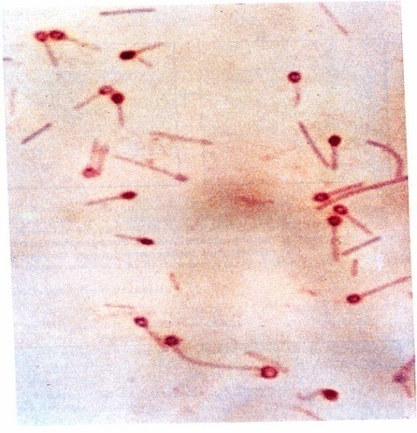
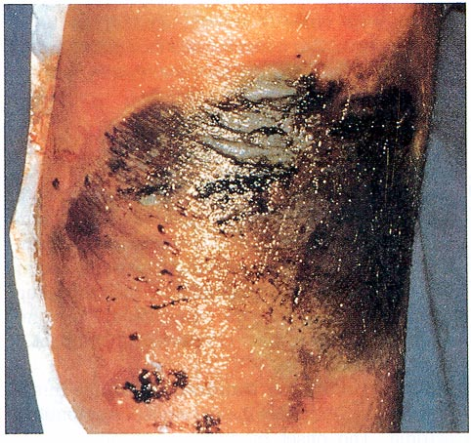
Anerobic Gram Positive Bacilli
C. tetani - Tetanus C. perfringens
Gas gangarene
C. botulinum - botulism
Descending weakness-->paralysis
diplopia, dysphagia-->respiratory failure
C. diphtheriae - Fever, pharyngitis, cervical LAD
thick, gray, adherent membrane
sequelae-->airway obstruction, myocarditis
‹#›

Slide 19
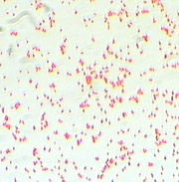
Gram-Negative Cocci
Neisseria gonorrhoeae
The Gonococcus
Neisseria meningitidis
The Meningococcus
Both Gram-negative intracellular diplococci
Moraxella catarrhalis
‹#›

Slide 20
Gram-Negative Rods
Enteric Bacteria they ferment sugars most important are;
E. coli
Salmonella
Shigella
Yersinia and Klebsiella pneumoniae
Proteus

Slide 21
Gram-Negative Rods
Fastidious GNRs
Bordetella pertussis
Haemophilus influenzae
Campylobacter jejuni
Helicobacter pylori
Legionella pneumophila
Anaerobic GNRs
Bacteroides fragilis
Fusobacterium

Slide 22
Oxidise positive non fermentative i.e. they do not ferment sugars e.g.
Pseudomonas that causes infection in
Immunocompromised patients
Oxidise negative non fermentative e.g.
Acinobacter species
‹#›

Slide 23
Oxidise positive comma shaped and also fermentative most important is Vibrio cholerae that causes cholera which is a disease characterized by severe diarrhea and dehydration
‹#›

Slide 24
Non-Gram-stainable bacteria
Unusual gram-positives
Spirochaetes
Obligate intra-cellular bacteria

Slide 25
Unusual Gram-positives
Mycoplasmas
Smallest free-living organisms
No cell wall
M. pneumonia, M. genitalium

Slide 26
Reference book and the relevant page numbers..

