Slide 1
GRANULOMATOUS INFLAMMATION
Many slides were taken from Dr. Maha Arafah.
Associate Professor and Histopathologist.
1st year- Safar 1439, Oct 2017
Osamah T. Khojah, Assistant Professor,
Hematopathologist, Immunopathologist & Blood Transfusionist,
0555485892, asd@ksu.edu.sa

Slide 2
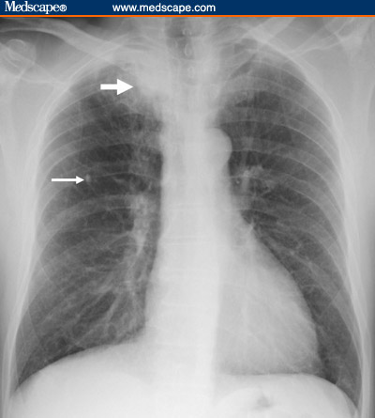

Slide 3
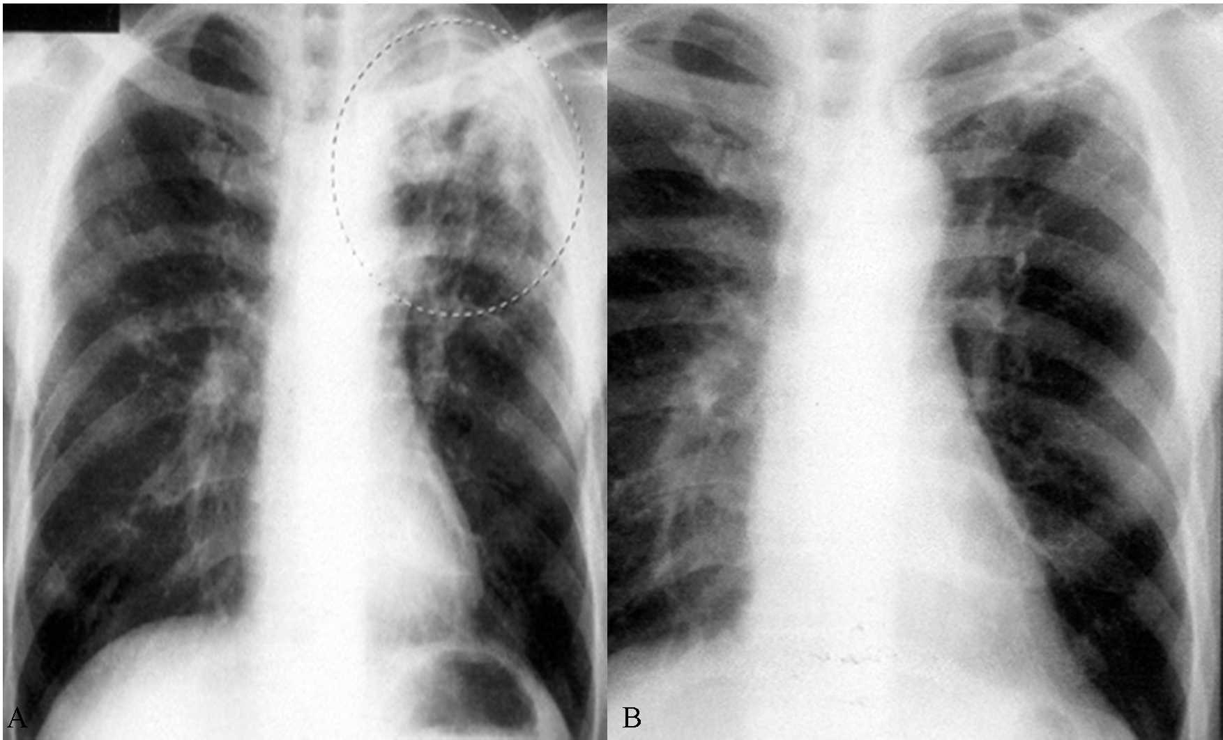

Slide 4
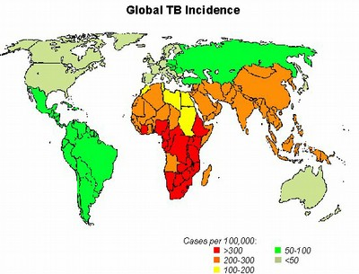

Slide 5
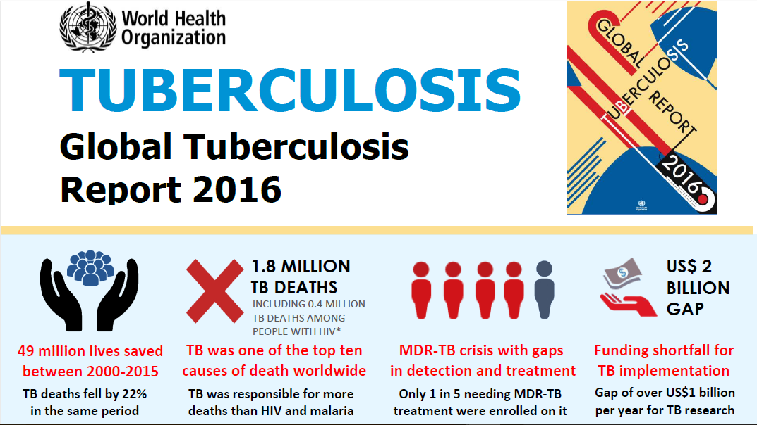
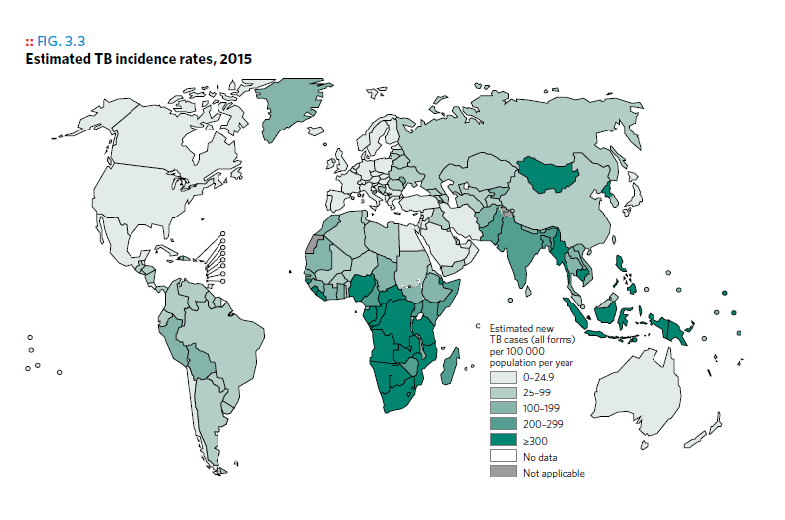
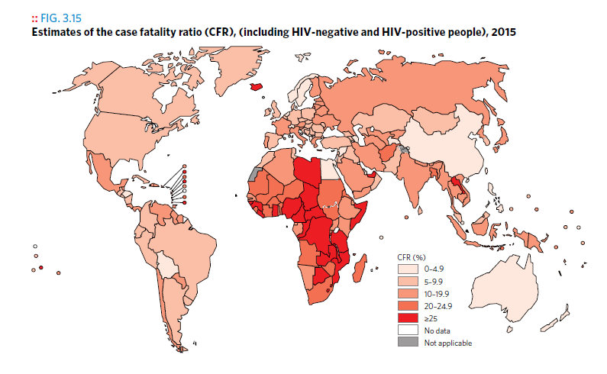
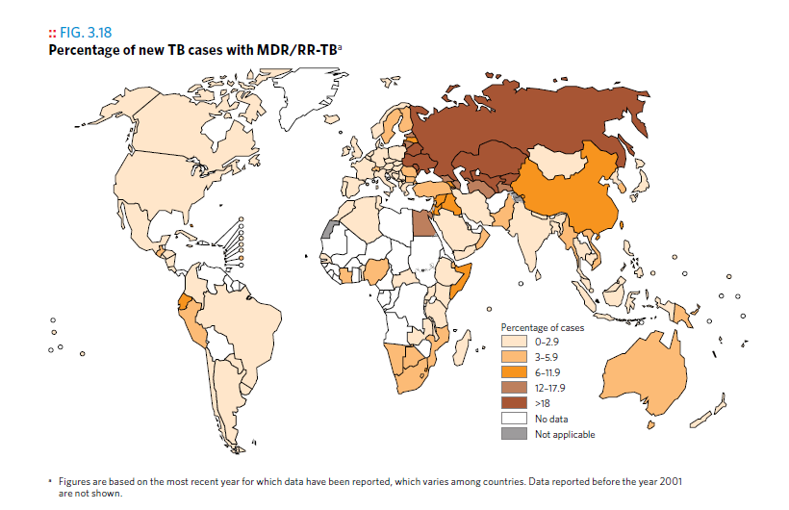
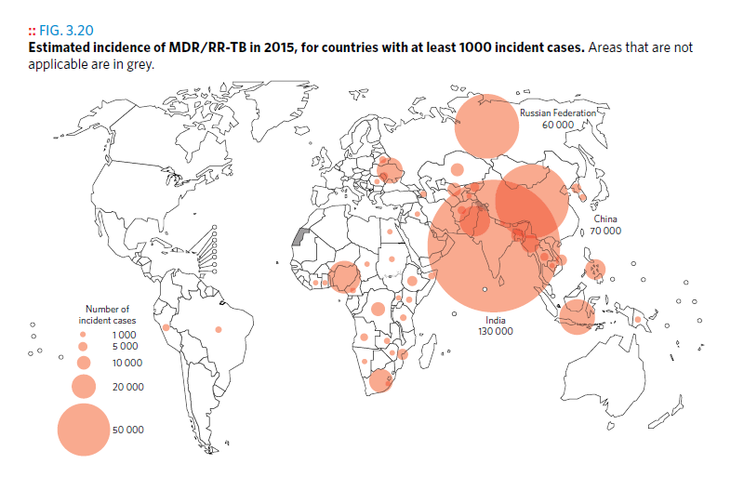
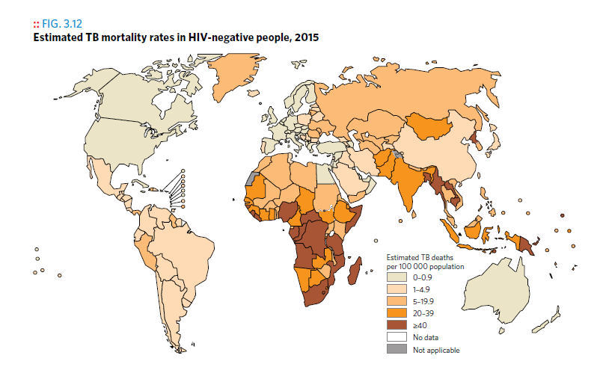
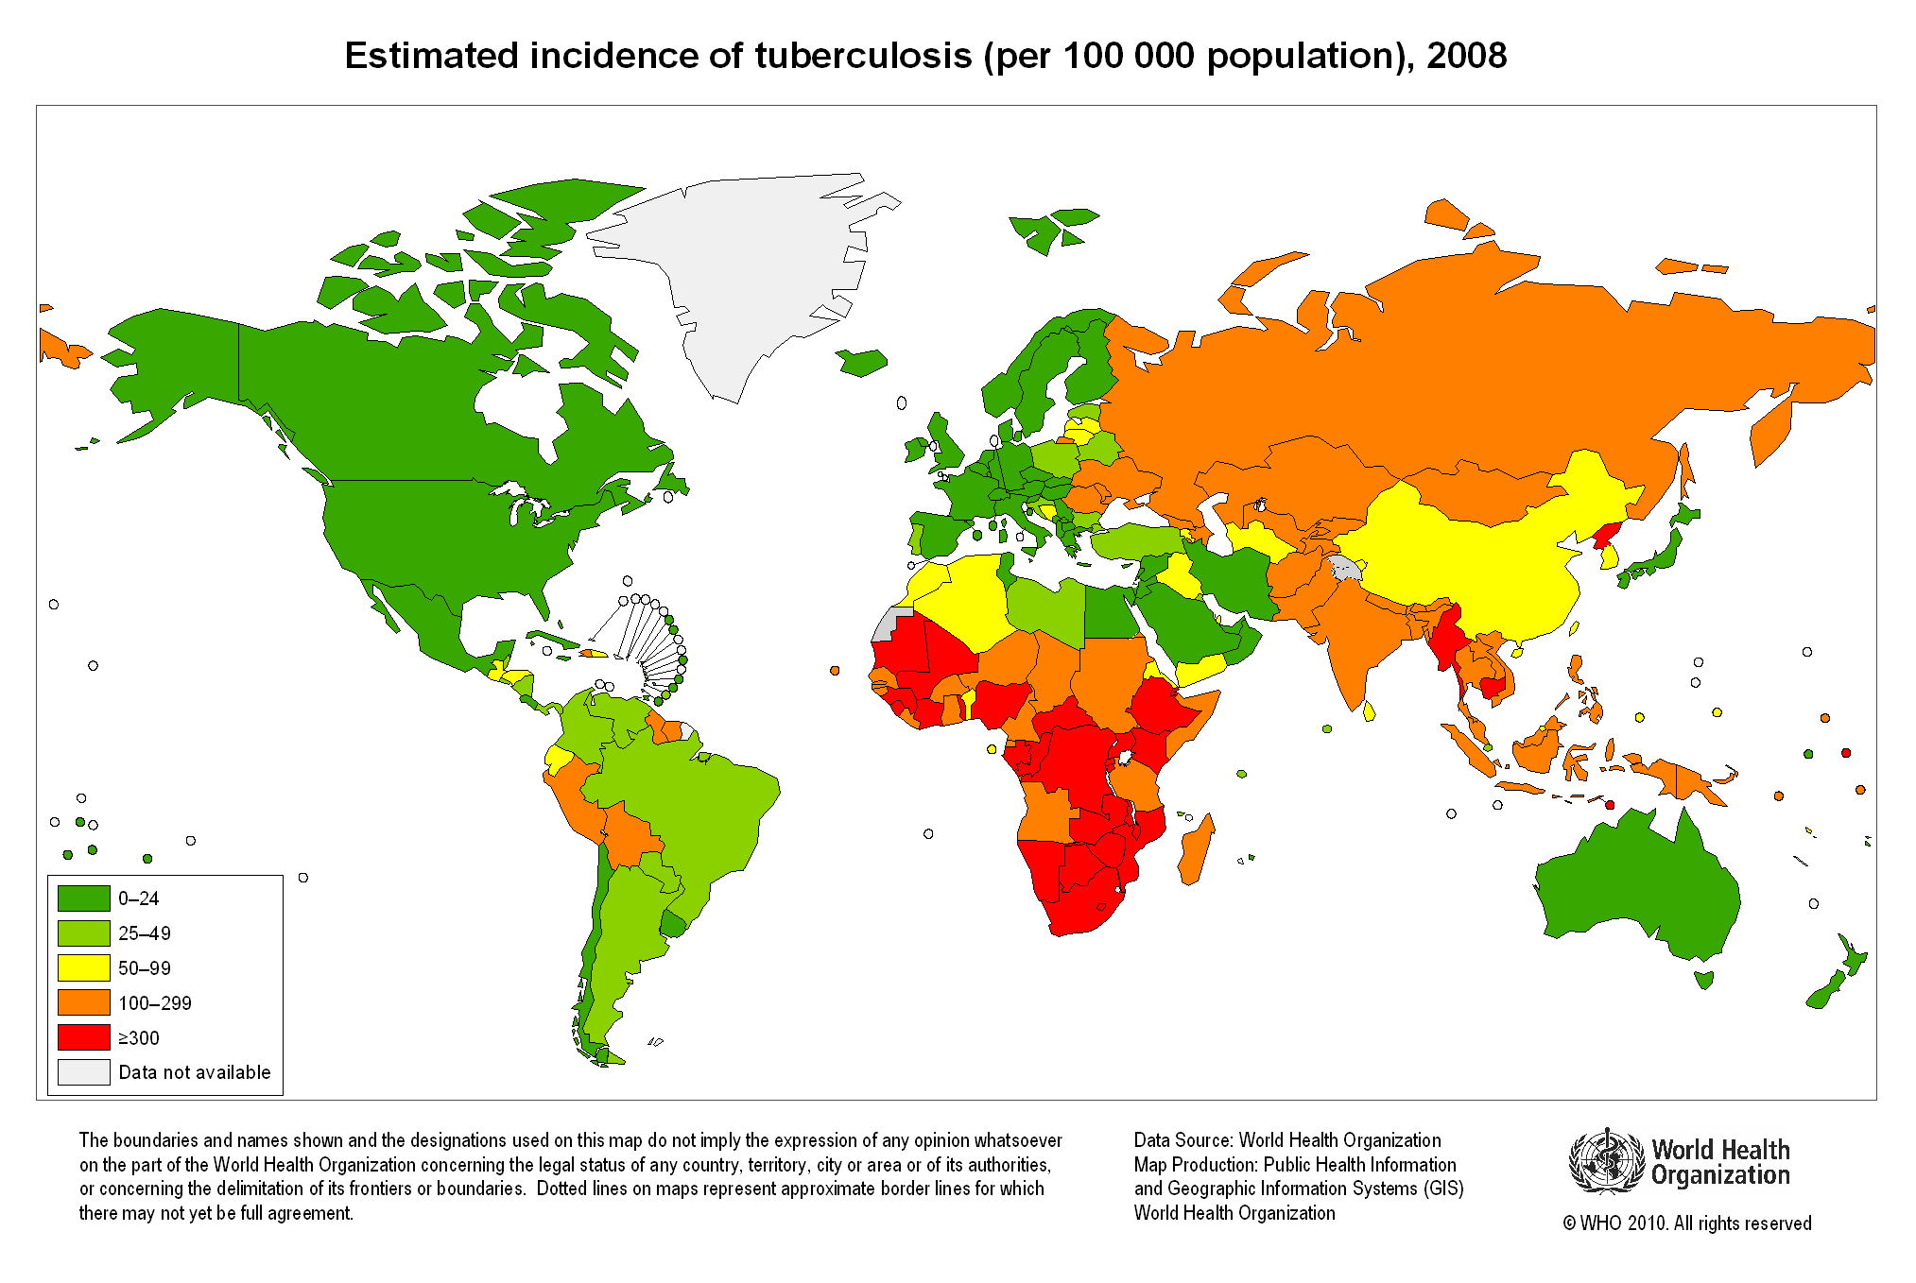

Slide 6
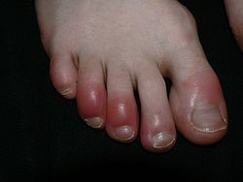
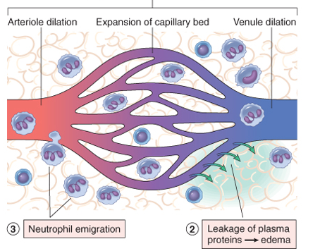
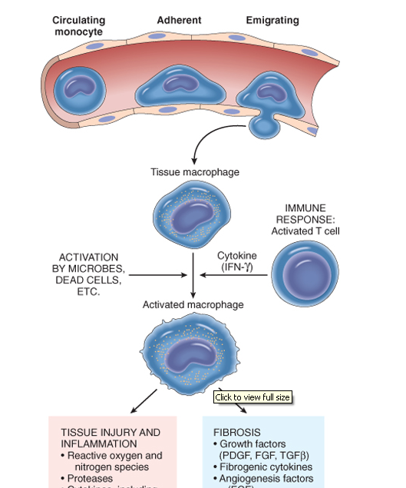
Inflammation
Acute inflammation
Chronic inflammation
Neutrophils
Macrophage
Lymphocytes
Plasma cells

Slide 7
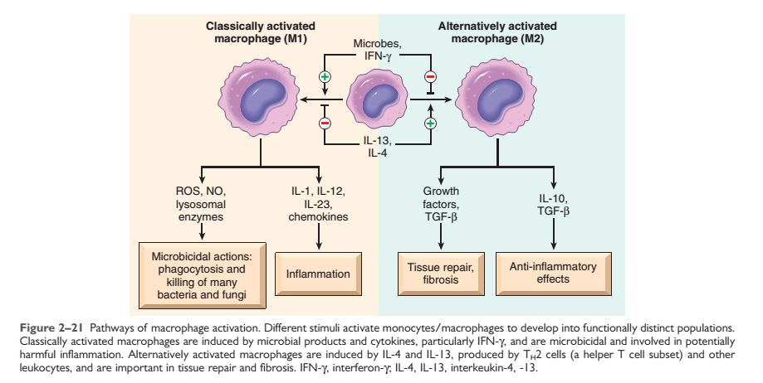

Slide 8
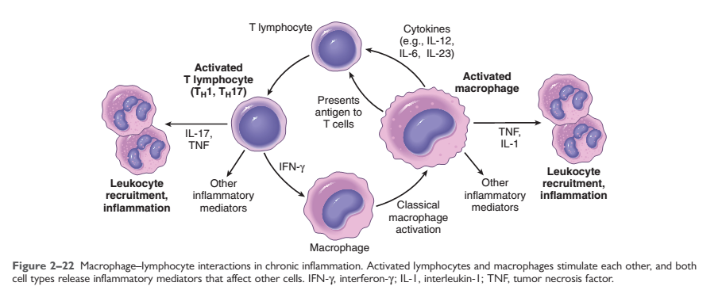

Slide 9
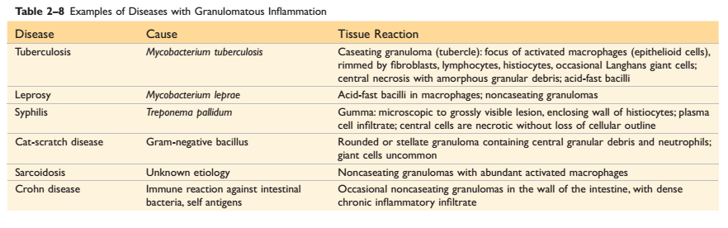

Slide 10
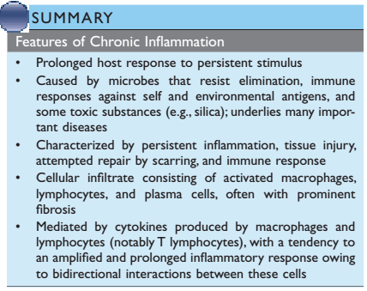

Slide 11
OBJECTIVES AND KEY PRINCIPLES TO BE TAUGHT:
Upon completion of this lecture, the student should:
Define Granulomatous inflammation.
Recognize the morphology of granulomas (tubercles) and list the cells found in granuloma along with their appearance.
Identify the two types of granulomas, which differ in their pathogenesis.
  Foreign body granulomas
  Immune granulomas
List the common causes of Granulomatous Inflammation.
Understands the pathogenesis of granuloma formation.

Slide 12
Granulomatous inflammation
A form of chronic inflammation characterized by the formation of granulomas.

Slide 13
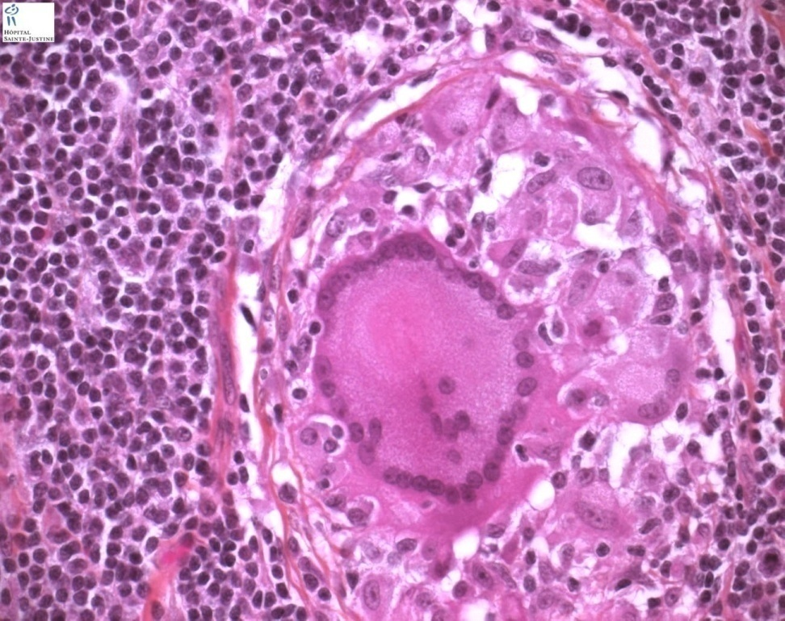
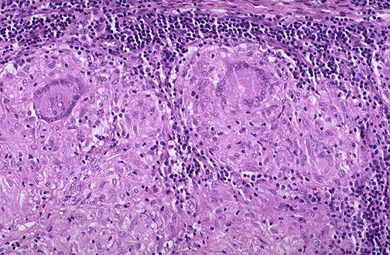
Granuloma = Nodular collection of epithelioid macrophages surrounded by a rim of lymphocytes
Epitheloid macrophages: squamous cell-like appearance

Slide 14
Why is it important?
Granulomas are encountered in certain specific pathologic states.
Recognition of the granulomatous pattern is important because of the limited number of conditions (some life-threatening) that cause it.

Slide 15
Granulomatous Inflammation pathogenesis
Neutrophils ordinarily remove agents that incite an acute inflammatory response. However, there are circumstances in which reactive neutrophils cannot digest the substances that provoke acute inflammation.

Slide 16
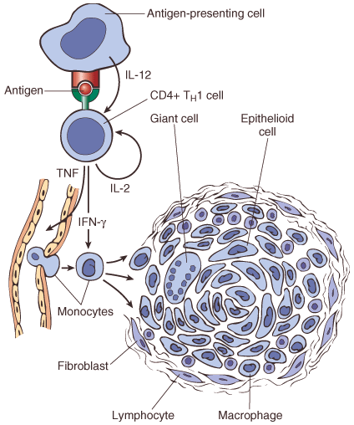
Granulomatous Inflammation mechanism
What is the initiating event in granuloma formation?
deposition of a indigestible antigenic material
IFN-γ released by the CD4+ T cells of the T_{H}1 subset is crucial in activating macrophages.
Type IV hypersensitvity

Slide 17
Epithelioid cell granulomas
When macrophages have successfully phagocytosed the injurious agent but it survives inside them.
When an active T lymphocyte-mediated cellular immune response occurs. Lymphokines produced by activated T lymphocytes inhibit migration of macrophages and cause them to aggregate in the area of injury and form granulomas.

Slide 18
Pathogenesis
There are two types of granulomas
Foreign body granuloma
Immune granuloma
are incited by relatively inert foreign bodies. Typically, foreign body granulomas form when material such suture are large enough to preclude phagocytosis by a single macrophage
These material do not incite any specific inflammatory immune response.
The foreign material can usually be identified in the center of the granuloma, by polarized light (appears refractile).
are caused by insoluble particles, typically microbes, that are capable of inducing a cell-mediated immune response.

Slide 19
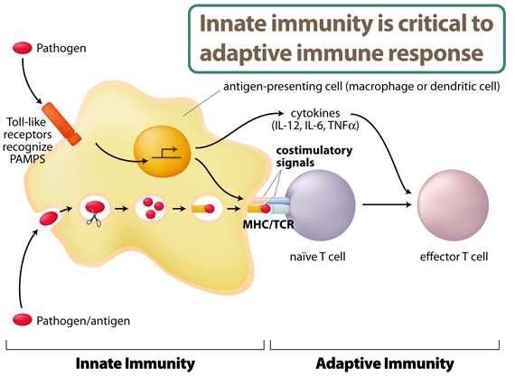
IL-2, and IFN-γ,

Slide 20
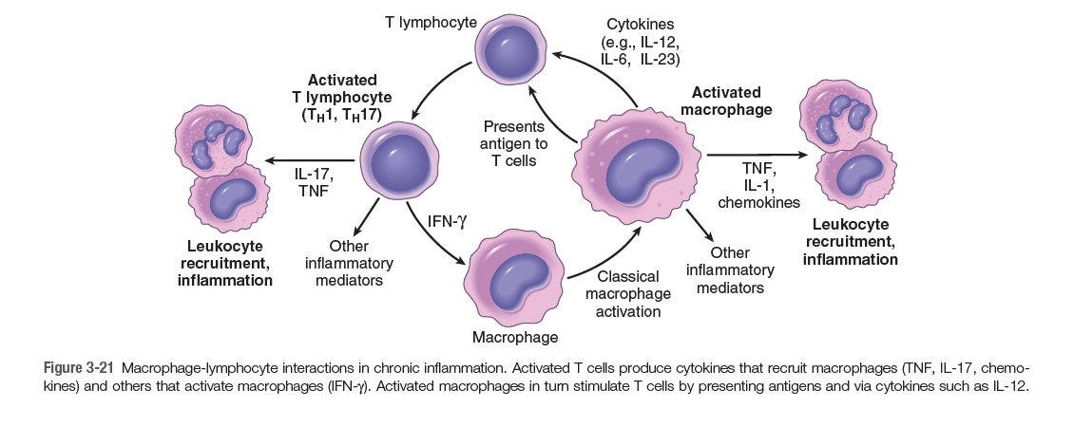

Slide 21
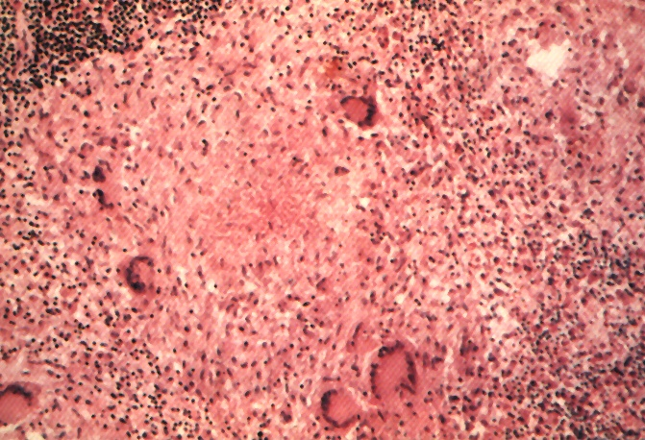
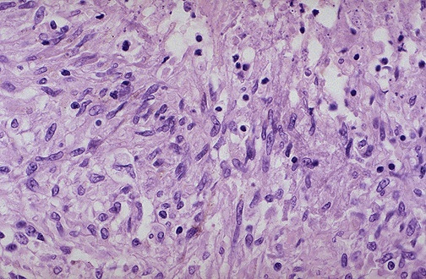
Granuloma
Langhans Giant Cell
Lymphocytic Rim
Caseous Necrosis
Epithelioid Macrophage

Slide 22
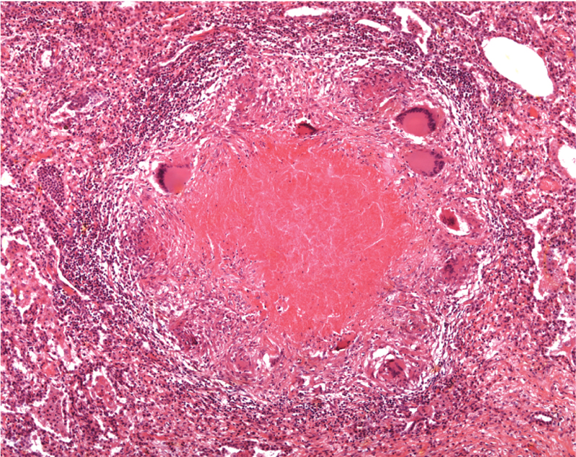
Epitheliod histiocytes
Lymphocytes
Multinucleated cell
Necrosis

Slide 23
Granulomatous Inflammation
Causes
Non-immune granuloma
Immune granuloma:
Foreign body
  Suture
  Graft material
  talc (associated with intravenous drug abuse)
Bacteria
  Tuberculosis
  Leprosy
  Actinomycosis
  Cat-scratch disease
Parasites
  Schistosomiasis
  Leishmaniasis
Fungi
  Histoplasmosis
  Blastomycosis
Metal/Dust
  Berylliosis
unknown
Sarcoidosis
Crohn’s disease

Slide 24
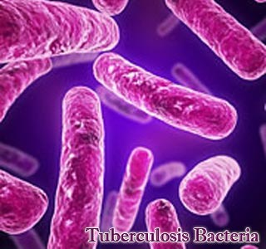
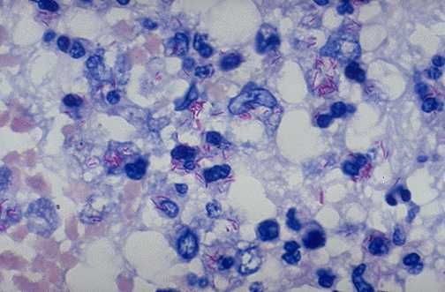
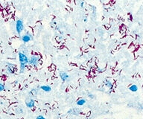
Tuberculosis
Mycobacterum tuberculosis
Mycobacteria – ‘fungus like..
slender rods
acid fast bacilli [AFB] (i.e., they have a high content of complex lipids that readily bind the Ziehl-Neelsen [carbol fuchsin] stain and subsequently resist decolorization).

Slide 25
Pathogenesis of TB
Cord factor is a glycolipid molecule found in the cell wall of Mycobacterium tuberculosis and similar species.
It protects M. tuberculosis from the defenses of the host
Cord factor presence increases the production of the cytokines interleukin-12 (IL-12), IL-1β, IL-6 and TNF which are all pro-inflammatory cytokines important for granuloma formation

Slide 26
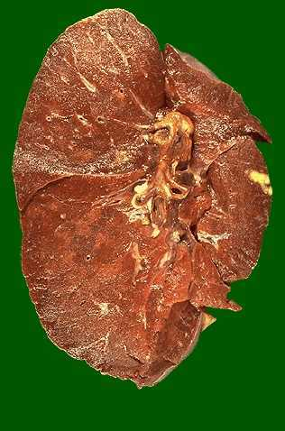
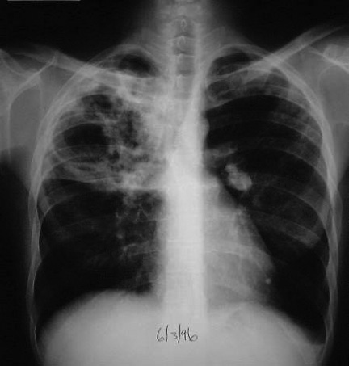
Tuberculosis

Slide 27
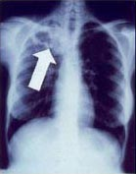
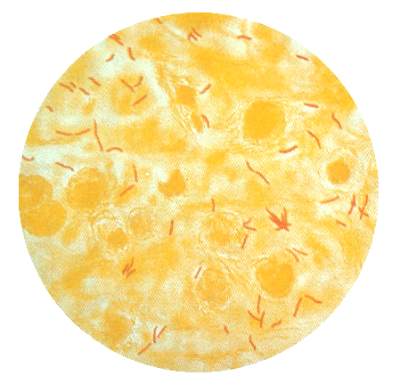
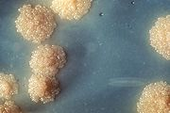
Signs, Symptoms and Diagnosis of TB
X-ray
Sputum smear microscopy
Culture

Slide 28
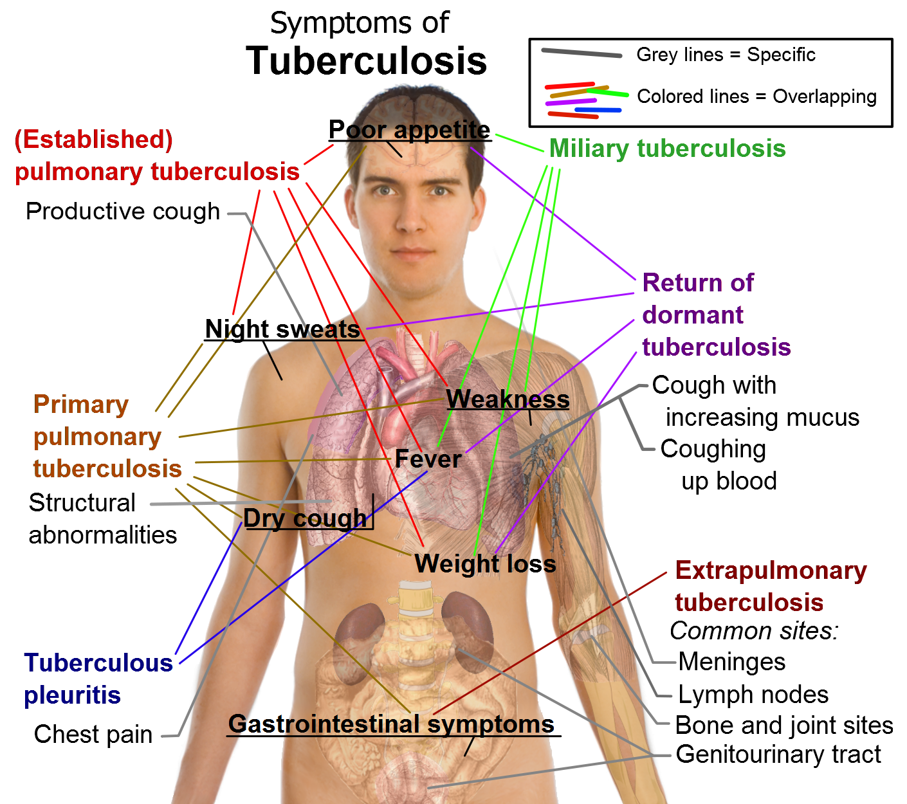

Slide 29
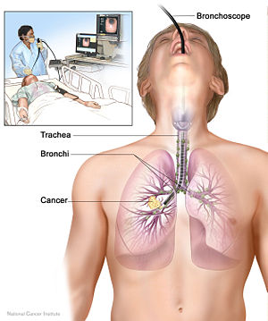
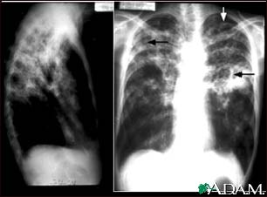
Diagnosis of pulmonary TB
  Sputum smear
      Acid fast stain (>10,000 CFU/ml)
  Bronchoscopy
  Chest X-Ray
  Tuberculin skin testing (TST)
Notes:
Lets briefly touch on some of the tools available to help establish a diagnosis of TB and when I refer to TB, we will be talking specifically about Pulmonary TB. We can perform a AF stain looking for AFB. Sometimes as we know sputum collection can be difficult. Some clinicians may elect to do Bronchoscopy where they can go in and extract some of the sputum for culture/AF stain. The chest x-ray can often be useful. Here in this example we can see patchy opacities. And finally the ever famous TST or formally known as the PPD= purified protein derivative of the organism. Basically the concept is that if a person has been exposed to TB and developed antibodies to the bacteria it will result in an immune response. It is important to remember that those who have received the BCG vaccine, mostly in foreign countries will always have a +TST. We do not typically use the BCG vaccine in the US due to concerns regarding efficacy. Medications and degree of immunosupression can also affect intrepreation of TST

Slide 30
Sputum , TB bacilli

Slide 31
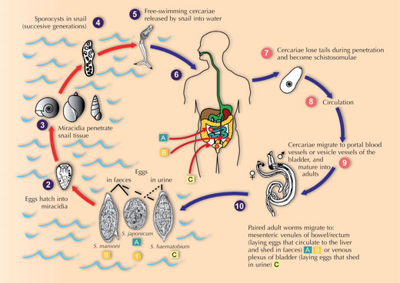
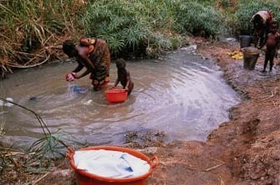
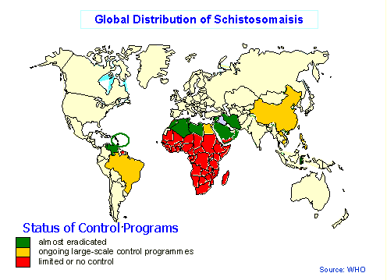
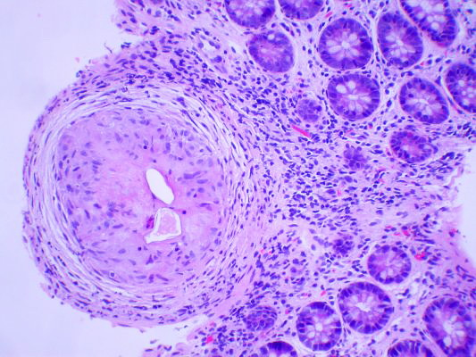
Schistosomiasis

Slide 32
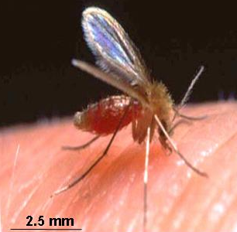
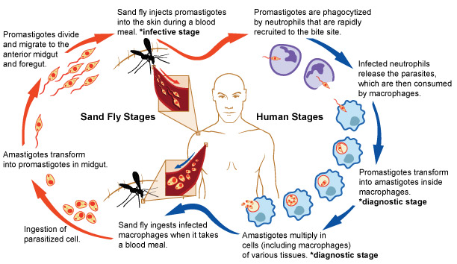
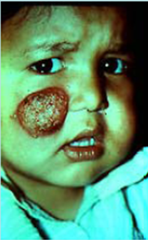
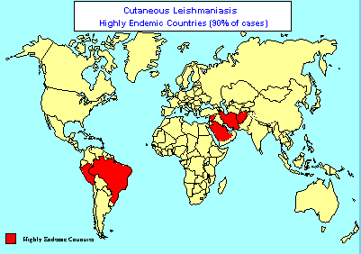

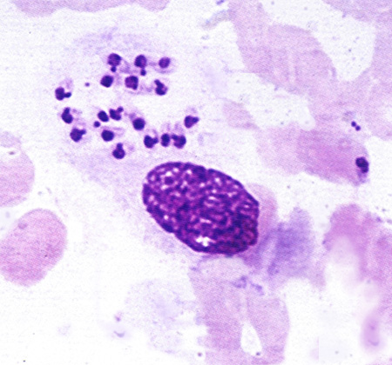
Leishmaniasis

Slide 33
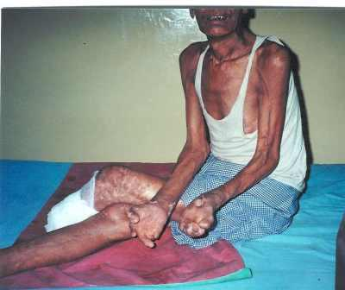
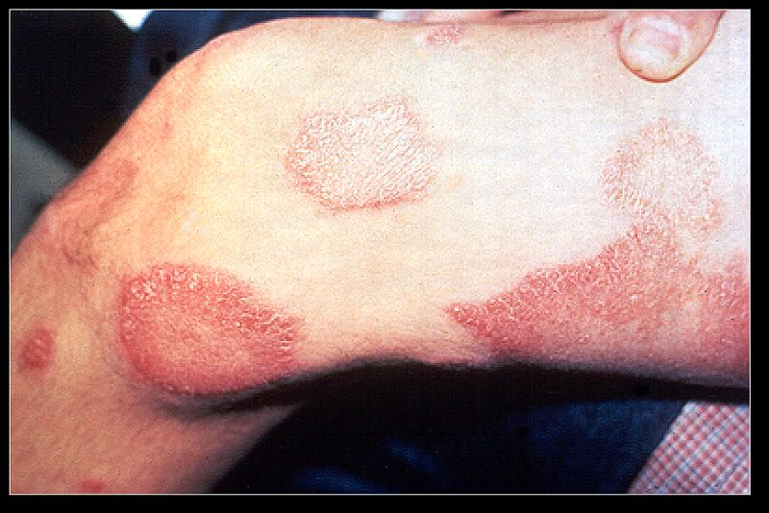
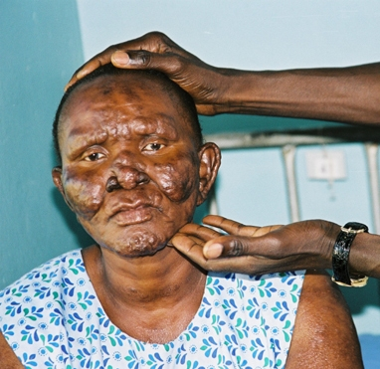
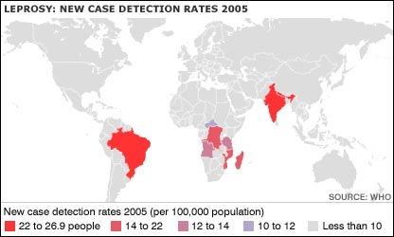
Leprosy

Slide 34
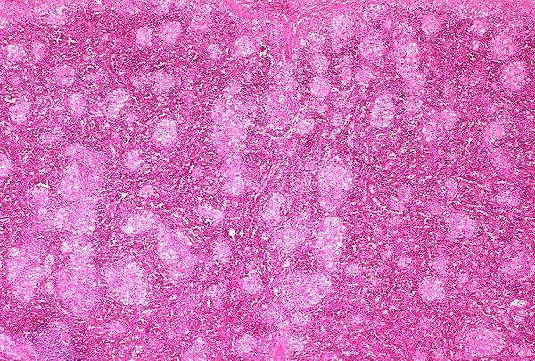

Leprosy

Slide 35




Sarcoidosis
Non-caseating granuloma

Slide 36
Match A and B
A
B
The most important cell in granulomatous inflammation
A cytokines that is important in activating macrophages and transforming them into epithelioid cells
Multinucleated cell in TB
Antigen presenting cells
pathogenesis of immune type granulomatous inflammation
Microscopic finding of TB
Found in the cell wall of TB
IFN-γ
Langhans cells
Epitheliod histiocyes
Cord factor
Langerhan’s cells
Type IV hypersensitivity reaction
Caseating granuloma

Slide 37

Langerhan’s` cells
Antigen presenting cells

Slide 38
Which of the following diseases does not cause granulomatous inflammation
Cat-scratch disease
Actinomycosis
Sarcoidosis
Leishmaniasis
Staphylococcus infection

Slide 39


Slide 40
TAKE HOME MESSAGES:
Granulomatous inflammation is a distinctive pattern of chronic inflammation characterized by aggregates epithelioid macrophages.
Damaging stimuli which provoke a granulomatous inflammatory response include; microorganisms which are of low inherent pathogenicity but which excite an immune response.
Granulomata are produced in response to:
  Bacterial infection.
  Parasitic infection: e.g. Schistosoma infection.
  Certain fungi cannot be dealt with adequately by neutrophils, and thus excite granulomatous reactions.
  Non-living foreign material deposited in tissues, e.g. keratin from ruptured epidermal cyst.
  Unknown factors, e.g. in the disease 'sarcoidosis' and Crohn's disease.

Slide 41
…Thank You…

