Slide 1
Excretion of Drugs
Ali Alhoshani, B.Pharm, Ph.D.
ahoshani@ksu.edu.sa
Office: 2B 84

Slide 2
Excretion
By the end of this lecture, you should:
Identify major and minor routes of excretion including renal elimination and biliary excretion
Describe enterohepatic circulation and its consequences on duration of drugs.
Describe some pharmacokinetics terms including clearance of drugs.
Biological half-life (t ½), multiple dosing, steady state levels, maintenance dose and Loading dose.

Slide 3
Excretion
Major Routes of Excretion
  Renal Excretion
  Biliary Excretion
Minor Routes of Excretion
  Pulmonary excretion.
  Salivary excretion.
  Mammary excretion via milk.
  Skin / Dermal excretion via sweat.
  Tears

Slide 4
Renal Excretion
Structure of kidney
The structure unit of kidney is nephron
That consists of :
  Glomerulus
  Proximal convoluted tubules
  Loop of Henle
  Distal convoluted tubules
  Collecting ducts

Slide 5
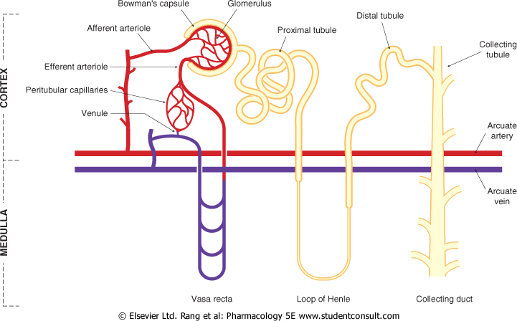
Kidney

Slide 6
Renal Excretion includes
The principle processes that determine the
urinary excretion of drugs are:
Renal Excretion= Filtration – Reabsorption + Secretion
  Glomerular filtration.
  Passive tubular reabsorption.
  Active tubular secretion.

Slide 7
Renal Excretion includes
Glomerular filtration
  Depends upon renal blood flow (600 ml/min)
  GFR 20% of renal blood flow = 125 ml/min.
  Glomerular filtration occurs to
    Low molecular weight drugs
    Only free drugs (unbound to plasma proteins)are filtered.

Slide 8
Renal Excretion includes
  Passive tubular reabsorption
  In distal convoluted tubules & collecting ducts.
  Passive diffusion of unionized, lipophilic drugs
  Lipophilic drugs can be reabsorbed back into blood circulation and excretion in urine will be low.
  Ionized drugs are poorly reabsorbed & so urinary excretion will be high.

Slide 9
Renal Excretion includes
  Active tubular secretion.
  occurs mainly in proximal tubules; increases drug concentration in lumen
  Organic anionic and cationic tranporters mediate active secretion of anionic and cationic drugs.
  Can transport drugs against conc. gradients.
    Penicillin is an example of actively secreted drug.

Slide 10
Renal Excretion includes
  Active tubular secretion.
    System for Acidic drugs.
      Salicylates
      Sulphonamides
      Penicillin
      Transport of acidic drugs is blocked by probenecid
    System for Basic drugs
      Morphine
      Atropine
      Quinine
      Neostigmine

Slide 11
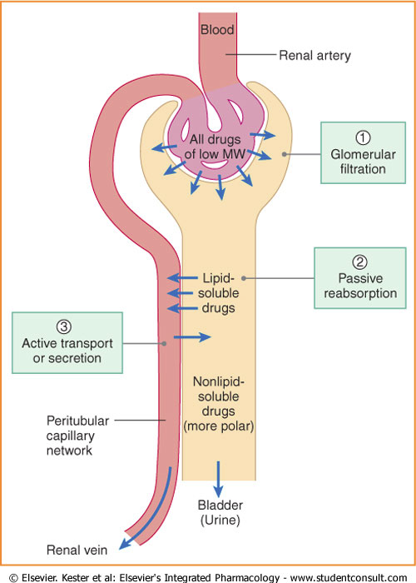
Renal Excretion includes

Slide 12
Renal Excretion includes
Polar drug= water soluble
Non polar drug = lipid soluble

Slide 13
Urinary pH trapping (Ion trapping)
Changing pH of urine by chemicals can inhibit or enhance the drug reabsorption from renal tubules back into blood circulation.
Ion trapping is used to enhance renal clearance of drugs during toxicity.
Urine is normally slightly acidic and favors excretion of basic drugs.

Slide 14
Urinary pH trapping (Ion trapping)
Acidification of urine using ammonium chloride (NH4Cl) increases excretion of basic drugs as amphetamine.
Alkalinization of urine using sodium bicarbonate (NaHCO₃)increases excretion of acidic drugs as aspirin.

Slide 15
Renal Excretion
Drugs excreted mainly by the kidney include:
Aminoglycosides antibiotics (as gentamycin)
Penicillin
Lithium
These drugs should be prescribed carefully in
patients with renal disease.
Elderly people

Slide 16
Biliary Excretion
Occurs to few drugs that are excreted into feces.
Such drugs are secreted from the liver into bile by active transporters, then into duodenum.
Some drugs undergo enterohepatic circulation back into systemic blood circulation

Slide 17
Enterohepatic circulation
Drugs excreted in the bile in the form of glucouronides will be hydrolyzed in intestine by bacterial flora liberating free drugs that can be reabsorbed back into blood if the drugs are lipid soluble.
This prolongs the duration of action of drugs e.g. digoxin, morphine, thyroxine.

Slide 18
Enterohepatic circulation

Slide 19
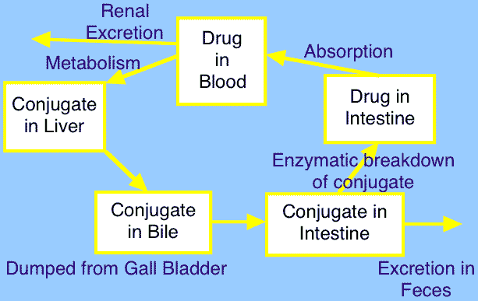
Excretion

Slide 20
Plasma half-life (t ½)
Is the time required for the plasma concentration of a drug to fall to half of its initial concentration.
Is a measure of duration of action.
Determine the dosing interval
Drugs of short plasma half life
Penicillin, tubocurarine.
Drugs of long plasma half life
Digoxin, Thyroxine.

Slide 21
Factors May Increase Plasma half-life (t ½)
Decreased metabolism
  Liver disease.
  Microsomal inhibitors.
Decreased clearance
  Renal disease.
  Congestive heart failure.
High binding of drugs
  Plasma proteins.
  Tissue binding.
Enterohepatic recycling

Slide 22
Steady State
  A state at which the therapeutic plasma concentration of the drug (mg/ml) remains constant with the therapeutic window (the range between effective and toxic levels of drugs).
  At steady state:
  rate of drug administration = elimination rate

Slide 23
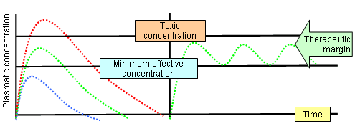
Therapeutic Window

Slide 24
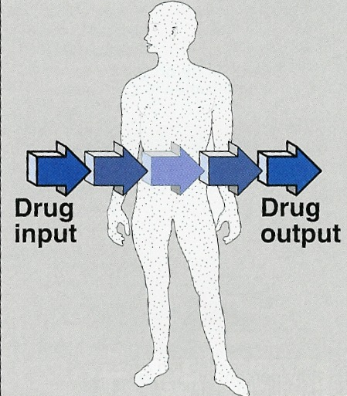
Steady State

Slide 25
Steady State
How many half-lives would be necessary to reach steady state?
Steady state concentration is attained after 3-5 half lives
E.g. Morphine

Slide 26
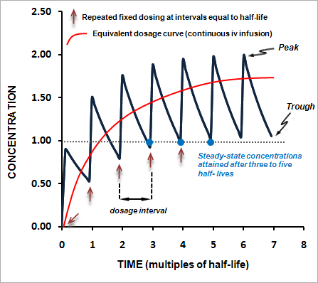
Steady State Level

Slide 27
Loading Dose
is the large initial dose that is given to achieve rapid therapeutic plasma level.
After administration of the drug, the plasma concentration decreases due to distribution of drug to other tissues.
These doses balances the drug distribution.
This is important for drugs with long halve lives.

Slide 28
Clinical Application of Loading Dose
A loading dose may be desirable if the time required to attain steady state of drug (4 elimination t1/2 values) is long and rapid relief is required in the condition being treated.
E.g. t1/2 of lidocaine (antiarrhythmic drug) is usually 1-2 hours. Arrhythmias after myocardial infarction are life-threatening, and one cannot wait 4-8 hours to achieve a therapeutic concentration.
Use of a loading dose of lidocaine in the coronary care unit is standard.

Slide 29
Maintenance Doses
are the doses required to maintain the therapeutic level of the drug constant or the steady state of the drug.
These doses balance the amount of drug lost during metabolism and clearance.
The patient needs to take regular doses of a drug such as amoxicillin ( 500 mg) / 8 hours to maintain the therapeutic level.

Slide 30
Summary
Polar drugs are readily excreted and poorly reabsorbed.
Lipid soluble drugs are reabsorbed back and excretion will be low
Acidic drugs are best excreted in alkaline urine (sodium bicarbonate).
Basic drugs are best excreted in acidic urine (ammonium chloride).
Enterohepatic circulation prolongs half life of the drug.

Slide 32
Questions

