Slide 1
Pharmacodynamics I Mechanisms of Drug action
Ali Alhoshani, B.Pharm, Ph.D.
ahoshani@ksu.edu.sa
Office: 2B 84

Slide 2
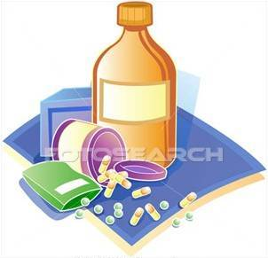
Mechanisms of Drug action
By the end of this lecture, you should:
Identify different targets of drug action
Differentiate between their patterns of action; agonism versus antagonism
Elaborate on drug binding to receptors

Slide 3
What is Pharmacodynamics?
Pharmacodynamics is a branch of pharmacology that deals with the study of the biochemical and physiological effects of drugs and their mechanisms of action.

Slide 4
What are the mechanisms of drug action?
Drugs can produce their actions by:
Binding with biomolecules (Receptor-mediated mechanisms):
Biomolecules = Targets=Receptors
Mostly protein in nature (protein target).
Non receptor-mediated mechanisms Physiochemical properties of drugs.

Slide 5
What are the mechanisms of drug action?
Drugs can produce their actions by:
Binding with biomolecules (Receptor-mediated mechanisms):
Protein targets for drug binding
Physiological receptors
Enzymes
Ion channels
Carriers
Structural protein

Slide 6
What are targets for drug binding ?
Ion channels
e.g. Sulfonylurea drugs (antidiabetic drugs): block K⁺ outflux via the K channels in pancreatic beta cells resulting in opening of calcium channels and insulin secretion.

Slide 7
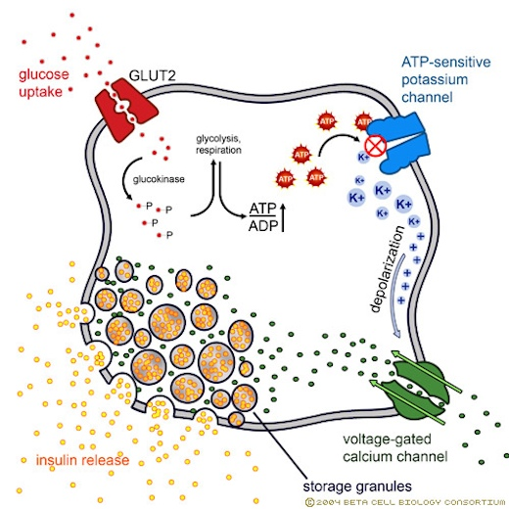
What are targets for drug binding ?
Ion channels
e.g. Sulfonylurea
drugs (antidiabetic drugs):

Slide 8
What are targets for drug binding ?
Carrier molecules
The drug binds to such molecules altering their transport ability
Responsible for transport of ions and small organic molecules between intracellular compartments, through cell membranes or in extracellular fluids.
e.g., Na+,K+-ATPase inhibitor

Slide 9
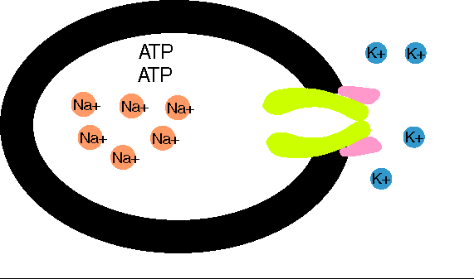
What are targets for drug binding ?
Carrier molecules
Digoxin: blocks Na efflux via Na pump; used in treatment of heart failure.
Digoxin

Slide 10
What are targets for drug binding ?
Carrier molecules
Cocaine: blocks transport or reuptake of catecholamines (dopamine) at synaptic cleft
The dopamine transporter can no longer perform its reuptake function, and thus dopamine accumulates in the synaptic cleft.

Slide 11
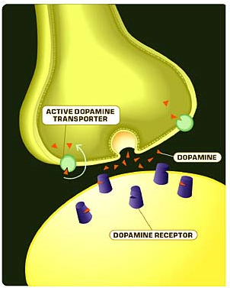
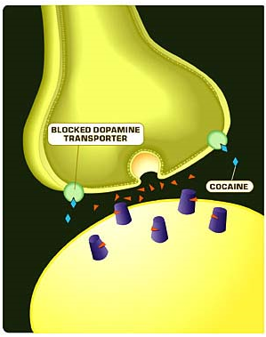
What are targets for drug binding ?
Carrier molecules
Effect of cocaine

Slide 12
What are targets for drug binding ?
Structural proteins
e.g. tubulin is target for:
Vincristine
anticancer agent
Colchicine
used in treatment of gout
Tubulin
Structure

Slide 13
Drug-Receptor Interaction
Binding Forces between drugs and receptors
Ionic bond.
Van-Dar-Waal.
Hydrogen bond.
Covalent bond.

Slide 14
Drug-Receptor Interaction
Affinity
Ability of a drug to combine with the receptor.
D + R D-R complex Effect.
Efficacy (Intrinsic Activity)
Capacity of a drug receptor complex (D-R) to produce an action.
is the maximal response produced by a drug (E max).

Slide 15
Drug-Receptor Interaction
Agonist
is a drug that combines with receptor and elicit a response (has affinity and efficacy).
Antagonist
is a drug that combines with a receptor without producing responses. It blocks the action of the agonist (has affinity but no or zero efficacy).
e.g. atropine

Slide 16
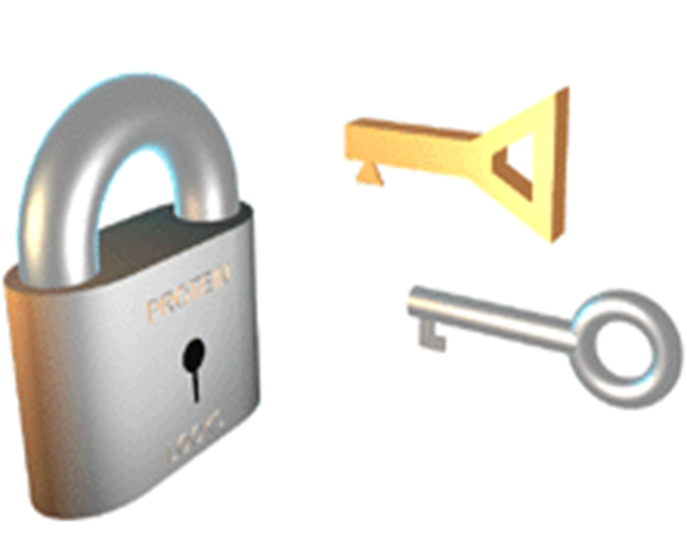
Drug-Receptor Interaction
Agonist and Antagonist

Slide 17
Drug-Receptor Interaction
Agonist
Full agonist.
Partial agonist
Full Agonist
A drug that combines with its specific receptor to produce maximal effect by increasing its concentration (affinity & high efficacy). e.g. acetylcholine (Ach).

Slide 18
Drug-Receptor Interaction
Agonist
Partial Agonist
combines with its receptor & evokes a response as a full agonist but produces submaximal effect regardless of concentration (affinity & partial efficacy).
e.g. pindolol
A beta blocker which is a partial agonist, produces less decrease in heart rate than pure antagonists such as propranolol.

Slide 19
Drug-Receptor Interaction

