Slide 1
Pharmacodynamics II Quantitative aspects of drugs
Ali Alhoshani, B.Pharm, Ph.D.
ahoshani@ksu.edu.sa
Office: 2B 84

Slide 2
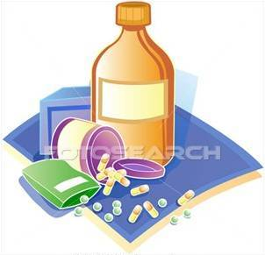
Quantitative aspects of drugs
By the end of this lecture, you should:
Determine quantitative aspects of drug receptor binding.
Recognize concentration binding curves.
Identify dose response curves and the therapeutic utility of these curves.
Classify different types of antagonism.

Slide 3
QUANTIFY ASPECTS OF DRUG ACTION
Bind
Occupy
Initiate
Activate
D
+
R
D
R
DR*
RESPONSE[R]
Relate concentration [C] of D used (x- axis) to the binding capacity at receptors (y-axis)
Relate concentration [C] of D used (x- axis) to response produced (y-axis)
A Concentration-Binding Curve
Dose Response Curves
AFFINITY
EFFICACY
POTENCY

Slide 4
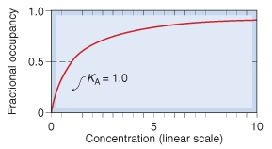
Concentration binding curves
Is a correlation between drug concentration [C] used (x- axis) and drug binding capacity at receptors [B] (y-axis). i.e. relation between concentration & drug binding
K_{D}

Slide 5
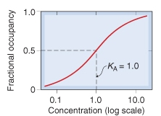
Concentration binding curves
(B_{max}): Total density of receptors in the tissue
K_{D}
K_{D}
(k_{D} )= [C] of D required to occupy 50% of receptors at equilibrium

Slide 6
Concentration binding curves
B_{max} (the binding capacity)
is the total density of receptors in the tissues
K_{D50}
is the concentration of drug required to occupy 50% of receptors at equilibrium.
The affinity of drug for receptor
The higher the affinity of D for receptor the lower is the K_{D} i.e. inverse relation ( Binding Potential= B_{max}/K_{D} )

Slide 7
Dose -response curves
Used to study how response varies with the concentration or dose.
Is a correlation between drug concentration [D] used (x- axis) and drug response [R] (y-axis).
i.e. relation between concentration & Response

Slide 8
Dose -response curves
Type of Dose-response curves
Graded dose-response curve
Quantal dose-response curve (all or none).

Slide 9
Dose -response curves
Type of Dose-response curves
Graded dose-response curve
Response is gradual
Gradual increase in response by increasing the dose (continuous response).
e.g. blood pressure, heart rate, blood glucose level, cholesterol,…

Slide 10
Dose -response curves
Type of Dose-response curves
Graded dose-response curve
Curve is usually sigmoid in shape
Used to calculate
Emax
EC₅₀
Potency
Efficacy

Slide 11
Dose -response curves- Graded
Max effect = E_{max}
Effect when all the receptors are occupied by D
100
100
% of Maximal Effect
80
% of Maximal Effect
80
60
60
40
40
20
20
0
0
0
200
400
600
800
1
10
100
1000
[C]
EC₅₀
[C]
EC₅₀
EC₅₀ =C that gives the half-maximal effect

Slide 12
Dose -response curves
Dose -response curves- Graded
Used to determine
Maximum Efficacy (Emax): is the maximal biological response produced by a drug.
Median Effective concentration (EC50): is the concentration of the drug that gives 50% of the maximal response (Emax).
Potency: the concentration of drug required to produce a specified response (50% of the maximal response = EC50).
Potency: is inversely proportional to EC 50.

Slide 13
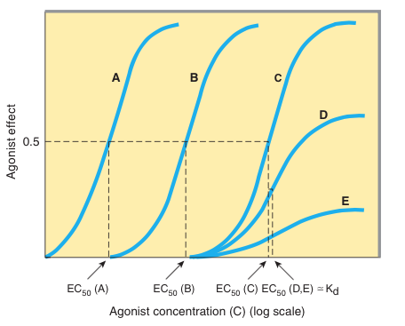
Dose -response curves
Dose -response curves- Graded

Slide 14
Dose -response curves
Type of Dose-response curves
Quantal dose-response curve
Relate drug concentration to % percentage of patients responding (all or none response).
The response may be therapeutic response, adverse effect or lethal effect.
e.g. prevention of convulsion, arrhythmias or death.
Used to determine
ED50
TD50 & LD50
Therapeutic index.

Slide 15
Dose -response curves-Quantal
100
Lethal Effect
80
Toxic Effect
Therapeutic Effect
60
% subjects responding
40
20
ED₅₀
LD₅₀
TD₅₀
[Dose]
0
1
10
100
1000
A.
B.
C.
A. 50% of individuals exhibit the specified therapeutic response
B. “ “ “ toxic effects
Predict the safety profile
C. “ “ “ death

Slide 16
Therapeutic Index (T.I.)
A measure of drug safety
“The ratio of the dose that produces toxicity to the dose that produces a clinically desired or effective response in a population of individuals”
Therapeutic Index = TD₅₀/ED₅₀ or LD₅₀/ED₅₀
TD₅₀ is the dose that produces a toxic effect in 50% of the population.
LD₅₀ is the dose that is lethal in 50% of the population
ED₅₀ is the dose that produces therapeutic response in 50% of the population
Large value = drug has wide margin of safety e.g diazepam
Small value = a narrow margin of safety e.g. digoxin

Slide 17
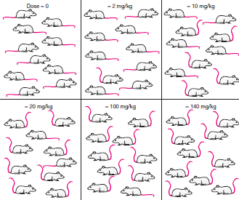
Dose -response curves-Quantal

Slide 18
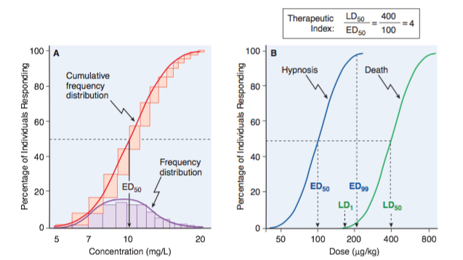
Therapeutic Index (T.I.)
Therapeutic Window
Therapeutic Index

Slide 19
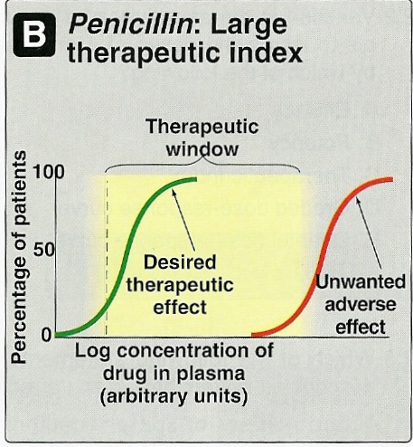
Therapeutic Index (T.I.)

Slide 20
Antagonism
It is the decrease or the complete abolishment of the effect of one drug in the presence of another.
Types
Physiological antagonism
Chemical antagonism
Pharmacokinetic
Pharmacodynamic antagonism (Receptor-blockade antagonism).
Competitive
Reversible
Irreversible
Non-competitive

Slide 21
Antagonism
Types
Physiological antagonism
Two drugs act on different receptors to produce different
physiological effects. e.g. Histamine & Adrenaline
Adrenaline → Vasoconstriction (↑ BP) & bronchodilation.
Histamine → vasodilatation (↓BP) & bronchoconstriction

Slide 22
Antagonism
Types
Chemical antagonism
Simple chemical reaction & loss of activity
No receptor.
e.g. Dimercaprol reduces heavy metal toxicity (as in lead toxicity).

Slide 23
Antagonism
Types
Pharmacokinetic
The antagonist effectively reduces the concentration of the active drug at the site of action.
e.g. Phenobarbitone accelerates hepatic metabolism of warfarin

Slide 24
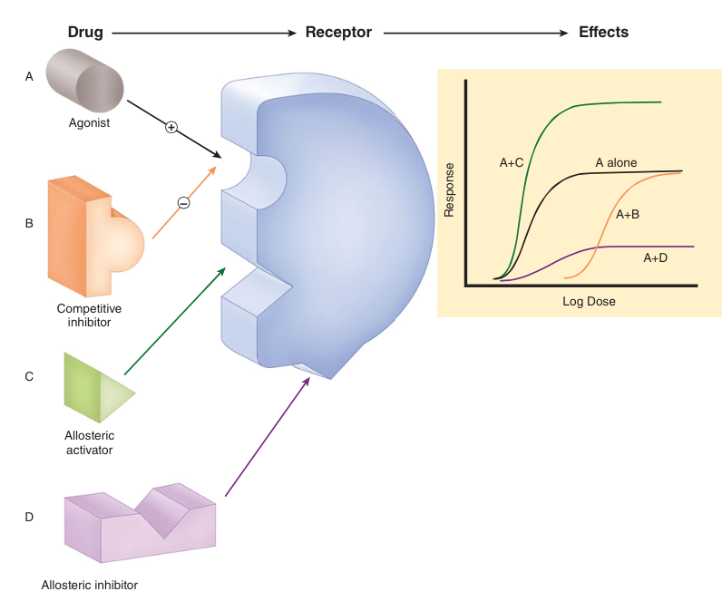
Antagonism
Types
Pharmacodynamic antagonism (Receptor-blockade antagonism).
Competitive
Reversible
Irreversible
Non-Competitive

Slide 25
Antagonism
Types
Pharmacodynamic antagonism (Receptor-blockade antagonism).
Competitive
Reversible
Two drugs compete for the same receptor.
The antagonist partially or completely prevents the pharmacological effect of agonist.
Antagonist dissociate rapidly from receptor.
Antagonism can be overcome by increasing the concentration of the agonist.
Parallel shift of the curve to the right, without any change in slope or maximum
e.g. acetylcholine and atropine

Slide 26
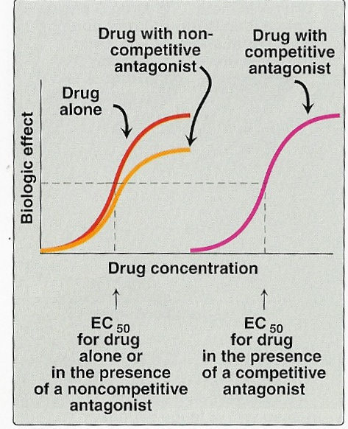
Antagonism
Types
Pharmacodynamic antagonism (Receptor-blockade antagonism).
Competitive
Reversible

Slide 27
Antagonism
Types
Pharmacodynamic antagonism (Receptor-blockade antagonism).
Competitive
Irreversible
Two drugs compete for the same receptor.
Antagonist forms stable, permanent chemical bond with receptor.
The original response can not be overcome even by increasing the dose of the agonist.
No parallel shift
A decrease in slope and a reduced maximum are obtained.
e.g. phenoxybenzamine and noradrenaline.

Slide 28
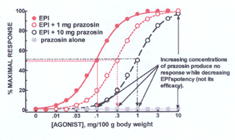
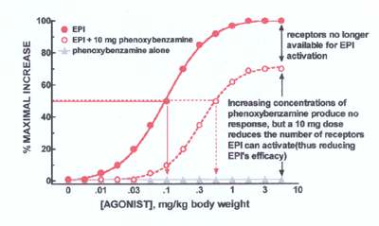
Antagonism
Competitive reversible antagonist vs Competitive irreversible antagonist

Slide 29
Antagonism
Types
Pharmacodynamic antagonism (Receptor-blockade antagonism).
Non-Competitive
Antagonist block at some point the chain of events that stimulate the response of agonist.
Agonist and Antagonist can be bound simultaneously.
Antagonism cannot be overcome by increasing concentration of agonist e.g. verapamil and noradrenaline.

