Slide 1
Pharmacodynamics III Receptor Families
Ali Alhoshani, B.Pharm, Ph.D.
ahoshani@ksu.edu.sa
Office: 2B 84

Slide 2
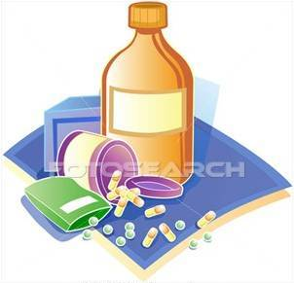
Receptor Families
By the end of this lecture, you should:
Classify receptors into their main superfamilies
Recognize their different transduction mechanism
Identify the nature & time frame of their response Classify.

Slide 3
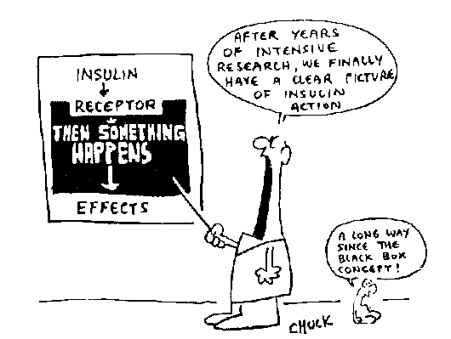
Main Receptor Classes ( Receptor Families)
Effect Persistency of drugs
Cellular mechanism of the drugs
Selectivity of drugs
Development of new drugs

Slide 4
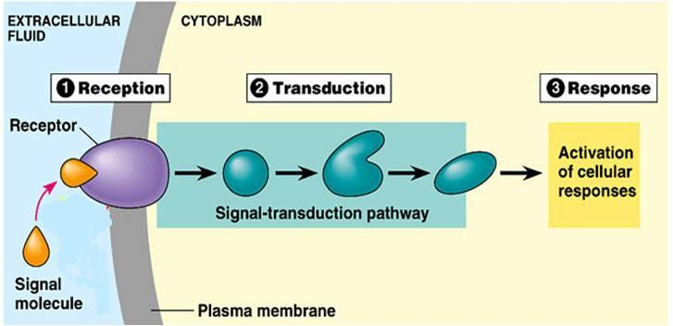
RECEPTORS
2
3
4
2. Reception
3. Transduction
4. Response
1
1. Recognition

Slide 5
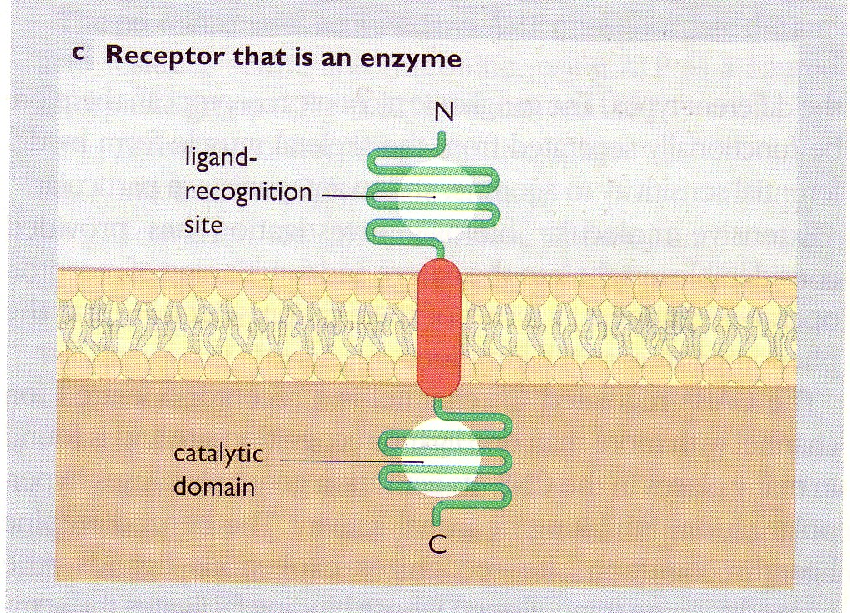
RECEPTORS STRUCTURE
Ligand recognition site
Inner catalytic domain
◉
Coupler Transduction

Slide 6
Receptor Families
Type I (Ion Channel-Linked receptors)
Type II (G-Protein coupled receptors)
Type III (Enzyme-Linked receptors)
Type IV (Receptors linked to gene transcription)

Slide 7
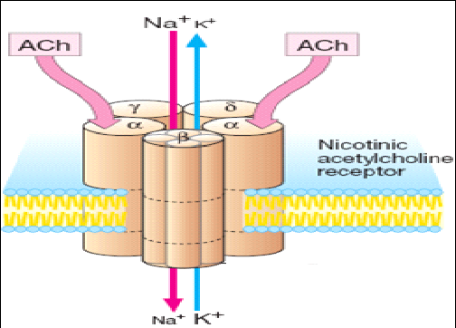
Receptor Families
Type I (Ion Channel-Linked receptors)
Ligand gated ion channels
Ionotropic receptors
Located at cell membrane
Directly activated by ligand binding
Involved in fast synaptic transmission.
Directly related to channels.
Response occurs in milliseconds.
E.g. Nicotinic receptors activated by acetylcholine

Slide 8
Receptor Families
Type II (G-Protein coupled receptors)
The largest family that accounts for many known drug targets
Located at cell membrane
Coupled to G-protein
Response through ion channels or enzymes.
Involved in rapid transduction
Response occurs in seconds.
Examples
Muscarinic receptors of Ach (M)
Adrenergic receptors of Noradrenaline (α and β)

Slide 9
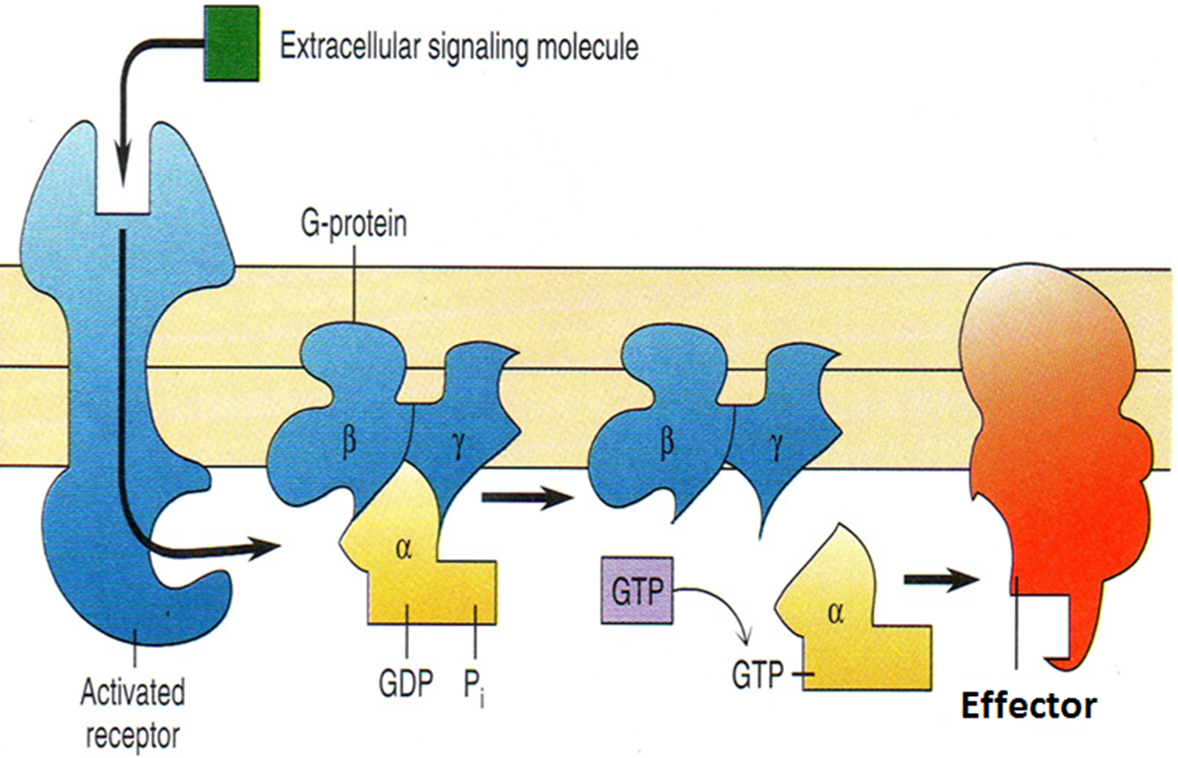
Receptor Families
Type II (G-Protein coupled receptors)
Is composed of 3 subunits [α β γ]
Difference G-Protein Classes according to their α-subunits into
Gs and Gi produce, respective, stimulation and inhibition of the effector ( Adenyl Cyclase)
Gq is linked to activation of the effector ( PLC-IP3 -Ca⁺⁺ CaM & PKC)

Slide 10
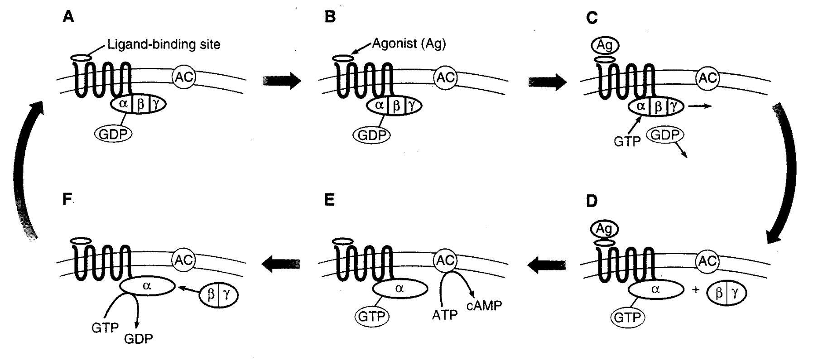
Receptor Families
Type II (G-Protein coupled receptors)
http://youtu.be/0nA2xhNiAow

Slide 11
Receptor Families
Type II (G-Protein coupled receptors)
GTP-binding regulatory proteins
Regulate guanine nucleotides GDP, GTP.
Comprise of three subunits (αβγ), α subunits possess GTPase activity
Receptors in this family respond to agonists
by promoting the binding of GTP to the G protein alpha ( α ) subunit.
GTP activates the G protein and allows it, in turn, to activate the effector protein.
The G protein remains active until it hydrolyzes the bound GTP to GDP and returns to its ground (inactive) state.

Slide 12
Receptor Families
Type II (G-Protein coupled receptors)
Targets for G-proteins
Ion channels
Muscarinic receptors in heart (K-channel), decrease heart rate
Second messengers
Cyclic AMP system (cAMP)
Inositol phosphate system (IP3+DAG)

Slide 13
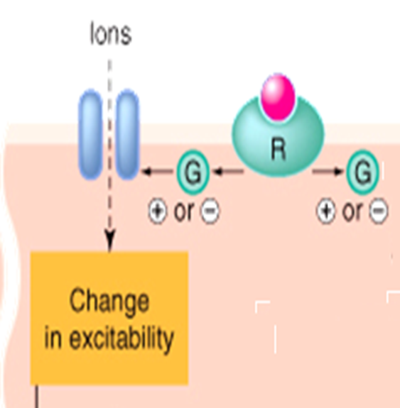
Receptor Families
Type II (G-Protein coupled receptors)
Targets for G-proteins
Ion channels
Muscarinic receptors in heart (K-channel), decrease heart rate

Slide 14
Receptor Families
Type II (G-Protein coupled receptors)
Targets for G-proteins
Second messengers
Cyclic AMP system (cAMP)
ATP
G Protein
Adenyl cyclase enzyme (AC)
cAMP
Phosphorylation of Protein kinase A (PKA)
Activation or inhibitions of ion channels or enzymes

Slide 15
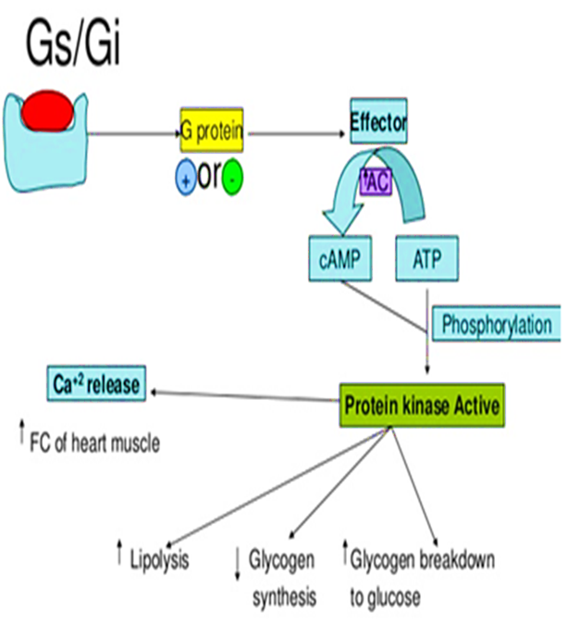
Receptor Families
Type II (G-Protein coupled receptors)
Targets for G-proteins
Second messengers
Cyclic AMP system (cAMP)
M₂ & M₄ Ach receptors couple to Gi to inhibit AC
α ₂ Adrenoceptors couple to Gi to inhibit AC.
β_{1&2} Adrenoceptors couple to Gs to stimulate AC

Slide 16
Receptor Families
Type II (G-Protein coupled receptors)
Targets for G-proteins
Second messengers
Inositol phosphate system (IP3+DAG)
G Protein
Phospholipase C
Phosphoinositol diphosphate2 (PIP2)
Inosito triphosphate IP3
Diacylglycerol (DAG)
Increase intracellular calcium
Protein kinase C (PKC)
Exocrine secretion
Increase heart rate
Smooth muscle contraction
Ion channels
Smooth muscle contraction

Slide 17
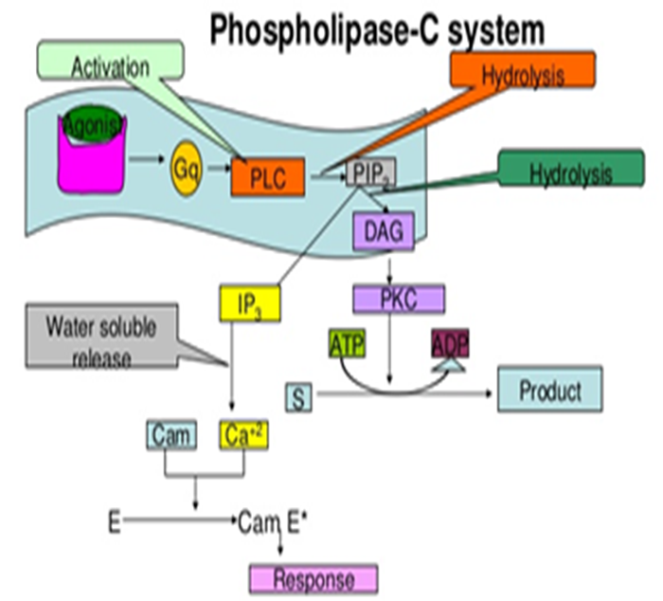
Receptor Families
Type II (G-Protein coupled receptors)
Targets for G-proteins
Second messengers
Inositol phosphate system (IP3+DAG)
M₁ & M₃ Ach receptors couple to Gq to stimulate PLC
α ₁ Adrenoceptors couple to Gq
to stimulate PLC.

Slide 18
Receptor Families
Type III (Enzyme-Linked receptors)
(Kinase-linked receptor)
Located at cell membrane with intrinsic enzymatic activity
Activation of receptors results in
Activation of protein kinases as tyrosine kinase with phosphorylation of tyrosine residue on their substrates and activation of many intracellular signaling pathways in the cell.
E.g. Insulin receptors

Slide 19
Receptor Families
Type III (Enzyme-Linked receptors)
(Kinase-linked receptor)
Involved in response to hormones, growth factors.
Response occurs in minutes to hours.
They control many cellular functions as metabolism and growth.

Slide 20
Receptor Families
Type III (Enzyme-Linked receptors)
Example : Insulin Receptor
Ligands dimerize receptors
Activated Receptor autophosphorylates
Phosphorylate other proteins that it docks

Slide 21
Receptor Families
Type IV (Receptors linked to gene transcription)
Nuclear receptors
Located intracellularly
Directly related to DNA (Gene transcription).
Activation of receptors either increase or decrease protein synthesis
Response occurs in hours or days and persists longer.
Their natural ligands are lipophylic hormones; steroids, thyroids, estrogen.

Slide 22
Receptor Families
Type IV (Receptors linked to gene transcription)
Nuclear receptors
They possess an area that recognizes specific DNA sequence in the nucleus which can bind it. This sequence is called a Responsive Element [RE]
This means that the activated receptors are acting as TRANSCRIPTION FACTORS [TF] → expressing or repressing target genes.

Slide 23
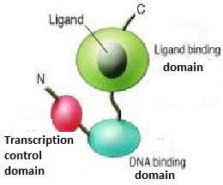
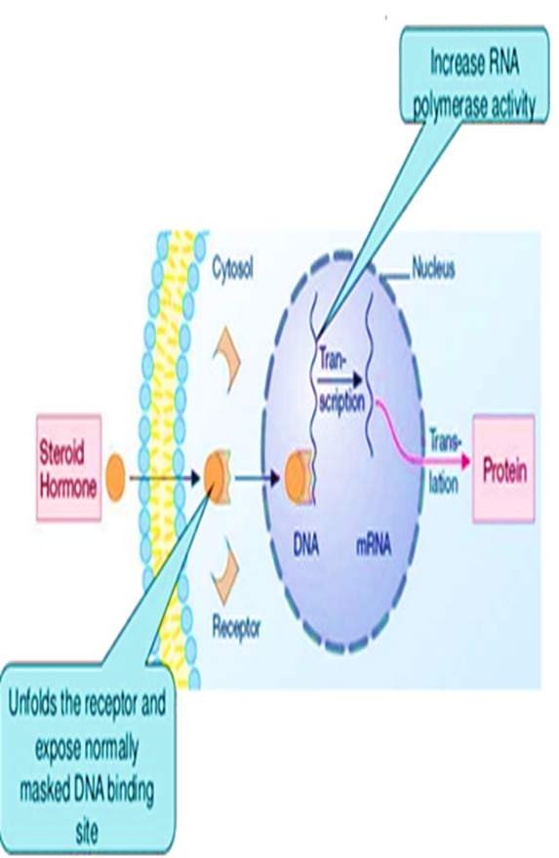
Receptor Families
Type IV (Receptors linked to gene transcription)
Nuclear receptors

Slide 24
Receptor Families
Type IV | Type III | Type II | Type I
Nucleus | Membrane | Membrane | Membrane | Location
Via DNA | Direct | G-Protein | Direct | Coupling
Very slow | slow | fast | Very Fast | Synaptic transmission
Hours or days | minutes | Seconds | milliseconds | Response
Estrogen Steroid receptors | Insulin receptors | Muscarinic receptors | Nicotinic receptors | Examples
DNA | Enzymes | Channels/ enzymes | channels | Effectors

Slide 25
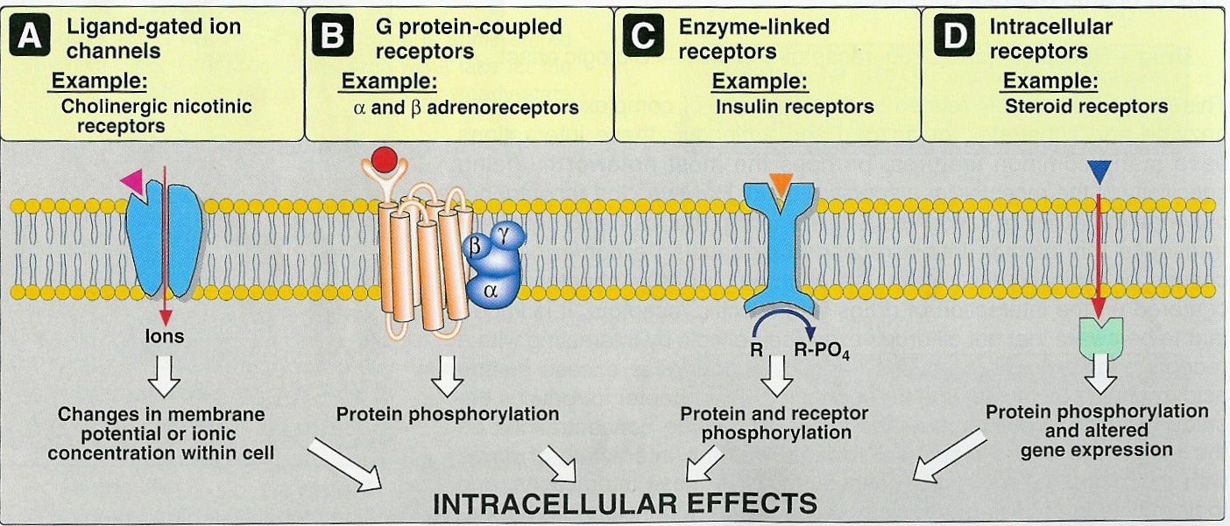
Receptor Families
Signaling Mechanisms

Slide 26
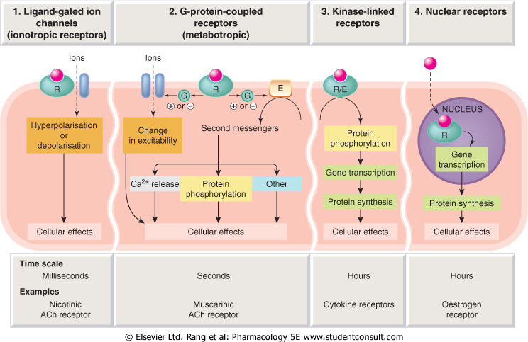
Receptor Families
Signaling Mechanisms
Conductance
Cell Signal  
Cell Signal 
Transcription
& Translation
Minutes / Hours
Hours / Days

