Slide 1
Control of Erythropoiesis, Iron Metabolism and Hemoglobin

Slide 2
Objectives;
Intended learning outcomes (ILOs)
After reviewing the PowerPoint presentation and the associated learning resources, the student should be able to:
Discuss regulation of erythropoiesis
Describe the factors required for normal erythropoiesis and the role of erythropoietin in erythropoiesis
Recognize clinical conditions associated with high level of erythropoietin in the blood
Summarize the synthesis of Hemoglobin
Recognize hemoglobin structure and its functions
Describe metabolism of iron and vitamin B12
Define anemia
Classify anemia and explain its assessment
Describe the physiological consequences and clinical picture of anemia
Define polycythemia
Classify polycythemia
Describe the physiological consequences of polycythemia

Slide 3
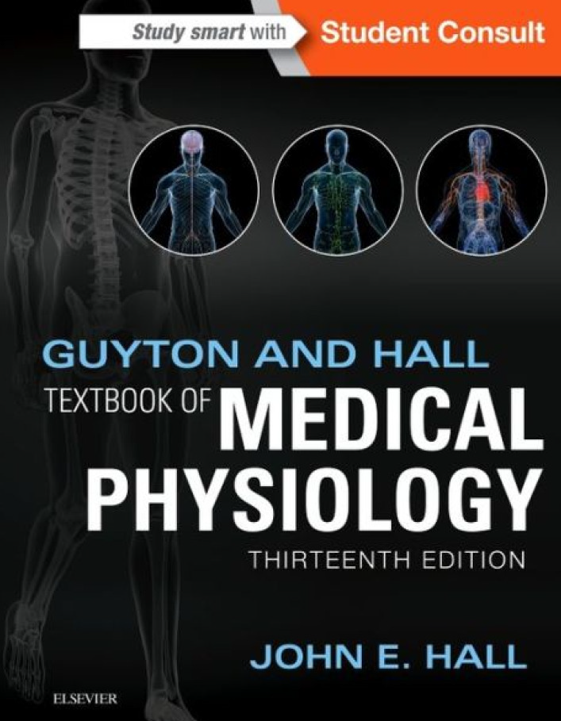
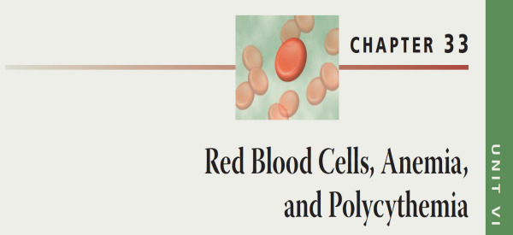
Learning Resources
Guyton and Hall, Textbook of Medical Physiology; 13th Edition; Unit VI-Chapter 33.

Slide 4
Regulation of Erythropoiesis
Erythropoiesis is under the influence of erythropoietin
Other Factors Influencing Rate of Erythropoiesis:
Hormones: androgens (testosterone), thyroxin, growth hormone and cortisol stimulate erythropoiesis. Deficiency of any of these hormones results in anemia
Adequate diet:
Amino acids: are important for the formation of globin in Hb. Severe protein deficiency → anemia
Iron (Fe): 60-70% of iron in the body is in the Hb inside the RBCs. Fe is important for the formation of heme in Hb. Iron deficiency → iron-deficiency anemia (microcytic hypochromic anemia)
Vitamins:
Vitamins B₁₂ and folic acid are important for the synthesis of nucleoproteins (DNA) and final maturation of RBCs. Deficiency of Vitamins B₁₂, folic acid → megaloblastic anemia. Pernicious anemia is due to deficiency of Vit. B₁₂ due to lack of intrinsic factor produced by gastric mucosa, which is needed for Vit B₁₂ absorption. Pernicious anemia is an autoimmune condition in which the body's immune system attacks the actual intrinsic factor protein or the parietal cells in the lining of the stomach that make it.
Other vitamins :Vit B₆, Riboflavin, nicotinic acid, biotin (B₇), Vit C, Vit E

Slide 5
Erythropoietin
Erythropoiesis is stimulated by erythropoietin
Erythropoietin is a glycoprotein, which is synthesized from renal cortex (90%) and the liver (10%)
Erythropoietin stimulate the production of proerythroblasts from hematopoietic stem cells in the bone marrow. Once the proerythroblasts are formed, erythropoietin causes these cells to pass more rapidly through the different erythroblastic stages and can increase it to perhaps 10 or more times normal
Erythropoietin can be measured in plasma & urine
High level of erythropoietin are produced in response to hypoxia (↓ O₂), which can be caused by:
Low RBC count (Anemia)
Hemorrhage
High altitude
Prolong heart failure
Lung disease

Slide 6
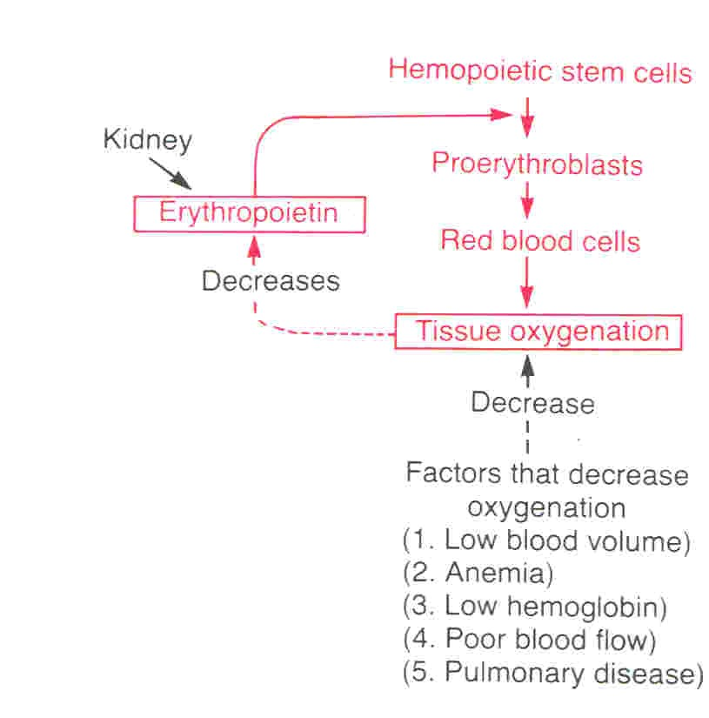
Feedback Control of Erythropoiesis

Slide 7
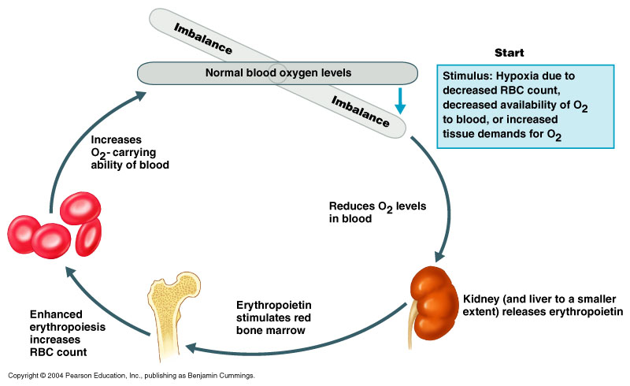
Feedback Control of Erythropoiesis

Slide 8
Vitamin B₁₂ and Folic Acid
Important for DNA synthesis and final maturation of RBCs.
Dietary sources include: meat, milk, liver, fat, green vegetables.
Deficiency leads to:
Failure of nuclear maturation & division
Abnormally large & oval shaped RBCs
Short life span of RBCs
Reduced RBC count & Hb concentration
Macrocytic (megaloblastic) anemia
Note the hypersegmented neurotrophil and also that the RBC are almost as large as the lymphocyte.
Finally, note that there are fewer RBCs.

Slide 9
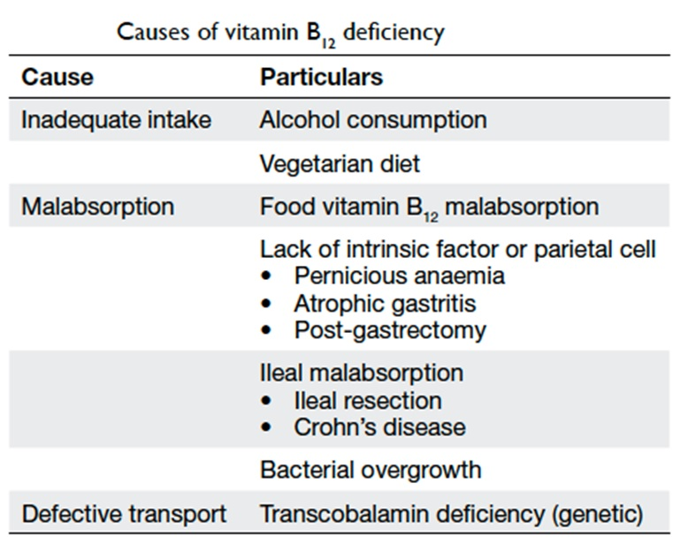
Causes of Vitamin B₁₂ Deficiency

Slide 10
Iron Metabolism
Iron is needed for the synthesis of hemoglobin, myoglobin, cytochrome oxidase, peroxidase & catalase
The total quantity of iron in the body averages 4-5 g
Hemoglobin: 65-75% (3 g)
Stored iron: 15-30%, particularly in the form of ferritin in the liver, spleen and bone marrow.
Myoglobin: 4%
Heme compounds that promote intracellular oxidation (cytochrome): 1%
Plasma iron: (transferrin): 0.1%
A man excretes about 0.6 mg of iron each day, mainly into the feces. Additional quantities of iron are lost when bleeding occurs. For a woman, additional menstrual loss of blood brings long-term iron loss to an average of about 1.3 mg/day.
Diet provides 10-20 mg iron per day.
Only 10% of dietary iron is absorbed (1 – 2 mg ).
Iron in food mostly in oxidized form (Ferric, F⁺³). It is better absorbed in reduced form (Ferrous, F⁺²). Iron in stomach is reduced by gastric acid, and Vitamin C.

Slide 11
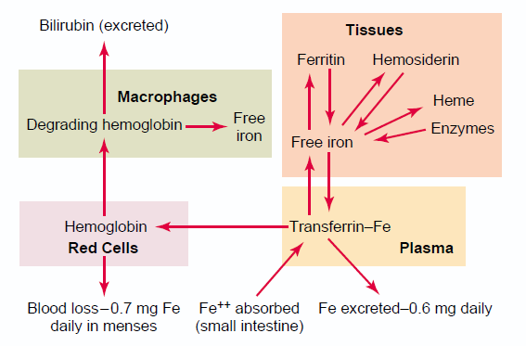
Iron is absorbed from all parts of the small intestine,
The liver secretes apotransferrin into the bile.
In the duodenum, the apotransferrin binds with iron forming transferrin.
The formed transferrin is absorbed into in the intestinal epithelial cells by receptor-mediated pinocytosis. This is later released into the blood capillaries in the form of plasma transferrin.
Only a few milligrams of iron can be absorbed per day. Thus, even when tremendous quantities of iron are present in the food, only small proportions can be absorbed.
Iron Absorption, Transport and Metabolism

Slide 12
Iron Absorption, Transport and Metabolism
When iron is absorbed from the small intestine, it immediately combines in the blood plasma with apotransferrin, to form transferrin, which is then transported in the plasma.
The iron is loosely bound in the transferrin and, consequently, can be released to any tissue cell at any point in the body.
Excess iron in the blood is deposited and stored especially in the liver hepatocytes and less in the Reticuloendothelial cells of the bone marrow.
In the cell cytoplasm, iron combines mainly with a protein, apoferritin, to form ferritin. This iron stored as ferritin is called storage iron.
Smaller quantities of the iron in the storage pool are in an extremely insoluble form called hemosiderin. This is especially true when the total quantity of iron in the body is more than the apoferritin storage pool can accommodate.

Slide 13
Iron Absorption, Transport and Metabolism
When the body has become saturated with iron so that all apoferritin is already combined with iron, the rate of additional iron absorption from the intestinal tract becomes greatly decreased.
Conversely, when the iron stores have become depleted, the rate of absorption can accelerate probably five or more times normal.
Thus, total body iron is regulated mainly by altering the rate of absorption.

Slide 14
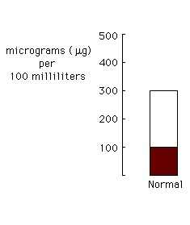
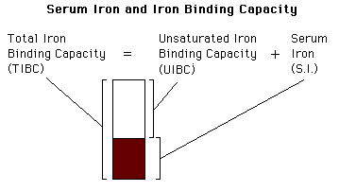
Serum Iron and Total Iron Binding Capacity (TIBC)
Normally transferrin in the plasma is 30-40% saturated with iron, giving a plasma iron level of 100-130 µg/100ml)
When transferrin is 100% saturated with iron → plasma iron level reaches 300 µg/100ml. This is referred to as Total Iron Binding Capacity (TIBC)

Slide 15
Anemia and Polycythemia
Anemia is decrease in RBC mass as determined by Hct or Hb values below reference level for age and gender.
The major causes of anaemia are: 1. RBC Loss without RBC destruction 2. Decreased RBC production 3. Increased RBC destruction over production Polycythaemia is increase in RBC mass as determined by Hct or Hb values above reference level for age and gender

Slide 16
Anemia
RBC loss without RBC Destruction | Decreased RBC Production | Increased RBC Destruction over Production (Hemolytic Anemias)
Hemorrhage Due to trauma Due to disorders: e.g.cancer, ulcers Menstrual flow Gynecological disorders - Parasitism Hookworms | Neoplasia Leukemia Myelofibrosis Pernicious anemia Iron Deficiency anemia Aplastic anemia Chloramphenicol administration Renal disease (lack of erythropoietin production) | Intrinsic Abnormalities Hereditary Spherocytosis Thalassemia Sickle Cell Anemia G6PD deficiency Hexokinase deficiency Extrinsic Abnormalities Infections Malaria Mycoplasma

Slide 17
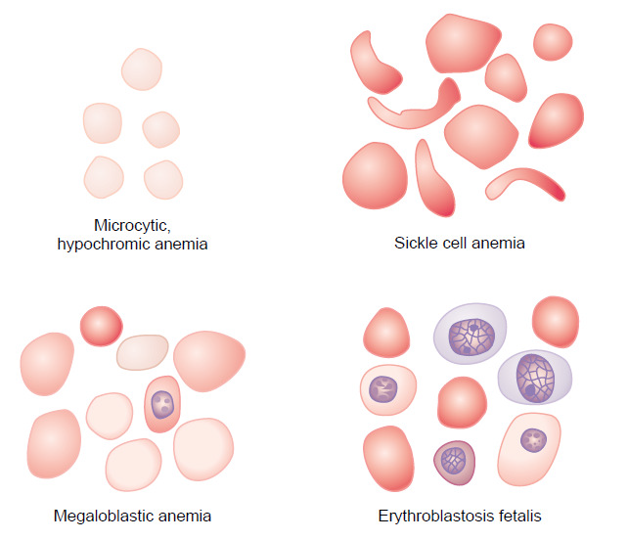
Anemia

Slide 18
Basic Evaluation of Anemia
Review of blood count, blood smear and RBC indices (MCV, MCH, MCHC)
MCV is the most accurate method of measuring red blood cells and most useful in classification of anaemia as:
Reticulocyte index
= reticulocyte count (%) x [observed haematocrit / normal haematocrit] ie normalized for hematocrit
Reticulocyte index > 2% indicates excessive RBC destruction or loss
Reticulocyte index < 2% indicates decreased production

Slide 19
Effects of Anemia on Body Functions
Increased cardiac output, as well as increased pumping workload on the heart, because of decreased viscosity and vasodilation.
Reduced oxygen-carrying capacity of blood and lack of O₂ for ATP and heat production, manifested mostly during exertion.
If severe, can lead to heart failure

Slide 20
Clinical Picture of Anemia
Symptoms
fatigue, cold intolerance and paleness
oxygen-carrying capacity of blood is reduced
- lack of O₂ for ATP and heat production
Signs
Pallor: an abnormal loss of skin or mucous membrane color.
Koilonychia: is when the nail curves upwards (becomes spoon-shaped)
Angular stomatitis: deep cracks and splits form at the corners of the mouth
Glossitis: is inflammation or infection of the tongue

Slide 21
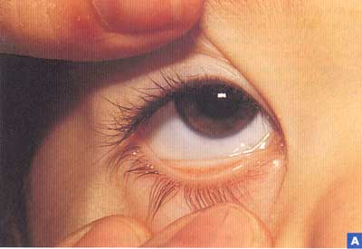
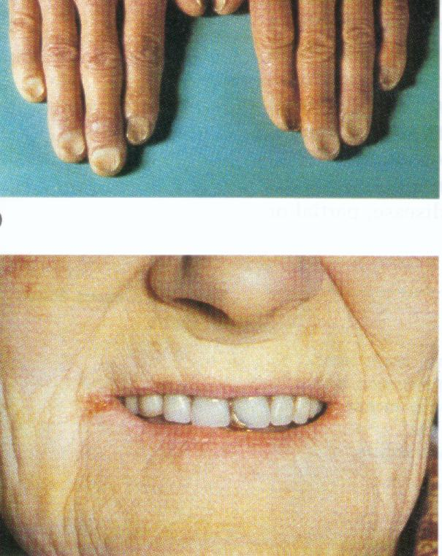
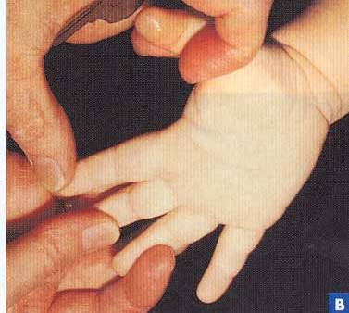
Clinical Picture of Anemia

Slide 22
Polycythemia
Types:
True or absolute
Primary (polycythemia rubra vera):
uncontrolled RBC production
Secondary to hypoxia: high altitude, chronic respiratory or cardiac disease
Relative
Hemoconcentration:
» loss of body fluid in vomiting, diarrhea, sweating
Complications of polycythemia: hyperviscosity of the blood

Slide 23
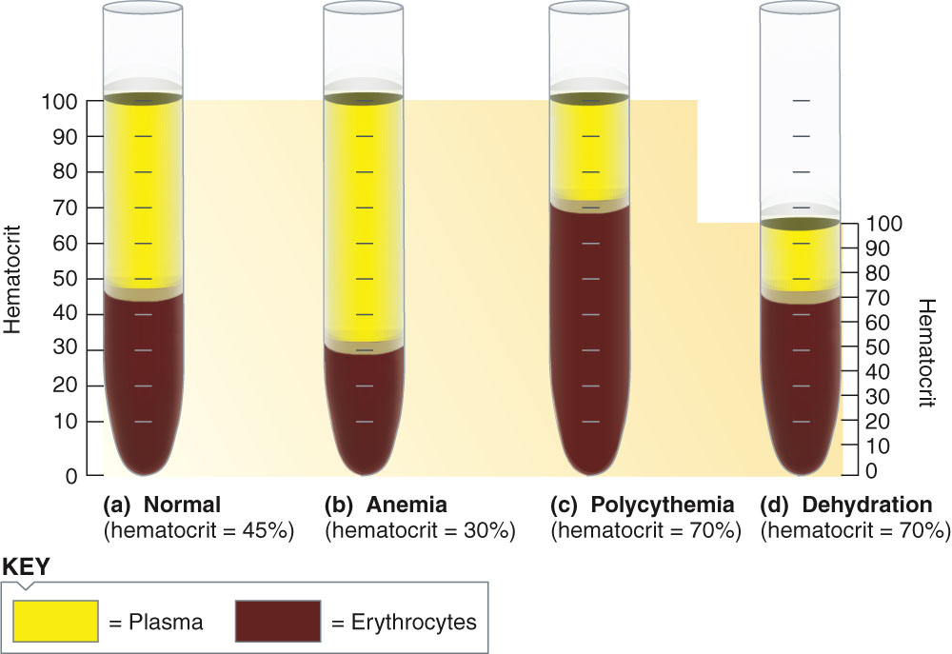
Hct under various conditions

Slide 24
Objectives;
Intended learning outcomes (ILOs)
After reviewing the PowerPoint presentation and the associated learning resources, the student should be able to:
Discuss regulation of erythropoiesis
Describe the factors required for normal erythropoiesis and the role of erythropoietin in erythropoiesis
Recognize clinical conditions associated with high level of erythropoietin in the blood
Summarize the synthesis of Hemoglobin
Recognize hemoglobin structure and its functions
Describe metabolism of iron and vitamin B12
Define anemia
Classify anemia and explain its assessment
Describe the physiological consequences and clinical picture of anemia
Define polycythemia
Classify polycythemia
Describe the physiological consequences of polycythemia

Slide 25
Thank You

