Slide 1
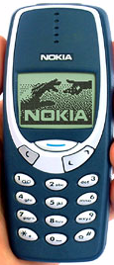
White Blood Cells (WBCs)
Leucocytes

Slide 2
Objectives;
Intended learning outcomes (ILOs)
After reviewing the PowerPoint presentation and the associated learning resources, the student should be able to:
Outline components of the immune system.
List the types of white blood cells(WBCs).
Describe the structure of the different types of WBCs.
Outline differential WBCs count.
Summarize the stages of formation of the different WBCs.
State the functions the different types of WBCs.
Describe the role of the WBCs in immune responses and defending against infection.
Explain the process of phagocytosis.
Recognize leukocytosis, leukopenia and leukemia.

Slide 3
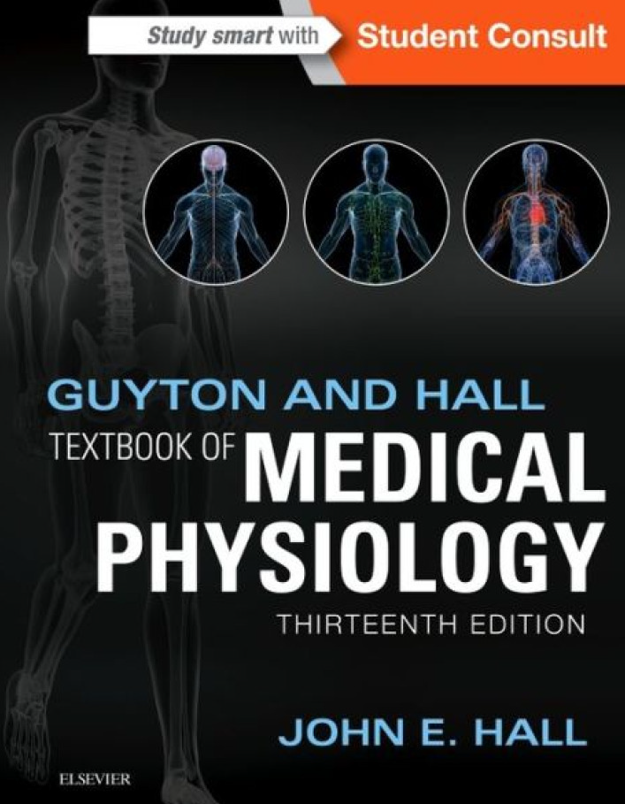
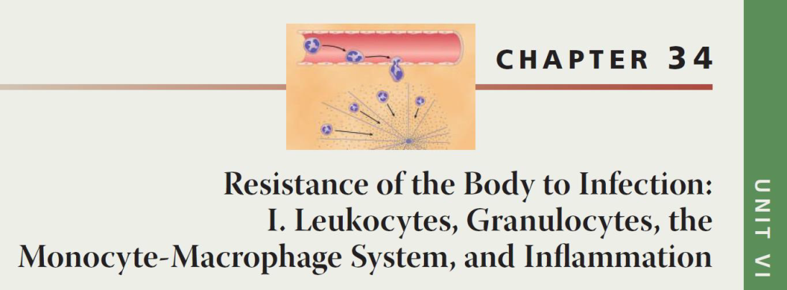
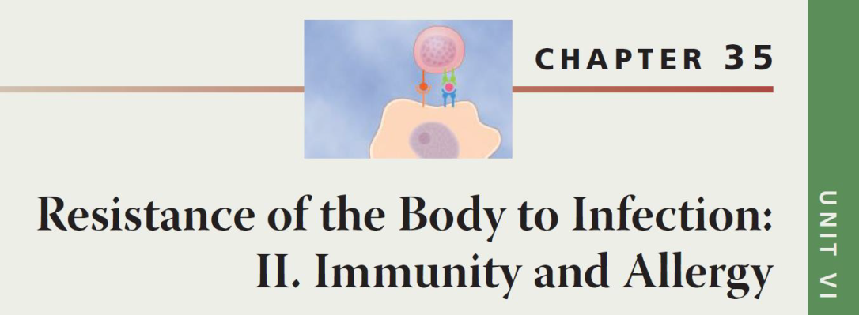
Learning Resources
Guyton and Hall, Textbook of Medical Physiology; 13th Edition; Unit VI-Chapters 34 & 35.

Slide 4
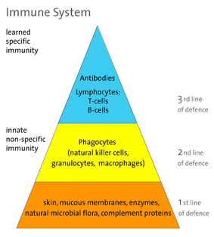
Immune System
The immune system is a system of barriers, cells, tissues and organs that work to fight invaders.
Another important component of the immune system is the complement system.
The major functions of the immune system are:
Differentiate self from non-self.
Eliminate foreign substances, cells and pathogens.

Slide 5
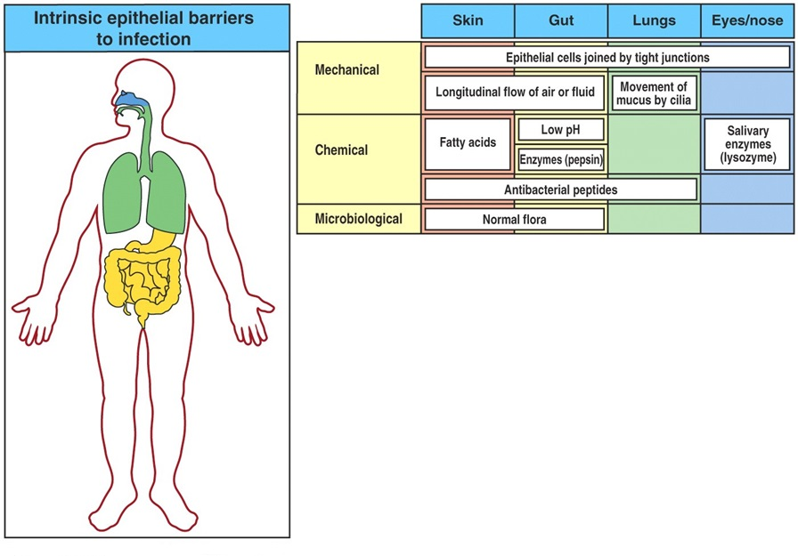
First line or defence – Epithelial Barriers

Slide 6
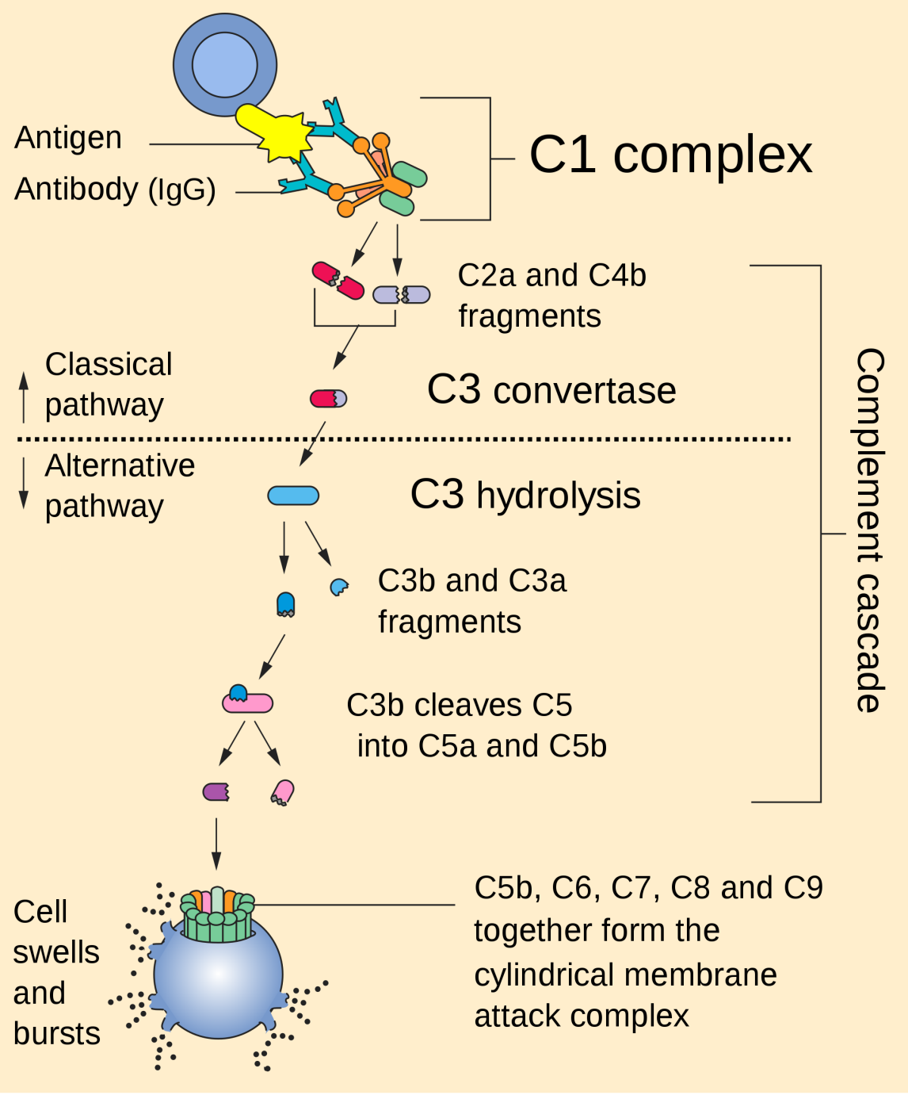
The Complement System is Part of the 1st Line of Defense
The first part of the immune system that meets invaders such as bacteria is a group of proteins called the complement system.
These proteins flow freely in the blood and can quickly reach the site of an invasion where they can react directly with antigens - molecules that the body recognizes as foreign substances. When activated, the complement proteins can:
Trigger inflammation.
Attract eater cells such as macrophages to the area.
Coat intruders so that eater cells are more likely to devour (swallow and eat) them (a process called as opsonization).
Kill intruders.

Slide 7
Types of Immunity
Immune system
Innate (non-specific;
natural) immunity
Adaptive (specific;
acquired) immunity
Second line of defense
Is present at birth
Persists throughout life
Can be mobilized rapidly and act quickly
Attacks all antigens fairly equally
Third line of defense.
Antigen specificity. It is activated by thousands of diverse antigens.
Responds with the proliferation of cells and the generation of antibodies.
Responds slowly, being fully activated about 4 days after the immunologic threat.
Exhibits immunologic memory, so that repeated exposure to the same infectious agent results in improved resistance against it.

Slide 8
Cells of the Immune System
Phagocytes
Monocytes and macrophages
Neutrophils
Dendritic Cells
Inflammatory cells:
Mast cell
Basophils and Eosinophils
Antigen Specific cells:
B cells or B lymphocytes
T cells or T lymphocytes
The cells of the immune system work together with different proteins to seek out and destroy anything foreign or dangerous that enters our body.

Slide 9
How is the immune system organized?
Cells
Primary (or central) lymphoid organs: Bone marrow, Thymus
Secondary (or peripheral) lymphoid organs: Tonsils, Spleen, Lymph nodes
Blood vasculature and lymph systems connect the different organs

Slide 10
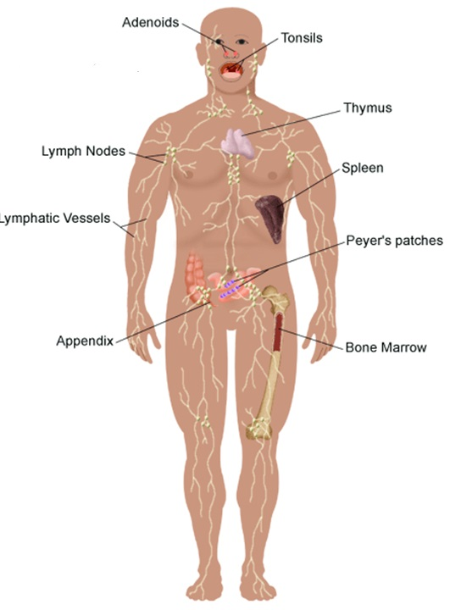
Major Organs
2º
2º
Primary Lymphoid Organs
The bone marrow and the thymus
Immune cells mature to become immunocompetent in these organs.
Most cells mature to immune cells within the bone marrow and, after release, begin a life of patrol in the blood. The exception is the pre-T cell, which first undergoes maturation in the thymus before circulating in blood.
Secondary (or peripheral) Lymph organs
These are the organs where mature immune cells participate in specific immune defense reactions.
2º
1º
2º
2º
2º
2º
1º

Slide 11
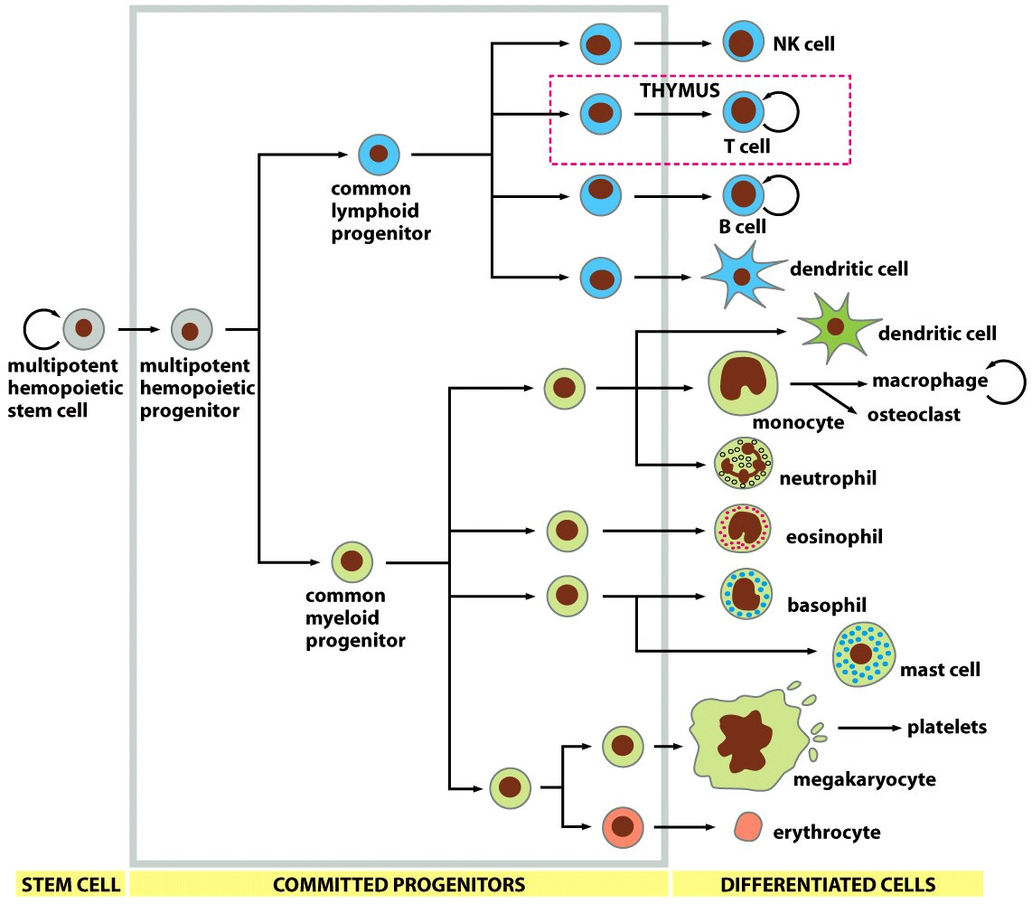
Cells of the Immune System

Slide 12
Classification of White Blood Cells (WBCs)
Granulocytes
Polymorphonuclear leukocytes (PMNs; because of multiple nuclei)
Neutrophils (10-16 µm, 2-5 lobes of Nucleus)
Eosinophils (12-18 µm, bilobed, coarse red granules)
Basophils (10-14 µm, rarely segmented nucleus hidden by large round bluish granules)
Agranulocytes
Lymphocytes( Round Nucleus, Small [5-8 µm] & large [9-15 µm])
T lymphocyte
B lymphocyte
Natural killer cells (NKCs)
Monocytes (15-20 µm, Kidney shaped nucleus). The monocytes make macrophage system

Slide 13
WBCs Concentrations (Normal Counts)
and Life Span
Life Span | Percentage of Total WBCs | Approximate Normal Range (/µL) | Cells
 |  | 4000 - 11000 | Total WBCs
4 – 8 hours in blood and 4 – 5 days in tissues where they are needed | 60 –70% (62%) | 3000 - 6000 | Neutrophils
 | 1 – 4% (2.3%) | 150 - 300 | Eosinophils
 | 0.4% (0.4%) | 0 - 100 | Basophils
Weeks - months | 20 – 40% (30%) | 1500 - 4000 | Lymphocytes
10 - 20 hours in blood before getting into the tissues where they can live for months | 2 – 8% (5.3%) | 300 - 600 | Monocytes (Macrophages)

Slide 14
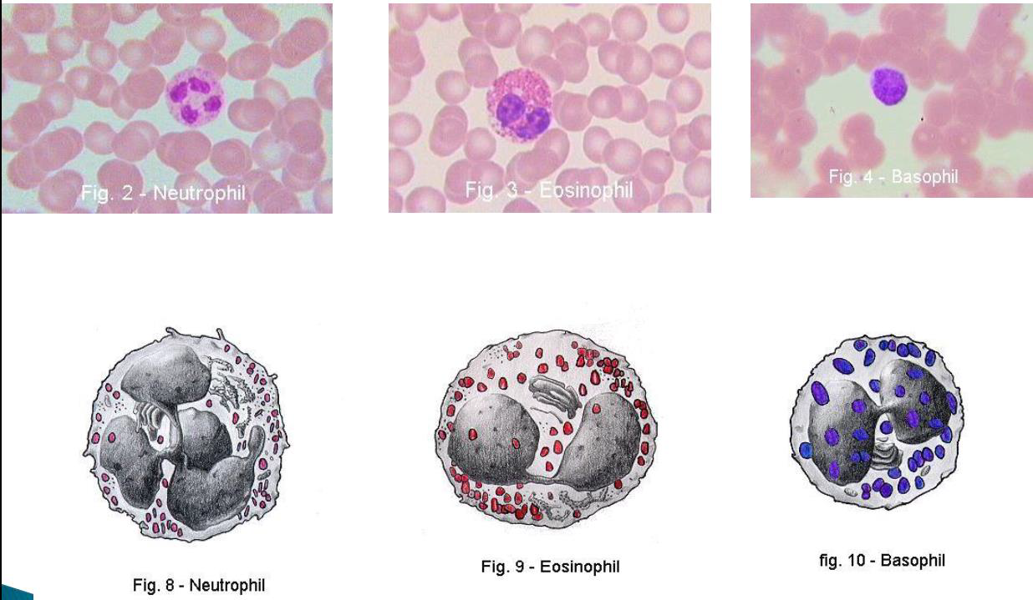
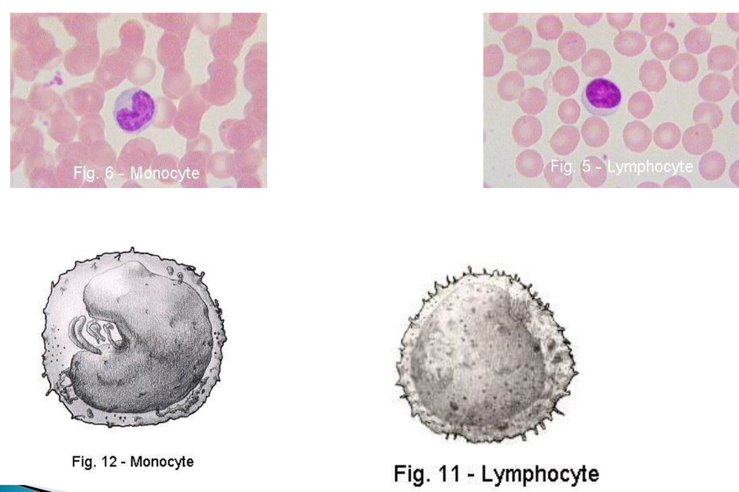

Slide 15
Leucopoiesis
Two major lineage of WBCs are formed:
Myelocytic lineage beginning with myelobast and giving rise to granular leucocytes and monocytes
Lymphocytic lineage beginning with lymphoblast and giving rise to lymphocytes
Sites of WBC Formation
The granulocytes and monocytes are formed only in the bone marrow.
Lymphocytes are produced in the bone marrow and the various lymphoid tissues especially the lymph glands, spleen, thymus, tonsils, and Peyer’s patches..
WBCs formed in the bone marrow are stored within the marrow until they are needed in the circulatory system. Various factors cause them to be released. Normally, about three times as many white blood cells are stored in the marrow as circulate in the entire blood.
The lymphocytes are mostly stored in the various lymphoid tissues, except for a small number that are temporarily being transported in the blood.

Slide 16
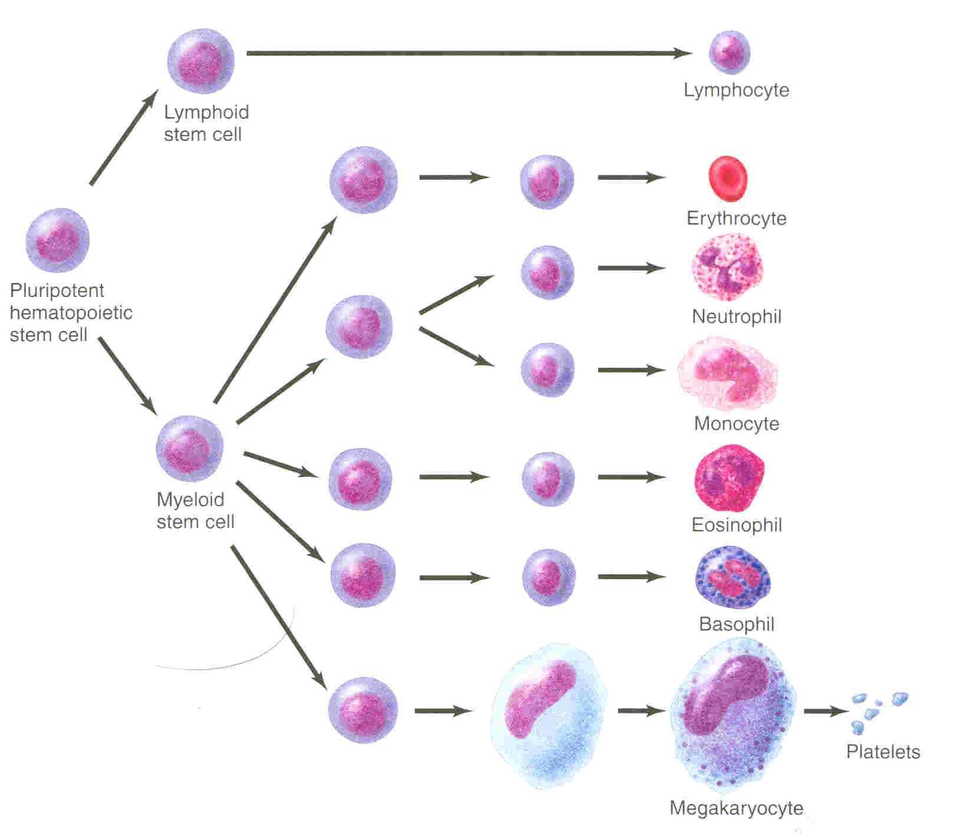
Leucopoiesis
Neutrophils myelocyte
Myeloblast
Mature neutrophil

Slide 17
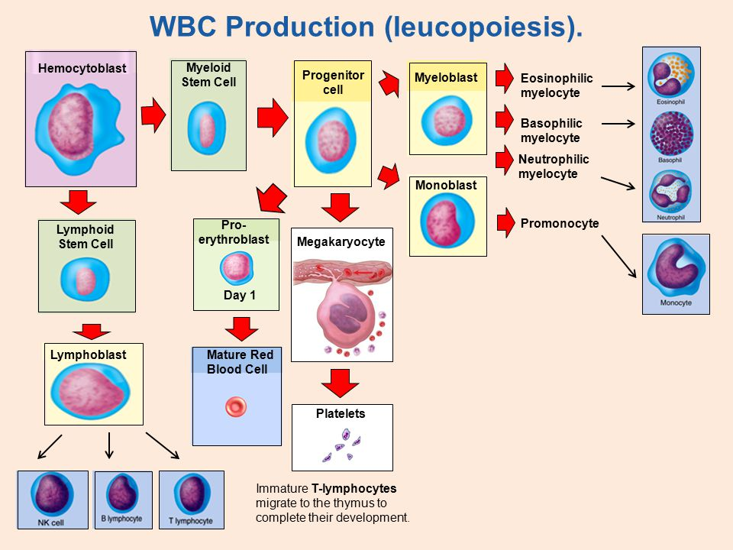

Slide 18
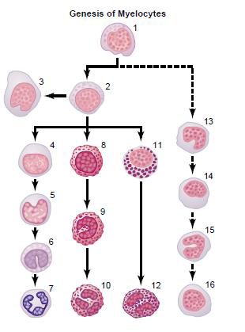
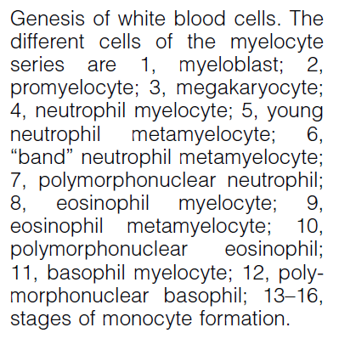
Leucopoiesis

Slide 19
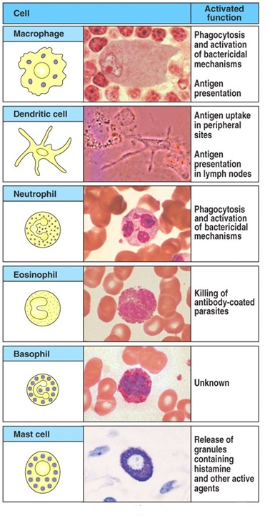
Cellular Elements of the Innate Immune System

Slide 20
Neutrophils
Granulocyte
They constitute 60-75% of WBCs.
They have cytoplasmic granules.
Polymorphonuclear.
They contain small granules of both acidic and basic.
They are phagocytic cells (Phagocytosis); Microphages.
Short life span (4-8 hours in the blood).
They constitute the first line of defence against bacterial infection.
Very important at “clearing” bacterial infections.

Slide 21
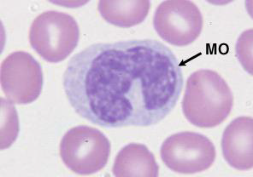
Monocytes/Macrophage
Monocyte is a young macrophage in the blood.
They are formed in the bone marrow: stem cell → monoblast → promonocyte → mature monocyte released into blood.
Monocytes which leave the blood stream turn into macrophages.
Monocytes contain agranular cytoplasm but when they enter the tissues and converted into macrophages, they swell and their cytoplasm become filled by large number of lysosomes and then they are called macrophages.
The momocytes are big eaters
15-20 µm
active cells 60-80 µm.
Life span.
They are slower to respond to invaders than the neutrophils, but they are larger, live longer, and have far greater capacities.
Monocyte
Macrophage
Phagocytosing
E coli

Slide 22
There are two types of macrophages; motile and fixed.
Functions of monocytes/macrophages:
Phagocytosis and killing of microorganisms. They are more Efficient than Neutrophils (100 bacteria vs 3-20 by Neutrphil, larger particles like old RBCs & malarial parasites).
Activation of T cells and initiation of the immune response by presenting the antigen to these cells.
Monocytes secrete:
Interleukin-1 (IL-1).
Colony stimulating factor (M-CSF).
Platelet-activating factor (PAF).
There are tissue-specific macrophages; fixed macrophages (monocyte-macrophage system; reticulo-endothelial system)
Alveolar macrophage
Peritoneal macrophage
Kuppfer cells in liver sinuses
Osteoclasts in bone
Microglial cells in brain
Histiocytes in skin and subcutaneous tissue
Mesengial cells in the kidneys
Few specialized endothelial cells in the bone marrow, spleen and lymph nodes
Monocytes/
Macrophage
Monocyte
Macrophage
Phagocytosing
E coli

Slide 23
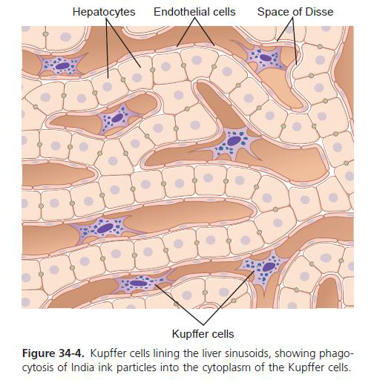
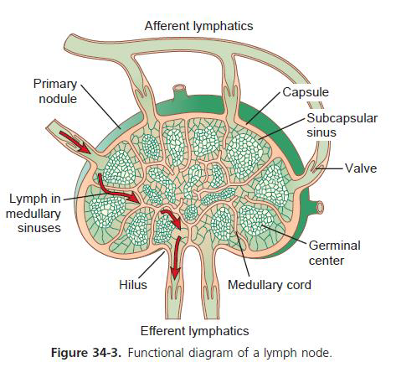
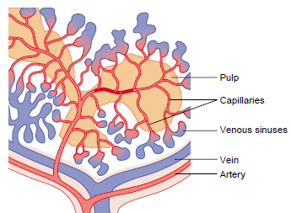
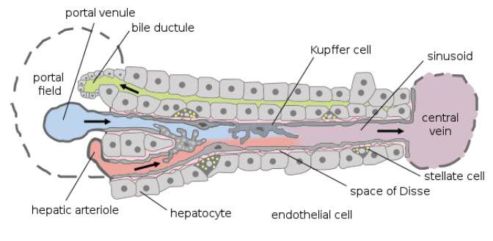
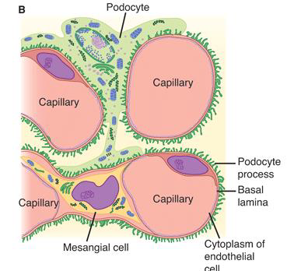
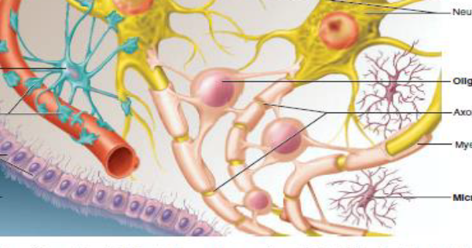
Functions of the Reticulo-endothelial System
Phagocytosis of bacterial, dead cells and foreign particles
Breakdown of Hb
Immune function
Storage of iron

Slide 24
Macrophage and Neutrophil Responses
During Inflammation
1st line of defense –Tissue macrophages, barriers and complement system.
2nd line of defense –Neutrophil invasion of the inflamed area.
3rd line of defense –Monocytes–macrophage invasion of inflamed area.
4th line of defense –Increased production of granulocytes and monocytes by the bone marrow.

Slide 25
Defensive Properties of Neutrophils and Macrophages
Invasion of the body by bacteria triggers the inflammatory response.
Margination: The Neutrophils and monocytes aggregate and stick along the walls of blood capillary.
Chemotaxis: Many different chemical substances in the tissues cause neutrophils and monocytes to move toward the source of the chemical. This phenomenon is known as chemotaxis.. The chemotactic agents include a component of the complement system (C5a); leukotrienes; and polypeptides from lymphocytes, mast cells, and basophils.
Diapedesis: Neutrophils and monocytes can squeeze through the pores of the blood capillaries by diapedesis. To enter the tissue spaces
Ameboid movement: Both neutrophils and macrophages can move through the tissues by ameboid motion.
Phagocytosis: The most important function of the neutrophils and macrophages is phagocytosis, which means cellular ingestion of the offending agent.
Opsonization: Some plasma factors act on the bacteria to make them “tasty” to the phagocytes (opsonization). The principal opsonins that coat the bacteria are immunoglobulins of a particular class (IgG) and complement proteins.

Slide 26
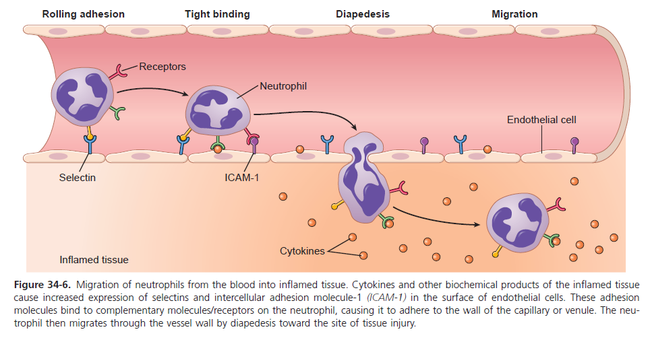

Slide 27
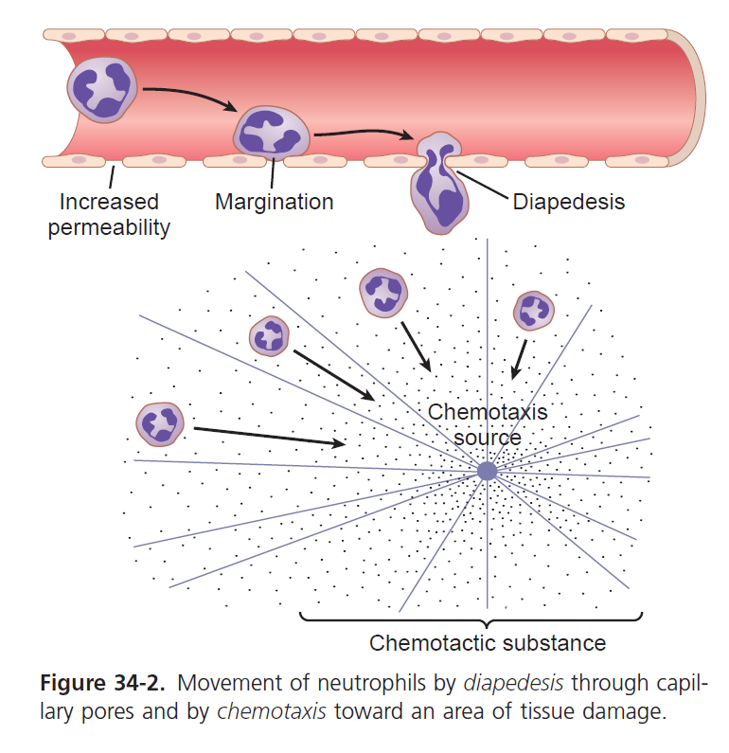

Slide 28
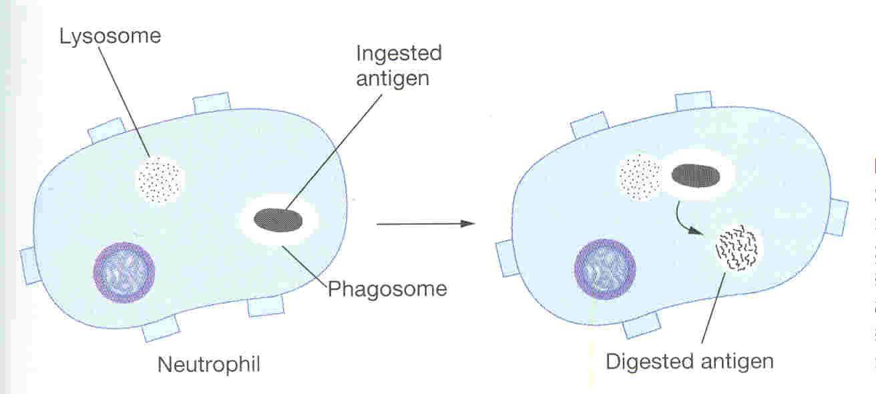
Phagocytosis and Digestion
Complement 3b or antibodies like IgG making them ready for killing a process known as opsonization.
Neutrophils encircle the bacteria with pseudopodia and engulf it inside into a vacuole (phagosome), can kill 3-20 bacteria

Slide 29
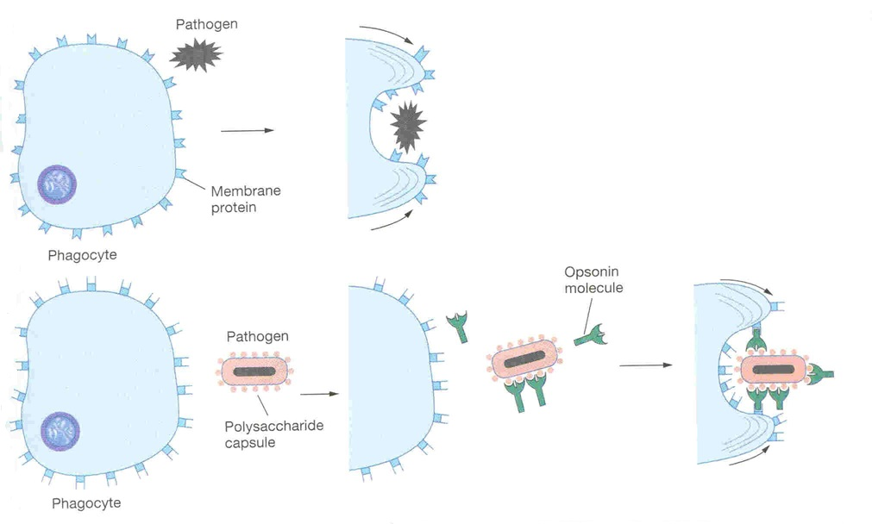
Opsonization and Phagocytosis

Slide 30
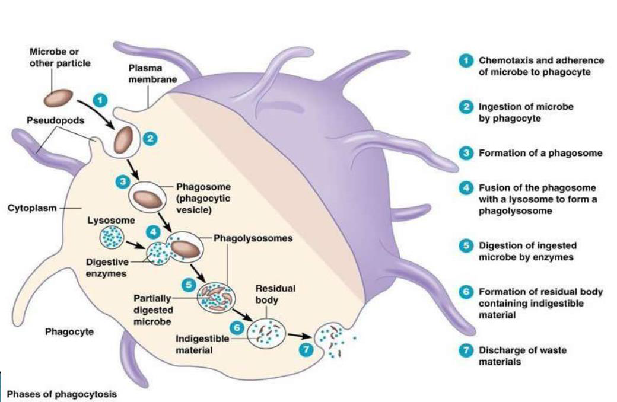
Microbial Killing

Slide 31
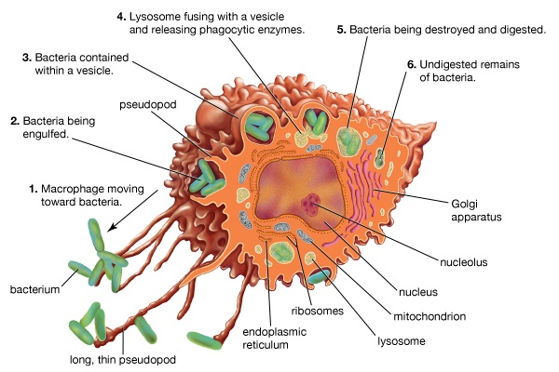
Microbial Killing

Slide 32
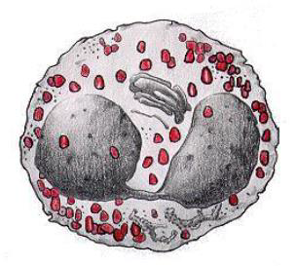
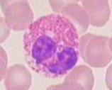
Eosinophis are formed in the bone marrow: Stem cell → myeloblast → promyelocyte → eosinophil myelocyte → eosinophil metamyelocyte → mature eosinophil released into the blood. The normally constitute ~2% of all the blood leucocytes.
Size: 10-14 μm in diam.
Life span: 4-5 hours in the circulation.
They have bilobed nucleus
The cytoplasm contains granules, which are arginine rich and take acid dye (eosin).
Functions:
They are weak phagocytes.
They are often produced in large numbers in people with parasitic infections, and they migrate in large numbers into tissues diseased by parasites., e.g., ascaris. Eosinophils attach themselves to the parasites by way of special surface molecules and release substances that kill many of the parasites
They are increased in allergic conditions by the release of eosinophil chemotactic factor released from the mast cells and basophiles. Eosinophils phagocytose the antigen-antibody complexes and release substances to neutralize the histamine.
They may produce profibrinolysin → fibrinolysin which digest fibrin clot.
Eosinophils

Slide 33
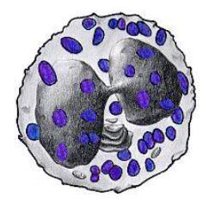
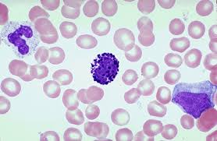
Basophils are formed in the bone marrow: Stem cell → myeloblast → promyelocyte → basophil myelocyte → basoophil metamyelocyte → maturebasophil released into the blood. The normally constitute less than 1% of all the blood leucocytes.
Size: 10-14 μm in diam.
Rarely segmented nucleus hidden by large round cytoplasmic polysaccharide granules, which take base dye (methylene blue) and stain blue in color.
Functions:
Both mast cells and basophils liberate histamine, heparin, bradykinin, Serotonin (5HT) , slow-reacting substance of anaphylaxis (a mixture of three leukotrienes) and a number of lysosomal enzymes.
They are increased in allergic reaction: immediate-type hypersensitivity (allergic) reactions.
Basophils

Slide 34
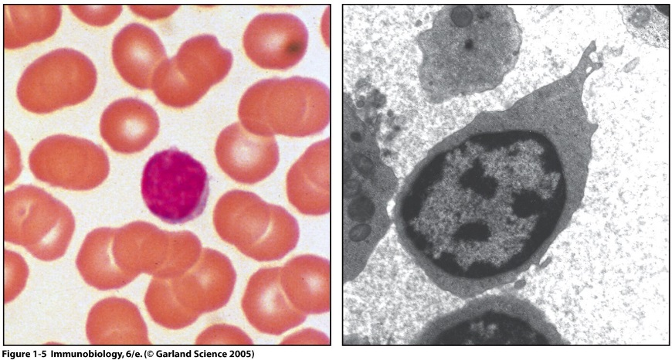
Cellular Elements of the Innate Immune System
Lymphocytes – T and B cells
Make up 20–40% of circulating leukocytes
3 Classes of circulating Lymphocytes
T cells: thymus-dependent
B cells: thymus-independent

Slide 35
Lymphocytes – T and B cells
Both types of lymphocytes are derived in the embryo from pluripotent hematopoietic stem cells that form common lymphoid progenitor cells.
All of the lymphocytes formed end up in the lymphoid tissue, but before doing so, they are further differentiated or “preprocessed”:
The lymphoid progenitor cells that are destined to eventually form activated T lymphocytes first migrate to and are preprocessed in the thymus gland, and thus they are called “T” lymphocytes. They are responsible for cellular or cell-mediated immunity
The B lymphocytes are preprocessed in the liver during mid–fetal life and in the bone marrow in late fetal life and after birth. They are changed to plasma cells and are responsible for humeral immunity or antibody- mediated immunity.

Slide 36
Lymphocytes – T and B cells
Lymphocytes migrate to the lymphoid organs.
On the surface of each lymphocyte are receptors that enable them to recognize foreign substances. These receptors are very specialized - each can match only one specific antigen.
It might seem limiting that the receptors of each lymphocyte cell can only match one specific type of antigen, but the body makes up for this by producing so many different lymphocyte cells that the immune system can recognize nearly all invaders.

Slide 37
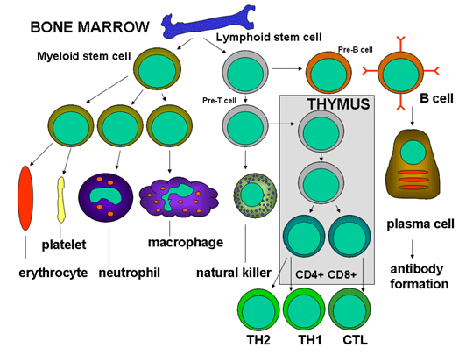
Lymphocytes – T and B cells

Slide 38
T cells
T cells are produced in the bone marrow and later move to the thymus where they mature, hence these lymphocytes are called T cells.
T cells come in two different types, helper cells and killer cells.

Slide 39
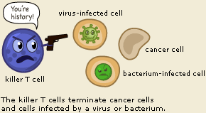
Killer T cells
A cytotoxic T cell (also known as T_{C}, cytotoxic Tlymphocyte, CTL, T-killer cell, cytolytic T cell, CD8+T-cell or killer T cell)
The killer T cell is specialized in attacking cells of the body infected by viruses and sometimes also by bacteria. It can also attack cancer cells.
The killer T cell has receptors that are used to search each cell that it meets. If a cell is infected, it is swiftly killed.
Infected cells are recognized because tiny traces of the intruder, antigen, can be found on their surface.

Slide 40
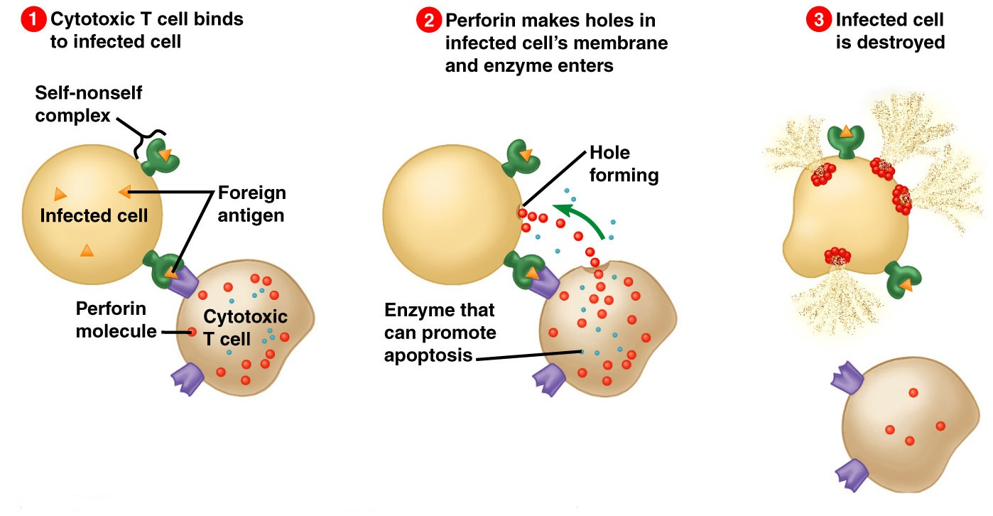
Killer T cells

Slide 41
Helper T cells
Helper T cells are the major driving force and the main regulators of the immune defense.
Their primary task is to activate B cells and killer T cells. However, the helper T cells themselves must be activated. This happens when a macrophage or dendritic cell, which has eaten an invader, travels to the nearest lymph node to present information about the captured pathogen. The phagocyte displays an antigen fragment from the invader on its own surface, a process called antigen presentation.
When the receptor of a helper T cell recognizes the antigen, the T cell is activated. Once activated, helper T cells start to divide and to produce proteins that activate B and T cells as well as other immune cells.

Slide 42
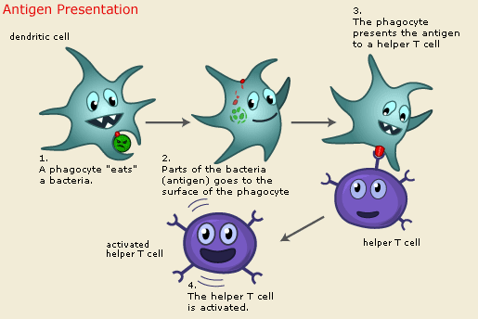
Antigen presentation

Slide 43
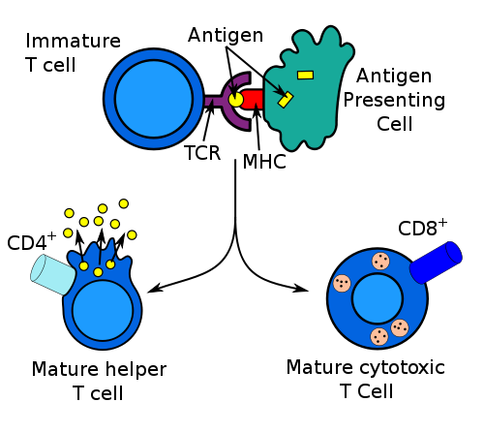
B cell activation Kill virally
infected cells

Slide 44
B cells
The B lymphocyte searches for antigen matching its receptors.
If it finds such antigen it connects to it, and inside the B cell a triggering signal is set off.
The B cell now needs proteins produced by helper T cells to become fully activated. When this happens, the B cell starts to divide to produce clones of itself.
During this process, two new cell types are created, plasma cells and B memory cells.
The plasma cell is specialized in producing a specific protein, called an antibody
The memory Cells are the second cell type produced by the division of B cells. These cells have a prolonged life span and can thereby "remember" specific intruders.
T cells can also produce memory cells with an even longer life span than B memory cells. The second time an intruder tries to invade the body, B and T memory cells help the immune system to activate much faster.
The invaders are wiped out before the infected human feels any symptoms. The body has achieved immunity against the invader.

Slide 45
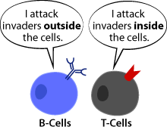
B cell activation Kill virally
infected cells

Slide 46
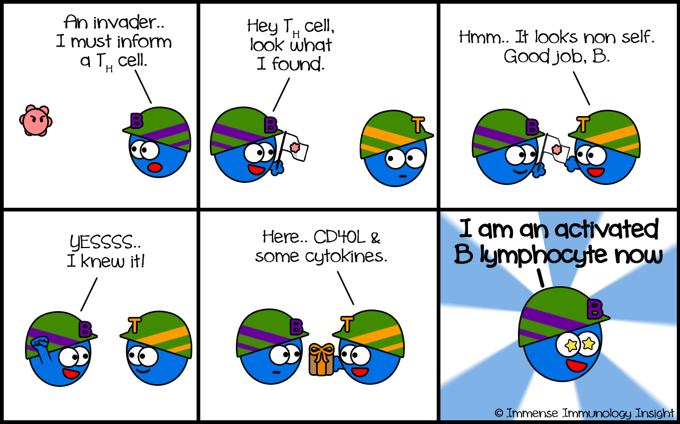

Slide 47
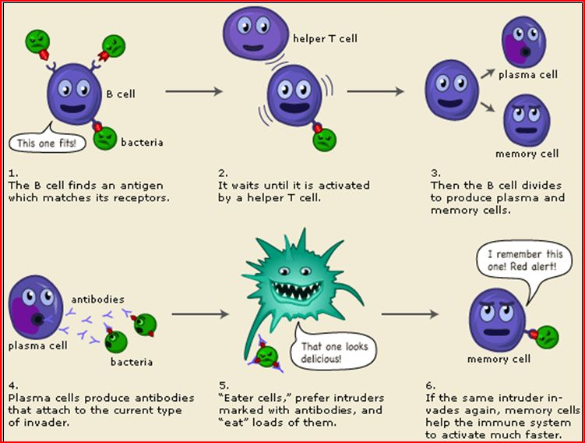

Slide 48
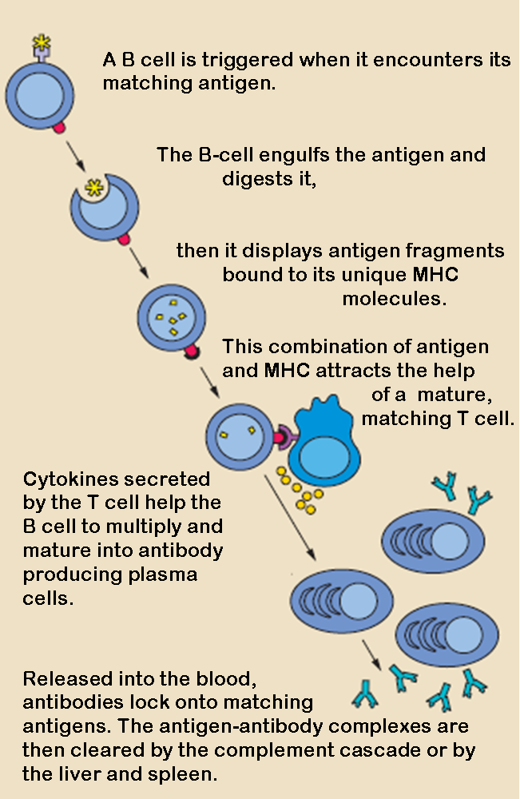

Slide 49
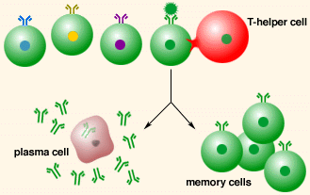

Slide 50
Physiological Leukocytosis
Increase in number of leucocytes above 11.000/mm³.
It occurs in the following conditions:
Muscular exercise
Emotions
Cold bath
Cold or hot weather
Pregnancy
Labor
Pain
Anesthesia
After meals.

Slide 51
Physiological Variations in WBCs Count
Age:
Infants: about 20,000 /mm³
Children:10,000 to 15,000/mm³
Adults: 4,000 and 11,000/mm³
Sex: males have more WBCs than females.
Diurnal variation: Minimum in early morning and maximum in the afternoon.
Exercise: Increases slightly.
Sleep: Decreases.
Emotional conditions like anxiety: Increases.
Pregnancy: Increases.
Menstruation: Increases.
Parturition: Increases.

Slide 52
Pathological Leukocytosis
Causes | Definition | Condition
Infections: of all types as acute or chronic, bacterial, viral or fungal. Inflammation as rheumatic fever Tissue damage as trauma, burn Malignant tumors Smoking. | An increase in the number of neutrophils | Neutrophilia
Allergic conditions as asthma, hay fever, skin allergy Parasitic infection Leukemia | an increase in the number of eosinophils | Eosinophilia
Allergic conditions as asthma, hay fever, skin allergy Leukemia | an increase in the number of basophils | Basophilia
Chronic infection as in tuberculosis Leukemia | an increase in the number of momocytes | Monocytosis
Chronic bacterial and viral infections Leukemia | an increase in the number of lymphocytes | Lymphocytosis

Slide 53
Leukemia
It is a malignant disease of bone marrow causing marked increase in WBCs may reach 500.000/mm³.
Leukemia is associated with anemia and bleeding tendency (due to decrease in bone marrow area responsible for RBCs and platelet synthesis respectively).

Slide 54
Leukopenia
Leukopenia (leucopenia) means a decrease in the total leucocyte count below 4.000/mm³.
In this condition the body is not protected against infections and death may occur.
It is caused by:
Bone marrow depression by radiation, drugs, and cancer chemotherapy.
Some bacterial infections as typhoid fever, brucellosis.
Some viral infections as AIDS, influenza, hepatitis.

Slide 55
Objectives;
Intended learning outcomes (ILOs)
After reviewing the PowerPoint presentation and the associated learning resources, the student should be able to:
Outline components of the immune system.
List the types of white blood cells(WBCs).
Describe the structure of the different types of WBCs.
Outline differential WBCs count.
Summarize the stages of formation of the different WBCs.
State the functions the different types of WBCs.
Describe the role of the WBCs in immune responses and defending against infection.
Explain the process of phagocytosis.
Recognize leukocytosis, leukopenia and leukemia.

Slide 56
Thank You

