Slide 1
Blood Groups and Blood Transfusion

Slide 2
Objectives;
Intended learning outcomes (ILOs)
After reviewing the PowerPoint presentation and the associated learning resources, the student should be able to:
Describe the ABO and Rhesus blood group systems
Recognize agglutinins in the plasma
Describe grouping, cross-matching & typing with anti-sera
List precautions taken in preparing blood for transfusion and storage of blood
Define autologous transfusion and list its advantages
Describe transfusion reactions.
Define hemolytic disease of newborn, describe its pathophysiology and outline its prevention

Slide 3
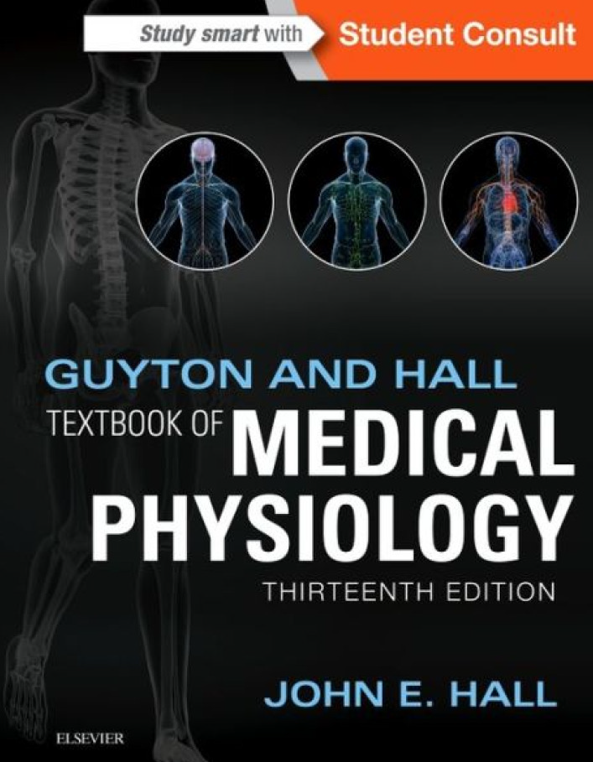
Learning Resources
Guyton and Hall, Textbook of Medical Physiology; 13th Edition; Unit VI-Chapter 36.

Slide 4
Blood Typing
RBC surfaces are marked by genetically determined antigens
- Agglutinogens or isoantigens
Blood is typed (grouped) based on surface antigens
At least 30 common antigens and 100s of rare antigens have been found on the surfaces of human blood cells
The ABO and Rhesus (Rh) systems of antigens are of major clinical importance as they are associated with transfusion reactions when mismatched
Other antigens are less likely to cause reactions; however, they are of forensic importance (establish parentage).

Slide 5
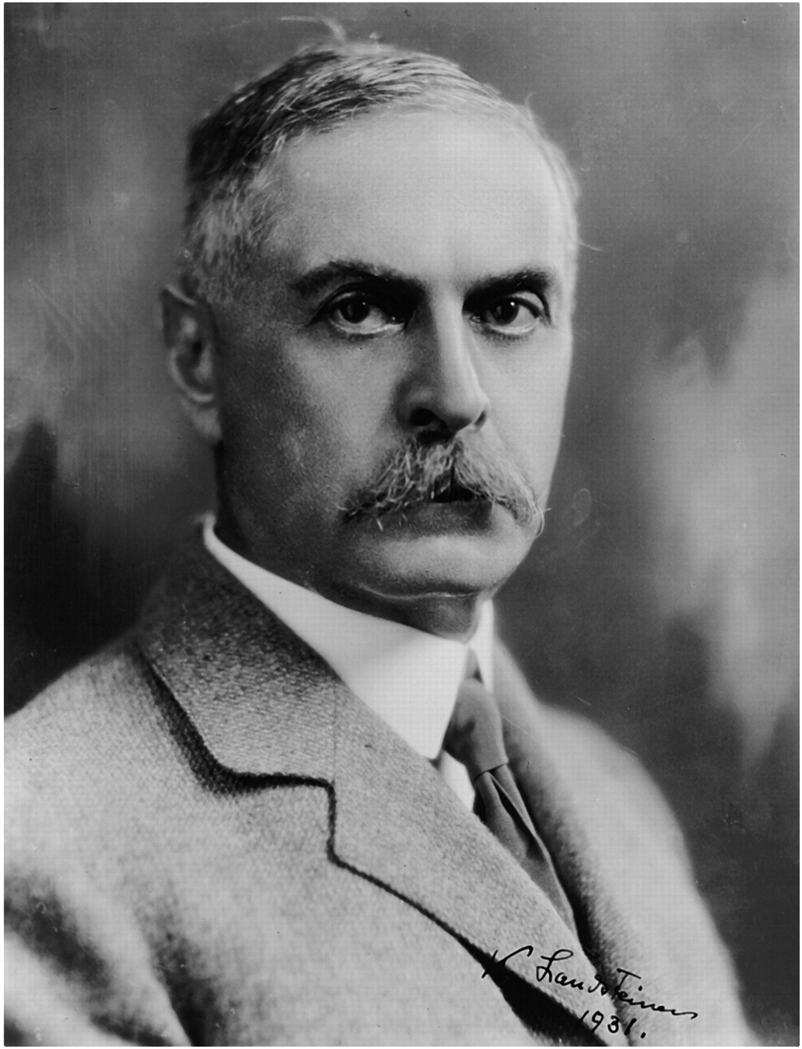
Karl Landsteiner
1901: was the first to discover the ABO blood agglutinins & classified blood groups accordingly.
1930: awarded the Nobel Prize in Physiology & Medicine for his discovery
1937: With Alexander S. Wiener, he identified the Rh factor.

Slide 6
Blood Typing
ABO blood group:
A and B antigens are found in:
- Most cells: RBCs, WBCs and platelets
- In secretions: saliva, sweat, semen
- They are glycoproteins, complex oligosaccharides that differ in their terminal sugar
RBCs with A antigen = Type A blood
RBCs with B antigen = Type B blood
RBCs with neither antigens = Type O blood
RBCs with both antigens = Type AB blood
Detection of A and B antigens in dried blood stains is of forensic importance

Slide 7
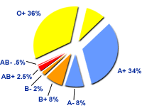
ABO Blood Group Frequency
Blood group | % Distribution
O | 47%
A | 41%
B | 9%
AB | 3%
Frequency of ABO has ethnic variation

Slide 8
Genetic Determination of ABO Antigens
Genotypes | Blood Types | Agglutinogens
OO | O | -
OA or AA | A | A
OB or BB | B | B
AB | AB | A and B
Two genes (one maternal and one paternal in origin), one on each of the two paired chromosomes number 9, determine the O-A-B blood type.
These genes can be any one of three types but only one type on each of the two chromosomes number 9: type O, type A, or type B.
The type O gene is either functionless or almost functionless, so that it causes no significant type O agglutinogen on the cells. Conversely, the type A and type B genes do cause strong agglutinogens on the cells.
The type A and type B genes are co-dominant. This meant that if a person inherited one type A gene and one type B gene, their red cells would possess both the A and B antigens

Slide 9
ABO Blood Group Inheritance
Mother/Father | OO | AA, AO | BB, BO | AB
OO | O | O, A | O, B | A, B
AA, AO | O, A | O, A | O, A, B, AB | A, B, AB
BB, BO | O, B | O, A, B, AB | O, B | A, B, AB
AB | A, B | A, B, AB | A, B, AB | A, B, AB

Slide 10
The Question of Paternity
Blood types cannot be used to prove paternity.
Blood types can disprove paternity.
Noura blood (type A) and Fahad blood (type B) Have a baby (blood type O) Can Fahad be the father?
Phenotype | Possible Genotype
Noura: A | AA or AO
Fahad :B | BB or BO
Baby: O | OO

Slide 11
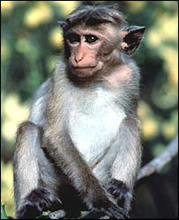
Blood Typing
Rh factor (D):
There are eight different Rh agglutinogens, three of which (C, D, and E) are common
Rh factor (antigen) are a complex system of antigens with Mendelian inheritance Cc, Dd, Ee
Rh factor (antigen) was first discovered in blood of Rhesus monkey. Rh factors only detectable on RBCs
C, D & E antigens (D is the most immunogenic)
RBCs with D protein = Rh⁺
RBCs without D protein = Rh–
85% of caucasians, 95% of black Americans, 99% of chinese and nearly 100% of black Africans are Rh+
Locus of alleles responsible of ABO system is on
long arm of chromosome 9 while Rh locus is on
chromosome 1

Slide 12
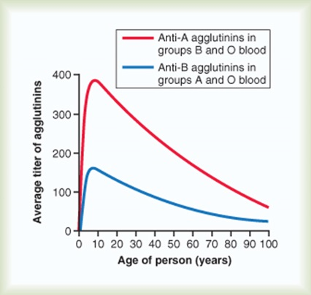
Agglutinins
Plasma contains isoantibodies or agglutinins (IgM) to the A or B antigens not found in the blood:
anti-A antibody reacts with antigen A.
anti-B antibody reacts with antigen B.
Anti-A and Anti-B antibodies are not present at birth. Two to 8 months after birth, an infant begins to produce agglutinins. A maximum titer is usually reached at 8 to 10 years of age, and this gradually declines throughout the remaining years of life.
Normal plasma contains no anti-Rh (anti-D) antibodies.
Anti-Rh antibodies (IgG) develop only in Rh⁻ blood type and only with exposure to the antigen:
transfusion of positive blood.
during a pregnancy with a positive blood type fetus.
LANDSTEINER's LAW:
If an agglutinogen is present on red blood cell membrane ,the corresponding agglutinin must be absent in the plasma.
If an agglutinogen is absent on red blood cell membrane, then corresponding agglutinin must be present in the plasma.
This law is only applicable to ABO blood grouping system.

Slide 13
Agglutinins
Anti-Rh antibodies (IgG) develop only in Rh⁻ blood type and only with exposure to the antigen:
transfusion of positive blood.
during a pregnancy with a positive blood type fetus.
Anti-Rh antibodies are not spontaneously formed in Rh– individuals.
However, if an Rh– individual receives Rh⁺ blood, anti-Rh antibodies form.
Anti-Rh agglutinins develop slowly (2-4 months). Once produced they persist for years and can produce serious transfusion reaction during 2nd transfusion.
This immune response occurs to a much greater extent in some people than in others. With multiple exposures to the Rh factor, an Rh-negative person eventually becomes strongly "sensitized" to Rh factor.

Slide 14
Agglutinins
Genotypes | Blood Types | Agglutinogens | Agglutinins
OO | O | - | Anti-A & Anti-B
OA or AA | A | A | Anti-B
OB or BB | B | B | Anti-A
AB | AB | A + B | -

Slide 15
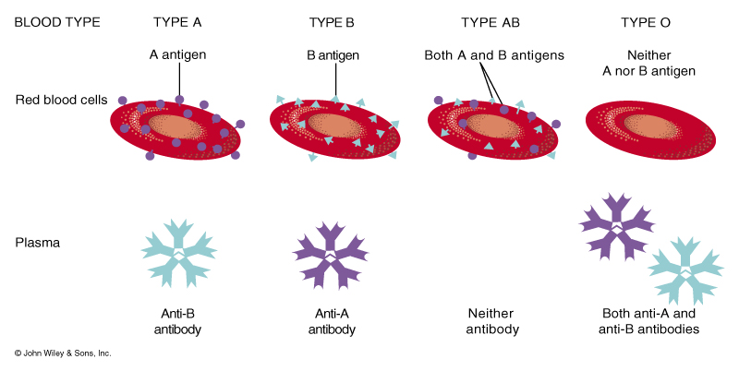
ABO Blood Typing
With ABO, person makes antibodies (agglutinens; IgM) against factors (agglutinogens) he/she does NOT have on his/her cells

Slide 16
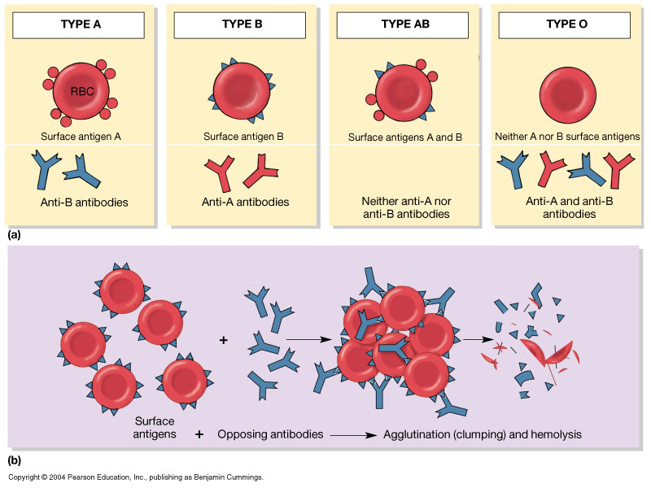
Blood Typing and Agglutination

Slide 17
ABO Blood Typing
Blood Type
A
B
AB[1]
O[2]
Agglutinogens (antigen proteins) Present
A
B
A & B
(neither)
Makes Agglutinins (antibodies) Against
B
A
(neither)
A & B
May Receive Blood From:
A, O
B, O
A, B, AB, O
O
May Give Blood To:
A, AB
B, AB
AB
A, B, AB, O
Rh Factor
Present or Absent
(A+ or A-)
Present or Absent
(B+ or B-)
Present or Absent
(AB+ or AB-)
Present or Absent
(O+ or O-)
[1] Universal Recipient [2] Universal Donor

Slide 18
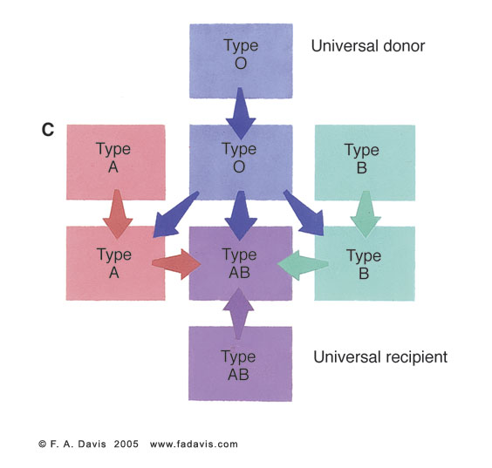

Slide 19
Blood Group
Antigens
Antibodies
Can give blood to
Can receive blood from
AB
A
B
O

Slide 20
Blood Group
Antigens
Antibodies
Can give blood to
Can receive blood from
AB
A and B
None
AB
AB, A, B, O
A
A
anti-B
A and AB
A and O
B
B
anti-A
B and AB
B and O
O
None
anti-A and anti-B
AB, A, B, O
O

Slide 21
Plasma compatibility table
Recipient | Donor
 | O | A | B | AB
O | OK | OK | OK | OK
A |  | OK |  | OK
B |  |  | OK | OK
AB |  |  |  | OK
When considering a plasma transfusion, keep in mind that plasma carries antibodies and no antigens. For example you can't give type O plasma to a type A, B or AB, because a person with type O blood has A and B antibodies and the recipient would have an immune response. On the other hand an AB donor could give plasma to anyone, since they have no antibodies.

Slide 22
Rh Blood Types
Blood Type
Rh⁺
Rh⁻
Agglutinogen D (antigen proteins)
Present or Absent
Present
Absent
Makes Agglutinins (antibodies) Against Agglutinogen
No
Yes[1]
May Receive Blood From:
Rh⁺ or Rh⁻
Rh^{-[2]}
May Give Blood To Without Reaction^{[2]}:
Rh⁺
Rh⁺ or Rh‑
Genotype
DD or Dd
dd
[1] Only makes antibodies (agglutinens) after exposure to Rh+ blood cells (via transfusion or during birth process)
[2] Transfusion of Rh⁻ individual with Rh+ blood results in production of anti-D agglutinens; sensitizes person to Rh factor and may result in anaphylaxis if exposed a second time. Erythroblastosis fetalis arises when Rh⁻ mother has been exposed to Rh⁺ blood and is carrying Rh⁺ child.

Slide 23
Universal Donor; Suitable for all?
Universal donor:
Blood group O, Rh negative.
May be given in emergency to patients with either A, B, AB and Rh negative or positive blood groups.
Antibody concentrations may be high, so may not be suitable if large volume of blood required.
Universal recipient:
People with type AB blood are called “universal recipients” since have no antibodies in plasma.

Slide 24
Importance of Blood Groups
In blood transfusion.
In preventing hemolytic disease (Rh incompatibility).
In paternity disputes.
In medico-legal cases.
In knowing susceptibility to disease
Group O- duodenal cancer
Group A- Carcinoma of stomach, pancreas & salivary glands

Slide 25
Blood Transfusion
Indications of blood transfusion:
1. Acute hemorrhage.
2. Sever anemia (if Hb decreased below 7 g/dL).
3. Erythroblastosis fetalis: in this case exchange transfusion is done.
4. To supply a necessary elements e.g. platelets, packed RBCs, and some clotting factors.

Slide 26
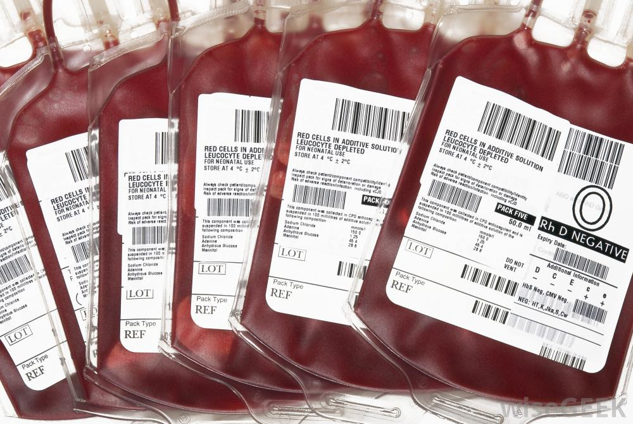
Requirements Prior to Blood Transfusion
Typing (grouping) of the recipient: determining red cell antigens in blood
- ABO typing
- Rh typing
Cross-matching:
Donor’s cells + Recipient's serum
Antibody Screening:
Hepatitis B and C virus
Antibody to HIV
HIV Antigens
Syphilis
Cytomegalovirus

Slide 27
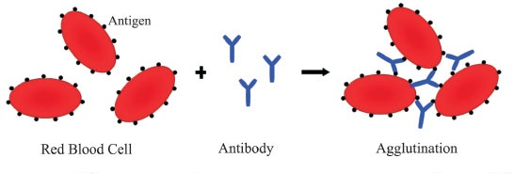
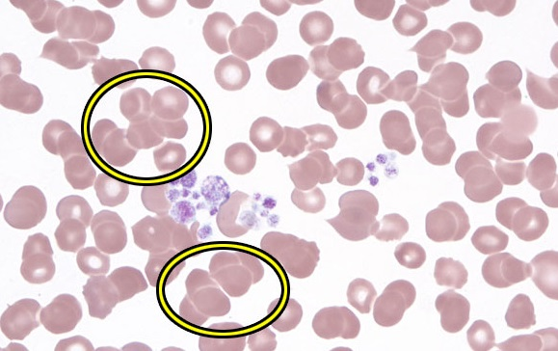
Typing and Cross-Matching Blood
Typing involves testing blood with known antisera that contain antibodies anti-A, anti-B or anti-Rh.
Cross-matching is mixing of donor cells with recipient’s serum.
Mixing of incompatible blood causes agglutination (visible clumping):
formation of antigen-antibody complex that sticks cells together (agglutination reaction).

Slide 28
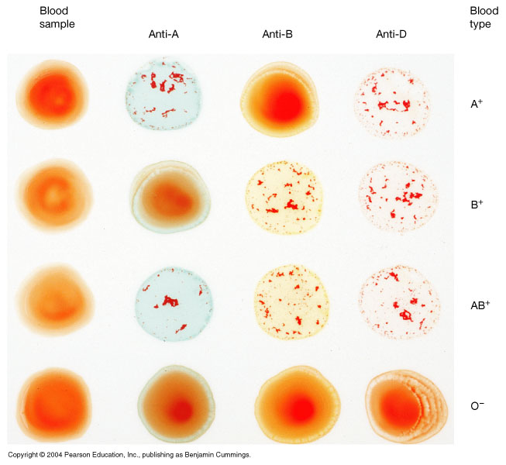
ABO Blood Grouping (Typing) in Laboratory Using Anti-sera
Group | Anti-A | Anti-B
A | Agglutination | Nil
B | Nil | Agglutination
AB | Agglutination | Agglutination
O | Nil | Nil

Slide 29
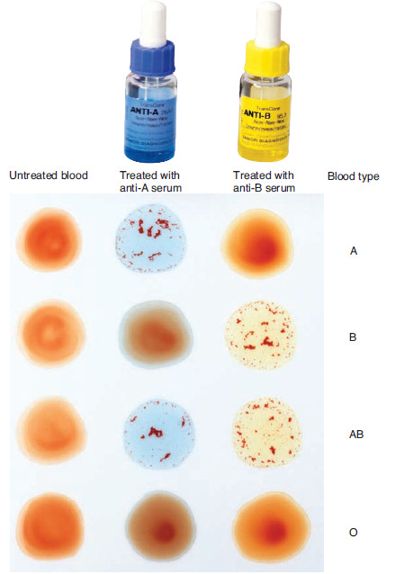

Slide 30
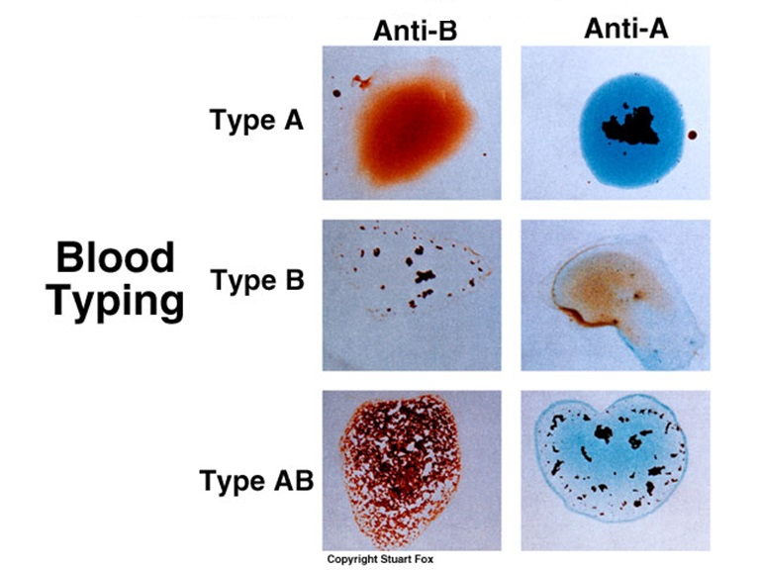

Slide 31
Transfusion Reactions
Incompatible blood transfusions
Mixing of incompatible blood causes the formation of antigen-antibody complexes between recipient’s plasma antibodies and “foreign proteins; antigens” on donated RBC's (agglutination)
Donated RBCs become leaky and burst → diminished oxygen-carrying capacity
Clumped cells impede blood flow
Ruptured RBCs release free hemoglobin into the bloodstream → circulating hemoglobin precipitates in the kidneys and causes kidney damage and renal failure
Problems are caused by incompatibility between donor’s cells and recipient’s plasma
Why do donor antibodies not attack recipient RBCs
Donor plasma is too diluted to cause problems

Slide 32
Symptoms and Signs of Transfusion Reactions
Pain at site of infusion
Dyspnea
Nausea
Flushing
Hypotension
Oliguria or Anuria
Chest Pain Back Pain
Chills
Shock
Fever

Slide 33
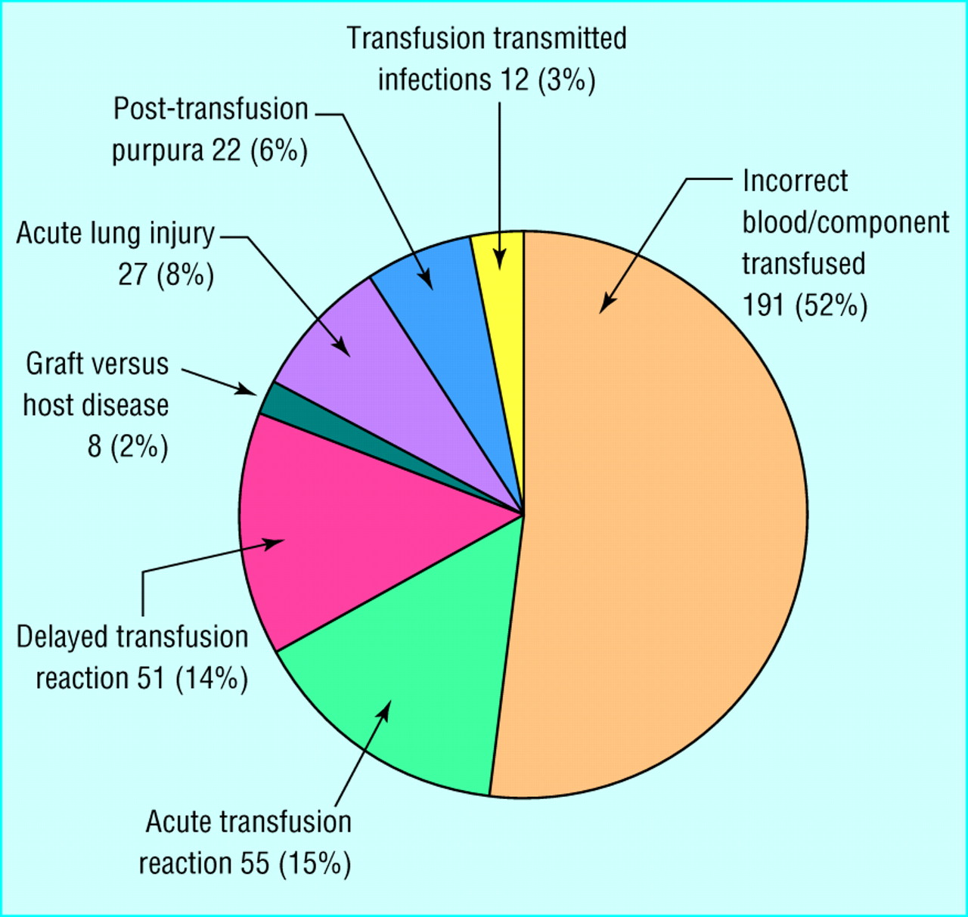
Serious Hazards of Blood Transfusion

Slide 34
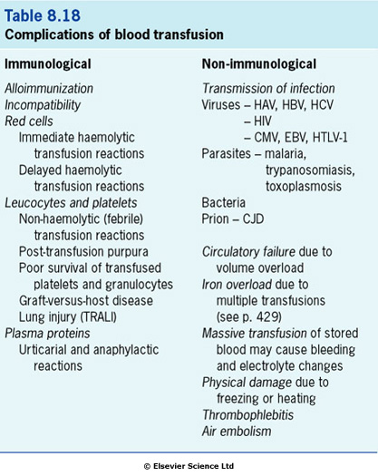
Complications of Blood Transfusion

Slide 35
Question
Transfusion reaction occurs between which of the following?
Donor’s plasma agglutinins against the red cell antigens of the recipient
Donor’s red cell antigens against plasma agglutinins of the recepient
Both
Explain

Slide 36
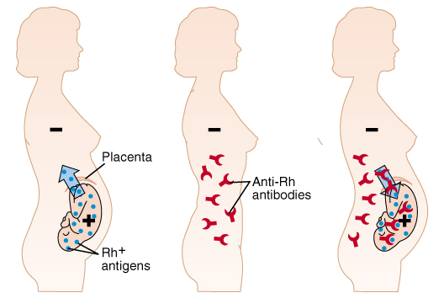
Hemolytic Disease of Newborn
During birth, there is often a leakage of the baby's red blood cells into the mother's circulation.
If the baby is Rh-positive (having inherited the trait from its father) and the mother Rh-negative, these red cells will cause her to develop antibodies (IgG class) against the RhD antigen unless she receives an anti-D injection soon after first delivery or abortion.
Anti-D binds to fetal red blood cells and remove them from body before she reacts
In 2nd child, hemolytic disease of the newborn may develop causing hemolysis of the fetal RBCs → anemia and jaundice.

Slide 37
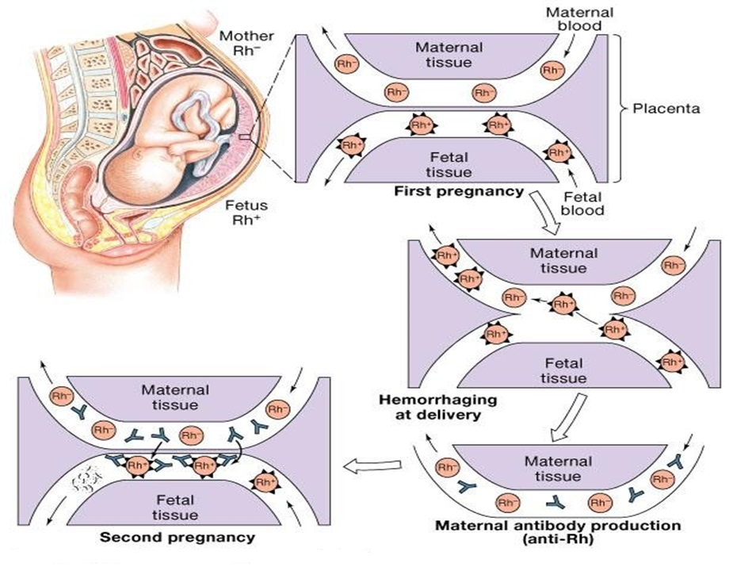

Slide 38
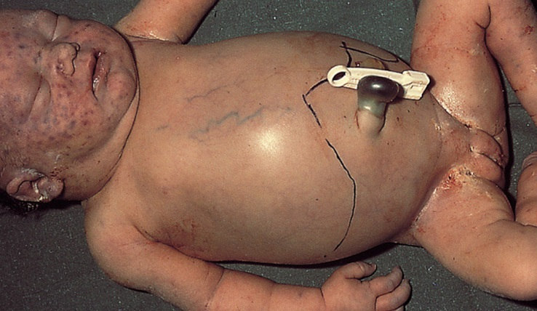
Hemolytic Disease of Newborn
Hemolytic anemia:
– If severe:
treated with exchange transfusion: Replace baby blood with Rh-ve RBC (several times)
Hydrops fetalis (death in utero)
Kernicterus
Prevalence of Disease
1st Pregnancy: 0%
2nd Pregnancy: 3
3rd Pregnancy: 10%

Slide 39
Fetal Incompatibility
Most anti-A or anti-B antibodies are of the IgM class and these do not cross the placenta.
Thus, an Rh⁻/type O mother carrying an Rh⁺/type A, B, or AB foetus is resistant to sensitization to the Rh antigen.
Her anti-A and anti-B antibodies destroy any fetal cells that enter her blood before they can stimulate anti-Rh antibodies in her.

Slide 40
Prevention of Hemolytic Disease of Newborn
Rh immune globulin (RhIg) or Rhogam or anti-D:
Shortly after each birth of an Rh-positive baby, the mother is given an injection of anti-Rh antibodies.
These antibodies destroy any Rh+ fetal cells that got into the maternal circulation before they can stimulate an active immune response in the mother.
The routine administration of such treatment to Rh -ve mothers after the delivery of Rh+ve baby has reduced the incidence of disease by >90%.
Fetal Rh typing from amniocenthesis, and treatment with small dose of Rh immune serum will prevent sensitization during pregnancy.

Slide 41
Objectives;
Intended learning outcomes (ILOs)
After reviewing the PowerPoint presentation and the associated learning resources, the student should be able to:
Describe the ABO and Rhesus blood group systems
Recognize agglutinins in the plasma
Describe grouping, cross-matching & typing with anti-sera
List precautions taken in preparing blood for transfusion and storage of blood
Define autologous transfusion and list its advantages
Describe transfusion reactions.
Define hemolytic disease of newborn, describe its pathophysiology and outline its prevention

Slide 42
Thank You

