Slide 1
Composition and Functions of the Blood

Slide 2
Objectives;
Intended learning outcomes (ILOs)
After reviewing the PowerPoint presentation and the associated learning resources, the student should be able to:
List the functions of the blood
Describe the physical characteristics of blood
Discuss the composition of the blood
Differentiate between the terms formed elements, Packed Cell Volume, plasma and serum
Outline the functions of the plasma proteins
Describe the shape of mature red blood cells and explain the advantages of this shape
Explain what maintains the shape of the normal red blood cell and outline the pathogenesis of hereditary spherocytosis
Summarize the functions of red blood cells
Describe the different hematological indices and indicate their physiological significance

Slide 3
Learning Resources
Guyton and Hall, Textbook of Medical Physiology; 13th Edition; Unit VI-Chapter 33.

Slide 4
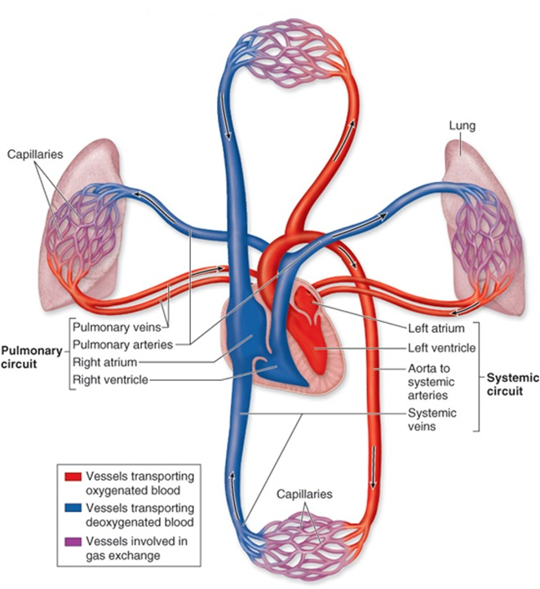
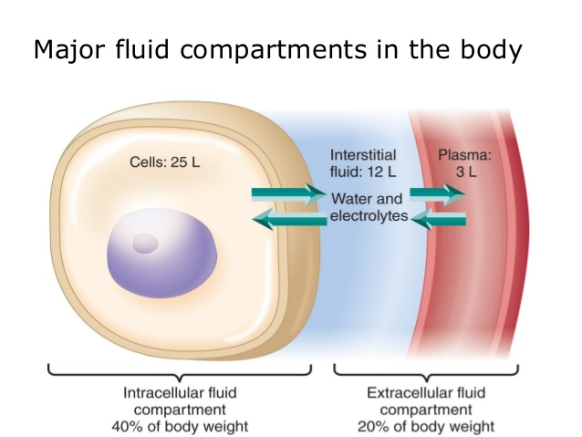
Major Components of the Circulatory System
Heart
Blood vessels
Blood

Slide 5
Some Physical Characteristics of Blood
Blood volume
Blood makes up 7-9% of body weight
Blood volume is 5 to 6 liters in adult males
4 to 5 liters in adult females
Viscosity (thickness and stickiness of blood)
Blood is thicker (more viscous) than water and flows more slowly than water
Plasma at 37°C is about 1.8-times more viscous than water; therefore, the relative viscosity of plasma (compared to water) is about 1.8
Whole blood viscosity (relative to water) = 4.5-5.5
pH
Slightly alkaline: 7.4
Ranges from 7.35 to 7.45

Slide 6
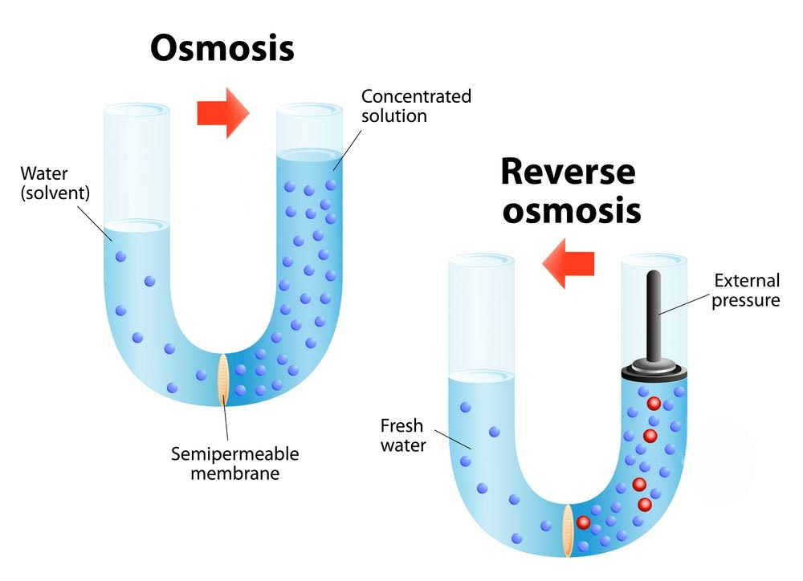
Color
Bright red = O₂ rich
Dull red = O₂ poor
Osmolarity
Plasma osmolarity is about 300 mOsmol/L
Plasma osmolarity is equal to the osmolarity of Normal Saline = 0.9% NaCl Solution. Hence, Normal Saline is an Isotonic solution
Osmotic Pressure
Osmotic pressure is the pressure necessary to prevent net movement of water (in osmosis)
In other words, osmotic pressure is the pressure developed by solutes dissolved in water working across a selectively permeable membrane.
At normal plasma osmolarity of about 300 mOsmol/L, the total plasma osmotic pressure is about 5540 mmHg.
Some Physical Characteristics of Blood

Slide 7
Some Physical Characteristics of Blood
Plasma Osmotic Pressure
Crystalloid osmotic pressure: is the pressure generated by all crystal substances, particularly electrolytes (mainly NaCl). This pressure modulates water distribution between inside and outside of cells. Hence, it is important in maintaining fluid balance across cell membranes.
Colloid osmotic pressure: is the pressure generated by plasma proteins, particularly albumin. This pressure modulates water distribution between inside and outside of blood capillaries. Hence, it is important in fluid transfer across capillaries. It is normally about 25 mmHg, which represents about 0.5% of the total plasma osmotic pressure.

Slide 8
Functions of Blood
Blood transports:
Oxygen from the lungs and nutrients from the digestive tract
Metabolic wastes from cells to the lungs and kidneys for elimination
Hormones from endocrine glands to target organs
Blood maintains:
Appropriate body temperature by absorbing and distributing heat
Normal pH in body tissues using buffer systems
Adequate fluid volume in the circulatory system
Blood prevents blood loss by:
Activating plasma proteins and platelets
Initiating clot formation when a vessel is broken
Blood prevents infection by:
Synthesizing and utilizing antibodies
Activating complement proteins
Activating WBCs to defend the body against foreign invaders

Slide 9
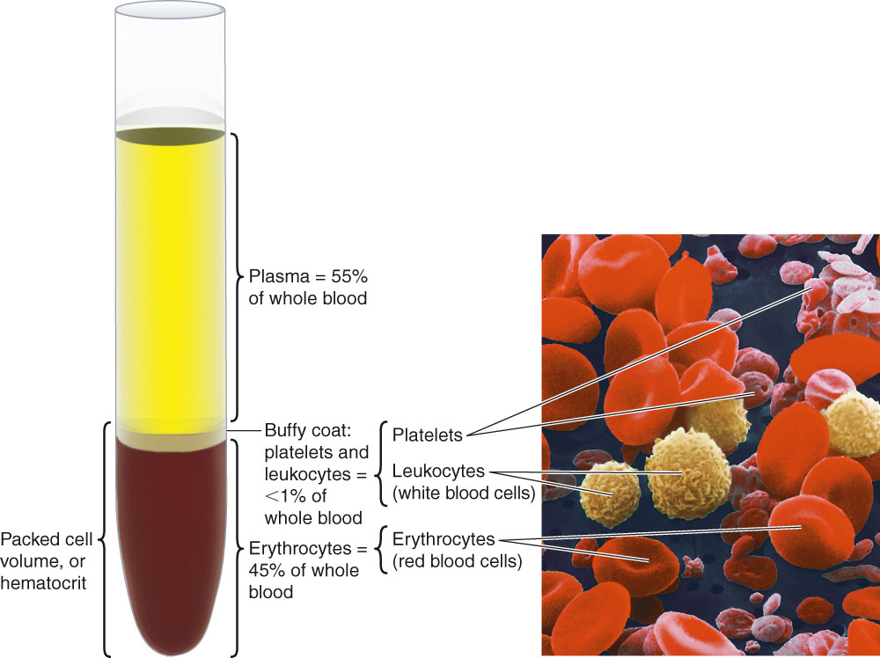
Composition of Blood
Cells and cell fragments = “formed elements”: 45%
Erythrocytes = RBCs
Leukocytes = WBCs
Thrombocytes = platelets (cell fragments)
Matrix (plasma): makes up 55% of blood volume

Slide 10
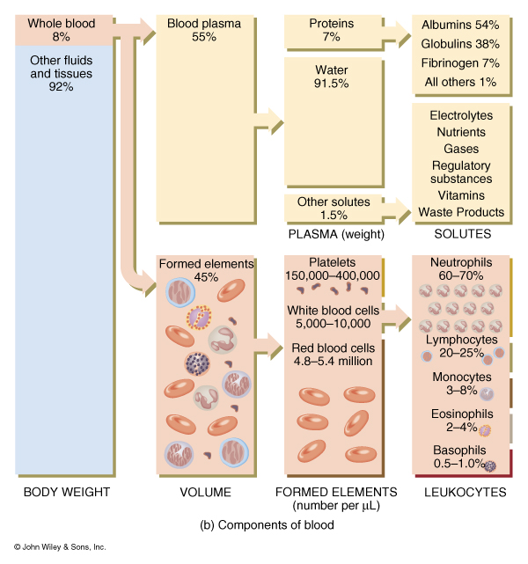
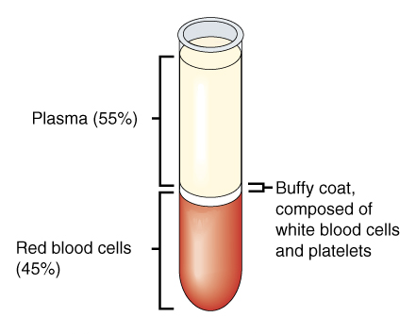
Composition
of Blood
45% cells
99% RBCs
< 1% WBCs and platelets
55% plasma

Slide 11
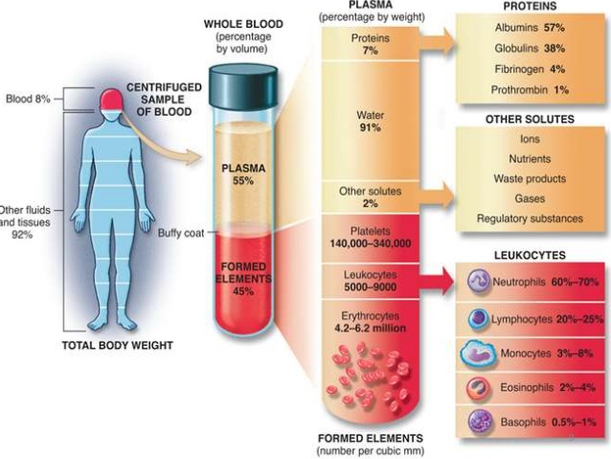
Composition of Blood

Slide 12
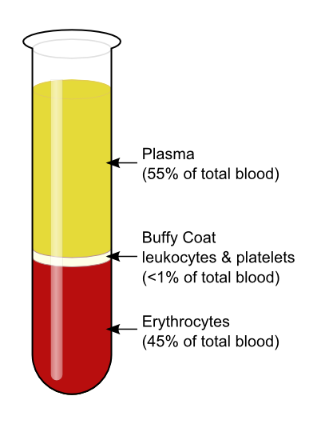
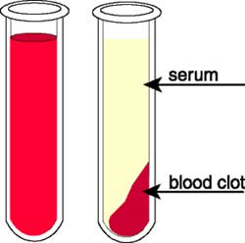
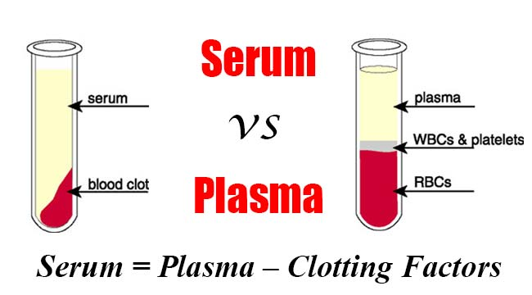
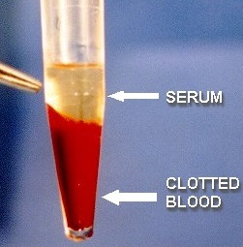
Plasma: Definition and Composition
Plasma = whole blood minus cells
Serum = plasma minus clotting proteins
If whole blood is allowed to clot
Then, clot is removed, the remaining fluid is SERUM
Thus, serum does not contain coagulation factors
Constituents of plasma
- 91.5% water
- 7% plasma proteins
- 1.5% other solutes including:
Electrolytes
Organic nutrients and wastes
Respiratory gases
Vitamins

Slide 13
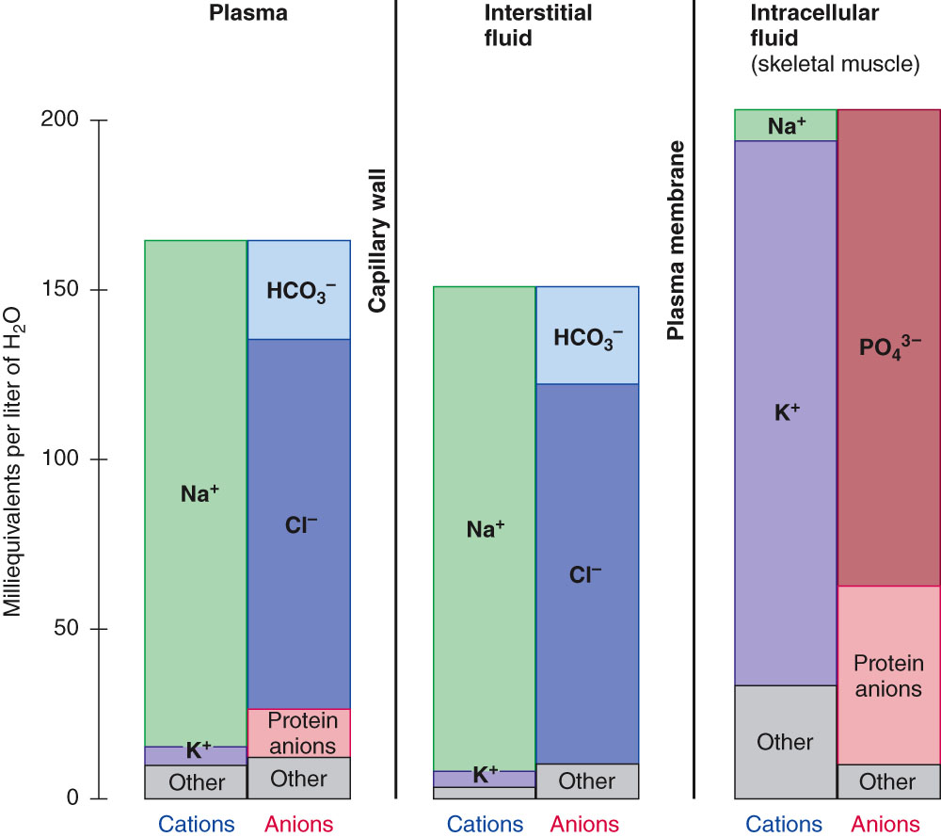
Ionic Composition of the Plasma
Ionic composition of the plasma is very similar to that of the interstitial fluid

Slide 14
Functions of Plasma Proteins
Generation of plasma colloid osmotic pressure (oncotic pressure): most capillary walls are relatively impermeable to the proteins in plasma, and the proteins therefore exert an osmotic force of about 25 mm Hg across the capillary wall (oncotic pressure that pulls water into the blood.) Albumin is the most abundant protein in plasma: about half of all plasma protein. It provides about 80% of plasma oncotic pressure.
Buffering function of plasma proteins: the plasma proteins are also responsible for 15% of the buffering capacity of the blood.
Plasma proteins function as nonspecific carriers for various hormones (e.g., cortisol, thyroxin), other solutes (e.g., iron, cupper), and drugs.
Defense: Gamma globulins are antibodies
Plasma proteins include proteins concerned with blood clotting.

Slide 15
Formed Elements of Blood
Red blood cells (erythrocytes)
White blood cells (leukocytes)
granular leukocytes
neutrophils
eosinophils
basophils
agranular leukocytes
lymphocytes = T cells, and B cells
monocytes
Platelets (special cell fragments)

Slide 16
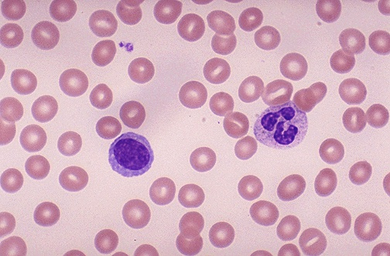
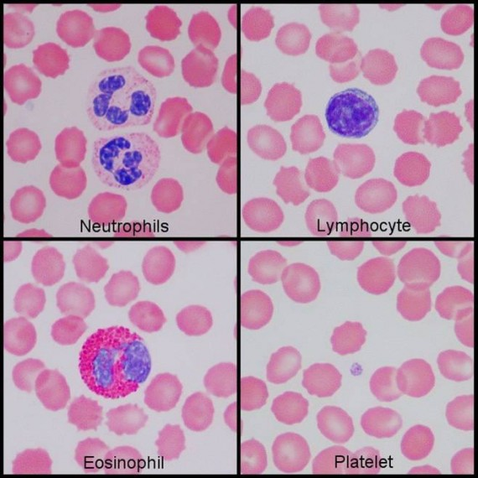
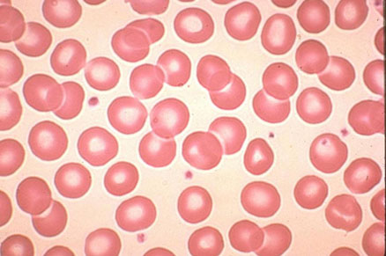
Blood Film (Blood Smear)

Slide 17
Blood Film (Blood Smear) Technique

Slide 18
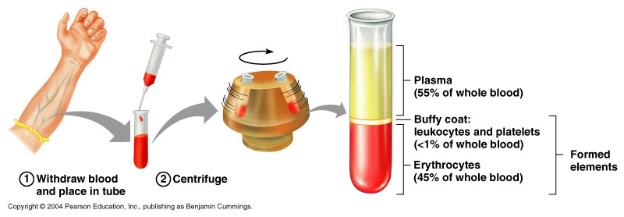
Hematocrit; Hct (PCV)
Hct is the ratio of formed elements to whole blood
It is the proportion of blood made up of cells (mainly RBCs)
It is expressed as percentage
Percentage of blood made up of cells
Males: average 47% (range: 42-52%)
Females: average 42% (range 37-47%)
Minimum hematocrit to donate blood = 38%
Hct is measured by centrifuging a tiny sample of blood
Centrifugation separates formed elements from plasma
After centrifugation the heavier red blood cells settle to the bottom of the tube. The plasma remains at the top.
The two layers are separated by a ‘buffy coat’ of white cells and platelets.

Slide 19
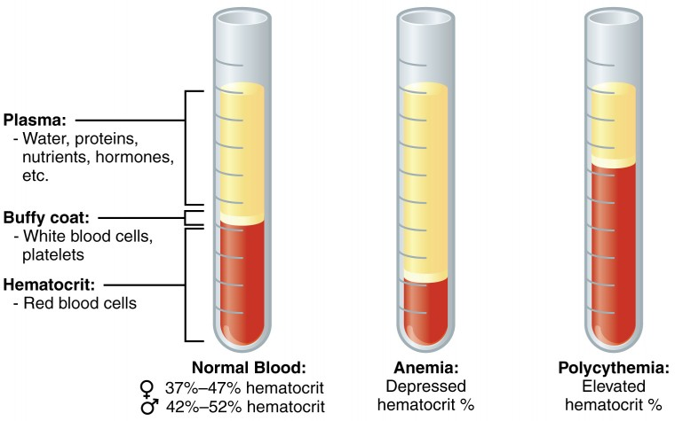
Hematocrit; Hct (PCV)

Slide 20
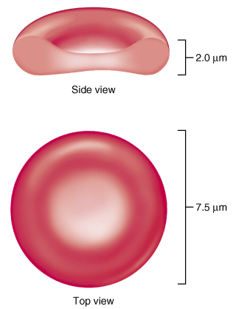
Characteristics of a Mature Erythrocytes (RBC)
A mature RBC is a biconcave disc having dimensions of (7.5X2X1 µm). The average volume is about 90-95 µm³.
It does not have nucleus, mitochondria, ribosomes, endoplasmic reticulum or Golgi apparatus.
The cytoplasm is filled with hemoglobin (Hb), a protein that functions in gas transport. It also contains the enzyme carbonic anhydrase and the enzymes for glucose metabolism and 2,3 DPG synthesis. Glucose enters RBC by facilitated (carrier-mediated) diffusion. Glycolysis accounts for 90% and HMP Shunt for 10% of glucose metabolism.
The plasma membrane contains the protien spectrin that:
Gives erythrocytes their flexibility
Allows them to change shape as necessary with significantly smaller forces
Erythrocytes are an example of the complementarities of structure and function
Structural characteristics that contribute to its gas transport function are:
Biconcave shape that has a huge surface area to volume ratio. This is essential for gas exchange
Discounting water content, erythrocytes are 97% hemoglobin
ATP is generated anaerobically, so the erythrocytes do not consume the oxygen they transport.

Slide 21
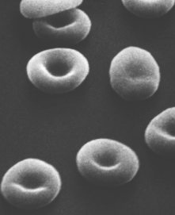
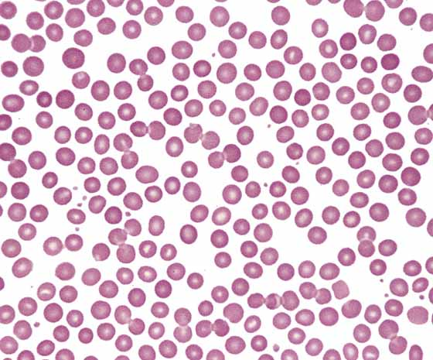
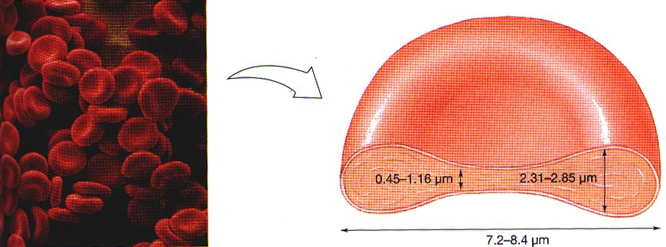
Normally, RBCs account for >99% of all formed elements
Red blood cell count:
In healthy men, the average number of red blood cells per cubic millimeter is 5,200,000 (±300,000); in women, it is 4,700,000 (±300,000).
Persons living at high altitudes have greater numbers of red blood cells.

Slide 22
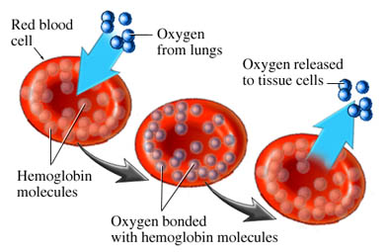
Functions of Red Blood Cells
A major function of RBCs is to transport hemoglobin, which, in turns, carries oxygen from the lungs to the tissues.
Hemoglobin combines reversibly with oxygen as blood passes through pulmonary capillaries in the lungs where oxygen is high.
Hemoglobin releases oxygen as blood passes through systemic capillaries in the tissues where oxygen is low.

Slide 23
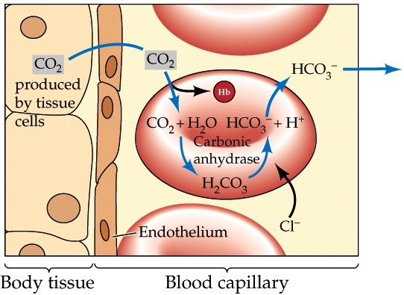
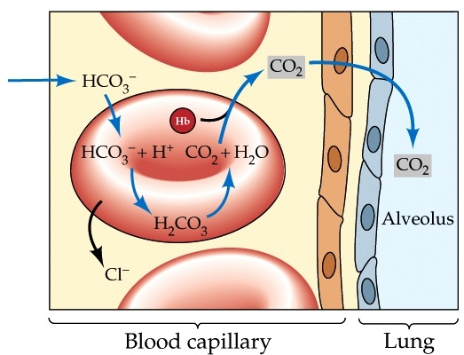
Functions of Red Blood Cells
RBCs contain the enzyme carbonic anhydrase. This enzyme that catalyzes the reversible reaction between carbon dioxide (CO₂) and H₂O to form carbonic acid (H₂CO₃), increasing the rate of this reaction several thousand fold.
The rapidity of this reaction makes it possible for the water of the blood to transport enormous quantities of CO₂ in the form of bicarbonate ion (HCO3⁻) from the tissues to the lungs, where it is reconverted to CO₂ and expelled into the atmosphere as a body waste product.
The hemoglobin in the cells is an excellent acid-base buffer (as is true of most proteins), so the red blood cells are responsible for most of the acid-base buffering power of whole blood.

Slide 24
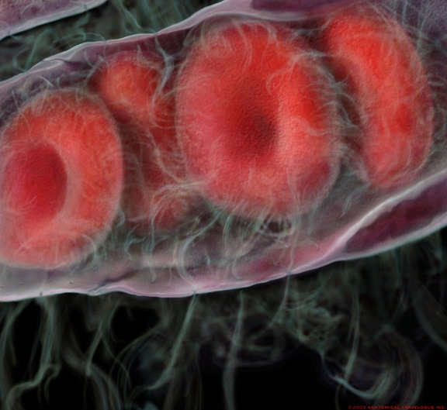
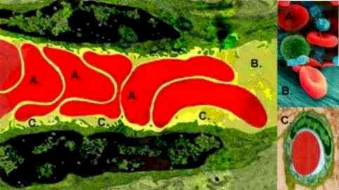
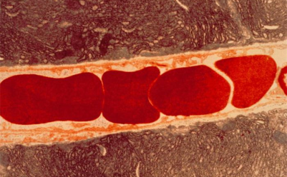
Red Blood Cells in Blood Capillaries
Blood capillaries are very narrow blood vessels.
The shapes of RBCs can change dramatically as the cells pass through blood capillaries since they squeeze through capillaries. Actually, the RBC is a bag of hemoglobin that can be deformed into almost any shape.
This feature keeps them in very close contact with the capillary walls, thereby reducing he diffusion distance for gas exchange with the surrounding tissues.
Because the normal RBC has a great excess of cell membrane for the quantity of material inside, deformation does not stretch the membrane greatly and, consequently does rupture the cell, as would be the case with many other cells.
RBCs in single file
RBCs are flexible and elastic
They are subject to high amounts of shear stress as they traverse the narrow capillaries of the microvasculature since they squeeze through the narrow capillaries.

Slide 25
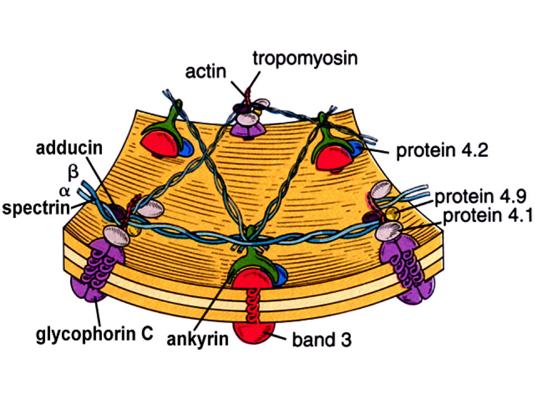
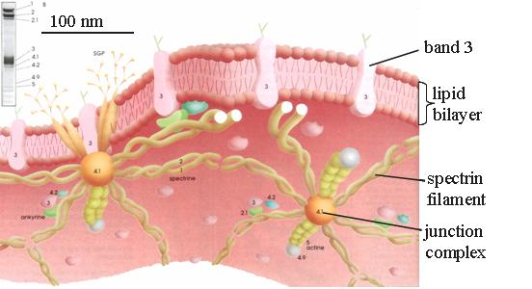
Red Blood Cell Cytoskeleton
The RBC, as it continuously
Circulates the narrow capillaries of the microvasculature, must be able to undergo extensive passive deformation and to resist fragmentation..
This requires a highly deformable yet remarkably stable membrane.
The cytoskeletal proteins are responsible for these important characteristics of the plasma membrane and give the red blood cell the unique biconcave shape.
Cytoskeletal protein network
Spectrin
Actin
Ankyrin
Tropomyosin
Proteins 4.1 , 4.2 and 4.9
Band 3

Slide 26
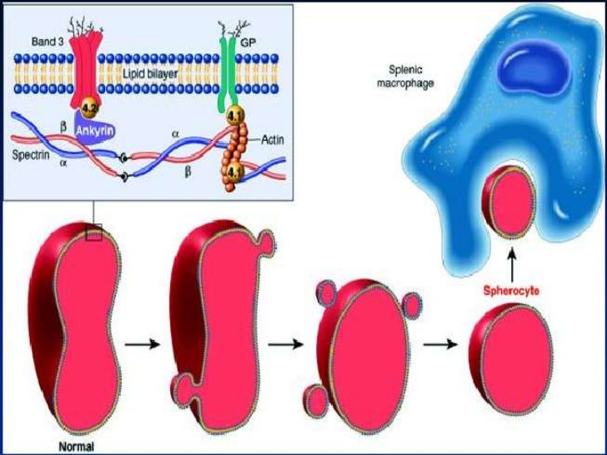
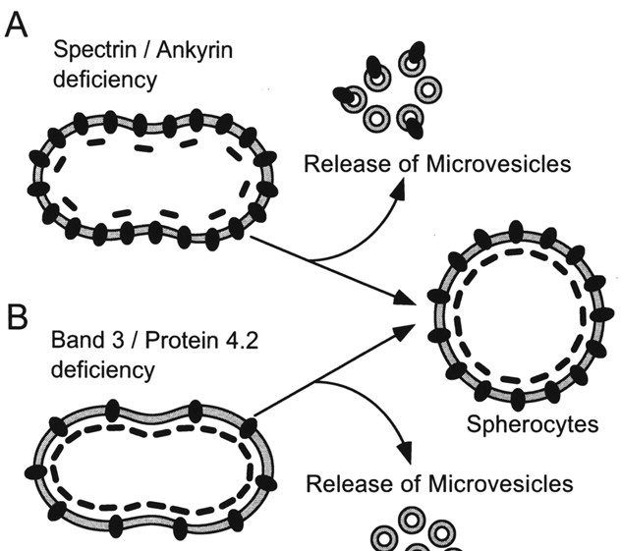
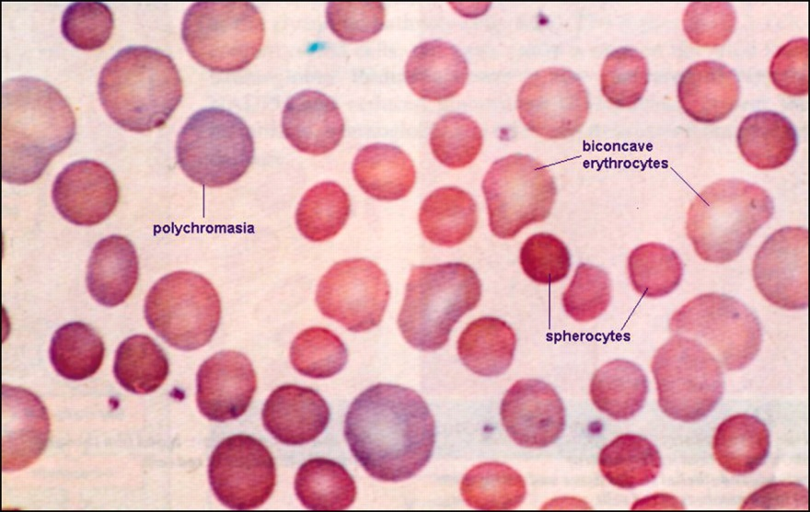
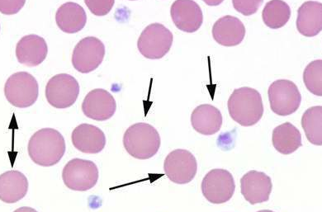
Hereditary Spherocytosis

Slide 27
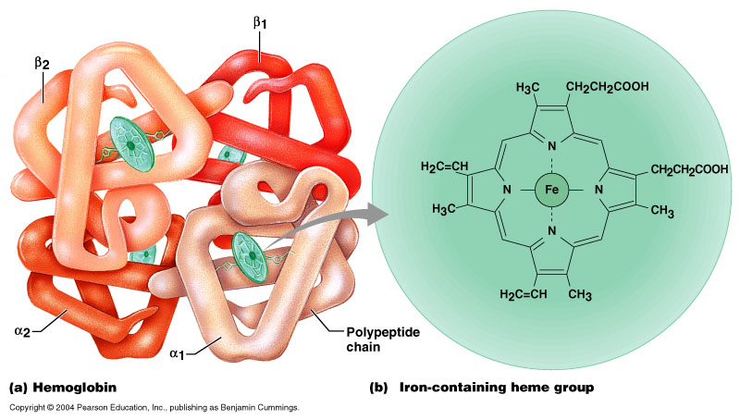
Globular protein
Heme + Globin
Accounts for > 95% of protein in RBC
Main functions: transportation of respiratory gases. It carries ~ 98.5% of all O₂
Hb Content of Blood Concentration of Hb in the Blood
Measured as g/dl (grams per deciliter, or per 100 ml)
Average values:
Male: 13.5 – 17.5 g/dl (16 g/dl)
Female: 12.0 – 15.5 g/dl (14 g/dl)
Infants: 14.0 – 19.0 g/dl
Hemoglobin (Hb)
Each gram of pure hemoglobin is capable of combining with 1.34 ml of oxygen.
Therefore, in a normal man a maximum of about 20 milliliters of oxygen can be carried in combination with hemoglobin in each 100 milliliters of blood, and in a normal woman 19 milliliters of oxygen can be carried.

Slide 28
Haematological indices
Mean corpuscular volume (MCV): The average volume of the red blood cells expressed in femtoliters (fl) or cubic micrometers.
Normal value: 90-95 femtoliters (10⁻¹⁵ liters) abbreviated fl.
Macrocytic anemias– larger than normal cells
Normocytic anemias – cells are normal in volume.
Microcytic anemias– cells are smaller than normal.
Mean corpuscular Hb (MCH):
The average amount of hemoglobin inside a RBC expressed in picograms (pg).
Normal value: 27-33 pg (10⁻¹² gram)
Normochromic
Hypochromic
Hyperchromic

Slide 29
Haematological indices
Mean corpuscular Hb concentration (MCHC):
The average concentration of hemoglobin in the RBCs expressed as (gm/dl).
- Normal value: 32- 35 g/dl of RBCs
Indices |  | Males | Females
Hematocrit (Hct) (%) |  | 47 | 42
Red blood cells (RBC) (10⁶/L) |  | 5.4 | 4.8
Hemoglobin (Hb) (g/dL); dL = 100 milliliters |  | 16 | 14
Mean corpuscular volume (MCV) (fL) ª |  | 90 - 95 | 90 - 95
Mean corpuscular hemoglobin (MCH) (pg) |  | 29 | 29
Mean corpuscular hemoglobin concentration (MCHC) (g/dL of cells) ^{b} |  | 34 | 34
Mean cell diameter (MCD) (µm) | = Mean diameter of 500 cells in smear | 7.5 | 7.5
ª Cells with MCVs > 95 fL are called macrocytes; cells with MCVs < 80 fL are called microcytes.
^{b} Cells with MCHs < 25 g/dL are called hypochromic.

Slide 30
Objectives;
Intended learning outcomes (ILOs)
After reviewing the PowerPoint presentation and the associated learning resources, the student should be able to:
List the functions of the blood
Describe the physical characteristics of blood
Discuss the composition of the blood
Differentiate between the terms formed elements, Packed Cell Volume, plasma and serum
Outline the functions of the plasma proteins
Describe the shape of mature red blood cells and explain the advantages of this shape
Explain what maintains the shape of the normal red blood cell and outline the pathogenesis of hereditary spherocytosis
Summarize the functions of red blood cells
Describe the different hematological indices and indicate their physiological significance

Slide 31
Thank You

