Slide 1
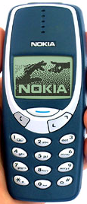
Erythropoiesis

Slide 2
Objectives;
Intended learning outcomes (ILOs)
After reviewing the PowerPoint presentation and the associated learning resources, the student should be able to:
Define erythropoiesis, leucopoiesis, and thrombopoiesis
List the sites (areas) of the body that produce red blood cells
Describe the steps involved in erythropoiesis from differentiation of stem cell to progenitor cell to final RBC
Outline the features of RBC maturation
Summarize the synthesis of Hemoglobin
Recognize hemoglobin structure and its functions
Describe the life cycle of normal RBCs

Slide 3
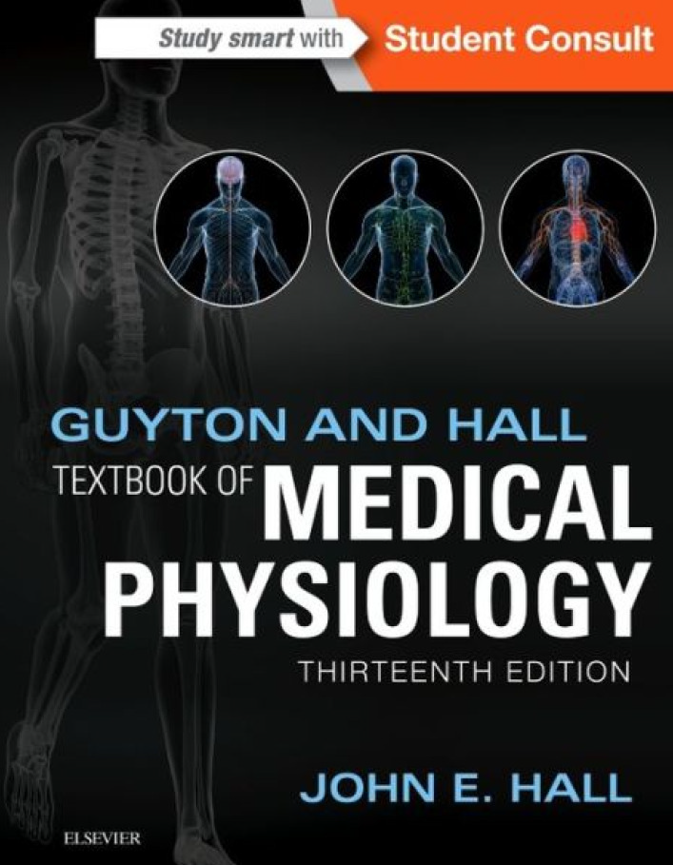
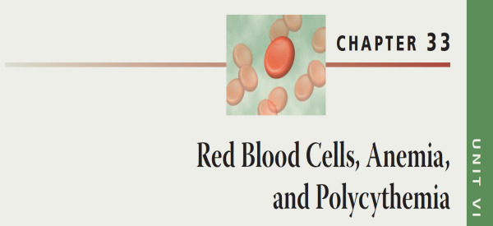
Learning Resources
Guyton and Hall, Textbook of Medical Physiology; 13th Edition; Unit VI-Chapter 33.

Slide 4
Formation of Blood Cells
Formation of erythrocytes (RBC)
Erythropoiesis
Formation of leucocytes (WBC)
Leucopoiesis
Formation of thrombocytes (platelets)
Thrombopiesis
Formation of blood
Haematopoiesis.

Slide 5
Locations of Erythropoiesis
During the 1st 8 weeks of embryonic development, RBCs are formed in yolk sac
During the 2nd to 5th months of embryonic development, RBCs are formed in liver (main supplier) and spleen
From the 5th month on, RBCs formed in bone marrow
After birth and in adults, RBCs are formed in red bone marrow
Portions of: vertebrae, ribs, scapulae, skull, pelvis, proximal heads of femur and humerus
Yellow marrow of medullary cavities can be converted back into red marrow, if needed

Slide 6
Locations of Erythropoiesis
100
%
Yolk sac
Liver
Spleen
Bone Marrow
50
3
6
Birth
3
6
Month

Slide 7
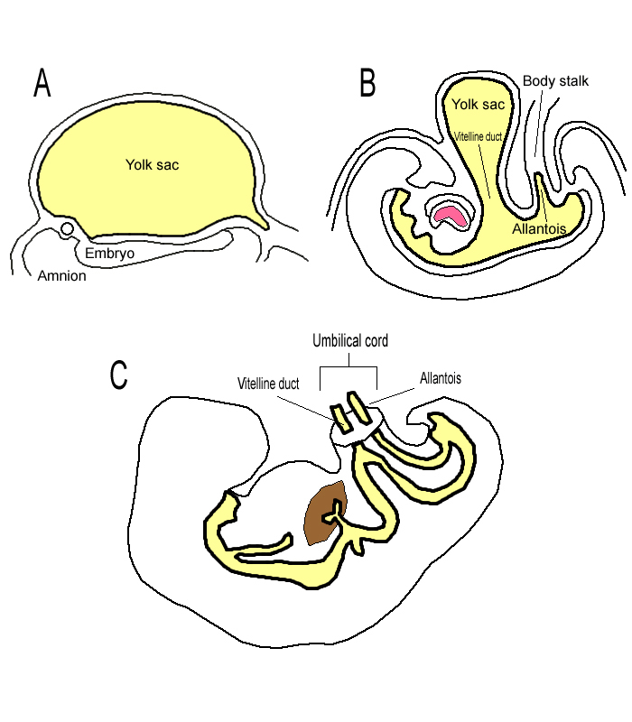
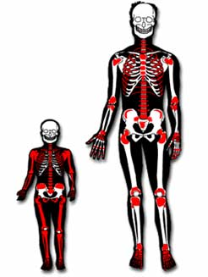
Locations of Erythropoiesis

Slide 8
Locations of Erythropoiesis

Slide 9
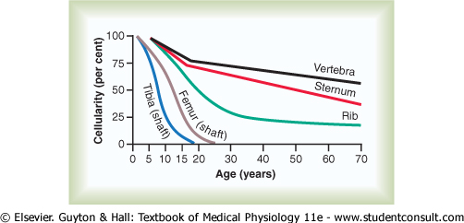
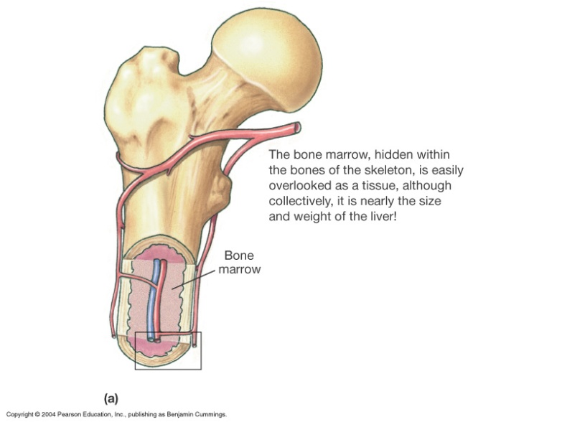
Locations of Erythropoiesis
Bone marrow of all bones produces red blood cells until a person is 5 years old.
Bone marrow of long bones, except for the proximal portions of the humeri and tibiae, becomes quite fatty and produces no more red blood cells after about age 20 years.
Beyond this age, most red cells continue to be produced in the marrow of the vertebrae, sternum and ribs.
Yellow marrow of medullary cavities can be converted back into red marrow, if needed

Slide 10
Stages of Erythropoiesis
The blood cells begin their lives in the bone marrow from a single type of cell called the pluripotential (pluripotent) hematopoietic stem cell (PHSC); hemocytoblast, from which all the cells of the circulating blood are eventually derived.
These PHSC are least differentiated and can develop into any blood cell.
They give rise to uncommitted stem cells that in turn give rise to committed stem cells; committed progenitor cells; progenitor cells (colony-forming units).
A committed stem cell that produces erythrocytes is called a colony-forming unit-erythrocyte (CFU-E).
CFUs form differentiation lines leading to RBCs, megakaryocytes and most WBCs.
Thus, the CFUs are specialized to form specific cell types.
For example: CFU-E develops eventually into only red blood cells

Slide 11
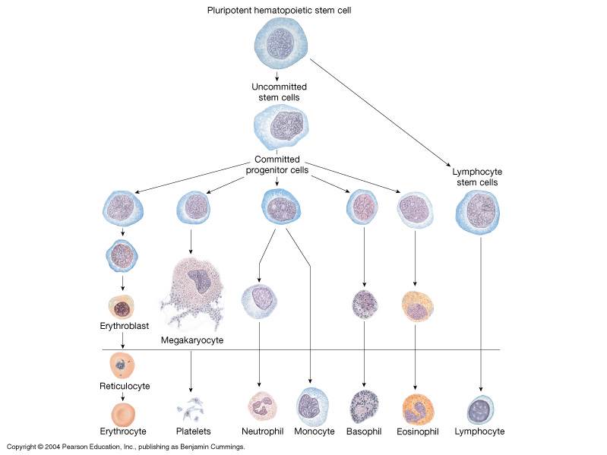
Growth and reproduction of the different stem cells are controlled by multiple proteins called growth inducers. One of these, interleukin-3, promotes growth and reproduction of virtually all the different types of committed stem cells, whereas the others induce growth of only specific types of cells.
Differentiation of the cells is the function of another set of proteins called differentiation inducers. Each of these causes one type of committed stem cell to differentiate one or more steps toward a final adult blood cell.
Formation of the growth inducers and differentiation inducers is itself controlled by factors outside the bone marrow. For instance, in the case of erythrocytes (red blood cells), exposure of the blood to low oxygen for a long time results in growth induction, differentiation, and production of greatly increased numbers of erythrocytes.
Required Growth factors:
- Erythropoietin
- Colony stimulating factors
- Interleukins
- Thrombopoietin

Slide 12
Stages of Differentiation of Red Blood Cells
RBCs are formed from PHSC (hemocytoblasts).
These give rise to uncommitted stem cells, which in turn give rise to committed stem (progenitor) cells (CFU-E), which give rise to proerythroblasts.
The proerythroblasts are considered as differentiated RBC precursors. They are the first cells that can be identified as belonging to the red blood cell series.
The proerythroblasts five rise to basophil erythroblasts
erythroblasts: synthesize Hb
normoblasts: lose nucleus , some mitochondria
Reticulocytes contain ribosomes and mitochondria (but no nucleus)
reticulocyte count: normally 0.8-2.0% of RBC population
In 1-2 days, reticulocytes eject the remaining organelles to become a mature RBC

Slide 13
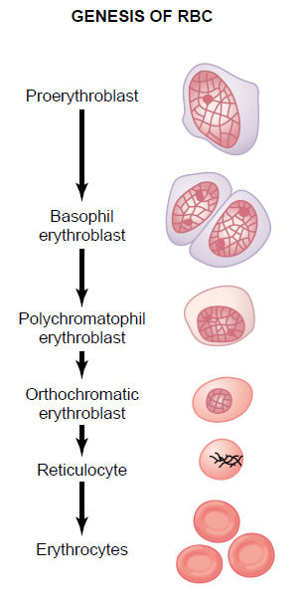
Stages of Differentiation of Red Blood Cells
Stages of RBC development:
Committed stem cell
Proerthroblast
Basophil erythroblast
Polychromatophil erythroblast
Orthochromatic erythroblast
Reticulocytes
Mature erythrocytes
In cases of rapid RBC production → ↑ reticlocytes in the circulation.
RBC maturation is characterize by:
Decrease in cell size.
Appearance of hemoglobin (Hb)
Disappearance of nucleus.
First Identifiable cell
First cell to appear in the circulation. It matures in 1 – 2 days

Slide 14
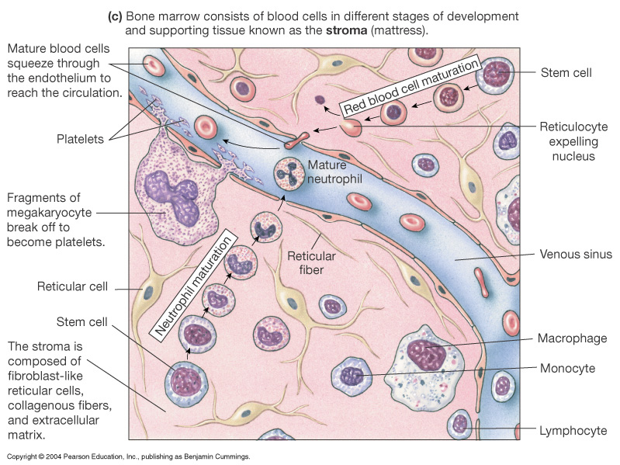
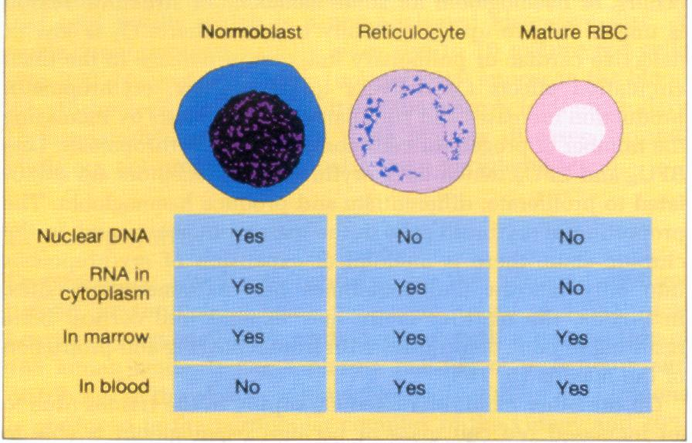
Stages of Erythropoiesis

Slide 15
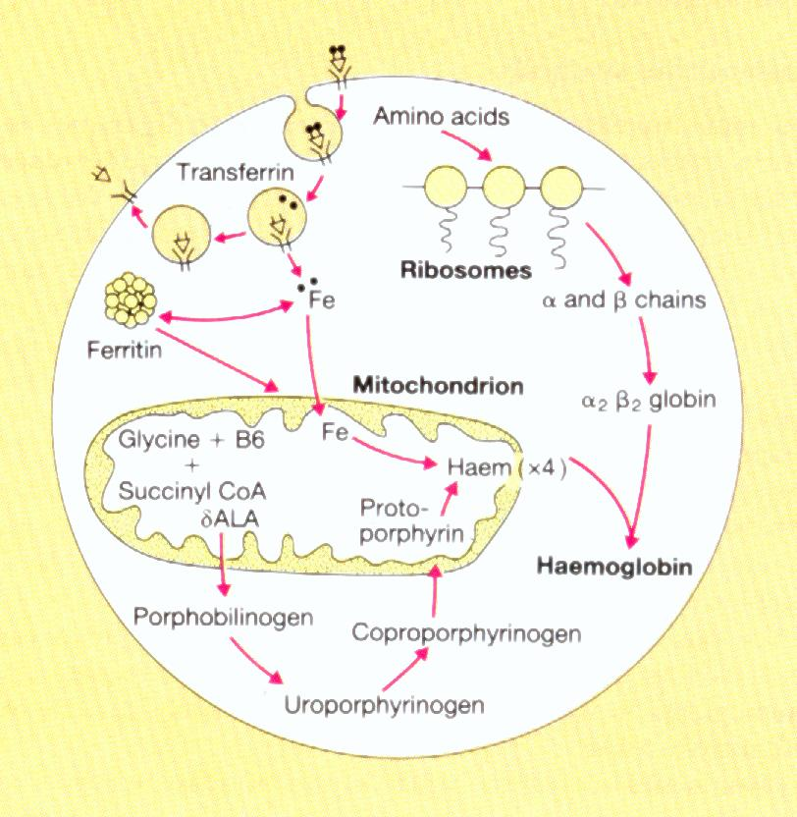
Hemoglobin synthesis occurs in the mitochondria of the developing RBC in bone marrow
Transferrin attaches to surface receptor
Iron is released and transported to mitochondria where it combines with protoporphyrin to form heme
Heme combines with α and β protein chains formed on the ribosomes to make hemoglobin
Functions of Hb:
Carriage of O₂ and CO₂
Buffer
Binds CO in Smokers
Hemoglobin (Hb) Synthesis

Slide 16
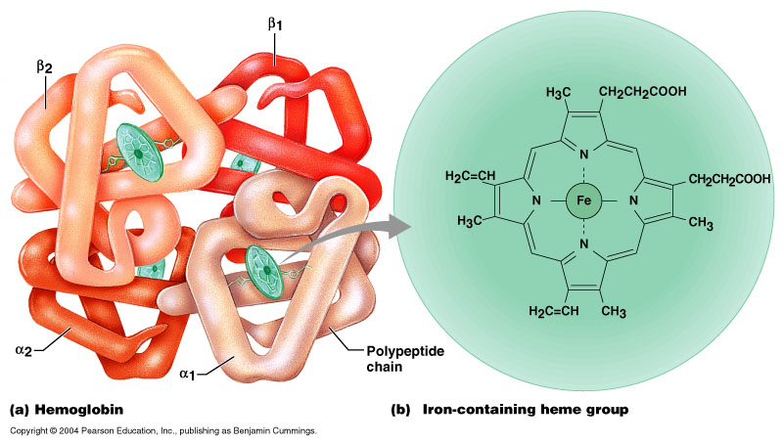
Adult human Hb:
tetrameric protein α₂β₂
alpha 141 aa residues
beta 146 aa residues
Hemoglobin (Hb)

Slide 17
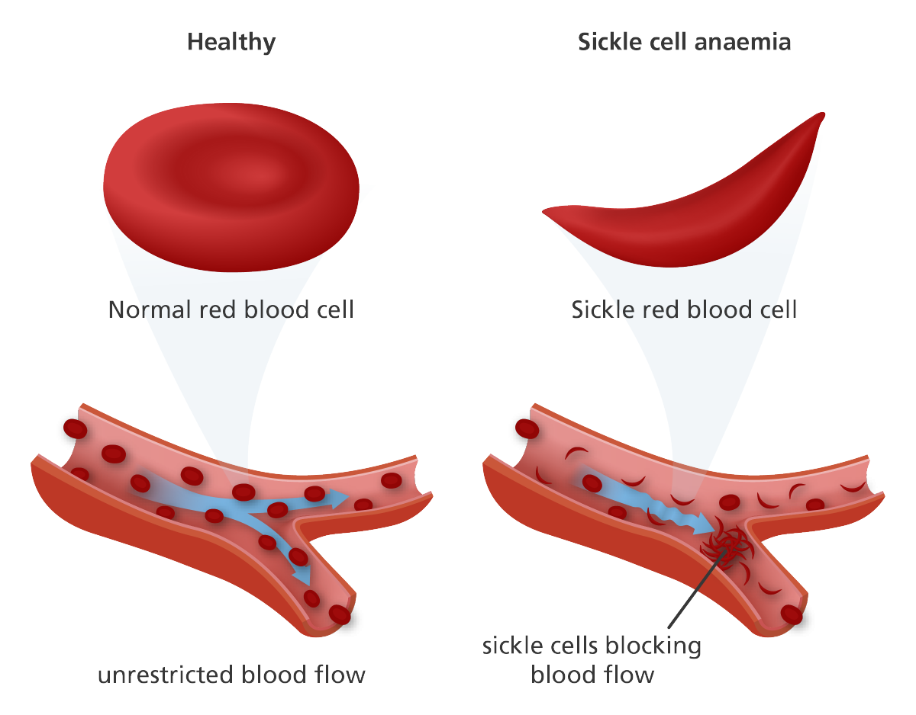
Types of Hemoglobin (Hb)
HbA (Adult Hemoglobin): This accounts for about 98% of adult Hb. Its polypeptide chains are (α₂β₂)
HbA2 (Minor Adult Form). This accounts for about 2.5% of adult Hb. Its polypeptide chains are (α₂δ₂)
HbF (Fetal Hemoglobin): This a accounts for 80-90% of fetal Hb at birth. Its polypeptide chains (α₂γ₂)
Abnormality in the polypeptide chain α & β results in abnormal Hb (hemoglobinopathies) e.g thalassemias, sickle cell anemia

Slide 18
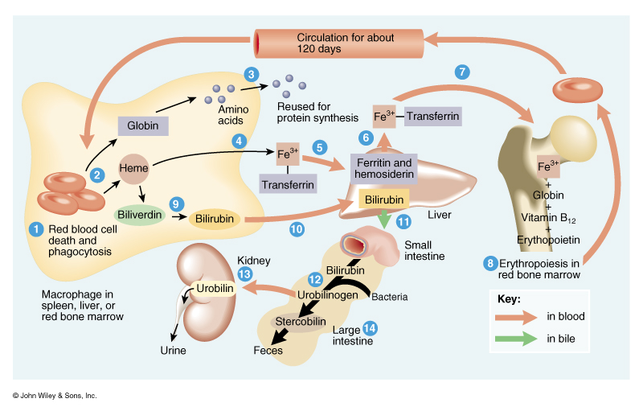
RBC Life Cycle
RBCs live only 120 days (cells need to be continually replaced)
Cells wear out from bending to fit through capillaries
Repair is not possible due to lack of organelles
Worn out cells are removed by macrophages in spleen and liver
Breakdown products are recycled
In macrophages of liver or spleen:
Globin portion is broken down into amino acids and recycled
Heme portion is split into iron (Fe⁺³) and biliverdin (green pigment)

Slide 19
Fate of Components of Heme
Iron(Fe⁺³)
- Transported in blood attached to transferrin protein
- Stored in liver
* attached to ferritin or hemosiderin protein
- In bone marrow, iron is used for hemoglobin synthesis
Biliverdin (green) is converted to bilirubin (yellow)
- bilirubin is secreted by liver into bile
* converted to urobilinogen then stercobilin (brown pigment in feces) by bacteria of large intestine
* if urobilinogen is reabsorbed from intestines into blood is converted to a yellow pigment, urobilin and excreted in urine

Slide 20
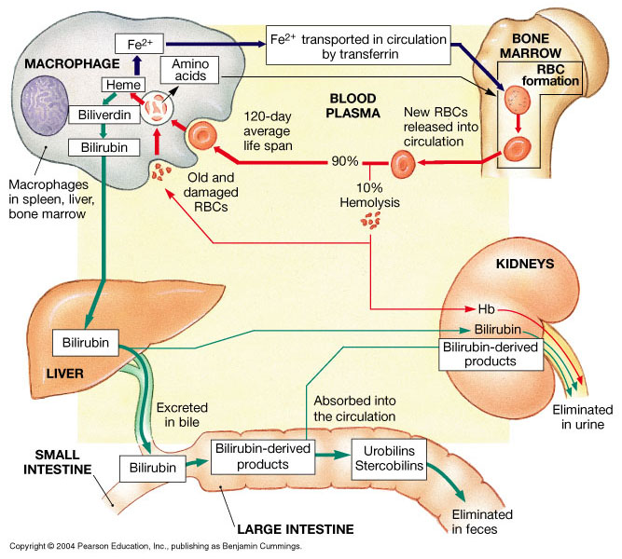
Fate of Components of Heme

Slide 21
Objectives;
Intended learning outcomes (ILOs)
After reviewing the PowerPoint presentation and the associated learning resources, the student should be able to:
Define erythropoiesis, leucopoiesis, and thrombopoiesis
List the sites (areas) of the body that produce red blood cells
Describe the steps involved in erythropoiesis from differentiation of stem cell to progenitor cell to final RBC
Outline the features of RBC maturation
Summarize the synthesis of Hemoglobin
Recognize hemoglobin structure and its functions
Describe the life cycle of normal RBCs

Slide 22
Thank You

