Slide 1
Anatomy OSPE 437
Preparation
Before you read this preparation:
Make sure you understand the difference between the term’s NAME & TYPE which have completely different answers.
Make sure your SPELLING is correct or relatively similar to ensure your grade on each question.

Slide 2
Fig(1)
CASE 1
1
Identify the numbered movements & the lateral bone in figure 1.
1. Supination
2. Pronation
3. Flexion
4. Extension
5. Dorsiflexion(ترفع رجلك عن البنزين)
6. Plantarflexion ((فرامل
7. Inversion (inside)
8. Eversion (Outwards)
Lateral bone in figure 1: Radius
2
3
4
5
6
7
8

Slide 3
الصورة للتوضيح فقط!

Slide 4
Case 2
A
Identify: A,B,C&D
A. Scapula
B. Humerus
C. Ulna ( Medial )
D. Radius ( Lateral )
B
C
D

Slide 5
CASE 3
A
Identify: A, B, C, &D
A. Hip Bone
B. Femur
C. Fibula (smaller & lateral)
D. Tibia (bigger & medial)
B
Identify the labeled bones:
1. Femur
2. Patella
3. Fibula (lateral)
4. Tibia (medial)
D
1
C
2
3
4

Slide 6
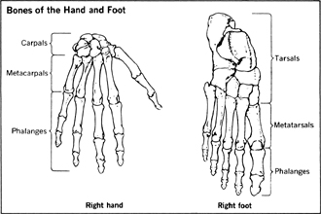
CASE 4
Identify the bones : A, B, &C
A. Ulna
B. Radius
C. 2nd Metacarpal bone
8
7
5
5
1
4
2
3
5
5
4
1
To count the metacarpal/metatarsal bones, we start from the thumb/big toe.
14
2
3
14

Slide 7
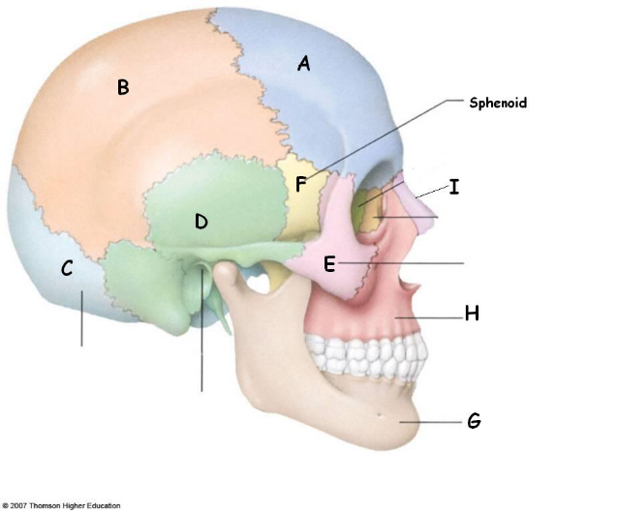
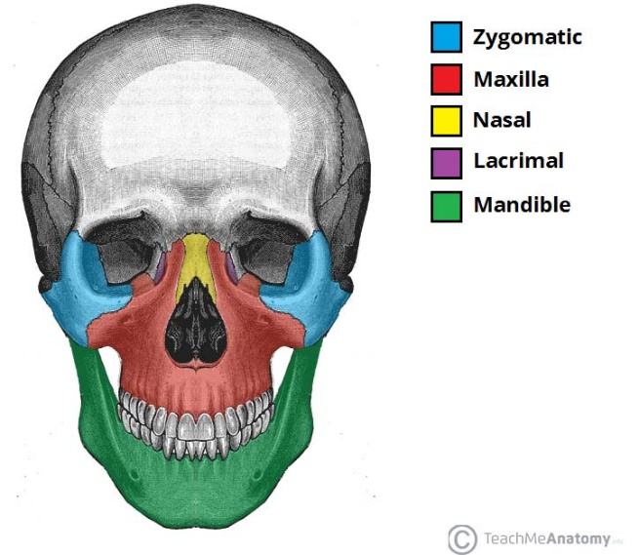
CASE 5
A
Identify the type & name of bone A
Flat bone – Frontal
B
B
Identify the name of bone B,C&D
B. Parietal
C. Occipital
D. Temporal
C
Extra:
The Facial
Bones
D

Slide 8
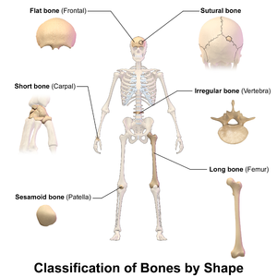
Types of bones:
Flat (sternum/skull bones/Scapula/Hip bone)
Irregular (vertebra)
Long (humerus of the arm) *could be any other long bone
Short (carpals of the wrist /Tarsals of the foot)
Sesamoid (patella)
Pneumatic (العظام الهوائية مثل الموجود بقلب الجمجمة)

Slide 9
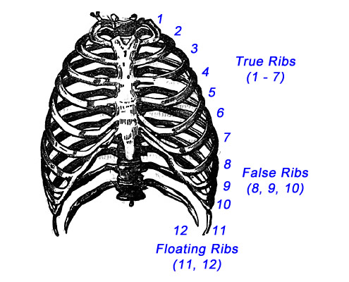
The region & number of vertebrae
Types of ribs (True,False&Floating)

Slide 10
CASE 6
Identify the following type & name of skeletal muscle:
Multipennate – Deltoid Muscle
Triangular
مهم تحفظون مثال على كل نوع

Slide 11
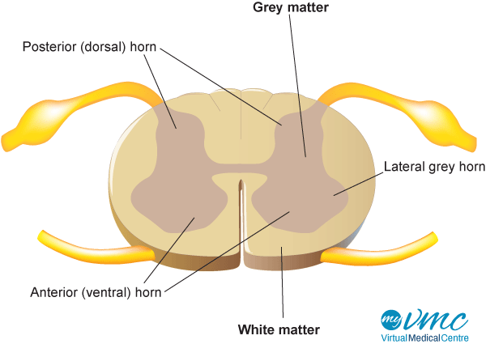
CASE 7
Identify the labeled structures:
A. Midbrain
B. Pons
C. Medulla Oblongata
D. Cerebellum
E. Cerebrum
F. Diencephalon
Brain stem
Extra:

Slide 12
Done By:
Faisal Fahad ALsaif
Lamia Abdullah AlKuwaiz
Fahad Abdullah Alfaiz
Good Luck
Some of the slides were taken from Team 436.

