Slide 1
Microbiology practical
Teamwork 437

Slide 2
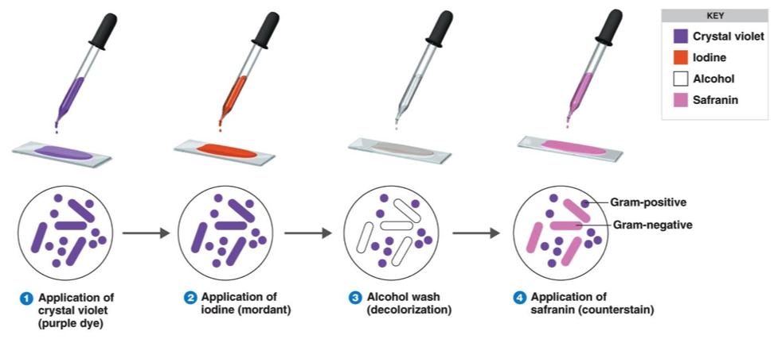
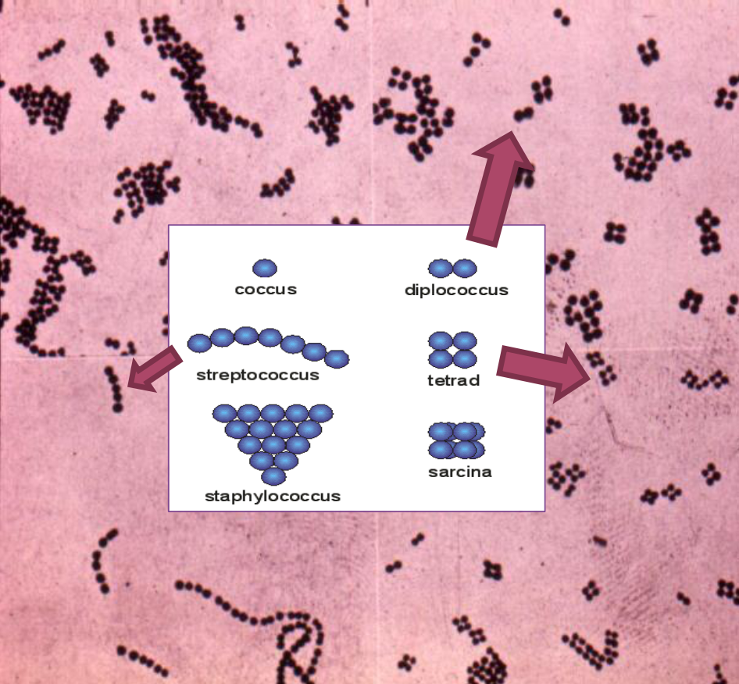
Laboratory diagnosis of infections . ID
Microscopic examination.
culture.
Serological tests (Ab).
Detection of Ag.
Molecular method .
BACTERIOLOGY
What do you need to describe after seeing the slide?
Gram reaction (positive if purple or dark, negative if
pink or light).
- Shape + arrangement
The most likely organism
Gram stain
1
2
3
“Write steps in exam”
4
Shape and arrangement
Bacteria cell wall
“ important “
Gram - | Gram +
Thin peptidoglycan | Thick peptidoglycan
Outer membrane that contains : 1- specific proteins (porins) important in transport of hydrophilic molecules 2- lipopolysaccharide and lipid ( endotoxin ) | Teichoic acid : anchors cell wall to cell membrane epithelial cell adhesion .
 | Antigens : - polysaccharide ( lancefield ) - Protein ( Griffith )

Slide 3
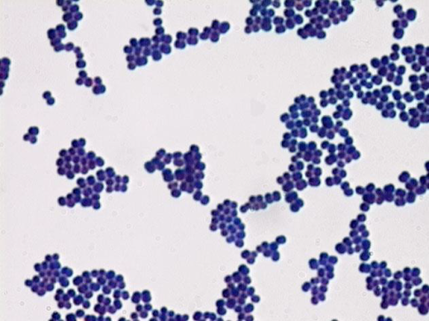
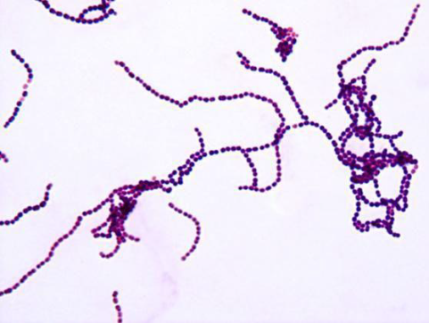
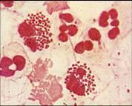
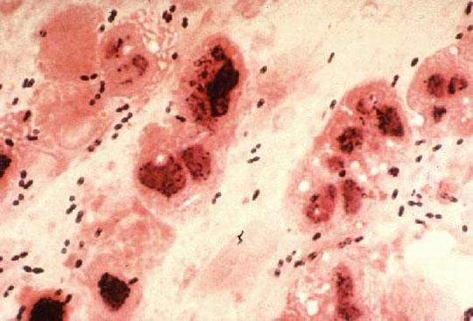
microscopic slides examples
Describe this organism?
Gram positive cocci arrange in clusters
staphylococcus
Gram positive cocci arrange in chain
streptococcus
“ important picture “
Gram negative cocci “Diplococci”
e.g Neisseria
Gram negative bacilli “Rod”
e.g E. coli Salmonella
case examples
Following is the Gram-stained smear of from urethra of a 25 year old male complaining of urethral discharge.
Describe the Gram stain of the intracellular bacteria? Gram negative
Describe the shape of the bacteria? cocci ( diplococci)
A gram-stained smear of a CSF sample from a 3 years old child seen in the emergency department presenting with fever and neck stiffness.
Describe what you see ? Gram-positive
diplococci & pus(neutrophils) cells
Streptococcus pneumoniae

Slide 4
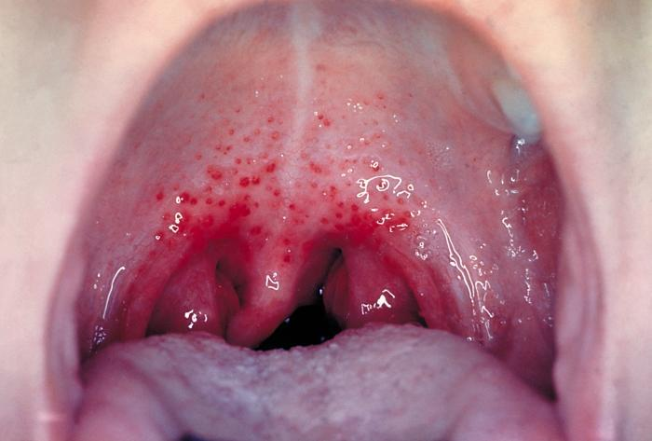
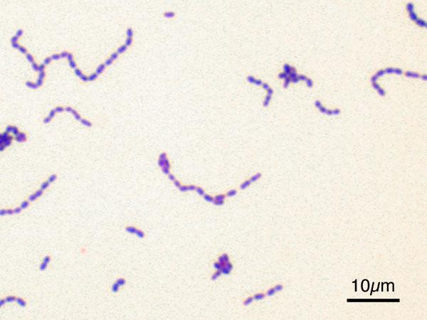
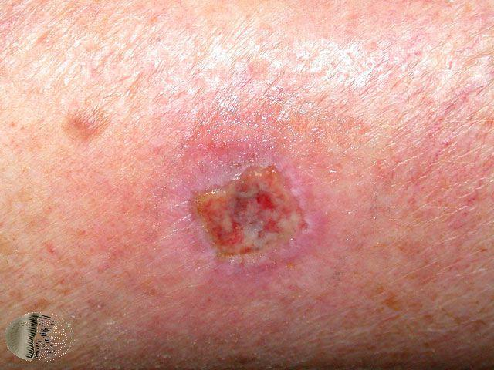
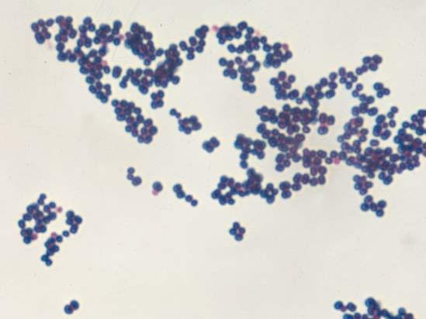
This is a bacterium isolated from a child with sore throat
and tonsillitis.
Describe the gram stain ? Gram positive streptococcus
Describe the shape and arrangement of the bacteria ? Cocci in chain
Following is the gram stained smear of an organism isolated from a wound infection.
Describe what you see in this slide? Gram positive cocci in clusters
What is the likely organism? Staphylococcus aureus
Bacterial culture media
Enriched medium ( chocolate agar ) | General culture medium ( Blood agar )
Selective medium ( Thiosulphate citrate bile salt sucrose TCBS ) | Differential medium ( MacConkey agar )
purpose | Type of media
Suppression of unwanted microbes ; encouraging desired microbes. | Selective
Differentiation of colonies of desired microbes from other. | Differential
Similar to Selective media but designed to increase number of desired microbe to detectable levels. | Enriched

Slide 5
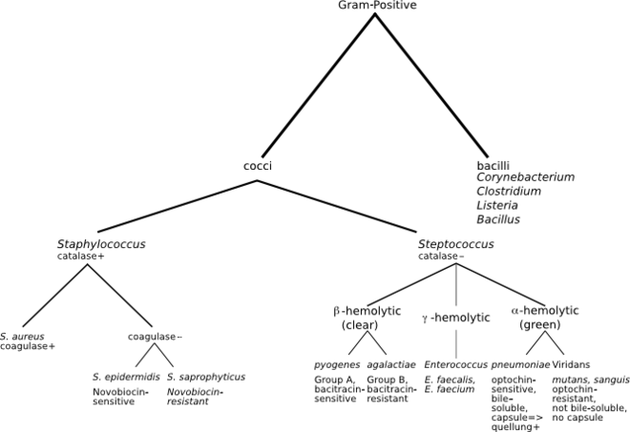
How to differentiate between various
type of gram +ve cocci ?
“ examples are important “
Identification of streptococci by ( Hemolytic reaction )
Colonies are surrounded by clear zone of hemolysis complete hemolysis
Beta-hemolytic Streptococcus colonies St. pyogenes
Colonies are surrounded by partial hemolysis Greenish color
Alpha-hemolytic Streptococcus colonies St. pneumoniae
No hemolysis
Gamma-hemolytic Streptococcus colonies Enterococcus faecalis
Beta-hemolytic
Streptococcus colonies
Gamma-hemolytic
Streptococcus colonies
Alpha-hemolytic
Streptococcus colonies
This is a blood agar
growing beta hemolytic
streptococci.
CASE
This culture was grown from a sputum specimen
of a 60 year old man complaining of cough, fever and chest pain.
Alpha-hemolytic streptococci on blood agar

Slide 6
Gram negative
MacConKey’s agar (Deferential Medium)
MacConKey’s agar
Lactose fermenting colonies E.coli
non lactose fermenting colonies Salmonella
Biochemical testing
To confirm the identify of bacteria .
Antibiotic susceptibility testings
Automated instrument for identification and susceptibility testings

Slide 7
Summary

Slide 8
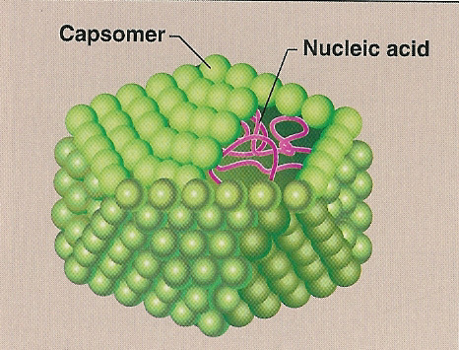
Virology
Structure
Helical Virus:
Icosahedral Virus:
Electron microscopy: (very important)
Herpes virus
Adeno virus
Rabies virus
Influenza virus

Slide 9
Examples:
1- These are electron micrographs of a virus:
Loose envelope
A) Name this virus
Herpes virus
B) Describe its structure.
- Enveloped virus ,
- Icosahedral capsid,
- Double stranded DNA genome
2- This is an electron micrographs of a virus:
Bullet Shaped
Rabies virus
A) Name this virus
- Enveloped virus ,
- Helical capsid,
- Single stranded RNA genome
B) Describe its structure.

Slide 10
3- This an electron micrograph of a virus:
C
Only virus with fiber
A) Name this virus
Adeno virus
B) Describe its structure.
- Non-Enveloped virus ,
- Icosahedral capsid,
- Double stranded DNA genome
4- This an electron micrograph of a virus:
Pleomorphic shape
A) Name this virus
Influenza virus
- Enveloped virus with spikes ,
- Helical capsid,
- Segmented Single stranded RNA genome
B) Describe its structure.

Slide 11
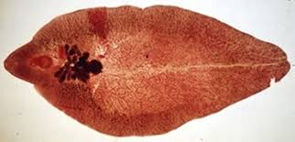
Parasitology
Classification of Parasites
Protozoa | Helminths
Unicellular Single cell for all functions | Mulicellular Specialized cells
Amoebae: move by psudobodia. Flagellates: move by flagella. Ciliates : move by cilia Apicomplexa:(sporozoa) Tissue parasites | Round worms (Nematodes) cylindrical, unsegmented Flat worms 1-Trematodes: leaf-like, unsegmented. 2-Cestodes: tape-like, segmented
Ascaris
lumbricoides
fasciola hepatica
Taenia saginata

Slide 12
Giardia lamblia cyst
Giardia lamblia trophozoite
Two nuclei, each with central karyosome Four pairs of flagella
Mature, infective cyst,
containing 4 nuclei
Note a straight axoneme running longitudinally
Examples
1- Following is the microphotograph of an organism found in the upper part of the small intestine .
A) Name the Organism
Giardia lamblia
B) What is the Stage?
Trophozoite stage

Slide 13
2- Following is the microphotograph of an organism found in stools
A) Name the Organism
Giardia lamblia
B) What is the Stage?
Cyst stage

Slide 14
Mycology
Fungi can be divided to two types based on morphology
A B
Based on morphology, name the two fungal structures in A and B?
A: Yeast
e.g. Candida
B: Mould fungi
e.g. Aspergillus
Microscopic appearance of fungi
A
B
Name the two fungal structures in A and B?
A: Budding yeast cells
e.g. Candida
B: Branching Fungal hyphae
e.g. Aspergillus

Slide 15
Done by:
Team leader :
عبير العبدالجبار
Team members
ميعاد النفيعي
إبتسام المطيري
رناد الفرم
شهد الطياش
لمى الهدلق
نورة الضبيب
روان الرحيلي
مها النهدي
آلاء الصويّغ
عهد القرين
رهف الشمري
Team leader :
علي شحادة

