Slide 1
Lecture 1 :
Anatomical terms and skeletal systems

Slide 2
Guide
Text in pink was only found in the girls’ slides
Text in blue was only found in the boys’ slides
Text in red is considered important
The Dr.’s comments in class are written in green

Slide 3
Objectives
Define the word “Anatomy”.
Enumerate the different anatomical fields.
Describe the anatomical position.
Describe different anatomical terms of position & movements as well different anatomical planes.
Classify bones according to shape, structure & development.
Enumerate different bones of both axial & appendicular skeleton.

Slide 4
ANATOMY, and it’s Sciences
The science which deals with the study of the:
Structure and Shape of the body.
Body parts & their Relationship to one another.
ANATOMICAL SCIENCES:
Gross Anatomy: Study of human body with Naked Eye.
Microscopic Anatomy (Histology): Study of fine structure (Cells & Tissues) of the human body with the help of Microscope.
Developmental Anatomy (Embryology).
Radiological Anatomy.
Cross-sectional Anatomy.
Applied Anatomy.
Surgical Anatomy.

Slide 5
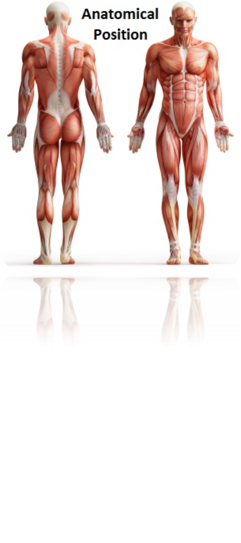
The Language Of Anatomy (Anatomical Terminology)
To prevent misunderstanding, a special set of terms are used to describe the Identification and Location of the body.
To accurately describe body parts, the body is in a standard position called the:
ANATOMICAL POSITION, in which:
It is the standard position in which the body assume to
describe its parts
Body is erect
Arms hanging by the side
Palm facing forward
Feet Parallel
Arms hanging
by the side
Palm facing forward
لا يُمكن دراسة العلاقات بين أجزاء الجسم و مواقعها بدون تحديد شكل معيّن ثابت للجسم.
Feet parallel

Slide 6
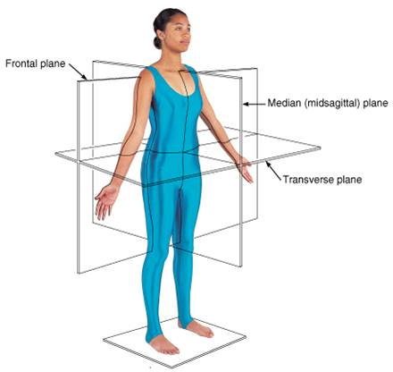
ANATOMICAL PLANES & SECTIONS
into superior &inferior parts
An imaginary line that cuts through the body wall is called a (plane)
There are four types of imaginary planes:
Sagittal (median): divides the body into 2 equal halves (right & left) , it is vertical plane and passes through the center of the body
Parasagittal (paramedian): divides the body into 2 unequal parts (right & left)
Frontal (coronal): divides the body into anterior & posterior parts , it is vertical plane.
Transverse (cross) (horizontal): divides the body into superior & inferior parts , it is also called cross section

Slide 7
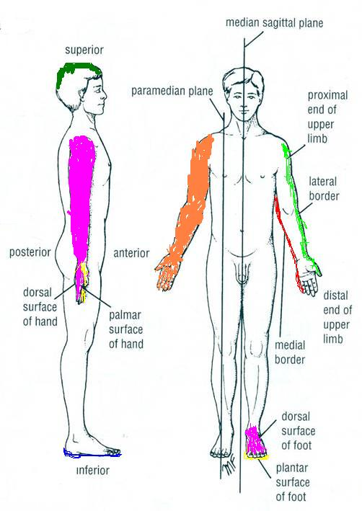
TERMS OF POSITION
Superior (cranial) (rostral): near to head
Inferior (caudal): away from head
Supine: The body lies on the back
Prone: The face is downwards
Anterior (ventral) : near to front
Posterior (dorsal) : near to back
Medial: near to median plane
Lateral: away from median plane
Proximal: near to trunk (used for the limbs)
Distal: away from trunk (used for the limbs)
Superficial (external) : near to skin (surface)
Deep (internal) : away from skin
Special cases:
Hand:
Anterior: Palmar
Posterior: Dorsal
Foot:
Anterior: Planter
Posterior: Dorsal

Slide 8
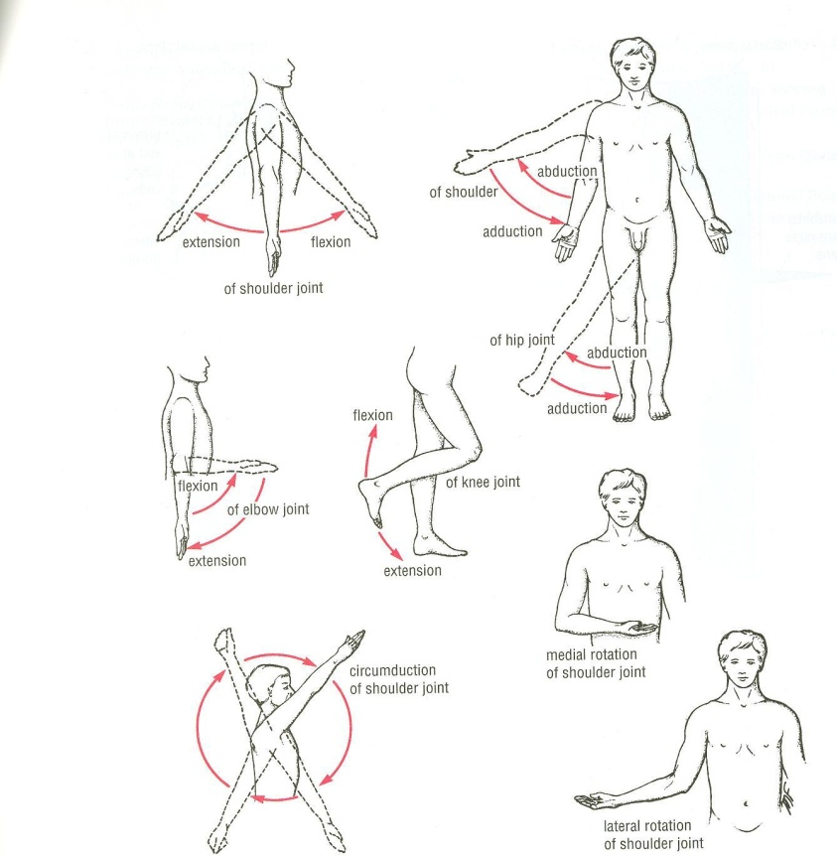
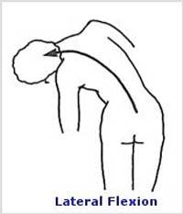
TERMS OF MOVEMENT
Flexion: approximation of 2 parts(decreasing the angle between 2 parts). It is usually anterior except in the knee joint and the opposite for the extension. Every flexion has an extension.
Extension: straightening (increasing the angle between 2 parts) Usually a posterior movement
Abduction: away from median plane
Adduction: toward median plane
Lateral rotation: rotation away from median plane
Medial rotation: rotation towards median plane
Circumduction: combined movements of flexion, extension , abduction & adduction
Lateral flexion: Side movement of the trunk
For the limb

Slide 9
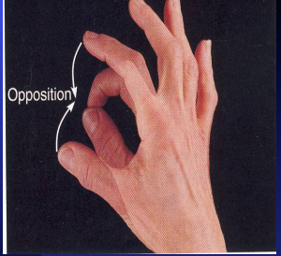
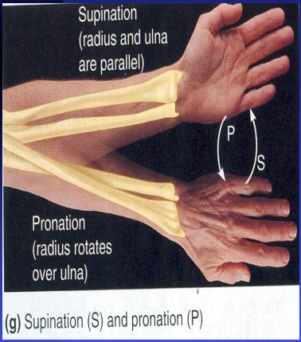
Movements of hand
من سلايدات البنات
Opposition: bringing tips of fingers and
thumb together as in picking something
up
■ Supination:
Lateral rotation of the forearm.
The palm faces Anteriorly.
The radius and ulna are Parallel.
■ Pronation:
Medial rotation of the forearm.
The palm faces Posteriorly
The radius Crosses the ulna and the two bones form an x

Slide 10
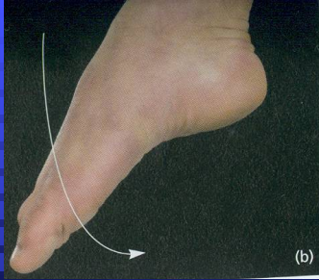
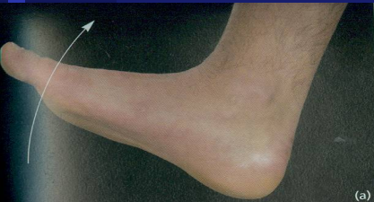
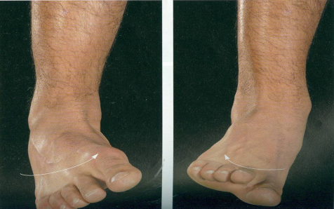
Movements of foot
من سلايدات البنات
■ Planter Flexion:
Depressing the foot (down ).
Movement with pointing the toes.
■ Dorsiflexion
Up movement of the foot
(Standing on the heels)
■ Inversion :
The sole faces in a Medial
direction.
Eversion :
The sole faces in a Lateral
direction.

Slide 11
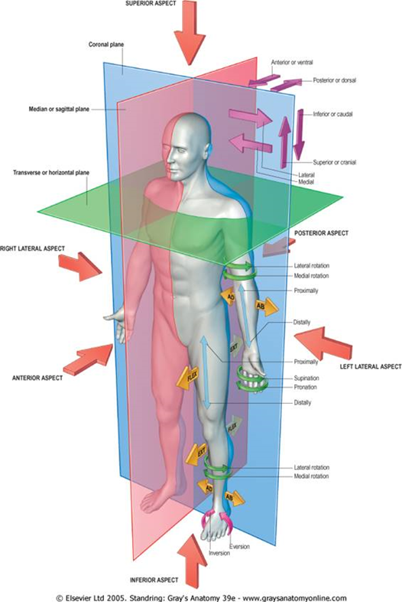
PLANES, TERMS OF POSITION & TERMS OF MOVEMENT

Slide 12
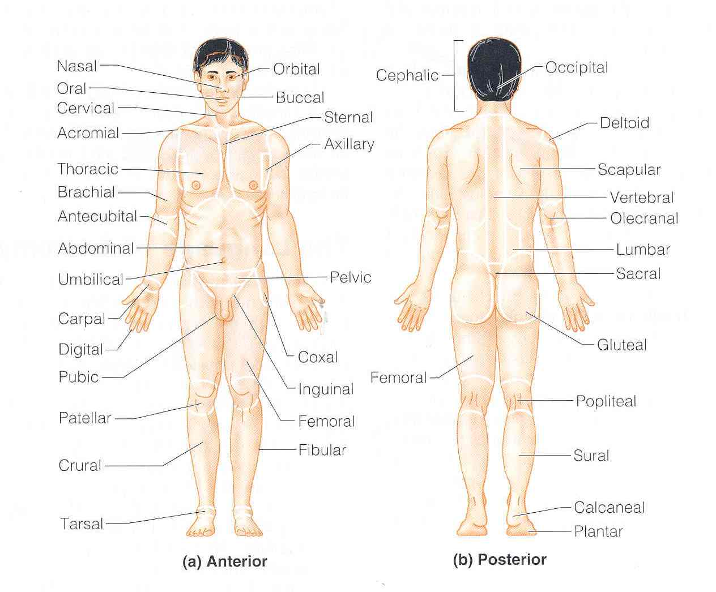
Terms of Regions
خاص بسلايدات البنات
Cranial (Cephalic) region of head
Cervical region of neck
Thoracic region of chest
Abdominal
Pelvic
Planter region of feet
Palmer

Slide 13
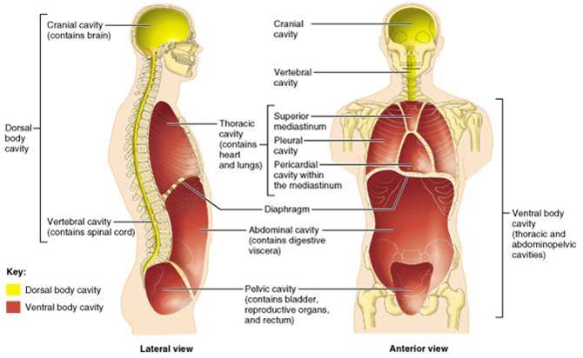
BODY CAVITIES
The body has two sets of internal cavities that lodge and protect the organs. Which are Dorsal & Ventral.
تنويه للصورة :لون الخط نفس نوع التجويف

Slide 14
BODY CAVITIES
Ventral body cavity
divided by diaphragm into:
Dorsal body cavity
divided into 2 parts continuous with each other:
Thoracic cavity: lies superior to diaphragm, contains heart & lungs
Abdominal cavity: lies (below) inferior to diaphragm, contains stomach, intestine, liver, urinary bladder .rectum , reproductive organs,, etc…
Cranial cavity: space inside skull, contains brain
Spinal cavity: space inside vertebral column, contains spinal cord.

Slide 15
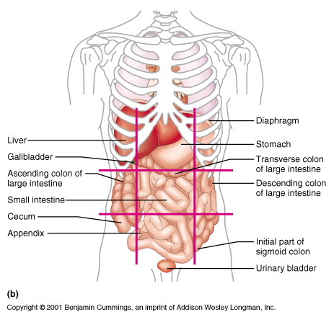
Abdominopelvic regions (girls slides only)
The
Abdominopelvic
area is divided into 9 regions by 2 vertical & 2 horizontal lines or planes
Objective: To locate the different organs in each region

Slide 16
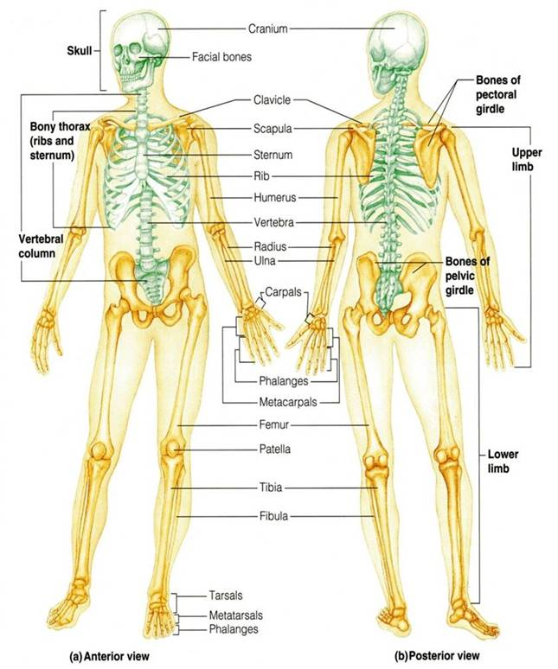
SKELETAL SYSTEM
Includes:
1-Bones
2-Joints:
articulations between bones

Slide 17
FUNCTIONS OF BONE
Support: of the body organs
Protection: of soft body organs
Attachment :of muscles
Movement: of the body as a whole, or of the body parts
Storage: of fat and minerals e.g. calcium and phosphorus
Blood cell formation (in bone marrow)

Slide 18
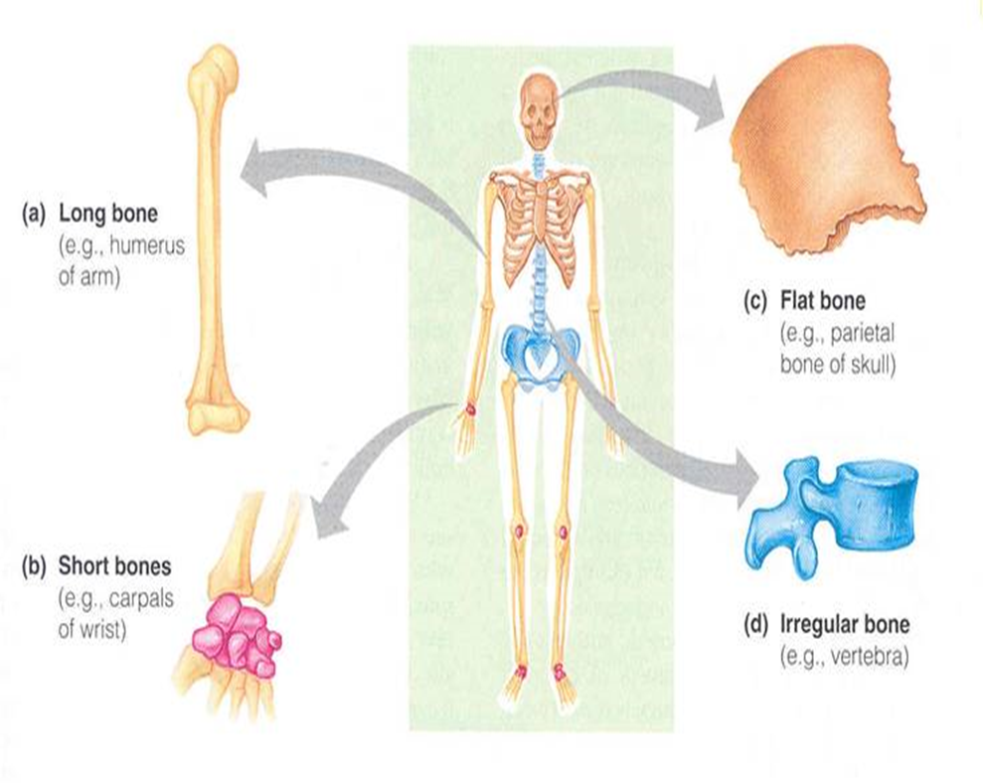
CLASSIFICATION OF BONE
Bones are classified base on their:
Shape: long, short, flat, irregular
Structure: compact, spongy
Development: membrane or Membranous, cartilage or Cartilagenous
N.B There is an additional classification in terms of shape which is sutural and sesamoid bones e.g: patella in the knee joint is a sesamoid bone.

Slide 19
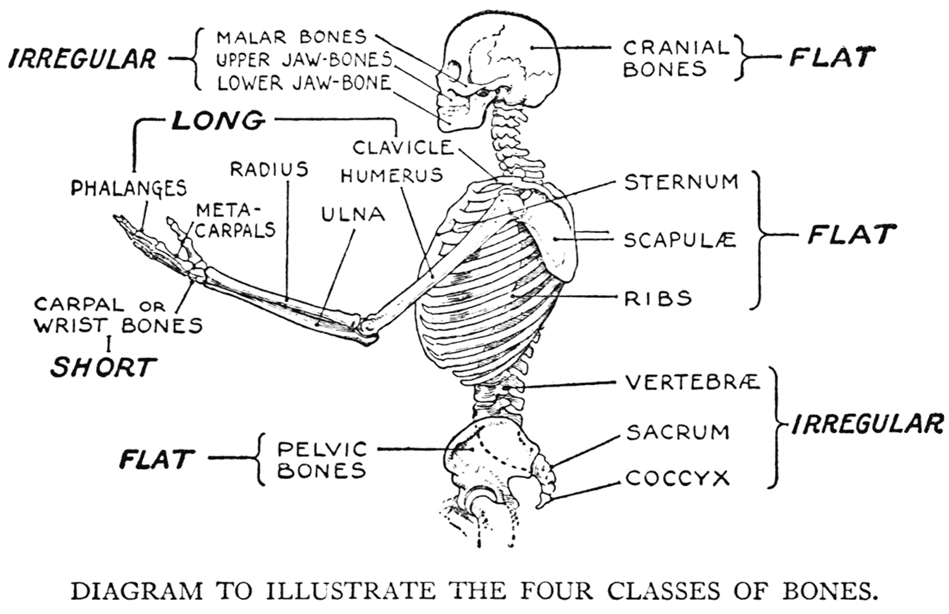
For further understanding of classifications:

Slide 20
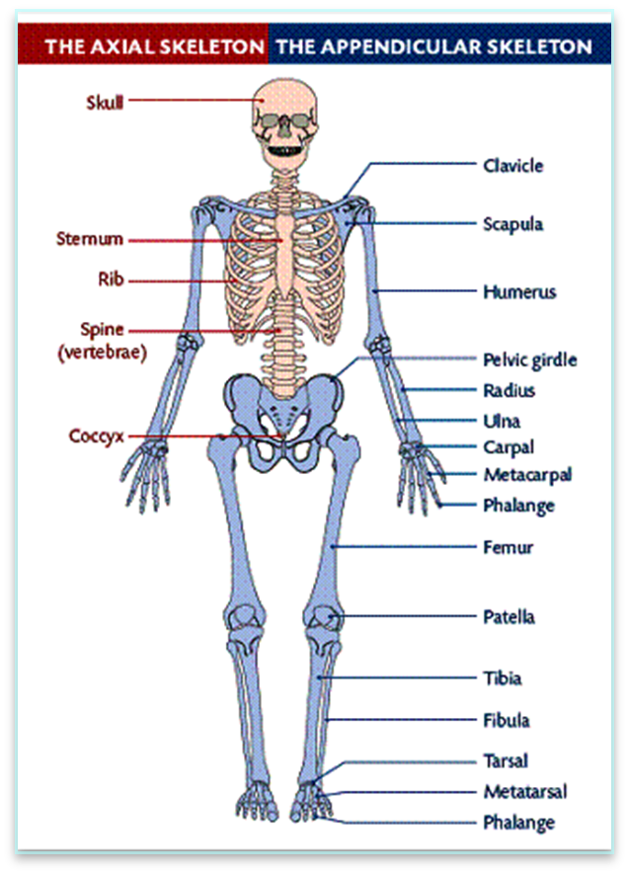
THE SKELETON
There are 206 bones in our body, arranged to form the body framework called, the skeleton.
The skeleton is perfectly adapted to the functions of body protection and motion.
Axial skeleton: bones forming the trunk (longitudinal axis) of body The Axial Skeleton consists of the (Skull bones,Vertebral colum,Sternum,Ribs)
Appendicular skeleton: bones forming the girdles & limbs, consists of the bones of the (Pectoral & Pelvic Girdles :connect the bones of the limbs to the axial skeleton
,Upper Limb ,Lower Limb )

Slide 21
BONES OF AXIAL SKELETON
SKULL
Consists of:
Cranium: bones enclosing brain: frontal, occipital, parietal, temporal , Sphenoid
Facial bones: bones of face: maxilla, nasal, zygomatic, mandible
الدكتور ما طلب حفظ أسامي العظام اللي باللون الأخضر لكن أنصح بحفظها احتياط ايضًا بتكون مفيدة جدًا في البلوك الجاي

Slide 22
BONES OF AXIAL SKELETON
VERTEBRAL COLUMN
Number: 33 vertebrae
Functions: protects spinal cord and supports the body
Forms the axial support of the body
Is a flexible curved structure, formed of 33 irregular bones, the (vertebrae)
Running through its cavity is the spinal cord
Formed of:
7 cervical vertebrae
12 thoracic vertebrae
5 lumbar vertebrae
5 sacral vertebrae fused to form sacrum
4 coccygeal vertebrae fused to form coccyx
Sacrum + coccyx
متحدة لكنها لا تعتبر عظمة واحدة

Slide 23
BONES OF AXIAL SKELETON
STERNUM (Flat bone)
Has 3 parts: manubrium, body & xiphoid process
RIBS
flat bone
Number: 12 pairs (1-7 true RIBS connected to the stenrum , 8-10 false RIBS (Not connected directly) , 11-12 floating RIBS )
All ribs articulate with vertebrae
Only upper 7 pairs articulate with sternum

Slide 24
BONES OF AXIAL SKELETON
VERTEBRAL COLUMN (irregular bone)
( 33 Vertebrae)
SKULL
RIBS
(flat bone)
(12 PAIRS)
STERNUM (Flat bone)
Cranium
Facial bones
manubrium
body
xiphoid process

Slide 25
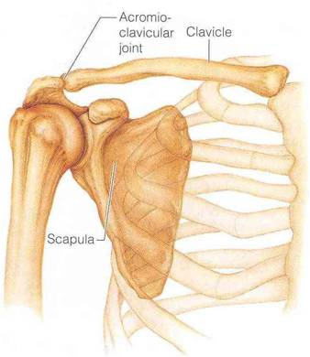
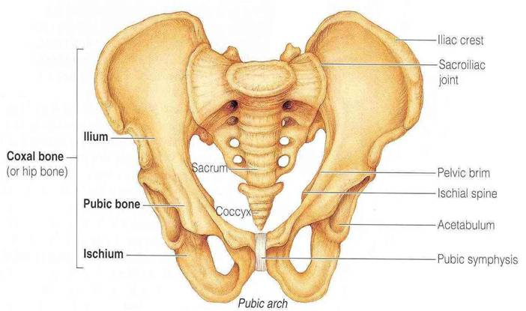
BONES OF APPENDICULAR SKELETON
Pectoral Girdle
Connects Upper limb with axial skeleton
Formed of: Clavicle & Scapula
Pelvic Girdle
Connects lower limb with axial skeleton
Formed of: hip bone (one bone on each side)

Slide 26
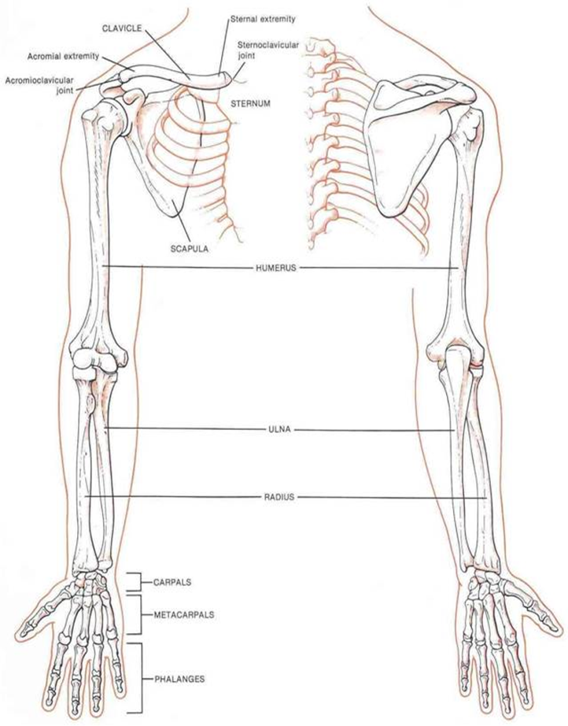
BONES OF APPENDICULAR SKELETON
UPPER LIMB
Bone of arm: humerus (humerus is Proximal to the forearm)
Bones of forearm: radius (lateral) & ulna (medial)
Bones of hand:
8 carpal bones
5 metacarpal bones (يتم ترقيم الميتا كاربل من الخارج للداخل)
14 phalanges: 2 for the thumb & 3 for each medial finger
1
5
4
2
3

Slide 27
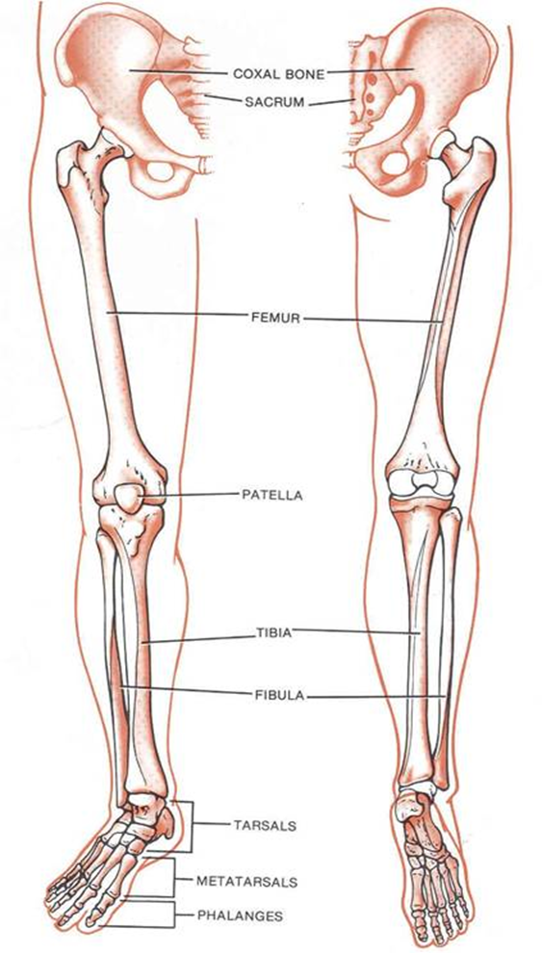
BONES OF APPENDICULAR SKELETON
LOWER LIMB
Bone of thigh: femur
Bones of leg: fibula (lateral) & tibia (medial)
Patella
Bones of foot:
7 tarsal bones
5 metatarsal bones(يتم الترقيم من الداخل للخارج نبدا الترقيم من الاصبع الأكبر )
14 phalanges: 2 for big toe & 3 for each of lateral 4 toes
5
4
1
3
2

Slide 28
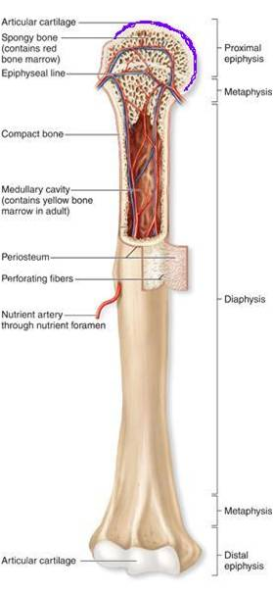
LONG BONES
Formed of:
A shaft (diaphysis) :
Composed of compact bone
Covered on its external surface by a fibrous connective tissue membrane called the periosteum.
Has a cavity called the marrow cavity. In adults, the marrow cavity is a storage area for fat and contains marrow. In infants, it contains red marrow and is the site of blood cells formation

Slide 29
LONG BONES
2. Two ends (epiphysis):
composed of spongy bone
Each epiphysis is composed of spongy bone, lined by a thin layer of compact bone.
Its external surface is covered by a layer of hyaline cartilage called the articular cartilage
Articular cartilage provides smooth slippery surface that decreases friction at joint surfaces

Slide 30
LONG BONES
3. Metaphysis:
The region of contact between epiphysis & diaphysis
Contains epiphyseal plate (thin plate of cartilage) responsible for linear bone growth (lengthwise growth of the long bones).

Slide 31
LONG BONES
Role of Periosteum
Protects the bone
Gives attachment to muscles
Carries blood vessels and nerves to bone
Deposits new bone on the surface thus increases the girth of bone
Growth of bone
Increase in length: epiphyseal plates
Increase in girth: periosteum

Slide 32
Question 1: Gross Anatomy is the study of human body with a:
The answer key is on the 36th slide
A- Light Microscope B- Naked Eye C- Electron Microscope

Slide 33
Question 2:
What does (Rostral) means?
The answer key is on the 36th slide
A.inferior
B.anterior
C.Superior
D.posterior

Slide 34
Question 3:
Extension is usually posterior except?
The answer key is on the 36th slide
A. Elbow joint
B. Knee joint
C. Finger joint

Slide 35
Question 4:
Cross plane divides the body into?
The answer key is on the 36th slide
A.superior & inferior
B.anterior & posterior
C.superior & posterior
D.left & right

Slide 36
Question 5:
Sternum bone is classified in terms of shape :
The answer key is on the 36th slide
A) irregular B) flat
C) Long D) short

Slide 37
Answer Key
1. B
2. C
3. B
4. A
5. B

Slide 38
Abduljabbar Alyamani

