Slide 1
Skeletal Muscles
SECOND LECTURE
{وَمَنْ يَتَوَكَّلْ عَلَى اللَّهِ فَهُوَ حَسْبُهُ}
هذا العمل لا يغني عن المصدر الأساسي للمذاكرة
Please check our Editing File BEFORE studying this lecture

Slide 2
Guide:
Objectives:
Text in BLUE was founded only in the boys’ slides
Text in PINK was founded only in the girls’ slides
Text in RED is considered important
Text in GREY is considered extra notes
Describe the main criteria of skeletal muscles.
Describe the attachments of skeletal muscles.
Describe the different directions of skeletal muscle fibers.
Describe the mode of action of skeletal muscles.
Describe briefly the naming of skeletal muscles.
Describe briefly the nerve supply of skeletal muscles.

Slide 3
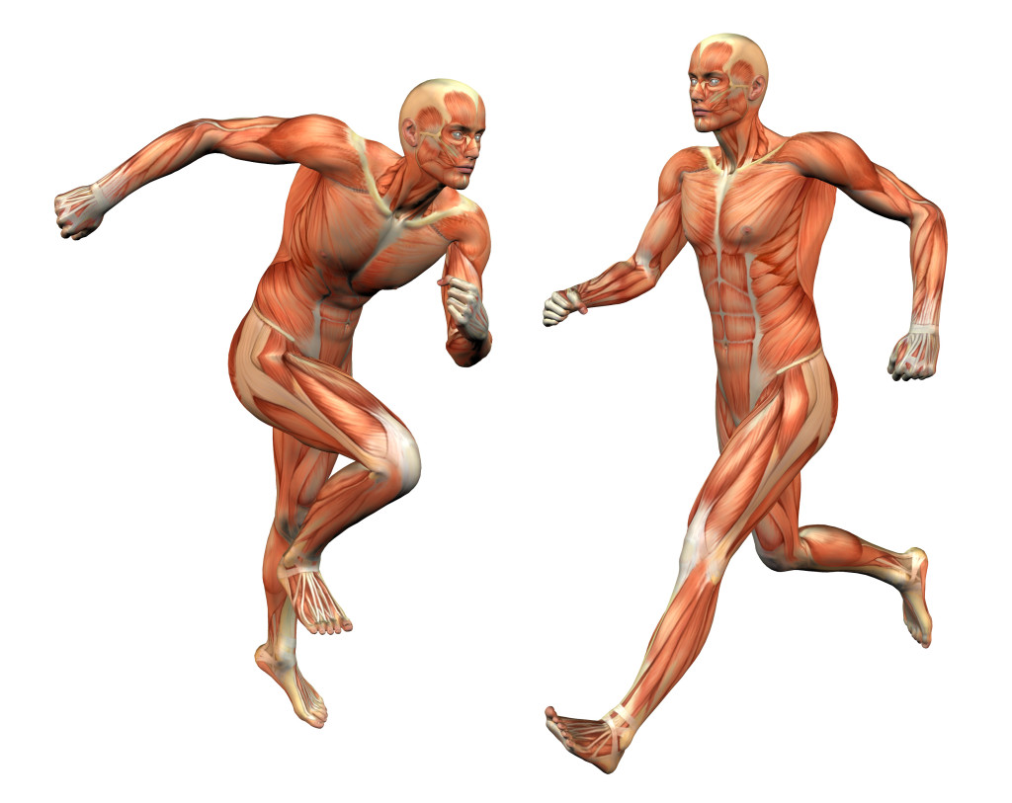
Functions of Muscles:
This slide is from the Girls’ lecture only
Movement of body and its parts.
Maintain posture.
Generate heat.
Stabilize joints.

Slide 4
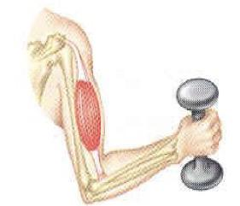
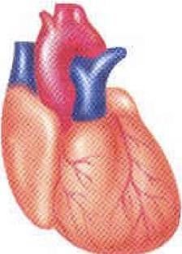
Classification Of Muscles:
 | Skeletal muscles | Cardiac muscles | Visceral muscles
Location | Attached to bones ,or For some facial muscles, to skin. | Wall of the heart | Mostly in walls of hollow visceral organ -other than the heart -
Action | Voluntary muscles Subject to conscious control | Involuntary muscles Not under conscious control | Involuntary muscles Not under conscious control
Microscopic structure | Striated | Striated | Non-striated [smooth | spindle shape ] No striations

Slide 5
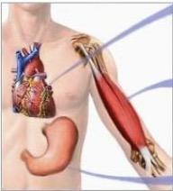
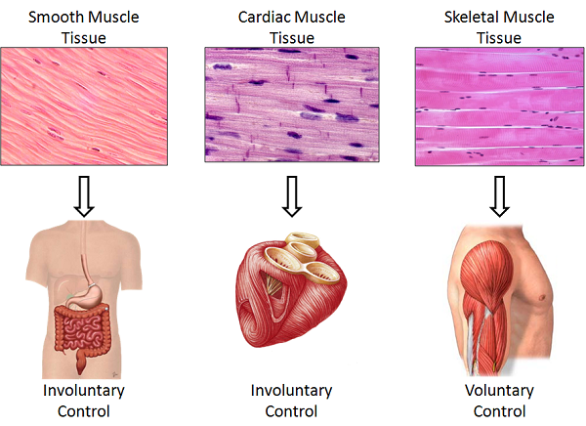

Slide 6
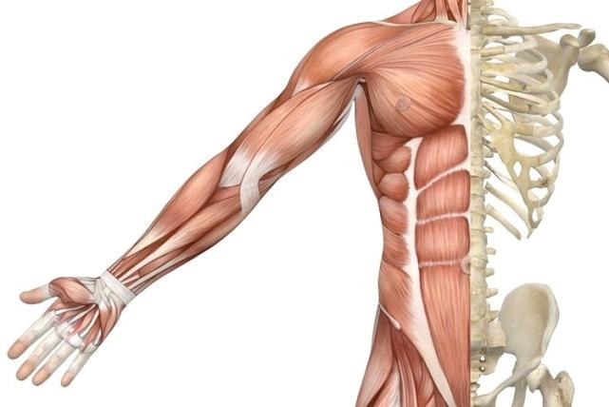
Main Criteria of Skeletal Muscles:
Striated.
Attached to skeleton.
Produce movement of skeleton.
Voluntary.
Supplied by somatic nerves. (The somatic nerves supply the skin,joints and muscles)

Slide 7
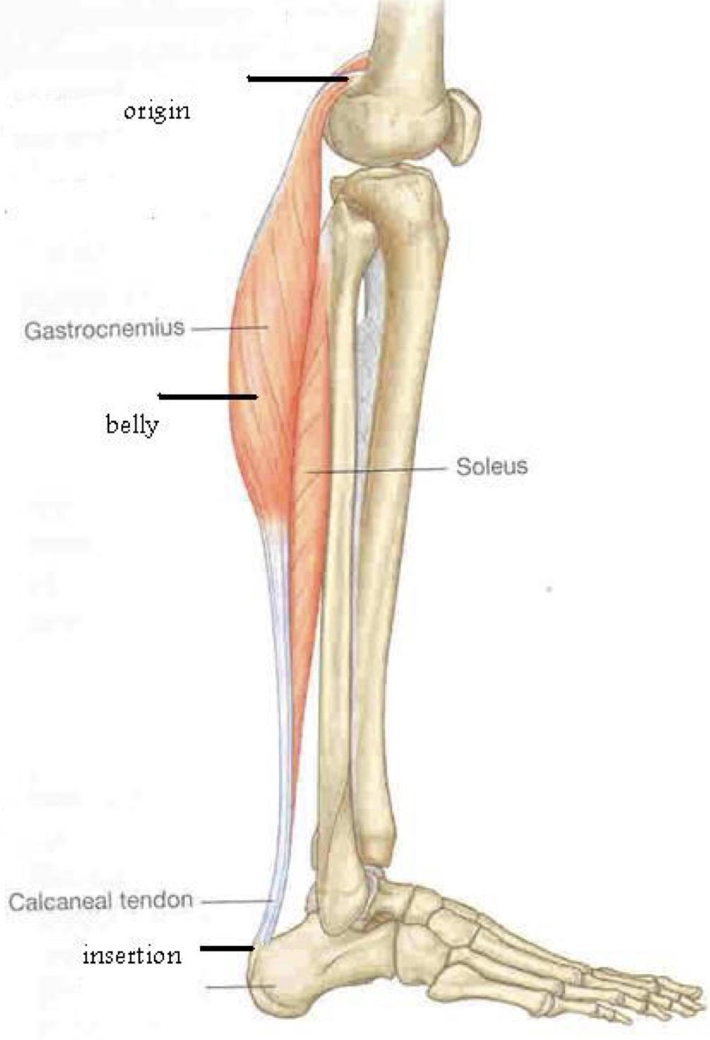
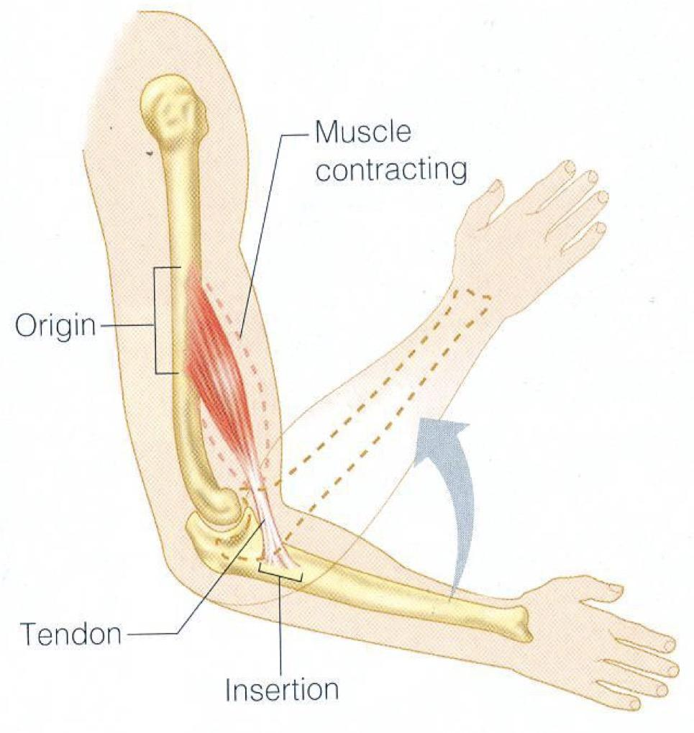
Attachments of Skeletal Muscles:
(Mostly two.)
Origin | Insertion
The proximal end. Least moveable. Mostly fleshy. | The distal end. Most moveable. Mostly fibrous.

Slide 8
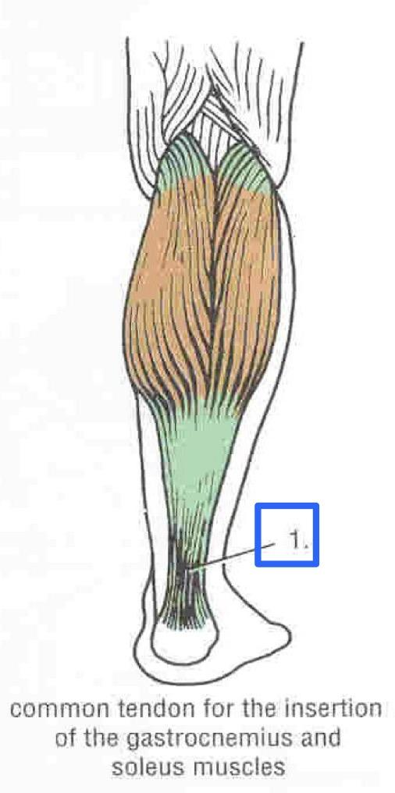
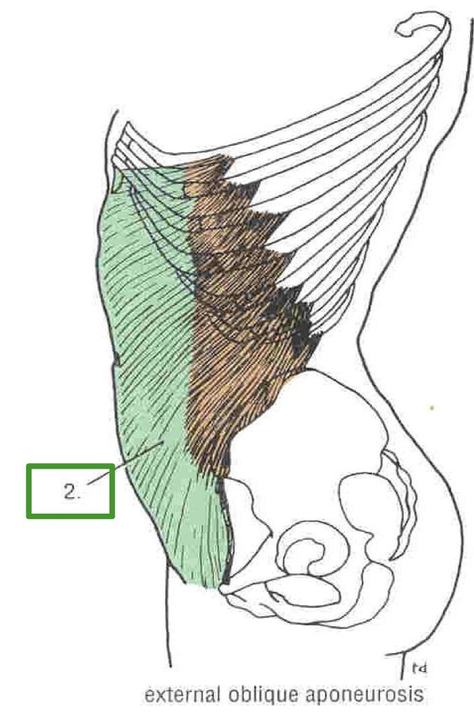
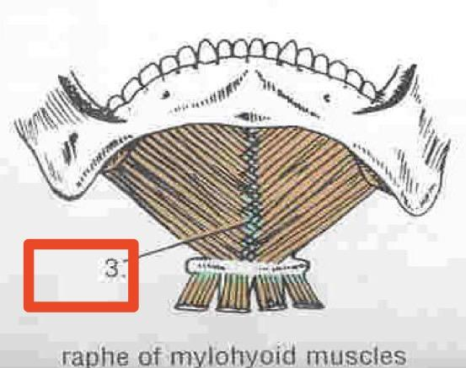
Types of Attachments:
Muscles are attached to bones, cartilage, or ligaments through:
1- Tendons (Cords of Fibrous tissue):
A tough cord of fibrous connective tissue that usually connects muscle to bone, and is capable of withstanding tension.
2- Aponeurosis:
A thin broad and strong sheet of fibrous tissue.
3- Raphe:
An interdigitation of the tendinous ends of the flat Muscles.
e.g. Raphe of mylohyoid muscle.
The difference between tendons and aponeurosis is that the tendons is more flexible (allowing the muscle to move), and even though the aponeurosis has less flexibility it makes the body strong and stable since it has a wide area attachment.

Slide 9
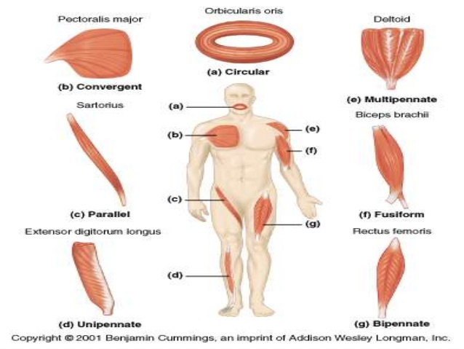
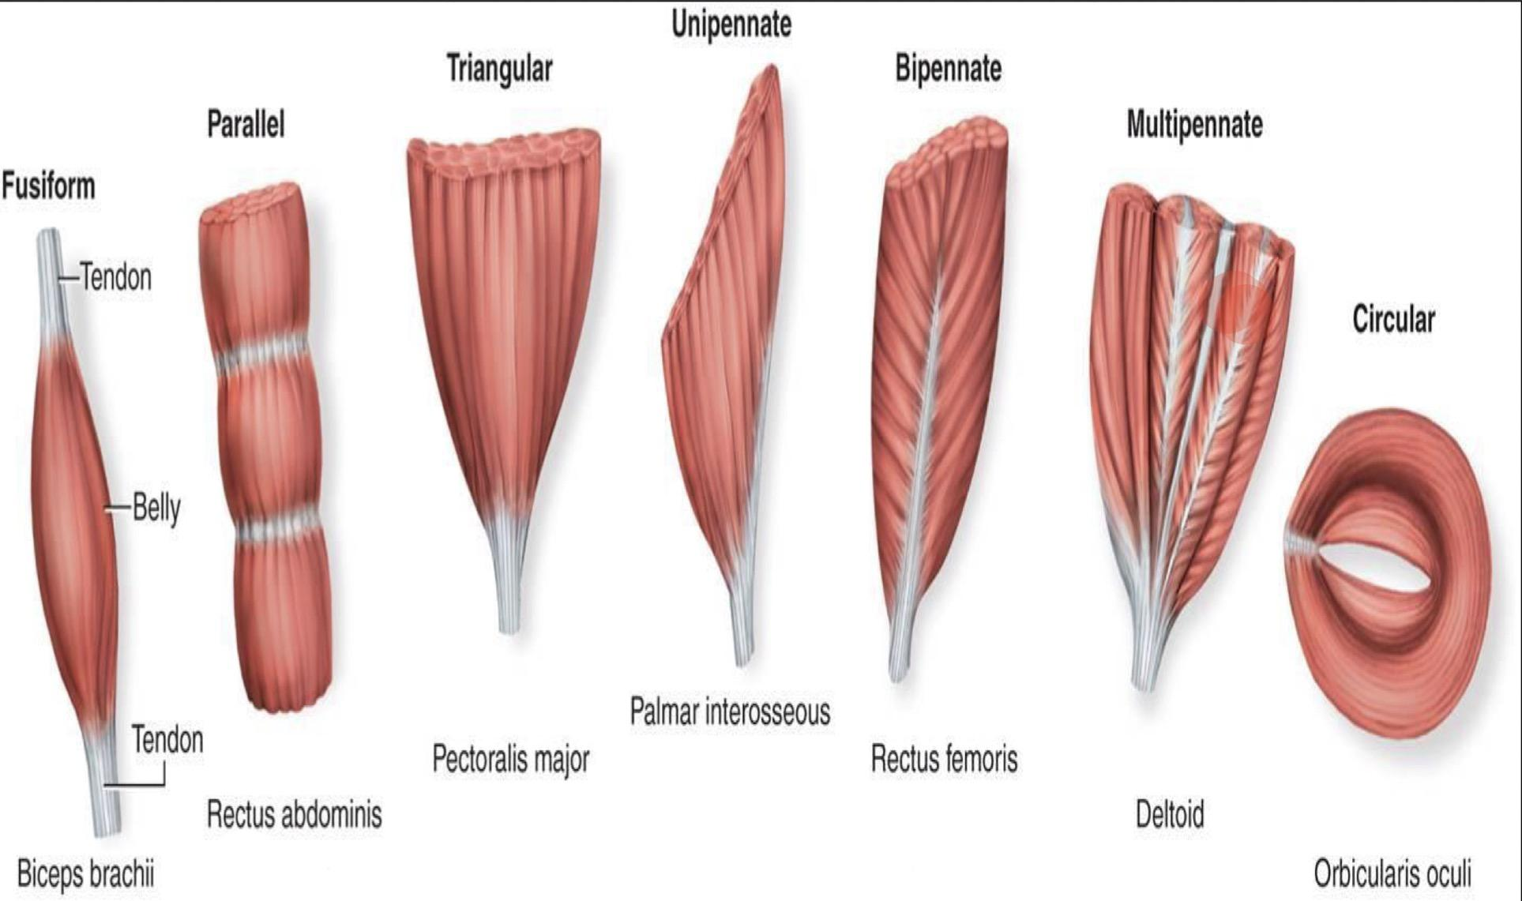
Direction of
Muscle Fibers:
The picture is from the boys’ lecture

Slide 10
Direction of Muscle Fibers
This slide is from the boys’ lecture only
The range of motion and the power of a muscle depends on the arrangement of its fascicles. It can be:
▪ Circular:
Surround a body opening or orifice, constricting it when contracted. Ex:Orbicularis oculi
▪ Convergent (triangular) :
have a broad attachment from which the fascicles converge to a single tendon.
Ex : Pectoralls Major
▪ Fusiform :
spindle-shaped (round, thick belly, & tapered ends).Ex: Biceps brachii

Slide 11
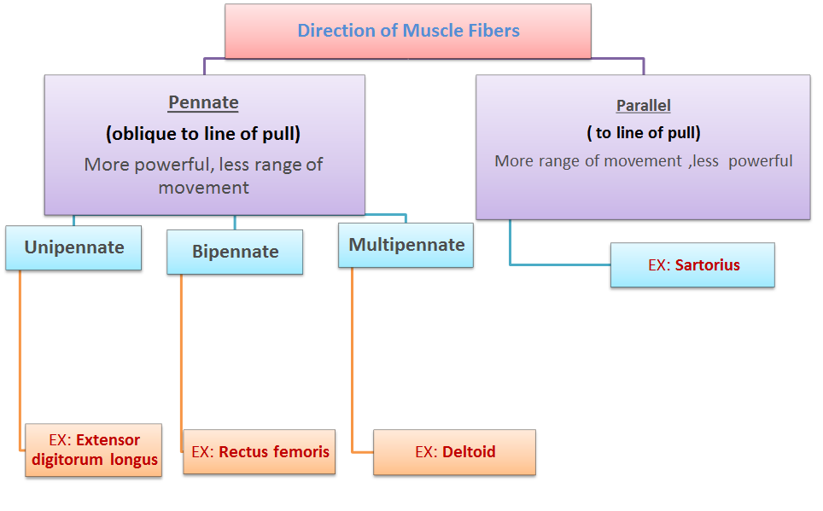
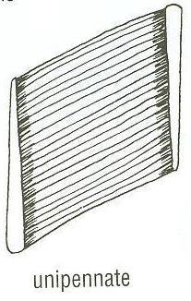
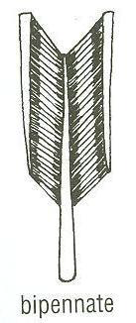
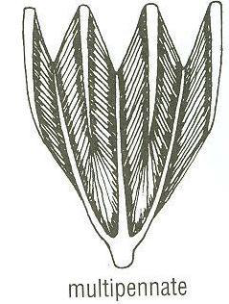
Important Slide

Slide 12
Mode (Mechanism) of Action:
Prime Mover (Agonist) | Antagonist | Synergist | Fixator
- It is the chief muscle responsible for a particular movement. | - It opposes the action of the prime mover. - Before contraction of prime mover, antagonist must be relaxed. | Prevents unwanted movement in an intermediate joint crossed by the Prime Mover. | Its contraction does not produce movement by itself but it stabilizes the origin of the prime mover so that it can act efficiently.
Example: - Extension of the knee joint: Quadriceps Femoris - Flexion of the elbow joint and forearm: Biceps Brachii | Example: - Flexion of the knee joint: Biceps Femoris (Flexor of knee) - Extension of the elbow joint and forearm: Triceps Brachii | Example: Flexors and Extensors of wrist joint They contract to fix wrist joint in order that flexors and extensors of fingers work efficiently. | Example: Muscles attaching the shoulder girdle to the trunk contract to fix the scapula, allowing deltoid muscle (taking origin from shoulder girdle) to move shoulder joint (humerus).
Muscles always work in pairs if one is pulled the other is relaxed: agonist and antagonist, so if both pull there will be no movement.

Slide 13
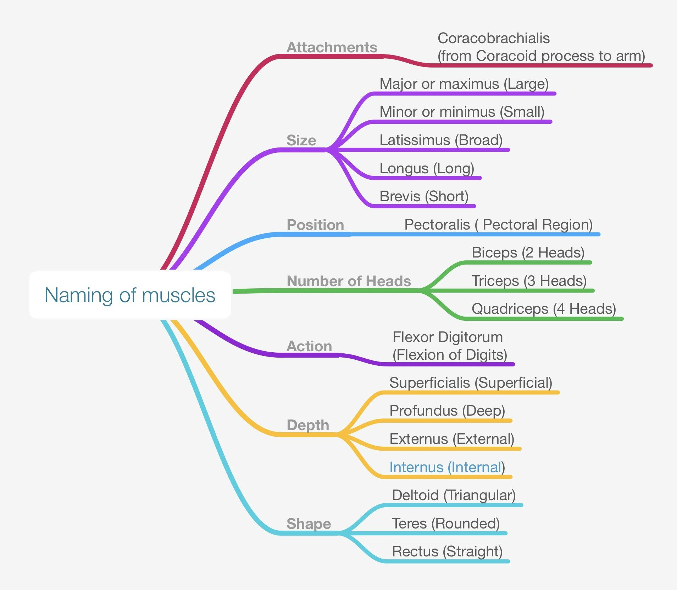

Slide 14
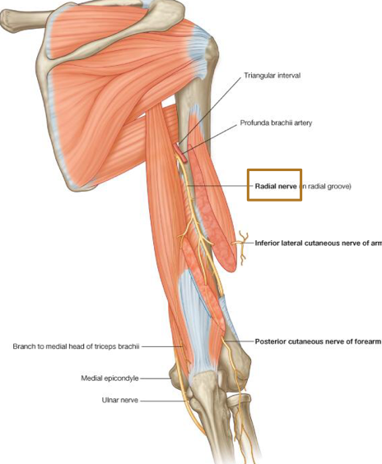
Nerve Supply Of Skeletal Muscles:
The somatic nervous system (is the part of the peripheral nervous system associated with skeletal muscle voluntary control of body movements.)
The nerves supplying the skeletal muscles are Mixed. 60% are Motor fibers. 40% are Sensory fibers.
It contains some Autonomic fibers, (Sympathetic) for its blood vessels.
The nerve enters the muscle at about the middle point of its deep surface.
Notes: • Sensory nerves: carries information from the nerves to the central nervous system
. • Motor nerves: carries information from the brain and the spinal cord to the muscles .

Slide 15
EFFECT OF EXERCISE ON MUSCLES :
This slide is only founded in the Girls’ lecture
The amount of work done by a muscle is reflected in changes in the muscle itself
Muscle inactivity leads to muscle weakness and wasting
Regular exercise increases muscle size, strength and endurance
Note:
ببساطة كل ما اشتغلت على العضلة راح يتغير حجمها وقوتها
وإذا ما تحركها راح تضعف
Helpful Video:
https://m.youtube.com/watch?v=rMcg9YzNSEs

Slide 16
Quiz:
Skeletal muscles are attached to?
Bones
Bones, and skin for facial muscles
Walls of visceral organs
Wall of the heat
2) Which of these is called smooth muscles?
Cardiac
Skeletal
Visceral
3) Somatic nerves supply?
Skeletal
Cardiac
Visceral
4) Which of the attachment points is the proximal end?
Origin
Insertion

Slide 17
5) Which of the attachment points is the most moveable?
Origin
Insertion
6) How many types of attachments are there?
1 type
2 types
3 types
4 types
7) what are they?
8) Attachment points are ..
Mostly 2
Mostly 3
Always 2
Answers:
1)B. 2)C. 3)A. 4)A. 5)B. 6)C. 7)Tendons,Aponeurosis,Raphe. 8)A
GOOD LUCK

Slide 18
Team Members
Lamia Abdullah AlKuwaiz (Team Leader) Abeer Alabduljabbar Afnan Abdulaziz Almustafa. Alanoud Mansour AlEssa. Albandari Alshaye. AlFahdah Abdullah Alsaleem. Layan Hassan Alwatban. Majd Khalid Albarrak. Norah Alharbi. Rinad Musaed Alghoraiby. Rawan Mohammad Alharbi Wafa Alotaibi. Wejdan Fahad Albadrani
Faisal Fahad ALsaif ( Team Leader) Abdulrahman Sulaiman ALDawood Fahad aldhowaihy Abdullah AlMeaither Abdulelah Abdulhadi Aldossari Saleh abdullah almoaiqel Abdulaziz Mohammed Alabdulkareem Abdulmajeed Khaled Alwardi Abdulaziz Ibrahim Aldrgam Akram alfandi saud Abdulaziz alghufaily Mohammed Alquwayﬁli ali alammari Sultan alfuhaid Zeyad Alkhenizan Fahad alshughaithry saad aloqile Abduljabbar Alyamni
Mohammed Alomar Abdulelah alsergani Abdulelah alqarni Fahad alshugaithry Mohammed Alomar Yazeed Aldossari

