Slide 1
NERVOUS SYSTEM
Text in pink was only found in the girls’ slides
Text in blue was only found in the boys’ slides
Text in red is considered important
The Dr.’s comments in class are written in green
Please check our Editing File before studying this lecture

Slide 2
At the end of the lecture, students should be able to:
List the subdivisions of the nervous system.
Define the terms: grey matter, white matter, nucleus, ganglion, tract and nerve.
Define neurons and neuroglia.
List the major parts of the brain.
Identify the external and internal features of spinal cord.
Enumerate the cranial nerves.
Describe the parts and distribution of the spinal nerve.
Define the term dermatome.
List the structures protecting the central nervous system.

Slide 3
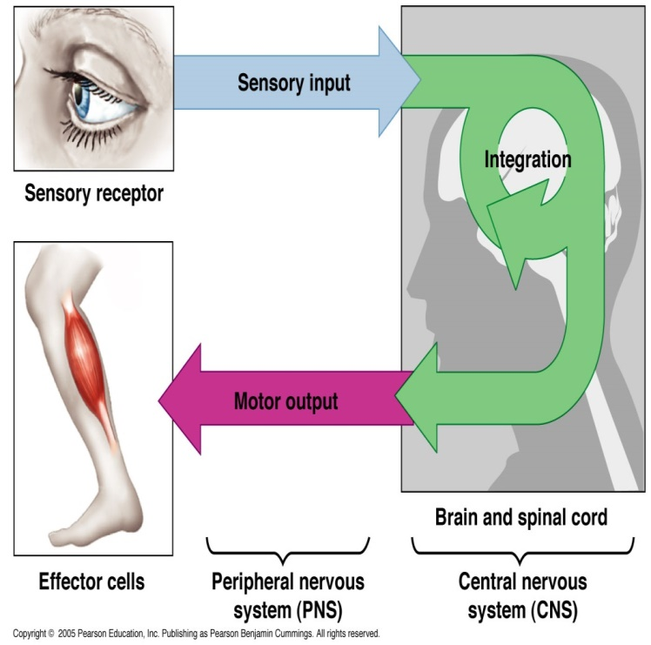
The nervous system has 3 functions: 1- Collection of Sensory Input: Identifies changes occurring inside and outside the body by using sensory receptors. These changes are called stimuli. 2- Integration: Processes, analyses & interprets these changes and makes decisions 3-Motor Output (Effects a response): It then effects a response by activating muscles or glands (effectors) via motor output
1-sensory input: sends the information to brain(ascendant).
2-integration(pentagon): analyses in the brain.
3-motor output(feedback): from the brain to the body to do the action(descending).

Slide 4
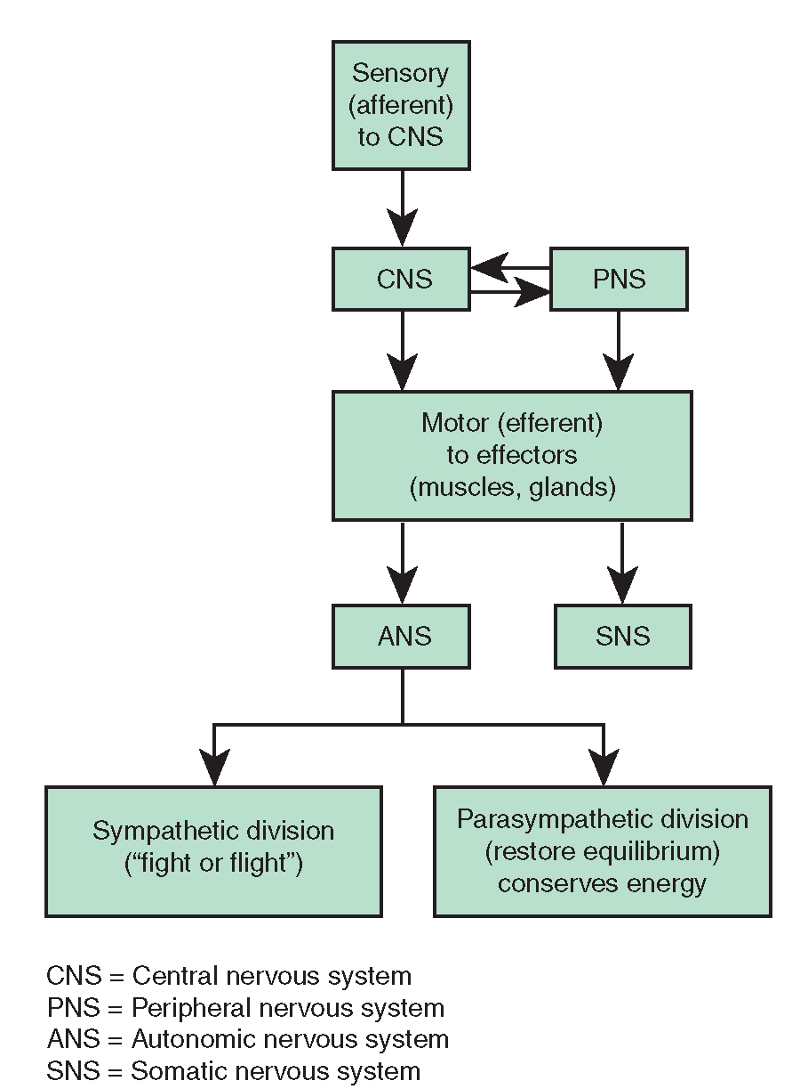
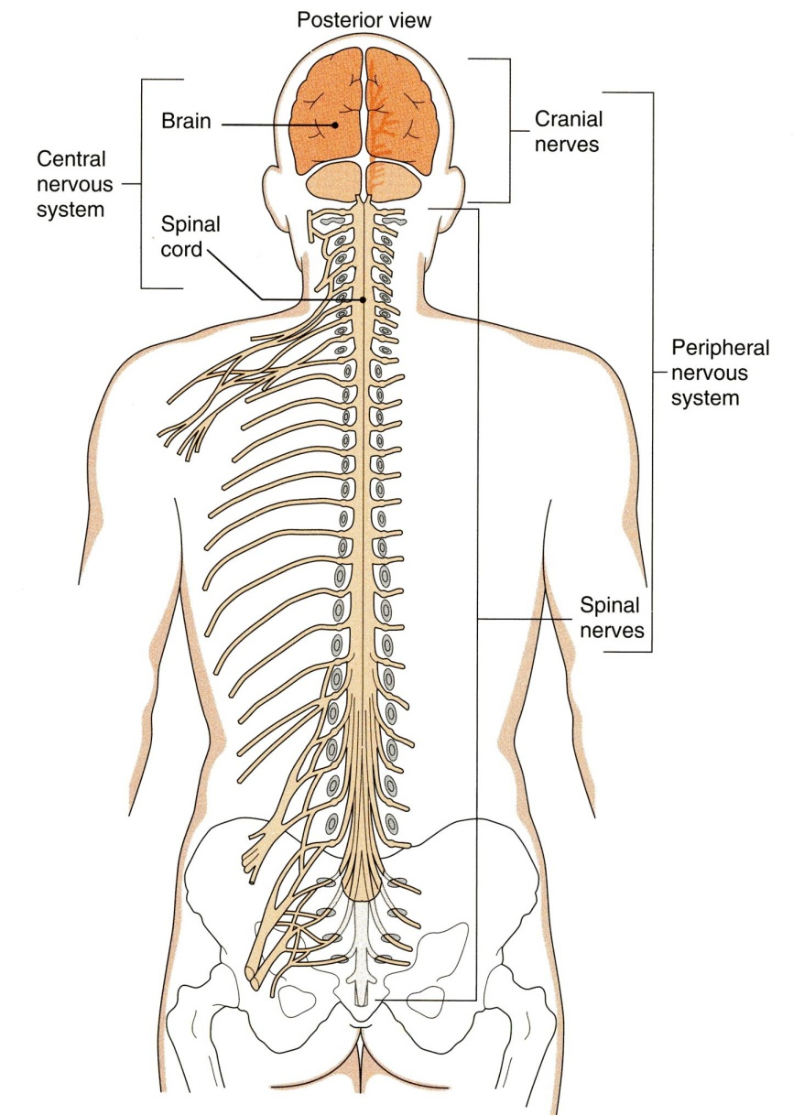
Organization
STRUCTURAL
Central Nervous System (CNS)
Brain & Spinal Cord
Peripheral Nervous System (PNS)
Nerves & Ganglia
FUNCTIONAL
Sensory Division (Afferent)
Motor Division (Efferent)
Autonomic (visceral)
Somatic
Cranial nerves
Spinal nerves
Helpful Video
1-Peripheral Nervous System is everything outside the CNS.
2-cranial nerves: goes out from the brain.
3-spinal nerves: goes out from spinal cord.

Slide 5
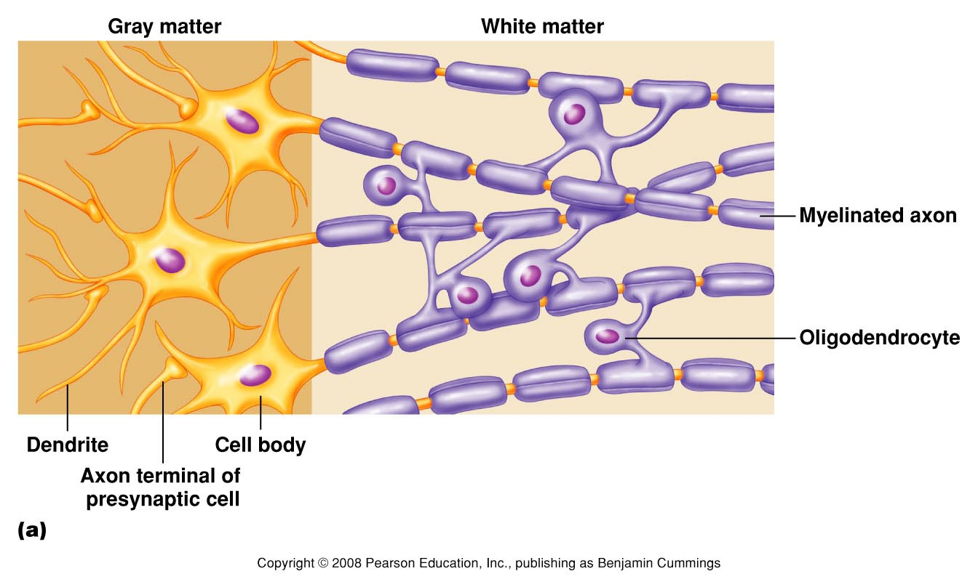
NERVOUS TISSUE
Nervous tissue consists of Nerve cells (Neurons) and supporting cells (Neuroglia).
Nervous tissue is organized as:
Grey matter | White matter
which contains the cell bodies & the short processes of the neurons, the neuroglia and the blood vessels. | which contains the long processes of the neurons (no cell bodies), the neuroglia and the blood vessels.
Axon
(nerve fiber)
1-neurons are made of dendrites, cell body and axon.
2-grey matter: contains the cell body and dendrites.
3-white matter: contains the axons and they call it white matter because of the myelin that covers the axon.
4- مايلين تساعد في تسريع نقل الاشارات العصبية.
nucleus
Myelin sheath

Slide 6
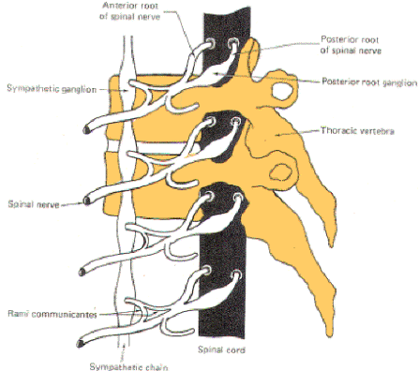
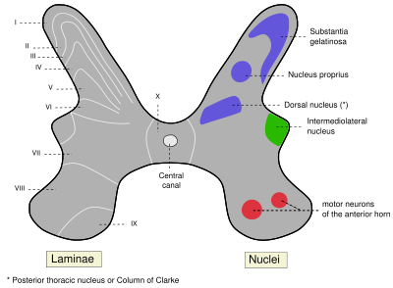
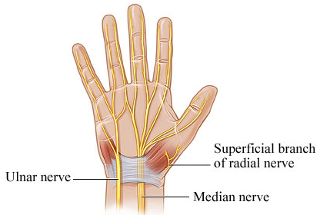
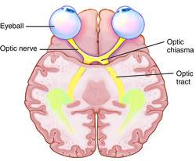
Ganglion
A group of neurons outside the CNS
Nucleus
A group of neurons within the CNS
We can set a location by using these terms
Nerve
A group of nerve fibers (axons) outside the CNS
Tract
A group of nerve fibers (axons) within the CNS

Slide 7
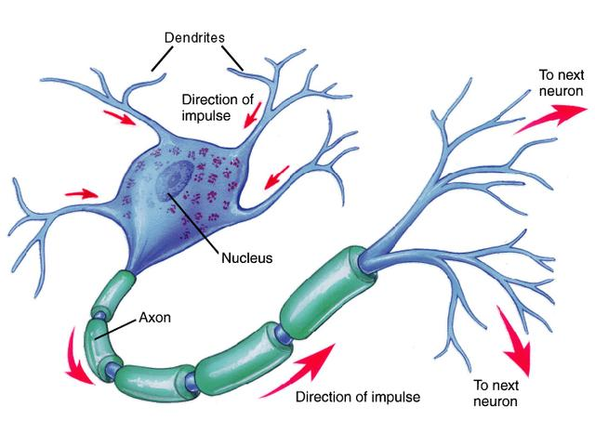
NEURONS
This slide is from the boys’ lecture.
The definition:
It is the basic structural (anatomical), functional and embryological unit of the nervous system.
The human nervous system is estimated to contain about 10¹⁰ neurons.
The functions of the neuron is to receive incoming information from sensory receptors or from other neurons and to transmit information to other neurons or effector organs.

Slide 8
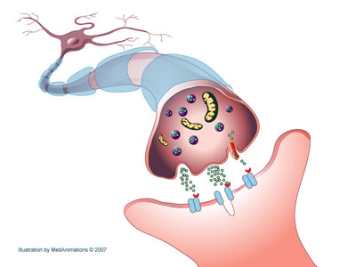
NEURONS
This slide is from the boys’ lecture.
Information is passed between neurons at specialized regions called synapses
There is a single cell body from which a variable number of branching processes emerge.
Most of these processes are receptive in function and are known as dendrites.
One of the processes leaving the cell body is called the axon which carries information away from the cell body.
At the end of the axon, specializations called terminal buttons occur.
Here information is transferred to the dendrites of other neurons.
Helpful Video

Slide 9
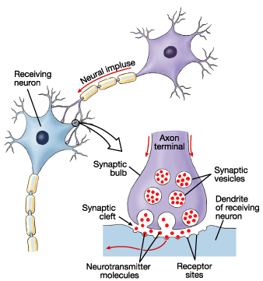
NEURONS
This slide is from the boys’ lecture.
Transmission of information between neurons almost always occurs by chemical rather than electrical means.
Action potential causes release of specific chemical that are stored in synaptic vesicles in the presynaptic ending.
These chemicals are known as neurotransmitters and diffuse across the narrow gap between pre- and postsynaptic membranes to bind to receptors on the postsynaptic cell.

Slide 10
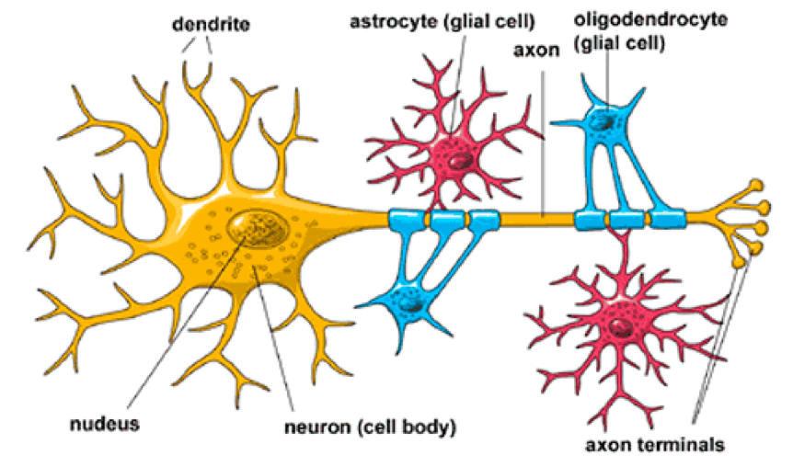
NEUROGLIA
This slide is from the boys’ lecture.
Neuroglia, or glia cells constitute the other major cellular component of the nervous system.
It is a specialized connective tissue for the nervous system.
Unlike neurons, neuroglia do not have a direct role in information processing but they are essential for the normal functioning of nerve cells.

Slide 11
This slide is from the boys’ lecture.
Three main types of Neuroglial cells are recognized:
Oligodendrocytes
They form the myelin sheath that surrounds many axons, which increases the rate of conduction (transmission).
Microglia
Astrocytes
They provide biochemical support for endothelial cells that form the blood–brain barrier.
They have a phagocytic role in response to nervous system damage.

Slide 12
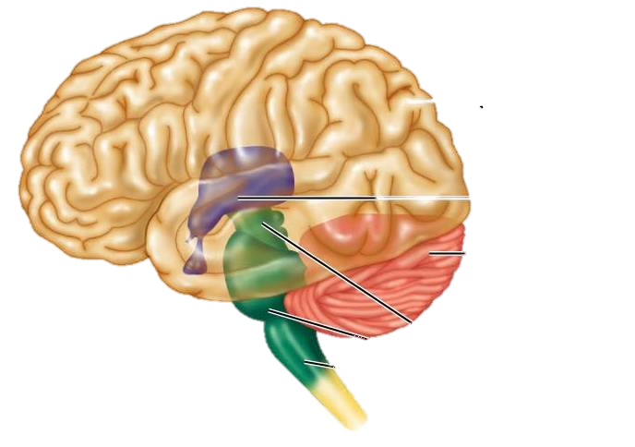
The Brain
(2) Diencephalon
Thalamus
Hypothalamus,
Subthalamus
Epithalamus
Large mass of nervous tissue located in the cranial cavity.
Has four major regions:
Cerebrum
2 Cerebral hemisperes
(4) Cerebellum
(3) Brain Stem
1-Midbrain
2-Pons
3-Medulla Oblongata

Slide 13
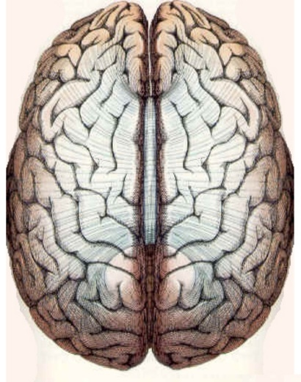
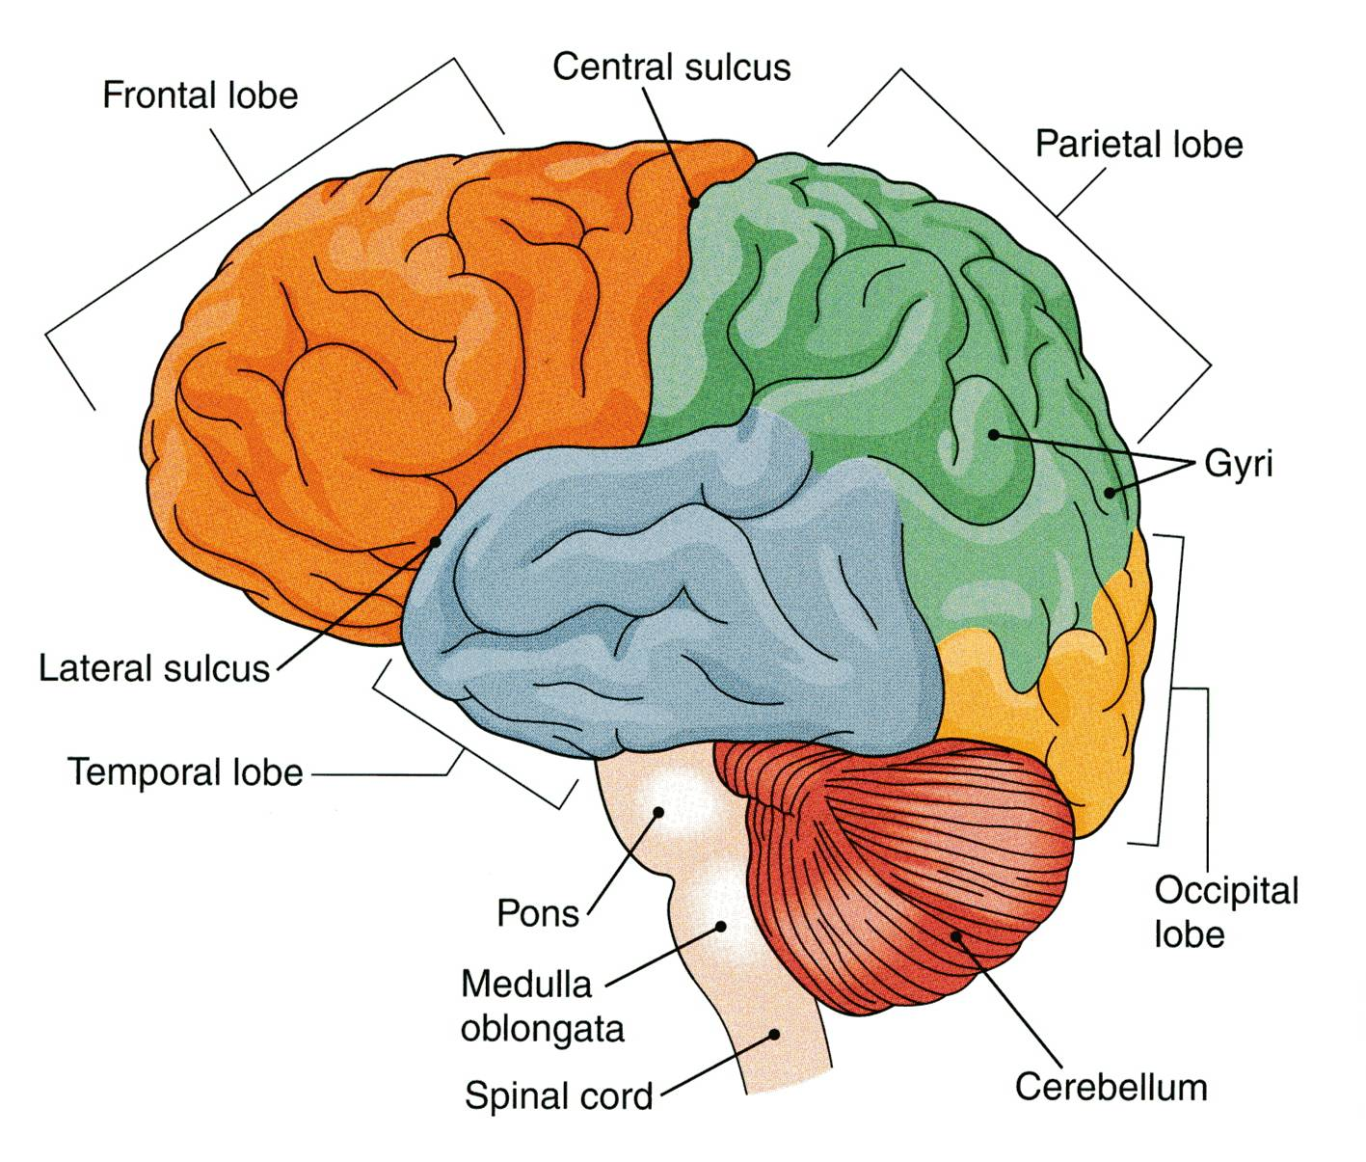
Cerebrum
Corpus callosum
The largest part of the brain, and has two hemispheres.
The cerebral hemispheres are connected by a thick bundle of nerve fibers called corpus callosum.
The surface shows ridges of tissue, called gyri (singular: gyrus ), separated by grooves called sulci (singular: sulcus).
Divided into 4 lobes by deeper grooves (sulci).
Frontal lobe
Parietal lobe
Temporal lobe
Occipital lobe (The visual processing center)
Left hemisphere
Right hemisphere
Gyrus
Sulcus
The Lobes are named after the bones that covers them.

Slide 14
Tissue of Cerebral Hemispheres
The outermost layer is called gray matter or cortex.
Deeper is located the white matter, composed of fiber tracts (bundles of nerve fibers)
Carrying impulses to and from the cortex.
Located deep within the white matter are masses of grey matter called the basal nuclei .
They help the motor cortex in the regulation of voluntary motor activities
White matter
Cortex “Grey matter”

Slide 15
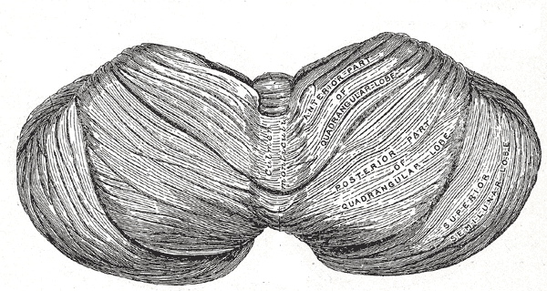
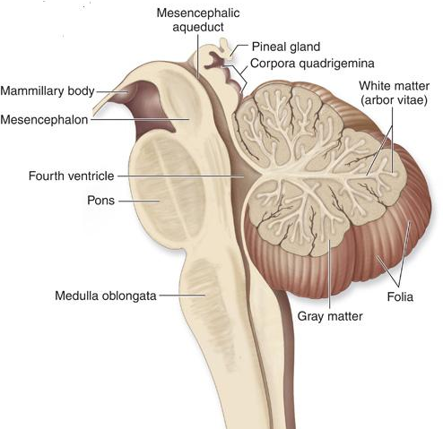
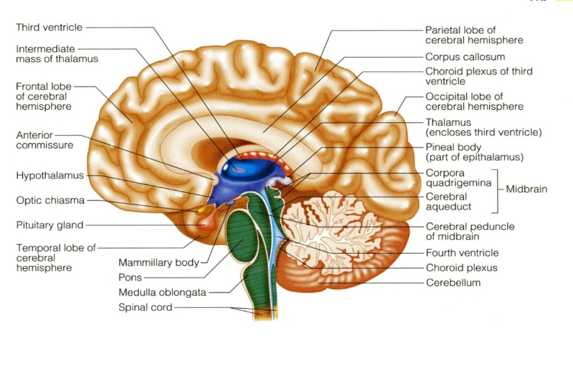
CEREBLLUM
The cerebellum has 2 hemispheres and a convoluted surface.
It has an outer cortex made from gray matter and an inner region of white matter.
It provides precise coordination for body movements and helps maintain equilibrium.
Cerebllum

Slide 16
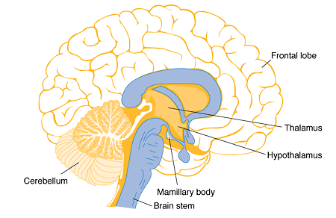
This slide is from the boys’ lecture.
Diencephalon
Consists of four parts;
Thalamus
Hypothalamus
Subthalamus
Epithalamus
Lies between the cerebrum and the brain stem.
Regulates visceral activities and the autonomic nervous system.

Slide 17
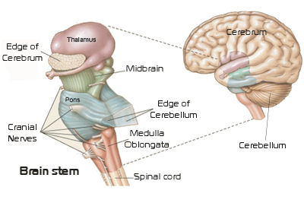
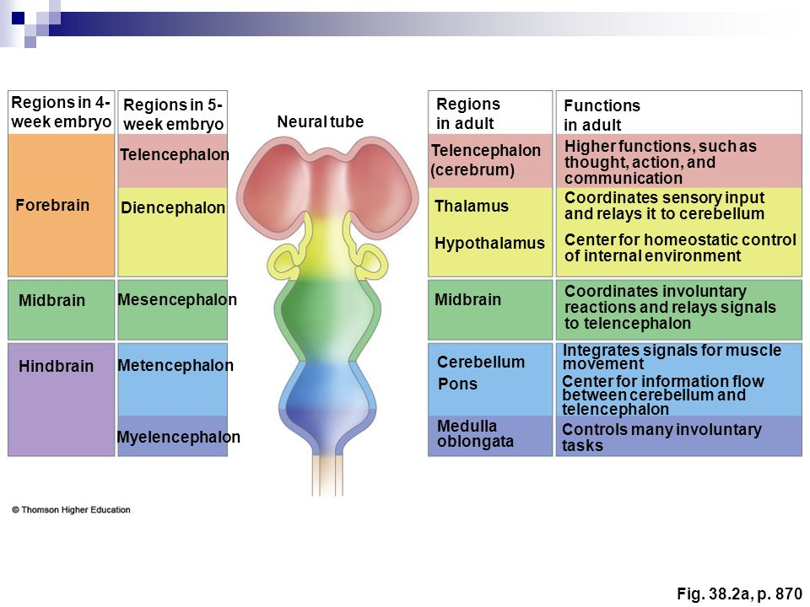
This slide is from the boys’ lecture.
Brain stem
Consists of three parts;
Midbrain
Pons
Medulla Oblongata
Produces the rigidly programmed, autonomic behaviors necessary.
Provides the pathway for fibers tracts running between higher and lower neuronal centers.

Slide 18
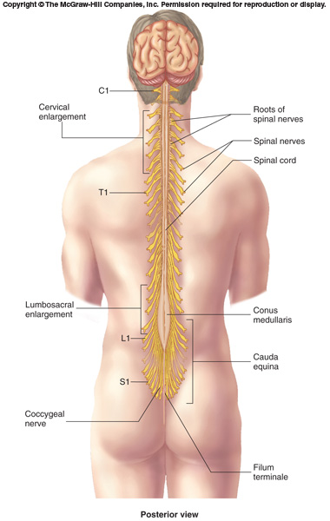
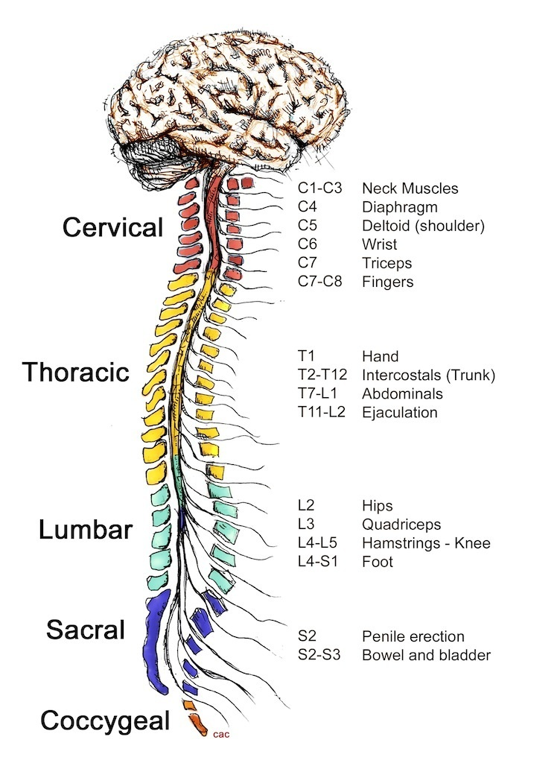
SPINAL CORD
It is a two-way conduction pathway to the brain & a major reflex center
42-45 cm long, cylindrical in shape, lies within the vertebral canal.
Extends from foramen magnum to L2 vertebra
Continuous above with medulla oblongata
Caudal tapering end is called conus medullaris
Has 2 enlargements: cervical and lumbosacral
Gives rise to 31 pairs of spinal nerves
Group of spinal nerves at the end of the spinal cord is called cauda equina

Slide 19
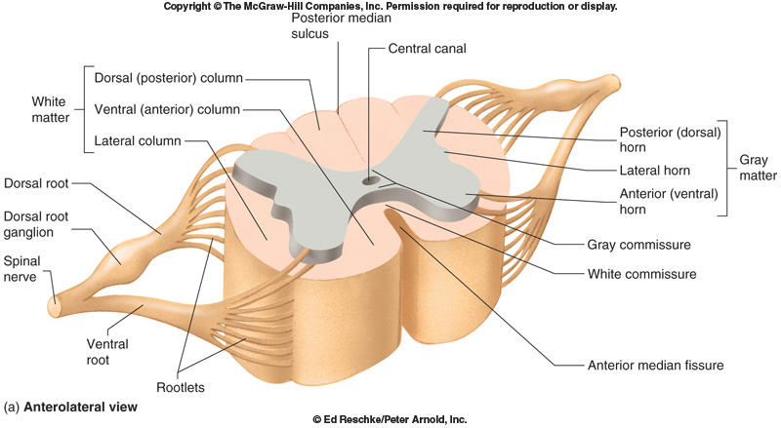
Cross Section Of Spinal Cord
The spinal cord is incompletely divided into two equal parts, anteriorly by a short, shallow median fissure and posteriorly by a narrow septum, the posterior median septum.
Composed of grey matter in the centre surrounded by white matter.
The arrangement of grey matter resembles the shape of the letter H, having two posterior, two anterior and two lateral horns/columns.

Slide 20
Peripheral Nerves
May be SENSORY, may be MOTOR or could be MIXED
Two TYPES:
Cranial: 12 pairs, attached to brain, named, and numbered from 1-12 (from anterior to posterior)
Spinal: 31 pairs, attached to spinal cord named and numbered according to the region of the spinal cord.

Slide 21
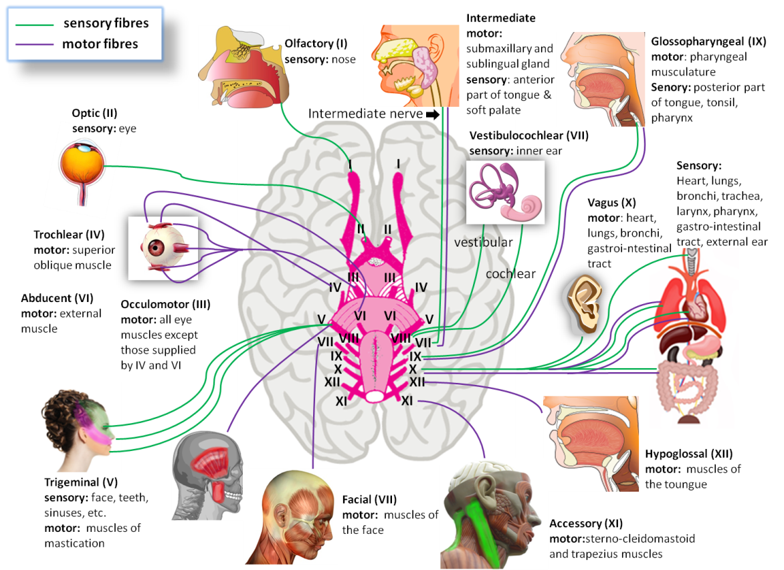
Cranial Nerves
Mixed Nerves | Motor Nerves | Sensory Nerves
trigeminal n. (5th) facial n. (7th) glossopharyngeal n. (9th) vagus n. (10th) | occulomotor n. (3rd) trochlear n. (4th) abducent n. (6th) accessory n. (11th) hypoglossal n. (12 | olfactory n. (1st) optic n. (2nd) vestibulocochlear n. (8th)
5-12 from brainstem

Slide 22
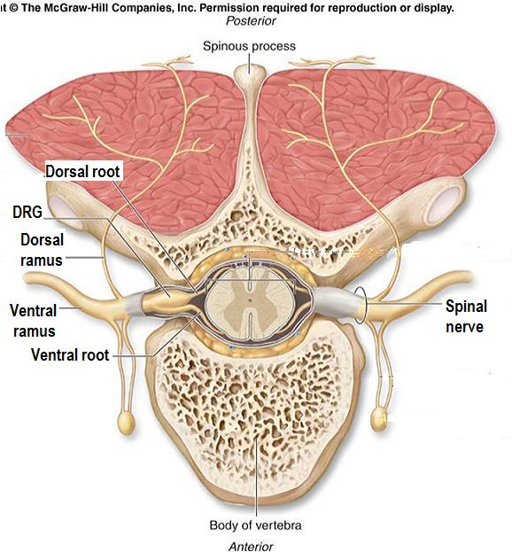
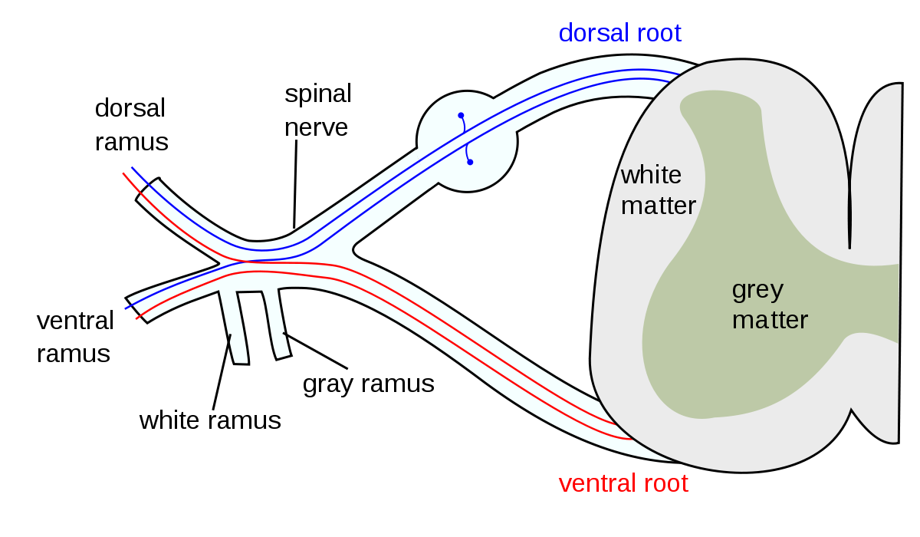
Spinal Nerves & Nerve Plexuses
31 Pairs
Each spinal nerve is attached by two roots:
Dorsal (sensory)
Ventral (motor)
Dorsal root bears a sensory ganglion (DRG)
Each spinal nerve exits from the intervertebral foramen and divides into a dorsal and ventral ramus.
The rami contain both sensory and motor fibers.
DRG

Slide 23
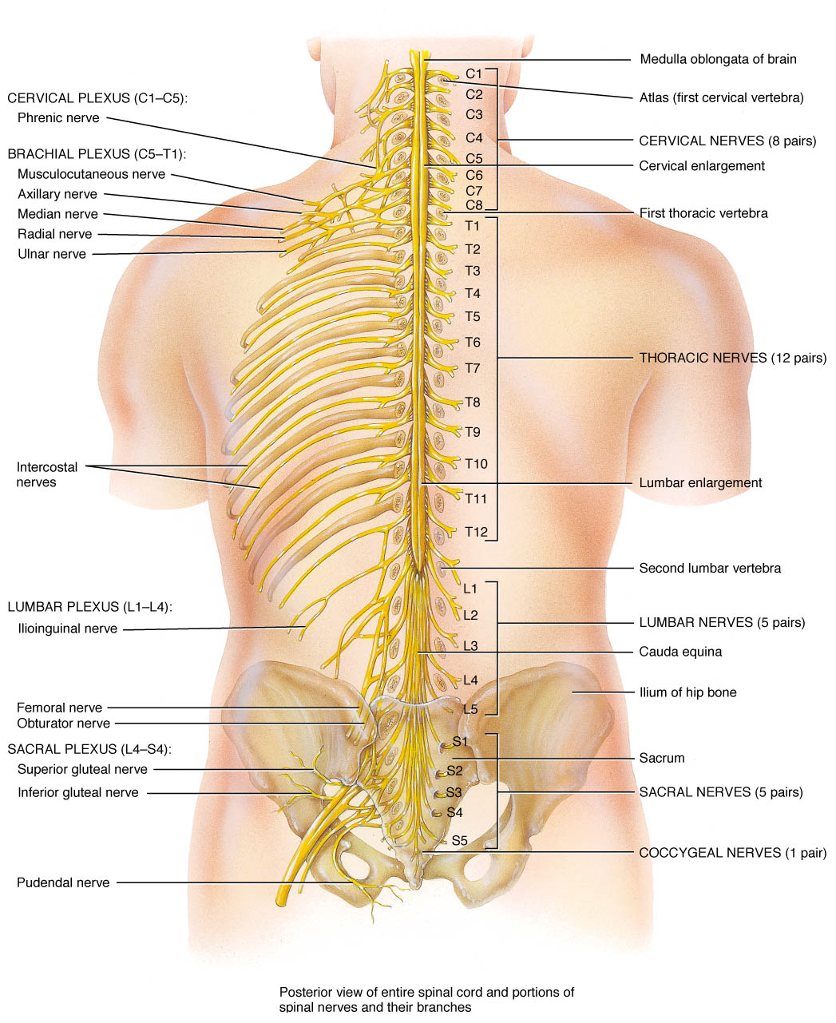
Spinal Nerves & Nerve Plexuses
The dorsal rami are distributed individually.
Supply the skin and muscles of the back
The ventral rami form plexuses
Except in thoracic region where they form the intercostal nerves
Supply the anterior part of the body

Slide 24
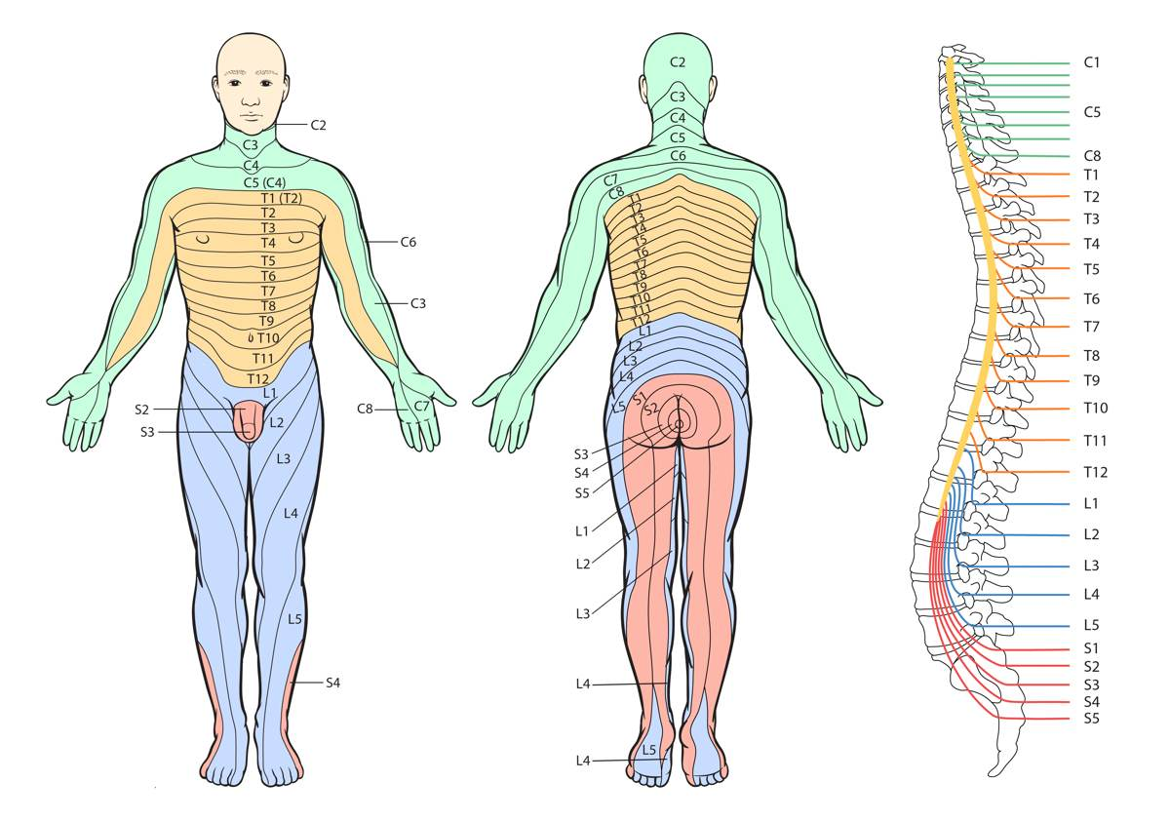
Dermatome
Dermatome is a segment of skin supplied by one spinal nerve.
كل عصب مختص بجزء محدد بالجسم

Slide 25
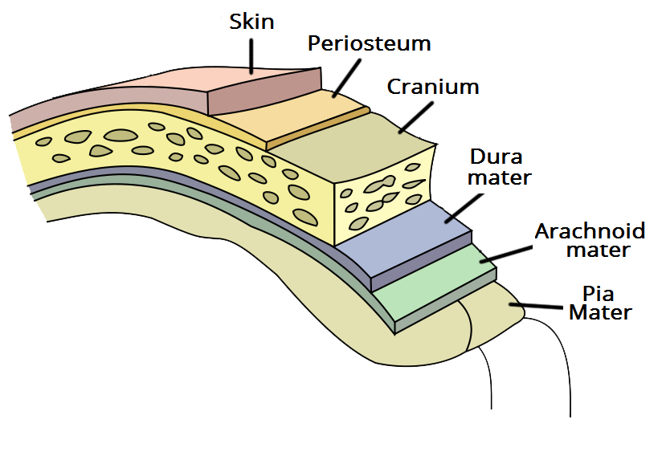
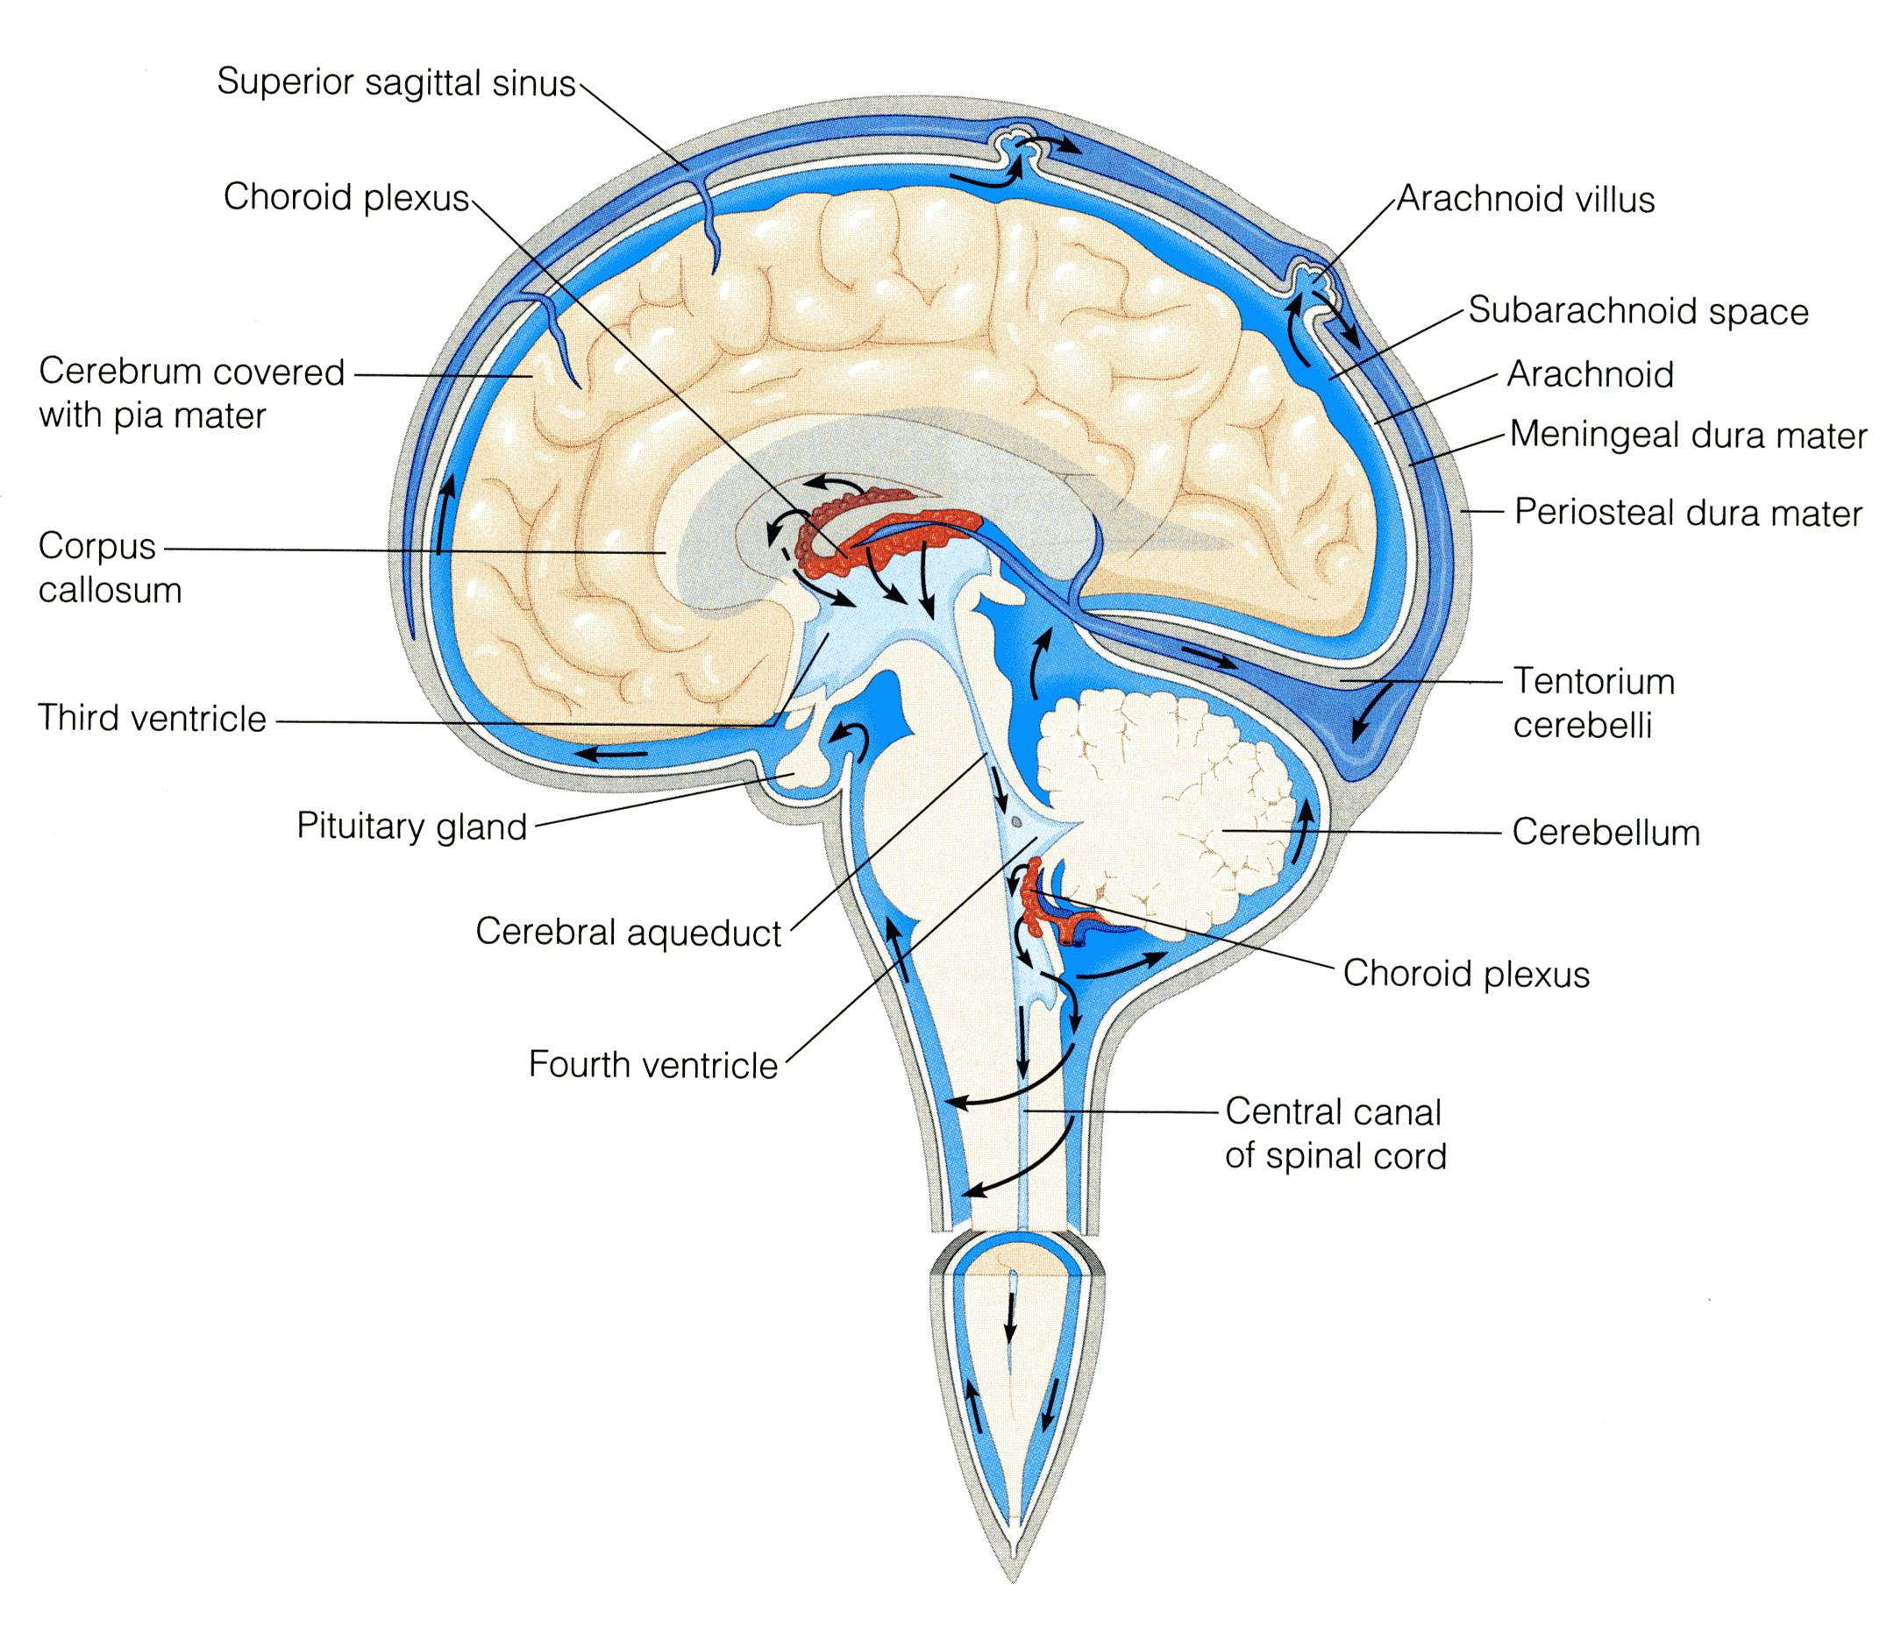
Protection Of CNS
Cerebral Fluid
The CNS Is Protected By:
Skull and the vertebral column (Bones)
Meninges (membranes):
dura mater (outermost).
arachnoid mater (middle).
pia mater (innermost).
Cerebrospinal fluid in the subarachnoid space.
CSF is constantly produced by the choroid plexuses inside the ventricles of brain.
CSF is constantly drained into the Dural sinuses through the arachnoid villi.
Most of the CSF drains from the ventricles into the subarachnoid space around the brain and spinal cord. A little amount flows down in the central canal of the spinal cord.
Between the Arachnoid mater and the pia mater.

Slide 26
Q6:Which statement(s) of the following is TRUE?
Nucleus is a group of neurons within the PNS
In the Brain, grey matter located in the centre and surrounded by white matter.
Oligodendrocytes they form the myelin sheath that surrounds many neuronal axons, which increase the rate of conduction.
Diencephalon provides the pathway for fibers tracts running between higher and lower neuronal centers.
Information is passed between neurons at specialized regions called synapses
Cerebrum provides precise coordination for body movements and helps maintain equilibrium.
Each spinal nerve exits from the intervertebral foramen and divides into a dorsal and ventral ramus.
The dorsal rami form plexuses .
Dermatome is a segment of skin supplied by one spinal nerve.
CSF is produced by the choroid plexuses inside the ventricles of brain.
The rami contain only sensory fibers.
CSF is drained into the dural sinuses through the arachnoid villi.
Answers : 1-F 2-F 3-T 4-F 5-T 6-F 7-T 8-T 9-T 10-T 11-F 12-T

Slide 27
Q1:Whats is the form of protection that the CNS uses that involves membranes?
Extra questions
Q2:Where can we find the cell body of a nervous cell?
A-Grey matter
B-white matter
C-both
D-axon
Q3:How many pairs of neurons originate from the spinal cord?
A-23
B-12
C-19
D-31
A-skull and vertebral column
B-Cerebrospial fluid
C-Dermatomes
D-Meninges
Q4:The surface shows ridges of tissue separated by grooves called:
A: gyri
B: cortex
C: sulci
D: Insula
Q5:Neuroglial cells are responsible for the transfer of information:
A-TRUE
B-FALSE
Answers:
1-D
2-A
3-D
4-C
5-B

Slide 28
Team Members
Faisal Fahad Alsaif (Team leader)
Abdulrahman Sulaiman ALDawood
Fahad aldhowaihy Abdullah AlMeaither Abdulelah Abdulhadi Aldossari Saleh abdullah almoaiqel Abdulaziz Mohammed Alabdulkareem Abdulmajeed Khaled Alwardi Abdulaziz Ibrahim Aldrgam Akram alfandi saud Abdulaziz alghufaily Mohammed Alquwayﬁli ali alammari Sultan alfuhaid Zeyad Alkhenizan
Lamia Alkuwaiz (Team leader)
Abeer Alabduljabbar
Afnan Almustafa
Alanoud Alessa
Albandari Alshaye
Alfahadah Alsaleem
Layan Alwatban
Majd Albarrak
Norah Alharbi
Rawan Alharbi
Rinad Alghoraiby
Wafa Alotaibi
Wejdan Albadrani
Fahad alshughaithry
saad aloqile Abduljabbar Alyamani Mohammed Alomar
Abdullah alsergani
Abdullah alqarni
Fahad alshugaithry
Mohammed Alomar
Yazeed Aldossari
Good Luck

