Slide 1
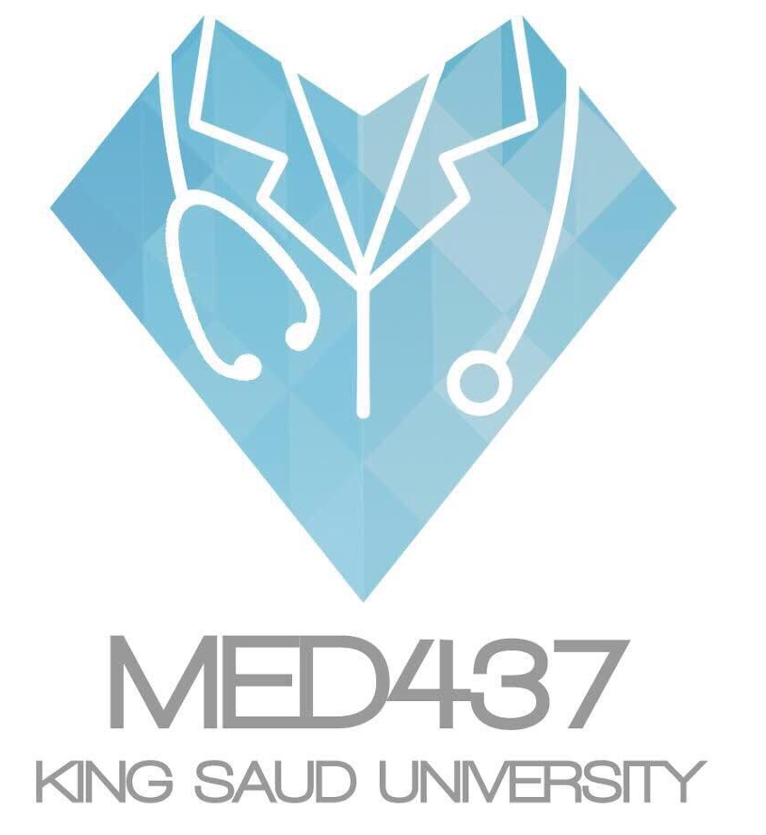
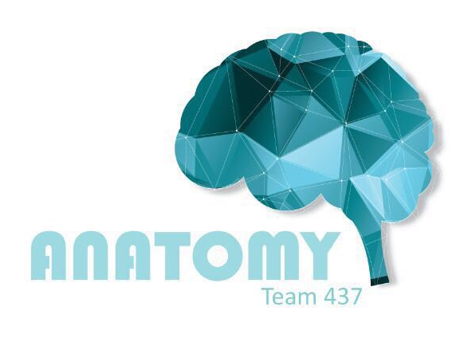
Cardiovascular System
5th LECTURE
Please check our Editing File before studying this lecture

Slide 2
Objectives:
Identify the components of the cardiovascular system.
Describe the heart in regard to (position, chambers, and valves).
Describe the blood vessels (arteries, veins, and capillaries).
Describe the portal system.
Describe the functional and anatomical end arteries.
Describe arteriovenous anastomosis.
Describe the components blood and its function.
Describe sinusoids.
Lecture’s Guide:
Text in pink was only found in the girls’ slides.
Text in blue was only found in the boys’ slides.
Text in red is considered important.
The Dr.’s comments in class are written in green.

Slide 3
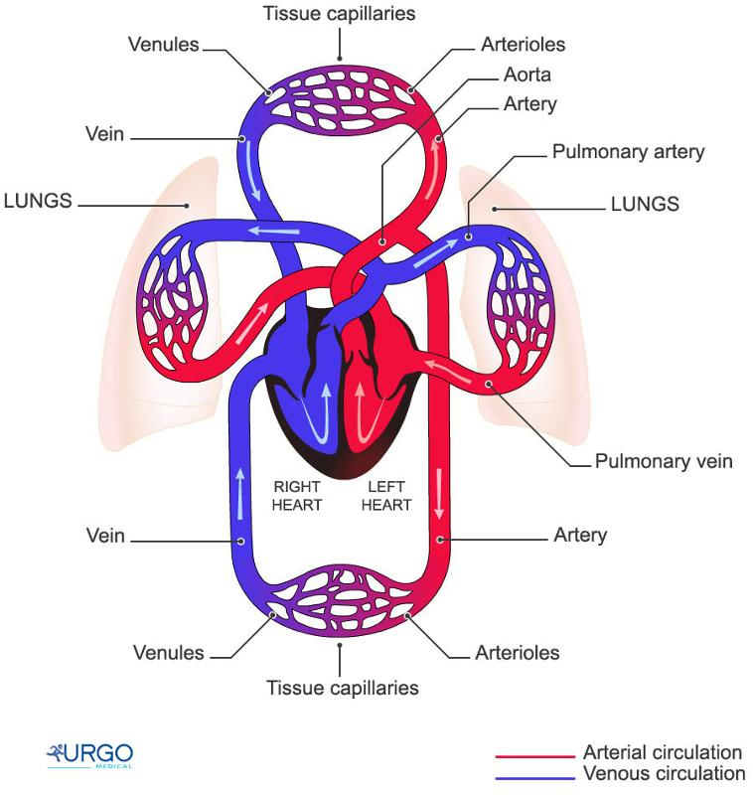
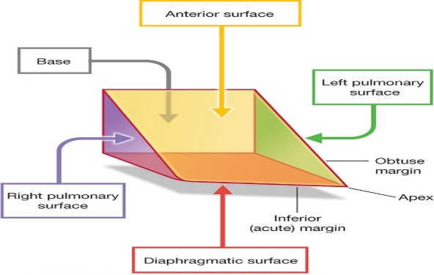
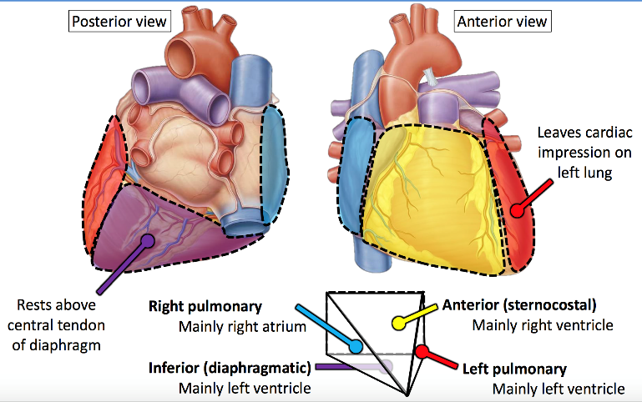
Composition of the Cardiovascular system:
1.Heart: pumps blood throughout the body.
2.Blood vessels: a network of tubules.
3.Blood: transport vehicle.
Functions of CVS:
It is a transportation system which uses blood as the transport vehicle.
It carries oxygen, nutrients, cell wastes, hormones, and many other substances vital for homeostasis.
The force needed to move blood around the body is provided by the beating of the heart (contraction of the heart).
The Heart:
Is a hollow, cone shaped muscular pump that keeps blood circulation going.
It is roughly the size of the person’s fist.
It has:
Apex (Inferior)
Base (Superior)
Two Surfaces:
Diaphragmatic (Inferior)
Sternocostal (Anterior)
Sometimes the base is considered a 3rd surface and is called the posterior surface.
•Borders: Right, Left, Inferior.

Slide 4
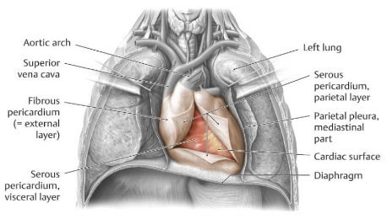
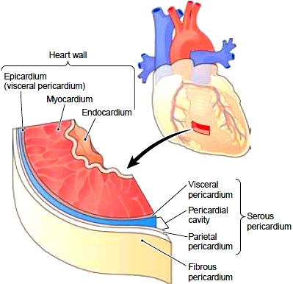
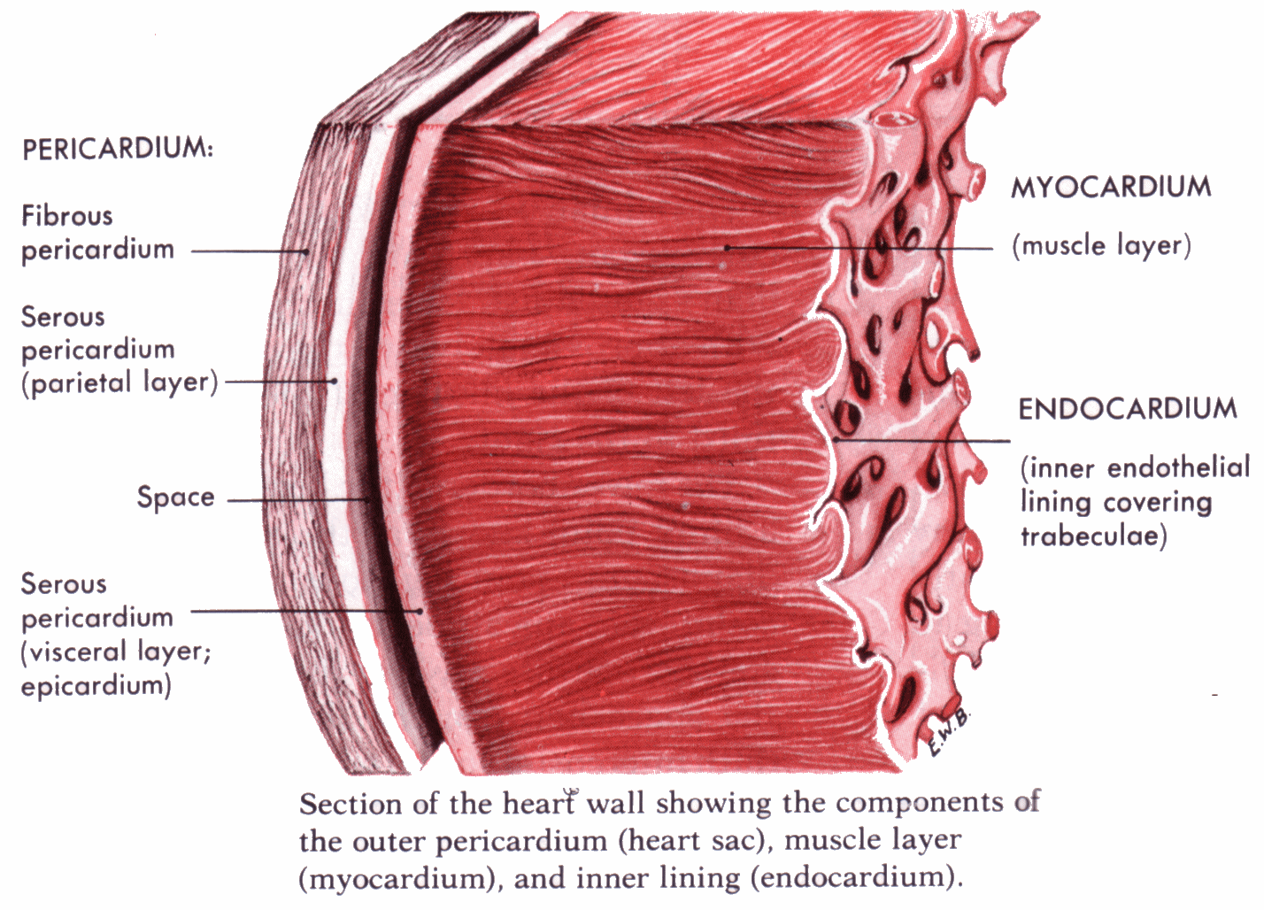
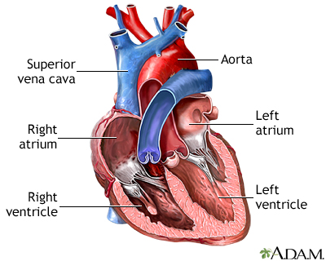
Location of the Heart
The pleural cavity: is the thin fluid-filled space between the two pulmonary pleurae (visceral and parietal) of each lung.
A pleura: is a serous membrane which folds back onto itself to form a two-layered membranous pleural sac.
It lies in a centrally located partition in the thoracic cavity known as the Middle Mediastinum between the two pleural sacs.
Mediastinum: space in the thoracic cavity between the two lungs, from the sternum to the vertebral column.
2/3 of the heart lies to the left of the median plane.
Enclosed by a double sac of serous membranes (Pericardium).
The outer wall of the heart is made up of three layers :
1- Epicardium
2- Myocardium
3- Endocardium
Champers of the heart
(2 Superior & 2 Inferior)
Atria: (plural: atria, singular: atrium)
Two (Right & Left)
Superior in position.
They are the receiving chambers.
They have thin walls.
The upper part of each atrium is the Auricle.
The Right Atrium is the first chamber that receives venous blood entering the heart from the body.
The Left Atrium receives arterial blood coming from the lungs.
Ventricles:
Inferior chambers (Right & Left).
They Have thick walls (because the ventricles are the pumping part of the heart.)
They are the discharging chambers (actual pumps).
Their contraction propels blood out of the heart into the circulation.
The left ventricle forms the apex of the heart.
The left ventricle is thicker than the right due to having to deal with a higher blood pressure.
The right atrium and ventricle receive and pump the venous blood (deoxygenated blood), while the left atrium and ventricle receive and pump the arterial blood (oxygenated blood).
For more explanation click Here
https://www.youtube.com/watch?v=H04d3rJCLCE&t=75s

Slide 5
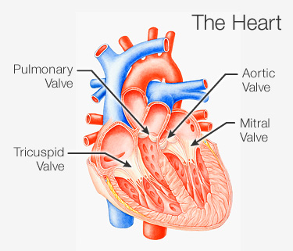
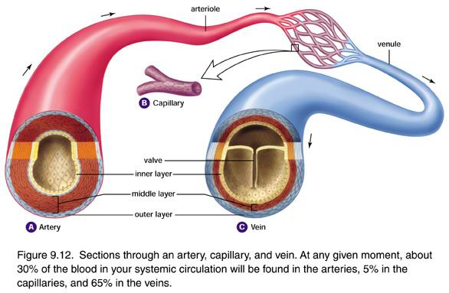
Valves of the heart
The heart has FOUR VALVES:
  Two Atrio-Ventricular valves.
  One Aortic Semilunar valve.
  One Pulmonary Semilunar valve.
ATRIOVENTRICULAR VALVES:
Valves between atria & ventricles.
They allow the blood to flow in one direction from the atria to the ventricles.
Right Atrioventricular Valve (Tricuspid). (connects the right ventricle & atrium)
Left Atrioventricular Valve (Bicuspid) (Mitral). (connects the left ventricle & atrium)
Valves (اختصار):تمنع رجوع الدم للوراء “one way direction”.
SEMILUNAR VALVES (AORTIC & PULMONARY):
Between the right and left ventricles and the great arteries leaving the heart.
  Aortic Semilunar Valve (between left ventricle and the aorta)
  Pulmonary Semilunar Valve (between right ventricle and the pulmonary trunk)
They allow the flow of blood from the ventricles to these arteries .
اذا رجع الدم للوراء يعني هناك خلل في الصمامات
BLOOD VESSELS
Arteries | Veins | Capillaries
Thick walled. Do not have valves. The smallest arteries are arterioles. | Thin walled. Many of them possess valves. The smallest veins are venules. | Connect arterioles and venules. Help to enable the exchange of water, oxygen, and other nutrients between blood and the tissues.

Slide 6
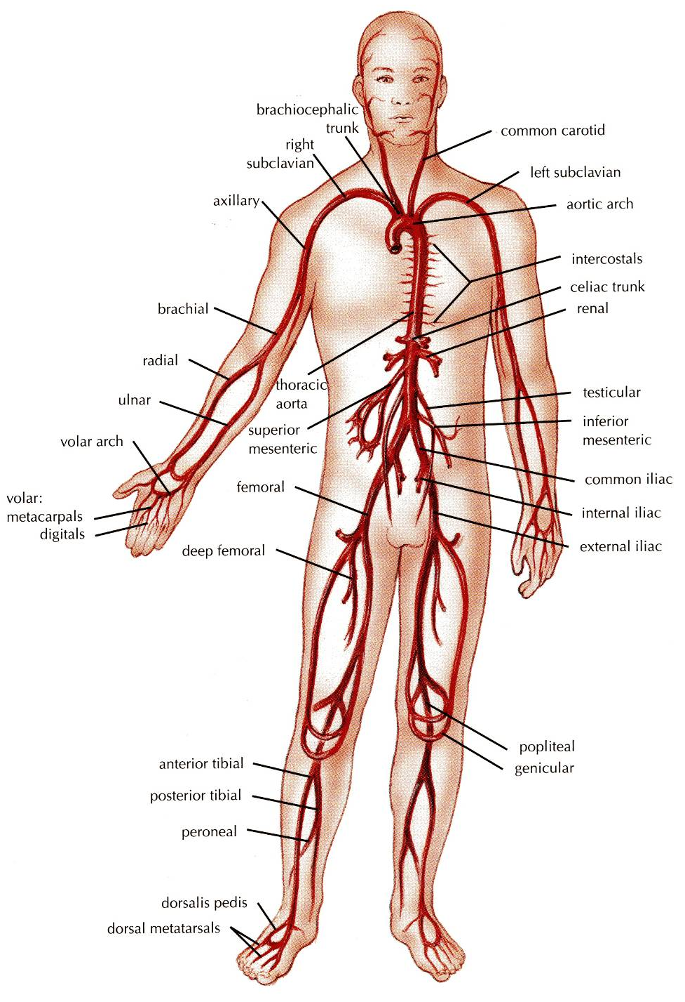
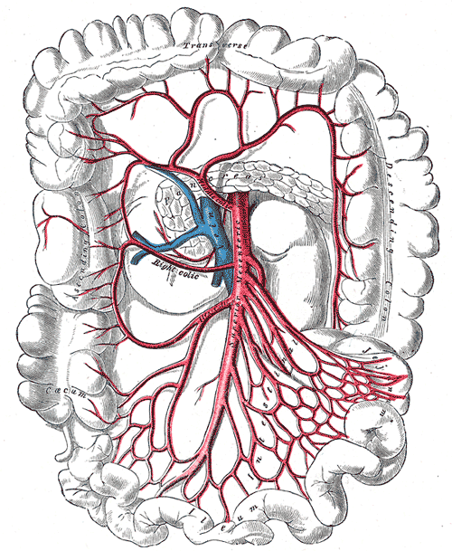
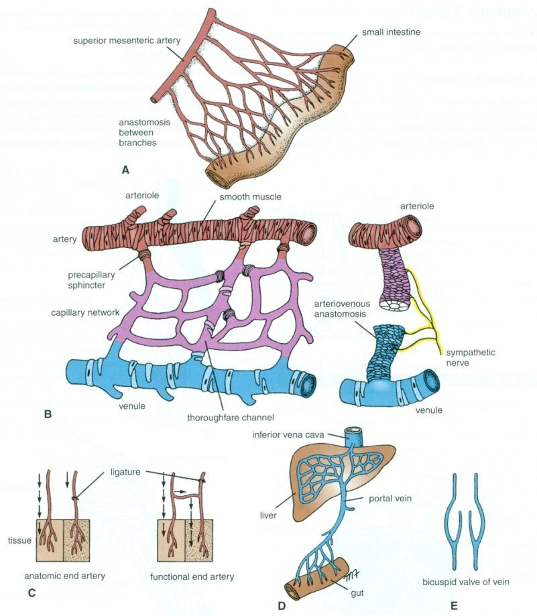
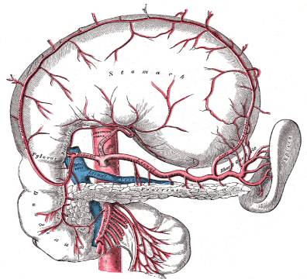
ARTERIES
They transport blood from the heart and distribute it to the various tissues of the body through their branches.
Carry oxygenated blood away from the heart.
  TWO EXCEPTIONS:
    The pulmonary arteries:
      Carries deoxygenated blood from the heart to the lungs.
    The umbilical arteries:
      Supplies deoxygenated blood from the fetus to the placenta in the umbilical cord.
ANASTOMOSIS
It is the joining of terminal branches of arteries.
It is the connection of two structures.
e.g. Intestinal arteries
الهدف منه ان لو جزء من من الاوعية انسد ،الدم يصل من الجزء الآخر.
يكون موجود في الأماكن اللي تحتاج دمن بصورة مستمرة ، مثل الأمعاء.
END ARTERIES
It is the artery that is the only supply of oxygenated blood to a portion of tissue.
  Arteries which do not anastomose with their neighbors are called end arteries.
  Examples:
    Splenic artery.
    Renal artery.
Anatomic End Arteries: | Functional End Arteries:
Vessels whose terminal branches do not anastomose with branches of arteries supplying adjacent areas (e.g. Central artery of Retina). | The terminal branches do anastomose with branches of adjacent arteries but the anastomosis is insufficient to keep the tissue alive if one of the arteries is occluded.

Slide 7
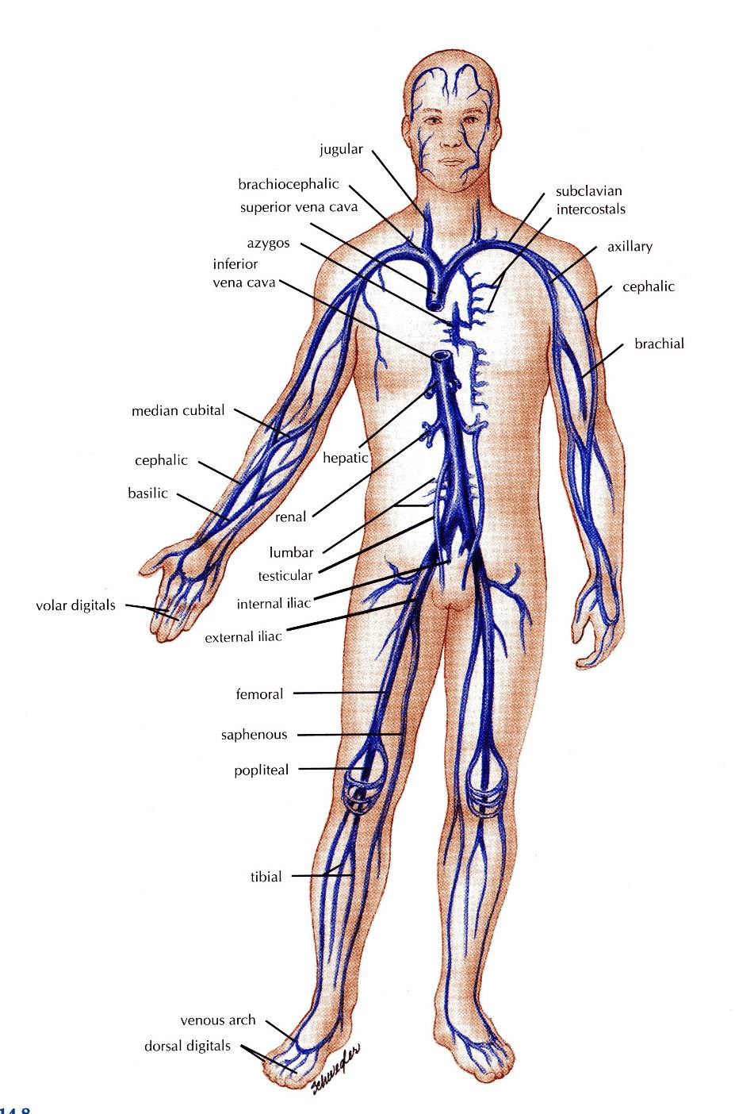
VEINS
They transport blood back to the heart.
The smaller veins (Tributries) unite to form larger veins which commonly join with one another to form Venous Plexuses.
Carry deoxygenated blood toward the heart.
Two Exceptions:
  The pulmonary veins:
    Receive oxygenated blood from the lungs and drain into the left atrium of the heart.
  The umbilical veins:
    Carry oxygenated blood from the placenta to the growing fetus.
DEEP VEINS (VENAE COMITANTES)
Two veins that accompany medium sized deep arteries
Vena comitantes is Latin for: accompanying vein.
They are found close to arteries so that the pulsations of the artery aid venous return.
Venae comitantes are usually found with smaller arteries, especially those in the limbs.
  Larger arteries do not have venae comitantes. They usually have a single, similarly sized vein.
Deep Veins
Large Arteries
1 vein
(No Venae Comitantes)
Medium Arteries
2 Veins, one on each side
(Venae Comitantes)

Slide 8
CAPILLARIES
Microscopic vessels in the form of a network.
They connect arterioles to venules. (Site of the union between the arteries and veins)
They allow the exchange of water, oxygen, and many other nutrients between blood and the tissue.
SINUSOIDS
Thin walled blood vessels like capillaries.
They are wider with irregular cross diameter.
They are found in:
Liver
Spleen
Bone marrow
Pituitary gland
ARTERIOVENOUS ANASTOMOSIS
Direct connections between arteries and veins without the intervention of capillaries.
Found in tips of the fingers and toes.

Slide 9
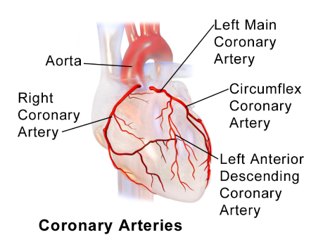
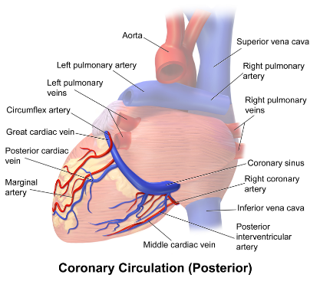
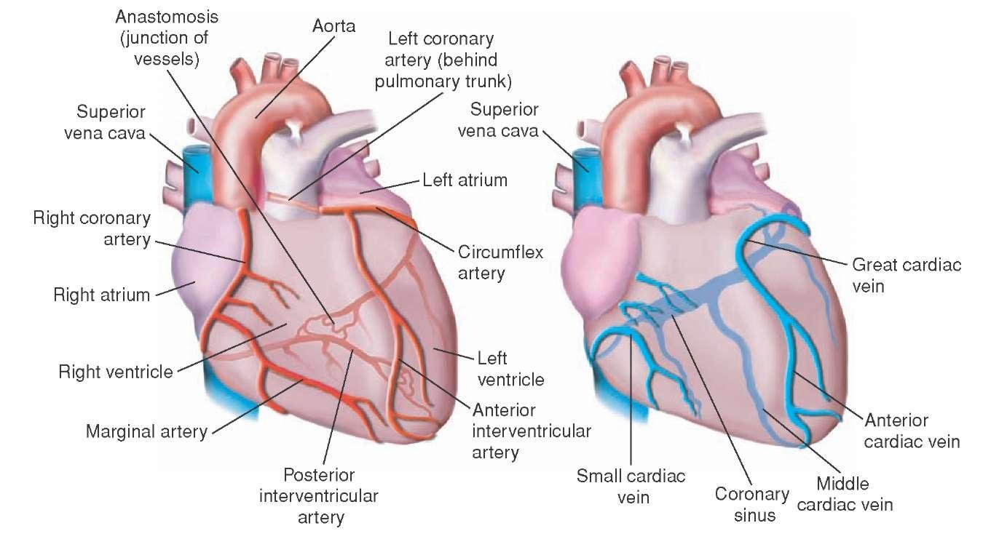
BLOOD CIRCULATION OF THE HAERT
(in boys slides only)
- القلب مسؤول عن تغذية الجسم كاملاً
CORONARY CIRCULATION
The heart has its own blood vessels that provide the myocardium with oxygen and the nutrients necessary to be able to pump blood to the body.
The left and right coronary arteries branch off from the aorta and provide blood to the left and right sides of the heart.
The coronary sinus is a vein on the posterior side of the heart that returns deoxygenated blood from the myocardium to the vena cava.
The coronary artery branches out of the base of the aorta.
Great, middle, and small coronary veins drain into the coronary sinus.
Coronary sinus drains into right atrium.
يطلع من))
Aorta
Left & Right Coronary Arteries
Nourish the Myocardium
Small, Middle, and Great Coronary Veins
Coronary Sinus
Right Atrium
Blood flow in the Blood Circulation of the heart:

Slide 10
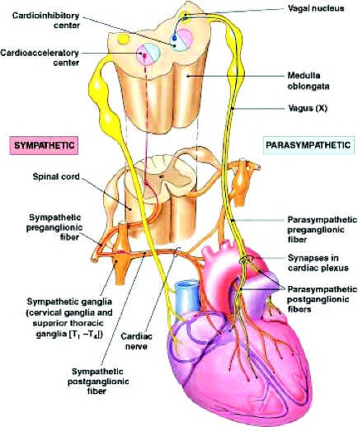
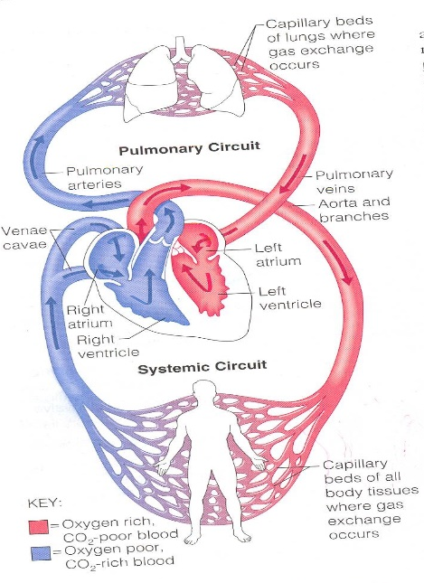
INNERVATION OF THE HEART
(in boys slides only)
VISCERAL MOTOR INNERVATION
The heart receives visceral motor innervations, by:
  Sympathetic (speeds up)
  Parasympathetic (slows down)
BLOOD CIRCULATION
1 - Systemic Circulation (Major Systemic Circulation): the flow of blood between the heart and the cells of the body.
Takes place between the heart and every cell of the body.
Blood is pumped from the left ventricle to all tissues in the body through the aorta and its systemic arteries which ultimately terminate in capillaries.
Oxygen poor blood circulates from the tissues to the capillaries, venules, & veins back to the right atrium through the Systemic Veins.
Left Ventricle
Aorta & Systemic Arteries
Capillaries
Tissue
Capillaries
Venules & Veins
Right atrium
2 - Pulmonary Circulation (Cardiopulmonary) (Minor Systemic Circulation): the flow of blood between the heart and lungs.
Takes place between the heart and lungs.
The right side of the heart (right atrium & ventricle) receive oxygen poor blood.
This blood is pumped from the heart to the lungs through the pulmonary trunk.
Gas exchange takes place in the lungs.
Blood is returned to the left side of the heart (left atrium & ventricle) through 4 pulmonary veins.
Right Atrium
Right Ventricle
Pulmonary Trunk (Artery*)
Lungs (Exchange gases)
4 Pulmonary Veins (2 from each lung)
Left Atrium
Left Ventricle
*Artery: any vessel exists from the heart, always containing Arterial blood.
Except (Pulmonary Trunk) contains Venous blood.
*Veins: any vessel enters the heart , always contain venous blood. Except (Pulmonary Veins) contain Arterial blood.

Slide 11
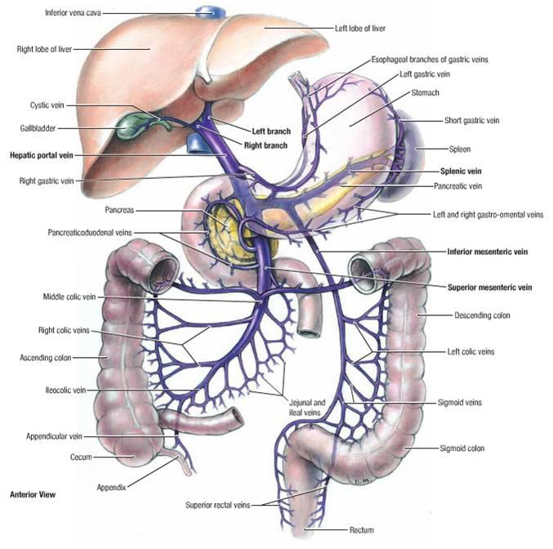
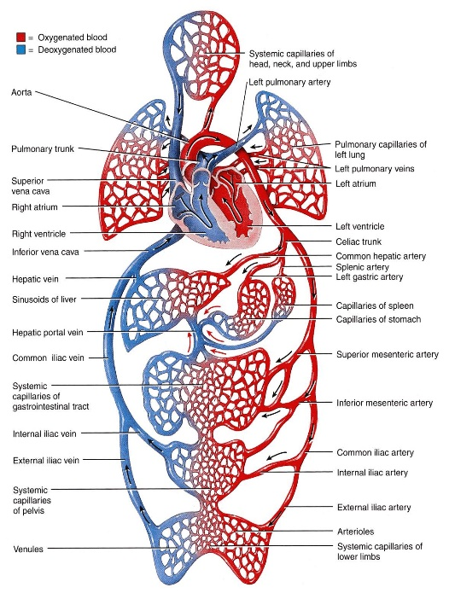
BLOOD CIRCULATION (cont.)
3 - Hepatic Portal Circulation: blood flows from the GIT to the liver through the portal vein then to systemic circulation via IVC (inferior vena cava).
*A network of capillaries is known as a capillary bed.
Portal circulation System
It is a system of vessels interposed between two capillary beds it occurs when a capillary bed pools into another capillary bed through veins, without first going through the heart.
It takes place in the liver and some endocrine glands (Pituitary gland).
Veins leaving the gastrointestinal tract do not go directly to the heart (because it contains CO₂ and digested food).
They pass the Portal Vein.
This vein enters the liver and breaks up into veins of diminishing size which ultimately join capillary like vessels (Sinusoids): first capillary bed.
Venous blood enters the 2nd capillary bed then to smaller veins that leave the liver through hepatic veins.

Slide 12
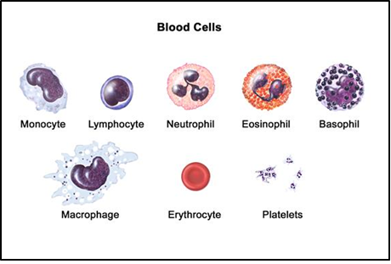
Blood in boys slide only
Blood is the actual carrier oxygen and nutrients into arteries.
Blood is made mostly of plasma, which is a yellowish liquid that is 90% water.
Plasma also contains salts, glucose, and other substances.
Most importantly, plasma contains proteins that carry important nutrients to the body’s cells and strengthen the body’s immune system.
Blood has 3 main types of blood cells that circulate with the plasma.
Types Of Blood Cells in boys slide only
PLATELETS
Help blood clot, clotting stops the blood from flowing out of the body when a vein or artery is broken. Platelets are also called thrombocytes.
RED BLOOD CELLS
Carry oxygen, a healthy adult has about 35 trillion of them. Red blood cells are also called erythrocytes.
WHITE BLOOD CELLS
These cells, which come in many shapes and sizes, are vital to the immune system against infections. When the body is fighting off infection, they increase. White blood cells are also called leukocytes.
For more details: watch this video
https://www.youtube.com/watch?v=nPfTQLpUQ3M

Slide 13
CARDIOVASCULAR DISEASES in boys slide only
HEART ATTACK
  Occurs when blood flow to a part of the heart is blocked by a blood clot. If this clot cuts off the blood flow completely, the part of the heart muscle supplied by that artery begins to die. Most people survive their first heart attack and return to their normal lives to enjoy many more years of productive activity.
ISCHEMIC STROKE
  Happens when a blood vessel that feeds the brain gets blocked, usually from a blood clot. When the blood supply to a part of the brain is shut off, brain cells will die.
HEMORRHAGIC STROKE
  Occurs when a blood vessel within the brain bursts. The most likely cause is uncontrolled hypertension.
HEART FAILURE
  It means the heart isn't pumping blood as well as it should. The heart keeps working, but the body's need for blood and oxygen isn't being met.
ARRHYTHMIA
  This is an abnormal rhythm of the heart. The heart can beat too slow, too fast or irregularly.
HEART VALVE PROBLEMS
  When heart valves don't open enough to allow the blood to flow through as it should.

Slide 14
Summary
The cardiovascular system is a transporting system.
It is composed of the heart and blood vessels.
The heart is cone shaped, covered by pericardium and composed of four chambers.
The blood vessels are the arteries, veins and capillaries.
Arteries transport the blood from the heart.
The terminal branches of the arteries can anastomose with each other freely or be anatomic or functional end arteries.
Veins transport blood back to the heart.
Sinusoids are a special type of capillaries.
The portal system is composed of two sets of capillaries.
It is found in the liver & pituitary gland.
Capillaries connect the arteries to the veins.
The portal system is composed of two sets of capillaries.
The veins from the GIT go to the liver first through the portal vein.
Blood is the actual carrier of oxygen and nutrients into arteries.

Slide 15
Summary (cont.)
Right Atrium
Pulmonary Trunk
4 Pulmonary Veins
Left Atrium
Right Ventricle
Tricuspid Valve
Pulmonary Semilunar Valve
Lungs
Bicuspid (Mitral) Valve
Left Ventricle
Aorta
Systemic Arteries
Capillaries
Venae Cavae
Systemic Veins
Aortic Semilunar Valve
BLOOD CIRCULATION

Slide 16
MCQ
Q1: The heart is located in the middle Mediastinum. (T or F)
A- True B- False
Q2: Which one of the following is a tricuspid valve?
A- Right AVV B- Left AVV C- Aortic valve D- Pulmonary valve
Q3: Arteries have valves. (T or F)
A- T B- F
Q4: Arteries which do not anastomose with their neighbors are called sinusoids. (T or F)
A- T B- F
Q5: Where can we find arteriovenous anastomosis?
A- Tips of fingers B- Apex of the heart
C- The end of umbilical vein D- Liver
Q6: Sinusoids are found in:
A- Pituitary gland B-Liver
C- Spleen D-All of the answers
Q7: Happens when a blood vessel that feeds the brain gets blocked, usually from a blood clot:
A- Heart attack B- Ischemic stroke
C- Hemorrhagic stroke D- Arrhythmia
Q8: Occurs when a blood vessel within the brain bursts.
A- Ischemic stroke B- Hemorrhagic stroke
C- Arrhythmia D- heart failure
Q9: Which of the following chambers receives arterial blood:
A- Left atrium B- Right atrium
C- Left ventricle D- Right ventricle
Q10: Thrombocytes are also known as:
A- RBC B- WBC C- Platelets D- Erythrocytes

Slide 17
MCQ Answers
1-A 2-A 3-B 4-B 5-A 6-D 7-B 8-B 9-A 10-C
Mind Map
https://imgur.com/a/DSjCM
Team members
Faisal Fahad ALsaif ( Team Leader)
Abdulrahman Sulaiman Aldawood
Fahad Aldhowaihy
Abdullah Almeaither
Abdulelah Abdulhadi Aldossari
Saleh Abdullah Almoaiqel
Abdulaziz Mohammed Alabdulkareem
Abdulmajeed Khaled Alwardi
Abdulaziz Ibrahim Aldrgam
Akram Alfandi
Saud Abdulaziz Alghufaily
Mohammed Alquwayﬁli
Ali Alammari
Sultan Alfuhaid
Zeyad Alkhenizan
Fahad Alshughaithry
Saad Aloqile
Abduljabbar Alyamani
Mohammed Alomar
Abdullah Alqarni
Yazeed Aldossari
Fahad Alfaiz
Lamia Abdullah AlKuwaiz (Team Leader)
Abeer Alabduljabbar
Afnan Abdulaziz Almustafa
Albandari Alshaye
Alfahdah Abdullah Alsaleem
Layan Hassan Alwatban
Majd Khalid Albarrak
Norah Alharbi
Rinad Musaed Alghoraiby
Rawan Mohammad Alharbi
Wafa Alotaibi
Wejdan Fahad Albadrani
Good Luck

