Slide 1
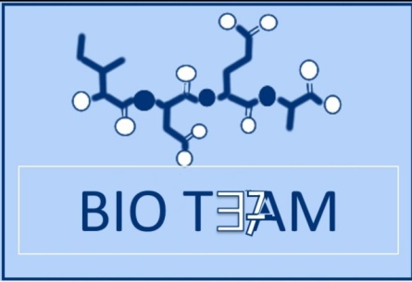
Amino Acids
Don’t forget who you are, there’s a rise after a fall
Don’t lose hope and don’t quit.
Color index:
Doctors slides
Notes and explanations
Extra information
highlights

Slide 2
Objectives:
What are the amino acids?
General structure.
Classification of amino acids.
Optical properties.
Amino acid configuration.
Non-standard amino acids.
Derivatives of amino acids.

Slide 3
What are amino acids?
The Chemical units that combine to form Proteins
A type of Organic Acid that contain both a Carboxyl group (COOH) and an Amino group (NH₂ )
* Chemical units= Monomers
Amino acids play central roles:
The building blocks of proteins.
As intermediates (وسيط)in metabolism.
There are 20 Amino acids
Human can produce half of amino acids.
The others must be supplied in the food.
When proteins are digested or broken down, amino acids are left.

Slide 4
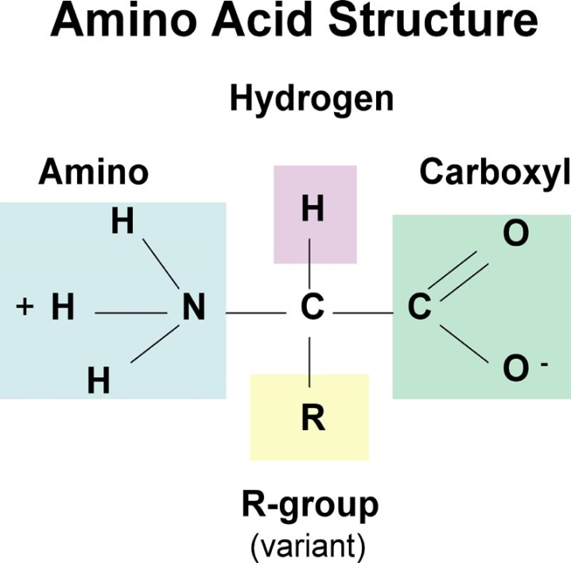
General structure of amino acids
Alpha carbon that is attached to:
A) Hydrogen atom (H)
C) Carboxylic acid group (COOH)
B) Side chain ( R ) (Which is distinctive for each amino acid and gives the amino acid a unique set of characteristics)
D) Primary Amino acid group NH₂
(except for Proline which has a secondary amino group).
H
Alpha Carbon: is between the Carboxyl and the Amino group.

Slide 5
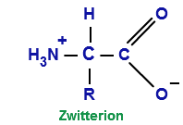
Isoelectric point (PI) and Zwitterion
Isoelectric Point (PI):
Is the PH at which the molecule carries no net charge (neutral). ( The sum of the positive charge equal the sum of the negative charge).
Zwitterion يعني ببساطة تصير في حالة
Zwitterion:
Is a neutral Amino acid with both positive and negative electrical charges.
The sum of those charges must equal ZERO.
(BASE)
-Proton Acceptor (Take protons)
(ACID)
-Proton Donor (give protons).
Zwitterions Simultaneously have both Cationic and Anionic states.

Slide 6
Cationic | Zwitterion | Anionic
Low PH | PH=PI | High PH
Positively charged | No net charge | Negatively Charged
When put in Acidic Solution | Isoelectric point | Alkaline Solution (Basic)
PH increasing (adding base)
The carboxylic acid will gain a proton (Hydrogen atom) and lose its negative charge. The overall charge on the molecule is now positive (Cationic). | Zwitterion is used to describe the molecule. Isoelectric point is used to describe the PH level. | The amino group will lose a proton and lose its positive charge. The negative overall charge on the molecule is now (Anionic).

Slide 7
pK Value: also known as pka or acid dissociation constant
Dissociate=split into smaller atoms
• It is the ability of an acid to donate a proton (dissociate).
pKa let us know how strong or weak an acid is .
lower pKa mean stronger acid (علاقة عكسية )
• The pK values of α-carboxylic group is in the range of 2.2. “low pK,stronger acid”
• The pK values of α-amino group is in the range of 9.4. “higher pK, weaker acid”
Dr. notes (436) : carboxylic group is a stronger acids (with low pk value) than the amino group, so it will give
off it's proton first (first pk value = 2.2 ) then the amino group ( higher pk value) will donate afterward
(second pk group = 9.4) .

Slide 8
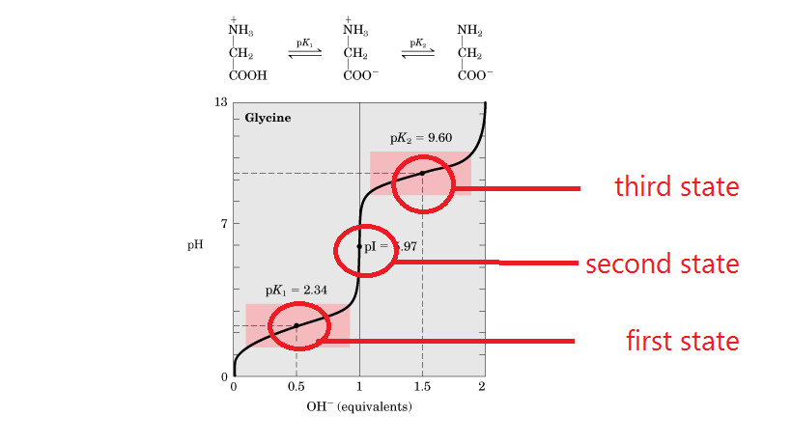
Titration curve of glycine
Titration is the slow addition of one solution of a known concentration (called a titrant) to a known volume of another solution of unknown concentration until the reaction reaches neutralization
“تسمى المعايرة، وتستخدم عادة لمعرفة تركيز محلول حمضي معين غير معلوم تركيزه بإضافة محلول قاعدي آخر معلوم التركيز
Adding base
dr. notes (436) :
- zwitterion the amino acid itself that has no net charge.
- If the side chain contains an ionized group, in this case the amino acid is not a zwitterion.
- Buffer is a solution resists change in pH when an acid or base is added into it.
- At physiological pH,(7.3) the a-carboxyl and a- amino groups are dissociated.
- All free amino acids and charged amino acids in peptide chains,(protiens) can serve as buffers.

Slide 9
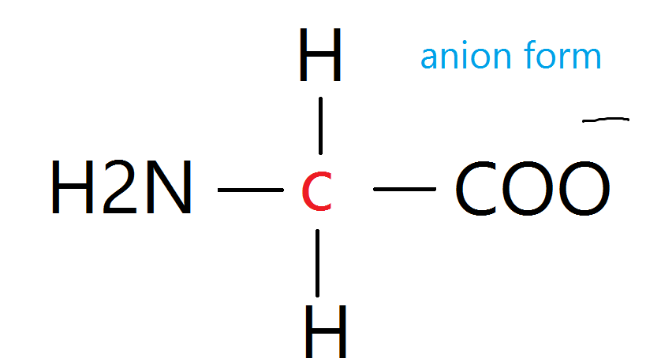
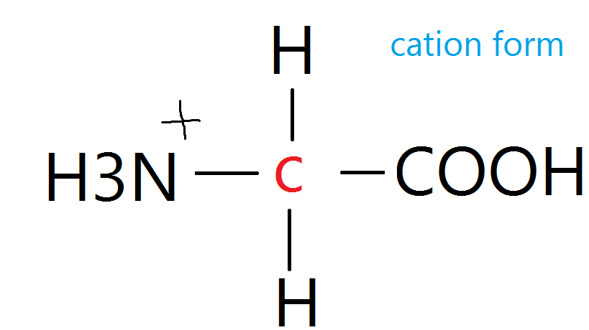
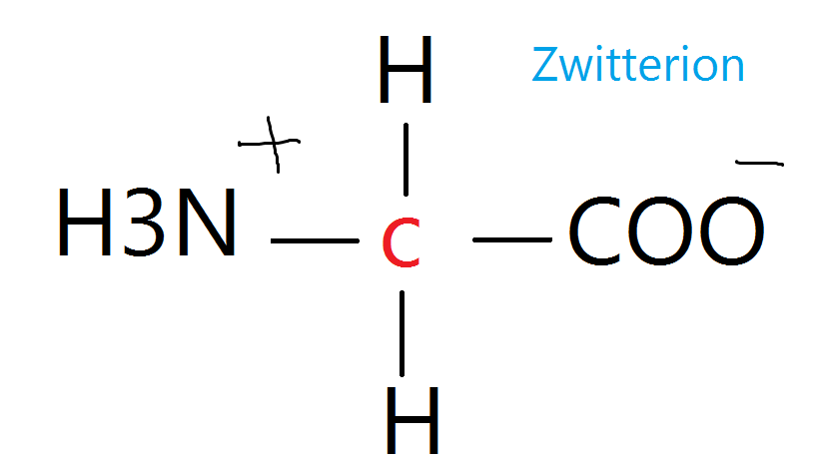
First state pK1 : pH=2.3
COOH group in glycine has lower pk then it will start donating its H first and become COO-
50% of the molecules are in cation form ( net charge is positive )
And 50% are in zwitterion (net charge is zero)
the buffering will be at its max .
Second state PI : pH=5.9
All COOH groups donated their H
100% of the molecules zwitterion net charge is zero
the buffering will be at its minimum .
Third state pK2 : pH=9.6
At this level the ammonia group start donating its H and become NH2
50% of the molecules are in anionic form (net charge is negative)
And 50% are in zwitterion (net charge is zero)
the buffering will be at its max.

Slide 10
Classification Of Amino Acids
*أسماء الاحماض تحفظ مع تصنيفها*
2-properties of the side chain
Non-Polar
hydrophobic
Polar
essential
non essential
conditional
Uncharged
Zero net charge at neutral pH
1-Body requirement
produced by the body
not essential except in time of illness or stress
cannot be produced by the body
phenylalanine
Valine
Threonine
Tryptophan
Isoleucine
Methionine
Histidine
Leucine
lysine
Glutamic acid.
Alanine
Asparagine
Aspartic acid
Proline
Glutamine
Glycine
Cysteine
Arginine
Tyrosine
Serine
1-With acidic side chain
2-With basic side chain
Glu Ala AsAs
قله على اساس
PGG CATS
“Big cats”
PVT TIM HALL

Slide 11
Non Polar
Each amino acid does not bind or give off protons or participate in hydrogen or ionic bonds.
They promote hydrophobic interactions
LOCATION OF NON POLAR AMINO ACIDS IN PROTEINS :
Proteins in aqueous solution
“polar environment”
The non polar side chain cluster together in the interior of the protein
The non polar R group fill up the folded protein thus giving its 3D shape
الحمض غير قطبي ولكن البيئة الخارجية للبروتين قطبية (ماء)
تتجمع الاحماض “الغير قطبية” داخل البروتين للهرب من البيئة “القطبية”
Proteins in Hydrophobic environment
Such as membrane
The non polar R group found on the outside surface of the protein
Interacting with lipid environment to stabilize protein structure
الحمض غير قطبي والبيئة ايضاً
غير قطبية
الاحماض الغير قطبية تتواجد بالسطح الخارجي للبروتين
تتفاعل الاحماض مع البيئة الدهنية لتثبيت هيكل البروتين

Slide 12
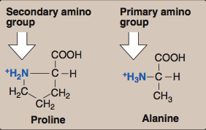
You don’t need to memorize the structures
Non-polar Amino Acids:
The structure of the proline amino acid differs from other nonpolar amino acids that the side chain of proline and its α-amino group form a ring structure (an imino group).
يختلف البرولين عن بقية الاحماض لان السلسلة الجانبية تكون حلقة مع مجموعة الأمين
مما يجعل مجموعة الأمين ”secondary”

Slide 13
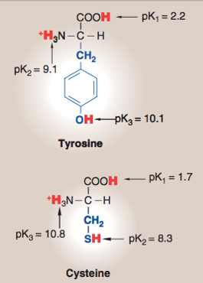
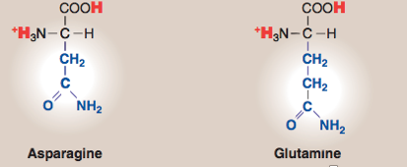
Uncharged amino acids: = zero net charge at neutral pH HOWEVER:
Hydroxyl group
1- The side chains of cysteine and tyrosine can lose a proton at an
> بي اتش عاليalkaline pH.
البروتونات فيه قليلة فبالتالي هو يحاول يكسب بروتونات دايم
2- Serine, Therionine and Tyrosine each contain a polar hydroxyl group that can participate in hydrogen bond formation.
both can participate in hydrogen bonds.
3- The side chains of asparagine and glutamine each contain a carbonyl group and an amide group, both of which can also participate in hydrogen bonds.

Slide 14
POLAR amino acids
Amino acids with acidic side chains:
Amino acids with basic side chains:
- Aspartic - glutamic acids
proton donors
-Histidine -Lysine -Arginine
proton acceptors
At neutral pH, these amino acids are fully ionized (negatively charged). So, they are called aspartate and glutamate.
At neutral pH, lysine and arginine are fully ionized (positively charged).

Slide 15
EXRA revision of amino acids and their classifications
ESSENTIAL
NON ESSENTIAL
CONDITIOMAL
phenylalanine
Valine
Threonine
Tryptophan
Isoleucine
Methionine
Histidine
Leucine
lysine
Glutamic acid.
Alanine
Asparagine
Aspartic acid
Proline
Glysien
Glutamine
Cysteine
Arginine
Tyrosine
Serine
Negative
(ate)
+
Contain C=O and NH2- < make H bonds
GLU ALA ASAS
Negative at an alkaline ph
+
+
PGG CATS
Non polar
Uncharged “zero net charge at neutral
ph.
Polar
+
PVT TIM HLL
Contain polar hydroxyl group = make hydrogen bonds

Slide 16
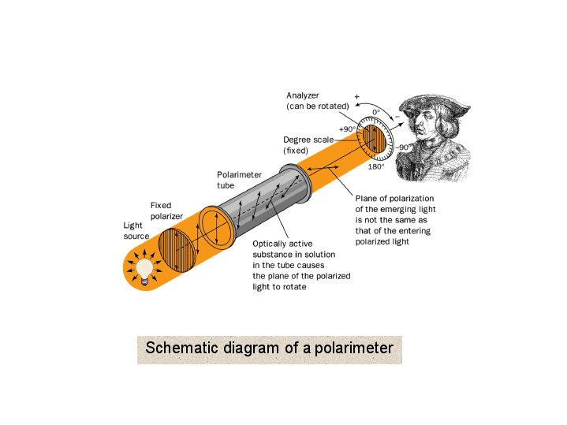
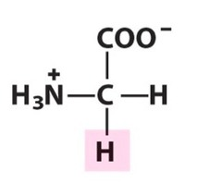
Optical properties
Optically Active amino acids
They rotate the plane of polarized light in a polarimeter
= asymmetric
= α-carbon attached to 4 different
chemical groups
Optically Inactive amino acids
= symmetric
= α-carbon attached to less than 4 groups
Only Glycine
ثديات
All mammalian amino acids except Glycine
* الكربون هنا متصل ب٣ مجموعات
3 < 4
فقط بالتالي هو symmetric
مقياس الاستقطاب هو أداة علمية تستخدم لقياس مقدار دوران مستوى الضوء المستقطب عند مروره خلال عينة من المركب الذي به نشاط ضوئي.
Optically active: they rotate the plane of polarized light in a (polarimeter).

Slide 17
Amino acid configuration
L-Amino acids | D-Amino acids
Rotate polarized light to the Left. | Rotate polarized light to the Right.
Both L and D forms are chemically same.
All mammalian amino acids are found in L-configuration. | D-Amino acids are found in antibiotics, plants and in the cell wall of microorganisms.

Slide 18
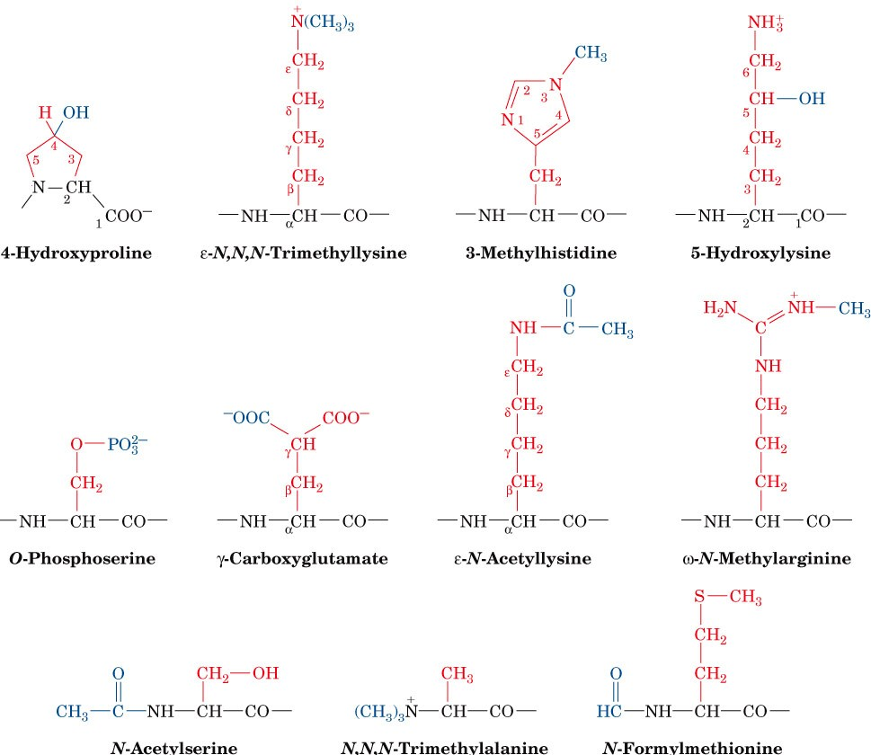
Non Standard Amino Acids:
-Aside from the twenty standard amino acids, there are a vast number of "non-standard" amino acids.
زيادة على الاحماض العشرين الاساسية
فيه زيادة احماض غير اساسية
-These nonstandard amino acids are usually formed through modifications to standard amino acids.
*اسمائها غير مطلوبة، فقط اعرفي انها non standard
تتكون هذي الاحماض من خلال تعديلات على الاحماض الاساسية

Slide 19
Amino acids derivatives
مشتقات
Derivavtive of | name | Role
tyrosine | dopamine | neurotransmitters
 | Thyroxine | an important thyroid hormone.
Histidine | histamine | The mediator of allergic reactions
Glutamic acid | Gamma amino butyric acid (GABA) | neurotransmitters
وسيط

Slide 20
Mnemonics
Non-polar
ProGAV PIL TM -proline, glycine, alanine, valine, phenylalanine, isoleucine, leucine, tryptophan, methionine CHARGED "SomeTimes Cats Try A Growl" -serine, threonine, cysteine, ,tryrosine asparagine, glutamine POLAR "A Good Lawyer Aims High" -Aspartate, Glutamate, Lysine, Arginine, Histidine

Slide 21
MCQs «اجتهاد شخصي و أرجو عدم الاعتماد عليها»
Amino acids are a) building blocks of carbohydrates
b) building blocks of nucleic acids
c) building blocks of lipids
d) building blocks of proteins
2. Acidic amino acids include
a) Arginine and glutamate
b) Aspartate and asparagine
c) Aspartate and lysine
d) Aspartate and glutamate
3. Amino acids with hydroxyl groups are
a) serine and alanine
b) Alanine and valine
c) serine and threonine
d) Valine and isoleucine
.4Positively charged basic amino acids are
a) Lysine and arginine
b) Lysine and asparagine
c) Glutamine and arginine
d) Lysine and glutamine

Slide 22
GIRLS TEAM:
الهنوف الجلعود
رهف الشنيبر
شهد الجبرين
لينا الرحمة
سارة البليهد
ليلى الصباغ
BOYS TEAM: 1-Dawood Ismail. 2- turkey al-bnhar 3- saeed alsarar 4- abdulmalik alsharhan 5- mohammed al-quefly 6- nwaf abdulaziz
Team leaders: 1- Mohammed hassa hakeem 2- Reham alhalabi Contact us: teambiochem437@gmail.com For editing file: https://docs.google.com/presentation/d/16yNcm2Y08Cr0Am83lDRfH5NB4F1ng3tdHiB3O1AqMc8

