Slide 1
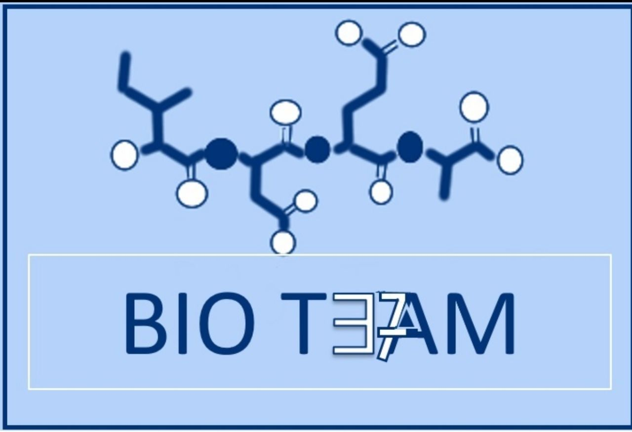
Color index:
Doctors slides
Notes and explanations
Extra information
Highlights

Slide 2
Objectives:
Define a metabolic pathway.
Describe the general metabolic pathways for glucose (production and utilization)
Briefly describe the HMP
Recognize the mechanisms of glucose transport

Slide 3
Pathway: Series of chemical reactions that have one goal.
Reaction: Substrate+Substrate = Product.
Metabolic pathways
Definition
Pathway for glucose happens in almost every cell, starting by oxidation of glucose and ending with pyruvate (or lactate).
Regulatory mechanism(s)
Site
Reaction
1- Rapid short-term
-Covalent modification
-Allosteric
2- Slow long-term (hormone)
-Induction\repression
- Cellular tissue (tissue)
- Subcellular
Inside the cell (Mitochondrial)
Few are rate-limiting enzymes (They are found only in irreversible pathways).

Slide 4
Metabolic pathways of glucose
Catabolic Cycles | Anabolic Cycles
Glycolysis & Kreb (mainly) Glycogenolysis HMP | Gluconeogenesis Glycogenesis
Production
Glycogenolysis
Gluco-neo-genesis
Hexose interconversion
Catabolic
Anabolic
To understand ☺
*You DON’T have to know this*
Prefix:
Glyco-: glucose
Glycogeno-: glycogen
*except in synthesis of glycogen: we say glycogensis instead of saying glycogeno-genesis.
To differentiate: the synthesis of glucose is glucoNEOgenesis*
Utilization
HMP / PPP
Glyco-lysis
Hexose interconversion
Glycogenesis
Catabolic
Catabolic
Anabolic
Suffix:
-genesis: process of producing
-lysis: breaking down.
Krebs cycle
Catabolic

Slide 5
Glycolysis
*Aerobic: with oxygen
*Anaerobic: without oxygen
Oxidation (breaking down) of glucose to provide energy.
The kind of glycolysis | Aerobic glycolysis | Anaerobic glycolysis
When | If there is enough(adequate supply) oxygen, Cells that has mitochondria | In absence of oxygen , cells that lack mitochondria
The end product | Pyruvate(s) + 8ATP | Lactate + 2 ATP

Slide 6
Glycogenesis and Glycogenolysis
Glycogenesis
Glycogenolysis
Synthesis of glycogen from glucose .
Occurs when glucose and ATP are present in relatively high amounts (This process is: storage)
Degradation (تكسير) of glycogen into glucose
Occurs in response to hormonal and neural signals
هرمونات او إشارات كهربائية ( اذا احتاج الجسم جلوكوز يرسل إشارات للجلايكوجين لكي يتحول )
(اذا زاد الجلوكوز في الجسم و كانت الطاقة موجودة يتم تخزين الجلوكوز على شكل جلايكوجين عشان يحرقه و يستخدمه بعدين)
Both the same location: Mainly in liver and muscle→ Cytosol

Slide 7
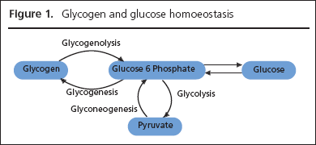
Gluconeogenesis
Synthesis of glucose from non-carbohydrate precursors.
The precursors could be lactate) Anaerobic), pyruvate(Aerobic ), glycerol and alpha-keto acids.
It requires both mitochondria and cytosolic enzymes.
It occurs in Liver and kidney.
Glycerol: is a part of the triacylglycerol molecule which is the main constituent of body fat.
Keto acids: are organic compounds that contain a carboxylic acid group and a ketone group. The alpha-keto acids are especially important in biology as they are involved in the Krebs citric acid cycle and in glycolysis.
cytosolic enzymes: present in cytosol

Slide 8
Hexose Monophosphate shunt (HMP) or Pentose Phosphate Pathway (PPP)
HMP shunt is an alternative pathway of glucose oxidation.
It is not involved in the generation of energy.
Around 10% of glucose is entered in this pathway.
In liver and kidney, this percentage is up to 30%.
PPP is a metabolic pathway parallel to glycolysis.

Slide 9
Biomedical Importance of HMP
It has two main functions:
Provides NADPH which is required for:
synthesis of fatty acids, steroids and some amino acids
Detoxification of drugs by Cytochrome P450.
In scavenging the free radicals.
Provides Pentoses, e.g. ribose
This pentose and its derivatives are useful in the synthesis of:
Nucleic acids (DNA and RNA)
Nucleotides (ATP, NAD, FAD and CoA)
Note: Cytochrome P450: enzymes also function to metabolize potentially toxic compounds, including drugs and products of endogenous metabolism such as bilirubin
Tissue Distribution of HMP
in the Cytosol of the following locations:
Adipose tissue | Liver
Erythrocytes (RBC) to reduce glutathione | Lactating mammary gland
Lens and cornea | Adrenal cortex
 | Gonads

Slide 10
Phases of HMP Shunt
It has two phases:
Oxidative phase (irreversible)
Non-oxidative phase (reversible)
There are two distinct phases in the pathway. The first is the oxidative phase, in which NADPH is generated, and the second is the non-oxidative synthesis of 5-carbon sugars.

Slide 11
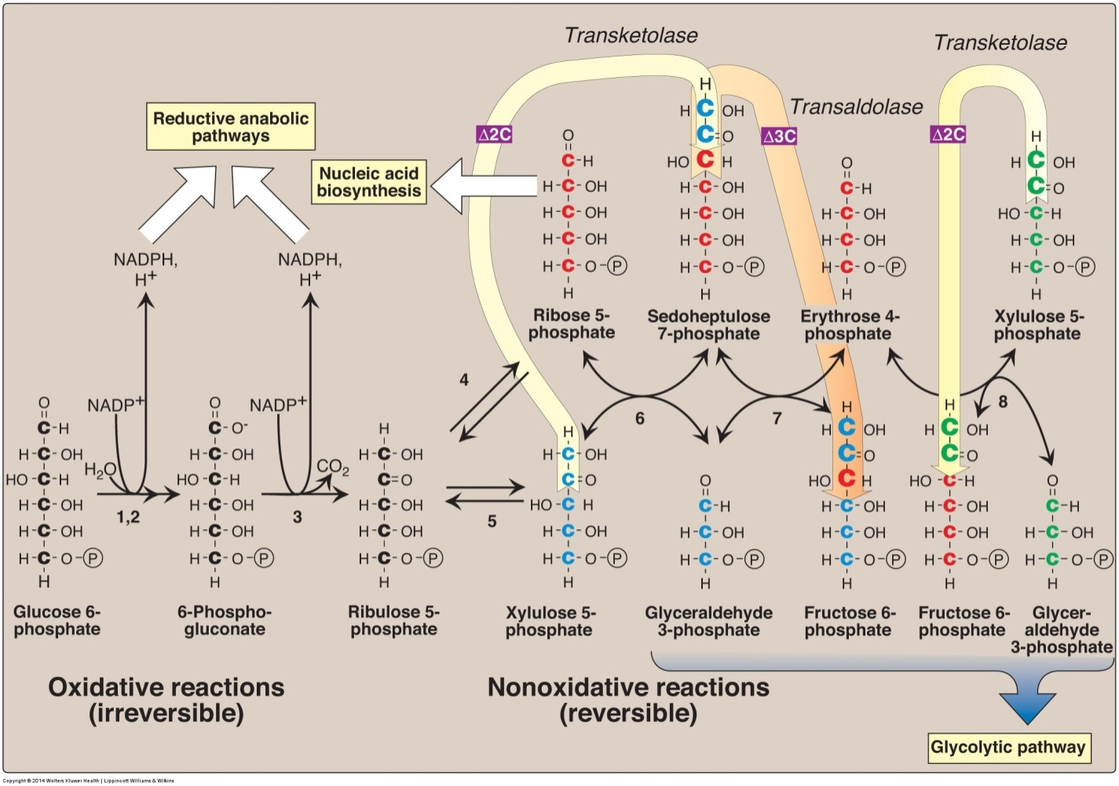
important : Enzymes numbered above are: 1, 2) glucose 6-phosphate dehydrogenase and 6-phosphogluconolactone hydrolase, 3) 6-phosphogluconate dehydrogenase, 4) ribose 5-phosphate isomerase, 5) phosphopentose epimerase, 6 and 8) transketolase (coenzyme: thiamine pyrophosphate), and 7) transaldolase.

Slide 12
Phase 1- Oxidative pathway
Source – wordpress.com

Slide 13
Phase 2- Non-oxidative a) Interconversion of pentoses

Slide 14
Phase 2- Non-oxidative

Slide 15
Phase 2- Non-oxidative a) Conversion of pentose phosphate to hexose phosphates

Slide 16
Transketolation

Slide 17
Transaldolation
هي عملية reversible أي ذو اتجاهين يقوم بها انزيمtransaldolase لتعطي التالي :
fructose 6-phosphate + erythrose 4-phosphate sedoheptolose 7-P+G3p
7th Reaction
add 3 carbon to sedoheptulose
Transketolation
- انزيم Transketolase يلعب دور مهم في التفاعلين السادس والثامن . - يضيف كاربونين ، عكس transaldolase الذي يعطي ٣ كربونات . -لا بد من وجود العامل المحفز coenzyme: thiamine pyrophosphate .
6- Ribose + xylulose ( this reaction is catalyzed by Transketolase with TPP). And will give us 2 new sugar molecules : Sedoheptolose (7C) AND glyceraldehyde (3C) التفاعل الأخير 8- Xylulose5-P+Erythrose4-P ( this reaction is catalyzed by Transketolase with TPP. And will give us 2 sugar molecules : Fructose 6-P AND Glyceraldehyde 3-P .

Slide 18
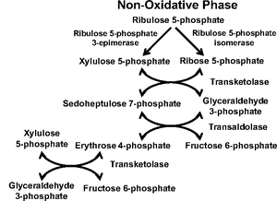
Clinical Correlations
4) ribose 5-phosphate isomerase, 5) phosphopentose epimerase, 6 and 8) transketolase (coenzyme: thiamine pyrophosphate), 7) transaldolase. يفضل فهمها من خريطة Glycolysis
Med436
Glucose-6-phosphate dehydrogenase deficiency
The condition is characterized by abnormally low levels of glucose-6-phosphate dehydrogenase, an enzyme involved in the pentose phosphate pathway that is especially important in the red blood cell. G6PD deficiency is the most common human enzyme defect
Hemolytic anemia: relating to or involving the rupture or destruction of red blood cells.
Neonata: relating to newborn children
Source – wordpress.com

Slide 19
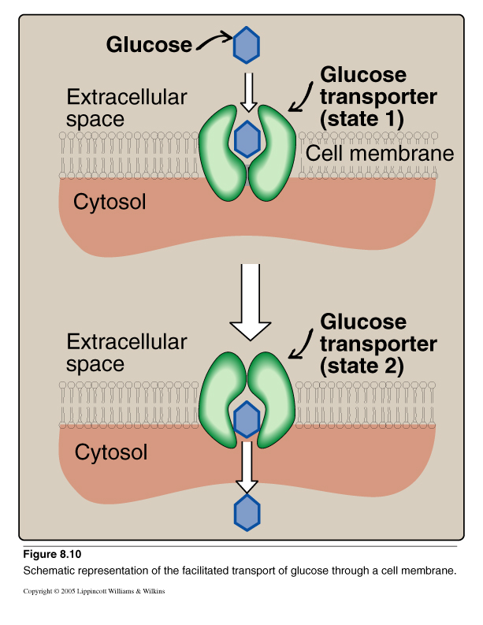
Glucose Transport
Na+-Monosaccharide Cotransporter: active transport | Na+-Independent Facilitated Diffusion:
Against concentration gradient (SGLT-1.2) Energy dependent Carrier-mediated Coupled to Na+ transport Small intestine, renal tubules & choroid plexus( blood brain barrir ). | Down the concentration gradient Energy Independent Glucose Transporters (GLUT 1-14)
Glucose Transport: Facilitated Diffusion

Slide 21
Take home messages
There are multiple pathways for glucose that can be grouped in to catabolic (utilizing glucose) or anabolic (producing glucose)
Glycolysis is the major metabolic pathway of glucose breakdown to provide energy
Alternative pathway for glucose oxidation but not meant for producing energy
Has two phases- oxidative and non-oxidative
During oxidative phase, glucose-6-P is oxidized with generation of 2 moles of NADPH, and one mole of pentose phosphate, with liberation of CO2
During non-oxidative phase, pentose phosphate is converted to intermediates of glycolysis

Slide 22
1- Phases of HMP Shunt
A-Oxidative phase and substrate-Level
B-Non-Oxidative phase and substrate-Level
C-Oxidative phase and Non-Oxidative
D-None
2- What is the main function of HMP ?
A- produce energy
B- Provides NADPH
C- Provides Pentoses
D- B & C
3- NADPH is required synthesis of
A- synthesis of fattyacids, steroid and some amino acids
B- In scavenging the free radicals
C- synthesis of Nucleic acids
D- A & B
4- what is the function of GLUT-5
A- Fructose transport
B- Uptake of glucose from the blood
C- Allowing glucose to flow in 2 directions
D- All of above

Slide 23
GIRLS TEAM:
الهنوف الجلعود
رهف الشنيببر
شهد الجبرين
لينا الرحمة
منيرة المسعد
ليلى الصّباغ
العنود المنصور
أرجوانة العقيل
ريناد الغريبي
مجد البراك
روان مشعل
BOYS TEAM:
١- محمد صالح القسومي
٢- نواف عبدالعزيز
٣- عبدالملك الشرهان
٤- صالح المعيقل
Team leaders: ١-محمد حسن حكيم
٢- رهام الحلبي Contact us: teambiochem437@gmail.com For editing file: https://docs.google.com/presentation/d/16yNcm2Y08Cr0Am83lDRfH5NB4F1ng3tdHiB3O1AqMc8

