Slide 1
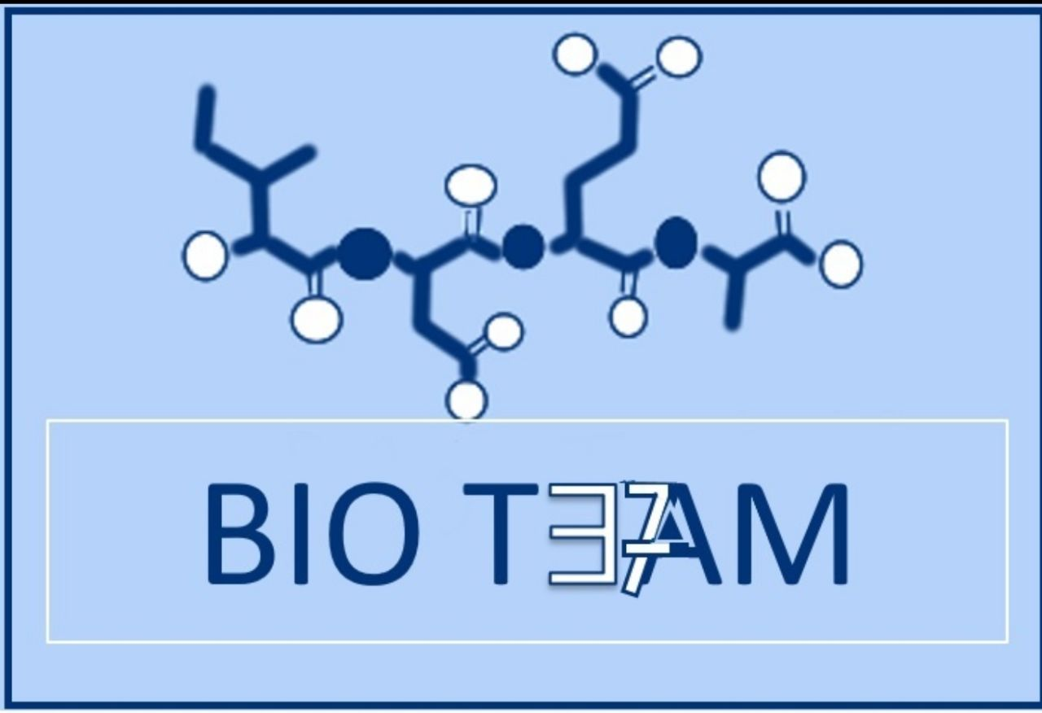
Color index:
Doctors slides
Notes and explanations
Extra information
Highlights

Slide 2
Objectives:
Of Oxidative Decarboxylation:
Recognize the various fates of pyruvate
Define the conversion of pyruvate to acetyl CoA
Discuss the major regulatory mechanisms for PDH complex
Recognize the clinical consequence of abnormal oxidative decarboxylation reactions
Of Krebs Cycle:
Recognize the importance of Krebs cycle.
Identify various reactions of Krebs cycle
Define the regulatory mechanisms of Krebs cycle
Assess the energy yield of PDH reaction and Krebs cycle’s reactions

Slide 3
Acetyl CoA
*in Krebs cycle
Oxaloacetate
*In Krebs cycle (it’s an intermediate)
* Activated by acetyl CoA
*Importance:
1. Replenishes intermediates of the TCA cycle.
2. Provide substrates for gluconeogenesis
3. An irreversible reaction
Ethanol
*It occurs in yeast and some Bactria (including intestinal flora)(Anaerobic)
* Thiamine pyrophosphate-dependent pathway
Alanine
Synthesis of non-essential amino acid using pyruvate + glutamine "essential”
*Done by Alanine transaminase enzyme “ALT”
• PLP = pyridoxal phosphate*
Fates of Pyruvates
Lactate
*in humans and some microorganisms “anaerobic”
)Remember: Pyruvate is the end product of glycolysis)

Slide 4
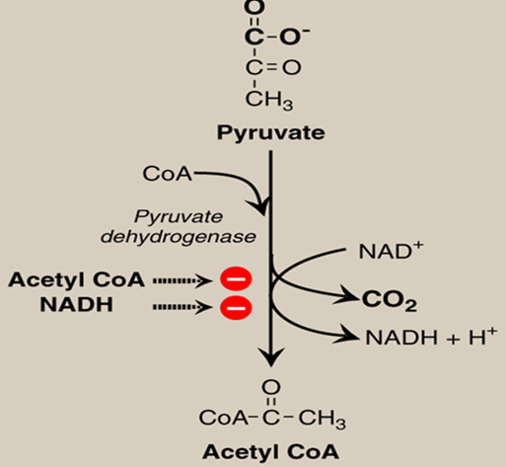
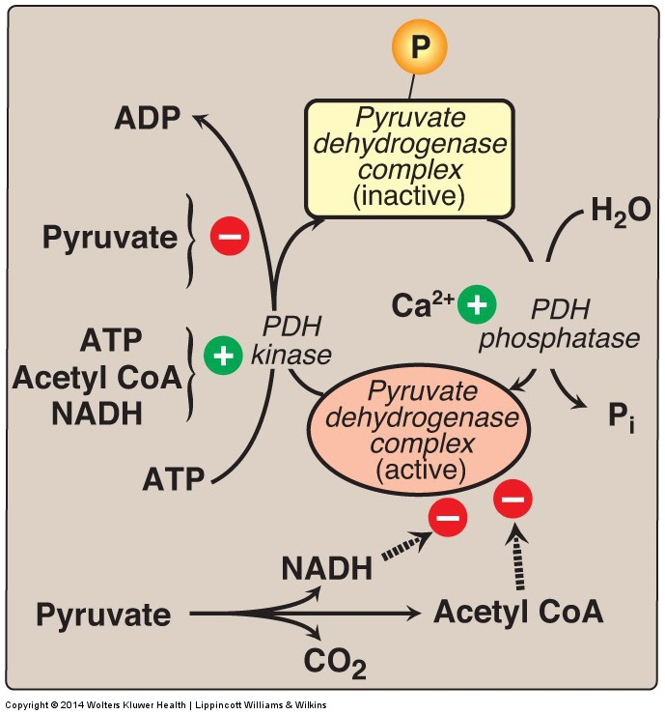
Oxidative Decarboxylation of Pyruvate
making acetyl Co-A from pyruvate by pyruvate dehydrogenase
Produces 2 NADH=6 ATP
Regulated by allosteric regulation of Acetyl coA and NADH
Inhibtors :Increased amount of Acetyl CoA and NADH act as “Negative Feedback” inhibitors of their respective reactions.
PDH Complex: Covalent Regulation
.
*Pyruvate dehydrogenase complex (PHD) has two forms active and inactive. Regulated by co-enzymes.
*inactive form: regulated by PDH kinase (adds phosphate)
*active form: regulated by PDH phosphatase (removes phosphate)
- ↑ pyruvate , Inactivation of PDH kinase (leading to activate acetyl CoA)
- ↑ ATP, acetyl co-A, NADH , Activation of PDH kinase (leading to inhibit making acetyl CoA)
Ca+2 activates PDH phosphate , which activates the enzyme pyruvate dehydrogenase, making more acetyl CoA
-NADH, Acetyl CoA inhibits PDH phosphate which inhibits making of acetyl CoA
شرح مبسط:
اذا زاد البيروفيت وصار متواجد بكميات كبيرة بديهيا نحتاج نتخلص منه ونحوله الى استيل كو أي ف رح نثبط انزيم الكينيز اللي وظيفته اساسا تثبيط عملية تحويل البيروفيت الى استيل كو اي والناتج من هذي العملية جزئ الطاقة, الحين اذا كان زايد عندك جزئ الطاقة والاستيل كو أي نفسه رح تحتاج تسوي عكس العملية اللي فوق وهي انك تحفز انزيم الكينيز اللي بوظيفته يثبط عملية التحويل

Slide 5
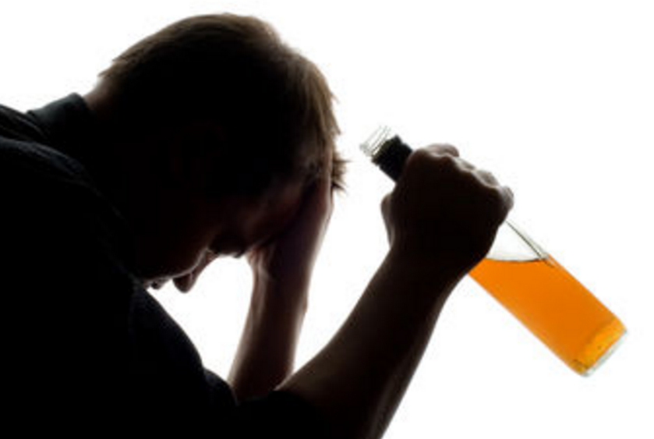
PDH Reaction: Clinical application
PDH complex plays a important role in CNS
How?
Brain cells are unable to produce sufficient ATP if the PDH complex is inactive ‘no production of acetyl coA thus, no krebs cycle thus, no ATP’
*Thiamine and niacin are co-factors that helps PDH complex
*Deficiencies of them can cause serious CNS problems
congenital lactic acidosis
PDH complex deficiency is the most common biochemical cause.
‘too many pyruvates leads to the use of anaerobic respiration which make lactate accumulate’
Wernicke-Korsakoff (encephalopathy-psychosis syndrome):
due to thiamine deficiency, may be seen especially with alcohol abuse.

Slide 6
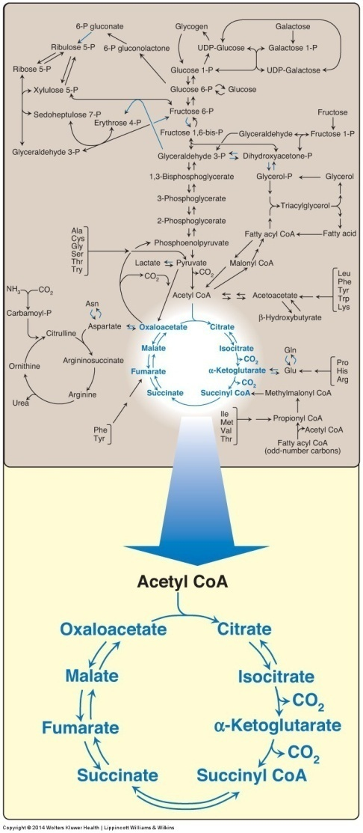
Tricarboxylic Acid Cycle: Krebs Cycle
The tricarboxylic acid cycle (Krebs) shown as a part of the essential pathways of energy metabolism.
CoA = coenzyme A.
Final common pathway for oxidation
Exclusively in mitochondria
Major source for ATP
Mainly catabolic with some anabolic features
Synthetic reactions (anabolic features):
Glucose from amino acids
Nonessential amino acids
Fatty acids
Heme
Please click to watch video before proceeding

Slide 7
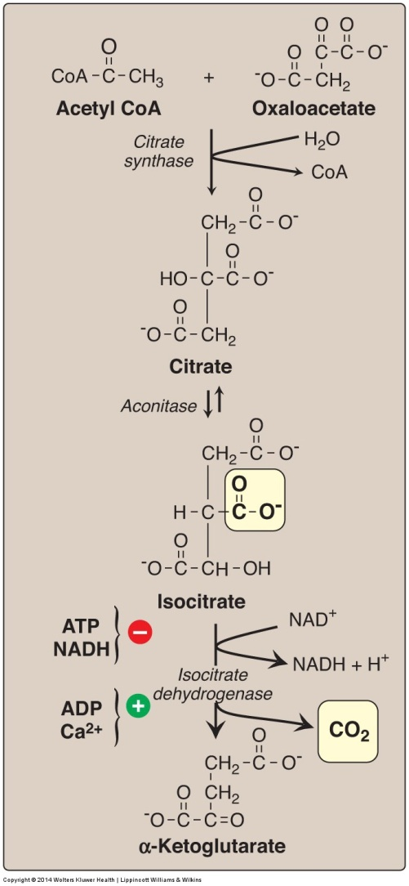
Krebs Cycle Reactions (1)
Formation of α-Ketoglutarate from acetyl CoA and oxaloacetate
Acetyl Co-A + Oxaloacetate
citrate (6C)
Citrate synthase:
H2O in
CoA out
1
Citrate
iso-citrate
Aconitase
2
6C
Iso-citrate
α-Ketoglutarate (5C)
IsoCitrate Dehydrogenase:
NAD+ is reduced
Co2 is out
3
Step (3) regulation:
Isocitrate dehydrogenase is :
1- activated by ADP – CA+2
2- inhibited by ATP- NADH
5C

Slide 8
Krebs Cycle Reactions (2)
Formation of malate from α-ketoglutarate.
α-ketoglutarate.
Succynyl CoA
Succinate
Fumarate
L-malate
Regulation:
1- inhibited by NADH – succinyl CoA
2-activated by CA+2
α-ketoglutarate dehydrogenase
Succinate Thiokinase
5C
Succinate thiokinaze
Substrate-Level
Phosphorylation
GTP generation
4C
Succinate dehydrogenase
FADH generation
fumarase
NAD(H) = nicotinamide adenine dinucleotide
GDP = guanosine diphosphate;
P = phosphate
FAD(H₂) = flavin adenine dinucleotide.
4C

Slide 9
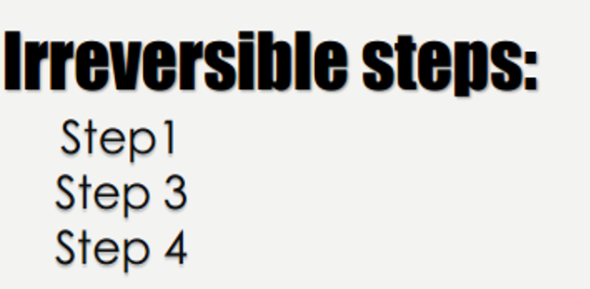
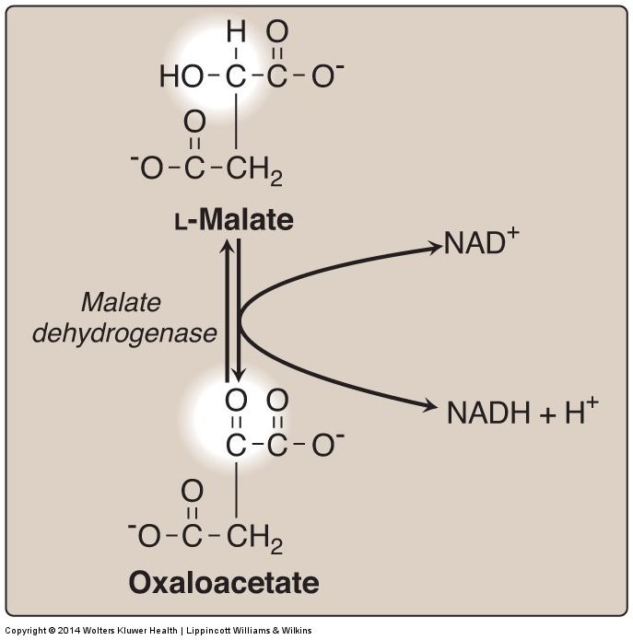
Krebs Cycle Reactions (3)
L-Malate Oxalo-acetate (4C)
Formation (regeneration) of oxaloacetate from malate.
NAD(H) = nicotinamide adenine dinucleotide

Slide 10
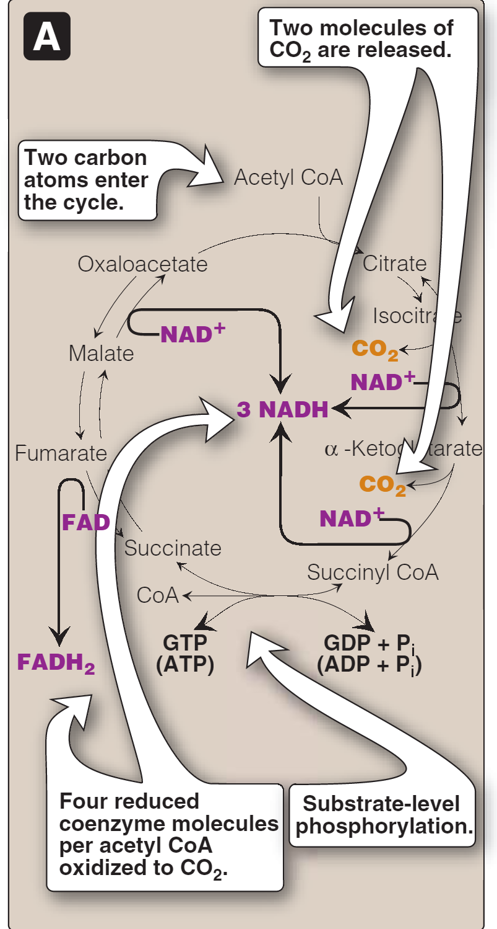
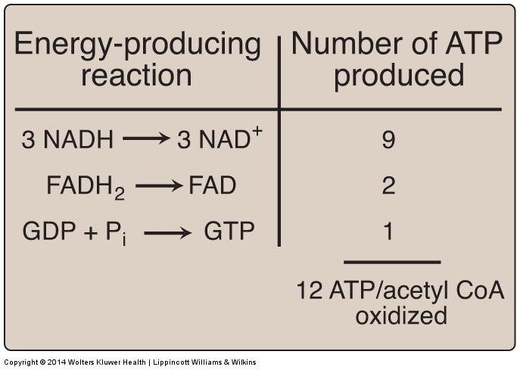
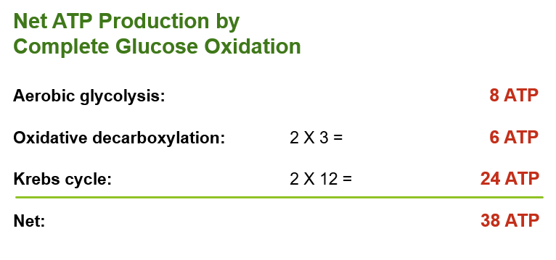
Krebs Cycle: Energy Yield
Team 36
Number of ATP molecules produced from the oxidation of one molecule of acetyl coenzyme A (CoA) using both substrate-level and oxidative phosphorylation.
Krebs energy outcome
We get 3 NADH from:
Isocitrate → α-Ketoglutarate
α-Ketoglutarate → Succinyl CoA
Malate → Oxaloacetate
So, we get 24 ATP from 2 Acetyl CoA
We get 1 FADH from:
Succinate → Fumarate
Other outcome
Succinyl CoA “high energy compound” breaks down which leads to a substrate level phosphorylation of GDP to GTP, which means 1 ATP.
NADH = 3 ATP
FADH = 2 ATP
GTP = 1 ATP
We get 2 CO2 from:
Isocitrate → α-Ketoglutarate
α-Ketoglutarate → Succinyl CoA

Slide 11
Regulation of Oxidative Decarboxylation and Krebs Cycle
PDH complex and the TCA cycle are both up-regulated in response to a decrease in the ratio of
ATP : ADP
NADH : NAD⁺
TCA CYCLE
Activators
Inhibitors
ADP
Ca²⁺
ATP
NADH
PDH complex & TCA: make ATP & NADH IN LOW ENERGY CONDITIONS
PDH: The Pyruvate Dehydrogenase TCA: Tricarboxylic Acid

Slide 12
videos
Team 36
Krebs cycle made simple
Krebs cycle حلقة كربس
MCQs
1\ Allosteric regulation in oxidative decarboxylation of pyruvate is done by:
A- Acetyl CoA
B- NADH
C- ATP
D- A & B
2\ PDH kinase is inhibited by:
A- Acetyl CoA
B- Pyruvate
C- ATP
D- ADP
3\ deficiencies of thiamine or niacin can cause serious problems in:
A- liver
B- kidney
C- CNS
D- GIT
4\ ADP AND Ca 2+ are:
A- TCA inhibitors
B- TCA activators
5\ net ATP production by oxidative decarboxylation is:
A- 8 ATP
B- 24 ATP
C- 6 ATP
D- 38 ATP
6\ net ATP production by complete glucose oxidation is:
A- 38 ATP
B- 24 ATP
C- 6 ATP
D- 8 ATP
1- D
2- B
3- C
4- B
5- C
6- A

Slide 13
Take Home Message
Pyruvate is oxidatively decarboxylated by PDH to acetyl CoA inside the mitochondria
Krebs cycle:
Final common pathway for the oxidation of carbohydrates, fatty acids and amino acids
Occurs in the mitochondria
Aerobic
Mainly catabolic, with some anabolic reactions
The complete oxidation of one glucose molecule results in a net production of 38 ATP molecules

Slide 14
BOYS TEAM:
1- سعيد آل سرار
GIRLS TEAM:
الهنوف الجلعود
رهف الشنيببر
شهد الجبرين
لينا الرحمة
منيرة المسعد
ليلى الصّباغ
العنود المنصور
أرجوانة العقيل
ريناد الغريبي
مجد البراك
روان مشعل
Team leaders: ١-محمد حسن حكيم
٢- رهام الحلبي Contact us: teambiochem437@gmail.com For editing file: https://docs.google.com/presentation/d/16yNcm2Y08Cr0Am83lDRfH5NB4F1ng3tdHiB3O1AqMc8

