Slide 1

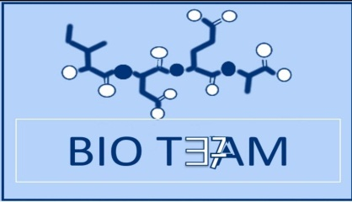

Protein structure
2nd lecture
Color Index:
Important
Doctor slides
Additional notes

Slide 2

$∎$Objectives
Understand the peptide bonding between amino acids.
Explain the different levels of protein structure and the forces stabilizing these structures and what happens when the protein is denatured.
Define the α-helix and β-sheet as the most commonly encountered secondary structures in a protein molecule.
Correlate the protein structure with function with hemoglobin as an example.
Understand how the misfolding of proteins may lead to diseases like Alzheimer’s or prion disease.

Slide 3

$∎$What are the proteins ?
They are a large complex of molecules
Play many critical roles in the bodyتلعب دور حساس في جسم الانسان
They do most of the work in the cell
They are required for the structure, function and regulation of the body’s tissue and organs.
They are made up of hundreds of or thousands of smaller unit, called amino acids, which are attached to one another in a long peptide bond

Slide 4

$∎$What are the proteins ?
The sequence of amino acids determines :
1- each protein’s unique three-dimensional (3D) structure
2- its specific function.
Proteins can be described according to their large range of functions in the body:
Antibody
Enzyme
Messenger
Structural component
Transport/storage
There are mainly 20 different types of amino acids that can be combined to make a protein.
We choose 20 Amino acids because of what’s found in the DNA.
The sequence of Amino Acid in the DNA strand determines the 3D structure of the protein

Slide 5
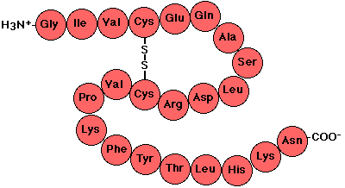
1.Primary structure
It is the linear sequence of amino acids in a protein
Covalent bonds in the primary structure of protein:
  1.Peptide bond
  2.Disulfide bond (if any) (it is not always present)
  Which is the ”SS bond” , It links two residues of cysteine NEAR TO EACH OTHER as shown in the picture.
  - The number of disulfide bonds depends on the number of cystiene amino acid.
  ملاحظة:
  Peptide bond are not broken by conditions that denature proteins, such as heat
  They can break by prolonged exposure to a strong acid or base at elevated temperatures to hydrolyze (break) these bond or by using enzymes
How to determine the primary structure sequence?
1. DNA sequencing.
2.Direct amino acids sequencing.
**Primary structure proteins are not functional
DNA sequencing or indirect sequencing means the sequence taken from the gene and translated
Direct amino acid sequencing means breaking down the protein by standard known methods, then we get to the primary structure

Slide 6
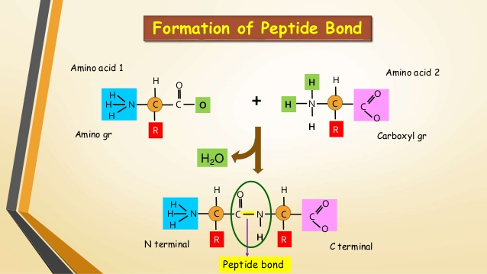
Peptide bond (amide bond):
Condense بمعنى تتكثف
ملاحظة:
Residues : amino acid in a peptide chain
We always start from N terminus to C terminus
The 2 sides of the polypeptide does not form amide bond

Slide 7
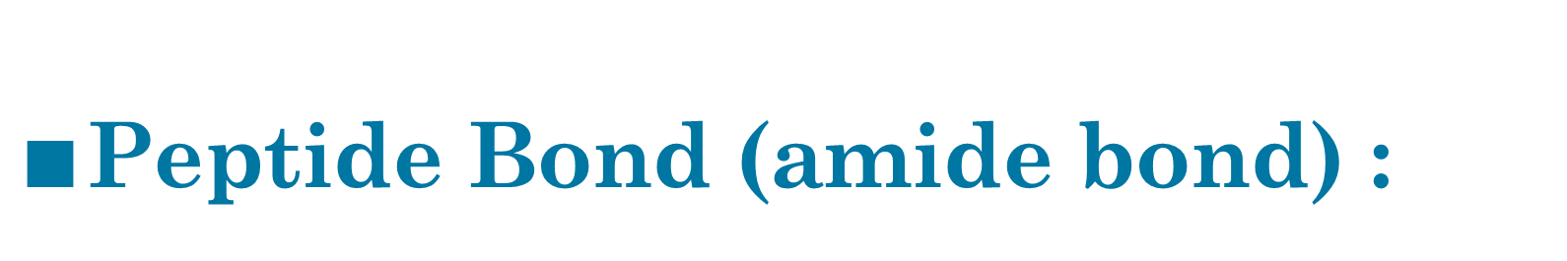
$∎$Peptide Bond (amide bond) :
Amide linkage
that is formed between α-carboxyl group
of an amino acid and α-amino group
of the other amino acid.
Each amino acid (in) a chain makes two peptide bonds.
The amino acids (at the two ends) of a chain make only one peptide bond.
Covalent bond formed by:
Removal of water :
1-OH from COOH
2-H from NH3 Group.
By : (dehydration)
The amino acid with a free amino group is called amino terminus or NH2-terminus.
The amino acid with a free carboxylic group is called carboxyl terminus or COOH-terminus.

Slide 8
peptides
Two amino acids
Dipeptide
One peptide(amide) bond
Oligo peptide
2-20 amino acids
Poly peptide
More than 20 amino acids
Amino acids can be polymerized to form chains:
Three amino acid
Tripeptide
two peptide(amide) bond
Oligo means a few
four amino acids
Tetrapeptide
three peptide(amide) bond
Poly means many
Number of peptide bonds = number of amino acid-1

Slide 9
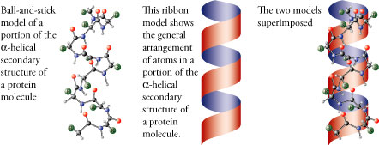
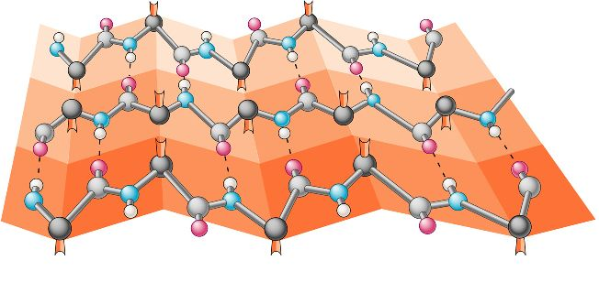
2.Secondary structure
It is regular arrangements of amino acids that are located near to each other in the linear sequence.
Examples of secondary structures frequently found in proteins are:
Excluding the conformations (3D arrangements) of its side chains.
*It is also not functional
α-helix
β-bends
β-sheet
*Bonds that are found in it: Hydrogen bonds
ملاحظة:
for the secondary structure , we do not look at the R side chains nor do we look at the hydrophobic interactions that give it its 3D structure so we exclude that.. We only look at the hydrogen bonds

Slide 10
Secondary structure
α-helix
It is a right-handed spiral (Anti-clockwise)
side chains of amino acids extended outward.
Hydrogen bonds are what Stabilize the α-helix. (Hydrogen bonds form between the peptide bond carbonyl oxygen and amide hydrogen)
Amino acids per turn: Each turn contains 3.6 amino acids.
كل لفة فيها 3.6 حمض أميني))(يعني اللفة الأولى بتحتوي على 3 أحماض و الرابعة بتسوي رابطة هيدروجينية مع الحمض الأول)

Slide 11
α-Helix

Slide 12
α-helix تابع :
  Amino acids that disrupt an α-helix:
    Proline ➔ imino group, interferes with the smooth helical structure.
    (لأنه تركيبه على شكل حلقة فبيخرب الشكل الحلزوني)
    Glutamate, aspartate, histidine, lysine or arginine ➔ form ionic bonds.
    ( these are all polar CHARGED amino acids so they would form ionic bonds thus it would change the shape)
    Bulky side chain → such as tryptophan.
    (حجمه كبير فبغير الشكل)
    Branched amino acids at the β-carbon, such as → valine or isoleucine.
Any huge R-group (side chain) will disturb the α-helix
*للفهم أكثر:
https://www.youtube.com/watch?v=V3DgrOG1exY

Slide 13
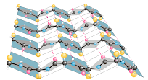
Secondary structure
  β-sheet (Composition of a β-sheet)
    Two or more polypeptide chains make hydrogen bonding with each other. (beta sheet could be a long polypeptide) (the helix is just one polypeptide chain)
    Also called pleated sheets:
    because they appear as folded structures with edges
    Hydrogen bonds: Stabilize the β-sheet.
*للفهم أكثر:
https://www.youtube.com/watch?v=koyE9Nplacc

Slide 14
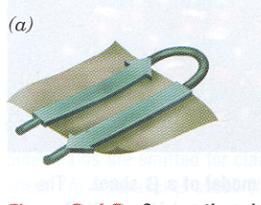
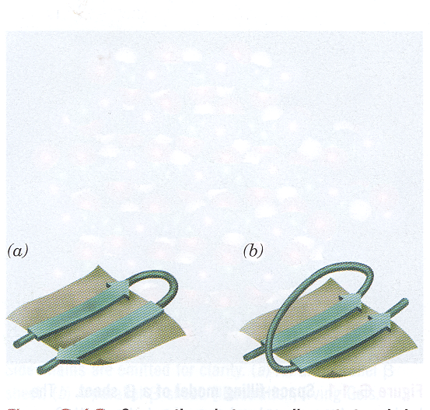
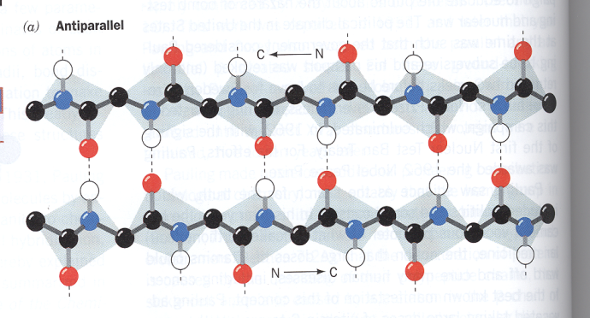
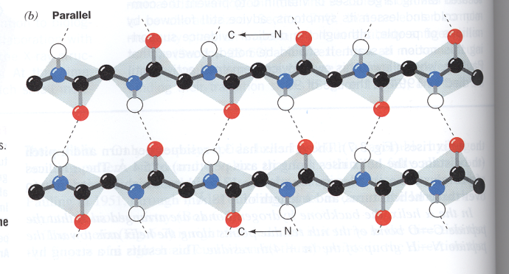
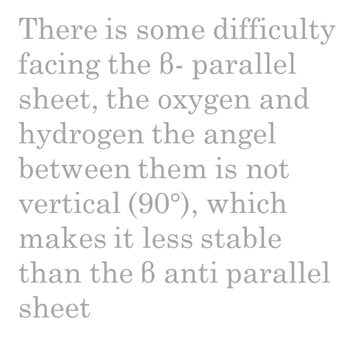
Secondary structure
β-sheet (Antiparallel and parallel sheets)
There is some difficulty facing the β- parallel sheet, the oxygen and hydrogen the angel between them is not vertical (90$°$), which makes it less stable than the β anti parallel sheet
The turn reverses the chain
Antiparallel:
N→C
C← N
Parallel:
N → C
N → C
Hydrogen bonds in the parallel direction are less stable than in the antiparallel (notice the dotted lines in the picture..in the antiparallel the lines are straight but in the parallel , they aren’t)

Slide 15
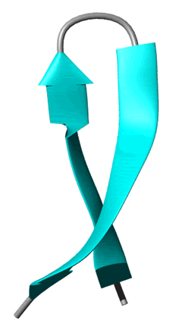
Secondary structure
B-bends
B-bends
Reverse the direction of the polypeptide chain
#found in the surface
#often include residus
Composed of 4 amino acid, proline and glycine are frequently found in the b- bends
The name comes because they often connect successive strands Of (متتالية) antiparallel β-sheets.

Slide 16
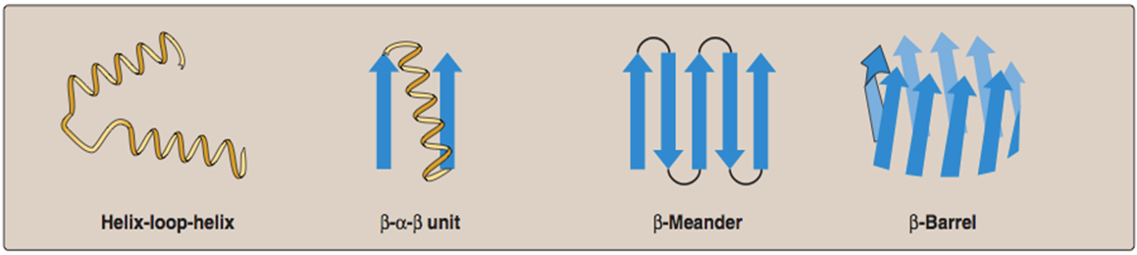
Other secondary structure
Supersecondary
(motifs)
Nonrepetitive
(loop,coil)
A combination of secondary structural elements (that is, α-helices, β-sheets, and coils) . These form primarily the core (interior) region of the molecule. They are connected by loop regions .
*ملاحظة
مجموعة منها تساعد في التركيب الثلاثي

Slide 17
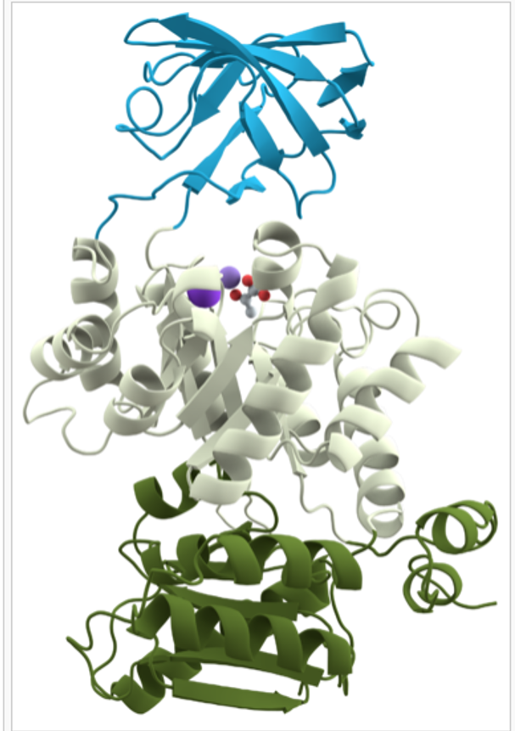
Tertiary structure
What is it?
It is the three-dimensional (3D) structure of an entire polypeptide chain including side chains.
The fundamental functional and 3D structural units of a polypeptide, >200 amino acids fold into two or more clusters.
The core of a domain is built from combinations of supersecondary structural elements (motifs) and their side chains.
Domains can be combined to form tertiary structure.
Domains are
The tertiary structure of a proteins is the functional protein.
a protein with three domains
supersecondary structural elements (motifs)
When combined
The core of a domain
Domains
tertiary structure.
Sometimes the tertiary structure is the end product of some proteins.

Slide 18
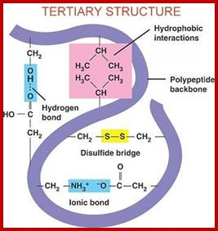
Interactions stabilizing tertiary structure:
Disulfide bonds.
Hydrophobic interactions.
Hydrogen bonds.
Ionic interactions.
  Extra: a covalent linkage formed from the sulfhydryl group (–SH) of each of two cysteine residues to produce a cystine residue
  Extra:Amino acids with nonpolar side chains tend to be located in the interior of the polypeptide molecule, where they associate with other hydrophobic amino acid
  Extra:Amino acid side chains containing oxygen- or nitrogen-bound hydrogen
  Extra: Negatively charged groups can interact with positively charged groups such as : carboxylate group (– COO–) in the side chain of aspartate and amino group (– NH3+)

Slide 19
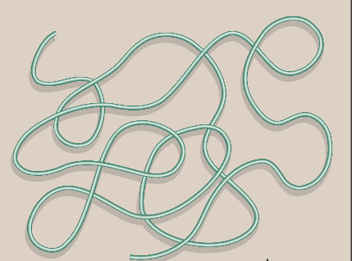
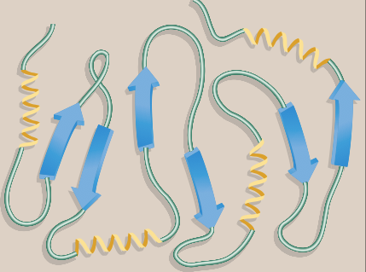
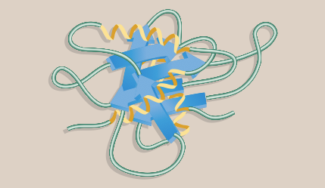
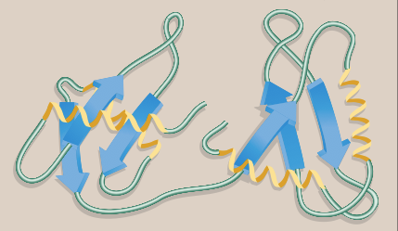
Tertiary structure
Primary
Secondary
Protein folding:
Interactions between the side chains of amino acids determine how a long polypeptide chain folds into the intricate three-dimensional shape of the functional protein.
Tertiary
Domain
للفهم أكثر:
https://www.youtube.com/watch?v=QSyCPD2qlPs

Slide 20
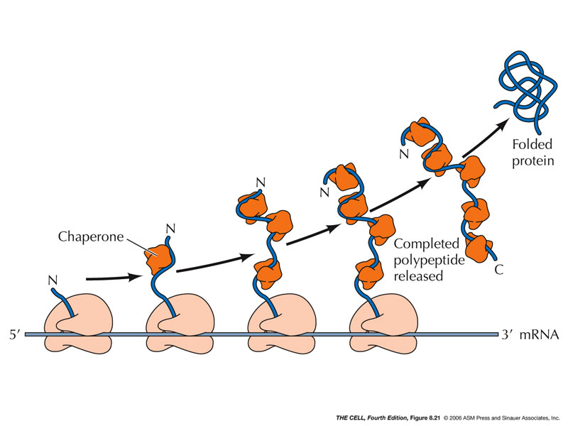
Tertiary structure
Chaperons
are a specialized group of proteins, required for the proper folding of many species of proteins.
Role of chaperons, also known as “heat chock”, in protein folding:
They interact with polypeptide at various stages during the folding process.
Examples of chaperons:
Hsp60 and Hsp70.

Slide 21
Quaternary structure
Some proteins contain two or polypeptide chains that may be more structurally identical or totally unrelated.
Each chain forms a 3D structure called subunit.
According to the number of subunits: dimeric, trimeric, … or multimeric.
Subunits may either function independently of each other, or work cooperatively, e.g. hemoglobin.

Slide 22
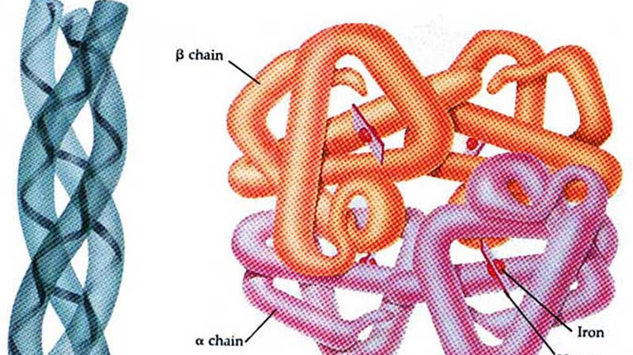
Hemoglobin
Hemoglobin is a globular protein.
يعني ان لها شكل كروي spherical ("globe-like")
A multisubunit protein is called oligomer
( an oligomer usually refers to a macromolecular complex )
Composed of α ₂ β ₂ subunits (4 subunits).
Two same subunits are called protomers.
(a protomer is the structural unit of an
oligomeric protein) .

Slide 23
Denaturation of proteins
when a protein is denatured, it results in the
unfolding and disorganization of the protein’s secondary and tertiary structures.
Denaturation agents
Heat
Organic solvents
Strong acids or bases
Mechanical mixing.
Detergents
Ions of heavy metals (e.g. lead and mercury)
Most proteins, once denatured, remain permanently disordered. (because the chaperons are ruined)
Denatured proteins are often insoluble and, therefore, precipitate from solution. تترسب

Slide 24
Synonyms for (final product)
Normal conformation
Functional structure
Fold conformation
Native conformation

Slide 25
Protein misfolding
Misfolding of protein leads to change of code of the amino acid, that will produce another amino acid, sometimes that makes it toxic to the cell.
Every protein must fold to achieve its normal conformation and function.
عند حدوث خلل في شكل البروتين تختل وظيفته لذلك ينتج عنه امراض للإنسان
Abnormal folding of proteins leads to a number of diseases in humans.
Alzheimer’s disease
β amyloid protein is a misfolded protein.
Amyloid is aggregates of misfolded proteins outside neurons, it interfere with neurons’ ability of sending massages.
It forms fibrous deposits or plaques in the brains of Alzheimer’s patients.
Creutzfeldt-Jacob or prion disease
Prion protein is present in normal brain tissue , in diseased brains, the same protein is misfolded.
It, therefore, forms insoluble fibrous aggregates that damage brain cells.
Prion protein is highly expressed in brain tissue
Another example:
Sickle cell anemia

Slide 26
Take home messages
Native conformation of the protein is the functional, fully folded protein structure
The unique 3D structure of the native conformation is determined by its primary structure, i.e. the amino acid sequence
Interactions of between the amino acid side chains guide the folding of the polypeptide chain to form secondary, tertiary and sometimes quaternary structures that cooperate in stabilizing the native conformation of the protein.
Protein denaturation results in unfolding and disorganization of of the protein’s structure, which are not accompanied by hydrolysis of peptide bonds.
Disease can occur when an apparently normal protein assumes a conformation that is cytotoxic, as in the case of Alzheimer disease and Prion disease.

Slide 27
Videos:
1- Protein structure
2- Alpha helix: • http://www.youtube.com/watch?v=eUS6CEn4GSA&list=U UgsuuOOUDgZPKLALDSWd7BA
3-• Denaturation of proteins • http://www.youtube.com/watch?v=SUCgAxI8rhg

Slide 28
GIRLS TEAM:
الهنوف الجلعود
رهف الشنيبر
شهد الجبرين
لينا الرحمة
سارة البليهد
ليلى الصباغ
BOYS TEAM:
1-Dawood Ismail.
2- turkey al-bnhar
3- saeed alsarar
4- abdulmalik alsharhan
5- mohammed al-quefly
6- nwaf abdulaziz
Team leaders:
1- Mohammed hassa hakeem
2- Reham alhalabi
Contact us:
teambiochem437@gmail.com
For editing file:
https://docs.google.com/presentation/d/16yNcm2Y08Cr0Am83lDRfH5NB4F1ng3tdHiB3O1AqMc8

