Slide 1
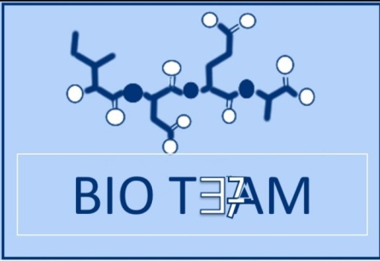
Molecular biology (1)
Color index:
Doctors slides
Notes and explanations
Extra information
highlights

Slide 2
Objectives
Know the central dogma of molecular biology.
Understand the composition, types and structure of DNA and RNA.
Describe the organization of DNA in the chromosome and the role of histone proteins.
للتوضيح:
Dogma : a principle or set of principles laid down by an authority. (well established fact)

Slide 3
The central dogma of Molecular Biology
What is central of dogma?
is an explanation of the flow of genetic information within a biological system
“ DNA to RNA to protien”
It involves three components: DNA, RNA and protein.
a portion of DNA called a gene is transcribed into RNA then translated into protein.
DNA
Or
Gene
Transcribed
into
RNA
Translated
into
protein
Human genome contains about 35,000 genes
Dr. Review:
1- a gene is inherited from parents to off spring
2-expression of gene defines a person
3-information is expressed as proteins; how?
DNA is transcribed to RNA in the nucleus then translated into protein in the cytoplasm.

Slide 4
Nucleic acids.
Nucleic acids
DNA
Deoxyribonucleic acid
RNA
Ribonucleic acid
Is the unit Required for the storage and expression of genetic information.
Building blocks of nucleic acids are nucleoside triphosphates (nucleotides).
Nucleosides are composed of:
nitrogen base + ribose sugar
nucleotides are composed of:
Nucleoside + phosphate group
There are two chemically distinct types of nucleic acids: DNA and RNA, which perform several crucial functions.

Slide 5
Nucleotides
Nitrogenous base:
Phosphate groups.
sugar
Pyrimidines
Cytosine (C)
Purines
Adenine (A)
Uracil (U) found in RNA
Sugar: pentose with 5 carbon ring
Ribose
(with –OH at C₂).
Deoxyribose (with –H at C2).
Thymine (T)
Guanine (G)

Slide 6
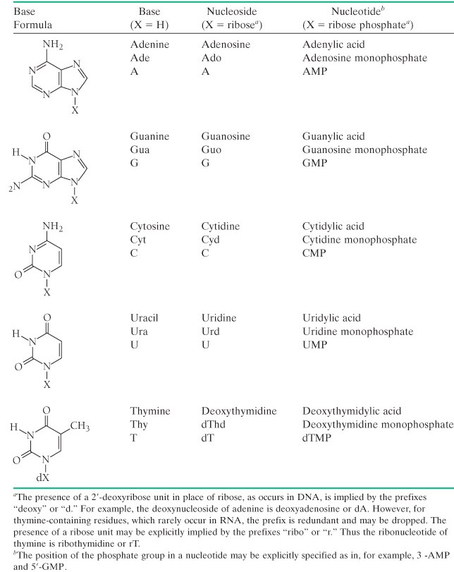
Nitrogen bases
*No need to memorize structures but know the names.

Slide 7
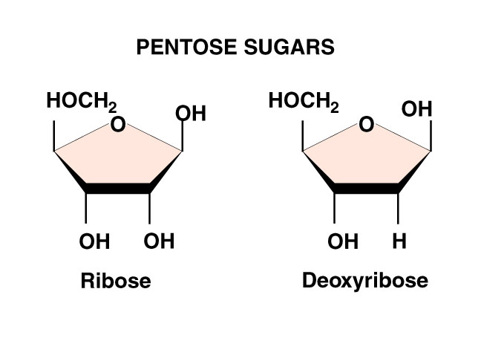
The pentose sugar
The sugar carbon numbers are primed (1’ 2’ 3’ etc.).
the nitrogenous base atoms are unprimed.
#The nitrogenous base is bonded to C₁’ of sugar.
The PO₄ group is bonded to C₃’ or C₅’ of sugar.
Nitrogenous base
“So we can know if we are talking about the carbon atoms of the sugar or the nitrogenous base”

Slide 8
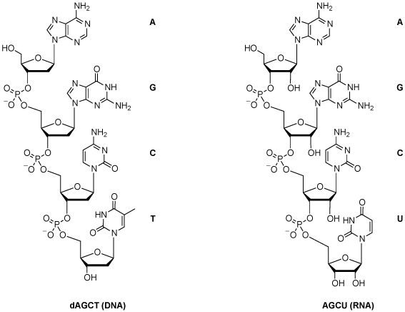
Chemical structure of DNA & RNA
The PO₄ bridges the 3’ and 5’ positions of ribose sugar.
PO4 + Pentose sugar = The backbone of DNA structure
The linkage between the nucleotides is called phosphodiester bond

Slide 9
Function of nucleotides:
Polymers of nucleotides
(as DNA or RNA)
Free nucleotides and
their derivatives
store and transfer
genetic information.
perform various metabolic
functions not related to
genetic information.
e.g. : FAD, NAD, CoA

Slide 10
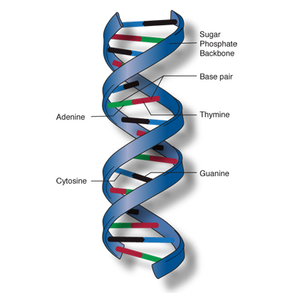
The double helix DNA
The structure of DNA was first determined by James Watson and Francis Crick in 1953.
Commonly known as Watson-Crick structure.

Slide 11
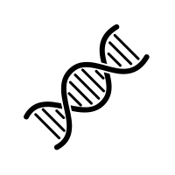
Features of Watson-Crick DNA structure
Two polynucleotide chains wind or spiral around a common axis (helical axis) to form a double helix.
The two strands are anti-parallel (run in opposite direction).
“ One runs from 5 to 3 and the other from 3 to 5. “
Each strand is a right-handed helix.
The nitrogenous bases are in the center of the double helix and the sugar-phosphate chains are on the sides.
Opposite to what we have in peptide chain the hydrogen group inside and R chain hanging out.
3’ 5’
5’ 3’
Polynucleotides chains

Slide 12
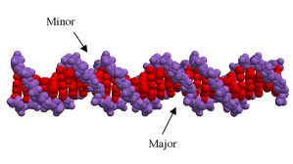
The surface of the double helix contains 2 grooves: the major and minor grooves.
Grooves are the places where protein binds and interact with DNA
Each base is hydrogen bonded to a base in the opposite strand to form a base pair (A-T and G-C), known as complementary base pairing.
The helix has 10 base pairs (bp) per turn.
so, once the helix starts from place and comes
back to the same position that include 10 pairs.

Slide 13
Watson-Crick base pairs
Adenine bonds with thymine by double bonds, and Guanine bonds with Cytosine by triple bonds
Adenine (A) Thymine (T)
Guanine (G) Cytosine (C)
purine
pyrimidine
In RNA, Thymine is replaced by Uracil (U)

Slide 14
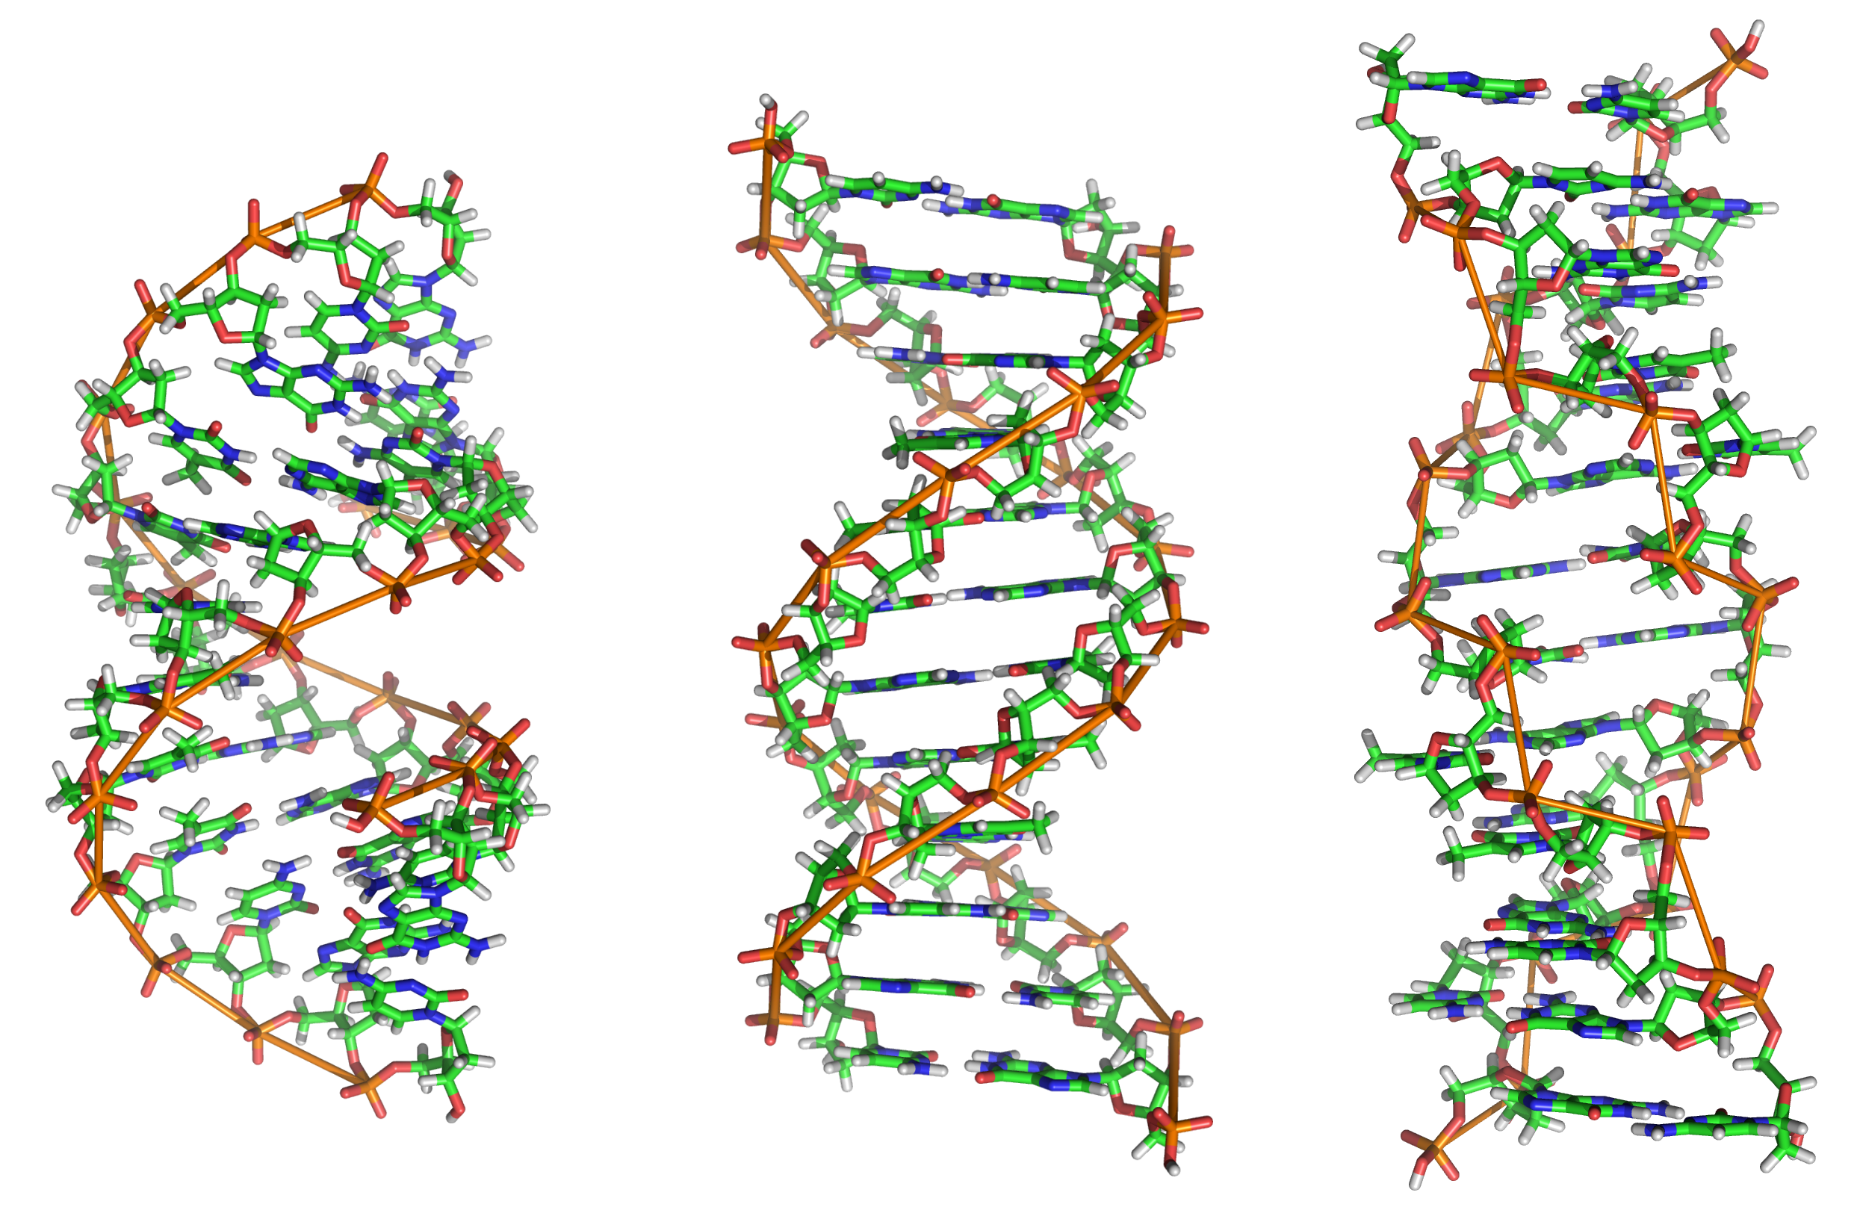
Types of DNA structure
 | A-DNA | B-DNA⁽Watson-Crick model ) | Z-DNA
Direction | Right-handed | Right-handed | Left-handed
Helix length | Short | Elongated | More elongated
Major groove | Deep and narrow | Wide | Not real groove
Minor groove | Wide | Narrow | Narrow
Placement of bp | Displaced away from the helical axis | Centred over the helical axis | Zig-zag pattern (nearly perpendicular to the helical axis)
bp per turn | 11 | 10 | 12
Conformation of deoxyribose | C₃ | C₂ | G (C₂) ; C (C₃)
The carbon where the oxygen is removed
major
Minor
What is the importance of the grooves?
Grooves are the sites where the protein binds and Interact.

Slide 15
DNA supercoiling
The chromosomes of many bacteria and viruses contain circular DNA which is supercoiled. «مما يقلل المساحة»
تشبيه:
مثل السلسال اذا تعقد

Slide 16
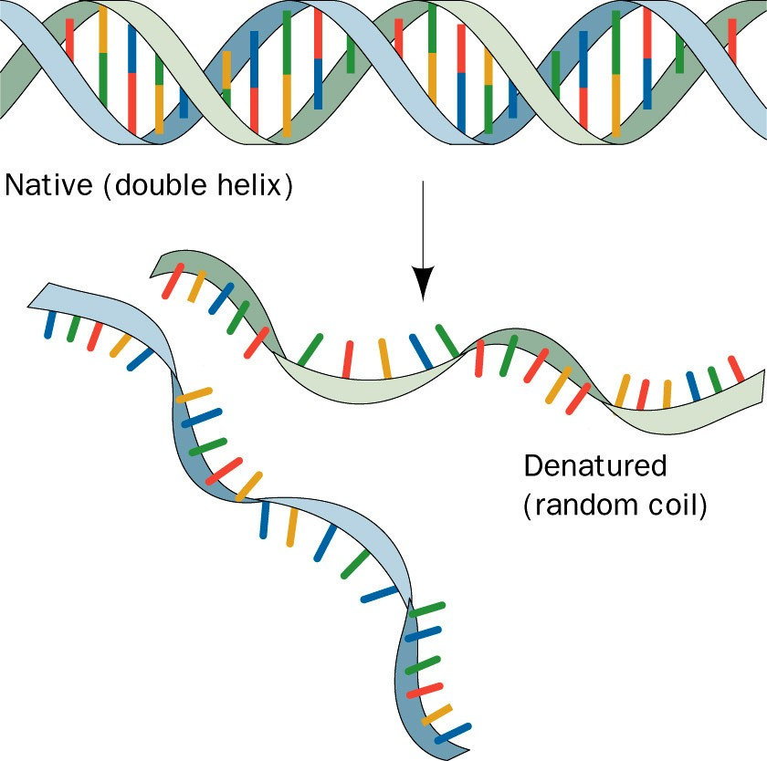
Melting temperature (MT)
The temperature at which the double-stranded DNA is separated into two single strands . (Bonding between nitrogenous bases is lost “melted” and DNA is separated from a double strand to a single strand, if the heat was removed, it will come back to its original state)
MT “melting temperature” of DNA depends on nitrogenous base content (A-T and G-C). A-T has 2 hydrogen bonds,G-C has 3 hydrogen bonds .
G-C ➔ stronger than A-T. (the more G-C bonds there is the more heat you need to break it) (it works on stabilizing the shape of the molecule)
Extra question example:
Which one will have higher melting temperature?
A) 40A-T bonds , 60G-C bonds B) 20A-T bonds , 80G–C bonds
(B) because it has more bonds so it needs more energy and heat to “melt” the bonds

Slide 17
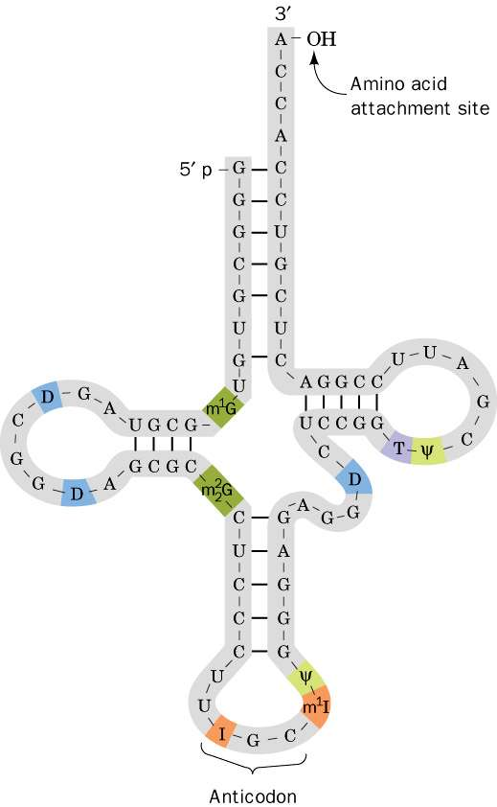
RNA (Types and function)
RNA is a single-stranded polymer of ribonucleotides. ( it can fold upon itself )
Types of RNA:
mRNA (messenger RNA) ➔ Function: Transcription process
(from DNA to mRNA).
tRNA (transfer RNA) ➔ Function: Recognition and transferring. It recognizes amino acids’ codons and transfers the selected amino acids to the growing protein chain.
rRNA (ribosomal RNA) ➔ Function: Site of protein synthesis (factory).
Structure of a tRNA

Slide 18
How DNA is organized in a chromosome?
The human genome contains 3.5 billion base pairs and more than 95% is non-coding or “junk” DNA.
The DNA from single 23 human chromosomes have a length of 1 meter.
How such large quantities of DNA are packed into a single cell? ( with the help of proteins called histones )
Each chromosome is a complex of a single linear DNA molecule and protein called chromatin. “Chromatin : DNA + Histones”
50% of chromatin consists of proteins called histones.
Difference between chromosome and chromatin ?
DNA exists in Chromatin form in the nucleus. The chromatin condenses to form Chromosomes during cell division
To package the long sequence of the genomic DNA, it is highly organized into chromosomes.

Slide 19
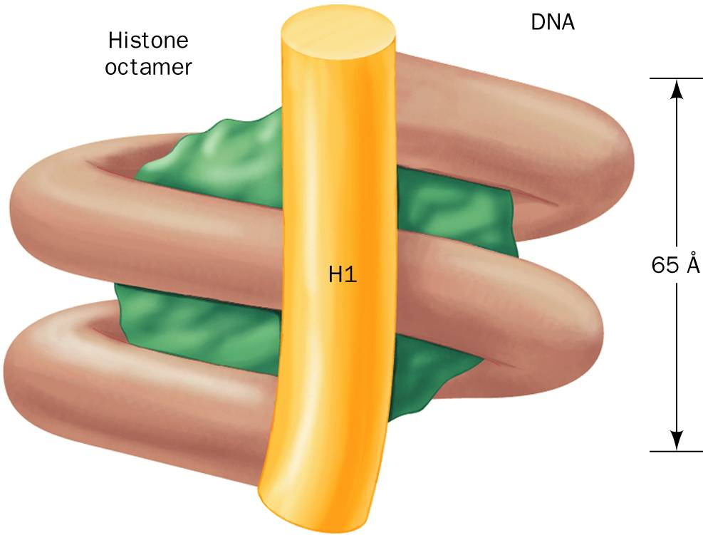
Histones “chromatin stabilizers”
Create a complex that the DNA can wrap around
Five major types of histones:
H1 H2A H2B H3 H4
Histones have positively charged amino acids (arginine and lysine).
These proteins bind to negatively charged PO₄ groups of DNA to stabilize the chromatin structure.
Holds the wrapped DNA on the complex

Slide 20
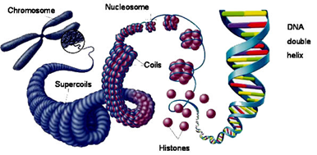
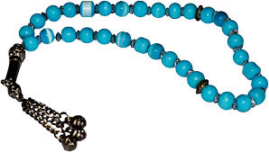
Nucleosomes
Nucleosomes are particles consisting of DNA and histones connected by thin strands of naked DNA (like beads on a string; Sibhah in Arabic).
Nucleosomes consist of the histone octamer (eight) and DNA
(H2A)₂(H2B)₂(H3)₂(H4)₂
H1 binds to 2 complete helical turns of DNA.
How DNA is packaged?
https://m.youtube.com/watch?v=gbSIBhFwQ4s

Slide 21
Electron micrograph of chromatin showing nucleosomes

Slide 22
A nucleosome showing interaction of histones with the DNA

Slide 23
Chromatin filament with nucleosomes and naked DNA

Slide 24
MCQs»اجتهاد شخصي للتدريب فقط وأرجو عدم الاعتماد عليها»
http://highered.mheducation.com/sites/0072552891/student_view0/chapter7/multiple_choice_quiz.html

Slide 25
GIRLS TEAM:
الهنوف الجلعود
رهف الشنيبر
شهد الجبرين
لينا الرحمة
سارة البليهد
ليلى
BOYS TEAM:
1-Dawood Ismail.
2- turkey al-bnhar
3- saeed alsarar
4- abdulmalik alsharhan
5- mohammed al-quefly
6- nwaf abdulaziz
Team leaders:
1- Mohammed hassa hakeem
2- Reham alhalabi
Contact us:
teambiochem437@gmail.com
For editing file: https://docs.google.com/presentation/d/16yNcm2Y08Cr0Am83lDRfH5NB4F1ng3tdHiB3O1AqMc8

