Slide 1
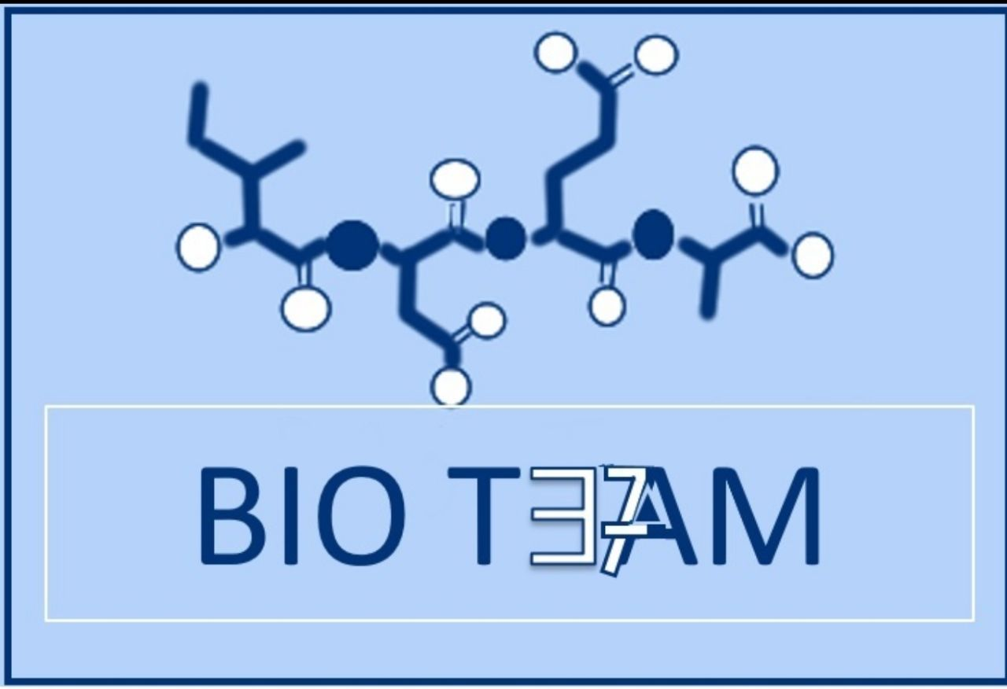
Molecular Biology 2
Color index:
Doctors slides
Notes and explanations
Extra information
highlights

Slide 2
Objectives:
1
To understand DNA replication
2
To know the transcription of genetic material into messenger RNA
3
To get an idea about the translation of mRNA into a functional protein.

Slide 3
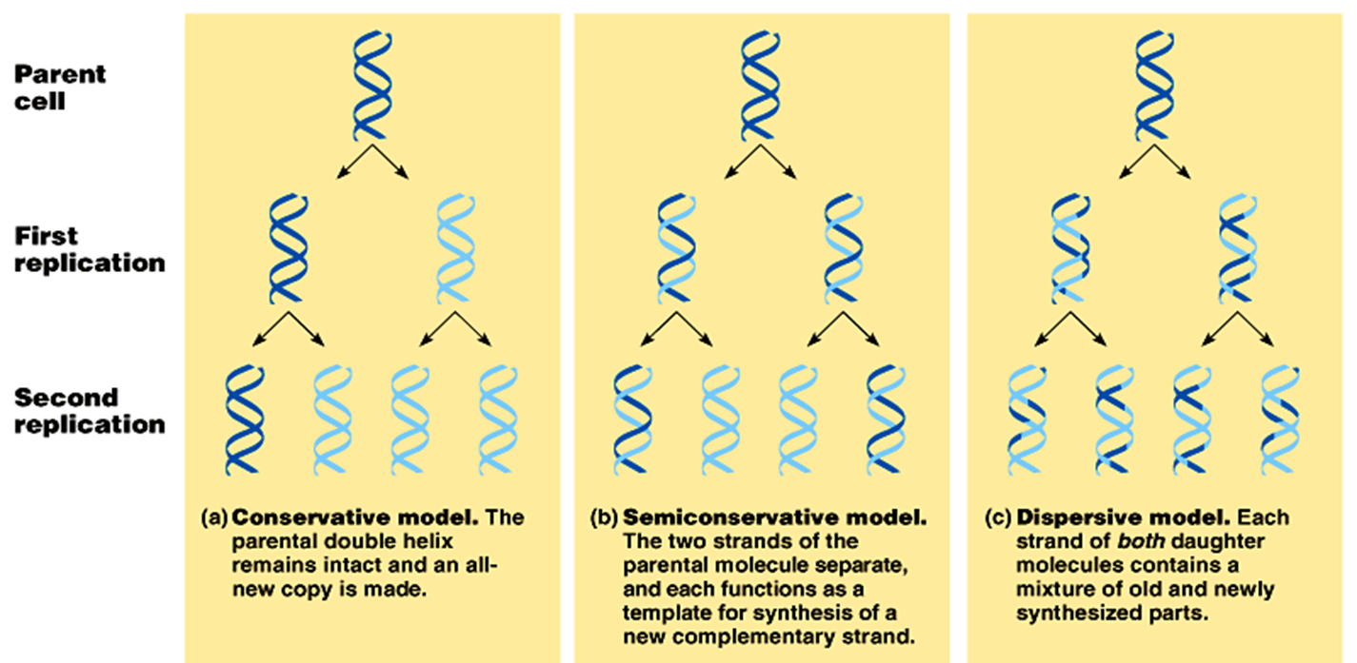
DNA is the genetic material
1- it replicates faithfully. (without mutations or mistakes)
2-has the coding ability (ability to transfer information) to produce proteins for all cellular functions.
Because it carries all the important genetic information; we should be able to inherent it without mistakes, and we should have a correction system if there were mistakes.

Slide 4
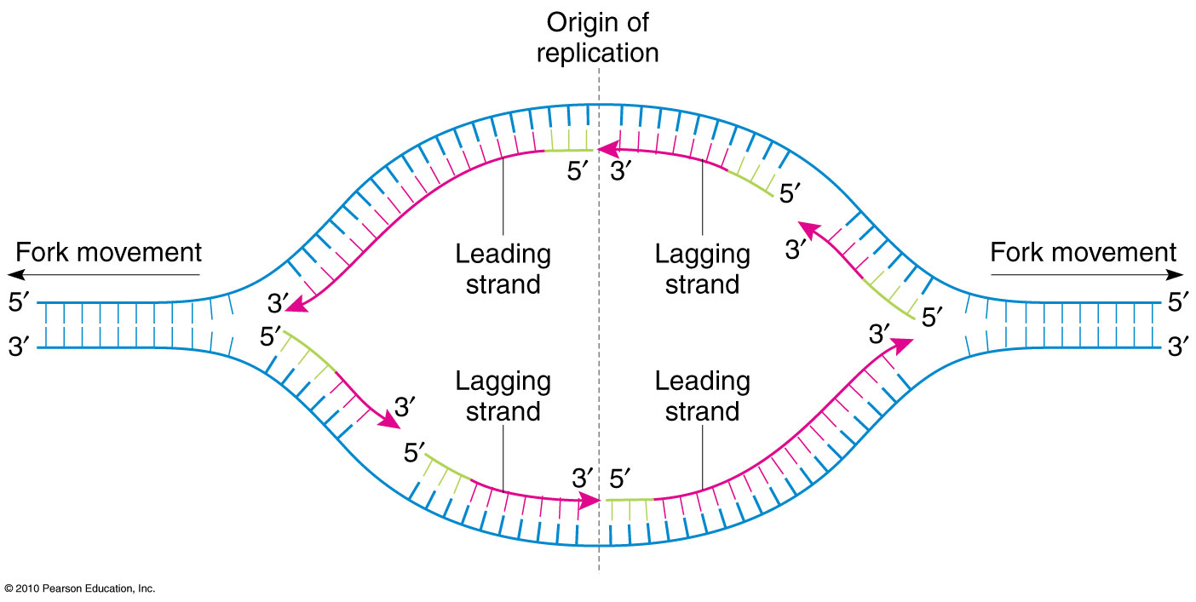
Features of Eukaryotic DNA:
Semiconservative
Daughter DNA molecule contains one parental
Bidirectional goes in both directions with multiple origins of replication
Origin of replication: is a particular sequence in a genome at which replication is initiated. The opening point of DNA
strand and one newly-replicated strand
Primed by short stretches of RNA.
a short segment of RNA, 10 nucleotides long) is required to start a new chain; removed later on during replication
Semi-discontinuous
The leading strand is synthesized continuously and the lagging strand is discontinuous (in fragments)
The directions will always be 5' -> 3' (either away or into the fork)
DNA:
Reading : 3’ > 5’
Synthesis :5’ > 3’

Slide 5
Proteins involved in DNA replication
Team 36

Slide 6
Steps in DNA replication
Helicase | Binds at the origin point , Untwists DNA strands, making a fork-like structure → called replication fork
Single-stranded binding proteins. | Prevents single strands from twisting again. (keeps DNA strands opened)
Primase | Makes RNA primer. (a short segment of RNA complementary to the DNA)
DNA polymerase. | 1-Adds nucleotides to the primer ( from 5’ to 3’) and checks if the bases added are correct or not, if not → removes incorrect nucleotides.(proofreads and corrects) 2- Removes the RNA primers by exonuclease activity (which creates gaps) 3-Fills the gaps that we got after removing the RNA primers (adding form 3’ to 5’)
Ligase | Connects the okazaki fragments by forming bonds between the sugar-phosphate backbone.(from 5’ to 3’)

Slide 7
DNA replication
Leading strand : continuous synthesis from 5’ to 3’ direction.
Lagging strand : discontinuous synthesis produce 5’ to 3’ DNA segments (okazaki fragments)

Slide 8
The central dogma of Molecular Biology
A portion of DNA, called a gene, is transcribed into RNA.
RNA is translated into proteins.

Slide 9
Transcription (mRNA synthesis)
A portion of DNA (a gene) is transcribed into messenger RNA (mRNA).
Only one of the DNA strands is transcribed (antisense strand).
The RNA polymerase II is responsible for this process.
The direction of transcription is 5’ → 3’.
ملاحظة:
Pay attention to the number of the protein (RNA polymerase II)
the template strand on which the mRNA is synthesized
Dr.note: The mRNA chain is complementary to the mother DNA chain, whereas the amino acid chain has the same sequence of the mother DNA and a complementary sequence to the mRNA

Slide 10
Steps of mRNA synthesis
1-Chain initiation:
RNA polymerase II binds to promoter region of DNA to start transcription.
A TATA box is a DNA sequence that indicates where a genetic sequence can be read and decoded.
Promoter region
Dr. notes:
1-Promoter region doesn’t code for proteins
2- before the promoter region is called (upstream) and after it is called (downstream)
3- exons will be expressed as protein while introns will be removed.
4-unlike DNA replication, RNA transcription happens only in one direction

Slide 11
Steps of mRNA synthesis
Chain elongation:
A portion of DNA template unwinds (opens) at the point of RNA
synthesis. (called a bubble)
This forms a short length of RNA-DNA hybrid.
Chain termination:
DNA contains specific sites which stop transcription (at a sequence of 4-10 AT base pairs).
After the termination we get an immature RNA, because this RNA has to travel to the cytoplasm, it needs some modifications to protect it and help the ribosomes recognize it. (post transcriptional modification)

Slide 12
Post-transcriptional modification
Capping: Addition of a methylated guanine nucleotide at
5’ end of mRNA
Function:
To prevent mRNA degradation by exonucleases.
It helps the transcript bind to the ribosome during protein synthesis.
Polyadenylation: Addition of a poly(A) tail (a highly conserved
AAUAA sequence) at 3’ end of mRNA.
Functions:
To protect the mRNA from degradation
For ribosomal RNA recognition
Intron removal for releasing mature mRNA from nucleus.

Slide 13
Translation (Protein synthesis)
It is a process of protein synthesis from mRNA
mRNA has genetic codes for amino acids present in proteins.
The genetic code is a dictionary that identifies the correspondence between a sequence of nucleotide bases and a sequence of amino acids.
Each individual word in the code is composed of three nucleotide bases (codons).
" الكودون هو ثلاثة نيوكليتايد تكون شفرة لحمض أميني معين "
One start codon (AUG)
(codes for the amino acid methionine)
3 stop codons UAA, UAG,and UGA.
61 codons specified for different 20 amino acids
AUG
UAA
UAG
UGA
64 possible codons
جملة لتسهيل حفظ كودونات التوقف:
"يُقال من يواعد يُواجه "
UGAl mn UAAed UAGeh
61 coding codons (including the start codon)
3 non coding stop codons

Slide 14
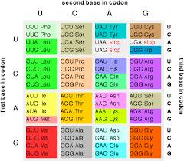
You only need to memorize the stop codons and the start codon (written in the previous slide)

Slide 15
Components required for Translation
Amino acids
Transfer RNA (tRNA)
Aminoacyl tRNA synthetase
mRNA
Functionally competent ribosomes
Protien factors
ATP and GTP

Slide 16
1. Initiation: in general it means {making complements}
Puts (ribosoms +tRNA+ mRNA} together and make it ready to start
Elongation: it happens until the termination (stop codon)
* P =peptide side, A=incoming amino acids, E= Exit site
Important enzyme in elongation : peptidyl transferase
Termination : the release factor binds to the A site > everything disassembles
(يتفكك الريبوسوم بمجرد ارتباط عامل فك الارتباط في الموقع أ)
Produces an initiation complex made of :
1- small ribosomal subunit
2- large ribosomal subunit
3-mRNA
4- methionine tRNA

Slide 17
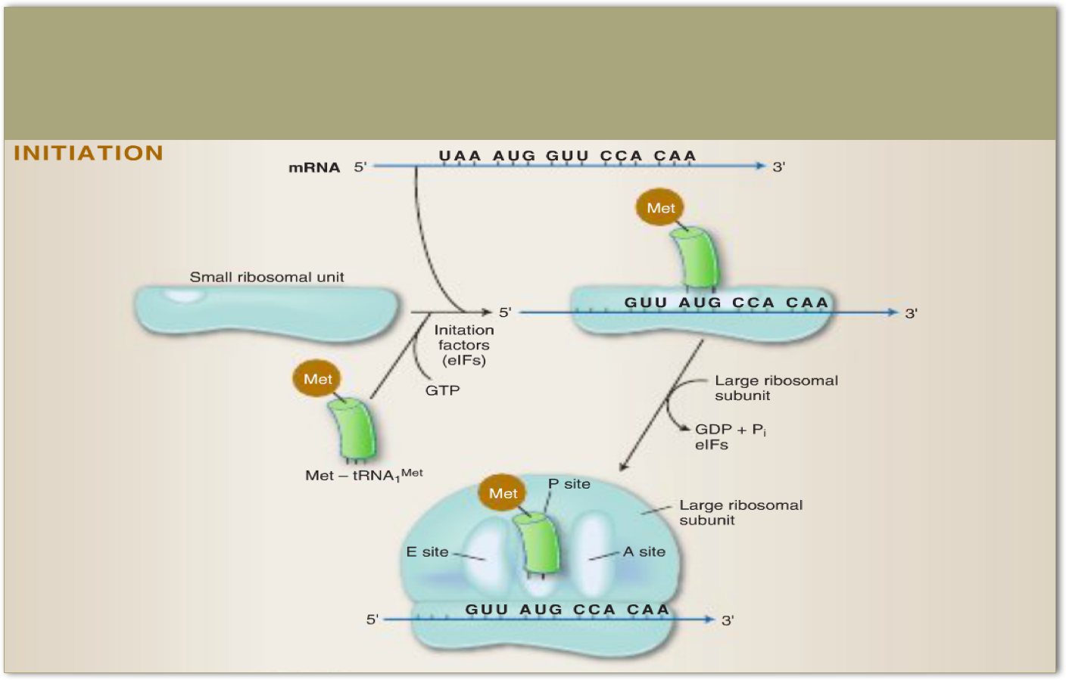
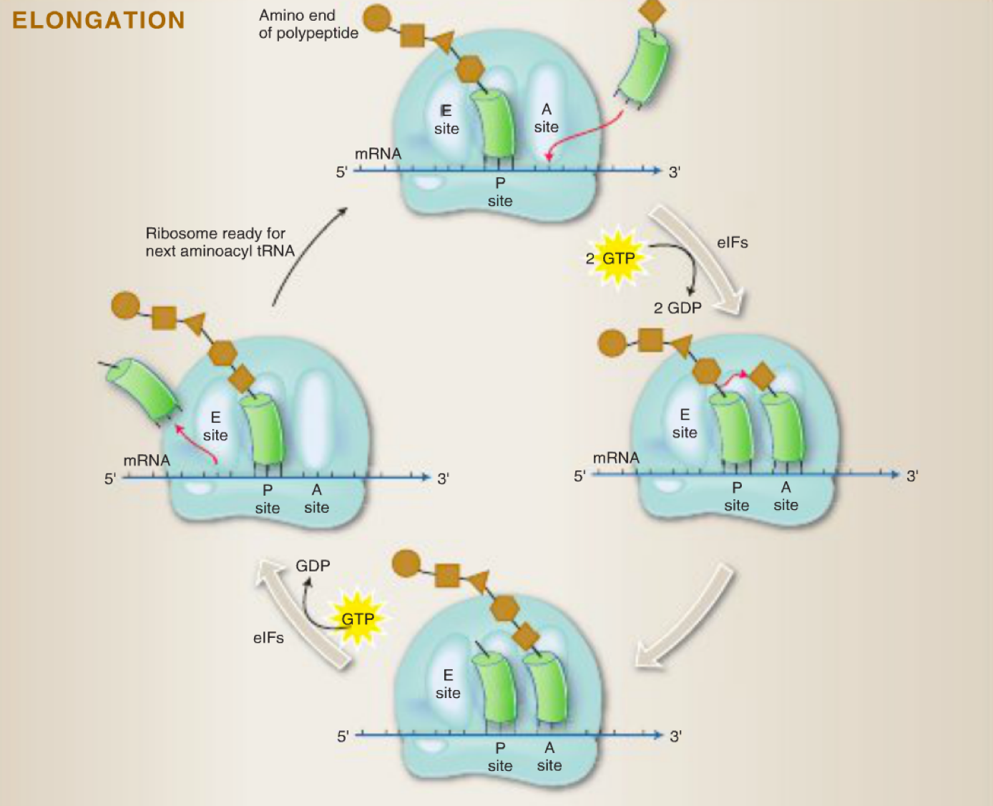

Slide 18
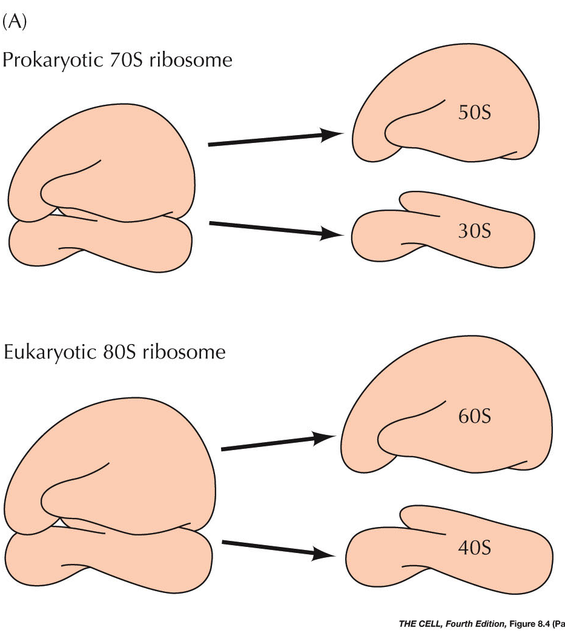
Mentioned in males lecture:
All prokaryotes have 70S ribosomes. 70S ribosome is made up of a large subunit (50S) and small subunit (30S)
Eukaryotes have larger ribosomes (80S) made up of 60S and 40S subunits.
S= Svedberg units to measure the size of the subunits
In humans the start codon is Methionine.
In bacteria the start codon might code with different codons.

Slide 19
In summary
Steps in protein translation
Components for translation
1- 61 codons specify 20 amino acids
2- AUG is the start codon
3- UGA UAG UAA are the stop codons
1- amino acids.
2-transfer RNA
Initiation
elongation
termination
Translation (protein synthesis)
There are 64 possible codons
3- aminoacyl - tRNA synthetases
4- mRNA
5- ATP and GTP
6- functionally competent ribosomes.
7-proteins factors

Slide 20
Quiz
Only ………..of the DNA strands is transcribed (antisense strand)
One Two Three Four
Protein makes a short segment of RNA
Single stranded Primase DNA Helicase Ligase
Addition of a methylated guanine nucleotide at 5’ end of mRNA
Polyadenylationcc intron axone capping
Polyadenylation and capping function as
helps the transcript bind to the ribosome during protein synthesis
ribosomal RNA recognition
a protect the mRNA from degradation
None
1-A
2-B
3-D
4-c

Slide 21
GIRLS TEAM:
الهنوف الجلعود
رهف الشنيبر
شهد الجبرين
لينا الرحمة
سارة البليهد
ليلى الصباغ
BOYS TEAM: 1-Dawood Ismail. 2- turkey al-bnhar 3- saeed alsarar 4- abdulmalik alsharhan 5- mohammed al-quefly 6- nwaf abdulaziz
Team leaders: 1- Mohammed hassa hakeem 2- Reham alhalabi Contact us: teambiochem437@gmail.com For editing file: https://docs.google.com/presentation/d/16yNcm2Y08Cr0Am83lDRfH5NB4F1ng3tdHiB3O1AqMc8

