Slide 1
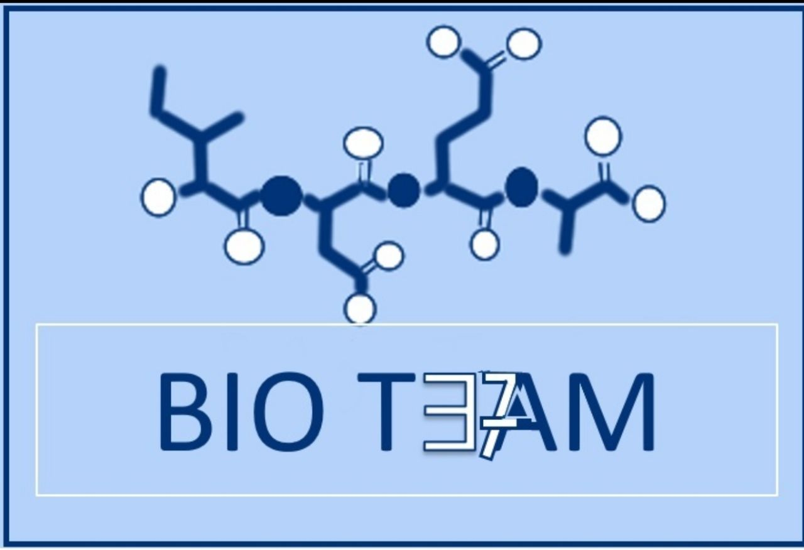
بِسْم الله الرحمن الرحيم
Enzymes and coenzymes 1
Color index:
Doctors slides
Notes and explanations
Extra information
Highlights

Slide 2
Objectives:
Understand how enzymes are able to speed up the rate of biochemical reactions in the body
Identify classes of enzymes based on the type of reactions they catalyze
Comprehend the basic terms of coenzymes, isoenzymes, enzyme activity and specificity along with factors affecting their activity
Understand the enzyme kinetics, types of inhibition and regulation of enzyme activity
Discuss the clinical role enzymes in the diagnosis of diseases

Slide 3
Titles:
What are enzymes?
Enzyme properties and specificity
Enzyme-substrate binding •Lock and key binding •Induced fit binding
Classification of Enzymes
Enzyme nomenclature (Naming)
Holoenzymes
Cofactors and Coenzymes
Ribozymes, Isoenzymes and zymogens
Enzymes decrease activation energy of a reaction
Enzyme Activity or Velocity
Factors that affect enzyme activity
Enzyme kinetics

Slide 4
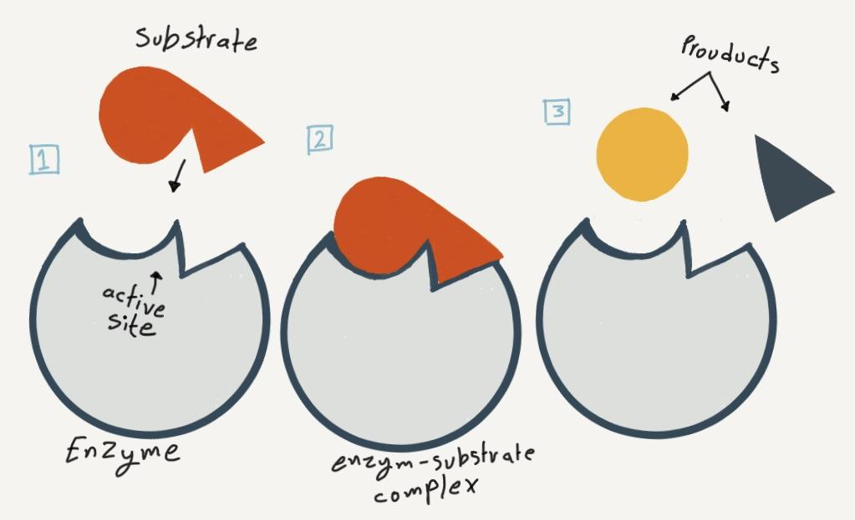
What are Enzymes?
Enzyme specificity
Everything that ends with “ase” is mostly an enzyme
Properties of Enzymes
Active site
biological catalysts that speed up the rate of a reaction without being changed in the reaction
The region of enzyme that binds with the substrate and where catalysis occurs
All enzymes have one or more active sites
Enzymes must at least have one active site
-Enzymes are highly specific
-Interact with only one or a few of the substrates Depending on the number of active sites
-Catalyze only one type of reaction
All enzymes are protein in nature All proteins are not enzymes
Specificity
Enzymes bind to their specific substrates in the active site to convert them to product(s) “not every substrate can bind to any enzyme”
Substance upon which the enzymes act are called substrates Enzyme converts substrates into product(s)
Regulation
Enzymes can be activated or inhibited so that the rate of product formation responds to the need of the cell “e.g. if we didn’t eat food, we don’t need digestive enzymes, therefore they are inhibited”
“If we need to do another reaction to the same substrate, we use a different enzyme”
Catalysts: anything that speed up a reaction and not being changed in the process
Example: Sucrase enzyme only interact with sucrose and only do one reaction which is “hydrolysis” thus breaking the bond and releasing “fructose and glucose” as products. If we needed to do another reaction, we use another enzyme

Slide 5
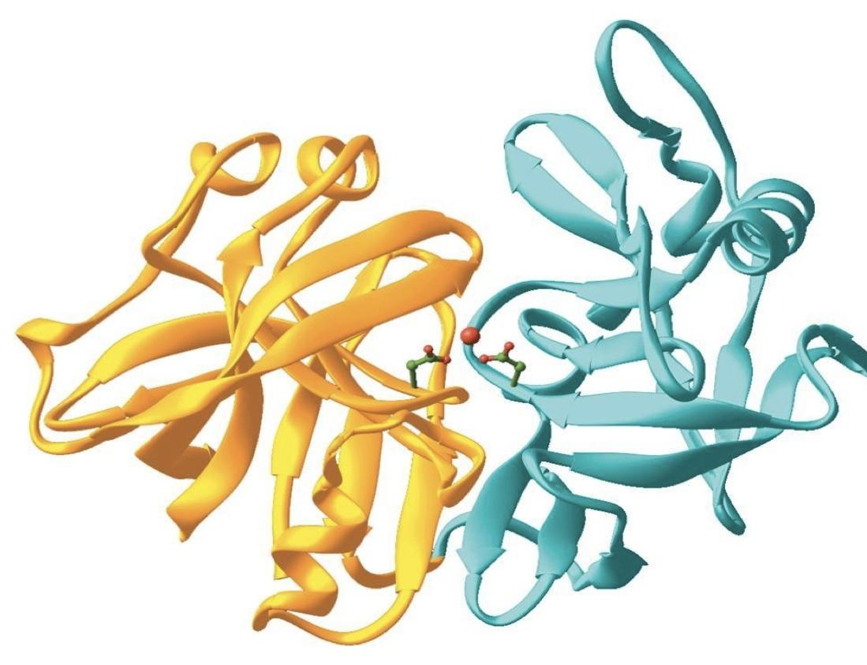
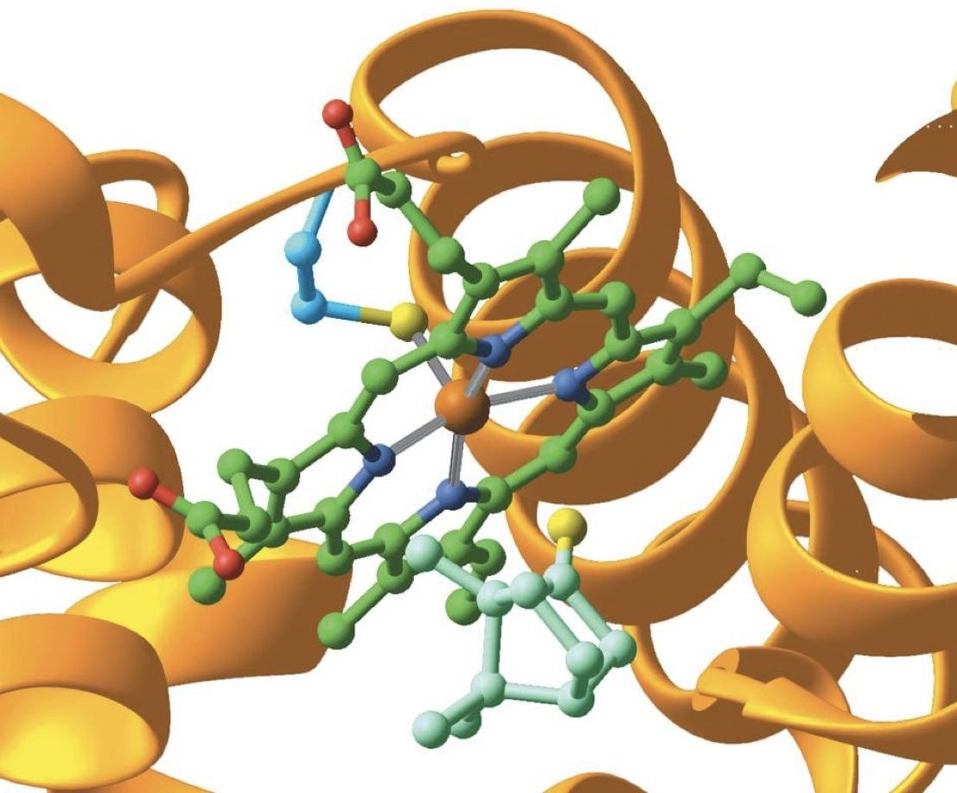
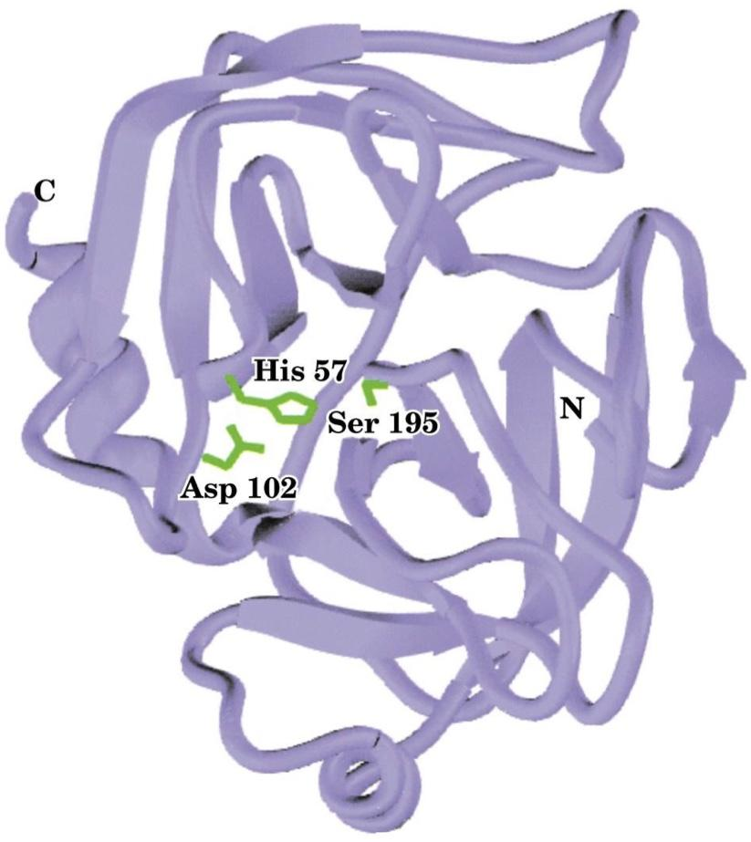
Structure of pepsin enzyme
An enzyme with its active site
Structure of trypsin enzyme
Structures are not for memorization

Slide 6
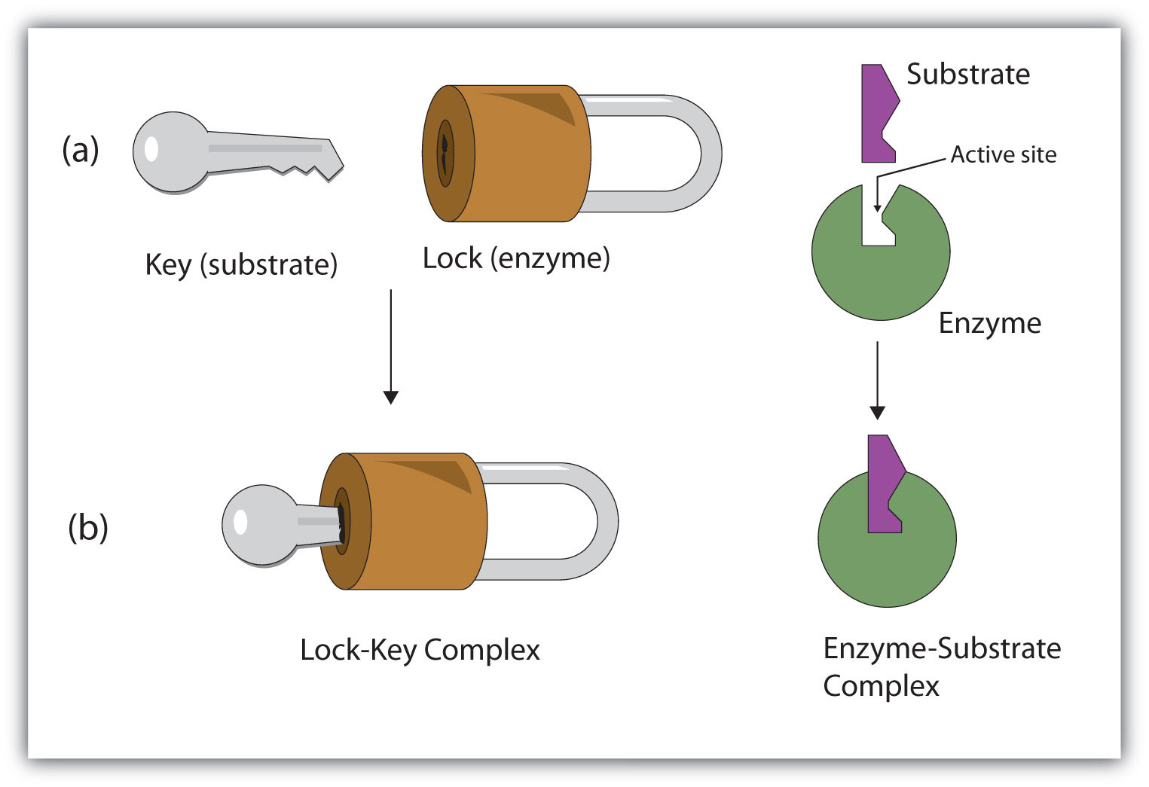
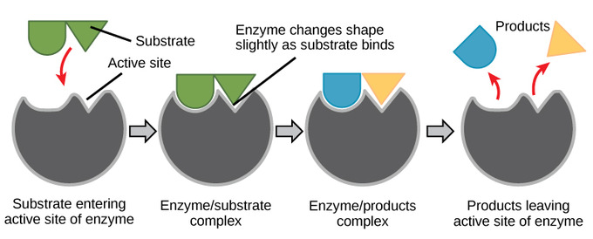
Enzyme-substrate binding
Classification of Enzymes
Lock and key binding
Induced fit binding
Classified into six types according to the reaction catalyzed
Oxidoreductases | Oxidation-reduction reaction
Transferases | Transfer of functional groups
Hydrolases | Hydrolysis reaction
Lyases | Group elimination to form double bonds
Isomerases | Isomerization
Ligases | Bond formation coupled with ATP hydrolysis
The enzyme has an active site that fits the exact dimensions of the substrate
The enzyme has a similar shape to the substrate, After the binding of substrate, the enzyme changes its shape to fit more perfectly with substrate
زي القفل ما يفتحه الا مفتاح واحد بنفس الشكل له
هذا ما يعني انه يقدر يغير شكله لاي سبسترايت لكن هو فقط يسوي تعديلات بسيطه لشكله عشان يناسب السبسترايت المحدد له بشكل احسن
**تحفظ بالترتيب
Overseas travelers heard lyrics in london

Slide 7
Enzymes Nomenclature (Naming)
Enzymes nomenclature is based on the rules given by IUBMB (International Union of Biochemistry and Molecular Biology).
Nomenclature order is:
Class.Subclass.Subsubclass.Enzyme number.
EC 3.4.17.1 (carboxypeptidase A)
Enzyme
commission
You don’t have to memorize this name just know what each number means.
Class
Subclasses
Enzyme
number
Sub-subclass

Slide 8
Holoenzymes
Inactive enzyme that binds to a nonprotein part to become active
Some enzymes require non-protein groups to become active
The inactive form of enzyme without its non-protein part is called an apoenzyme
NonProtein part
Cofactor or coenzyme
=
Holoenzyme
(Active)
+
Apoenzyme
(Inactive)
Examples
e.g.
_______
e.g.
_______
Transiently= temporary

Slide 9
Ribozymes, isoenzymes and zymogens
Isoenzymes “نظائر تقريباً”
Enzymes that catalyze the same chemical reaction but they have slightly different structure
e.g. protein kinase have a multiple isoenzymes that are structurally different but share the same function
Ribozymes
RNAs (ribonucleic acid) with enzyme activity
Zymogens
Inactive enzyme precursors that require a biochemical change to become active (activated when needed) e.g. cleavage of peptide blocking the active site
enzymes involved in digestion like trypsin, pepsin and chymotrypsin are synthesized as zymogens because we don’t need them all the time.
Zygomens are a group of proteins that display no catalytic activity but are transformed within an organism into enzymes

Slide 10
Enzymes decrease activation energy of a reaction
In every chemical reaction, the reactants pass through a transition state that has greater energy than that of the reactants or products alone
The difference in energy between the reactants and the transition state is called the activation energy (Ea)
If the activation energy is available then the reaction can proceed forming products
An enzyme reduces the activation energy required for a reaction
It provides an alternative transition state of lower energy called the enzyme- substrate complex and thus speeds up the reaction
Enzymes decrease the activation energy but they do not alter the change in the free energy (∆G)

Slide 11
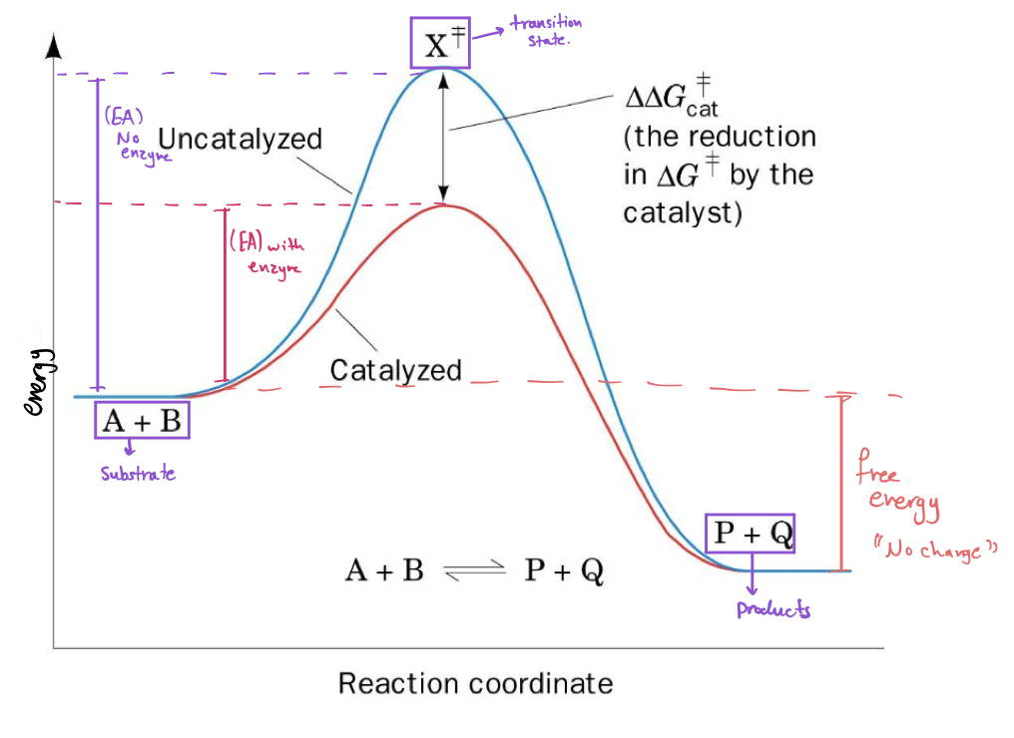
The effect of catalyst on the transition state diagram of a reaction
catalysts lowers the energy required to reach the transition state which make the formation of a product faster but it doesn’t change the free energy
Free energy change of the reaction is the difference of reactants and products.

Slide 12
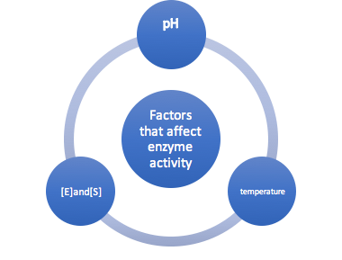
Enzyme Activity or Velocity
. Velocity is the rate of a reaction catalyzed by an enzyme-
Enzyme activity is expressed as -
mmoles of product formed/min/mg enzyme
“How many substrates were converted into products for a unit time”
Millimoles / min / milligram
Or
Micromoles / min / microgram
“Always use the same unit”

Slide 13
Effect of temperature:
– Every enzyme has an optimal temp. for catalyzing a reaction (In humans most enzyme have an optimal temp. of 37C )
– The rate of an enzyme reaction initially increases with rise in temperature.
–At high temp. enzymes are denatured and become inactive.
– In humans, most enzymes have an optimal temp of 37 c
كل انزيم له درجه حراره محدده يعمل فيها وكل مازادت درجه الحراره يزداد rate of reaction ولكن اذا وصلت درجه حراره عاليه مره راح يتأثر الانزيم وبالتالي ما راح يشتغل ( الشيء اذا زاد عن حده انقلب ضده)

Slide 14
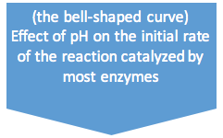
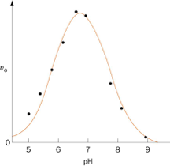
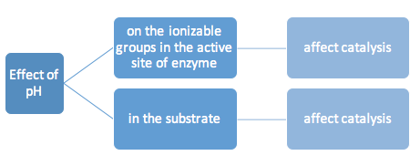
2) Effect of pH:
Every enzyme has an optimal pH for catalyzing a reaction
•Most enzymes have highest activity between pH 6 and pH 8
•Pepsin (digestive enzyme in the stomach) has highest activity at pH 2
Optimal
Effect of temperature and pH
حمضية أو قاعدية الوسط المناسب لعمل الإنزيم تعتمد على مكان عمله؛ اذا كان يعمل في بيئة حامضية مثل المعدة، يكون الوسط المناسب له حامضي؛ أو قاعدية مثل الأمعاء يكون الوسط المناسب له قاعدي

Slide 15
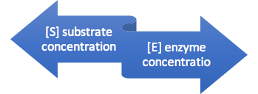
3) Effect of [E]and[S]:
The reaction velocity increases initially
with increasing [S]
Until excess substrate causes the reaction velocity to be constant *Further addition of substrate has no effect on enzyme velocity (v)* (because enzyme is saturated).
If [S] > enzyme => the rate of enzyme reaction will be directly proportional to the concentration of enzyme.
At low [S], the reaction rate is proportional to [S]
اذا كان [S] اكثر من [E] في هذه الحاله سرعه التفاعل راح تعتمد بشكل طردي على [E] فكل مازادت تركيز الانزيمات يكون التفاعل اسرع
-At limited substrate (substrate is constant) ; the velocity depends on the concentration of the enzyme
-At limited enzyme concentration (number of enzymes is constant) ; the velocity depends on the substrate concentration
Effect of [E]and[S]

Slide 16
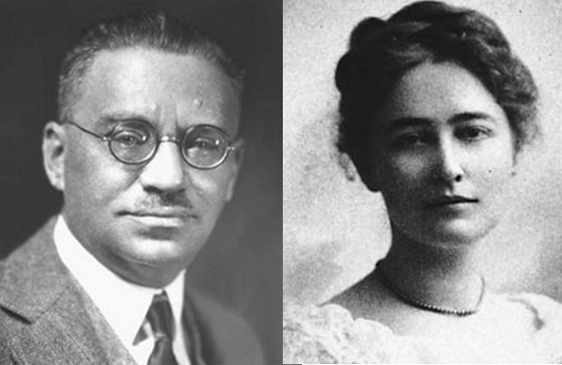
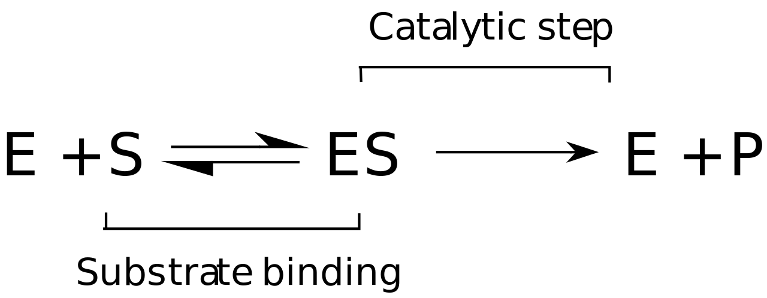
Enzyme kinetics
Initial rate of enzyme reaction
The time they take to get arranged
The model of enzyme kinetics was first proposed by Michaelis and Menten in 1913 and later modified by Briggs and Haldane.
The Michaelis Menten equation describes the relationship of initial rate of an enzyme reaction to the [S]
1. Pre-steady state:
Enzyme + high concentration of substrate= an initial short period of time (a few hundred microseconds) during which intermediates of products gradually build up..NO PRODUCT DURING THIS PHASE.
Initial rate= when nothing is limited
Enzyme-substrate complex formation only
product
2. steady state:
occurs after initial state, when the reaction rate and the concentration of intermediates change slowly with time
An intermediate changes into steady state when the rate of its synthesis becomes equal to its rate of degradation.
Enzyme
very useful video :)

Slide 17
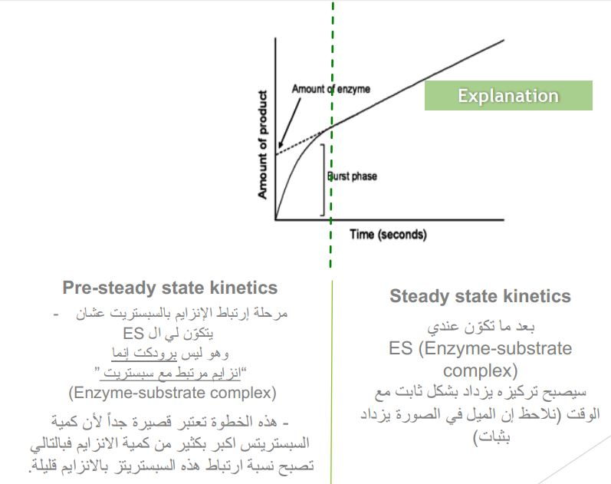
an additional slide
TEAM 436

Slide 18
Michaelis Menten Equation
•It measures the initial velocity (vo)
of an reaction enzyme
Vmax [S]
vo = ------------
Km + [S]
[S] = substrate concentration
Vmax = maximum velocity
Km = Michaelis constant
You might be asked to either find (Vo, or Vmax, or Km or [S] ) using this equation

Slide 19
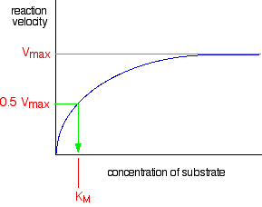
Initial velocity Vo of a simple Michaelis Menten reaction- versus the substrate concentration
Saturation

Slide 20
K_{m} (Michaelis Constant)
K_{m} is the substrate concentration at which the initial rate is one-half of the maximum rate (½ V_{max})
It is the [S] (substrate concentration) required to saturate half of all of the active sites of an enzyme
You must know the definitions.
The K_{m} value of a substrate depends on its affinity with the enzyme
High K_{m} means low affinity with enzyme (more substrate needed to saturate the enzyme)
Low K_{m} means high affinity with enzyme (less substrate needed to saturate the enzyme)
Affinity= tendency to bind to a substrate

Slide 21
Lineweaver-Burk plot
•Also called the double-reciprocal plot, obtained by taking reciprocals of the Michaelis Menten equation
•It is plotted to calculate the Km and Vmax values and to determine the mechanism of action of enzyme inhibitors
Definition
Usage:
1
2

Slide 22
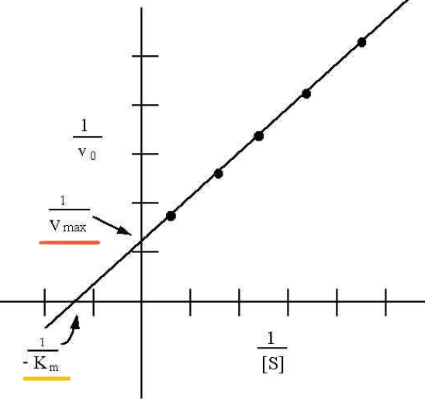
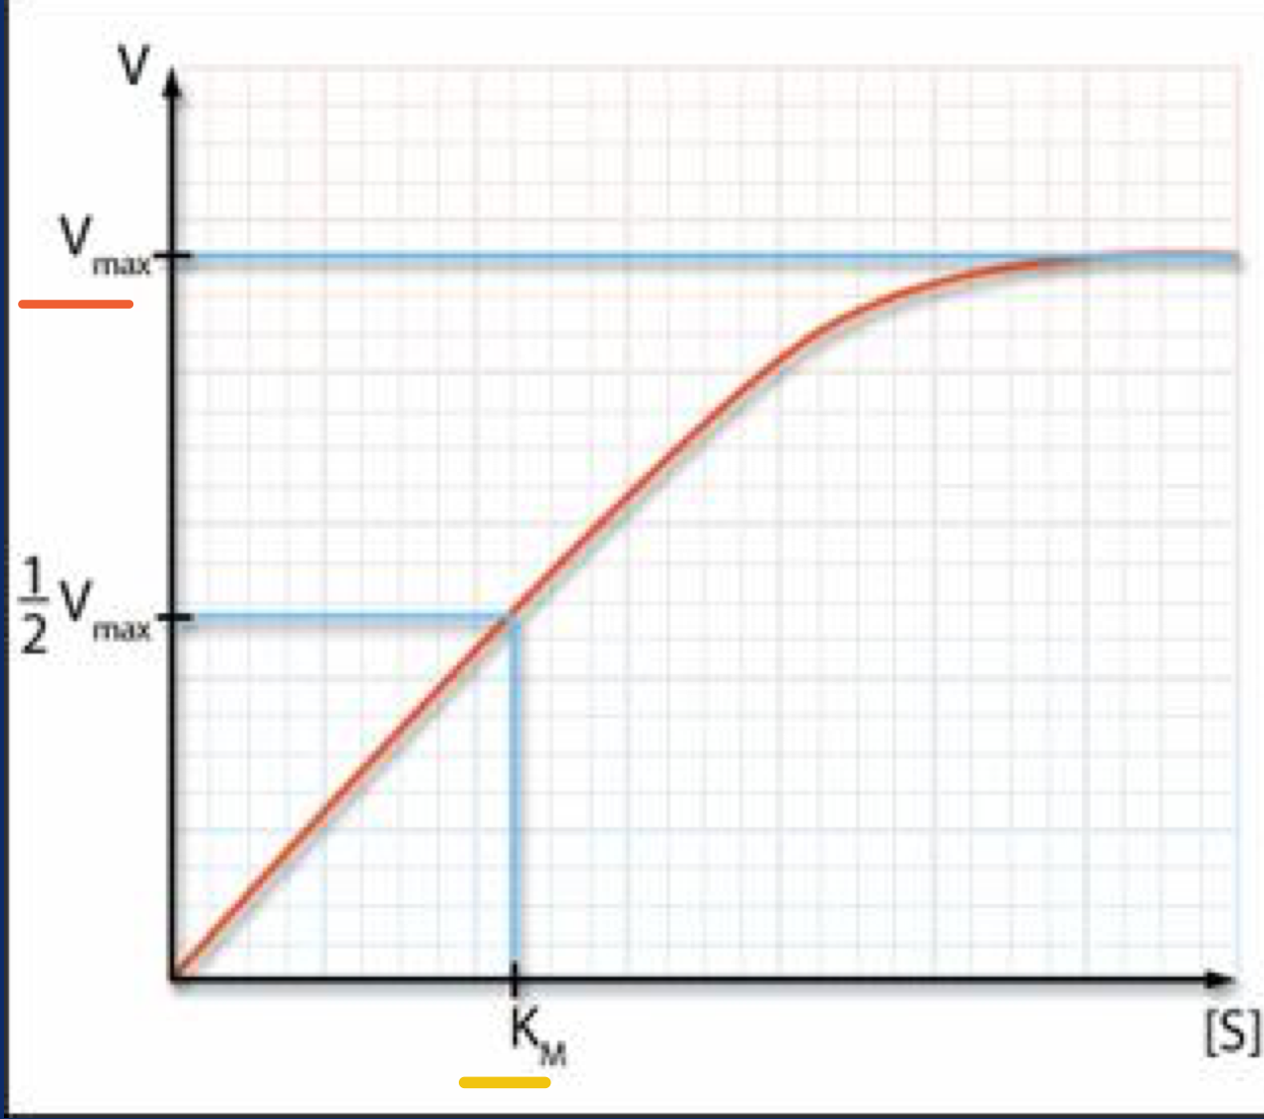
The graphs are for further understanding, but you should be able to recognize each graph.
Initial velocity Vo of a simple Michaelis Menten reaction- versus the substrate concentration
Lineweaver-Burk plot

Slide 23
Mcq:
Which of the following statements about enzymes or their function is true? A. Enzymes do not alter the overall change in free energy for a reaction B. Enzymes are proteins whose three-dimensional form is key to their function C. Enzymes speed up reactions by lowering activation energy D. All of the above
Answer: D
Enzymes having slightly different molecular structures but performing identical activity are:
a) holoenzymes b)apoenzymes c) isoenzymes d) coenzymes
Answer:c
An enzyme is a-lipid b-cabrohydrates c-protein d-nucleic acid
Answer: c
Which factor is responsible for inhibition enzymatic process during feed back? a) Enzymes b) End product c) Temperature d) Substrate
Answer: b
The term apoenzyme is applicable to a) Simple enzyme b) Protein part of conjugate enzyme c) Organic cofactor of a conjugate enzyme d) Inorganic cofactor of a conjugate enzyme
Answer: b
The Michaelis constant depends on?
a) The affinity of an enzyme to a receptor.
b)The concentration of substrates.
c)The affinity of a substrate to an enzyme.
d)The dissociation rate of a substrate to an enzyme.
`Answer :c

Slide 24
GIRLS TEAM:
الهنوف الجلعود
رهف الشنيببر
شهد الجبرين
لينا الرحمة
منيرة المسعد
ليلى الصّباغ
العنود المنصور
أرجوانة العقيل
ريناد الغريبي
مجد البراك
روان مشعل
BOYS TEAM:
داوود اسماعيل
عبدالله الحربي
عبدالملك الشرهان
٤- تركي آل بنهار
احمد ابراهيم العريفي
سعيد آل سرار
عبدالرحمن التركي
سلطان بن عبيد
صالح المعيقل
صالح الوكيل
عدنان المقبل
- علي العماري
محمد ابراهيم
محمد صالح القسومي
نواف عبدالعزيز
Team leaders:
محمد حسن حكيم
رهام الحلبي Contact us: teambiochem437@gmail.com For editing file: https://docs.google.com/presentation/d/16yNcm2Y08Cr0Am83lDRfH5NB4F1ng3tdHiB3O1AqMc8

