Slide 1
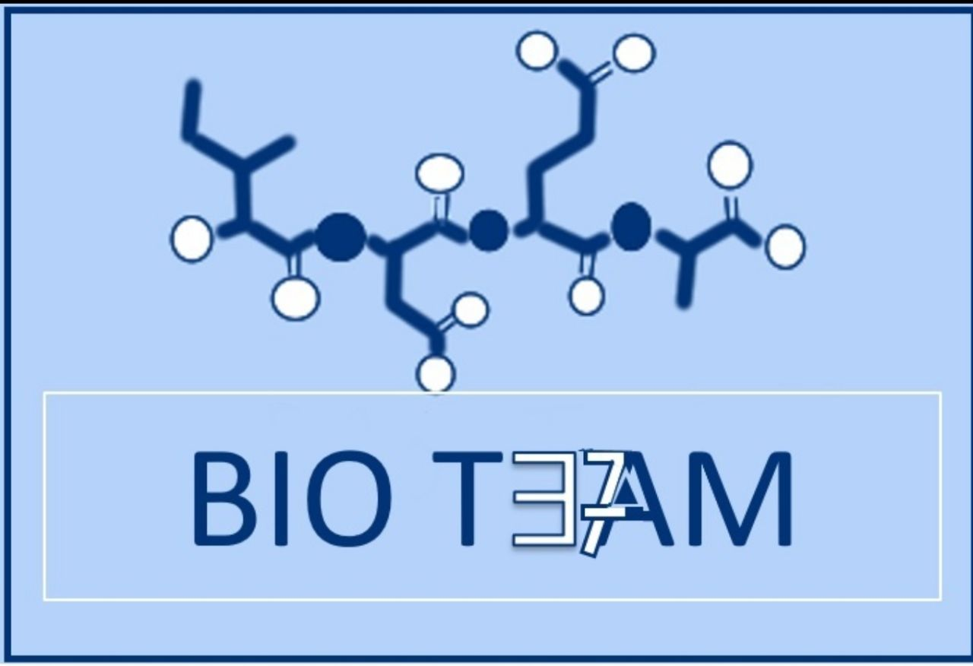
Enzyme inhibition
Color index:
Doctors slides
Notes and explanations
Extra information
highlights

Slide 2
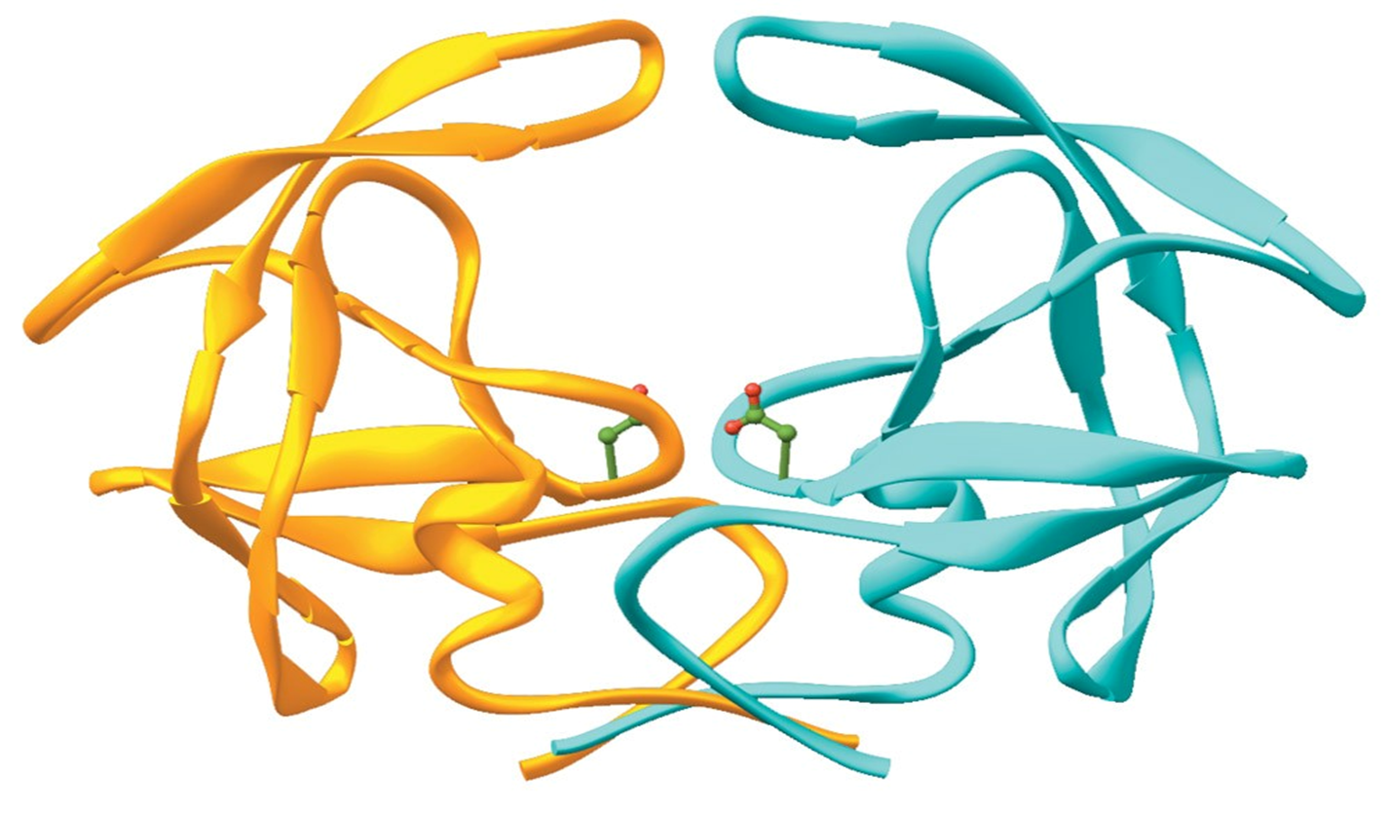
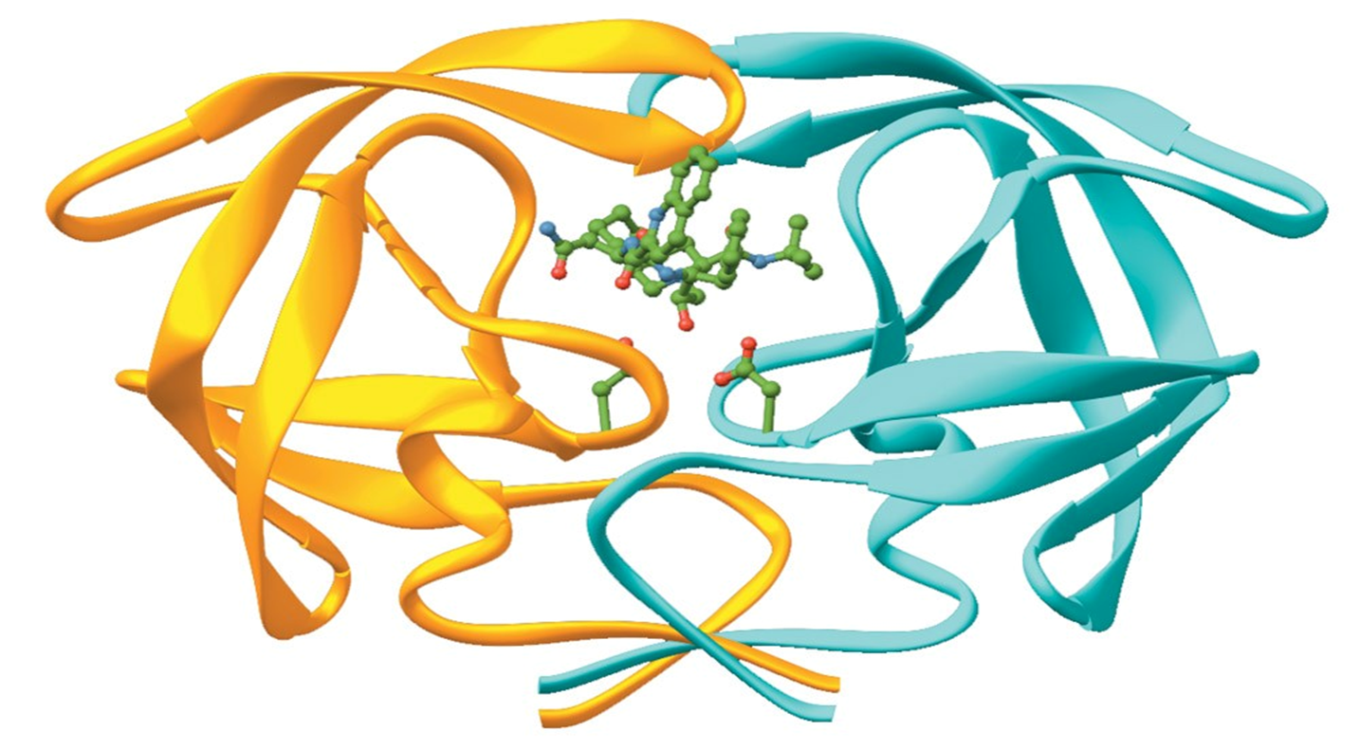
Inhibition is a process in which the enzyme activity is regulated or controlled or stopped. - Ki ( inhibitor constant ) is a measure of the affinity of the inhibitor for the enzyme. Also, known as dissociation constant.
There are three types of enzyme inhibition:
Uncompetitive
( this type of inhibition was only mentioned in boys slides).
Competitive
- Inhibitor has a similar structure to substrate
- It competes with substrate for binding to active site of enzyme.
Noncompetitive
- Inhibitor does not have similar structure to substrate
-No competition exists between inhibitor and substrate
Affinity: تعني انجذاب المركب لمركب اخر
An enzyme without inhibitor
An enzyme with inhibitor

Slide 3
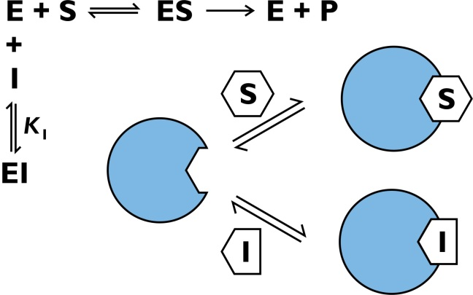
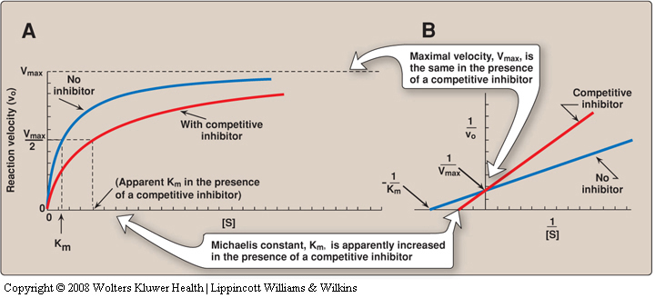
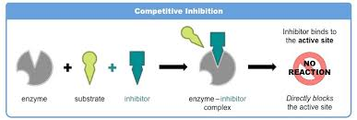
COMPETITIVE INHIBITION
The inhibitor is a structural analogue (similar) *to the substrate* that competes with the substrate for binding to the same active site of enzyme (competitive). Thus prevent the enzymatic reactions
Competitive inhibition is always reversible reaction.
Vmax → unchanged in the presence and the absence of inhibitor.
Km → increased, because Substrate and Inhibitor compete for binding at the same site.
*A higher concentration of substrate is required to achieve half-maximal velocity*
Two reactions are possible:
E + S ↔ ES → E + P
and
E + I ↔ EI
I: inhibitor, S: substrate

Slide 4
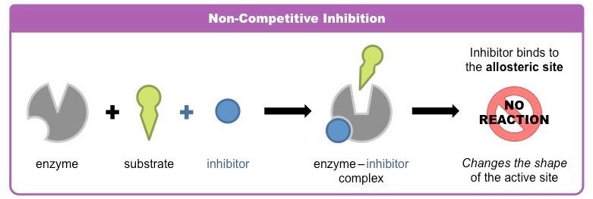
Noncompetitive inhibition
Inhibitor doesn’t have a similar structure to the substrate.
It binds somewhere other than the active site.
Non-competitive inhibition could be irreversible or reversible.
The inhibitor can bind to: a free enzyme or to an enzyme-substrate complex. In both cases the complex is catalytically inactive
Vmax → decreased by the inhibitor.
Km → unchanged because the affinity of Substrate for Enzyme is unchanged
Two reactions are possible:
ES + I ↔ ESI (inactive)
E + I ↔ EI (inactive)
Km:السبب انها لم تتغير أن المثبط لا يرتبط في نفس الجهة لذا لا يؤثر على انجذاب المكب للإنزيم
Vmax: يوثر عليها لأنه زاد تشبع الانزيم يعني أصبحت الانزيمات الفارغة للمركب للتفاعل معها اقل و بالتالي كانه قلت كمية الانزيمات و زاد التشبع.
Vmax: الحد الذي يصل عنده المركب للتشبع

Slide 5
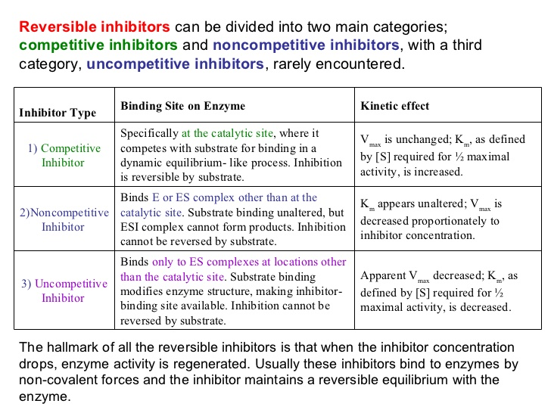
Summary

Slide 6
Regulation of enzyme activity
Regulatory enzymes usually catalyze the first or an early reaction in a metabolic pathway
They catalyze a rate limiting reaction that controls the overall pathway
They may also catalyze a reaction unique to that pathway known as committed step
Feedback inhibition:
When the end-product of a metabolic pathway exceeds its conc. limit, it inhibits the regulatory enzyme to normalize the pathway (feedback inhibition)
Feed positive activation:
When the end-product of a metabolic pathway is below its conc. limit, it activates the regulatory enzyme to normalize the pathway
الانزيم يتم تنظيم عمله عبر عملية تسمى التغذية الراجعة ( زي مهارات التواصل تذكرها ) لكي يعرف الانزيم متى يشتغل و متى يوقف, هذه العملية يا تكون إيجابية (تأمره بالعمل ), او مثبطة ( توقفه عن عمله) و كل ذلك ليصل الجسم لحالة توازن.
و هذه العملية ( التغذية الراجعة )
لها عدة طرق ركز في الصور

Slide 7
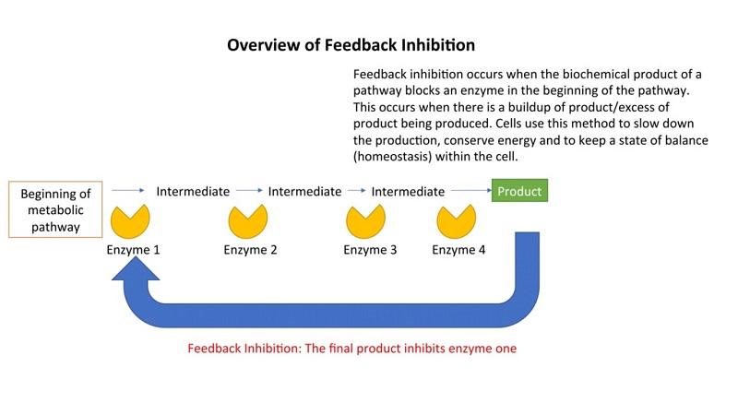
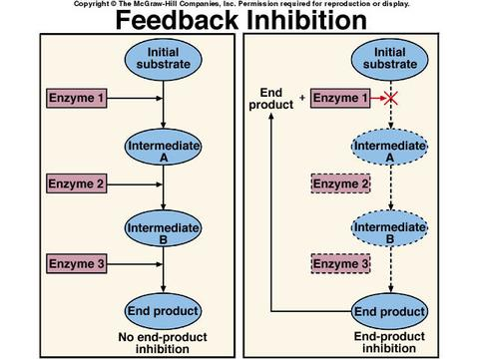
-Feedback Inhibition of biochemical pathways :
https://www.youtube.com/watch?v=n3i7XMQTZ_s
Feedback Inhibition or End Product Inhibition of Enzymes:
https://www.youtube.com/watch?v=bRGsmNLMn4I
Better video
https://www.youtube.com/watch?v=WAZXqhtduFw

Slide 8
Regulation of allosteric enzymes
Homotropic: Effect of one ligand on the binding of the same ligand
A regulatory enzyme controlled by its own substrate
Heterotropic: Effect of one ligand on the binding of a different ligand
Allosteric enzyme regulation
Enzymes in metabolic pathways are regulated by certain compounds (ligands)
These ligands do not bind to active site
They bind to other site (regulatory site) on the enzyme (allosteric enzymes)
The term “allosteric” came from Greek word “allos” meaning “other
بالمختصر المفيد الامر متعلق بالمركب المثبط , لو كان هو نفسه المتفاعل قلنا انه (homotropic)
لو كان المركب المثبط ليس من المتفاعلات لهذا الانزيم انما ناتج او غيره مثل الصورة تحت قلنا عنه (heterotropic)
REGULATION OF ENZYME ACTIVITY
Allosteric enzyme regulation
Cooperative binding
1.Heterotropic effectors
2.Homotropic effectors

Slide 9
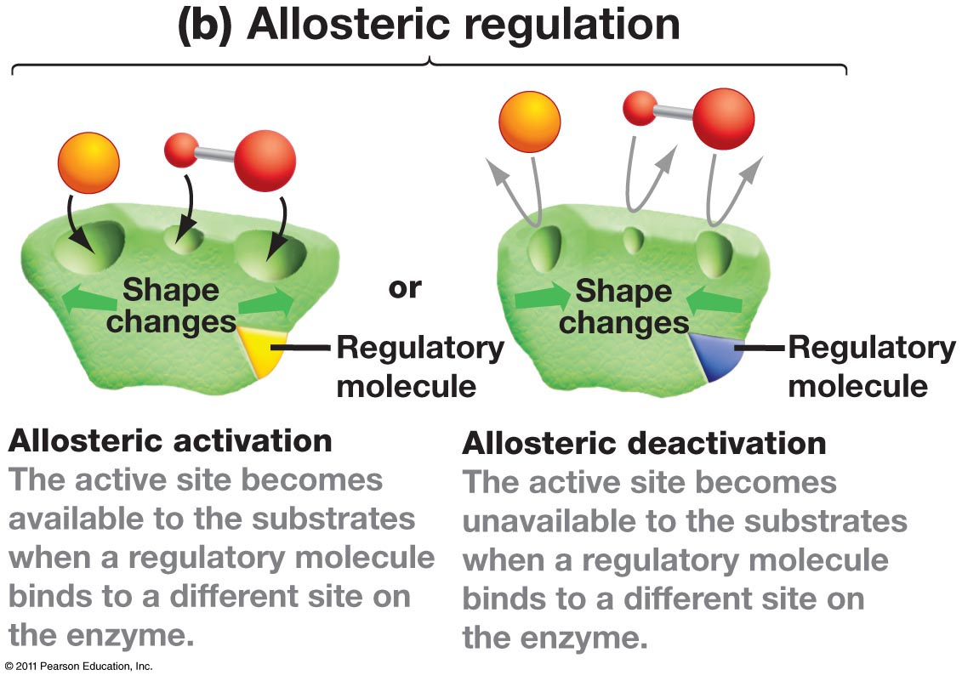
Cooperative binding
It is the process by which binding of a ligand to a regulatory site affects binding of the same or of another ligand to the enzyme. بمعنى ارتباط المادة مع الانزيم في منطقة وحدة يحفّز المناطق الأخرى بنفس الإنزيم.
Binding of an allosteric modulator causes a change in the conformation of the enzyme
This causes a change in the binding affinity of enzyme for the substrate
The effect of a modulator may be positive (activation) or negative (inhibition)
Positive: increased E, S affinity
Negative decreased E, S affinity
Most allosteric enzymes are oligomers (two or more polypeptide chains or subunits)
The subunits are known as protomers
Cooperative binding: binding of one molecule facilitates binding of another molecule.
The first molecule to bind always takes the longer time

Slide 10
Enzymatic diagnosis and prognosis of diseases
They are used as:
As indicators of enzyme activity or conc. in body fluids (serum, urine) in the diagnosis/prognosis of diseases
As analytical reagents in measuring activity of other enzymes or compounds in body fluids
As therapeutic agents
The most commonly used body fluids for measuring enzyme activity are serum and plasma
There are:
Plasma-specific enzymes
Nonplasma-specific enzymes
Serum markers in the diagnosis of diseases
Heart disease
Pancreatic diseases
Liver diseases
e.g if we find liver enzymes in the blood, that means there is something wrong with the liver

Slide 12
summary
 | Competitive inhibition | Noncompetitive
meaning | similar to the structural of the substrate and competes with it for binding at the active site | The inhibitor does not have structural similarity to the substrate. The inhibitor binds to the enzyme at a site away from the substrate binding site
V_{max} | V_{max} is unchanged in the presence and the absence of inhibitor | The value of V_{max} is decreased by the inhibitor
K_{m} | K_{m} is increased because substrate and inhibitor compete for binding at the same site | K_{m} is unchanged because the affinity of S for E is unchanged
-Regulatory enzymes usually catalyze the first or an early reaction in a metabolic pathway.
-There are two types of regulation allosteric enzyme regulation and cooperative binding
-Feedback inhibition inhibits the regulatory enzyme to normalize the pathway (feedback inhibition) while the feedback positive activation
activates the regulatory enzyme to normalize the pathway.
-Two types of interactions occur in allosteric enzymes:
Homotropic: Effect of one ligand on the binding of the same ligand .
Heterotropic: Effect of one ligand on the binding of a different ligand.
Enzymes are used clinically in three ways.

Slide 13
GIRLS TEAM:
الهنوف الجلعود
رهف الشنيببر
شهد الجبرين
لينا الرحمة
منيرة المسعد
ليلى الصّباغ
العنود المنصور
أرجوانة العقيل
ريناد الغريبي
مجد البراك
روان مشعل
Team leaders: ١-محمد حسن حكيم
٢- رهام الحلبي Contact us: teambiochem437@gmail.com For editing file: https://docs.google.com/presentation/d/16yNcm2Y08Cr0Am83lDRfH5NB4F1ng3tdHiB3O1AqMc8
BOYS TEAM:
١-داوود اسماعيل
٢- عبدالله الحربي
٣- عبدالملك الشرهان
٤- تركي آل بنهار
٥- احمد ابراهيم العريفي
٦-سعيد آل سرار
٧- عبدالرحمن التركي
8-سلطان بن عبيد
9- صالح المعيقل
10- صالح الوكيل
11- عدنان المقبل
12- علي العماري
13- محمد ابراهيم
14- محمد صالح القسومي
15- نواف عبدالعزيز

