Slide 1
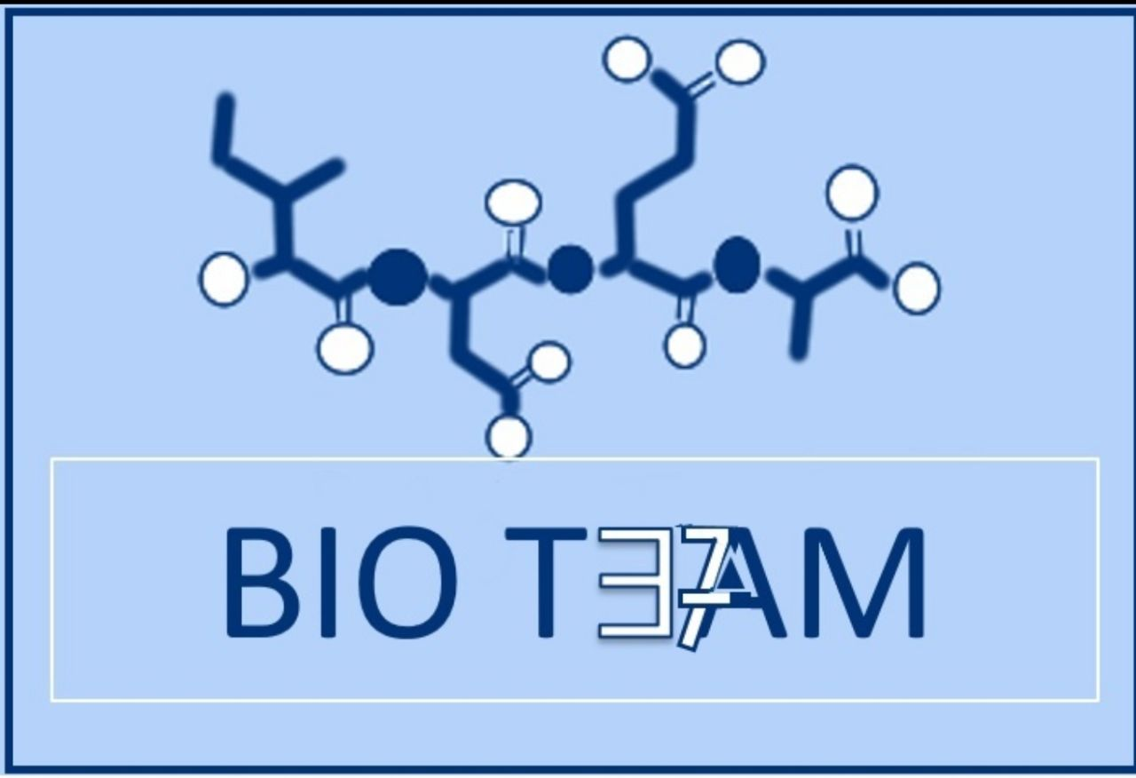
بِسْم الله الرحمن الرحيم
Metabolism: anabolism and catabolism
Color index:
Doctors slides
Notes and explanations
Extra information
Highlights

Slide 2
Objectives:
Understand the concept of metabolic pathway
Identify types and characters of metabolic pathways- anabolic and catabolic
Identify ATP as the energy currency of cells

Slide 3
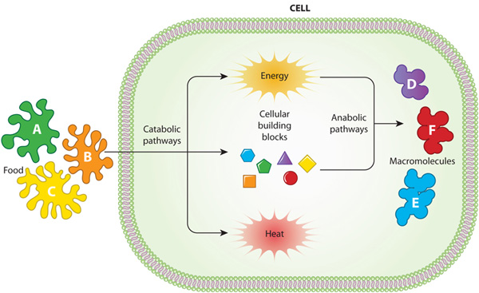
Metabolism:
METABOLISM is all the chemical reactions taking place inside a cell.
A metabolic pathway is a multistep sequences of enzyme-catalyzed reactions. > Metabolic pathways are tightly regulated and highly integrated.
Consists of (classified as):
1- Anabolism (anabolic pathway) بناءة
بنى
2- Catabolism (catabolic pathway) هدامة
Pathways that regenerate a component are called cycles.

Slide 4
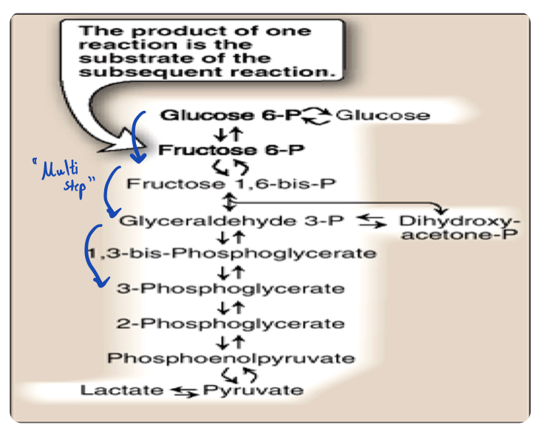
Pathway Vs Chemical reaction
An example of a metabolic pathway (Glycolysis):
Original substrate
Metabolic pathways:
A multi-step sequence of chemical reactions.
A product of first reaction becomes a substrate for second reaction.
Integrated (not separated) pathways.
Metabolic pathways are bidirectional.
End product
Whereas chemical reactions happen with one step and one direction

Slide 5
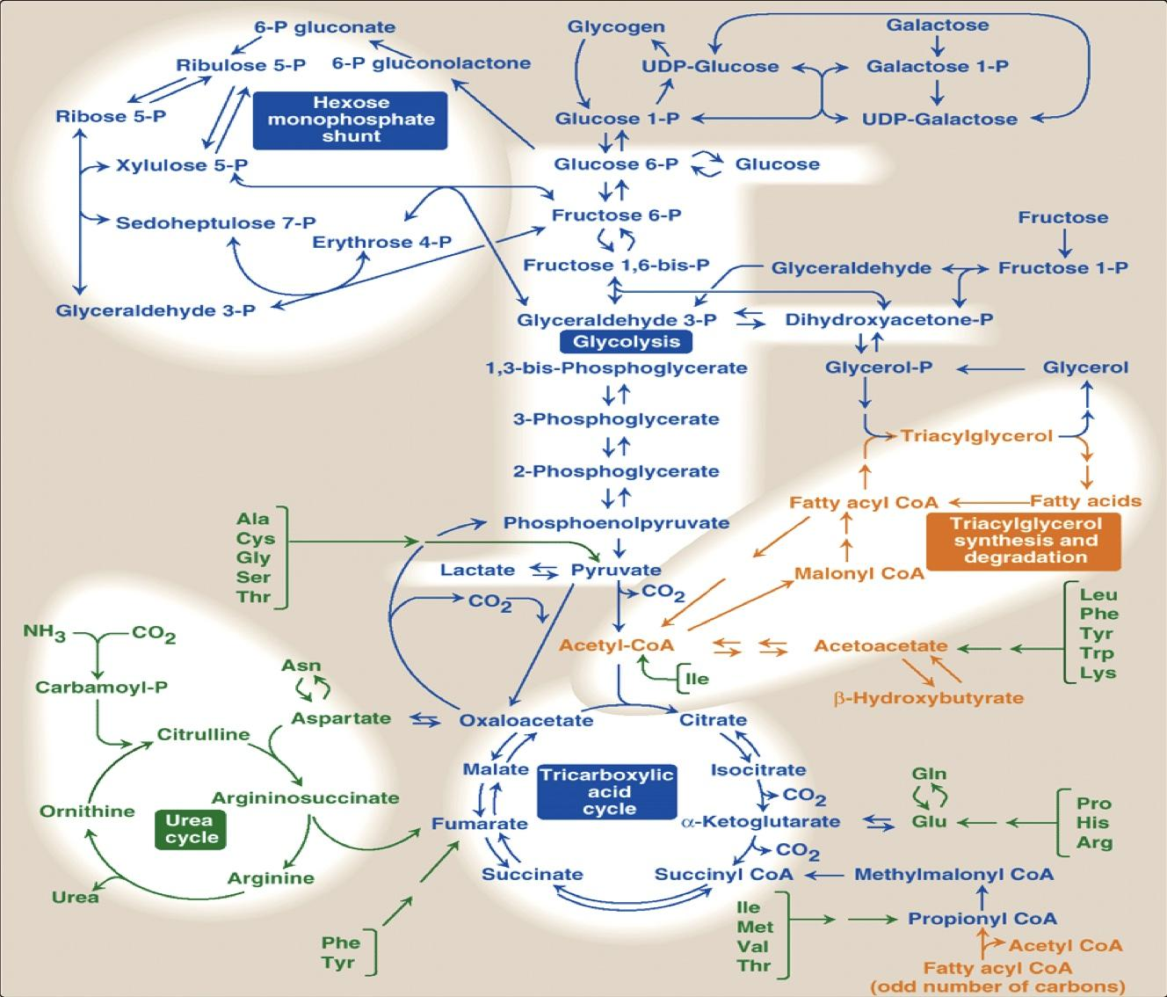
Metabolic Map
Example:
(الصورة للفهم فقط)
Different pathways can intersect, forming an integrated and purposeful network of chemical reactions The Metabolic Map.
> The metabolic map shows how all pathways come together, it helps us understand the effect of each path on the entire metabolism.

Slide 6
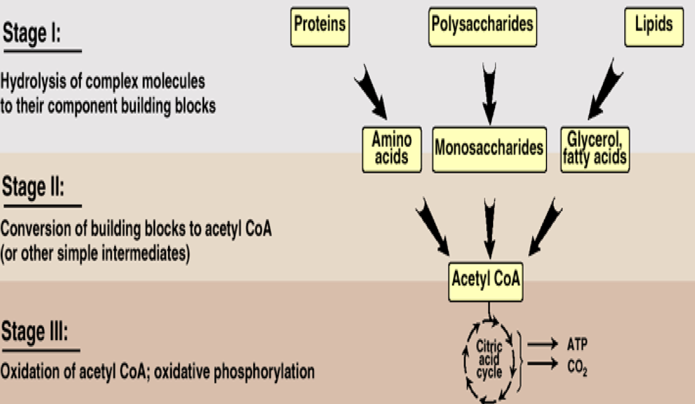
Catabolic Pathways
Anabolic Pathways
Breaking down complex molecules to produce energy
-Use ATP produced by catabolic pathways
-Monomers + Energy (ATP) = Polymers
Precursor molecules into complex molecules
Endergonic reactions require ATP
Divergent process
Classification of metabolic pathway
Starts with a small number of molecules and keeps on increasing
Amphibolic Pathways
Amphi = Dual, amphibolic: dual pathway (both catabolic and anabolic)
For example: Krebs cycle is mainly a catabolic cycle, but with some anabolic features, e.g., part of Krebs cycle is used for the synthesis of glucose from amino acids
Therefore, Krebs cycle is amphibolic

Slide 7
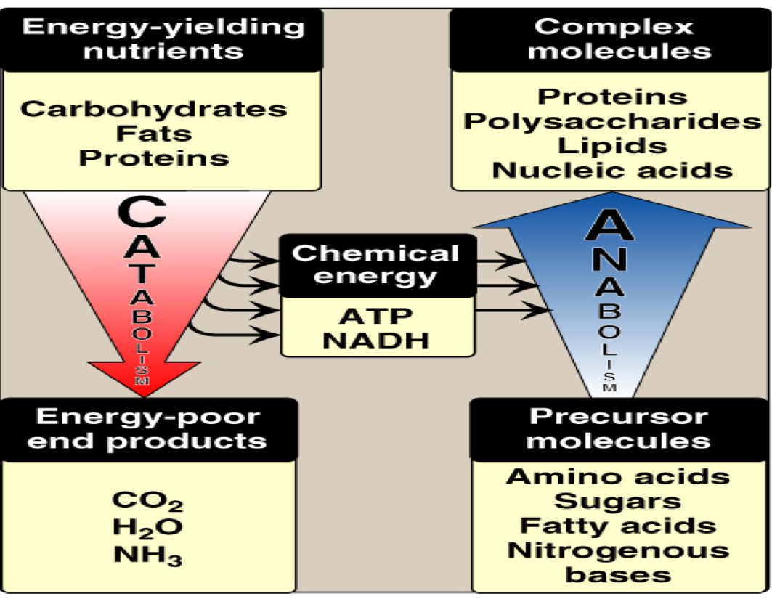
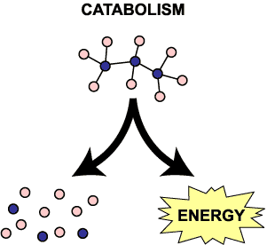
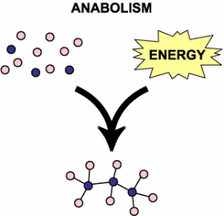
Catabolism Vs Anabolism
Catabolic | Anabolic
Complex to simple molecules | Simple to complex molecules
Exergonic (energy producing) (provides energy in form of ATP) | Endergonic (energy consuming)
Involves oxidations | Involves reductions
Requires NAD⁺ | Requires NADPH
Convergent process | Divergent process
Converging
Uses ATP
Makes ATP
Diverging

Slide 8
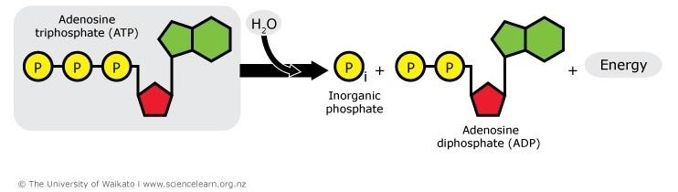
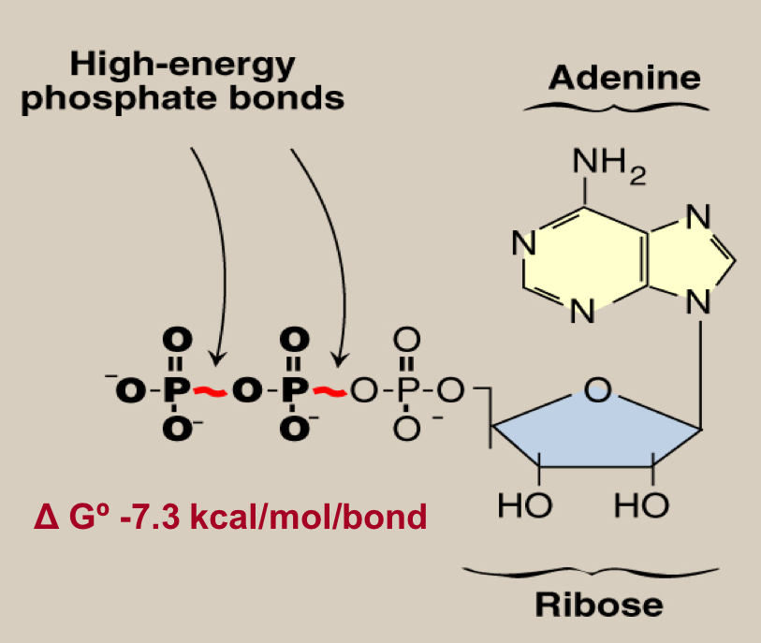
Energy Currency: ATP
ATP + H₂O → ADP +P_{i}
The free energy liberated in the hydrolysis of ATP is used to drive the endergonic reactions
ATP is formed from ADP and P_{i} when fuel molecules are oxidized
This ATP-ADP cycle is the fundamental mode of energy exchange in biological systems
ATP is the energy currency of the cells

Slide 9
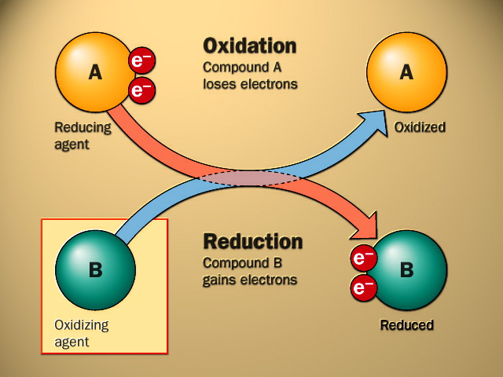
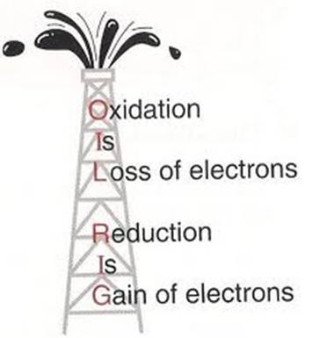
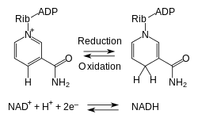
Oxidation and Reduction
Oxidation: Loss of hydrogen - Loss of electrons
Reduction: Gain of hydrogen - Gain of electrons
NAD+ and NADH
“NAD= Nicotinamide Adenine Dinucleotide”
From NADH to NAD+ (oxidation) “loss of hydrogen”
From NAD+ to NADH (reduction) “gain of hydrogen”

Slide 10
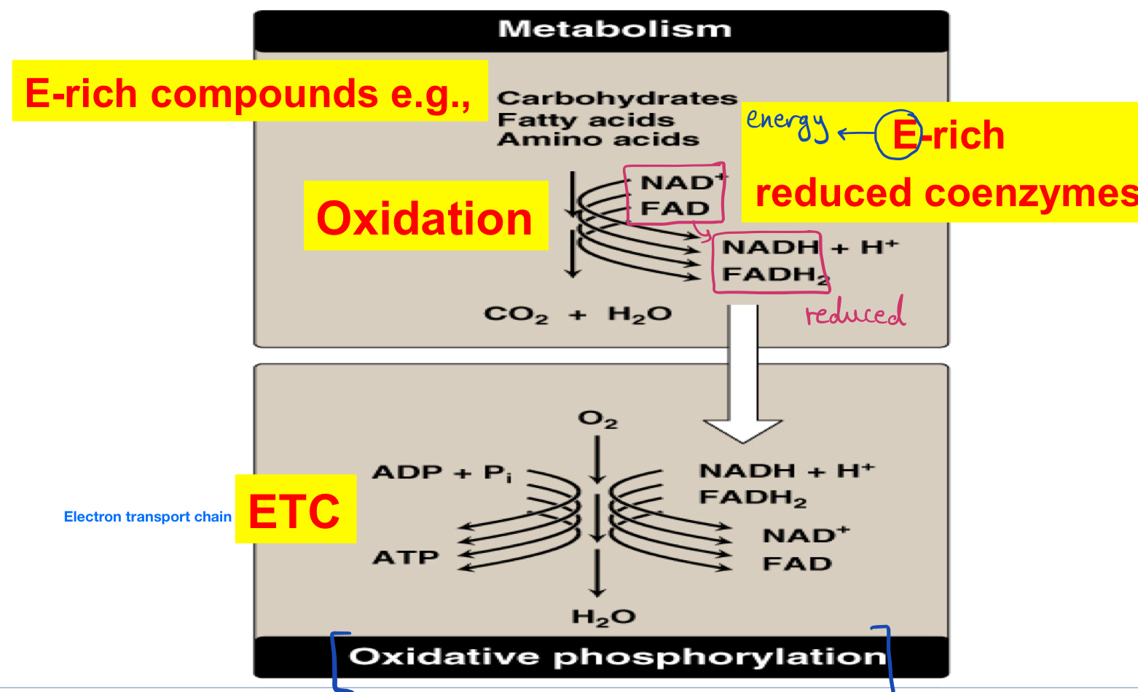
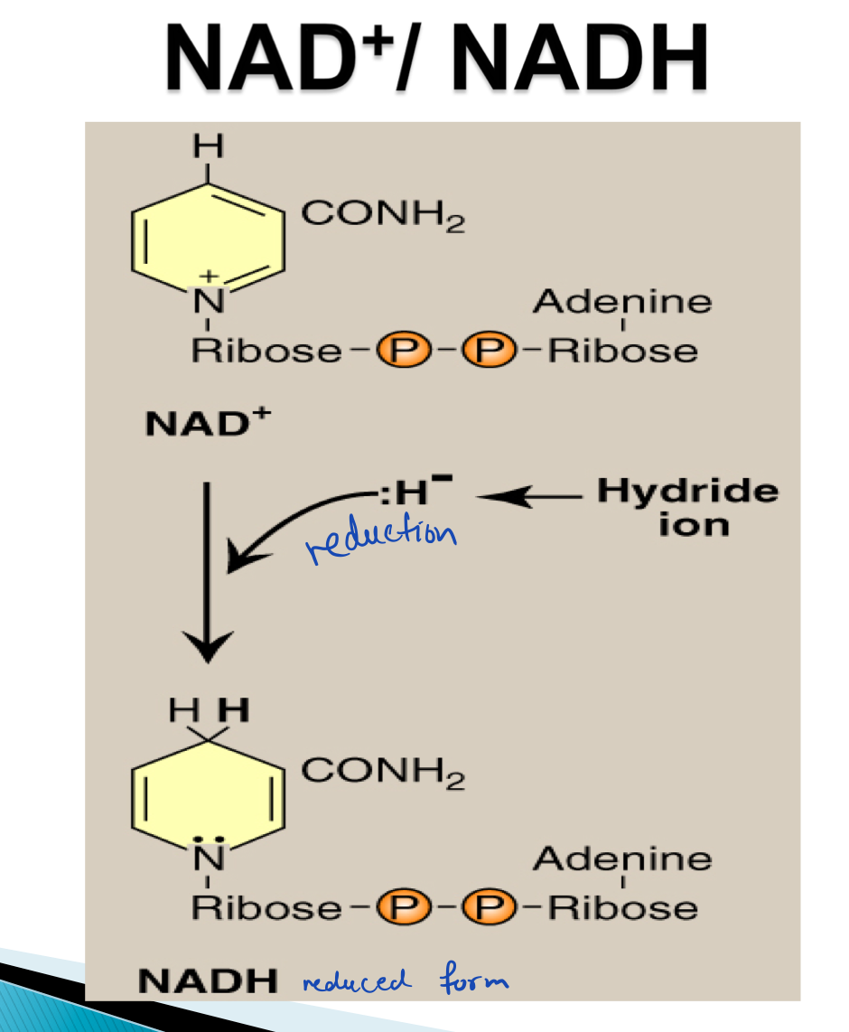
Oxidation and reduction are present in metabolism
Explanation: The carbohydrates, fatty acids, amino acids were oxidized, while the enzymes NAD and FAD were reduced =
Both oxidation and reduction happen together in metabolism

Slide 11
Regulation Of Metabolism
We regulate metabolism by regulating enzymes.
We need signals to control metabolism, these signals could be:
Intracellular signals (inside cells):
this kind of regulation is fast
Substrate availability
(If substrate needed is not available > it won’t activate
If substrate needed is available > it will activate and make
product)
Product inhibition
(Feedback inhibition happens when the end product of a
metabolic pathway exceeds its concentration limit, it inhibits
the regulatory enzyme to normalize the pathway -output used
as input- )
Allosteric activators or inhibitors
(Happens when an effector molecule binds at the protein's
allosteric site -which is a site other than the active site- and
that can either activate or inhibit the process)
Intercellular communications (between cells):
Chemical signaling
(hormones: first messenger)
Second messengers:
(cAMP, cGMP, Ca++/phosphatidylinositol)
*c means cyclic
Explanation:
A hormone binds to a receptor outside the cell, leading to the activation of cell messengers inside the cell.
Some notes in this slide were taken from teams 435 & 436

Slide 12
Metabolic Fuel
Carbohydrates & lipids (mainly) and proteins (little extent) are used for energy production.
1- Carbohydrates (glucose)
2- Lipids (fatty acids)
3- Protein (amino acids)
Glucose is the major metabolic fuel of most tissues

Slide 13
GIRLS TEAM:
الهنوف الجلعود
رهف الشنيببر
شهد الجبرين
لينا الرحمة
منيرة المسعد
ليلى الصّباغ
العنود المنصور
أرجوانة العقيل
ريناد الغريبي
مجد البراك
روان المشعل
BOYS TEAM:
داوود اسماعيل
عبدالله الحربي
عبدالملك الشرهان
٤- تركي آل بنهار
احمد ابراهيم العريفي
سعيد آل سرار
عبدالرحمن التركي
سلطان بن عبيد
صالح المعيقل
صالح الوكيل
عدنان المقبل
- علي العماري
محمد ابراهيم
محمد صالح القسومي
نواف عبدالعزيز
Team leaders: 1- Mohammed hassan hakeem 2- Reham alhalabi Contact us: teambiochem437@gmail.com For editing file: https://docs.google.com/presentation/d/16yNcm2Y08Cr0Am83lDRfH5NB4F1ng3tdHiB3O1AqMc8

