Slide 1
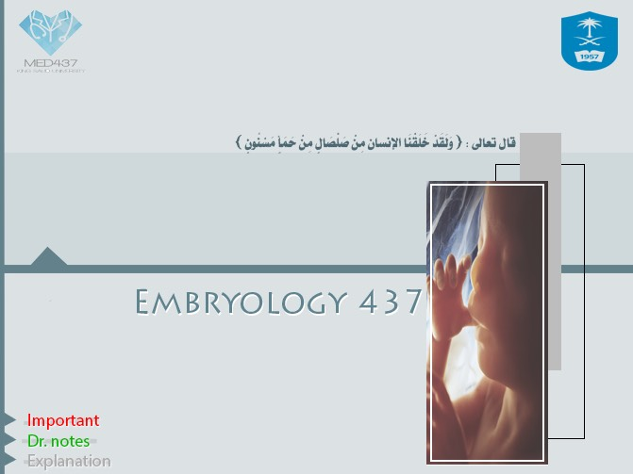

Gametogenesis
Gametogenesis

Slide 2

Objectives:
Objectives:
1-Describe the female cycles (ovarian – uterine).
2-Define gametogenesis.
3-Describe the process of spermatogenesis.
4-Describe the process of oogenesis.

Slide 3
Ovarian and uterine cycles:
(سن اليأس) -starts at puberty until the menopause
-Both cycles depend upon factors to be activated and managed.
Pituitary gland
Uterus
Uterine tubes
Vagina
Ovaries
Mamary glands
hypothalamus

Slide 4
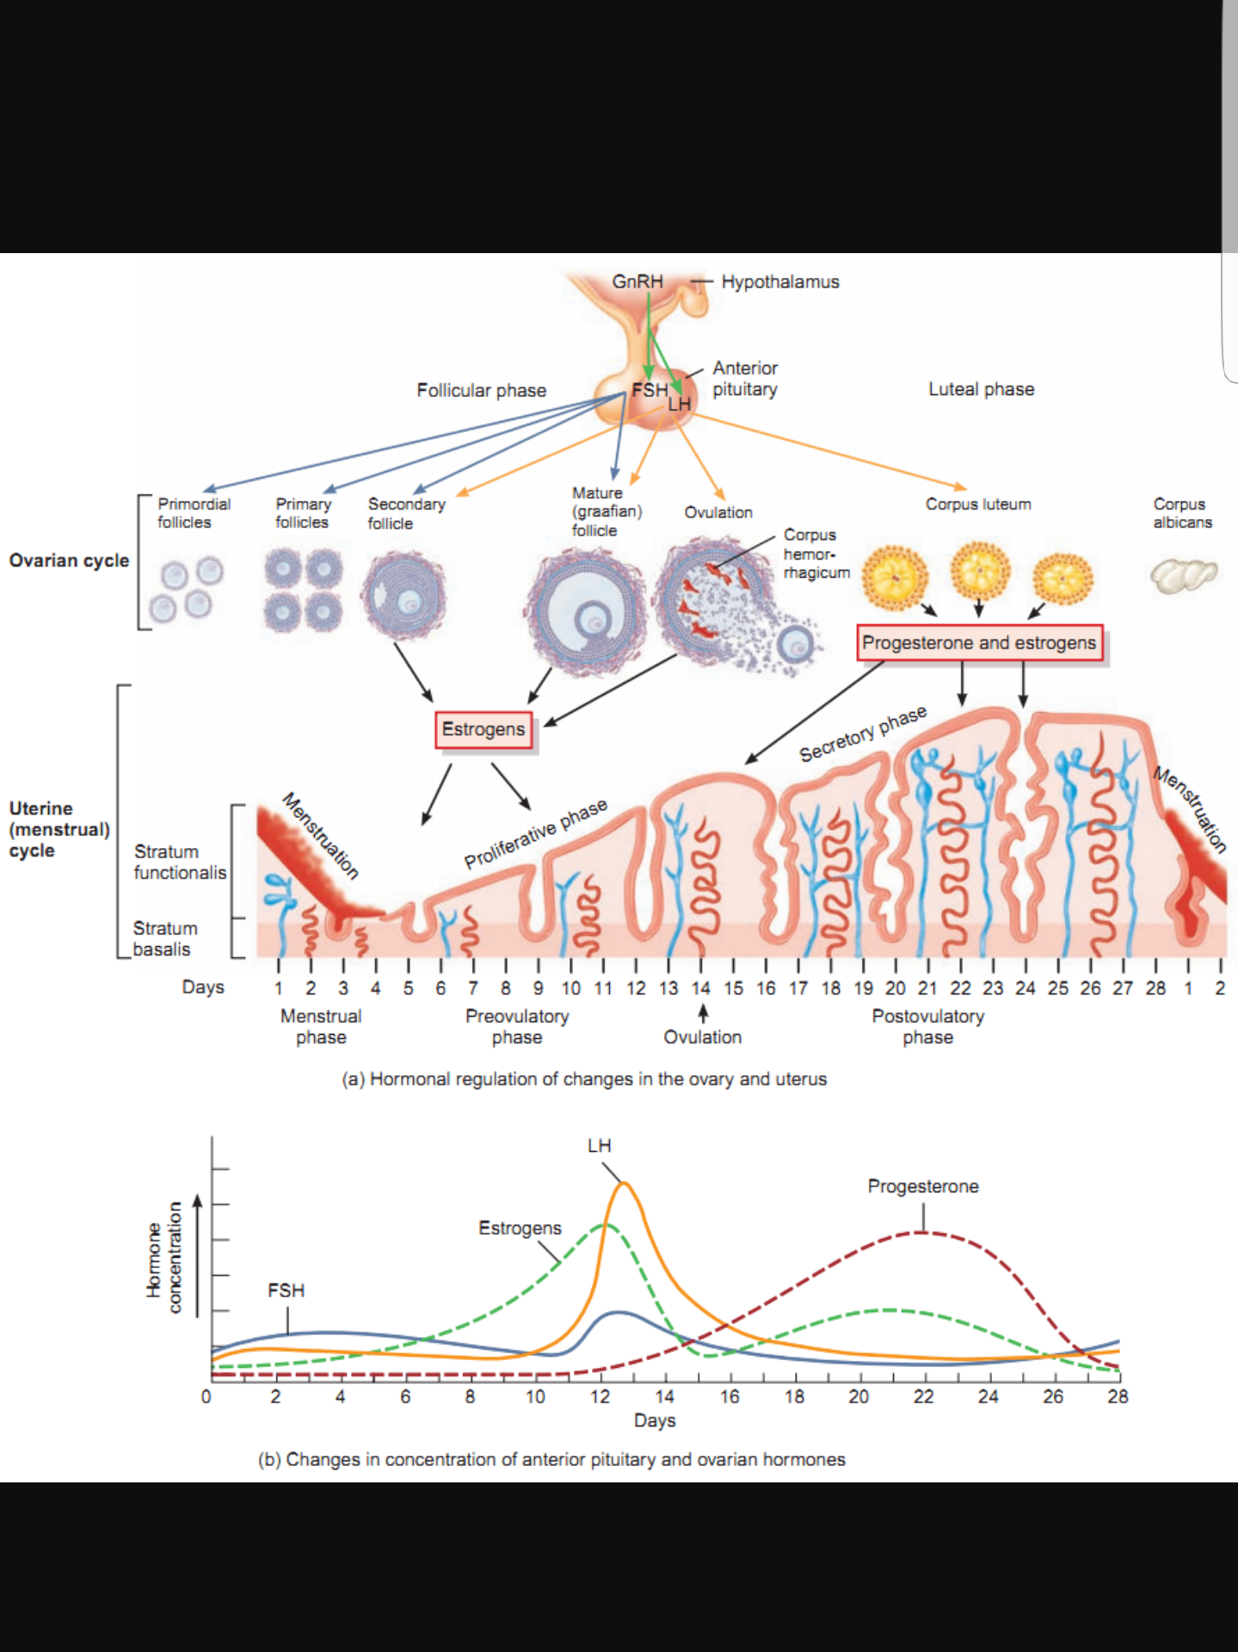
Hypothalamus :
It has neurosecretory cells that synthesize Gonadotrophin-releasing hormone (GnRH)
- The Pituitary gland (anterior lobe) is stimulated by GnRH to release two hormones that act on ovaries called FSH and LH .

Slide 5
The ovarian cycle:
The ovarian cortex contains (400,000 to 500,000) of primordiall follicles
-Each primary follicle consists one of primary oocyte surrounded by single layer of flat follicular cells.
Pituitary Gland control the ovarian cycle, ovarian cycle has three phases (FOL) :- -
1-Follicular(FSH and little LH )
2-Ovulatory(LH and little FSH)
3-Luteal(LH)
يوجد اختلاف في الهرمونات وأيضا نسبتها إلى أي مرحلة ،المهم أن تعرف أن FSH في التكوين البدائي وأن LH المسؤول عن الإباضة والمراحل النهائية .
These are follicle levels until it becomes primary.
Growing is just description
Very Important Notes :-
-all the primary oocytes are formed before birth , and are not made after birth .
-all primary oocytes complete the prophase and stay until puberty .
- Both FSH and LH are secreted by the pituitary gland .

Slide 6
Follicular Phase :
  It is the phase in which follicles gets developed and becomes mature .
  Follicle-Stimulating Hormone (FSH) does the following (Functions):
  Stimulates the ovarian primary follicles to develop and become mature.
  Production of Estrogen by the follicular cells.
  FSH makes the simple flat follicular cells become cuboidal, then columnar then forming many layers around the oocyte forming primary follicle.

Slide 7
Ovulatory Phase :
  The follicle grows up until it gets maturity. It produces swelling on the surface of the ovary.
  Growing follicles produce estrogen which control the development and functions of the reproductive organ.
  Luteinizing Hormone (LH) does the following (Functions):
    Triggers ovulation (الإباضة)
    Stimulates the follicular cells to produce estrogen .
    Stimulate corpus luteum(الجسم الأصفر) to produce progesterone and some estrogen .

Slide 8
Luteal Phase :
  The remaining of the ruptured follicle is now called corpus luteum. (الجسم الأصفر)
  It secretes Progesterone and small amount of Estrogen.
  These 2 hormones stimulate endometrial glands to secrete and prepare endometrium(بطانة الرحم) for planting of fertilized ovum [Blastocyst]
  If the oocyte is fertilized the Corpus Luteum grow up and remains until the 4th month of pregnancy.
  If the oocyte is not fertilized the corpus luteum shrink and degenerates in 10-12 days.

Slide 9
  FSH and LH OVERVIEW :
  These 2 hormones stimulate endometrial glands to secrete and prepare endometrium for planting of fertilized ovum [Blastocyst].
  If the oocyte is fertilized the Corpus Luteum grow up and remains until the 4th month of pregnancy.
  If the oocyte is not fertilized the corpus luteum shrink and degenerates in 10-12 days.
  Note:
  Early development of ovarian follicle is induced by FSH.-
  -Final stages of maturation require LH, it causes ovulation (rupture of the mature follicle) as mentioned before .

Slide 10
Uterine or menstrual cycle
What is it? - | Cyclic changes in the endometrium.
What cause it?- | Caused by estrogen & progesterone.
It’s average days?- | An average is 28 days, the range between 23 and 35 days in 90% of women.
What else you need to know about menstrual cycle?- | Day one is the day when menstrual blood flow begins. varies by several days in normal women and It sometimes varies in the same woman.

Slide 11
Phases of the menstrual cycle:
3-Luteal Phase:
  -Starts 1st day and Lasts for 4-5 days.
  Functional layer of the endometrium is sloughed off and throw away with the menstrual flow.
  Blood discharge from vagina is combined with small pieces of endometrial tissue.
  -Is a phase of repair and proliferation.
  -Lasts for 9 days.
  -Coincides with growth of ovarian follicle.
  -So it is controlled by Estrogen secreted by the follicular cells.
  -Thickness of the endometrium is increased into 2-3 folds.
  -The glands increase in number and length and the spiral arteries elongate.
  Is a Secretory of Progesterone phase.
  -Lasts about 13 days.
  -Coincides with the formation, growth and functioning of the Corpus Luteum.
  -Glandular epithelium secretes glycogen rich material.
  -Endometrium thickens under the influence of estrogen and progesterone.
  *What happens to the endometrium in this phase?
  -The spiral arteries grow into the superficial layer of the endometrium.
  -Arteries become increasingly coiled.
  -Large venous network develops.
  -Direct arterio-venous anastomoses are the prominent features.
1-Menstrual Phase
2-Proliferative Phase

Slide 12
Degeneration of corpus luteum leads to decrease the levels of estrogen & progesterone. (نقص الاستروجين والبروجيسترون)
-Loss of interstitial fluid.
-Marked shrinking of endometrium.
-Spiral arteries become constricted.
-Venous stasis & Ischemic necrosis.
-Rupture of damaged vessel wall.
-Blood seeps into the surrounding connective tissues.
-Loss of 20-80 ml of blood.
-Entire compact layer and most of the spongy layer of endometrium is discarded.
4-Ischemic Phase:

Slide 13
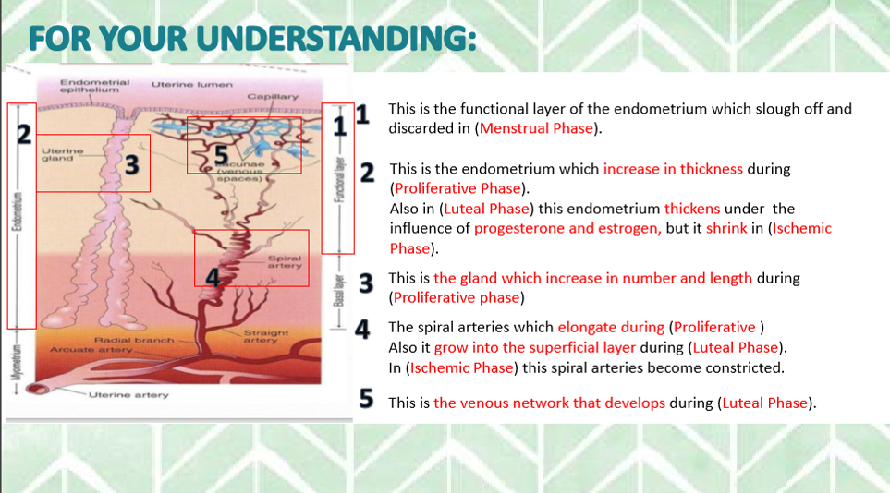
For your understanding “team 436”

Slide 14
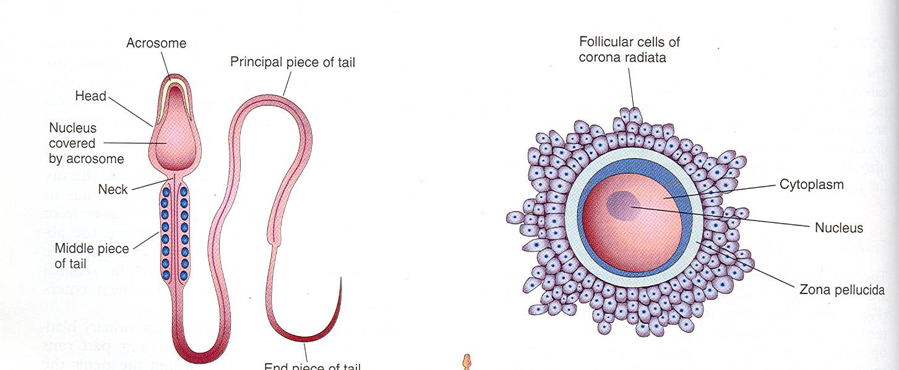
Gametogenesis :it is the production of mature male & female gametes (Sperms& Ova)
Spermatogenesis:
It is the series of changes by which the primitive germ cells (spermatogonia) are transformed into mature sperms.
Oogenesis:
Sequence of events by which the primitive germ cells (oogonia) are transformed into mature oocytes.
Meiosis
It is the cell division that takes place in the germ cells to produce male & female gametes.
It consists of two cell divisions, meiosis I & meiosis II during which the Diploid number of chromosomes (46) is reduced to Haploid number (23).

Slide 15
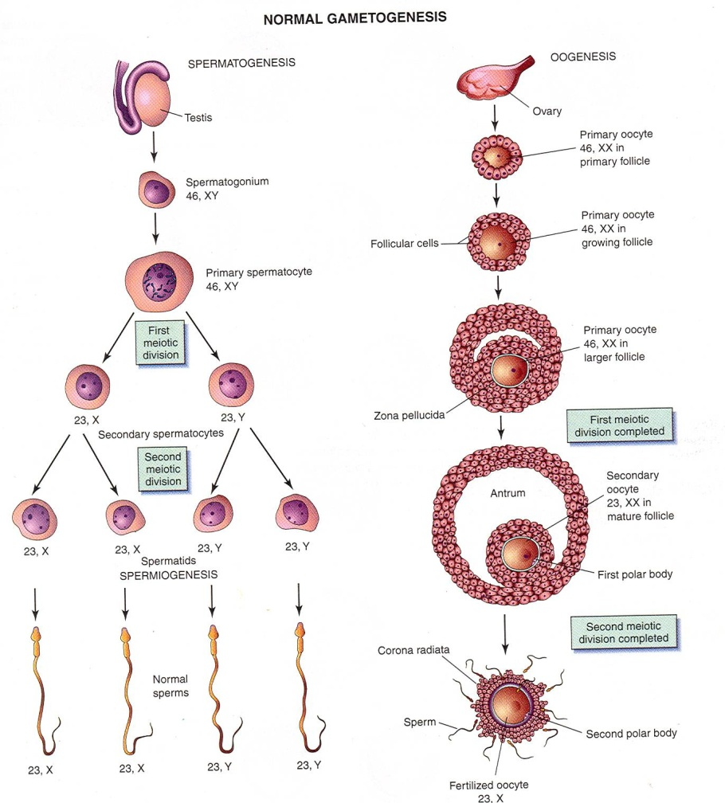
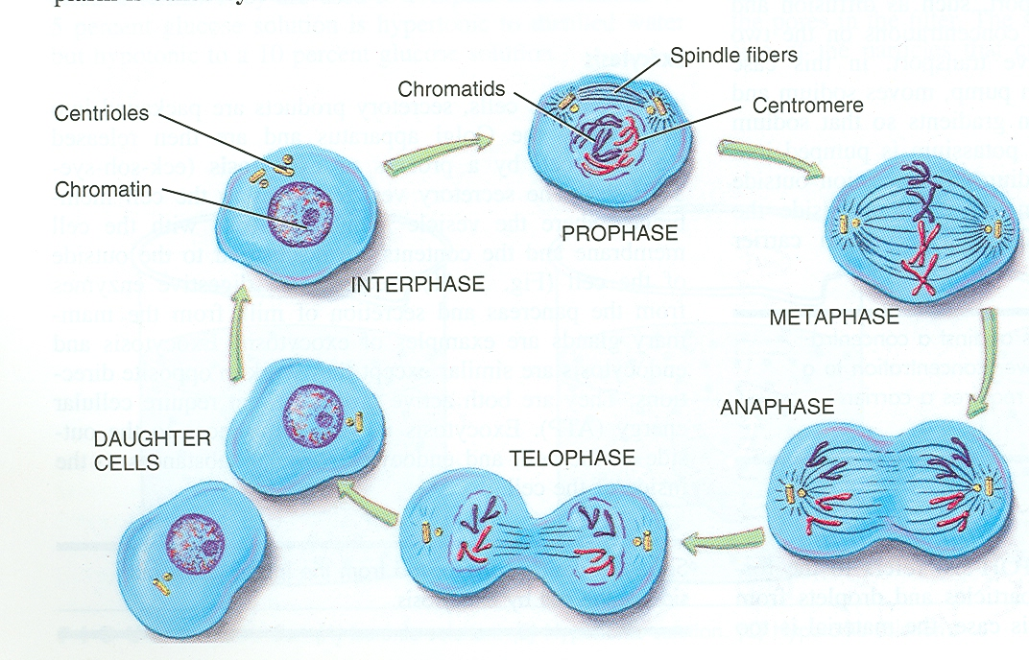
FIRST MEIOTIC DIVISION
At the beginning of 1st meiosis , (prophase) male & female germ cells replicate their DNA so that
each of the 46 chromosomes is duplicated into sister Chromatid.
By the end of the 1st meiotic division, each new cell formed (Secondary Spermatocyte or Secondary Oocyte) has haploid (half) number of chromosome.
It is half number of chromosomes of the Primary Spermatocyte or primary Oocyte.

Slide 16
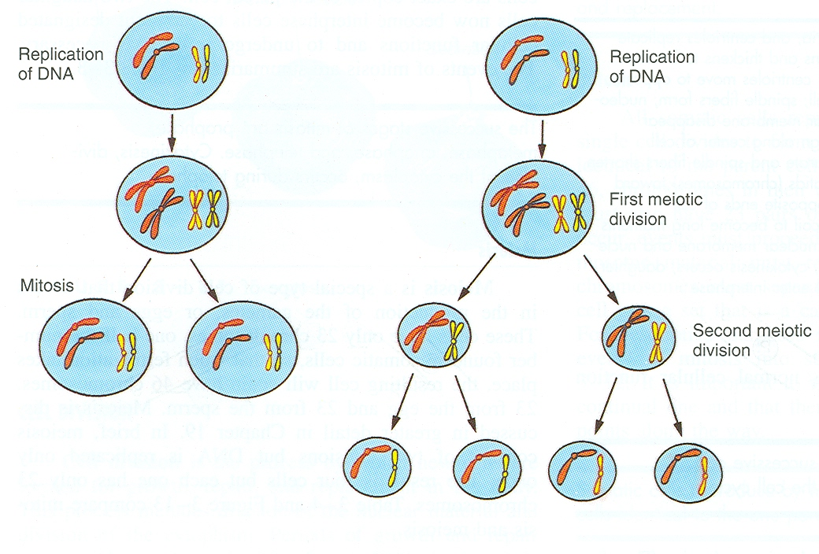
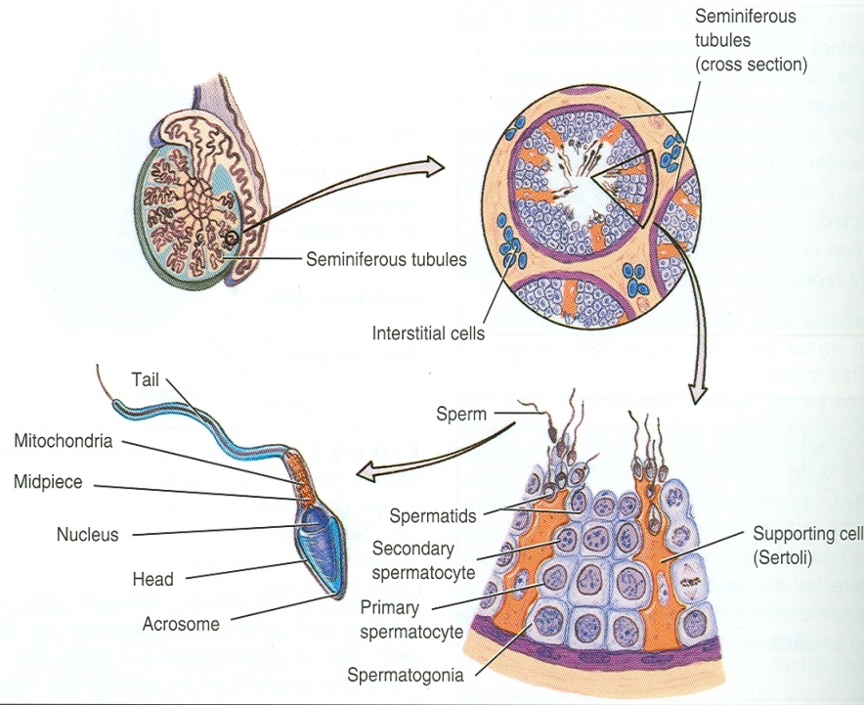
WHAT IS THE DIFFERENCE BETWEEN MITOSIS & MEIOSIS?
SPERMATOGENESIS vs. OOGENESIS
SPERMATOGENESIS |  | OOGENESIS
Formation of mature sperms with haploid number of chromosomes. | AIM | Formation of secondary oocytes with haploid number of chromosomes
Seminiferous tubules of the testis. | SITE | Cortex of the ovary
From puberty till old age. | TIME | Starts during fetal life becomes completed after puberty & continues until menopause.
About two months | DURATION | It occurs monthly Except during pregnancy.
NOTE
Sperms are stored and become functionally mature in the Epididymis.
DIPLOID
HAPLOID
Mitosis:
The final product is diploid (has the same num. of chromosomes) and also the cells have the same size.
Meiosis:
The final product is haploid (has the half num. of chromosomes) and also the size of the cells become smaller.

Slide 17
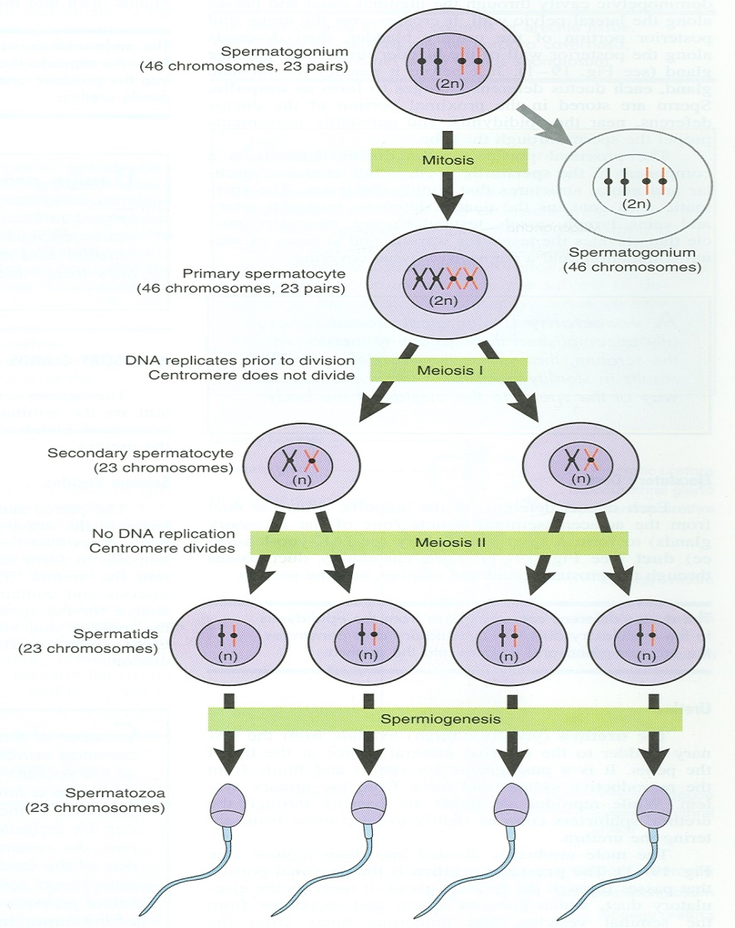
SPERMATOGENESIS
1
1-Each spermatogonium divides by mitosis into 2 daughter spermatogonia .
2- Each daughter Spermatogonia grows to give primary spermatocyte (46).
3- Primary spermatocyte undergoes meiotic division to give 2 secondary spermatocyte (22+ x) or (22+y).
4- Secondary spermatocytes undergo 2nd meiotic division to form 4 haploid spermatids (half size).
5- Spermatids are transformed into 4 mature sperms by a process called spermiogenesis.
2
3
4

Slide 18
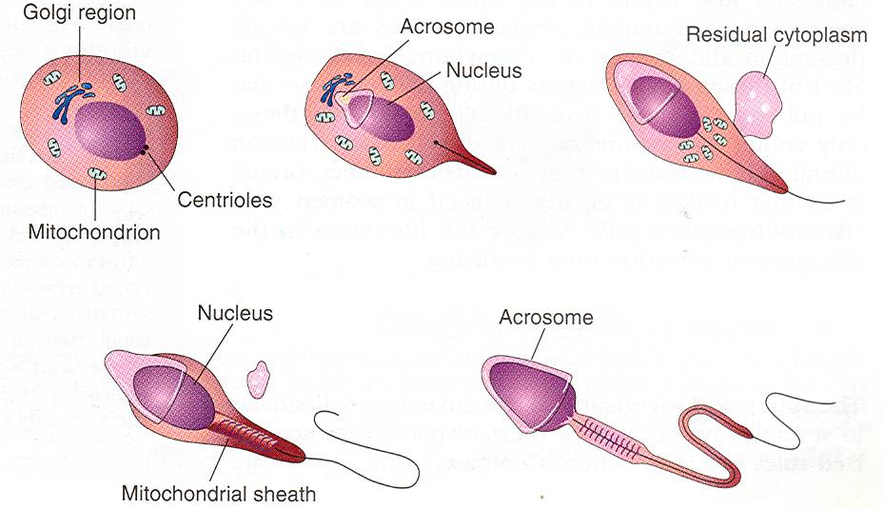
SPERMIOGENESIS :
It is change in shape (metamorphosis) through which Spermatids are transformed into mature Sperms .
4. Centriole elongates to form the axial filament.
Nucleus is condensed and forms most of the head.
2. Golgi apparatus forms the Acrosome.
Note the difference:
SPERMATOGENESIS
SPERMIOGENESIS
3. Mitochondria forms a spiral sheath.

Slide 19
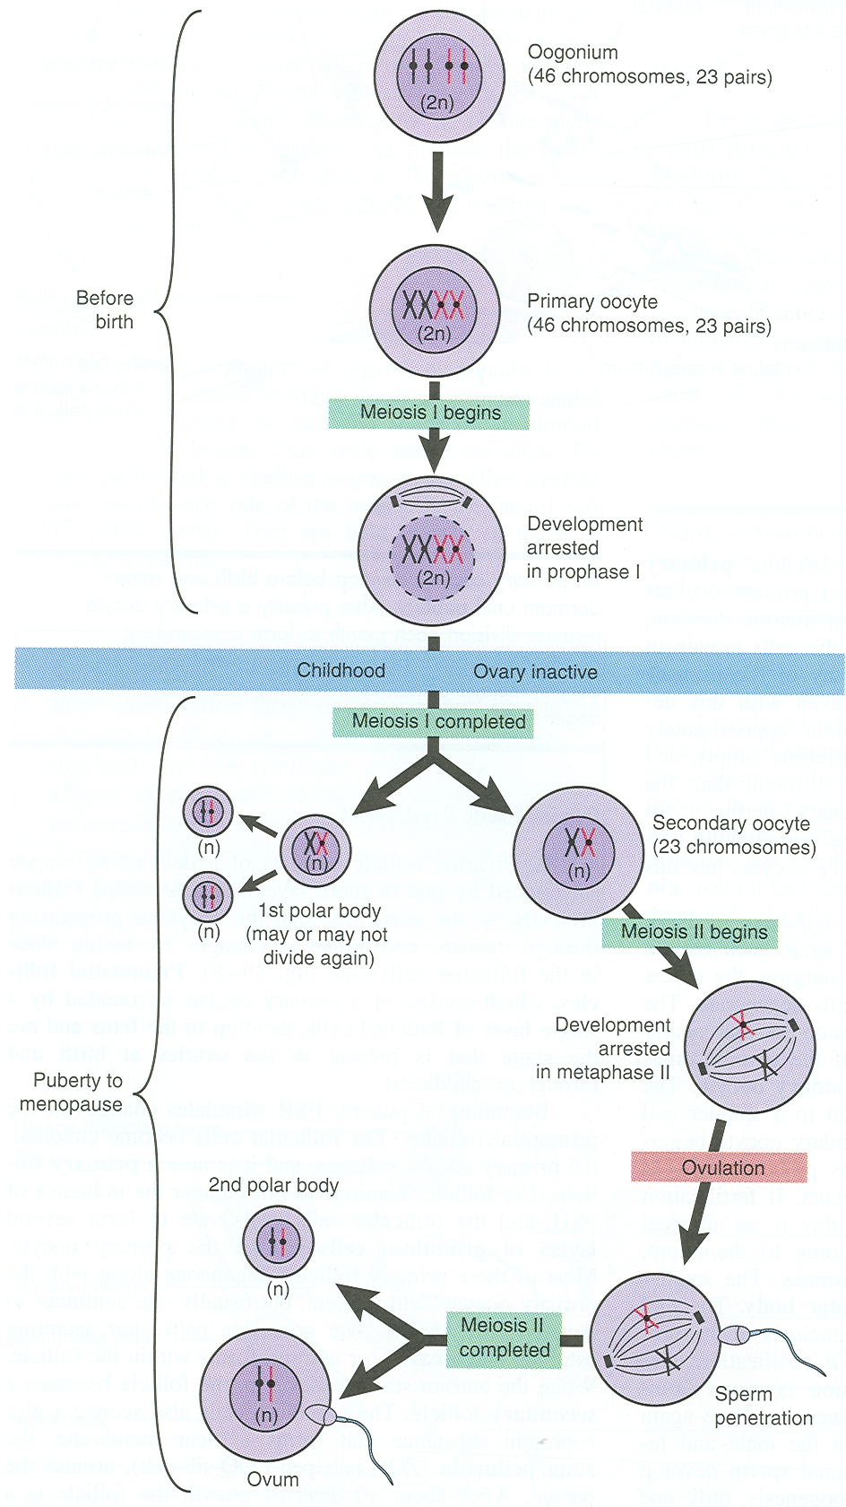
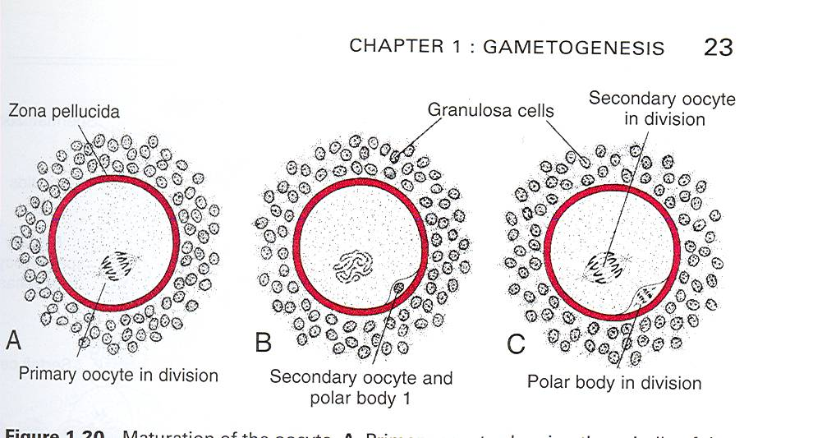
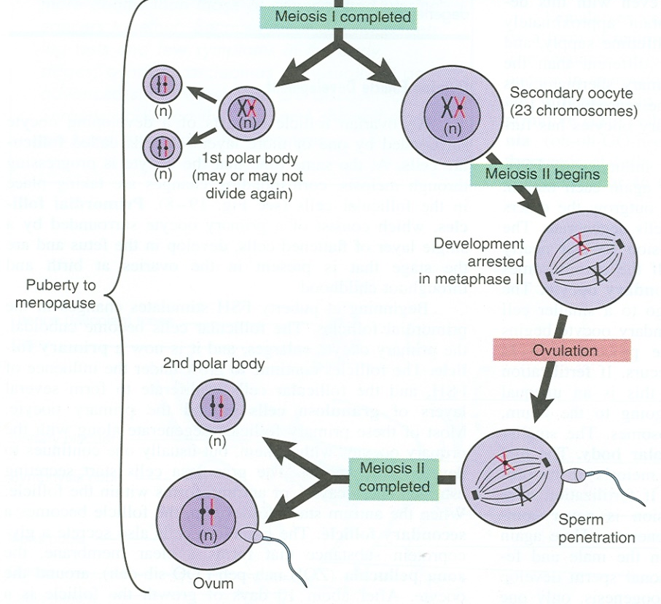
OOGENESIS
Before Birth: During early fetal life, primitive ova (Oogonia). proliferate by mitotic division and enlarge to form Primary Oocytes (46)
At Birth all primary oocytes have completed the prophase of the 1st meiotic division and remain arrested and do not finish their first meiotic division until at puberty.
At Puberty : Shortly before ovulation, the Primary Oocyte completes its 1st meiotic division to give Secondary oocyte (23) & First Polar Body.
The Secondary Oocyte receives almost all the cytoplasm.
The First Polar Body receives very little.
It is small nonfunctional cell that soon degenerates.
At ovulation, the secondary oocyte begins the second meiotic division but progresses only to metaphase where division is arrested.
At Puberty-shortly before ovulation
At Ovulation
At Birth
Fertilization

Slide 20
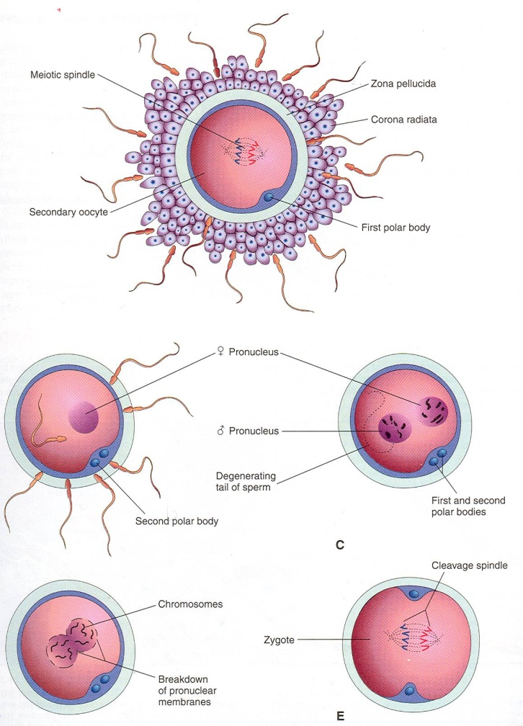
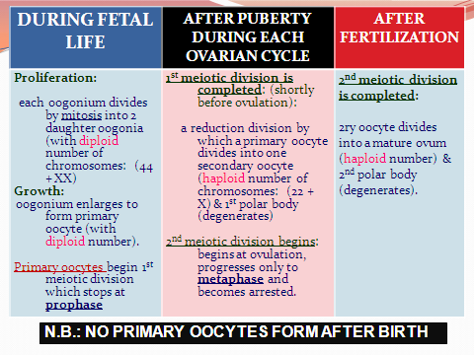
OOGENESIS
If the secondary oocyte is fertilized, the second meiotic division is completed
otherwise it degenerates 24 hours after ovulation.
Most of the cytoplasm is retained by the Mature Oocyte (Fertilized Oocyte).
The rest is in the 2nd Polar Body which soon degenerates.

Slide 21
Some videos for enriching what has been read :-
Ovulation
Spermatogenisis and Oogenisis
Quick quiz :-
Gametogenesis & Female cycles

Slide 22
