Slide 1



Slide 2

OBJECTIVES :
By the end of the lecture, you should be able to:
• Identify fertilization and its site.
• List the phases of fertilization.
• Describe the results of fertilization.
• Describe the formation of blastocyst.
• Identify implantation and its site.
• Describe the mechanism of implantation.
• Describe the formation of primary chorionic villi .
• List the common sites of ectopic pregnancies .

Slide 3
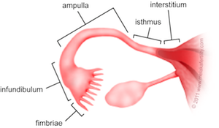
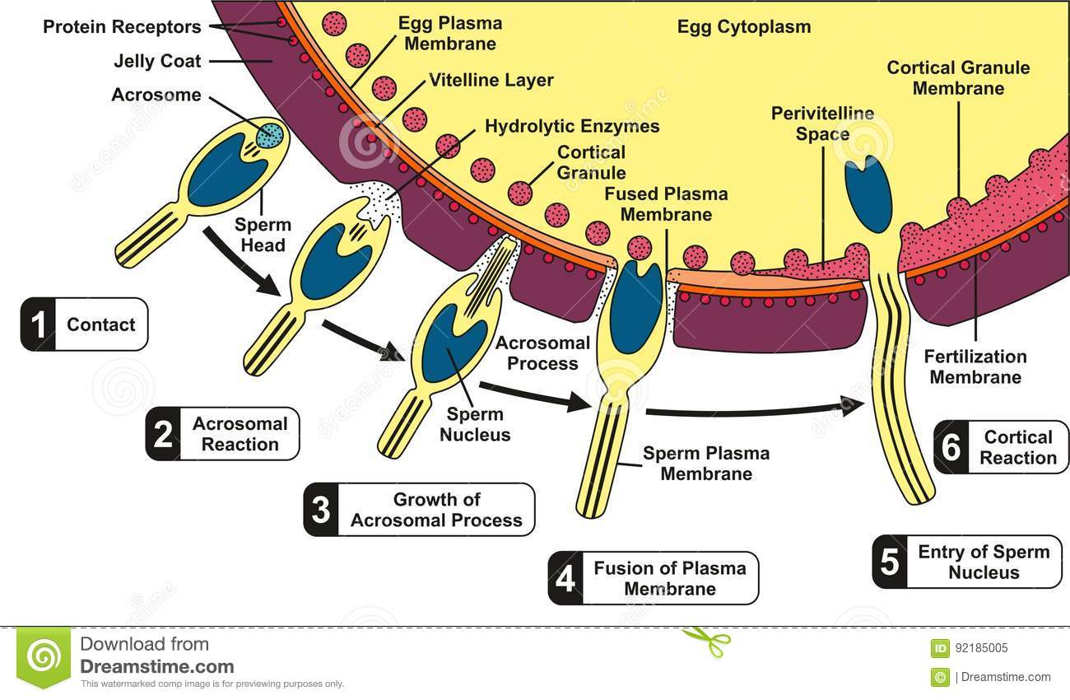
FERTILIZATION
Definition:
it is the process during which a male gamete (sperm) unites with a female gamete (oocyte) to form a single cell (ZYGOTE).
It is a complex process.
It begins with a contact between sperm & ovum.
Ends up with intermingling of the maternal and paternal chromosomes.
Where Does Fertilization Normally Occur?
Site :
Usually in the ampulla of uterine tube or fallopian tube (مترادفات)
may occur in any other part of tube.
Never occurs in the uterine cavity.
longest and widest part of the tube.
Chemical signal from oocyte attracts the sperms.
Peristaltic movement of the tube from medial to lateral.
Phases :
1- Passage
of the sperm through the cells of the corona radiata by the effect of:
a) Hyaluronidase enzyme secreted from the sperms.
b) By movement of its tail.
2- Penetration
of the zona pellucida by acrosine (a substance secreted from acrosomal cap).
3- Fusion
of the plasma membranes of the oocyte and the sperm.
4- Completion
of the second meiotic division of the oocyte which was arrested at metaphase
تجي اسئلة عن phases and results
6- formation
of the male pronuleus
5- Formation
of the female pronucleus.
7- Union
of the 2 pronuleii.

Slide 4
CHROMOSOMES IN THE ZYGOTE
Zygote is genetically unique. (why ?)
Half of its chromosomes comes from the father and the other half comes from the mother.
- New combination is formed which is different from either of the parents.
- This mechanism forms biparental inheritance and leads to variation of the human species.
Sex of the Embryo
Embryo's chromosomal sex is determined at the time of fertilization ,, (How?) by genetic studies.
Sex is determined by the type of sperm (X or Y) that fertilizes the oocyte.
So, it is the father whose gamete decides the sex.
Zonal reaction : it is a change in properties of zona pellucida that makes it impermeable to other sperms.( allows only one sperm to enter )
Zonal reaction للحفظ :
zona pellucida متعلق بـ
Results of Fertilization
Stimulates the penetrated oocyte to complete its 2nd meiotic division.
Restores the normal diploid number of chromosomes.
Determines the sex of the embryo.
Initiates cleavage (cell division) of the zygote.

Slide 5
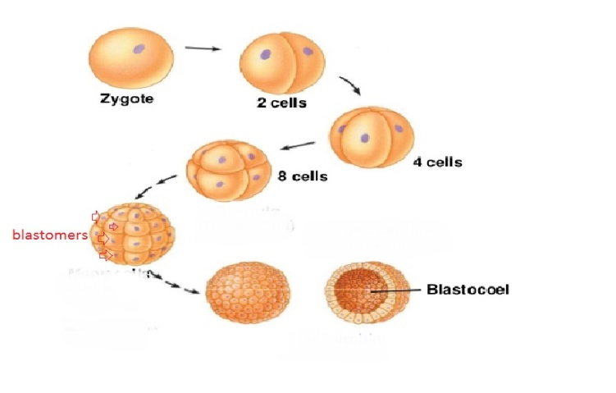
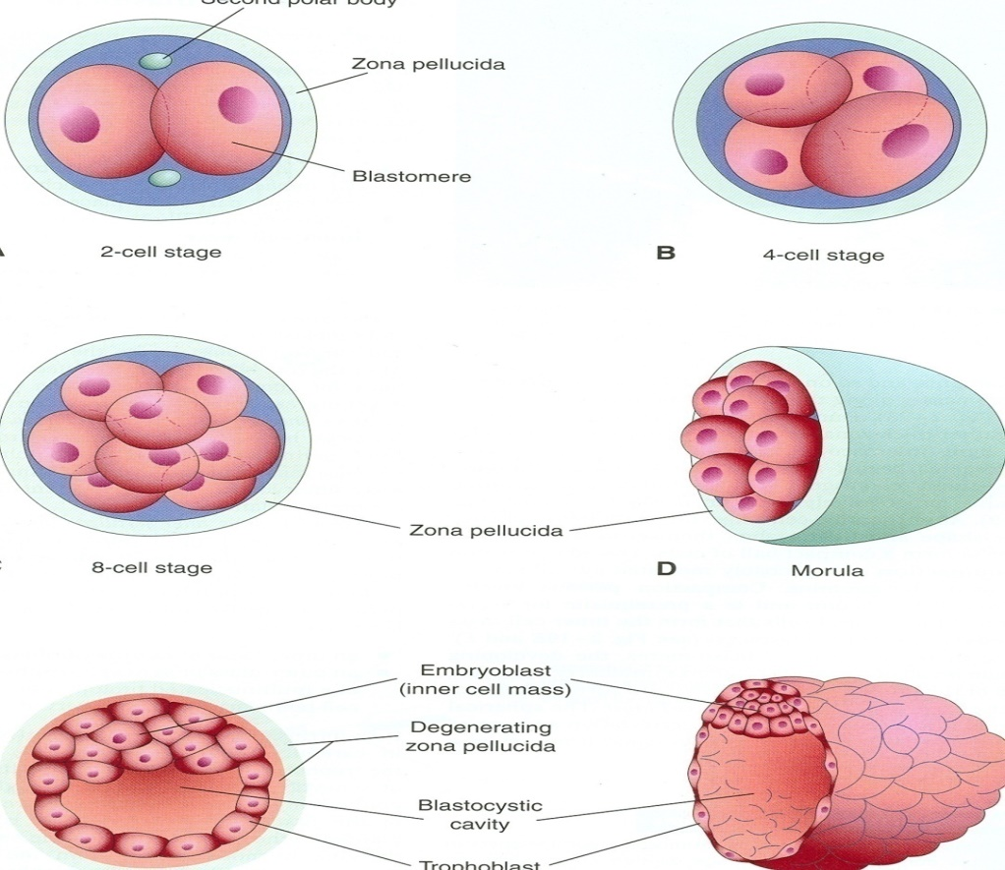
This single cell will undergo a multiple “mitotic” division to form (Blastomeres).
After 30 hours of fertlizition , the cleavage begins
Cleavage of Zygote
It is the repeated mitotic divisions of the zygote.
Normally occurs in the uterine tube.
Rapid (high speed) increase in the number of the cells.
that divided from the single cell (Zygote) to a sequence of 2 cells, then 4,8 and 16…. And so on.
These smaller embryonic cells are now called, Blastomeres.
During cleavage (after 30 H) these cells will be surrounded by thick zona pellucida
the zona pellucida is a translucent (شفاف) membrane under the microscope.
Zygote lies within the thick zona pellucida during cleavage.
Zygote migrates in the uterine tube during cleavage from its lateral end to its medial end.
(until it reaches the uterine cavity).

Slide 6
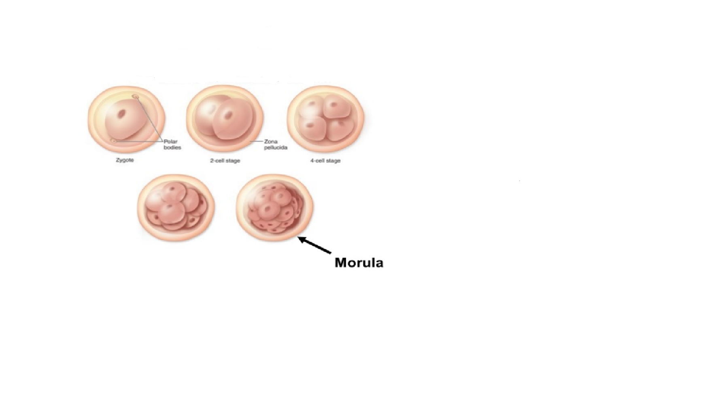
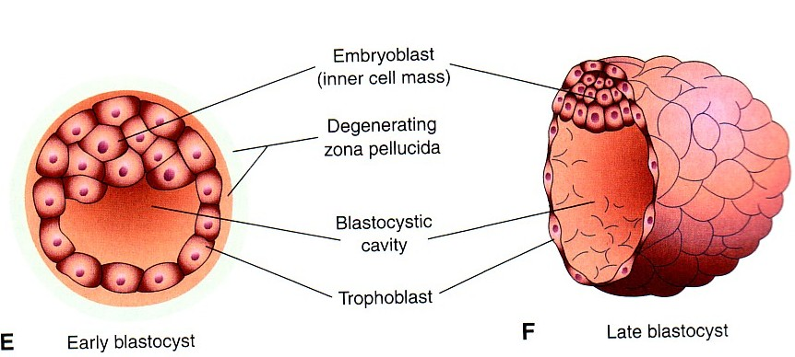
Morula
The Morula reaches the uterine cavity at this stage.
Spherical Morula is formed about the 3rd day after fertilization.
When there are 16 to 32 blastomeres the developing human is called MORULA.
It resembles mulberry or blackberry.

Slide 7
The Mechanism
The Morula reaches the uterine cavity by the 4th day after fertilization.
It remains free within the uterine cavity for one or two days.
Now the Morula is called Blastocyst, its cavity is called blastocystic cavity or blastocele, and its cells divided into Embryoblast & Trophoblast.
Fluid passes from uterine cavity to the Morula.

Slide 8

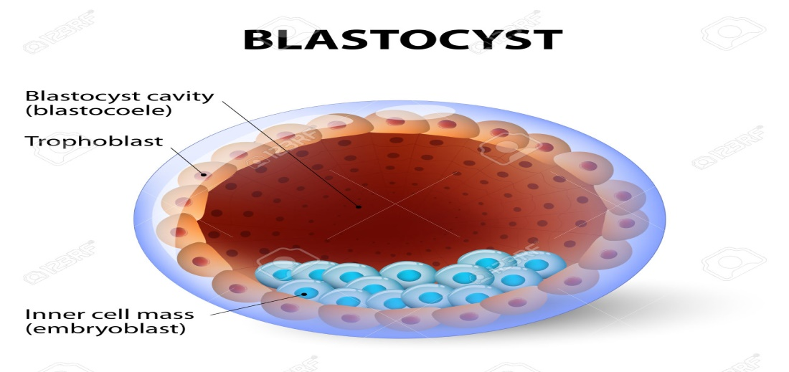
BLASTOCYST
A cavity appears within the morula dividing its cells into 2 groups:
1-Outer cell layer called trophoblast.
2-Inner cell layer (mass) called Embryoblast attached to one of the poles of the blastocyst.
The cavity is called blastocystic cavity or blastocele.

Slide 9
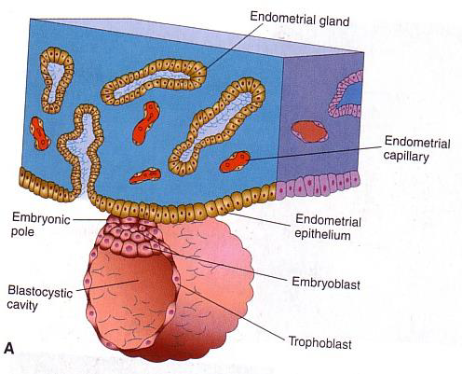
Definition:
It is the process by which the Blastocyst penetrates the superficial (compact) layer of the endometrium of the uterus.
Site:
The normal site of implantation is the posterior wall of the body of the uterus near the fundus.
Time:
-It begins about the 6th day after fertilization.
-It is completed by the 11th or 12th day.
IMPLANTATION

Slide 10
SUMMARY :
5th Day | the Zona pellucida degenerates, To allow the blastocyst to increase in size and penetrate the endometrium
6th Day | Blastocyst begins implantation & adheres to the endometrium and beginning of penetration.. Trophoblast cells at the embryonic pole of the balstocyst begine to penetrate the epithelium of the endometrium (uterine mucosa) Penetration results from proteolytic enzymes (eg.COX-2) produced by the trophoblast. (in females lecture )
7th Day | Trophoblast differentiated into 2 layers: 1-Cytotrophblast, inner layer, mitotically active. 2-Syncytiotrophoblast (outer multinucleated mass, with indistinct cell boundary * Invasion of endometrium continues with the syncytiotrophoblasts
8th Day | the blastocyst is superficially embedded in the compact layer of the endometrium.
10th or 11th Day | Blood-filled Lacunae appear in the Syncytiotrophoblast which communicate forming a lacunar network Syncytiotrophoblast erodes the endothelial lining of the maternal capillaries which known as sinusoids.
11th or 12th Day | blood of maternal capillaries reaches the lacunae so Uteroplacental circulation is established
13th to 15th Day | Proliferation of Cytotrophblast cells produce extension inside the Syncytiotrophoblast to form the primary chorionic villi.
Extra Notes: Chorionic villi are villi that sprout from the chorion to provide maximum contact area with maternal blood.
  Secondary chorionic villi are identified by having connective tissue
  Tertiary chorionic villi are identified by having capillaries

Slide 11
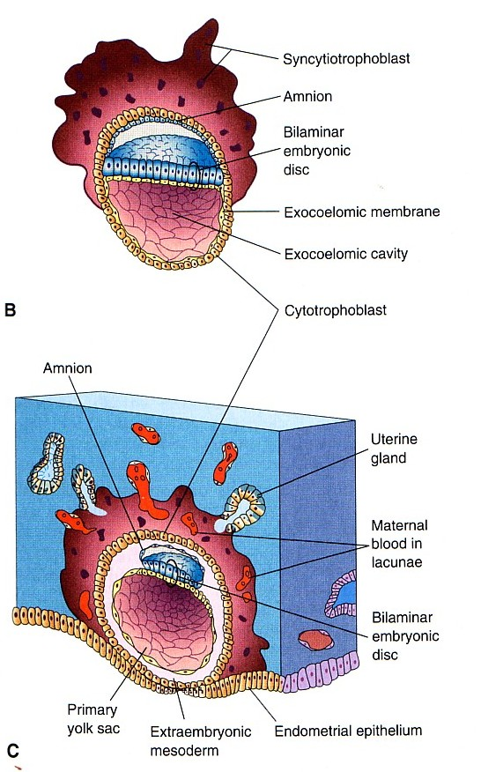
Endometrial cells undergo a process called apoptosis , (programmed cell death) to facilitate invasion of endometrium by the Syncytiotrophoblast.
Syncytiotrophoblast engulf these degenerated cells for nutrition of the embryo.
Implantation can be detected by:
1- Ultrasonography.
2- Pregnancy test hCG : (human chorionic gonadotrophin) a hormone which is secreted by the Syncytiotrophoblast about the end of 2nd week
(HCG can be measured in both the blood and urine to determine if a woman is pregnant).
Early Pregnancy Factor: (EPF)
Is an immunosuppressant (مخمد للمناعة) protein.
It Is Secreted by trophoblast cells.
It Appears in maternal serum within 24--48 hrs., after fertilization.
Serum: blood plasma minus clotting proteins.
Its function is to prevent the immune system from attacking the new embryo.
It is the basis for EPT (Early pregnancy test) in the first 10 days of development.

Slide 12
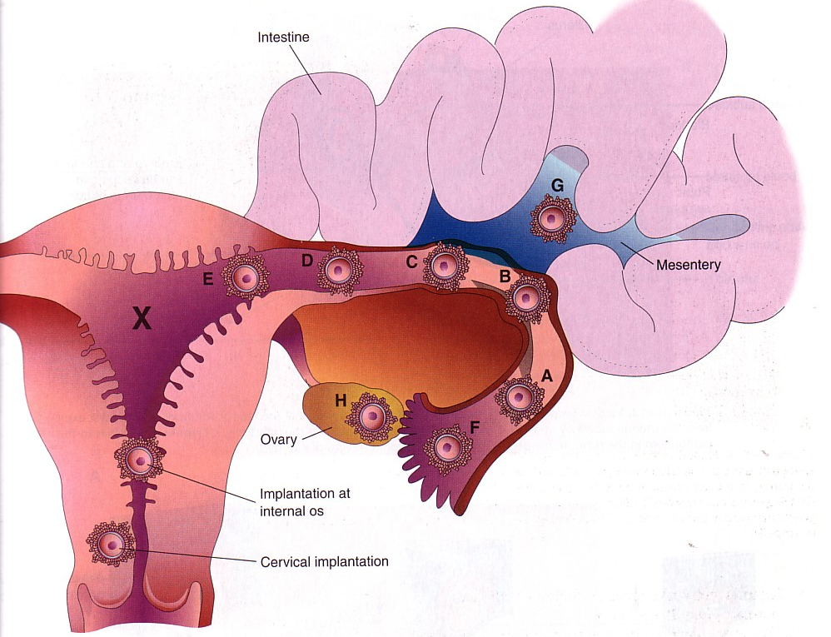
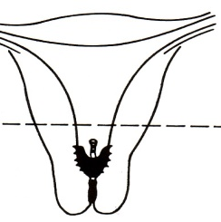
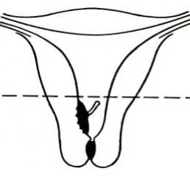
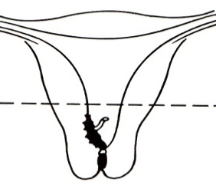
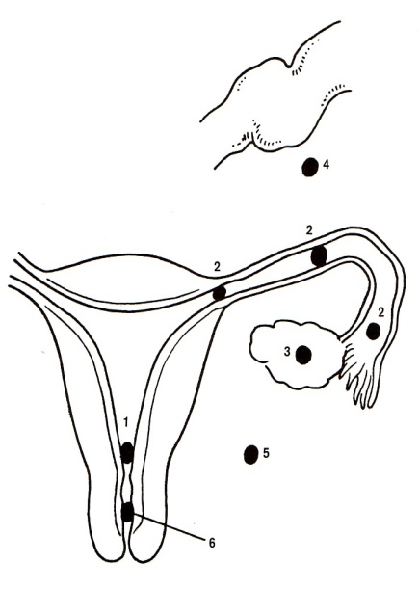
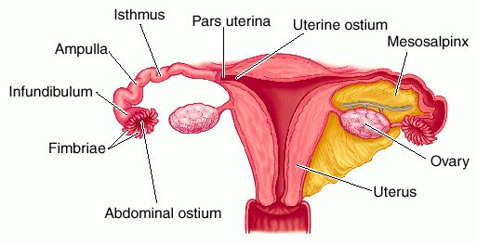
Ectopic Implantation (Pregnancy)
(الحمل خارج الرحم)
It means implantation outside the uterine cavity.
1. 95 to 97% of ectopic pregnancies occurs in the uterine tube.
Most are in the ampulla & isthmus.
2. Placenta previa:
Implantation occurs in the lower uterine segment.
The usual site of implantation is the posterior wall of the body of uterus
(تستلزم ولادة قيصرية)
Tubal pregnancy
is the most common type of ectopic pregnancy
Placenta previa centralis
Placenta previa lateralis
Placenta previa marginalis
Ovarian pregnancy
is the least common type of ectopic pregnancy
sites of Ectopic Pregnancy:
1- Placenta Previa.
2- Tubal.
3- Ovarian.
4- Abdominal.
5- Pelvic.
6- Cervical.

Slide 13
Video may be helpful for your understanding:
Human Physiology - Fertilization and Implantation
Online quiz:
Fertilization and Implantation online quiz

Slide 14


