Slide 3
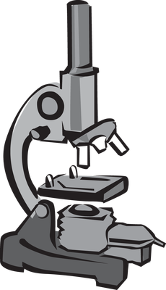
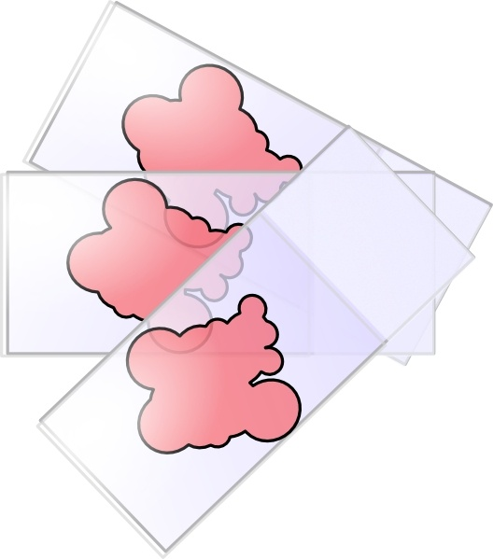
INTRODUCTION
Histology is the microscopic study of normal tissues.
Types of microscopes: LM & EM.
Organs are made of tissues and tissues are made of cells.
Thin sections are cut and mounted on glass slides.
Sections are stained with Haematoxylin (H) and Eosin (E).
- Nucleus is always blue (basophilic)
- Cytoplasm may be red (acidophilic)
or blue (basophilic).

Slide 4
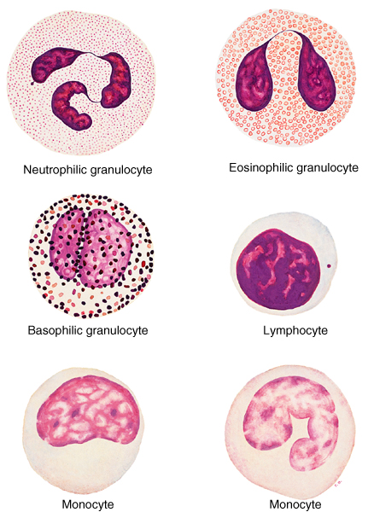
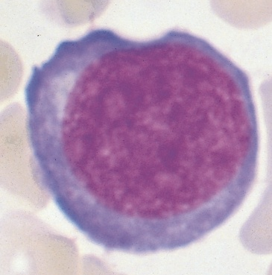
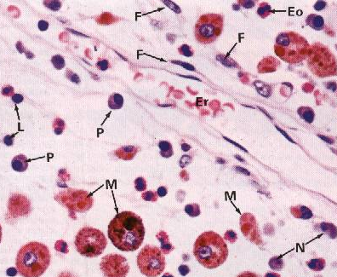
THE CELL
NUCLEUS (L\M)
it is the structural & functional unit of all living tissues.
cells have different shapes & sizes.
the cell is made of: 1-nucleus 2- cytoplasm.
Shapes of nuclei.

Slide 5
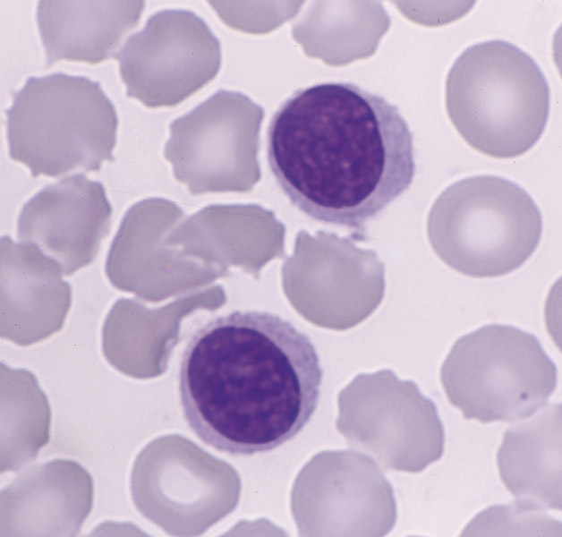
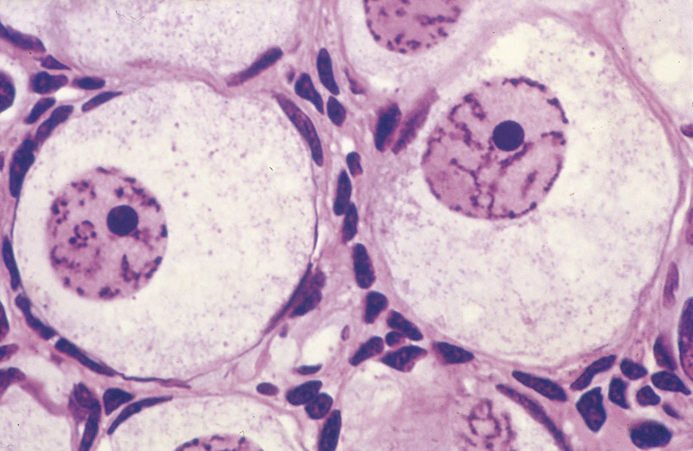
THE CELL
Appearance of nuclei :
VESICULAR (OPEN FACE) NUCLEUS. | DARK NUCLEUS (DEEPLY-STAINED NUCLEUS) DEEPLY BASOPHILIC NUCLEUS

Slide 6
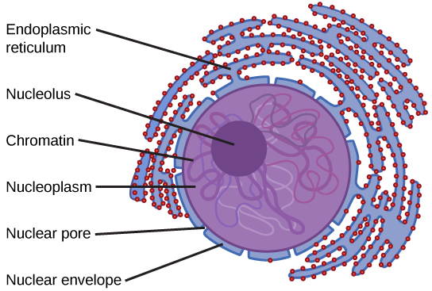
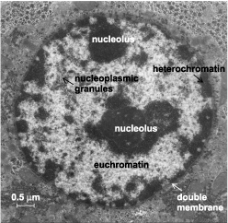
THE CELL (NUCLEUS)
Formed of:
1) Nuclear Envelope:
A double membrane with many pores.
- Outer membrane.
- Inner membrane.
- Nuclear pores: (function) provide communication
between nucleus and cytoplasm.
2) Chromatin
Formed of DNA.
2 Forms:
– Heterochromatin: condensed inactive chromatin
(dark = electron dense areas)
– Euchromatin: extended active chromatin
(pale= electron-lucent areas)
Functions:
– Carries genetic information.
– Directs protein synthesis.

Slide 7
THE CELL (NUCLEUS)
3) Nucleolus :
E/M: It is mostly dark mass (electron-dense) not surrounded by a membrane.
Usually one.
L/M: It is a spherical dark basophilic mass.
Function: formation of ribosomal RNA (rRNA),which is responsible for protein synthesis in the cytoplasm.
4) Nucleoplasm
It is a clear fluid medium in which all the contents of
the nucleus are embedded.
Function: Provides a medium for movement of 3 types
of RNA (ribosomal, messenger and transfer RNA) from the
nucleus to the cytoplasm.

Slide 8
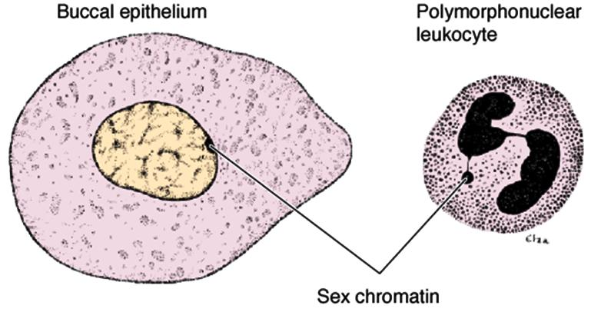
THE CELL (NUCLEUS)
*Sex chromatin (Barr Body)
A dark stained of chromatin , usually adherent to the inner aspect of the nuclear envelope of female somatic cells. e.g buccal epithelial cells.
A drumstick mass protruding from the nucleus of neutrophils.
Represents one of two X chromosomes witch is inactive (condensed) in the normal female.
Seen in the normal female cells.
Absent in the females with turner’s syndrome XO.
Seen in males with Klinefelter's syndrome XXY.
THE CELL (NUCLEUS)
Function of nucleus:
It is essential for the vitality and division of the cell.
It is the site of storage of genetic information.
It is the site of formation of the three types of RNA.

Slide 9
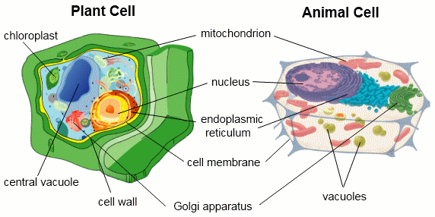
CYTOPLASMIC ORGANELLES
CYTOPLASM
is formed of:
1-ORGANELLES: They are specialized structures, ESSENTIAL for vital processes of the cell.
2-INCLUSIONS: They are not essential for vitality of cells, may be present or absent.
Examples are lipids, glycogen and pigments like melanin & lipofuscin.
B) NON-MEMBRANOUS | A) MEMBRANOUS
1. Ribosomes. 2. Centrioles. 3. Cilia & Flagella. 4. Filaments: (Actin, Intermediate filaments & Myosin). 5. Cytoskeleton: (actin, intermediate filaments & microtubules). | 1. Cell membrane. 2. Mitochondria. 3. Golgi apparatus. 4. Endoplasmic reticulum: (rough & smooth). 5. Lysosomes. 6. Secretory vesicles.

Slide 10
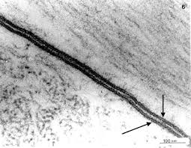
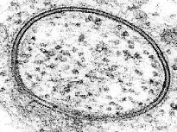
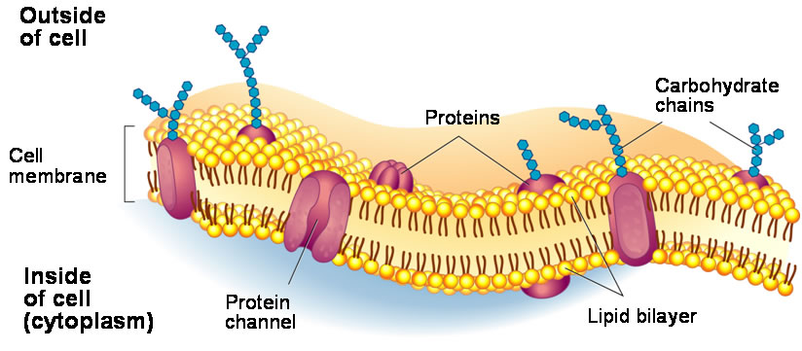
CELL MEMBRANE
A very thin membrane that surrounds the cell.
LM: Not visible.
EM: appears as 2 dark lines (electron dense), separated by a light one
(electron-lucent) (trilaminar appearance).
Function: selective barrier.
Chemical Structure:
1- Phospholipid molecules: arranged in 2 layers.
2- Protein molecules: a) Peripheral protein | b) Integral protein
3- Carbohydrate molecules: attached to either proteins or lipids (glycoproteins and
glycolipids), forming the surface or cell coat (Glycocalyx).
Function of (Glycocalyx):
- Protection of the cell.
- Cell recognition and adhesion.

Slide 11
CELL MEMBRANE (SPECIALIZATIONS)
CILIA
– Long motile hair-like structures surrounded by cell membrane.
– Their core is formed of microtubules.
MICROVILLI (BRUSH BORDER)
– Cylindrical cytoplasmic projections of apical surface to increase surface area.
– Their core contains actin filaments.
INTRACELLULAR JUNCTIONS
Occluding (Tight) Junction: seals the intercellular space.
Adherening Junction: fixes adjacent cells together:
Zonula Adhering Junction.
Desmosome (Macula Adherening Junction).
Gap junction: Allow free communication between the cells.
*When a combination of 1 , 2a and 2b is present, this is called a junctional complex.
1
1
2
2a
2a
2b
2b
3
3

Slide 12
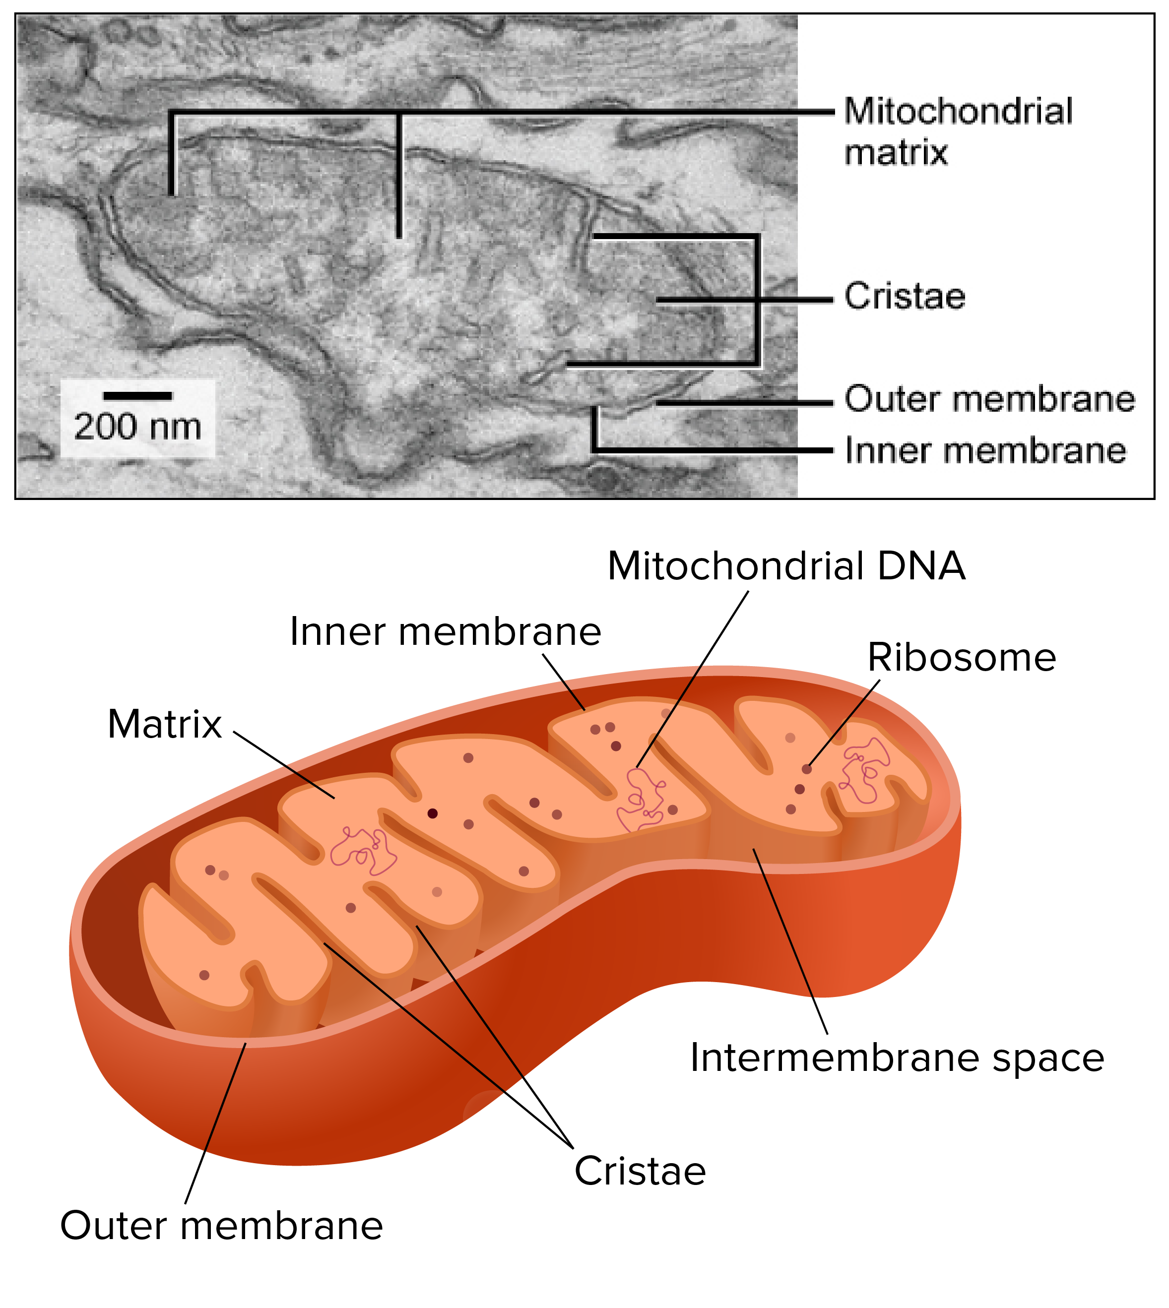
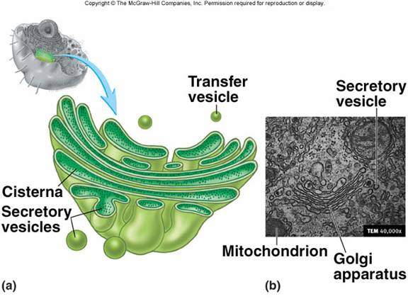
MITOCHONDRIA
Each mitochondrion is rod-shaped .
The wall is composed of 2 membranes.
The outer is smooth, the inner is folded to form cristae.
The cavity is filled with mitochondrial matrix, which
contains enzymes. Also contains its own DNA.
Functions:
1- Generation of ATP which is the source of energy for the cell , They are called the power-house of the cell.
2- They can form their own proteins and undergo self replication.
GOLGI APPARATUS
The secretory apparatus of the cell.
Consists of stacked saucer-shaped flattened vesicles.
Each vesicle has two faces:
1- Convex (forming) face: receives transfer vesicles. 2- Concave (mature) face: forms secretory vesicles.
Functions:
1- Sorting, modification & packaging of proteins.
2- Secretory vesicles formation.
3- Formation of lysosomes.

Slide 13
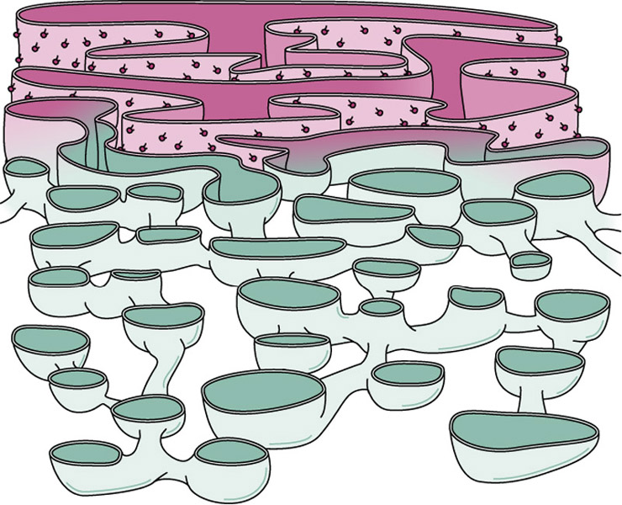
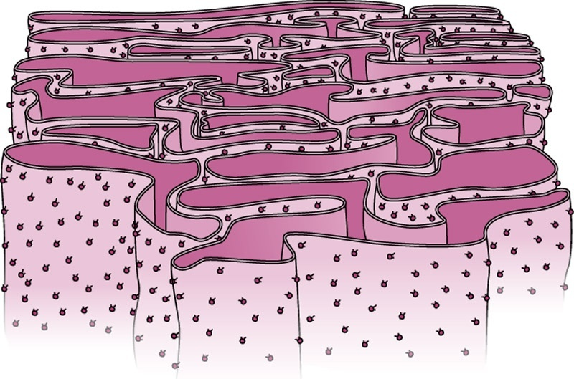
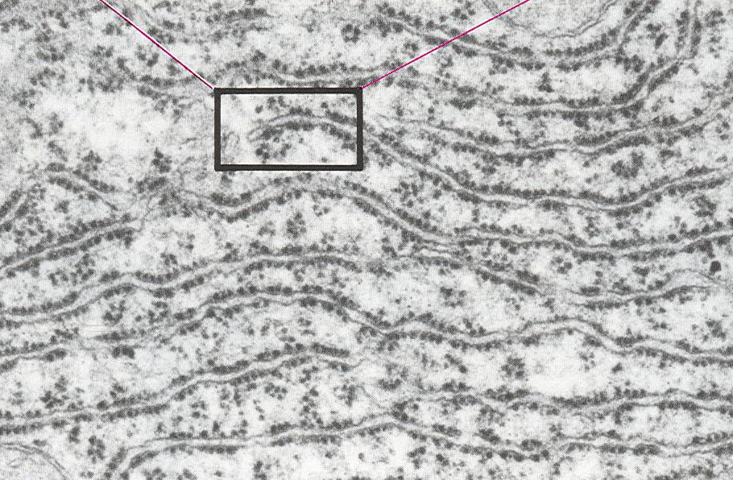
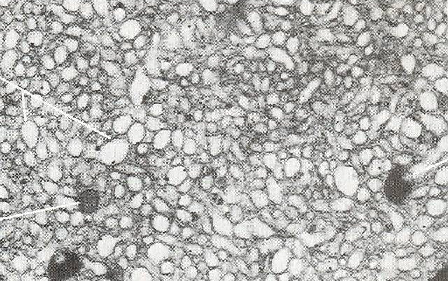
ENDOPLASMIC RETICULUM
It is a system of communicating membranous tubules, vesicles & flattened vesicles (cisternae).
SMOOTH ENDOPLASMIC RETICULUM | ROUGH ENDOPLASMIC RETICULUM
Membranous tubules and vesicles, with NO ribosomes on the surface. | Membranous sheets of flattened tubules & vesicles with ribosomes on the surface.
FUNCTION: 1) Synthesis of lipids & cholesterol. 2) Synthesis of steroid hormones, e.g. cortisone. 3) Helps muscle contraction, by acting as a calcium pump. 4) Detoxification of drugs & toxins. | FUNCTION: 1) Synthesis of proteins by ribosomes on its outer surface. 2) Transfer vesicles transfer the formed protein to Golgi.

Slide 14
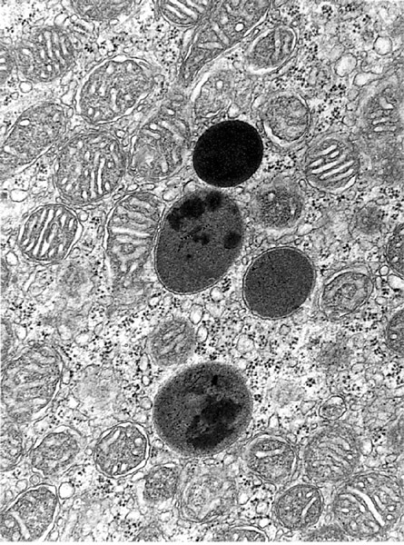
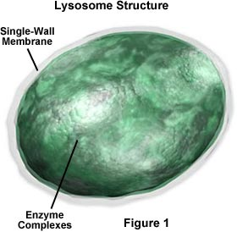
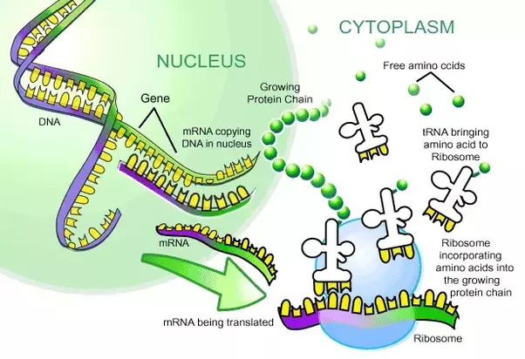
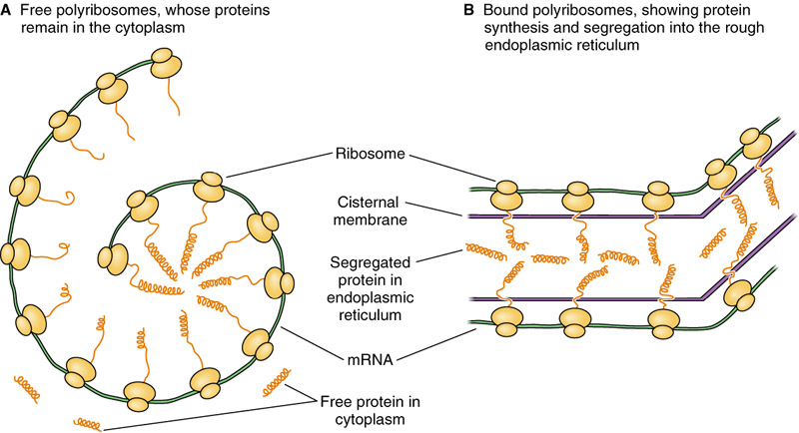
LYSOSOMES
The digestive apparatus of the cell.
E/M: Spherical membranous vesicles.
Contain hydrolytic enzymes.
Originate from mature surface of the Golgi apparatus, while their hydrolytic enzymes are formed in the rough endoplasmic reticulum.
Functions:
intracellular digestion of ingested material or old organelles.
RIBOSOMES
Formed in the nucleolus.
LM: Basophilic cytoplasm is due to numerous ribosomes .
Consist of ribosomal RNA (rRNA), combined with proteins.
EM: Formed of 2 subunits.
Free in the cytoplasm (may form polyribosomes) or attached to rER.
Function:
Protein synthesis.

Slide 15
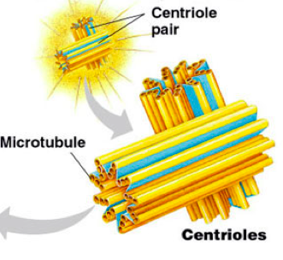
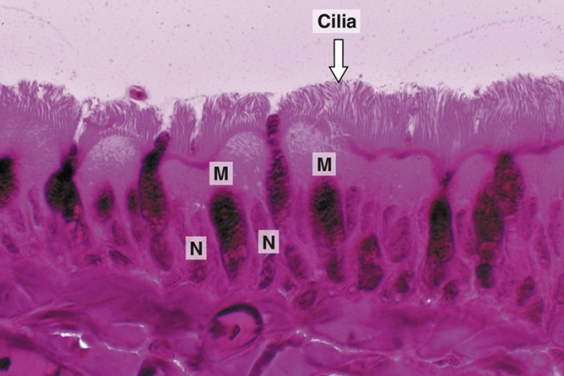
MICROTUBULES-CONTAINING ORGANELLES
FLAGELLA | CILIA | CENTRIOLES
- Longer and larger than cilia. - Form the tails of sperms. | - Hair-like striations on the free surface of some cells. - Basal body is similar to centriole. - Shaft is formed of 9 doublets and 2 central singlets of microtubules, i.e. 20 microtubules. | - 2 cylinders, perpendicular to each other. - Wall is made of 9 triplets of microtubules, i.e. 27 microtubules.
Function: Important for movement of the sperms. | Function: Movement of particles or fluids on the free surface of the cell in one direction. | Functions: 1- Essential for cell division. 2- Formation of cilia and flagella.

Slide 16
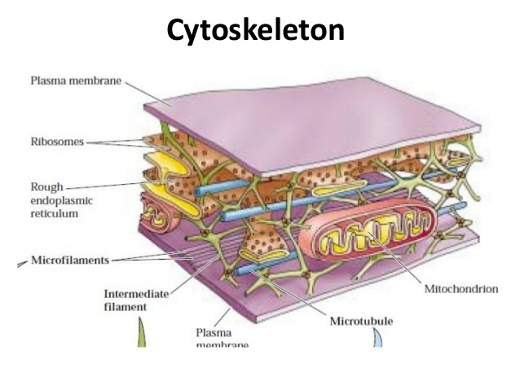
CYTOSKELETON
It is the structural skeleton of the cell.
Consists of:
1- Microfilaments (actin).
2- Intermediate filaments, e.g. Keratin.
3- Microtubules.
Functions:
1- Maintains shape of the cell.
2- Helps transport of material within the cell.
CLINICAL APPLICATION
Immotile cilia syndrome:
Disorder that causes infertility in male and chronic respiratory tract infection in both sexes.
caused by immobility of cilia and flagella induced by deficiency of dynein.
Dynein protein is responsible for movements of cilia and flagella.

Slide 19
" لنكن يداً بيد ليرى العالم إنجازاتنا
وتحمّلوا شقاء اليوم لأجل حلم الغد "

