Slide 3
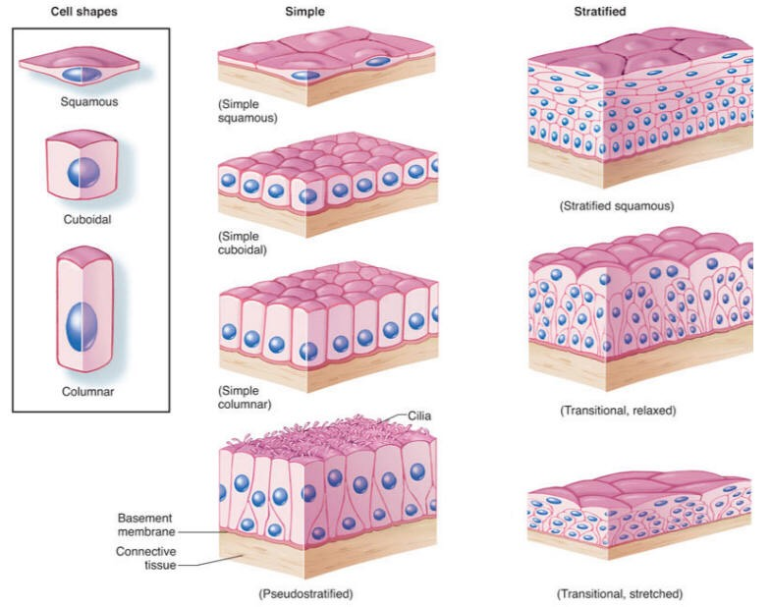
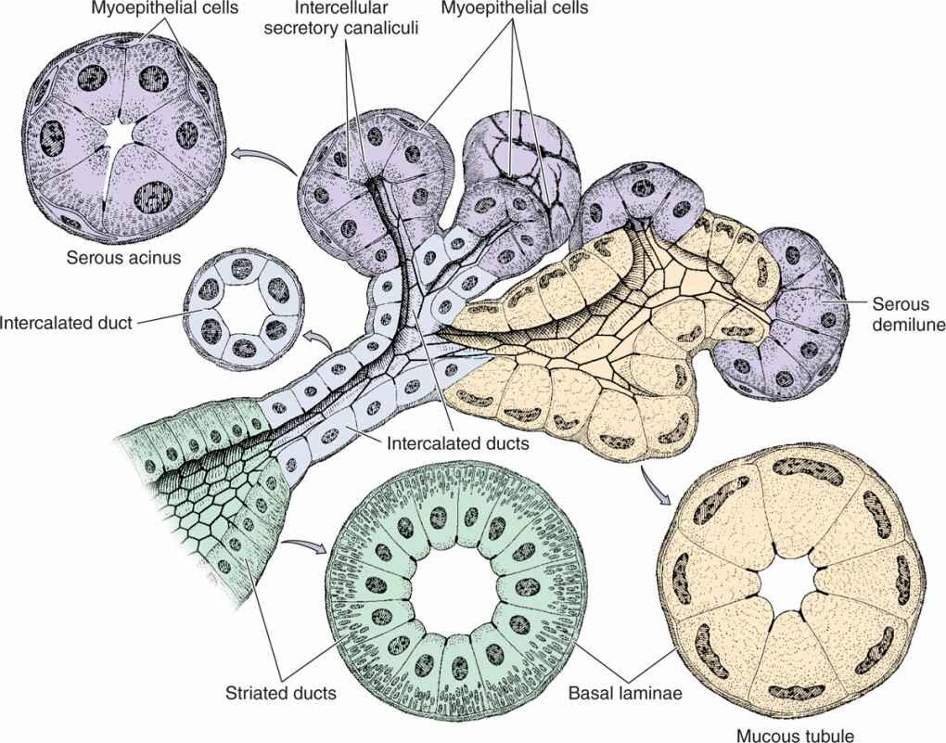
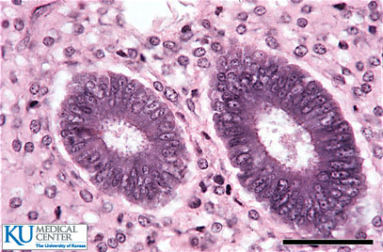
EPITHELIAL TISSUE
General characteristics:
Cells are tightly joined with little intercellular space.
Rest on a basement membrane.
Avascular. “lack of blood vessels”
High power of regeneration.
Classification:
Epithelial membranes: - Simple epithelium: one layer. - Stratified epithelium: more than one layer.
Glands (Glandular Epithelium).
Functions :
Protection as in epidermis of skin.
Secretion as in glands.
Absorption as in small intestine.
Excretion as in kidney.
Reproduction as in gonads.
Smooth lining as in blood vessels.

Slide 4
SIMPLE EPITHELIUM
2) Simple cuboidal Epithelium | 1) Simple Squamous Epithelium
One layer of cuboidal cells Central rounded nuclei | One layer of flat cells Flat nuclei Provides smooth thin surface
Example: Thyroid follicles | Examples: Endothelium (lining the CVS “cardiovascular system”) Alveoli “air sacs” of lung

Slide 5
SIMPLE EPITHELIUM
4) Pseudo-Stratified Columnar | 3) Simple Columnar Epithelium
One layer of columnar cells Nuclei appear at different levels Some cells are tall, others are short and don’t reach the surface All cells rest on the basement membrane Types: ciliated “with Goblet cells” Non-ciliated | One layer of columnar cells Basal oval nuclei Types: ciliated “with cilia on free surface” Non-ciliated
Examples: Ciliated: (respiratory epithelium) trachea & bronchi Non-ciliated: vas deferens | Examples: Ciliated: Fallopian tubes Non-ciliated: lining of stomach, gall bladder, and intestines (with goblet cells).

Slide 6
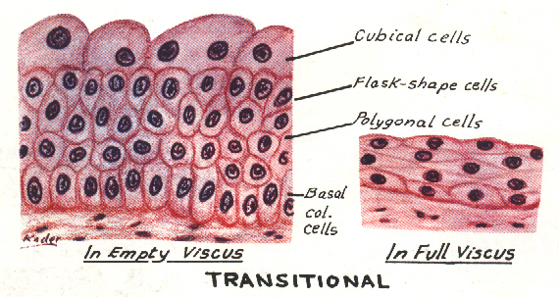
STRATIFIED EPITHELIUM
3) Stratified Columnar Epithelium | 2) Transitional Epithelium | 1) Stratified Squamous Epithelium
Multiple layers of cells. Basal cells are columnar Intermediate cells are polygonal Surface cells are columnar | Multiple layers of cells Basal cells are columnar Intermediate cells are polygonal. Surface cells large cuboidal with convex free surface and may be binucleated. | Multiple layers of cells Basal cells are columnar with basal oval nuclei Intermediate cells are polygonal with central rounded nuclei. Surface cells are flat with flattened nuclei. Types: Keratinized “with a layer of keratin on the surface” Non-keratinized
Examples: large ducts of glands. | Examples: Urinary bladder. | Examples: Keratinized: epiderms of skin Non-Keratinized: oesophagus

Slide 7
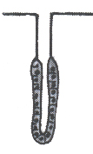
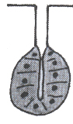
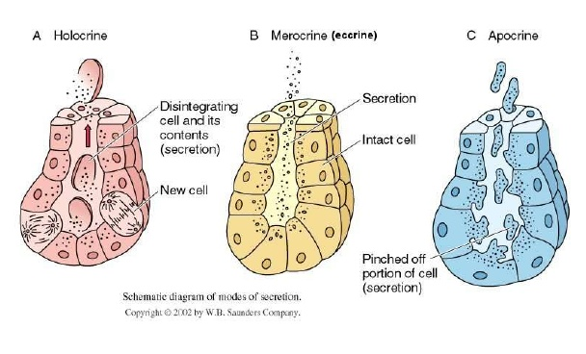
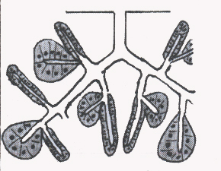
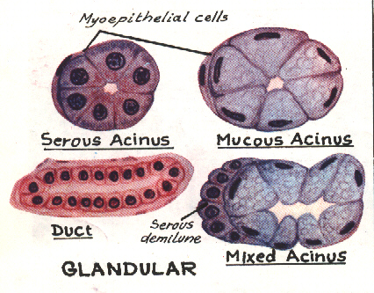
GLANDS (GLANDULAR EPITHELIUM) classification according to :
Nature of secretion | Shape of secretory part | Mode of secretion | Number of cells | Presence or absence of ducts
Serous: e.g. parotid gland Mucous: e.g. goblet cells Muco-serous: e.g. sublingual gland Watery: e.g. sweat gland | 1) Tubular: e.g. intestinal gland 2) Alveolar (acinar): e.g. mammary gland 3) Tubulo-alveolar: e.g. pancreas. | 1) Merocrine: No part of the cell is lost with the secretion, e.g. salivary glands. 2) Apocrine: The top of the cell is lost with the secretion, e.g. mammary gland 3) Holocrine: The whole cell detaches with the secretion, e.g. sebaceous glands | Unicellular: e.g. goblet cells. Multicellular: e.g. salivary glands. | Exocrine: e.g. salivary glands Endocrine: e.g. thyroid gland. Mixed: e.g. pancreas.
1
2
3
1
2
3

Slide 8
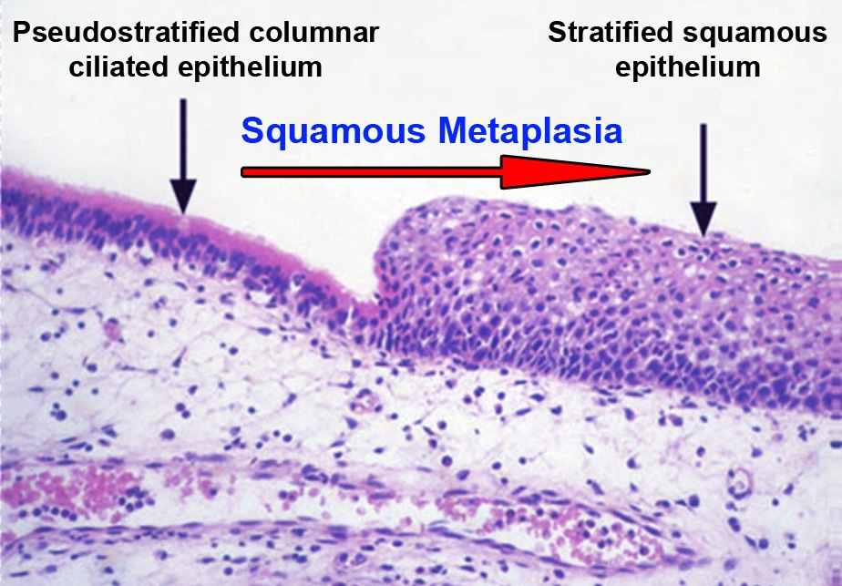
CLINICAL APPLICATION
IMMOTILE CILIA SYNDROME (KARTEGENER’S SYNDROME):
Disorder that causes infertility in male and chronic respiratory tract infection in both sexes.
It is caused by immobility of cilia and flagella induced by deficiency of dynein.
Dynein protein is responsible for movements of cilia and flagella
METAPLASIA
It is the transformation of one type of tissue to another in response to injury.
This condition is usually reversible if the injury is removed.
Example: pseudostratified ciliated columnar epithelium of the respiratory passages,
e.g. trachea, of heavy smokers may undergo squamous metaplasia, transforming into
stratified squamous epithelium.

