Slide 3
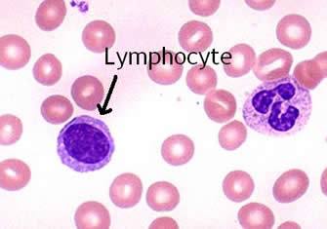
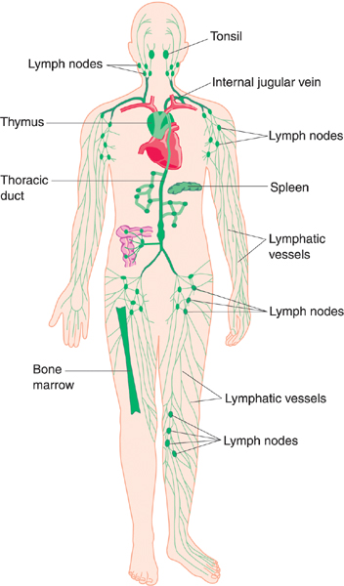
LYMPHOID TISSUE
Encapsulated
Lymph nodes
Spleen
Diffuse (mucosa associated lymphoid tissue)
Tonsils
(Are incompletely incapsulated)
Thymus
Mucosa is epithelial and connective tissue in wet location like inside the mouth or nose.
LYMPH: is a pale fluid that contains white blood cells and that passes through channels in the body and helps to keep bodily tissues healthy.
The lymph is formed when the interstitial fluid is collected through lymph capillaries.
LYMPH SINUSES: Channels which allows the free movement of lymphatic fluid.
T cells located in lymph nodes(paracortex), spleen (preartrial lymphatic sheaths) and tonsils.

Slide 4
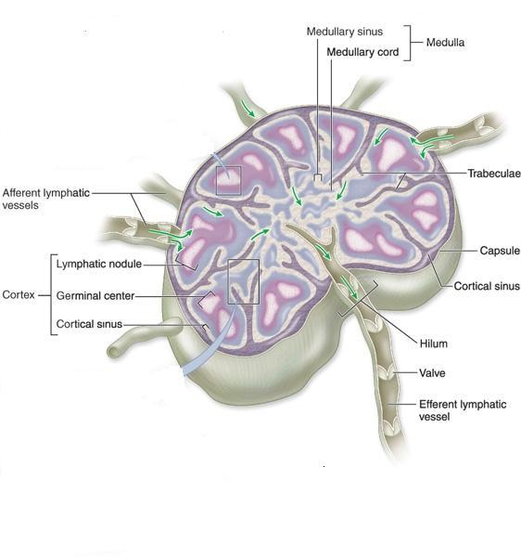
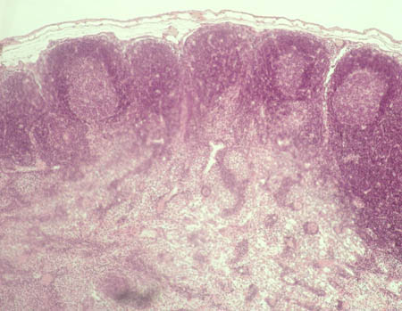
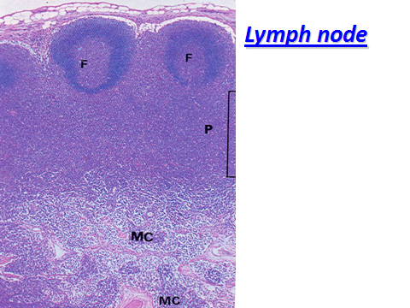
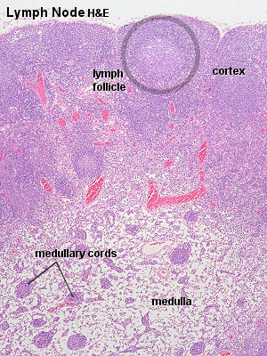
LYMPH NODES (L.N.)
Function: Proliferation of B and T lymphocytes. Filtration of lymph from bacteria and other foreign substances. filtration of the lymph fluid.
(B) Parenchyma (lymphoid tissue + lymph sinuses) |  |  | (A) Stroma
Medulla of L.N | Paracortex of L.N | Cortex of L.N | Reticular C.T | Trabeculae (septa) | Capsule
C
PC
M

Slide 5
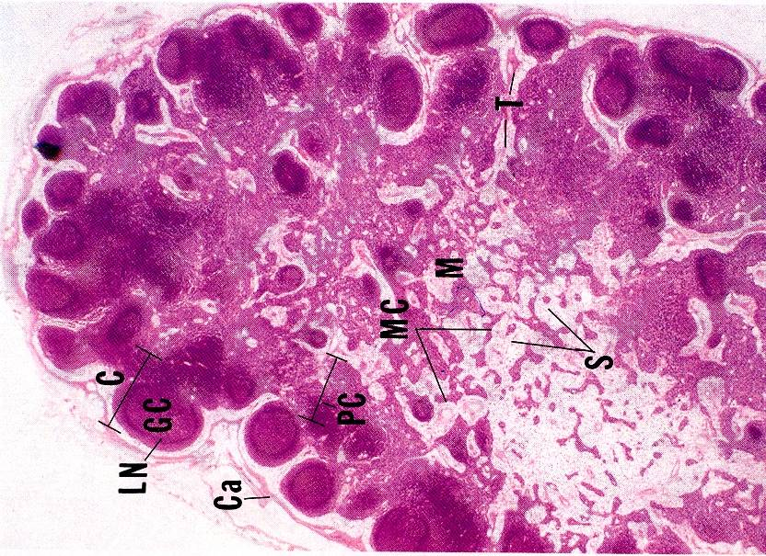
LYMPH NODES (L.N.)
Ovoid, kidney shaped organs.
Each node has:
1- A convex surface which receives afferent lymph vessels
2- A hilum where efferent lymph vessels leave and drain lymph from the node.
Each lymph node has a dense connective tissue capsule.
From the capsule, connective tissue septa (trabeculae) extend into the outer part (cortex) of the node and divide it into incomplete compartments
The framework of the node is formed by reticular connective tissue.
Each lymph node is divided into three regions:
1- CORTEX
2- Paracortex
3- Medulla
C
PC
M

Slide 6
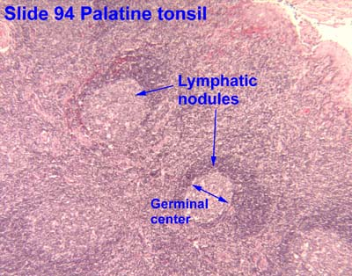
CORTEX:
contains:
Subcapsular lymphatic sinus.
Cortical sinuses.
Lymphoid nodules (Follicles): - Composed mainly of B lymphocytes, macrophages and reticular cells - Lymph nodules are small masses of lymph tissue (lymphocytes). - Lymph nodules may be: (A) Primary nodules: formed of virgin B lymphocytes. (B) Secondary nodules: with paler germinal centers and it Contain: - Germinal centers, central light areas filled with activated lymphocytes (B lymphoblast), plasma cells and macrophages. - The germinal center is surrounded by a darker-staining region called the corona.
PN
SN

Slide 7
PARACORTEX:
It is the region between cortex and medulla.
It is the thymus dependent zone and contains T lymphocytes.
It contains high endothelial venules through which lymphocytes enter the lymph node; B cells enter the cortex and T cells settle in the paracortex.
Has NO nodules.
MEDULLA:
Consists of:
Medullary cords.
are composed of:
B & T lymphocytes, plasma cells and macrophages.
Medullary lymph sinuses.
are continuous with:
the subcapsular and cortical lymph sinuses.

Slide 8
LYMPH FLOW THROUGH THE LYMPH NODE
Afferent lymph vessels
Subcapsular sinuses
Cortical sinuses
Medullary sinuses
Efferent lymphatic vessels
Clinical Applications
Palpable lymph node
The presence of antigen or bacteria leads to rapid proliferation of lymphocytes of the lymph node (L.N), leading to increase of L.N. to several times of its normal size, so the L.N. becomes enlarged and palpable to the touch.

Slide 9
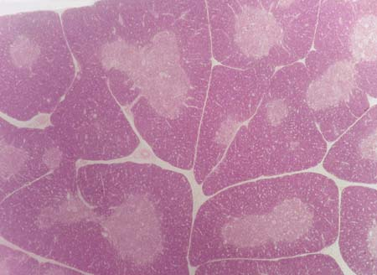
THYMUS
Function: Maturation of T lymphocytes (produce immunocompetant T lymphocytes). It involutes after puberty and becomes infiltrated by adipose tissue. Remnants of thymus remain in adult to form T lymphocytes. No B lymphocytes,no plasma cells in the thymus.
(B) Thymic lobule |  | (A) Stroma
Medulla | Cortex | Interlobular trabeculae (incomplete) | Capsule
Bilobed lymphoid organ located in thorax.
Enclosed in a thin connective tissue capsule.
Septa (trabeculae) from the capsule into the organ, subdividing it into incomplete lobules..
Possesses no lymph nodules, no lymph sinuses, no reticular fibers.
Thymus gland doesn't have B cells.
The whit area in thymus it is full of connective tissue.
B cell is secreted by bone marrow (programed).
No lymphocytes plasma cells in the thymus.
C
L
L
S

Slide 10
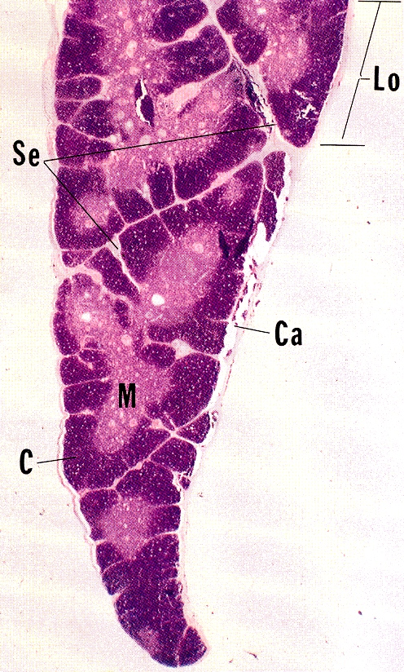
Each lobule is divided into an outer cortex and inner medulla.
CORTEX:
is darker than the medulla because it is populated with immunologically immature T-lymphocytes (more than 90% will die), epithelial reticular cells, and macrophages. Here the immature T cells undergo proliferation, and transform into mature cells and then migrate to medulla.
T cell is secreted by bone marrow (not programed) than it will stay in thymus gland until maturation.
Inactive T cell will be in cortex of thymus than it will be engulf by macrophages.
Active T cell will be in medulla of the thymus.

Slide 11
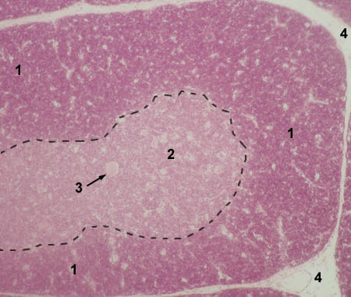
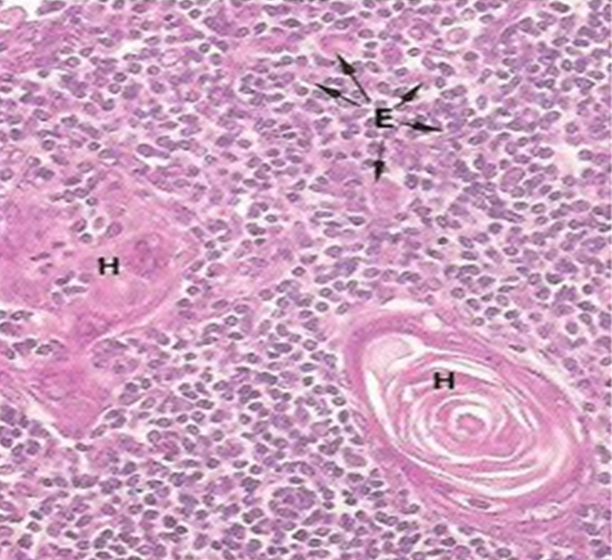
MEDULLA:
consists of
mature T-lymphocytes
epithelial reticular cells: Epithelial reticular cells are special component only for thymus. Epithelial reticular cells responsible for maturation of T cell.
macrophages.
thymic (Hassall’s) corpuscles: Hassall’s corpuscles are unique structure for medulla of thymus 1- Are composed of groups of concentrically arranged keratinized epithelial reticular cells. 2- Are found in medulla of thymic lobules. 3- Increase in number with age. 4- Probably represent a degenerative process.
1 - cortex 2 - medulla 3 - Hassall's corpuscle 4 - interlobular C.T. (septa)
Hassall’s Corpuscles

Slide 12
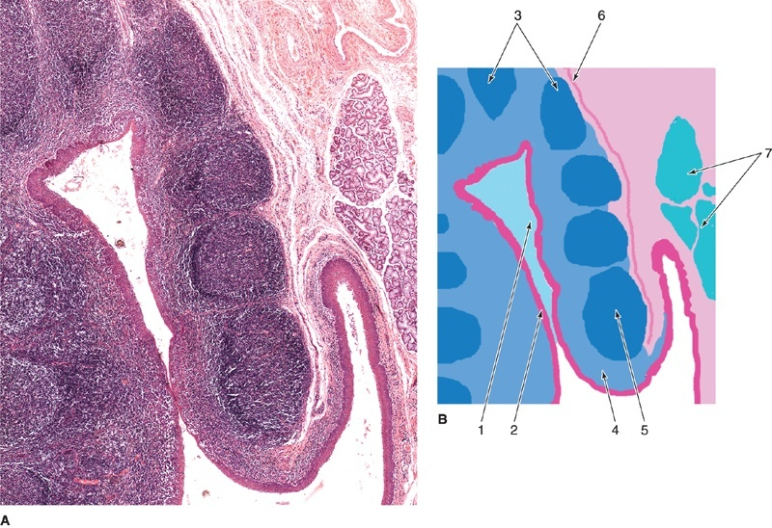
TONSILS
The tonsils are incompletely encapsulated aggregates of lymphoid nodules that guard the entrance to the pharynx
Function: production of antibodies.
Lingual tonsils | Pharyngeal tonsils | palatine tonsils
 |  | Bilateral, located at the entrance of the oral pharynx. Incomplete capsule separates its deep aspect from the wall of the pharynx. The superficial aspect is covered by stratified squamous nonkeratinized epithelium that dips into 10-12 crypts. The parenchyma is composed of lymphoid nodules with germinal centers.

Slide 13
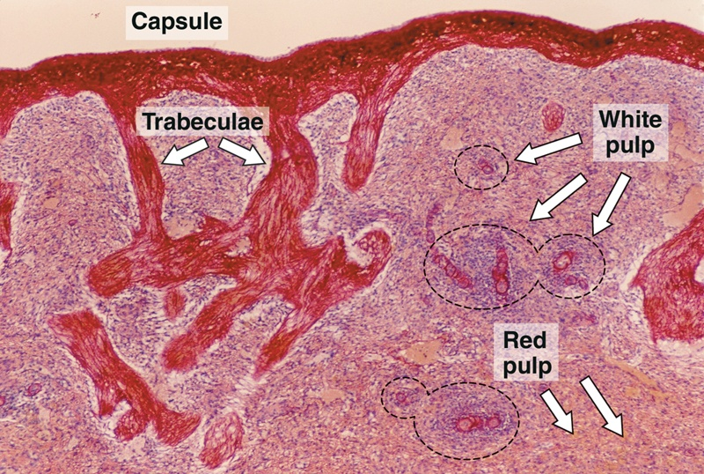
SPLEEN
Functions: Filtration of blood. Phagocytosis of old RBCs & old blood platelets & invading microorganisms. Production & proliferation of immunocompetent B & T lymphocytes. Production of antibodies.
(B) Parenchyma |  | (A) Stroma
White pulp. Red pulp. |  |  | Capsule. Trabeculae. Reticular C.T.
Note: No cortex, No medulla, No afferent lymphatic vessel.

Slide 14
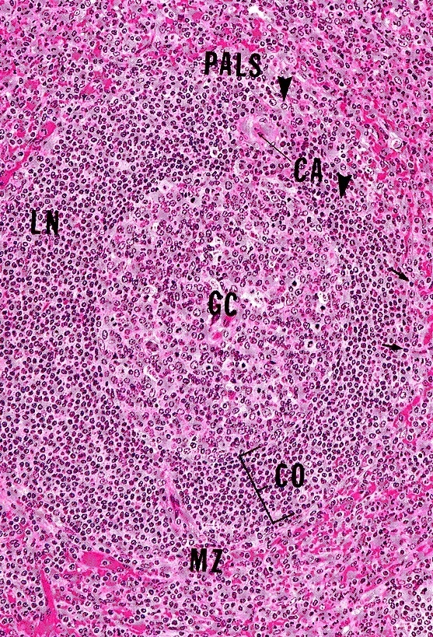
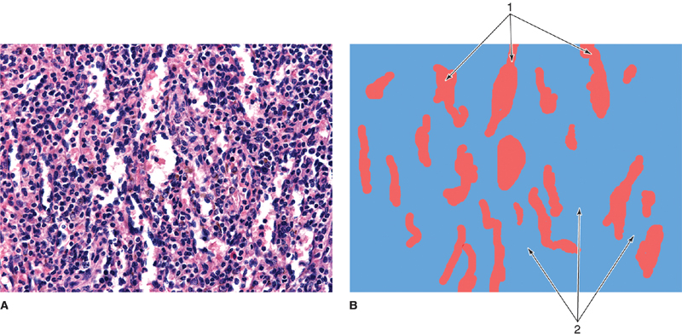
STROMA OF SPLEEN:
Capsule:
1- is covered by visceral layer of peritoneum; mesothelium
2- Is formed of fibromuscular C.T. : Dense fibrous C.T. + smooth muscle cells.
Trabeculae:
Are irregular, incomplete, divide the spleen into intercommunicating compartments (lobules).
Reticular C.T. :
Reticular connective tissue located in lymph nodes, bone marrow, spleen and liver.
PARENCHYMA OF SPLEEN:
(A) White Pulp:
1) Periarterial lymphatic sheaths (PALS): housing T lymphocytes.
2) Lymphoid follicles (with germinal centers): housing B lymphocytes.
Note: Both 1&2 have the centrically located central artery (central arteriole) (follicular arteriole).
(B) Red pulp:
1) Splenic (pulp) cords:
Extravasated blood cells, plasma cells, macrophages & reticular cells and fibers.
2) Splenic blood sinusoids:
Are lined with elongated fusiform endothelial cells with large intercellular spaces & supported by discontinuous, circular basement membrane.

Slide 15
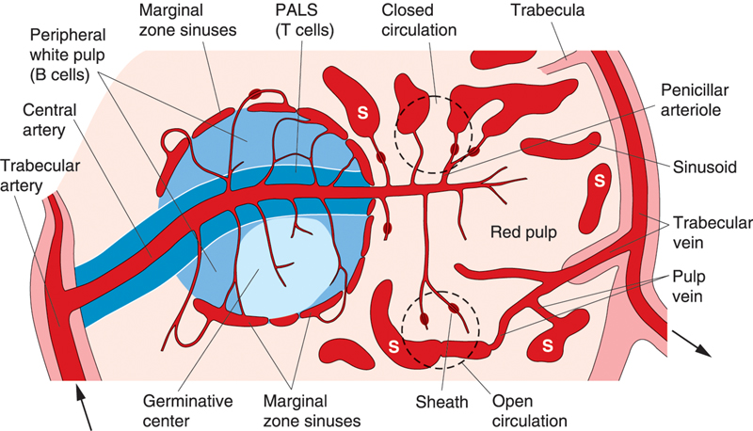
CELLS OF PARENCHYMA OF SPLEEN
1. Lymphocytes.
2. Plasma cells.
3. Macrophages.
4. Blood elements (RBCs, leucocytes and blood platelets).
Splenic Microcirculation

Slide 16
Clinical Applications
Rupture of the Spleen
Spleen is a fragile or friable organ, so major trauma to the upper left abdominal quadrant usually leads to rupture of the spleen. Surgical removal of that ruptured spleen is essential.

