Slide 3
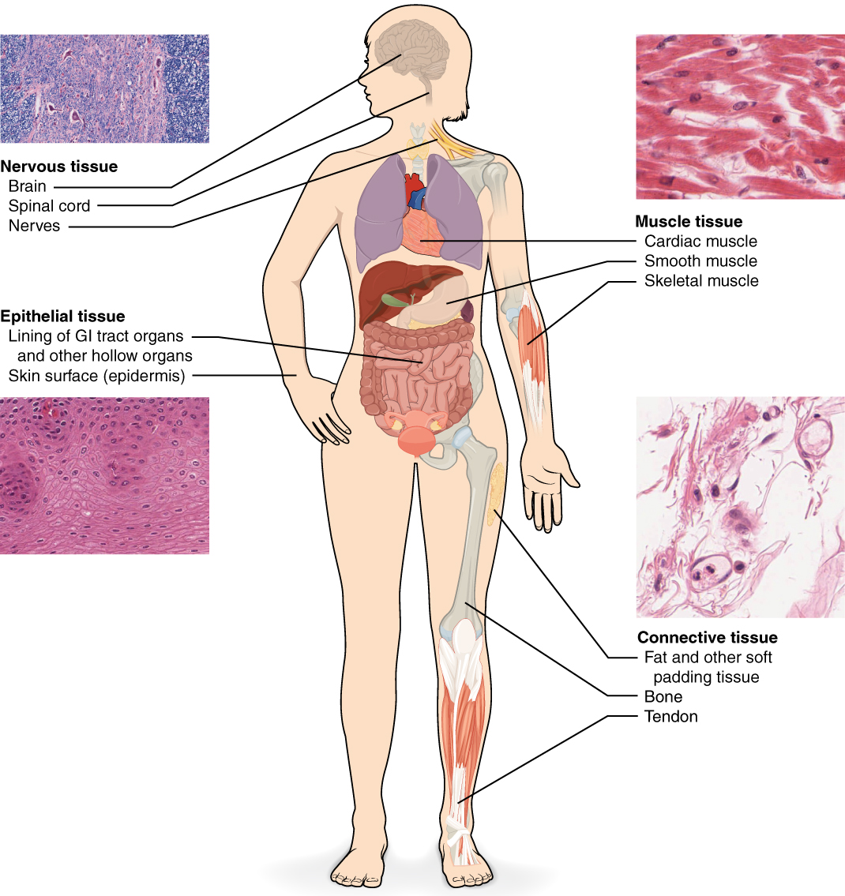
CONNECTIVE TISSUE (C.T)
Definition:
It is one of the 4 basic tissues “Epithelial, connective, muscular & nervous”.
It is mesodermal in origin.
General characteristics:
is formed of widely separated, few cells with abundant extracellular matrix.
Most are vascular “have blood vessel”
(Remember: Epithelial tissue & cartilage Avascular “lack of blood vessel”)
Functions :
It supports, binds, and connects other tissues and organs
providing structural and metabolic support for them.

Slide 4
Components
Cells
Matrix
Adipose tissue
Dense collagenus
Elastic
Reticular
Fibroblasts
Types
Elastic
Fibers
Collagen
Macrophages
Mast cells
Plasma cells
Leucocytes
Reticular
Loose (Areolar)
Adipose cells
COMPONENTS OF C.T
Cells difference types
Matrix
Rigid (rubbery, firm) “Cartilage”
Fluid (liquid) “Blood”
Soft “C.T Proper”
Fibers Collagenous, elastic & reticular
Hard (solid) “Bone”
the intercellular substance, in which
cells and fibers are embedded.

Slide 5
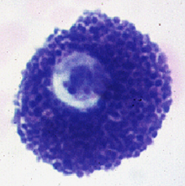
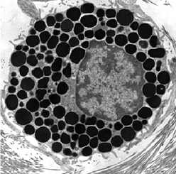
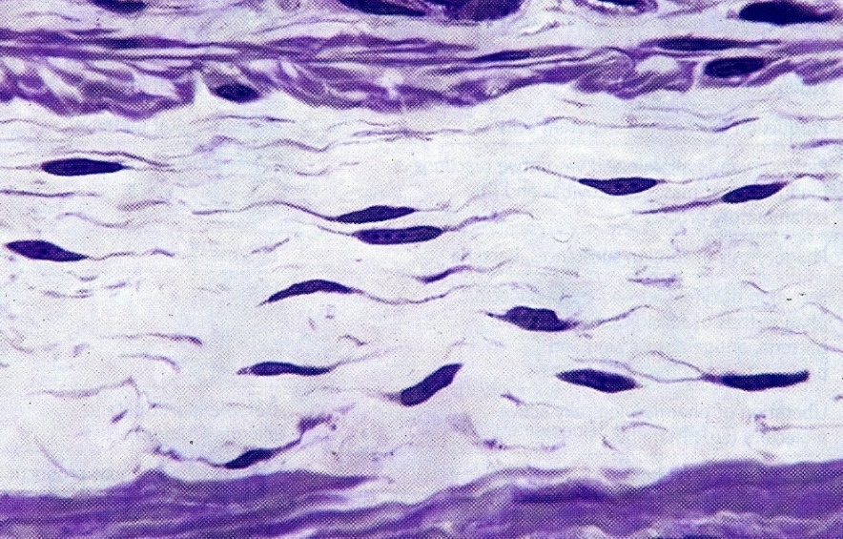
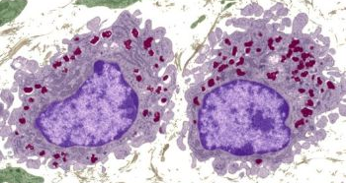
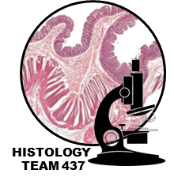
COMPONENTS OF C.T PROPER (CELLS):
3) Mast Cells | 2) Macrophages | 1) Fibroblasts
L/M: Cytoplasm contains numerous basophilic cytoplasmic granules Function: 1. Secrete heparin (anticoagulant) “for maintain fluidity for blood ” 2. Secrete histamine (allergic reactions) “for control diameter for bronchioles and blood vessel” *When histamine increase the diameter of blood vessel increase and the diameter for bronchioles decrease *Heparin and histamine are hormones that secret by must cell in specific quantities | L/M: Basophilic cytoplasm, rich in lysosomes Irregular outlines They can divide They originate from blood monocytes “inside blood = monocyte , inside connective tissue = macrophage” | L/M: Most common cell ; found nearly in all types of C.T proper Flat branched cells (spindle-shaped) with basophilic cytoplasm (rich in ribosomes) They can divide Old fibroblasts are called fibrocytes
 | Function: Phagocytosis | Function: Formation of proteins of C.T fibers (Make Extracellular Fluid) Formation of C.T. matrix Healing of wounds

Slide 6
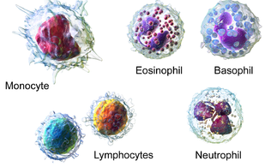
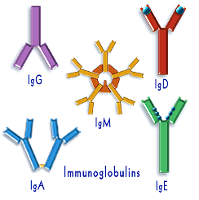
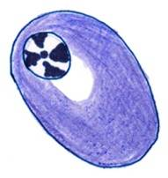
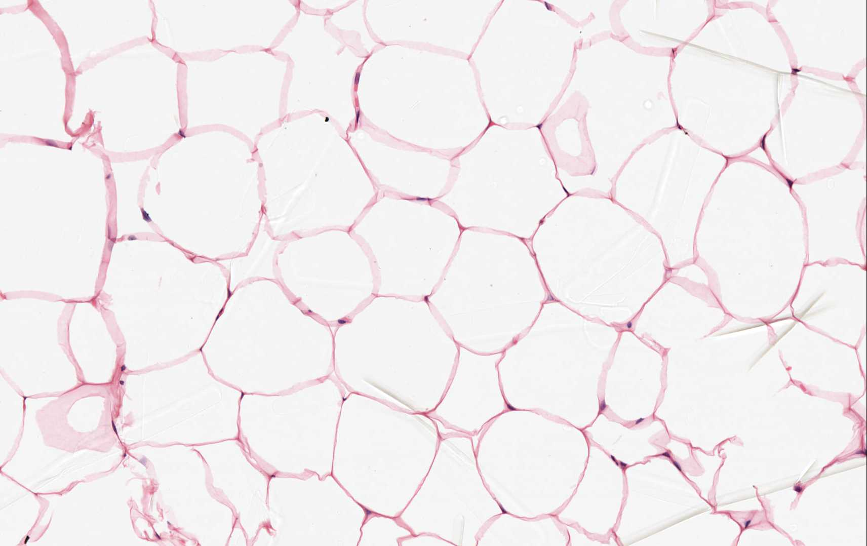
COMPONENTS OF C.T PROPER (CELLS):
6) Leucocytes (White Blood Cells) | 5) Adipose Cell (Adipocyte, Fat Cells) | 4) Plasma Cells
Appear normally in C.T. proper there are 5 types of WBC : Neutrophils, Lymphocytes, Monocytes, Eosinophils & Basophils Neutrophils increase in acute inflammation Lymphocytes and monocytes increase in chronic inflammation Eosinophils and basophils increase in allergic inflammation | L/M: Unilocular adipose cells “Uni=one=وحيد , locular=تجويف” Large spherical, with a single large fat droplet Thin rim of cytoplasm at the periphery Nucleus: flattened, peripheral | L/M: Basophilic cytoplasm with a negative Golgi image Nucleus: spherical, eccentric with a clock-face appearance of chromatin Derived from B-lymphocytes B lymphocyte it is the plasma cell Active B lymphocyte known as plasma cell
 | Functions: Storage of fat Source of heat & energy | Function: Secretion of antibodies (5 immunoglobulins)

Slide 7
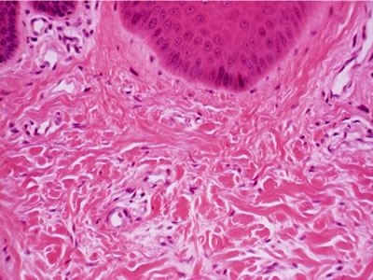
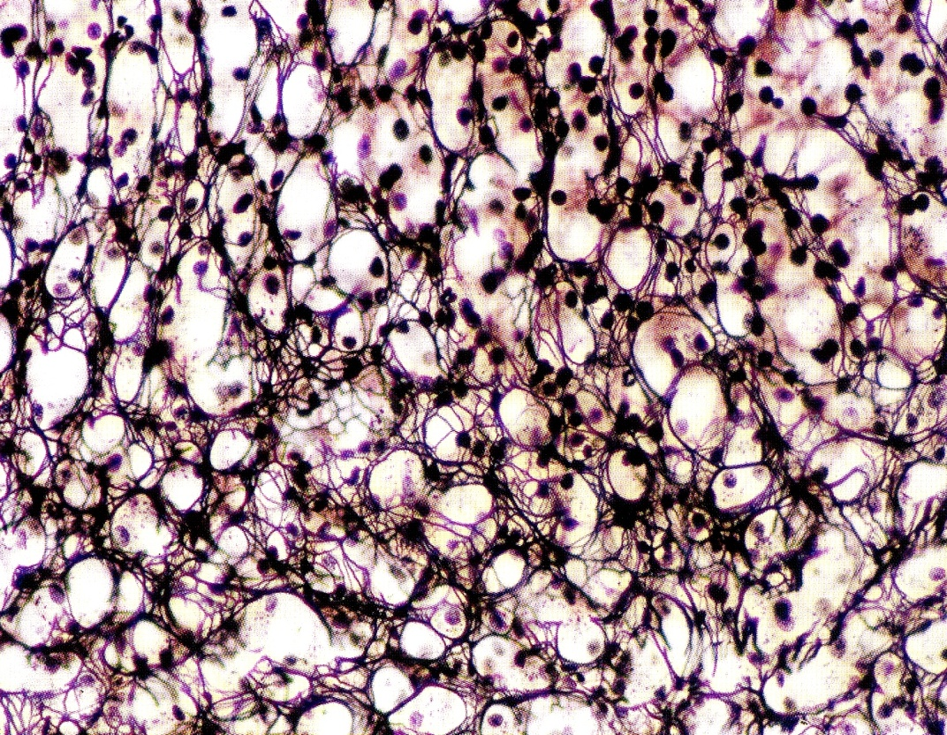
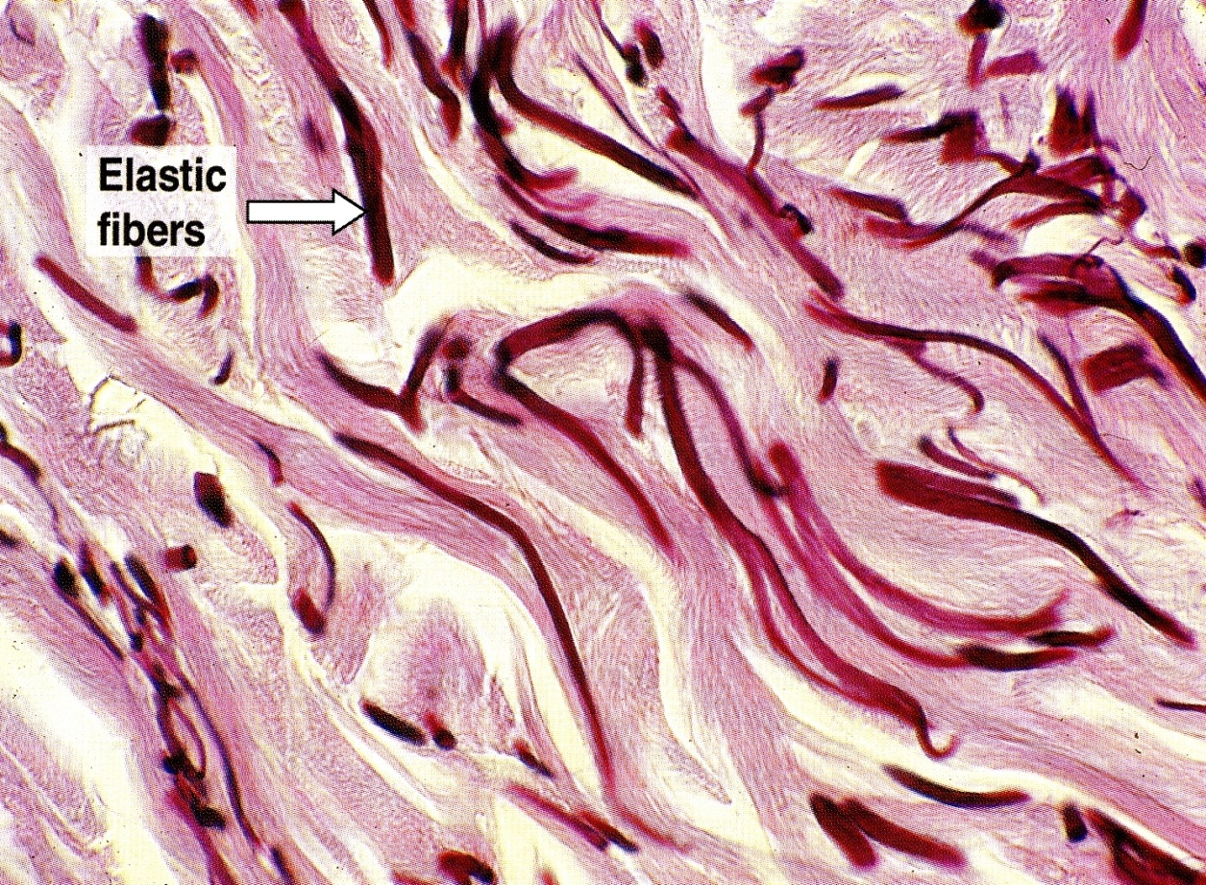
COMPONENTS OF C.T PROPER (FIBERS):
3) Elastic Fibers | 2) Reticular Fibers | 1) Collagen Fibers
Made of elastin | Made of collagen type III | Made of collagen type I
Branched | Branch and form a network | Non-branched fiber & arranged in bundles
Stained brown with orcein. | Stained black with silver | Acidophilic
Other important types of collagen include:
Type II (In cartilage)
Type IV (in basement membranes)

Slide 8
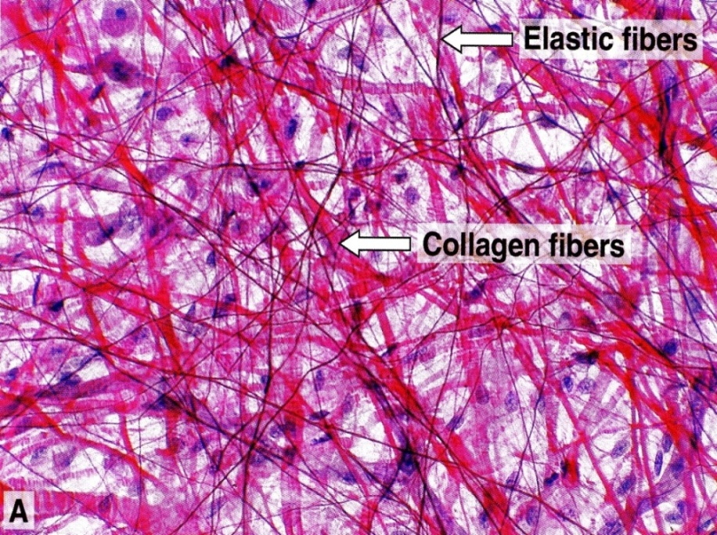
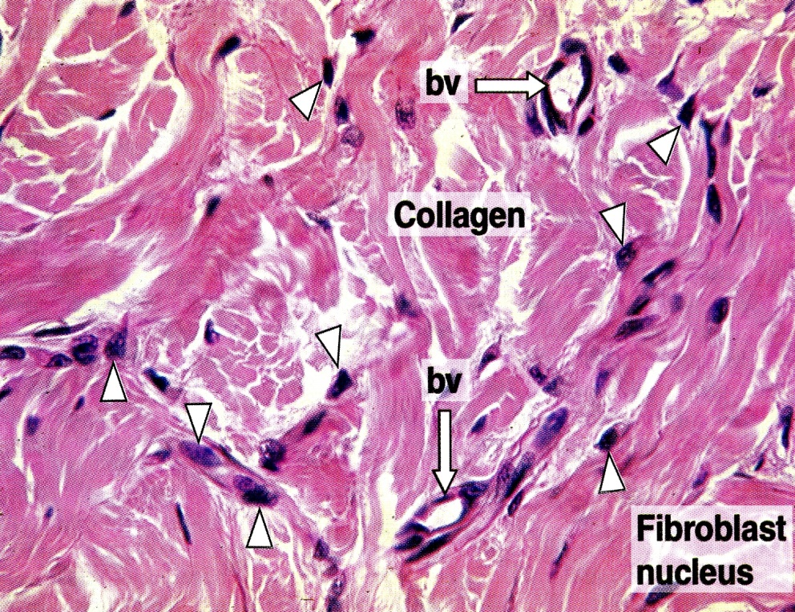
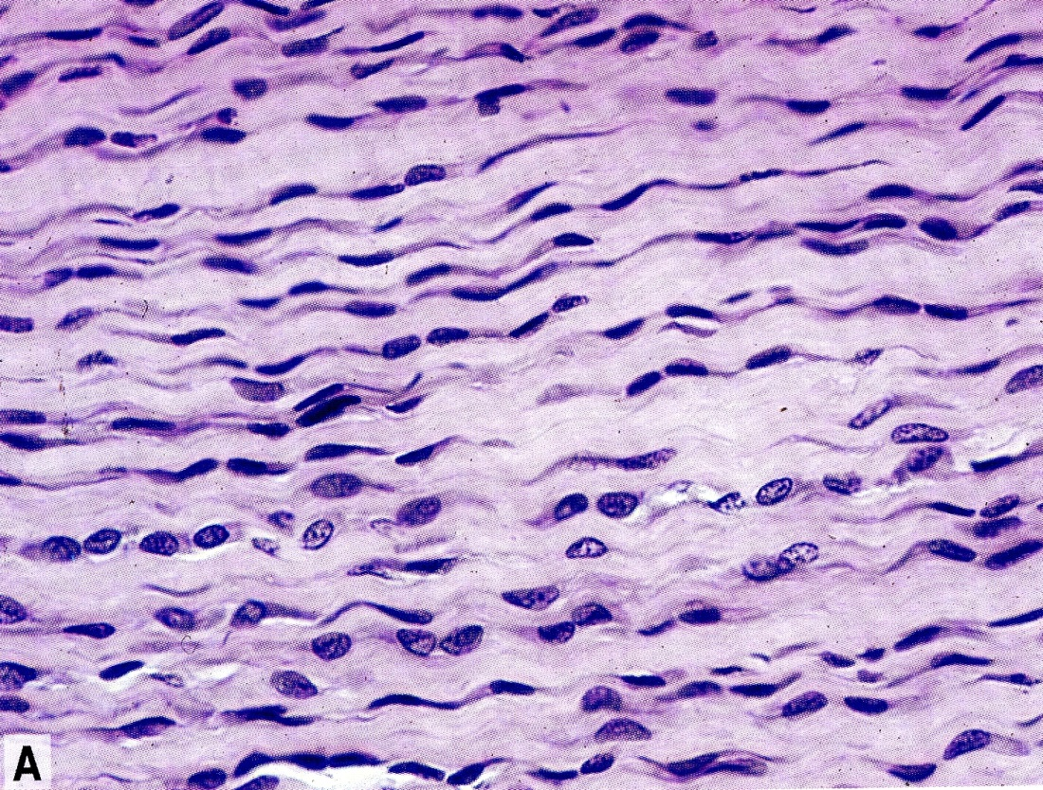
TYPES OF CONNECTIVE TISSUE PROPER:
3) Elastic Tissue | 2) Dense Collagenous C.T | 1) Loose (Areolar) C.T
L/M: Predominance of elastic fibers (sheets or membranes) + fibroblasts rich in elastic fiber | L/M: Predominance of collagen fibers + fibroblasts rich in collagen fiber | Most common type. L/M: Contains all of C.T components in equal amount (cells, fibers & matrix) No predominant element
Sites: Large arteries, e.g. Aorta | Sites: Dense irregular: “vascular” dermis of the skin, capsules Dense regular: “Avascular” tendons, ligaments | Sites: Subcutaneous tissue “under skin”
Function: elastic tissue & stretchable | Function: tough tissue & resistant to stretch

Slide 9
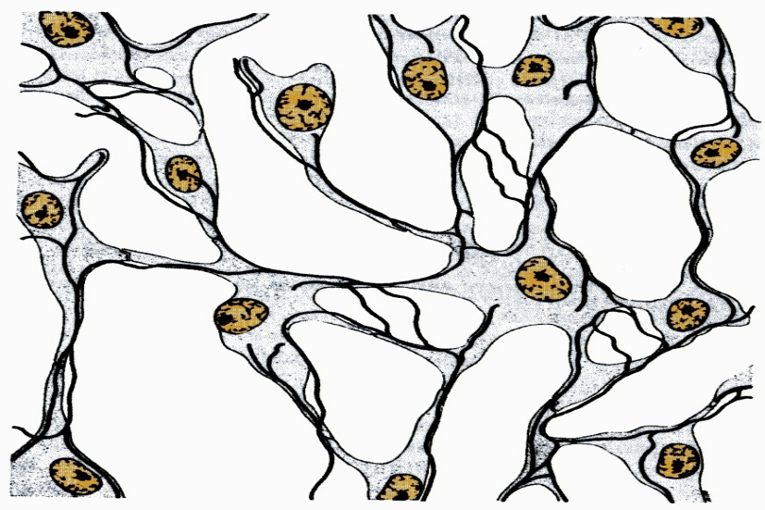
TYPES OF CONNECTIVE TISSUE PROPER:
5) Unilocular Adipose Tissue (White Adipose Tissue) | 4) Reticular Tissue
L/M: Predominance of unilocular fat cells *There is two type of adipose tissue : unilocular and multilocular | L/M: Predominance of reticular fibers + reticular cells (specialized fibroblasts)
Sites: Subcutaneous tissue “under skin” especially in: Buttocks Abdominal wall Female breast Hips Around kidney | Sites: Stroma of organs (liver, spleen & lymph node)
Function: Synthesis, storage & release of fat Supports organs, e.g. kidney Heat insulation (Especially in newborn children) | Function: structural support

Slide 10
FUNCTIONS OF CONNECTIVE TISSUE PROPER
1) Supports, binds, and Connects other tissues and organs.
2) Nourishes the surrounding structures, through its blood vessels.
3) Its Cells provide healing of injured tissues, produce heparin, histamine & antibodies, store fat & preserve body temperature and protect against microorganisms.
4) Its fibers provide rigidity or elasticity.

