Slide 1
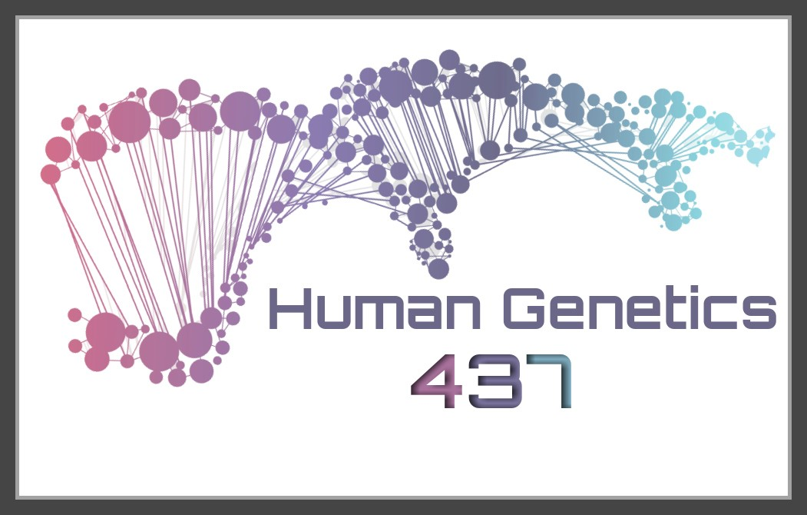
HUMAN GENETICS
Color index:
Important
Slides
Drs’ notes
Extra information
LECTURE 1
Human chromosomes:
Genotype / Phenotype
EDITION FILE

Slide 2
OBJECTIVES
By the end of this lecture, the students should be able to:
Describe the number, structure, and classification of human chromosomes.
Explain what a Karyotype is and how it is obtained.
Describe chromosomal banding and explain its use.
Describe the process of in situ hybridization and the information it provides.

Slide 3
EUKARYOTIC CELL

Slide 4
Genetics
■ Cytogenetics: (Chromatin)
The study of the structure and function of chromosomes and chromosome behaviour during somatic and germline division*.
■ Molecular genetics: (a Single gene, i.e. A,G,C,T.)
The study of the structure and function of genes at a molecular level and how the genes are transferred from generation to generation.
*Only to differentiate between Somatic and Germ-Line division

Slide 5
cytogenetics
Human Cytogenetics:
the study of human chromosomes in health and disease.
Chromosome studies are an important laboratory diagnostic procedure in;
prenatal diagnosis
certain patients with mental retardation and multiple birth defects
patients with abnormal sexual development
some cases of infertility or multiple miscarriages
in the study and treatment of patients with malignancies & hematologic disorders.
Physiology of blood

Slide 6
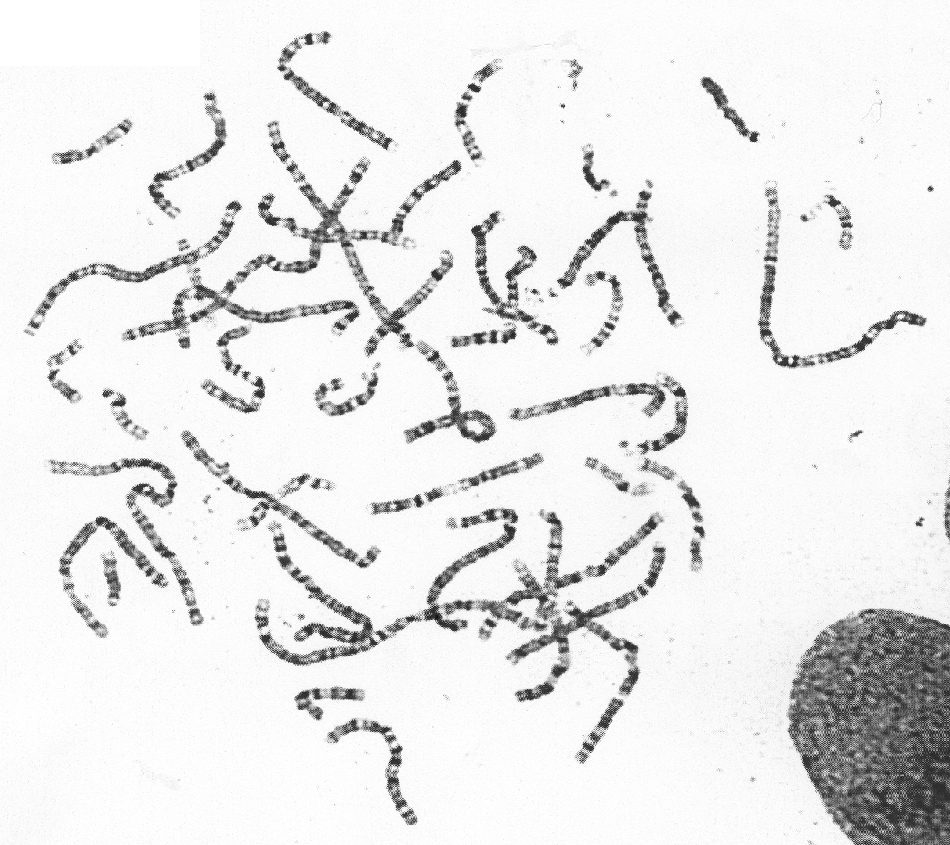
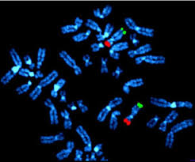
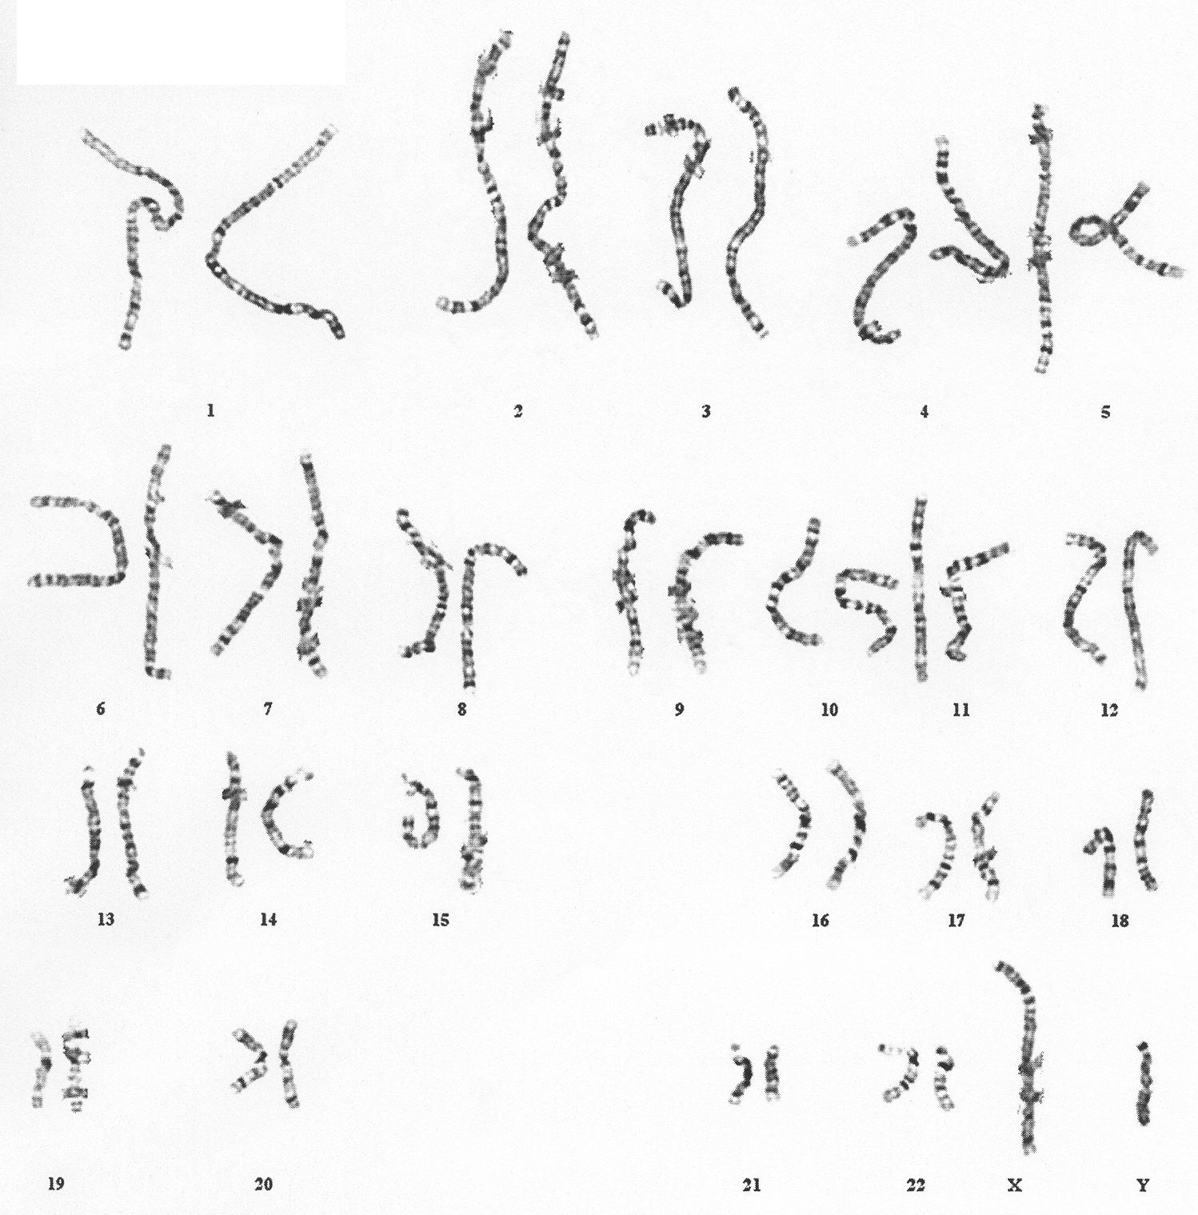
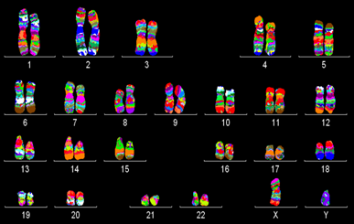
CYTOGENETICS
Molecular cytogenetics
Non-Banded Karyotype
Banded Karyotype
High Resolution Karyotype
Fluorescent In Situ Hybridization (FISH)
Technology that is used to examine a specific gene by (Primers) that are made in the lab
Special dyes gives the chromosome signature

Slide 7
Structure of chromosomes
Chromatin
Chromatin fibers form long loops on non-histone proteins* tighter coils chromosome
Secondary coiling:
around histones (basic proteins)
nucleosomes
Tertiary coiling:
Chromatin fiber
Primary coiling:
DNA double helix
Orders of DNA coiling and folding
*Non-histone Proteins
Molecular level

Slide 8
chromosomes
Electron microscope of human chromosomes
■ carry genetic material*
■ heredity: each pair of homologues** consists of one paternal and one maternal chromosome.
■ The intact set is passed to each daughter cell at every mitosis.
*So there’s no particular job for the chromosome itself, but the genetic information hold on this particular preserver are the one will affect and cause the disease if there’s a malformation of this chromosome.
**A couple of homologous chromosomes, or homologs, are a set of one maternal and one paternal chromosome that pair up with each other inside a cell during meiosis. Homologs have the same genes in the same loci where they provide points along each chromosome which enable a pair of chromosomes to align correctly with each other before separating during meiosis

Slide 9
Mitotic cell cycle
The best phase to study chromosomes is the late Prophase (Prometaphase);
Because it would give us a better resolution of the chromosome.
10-12 hrs.
2-4 hrs.
why we need a better resolution to study the chromosomes?
Because the chromosome is segmented as parts: black and white.
Therefore we will know the inactive areas and the active ones.
6-8 hrs.

Slide 10
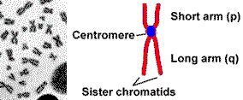
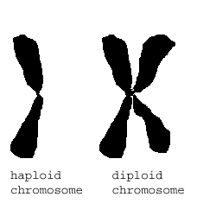
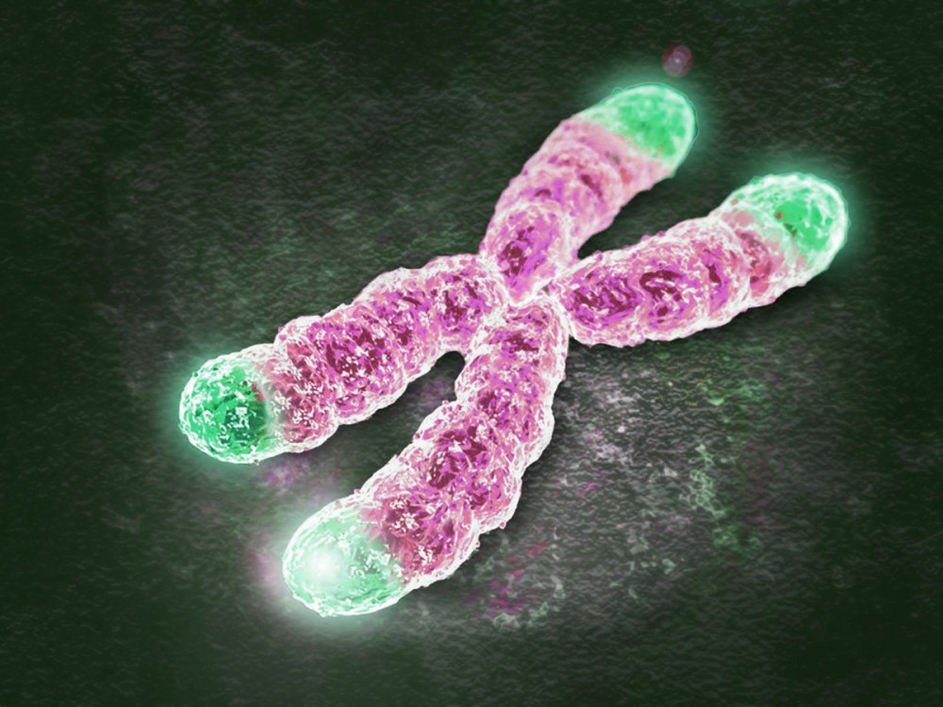
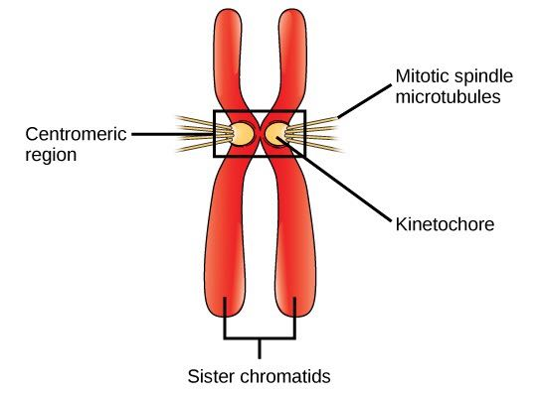
Metaphase chromosomes
*A single complete set of chromosomes. (N=23 for humans)
■ The 2 sister-chromatids
are principally held together at the centromeric region.
■ Each chromosome has a centromere (CEN),
region which contains the kinetochore.
■ CEN divides the chromosome into two arms:
the short arm (p arm) and the long arm (q arm).
■ Each arm terminates in a telomere*.
Telomeres
*which will protect the chromosome from degradation “الانحلال”.

Slide 11
Centromeric position and arm length
Satellites: are small regions on the top of a chromosome exists to classify the chromosome
The ratio of the lengths of the two arms is constant for each chromosome.
This ratio is an important parameter for chromosome identification and allows classification of chromosomes into several basic morphologic types:
i-metacentric ii-sub-metacentric iii-acrocentric
In the human karyotype chromosome pairs 13, 14, 15, 21, 22 are acrocentric.
It’s important to identify the exact place of the centromere

Slide 12
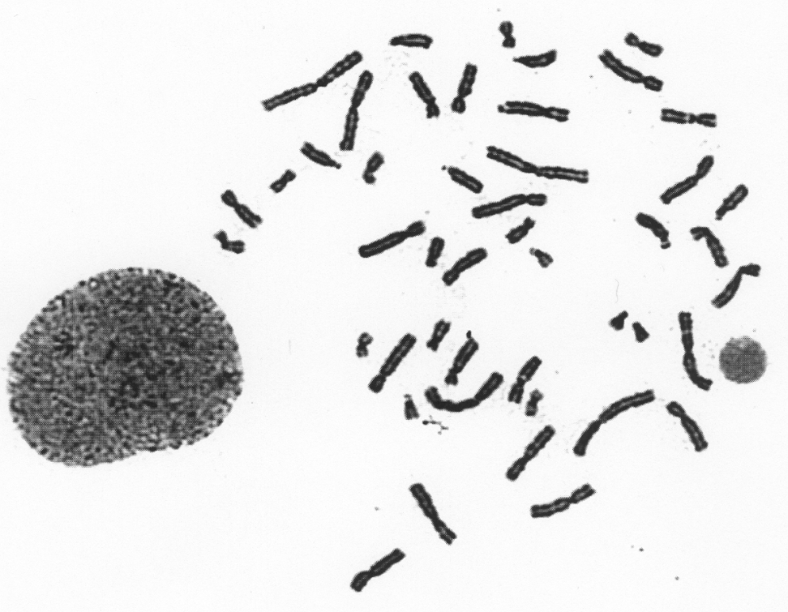
Chromosomal classification
Human chromosome
22 Pairs
of autosomes, numbered from 1 to 22 by order of decreasing length
1 Pair
of sex chromosomes:
XX in the female,
XY in the male.

Slide 13
CHROMOSOME PREPERATION FROM PERIPHERAL BLOOD
I M P O R T A N T
You must know the added chemicals and in which they arrest the cell division
اعرفوا اسمائهم وفي أي مرحلة ينحطون
Culture media contains Phytohemagglutinin to stimulate T lymphocytes to divide
These drops are colorless actually
Prevents formation of the spindle arrest cell division during metaphase
For extra information
(turn sound off please)

Slide 14
Karyotype
CULTURING
HARVESTING
SLIDE-MAKING
BANDING
STAINING
KARYOTYPING
CHROMOSOME ANALYSIS

Slide 15
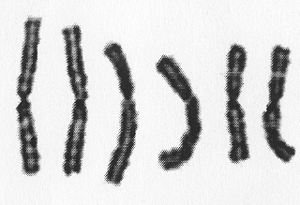
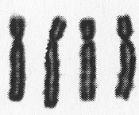
karyotyping
Items in the Description of Karyotype
■ Normal Karyotypes
46, XY
46, XX
■ Abnormal Karyotypes
47,XY,+ 21 Down Syndrome
45,X Turner Syndrome
KARYOTYPING
Is based on:
•The Length
•The position of the centromere
•The presence or absence of satellites*
A
B
C
You must know and remember the right numbers and the right order of the Normal Karyotypes.
*chromosome segment that is separated from the main body of the chromosome, can be found in some chromosomes at metaphase. used as markers that identify particular chromosomes
D
E
F
G
X

Slide 16
banding
Chromosome banding
Band resolution = estimate of number of light + dark bands per haploid set of chromosomes
400 → 850+
Certain staining techniques cause the chromosomes to take on a banded appearance,
Each arm presenting a sequence of dark and light bands.
Patterns are specific and repeatable for each chromosome*,
Allowing accurate identification and longitudinal mapping for locating gene positions and characterizing structural changes.
Patterns, and the nomenclature for defining positional mapping have been standardized.
Just like the fingerprint, every chromosome differs
from another
*So every chromosome has different dyed look.

Slide 17
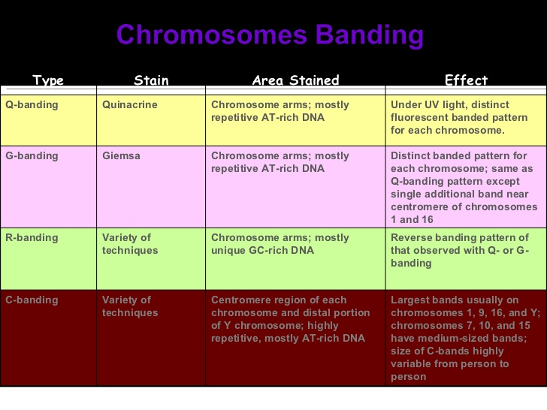
banding
Active and inactive areas in:
G-Banding
Black:
Inactive
White:
Active
R-Banding
Black:
Active
White:
Inactive
G Banding:
Treat with trypsin and then with Geimsa Stain.
R Banding:
Heat and then treat with Geimsa Stain.
Q Banding:
Treat with Quinicrine dye giving rise to fluorescent bands. It requires an ultraviolet fluorescent microscope.
C Banding:
Staining of the Centromere. Treat with acid followed by alkali prior to G banding.
*Extra information
The most important bandings are: G & R Bandings
Banded Karyotype:
Normal Banded Karyotypes
A normal G-banded
male Karyotype
A normal R-banded
male Karyotype
Sometimes we use 2 kinds of banding
R-Banding is important, and is used to locate the satellites at the distal region (because it’s black thus easy to see)
For extra information
https://www.slideshare.net/xulkifal/cytogenetics/1

Slide 18
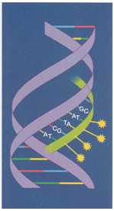
Fluorescence in-situ hybridization (fisH)
FISH of metaphase with a probe for telomere showing signals at the end of each chromatid
FISH of interphase nuclei with a chromosome 21 centromeric probe showing 3 signals consistent with trisomy 21
FISH, an acronym"اختصار" for Fluorescent In-Situ Hybridization, is a method used to detect and visualize protein, RNA, and DNA structures in the cell. FISH analysis is a relatively fast method that provides great resolution as it incorporates "تدمج" fluorescent probes labeled for detection of specific regions, deletions, and translocations.
https://www.youtube.com/watch?v=Bsnyy5JAKUE
ببساطة: هذه التقنية تُستخدم لتحديد و إظهار بروتينات أو مواد جينية أخرى، و لكنّها محدودة لإظهار جزء مرغوب معيّن، و هذه من السلبيات حيث لا نستطيع اكتشاف مرض محدد إلا بعد استخدام التقنية المحددة لهذا المرض أو هذا الجزء المرغوب.
كيف؟ هذه العملية السريعة نسبياً و تكون عن طريق دمج أعواد مضيئة مصنّفة، مع شريط واحد من الدي إن إي مثلاً؛ لتحديد: مناطق معيّنة أو مناطق حذف أو تبديل (سيتم شرح هذه المناطق في المحاضرة القادمة)
Some helping videos

Slide 19
TAKE HOME MESSAGES
The packaging of DNA into chromosomes involves several orders of DNA coiling and folding.
The normal human karyotype is made up of 46 chromosomes consisting of 22 pairs of autosomes and a pair of sex chromosomes, XX in the female, and XY in the male.
Each chromosome consists of a short (p) and a long (q) arm joined at the centromere.
Chromosomes are analyzed using cultured cells and specific banding patterns can be identified using special staining techniques.
FISH is based on the ability of a single-stranded DNA probe to anneal to its complementary target sequence. It can be used to identify and study genes on chromosomes in metaphase or interphase.

Slide 20
MCQ
https://www.onlineexambuilder.com/human-genetics-1/exam-181773
Alternative hyperlinks (if didn’t work):
Chromosomes spread (turn sound off please): https://www.youtube.com/watch?v=BUWOgY0ohos
What is Fluorescence?: https://www.youtube.com/watch?v=WnWIt0iz00A
FISH Technique animation: https://www.youtube.com/watch?time_continue=1&v=w5l5SmKvS1o

Slide 21
Team leaders: Abdulmajeed Alwardi Haifa Alessa
تمّ بحمدِ الله
GIRLS TEAM:
Ghaida Alsanad
Munira Alhadlg
Batoul Alruhaimi
Dimah Alaraifi
Fatimah Albassam
Arjuwana Alaqeel
BOYS TEAM:
Abdullah Alzahrani
Abdulaziz Aljohani
Adel Alzahrani
Hamdan Aldossri
Rakan Alsalhi
نسعدُ باستقبالِ اقتراحاتكم و ملاحظاتكم على البريد الإلكتروني:
GeneticsTeam437@gmail.com

