Slide 1
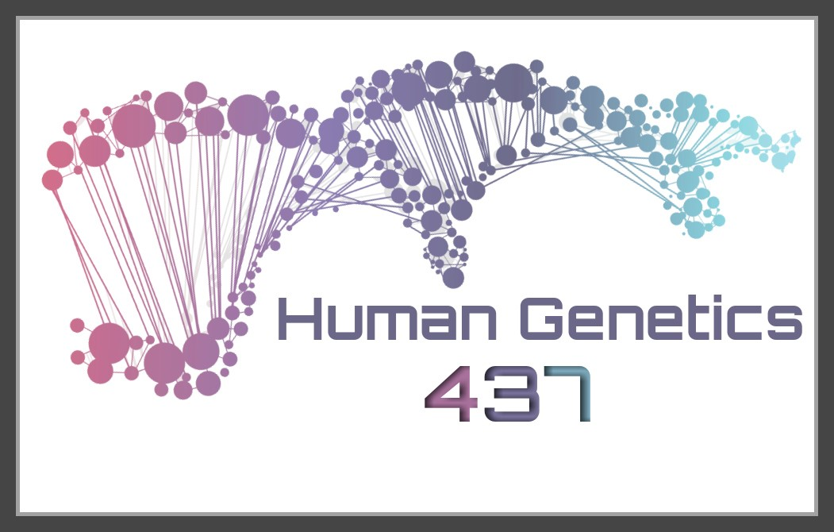
HUMAN GENETICS
Color index:
Important
Slides
Drs’ notes
Explanation
New terminology
LECTURE 2: Chromosomal anomalies
EDITION FILE

Slide 2
OBJECTIVES
By the end of this lecture, the students should be able to:
Describe and explain the events in mitosis & meiosis.
Define non-disjunction and describe its consequences on meiosis.
Classify chromosomal abnormalities: Numerical & structural
- 3a Understand the common numerical autosomal disorders: trisomies 21, 13, 18.
- 3b Understand the common numerical sex chromosome disorders: Turner`s & Klinefelter`s syndromes
- 3c Recognize the main structural anomalies in chromosomes

Slide 3
Mitosis & Meiosis: Typical mitotic cell cycle
Objective 1: Describe and explain the events in mitosis & meiosis.
one diploid | During G1
duplication of each chromosome’s DNA → Two sister chromatids | S phase S= synthesis of DNA
chromosomes begin to condense and become visible | G2 Phase
G1, S, and G2 phases = constitute interphase Interphase > “preparation for mitosis”
• Cell cycle (G1 → S → G2 → M)
Two daughter cells = equal genetic information
The result is two diploid daughter cells with identical genetic information

Slide 4
Events of mitosis
Objective 1: Describe and explain the events in mitosis & meiosis.
Prophase.
- formation of mitotic Spindle & pair of centrosomes
Prometaphase.
- Nuclear membrane dissolves
- Chromosomes to disperse & attach by kinetochores to mitotic spindle microtubules
Metaphase.
Chromosomes condensed & line up at the equatorial plane
Anaphase.
- Chromosomes separate at centromere &
- Sister chromatids of each chromosome become independent daughter chromosomes
Telophase.
- Chromosomes de-condense from their highly contracted state,
- Nuclear membrane re-form around each of the two daughter nuclei.
- Division of the cytoplasm
- resume their interphase

Slide 5
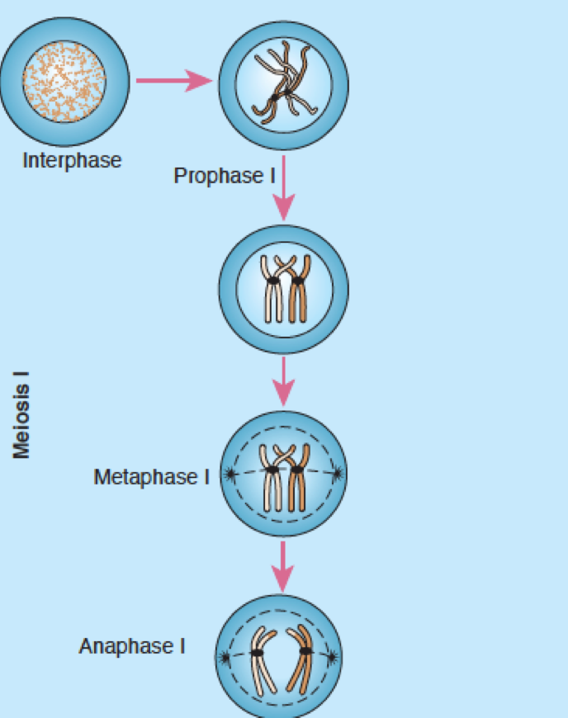
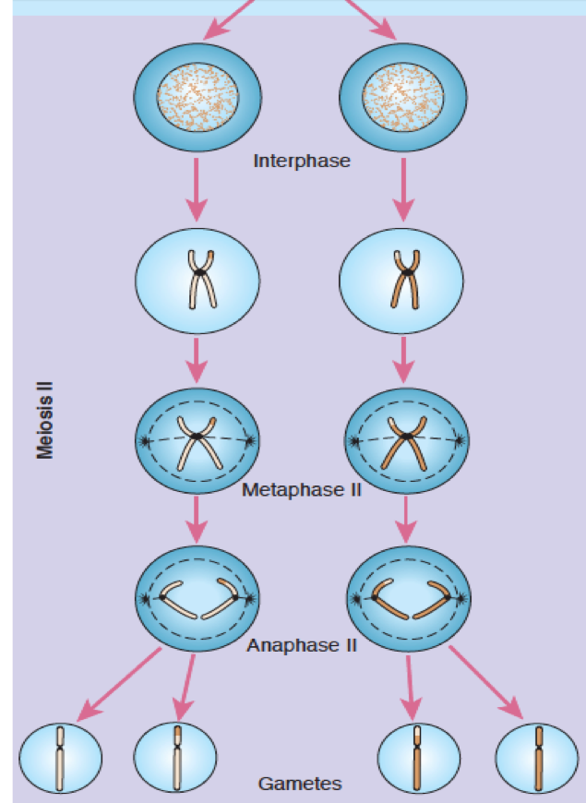
Events of meiosis I & II
Objective 1: Describe and explain the events in mitosis & meiosis.
Events of meiosis
Consists of tow successive nuclear division
In the first nuclear division the homologous chromosomes are separated from each other (daughter chromosomes consists of two chromatids )
The second nuclear division resembles a mitotic division but there is no DNA replication (already replicated before the first division )
The result is four haploid daughter cells
Note that the anaphase occurs once in mitosis and twice in meiosis

Slide 6
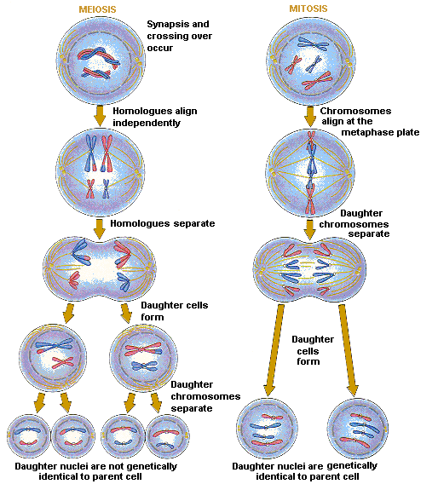
Objective 1: Describe and explain the events in mitosis & meiosis.
Meiosis Vs. Mitosis
Normal Gametes → 4 Haploids

Slide 7
Objective 1: Describe and explain the events in mitosis & meiosis.
Meiosis

Slide 8
Non-disjunction in Meiosis
Objective 2: Non-disjunction and its impact on meiosis.
- The failure of chromosomes to disjoin normally during meiosis phase 1 or phase 2.
- Two chromosome homologs migrate to the same daughter cell instead of disjoining normally and migrating to different daughter cells.
- The result of this error is a cell with an imbalance of chromosomes (Aneuploidy)
Can affect each pair of chromosomes
is not a rare event
Non disjunction in first meiotic division produces 4 unbalanced gametes.
Non disjunction in second division produces 2 normal gametes & 2 unbalanced gametes:
Gamete with an extra autosome
Nullosomic gamete (missing one chromosome)
A normal disjunction in first meiotic division produces 4 balanced gametes

Slide 9
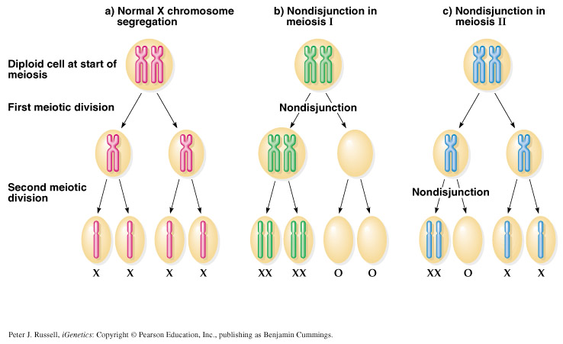
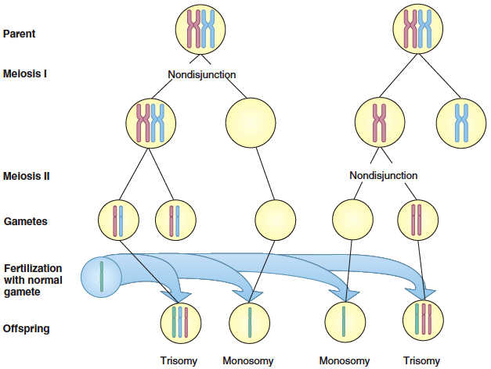
Objective 2: Non-disjunction and its impact on meiosis.
In meiotic nondisjunction
- This product of fertilization with normal gamete would be monosomic and trisomic offspring (Aneuploidy)
Presence of an abnormal number of chromosomes in a cell

Slide 10
CHROMOSOME ANOMALIES
Objective 3: Classifications of chromosomal abnormalities
الخريطة غير موجودة بالمحاضرة ولكن للتوضيح وتسهيل الفهم والربط
CHROMOSOME ANOMALIES
Structural
Numerical
Sex chromosomes
autosomes
Reciprocal translocation
Robertsonian translocation
Deletion
Inversion
Isochromosome
Ring formation
Affect the structure and organization of genomic content of the chromosome
affect the number of complete haploid set (n) of chromosomes
- Turner’s syndrome
- Klinefelter Syndrome
- Down syndrome
- Edward's syndrome
- Patau Syndrome
- In structural
The structure of the chromosome has been affected
- In numerical
Excess or loss of the chromosome

Slide 11
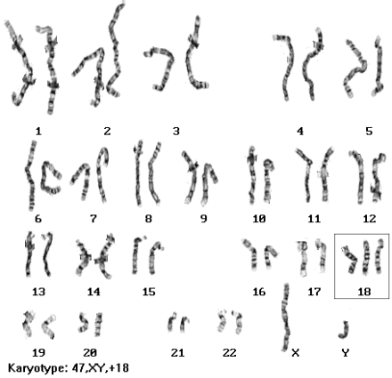
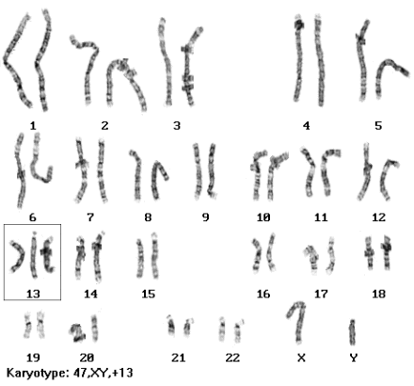
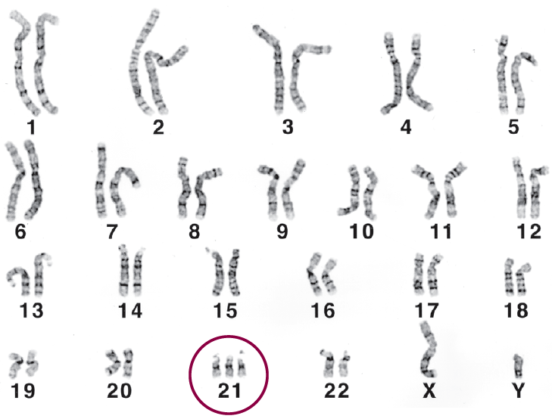
Objective 3a: Understand the common numerical autosomal disorders: trisomies 21, 13, 18
NUMERICAL CHROMOSOMAL ANOMALIES
"Numerical anomalies in autosomes"
Patau syndrome, Trisomy 13 Karyotype: 47, XY, +13 | Edward's syndrome, Trisomy 18 Karyotype: 47, XY, +18 | Down syndrome, Trisomy 21 Karyotype: 47, XY, +21
Most cases arise from non-disjunction in the first meiotic division.
The incidence of trisomy 21 rises
sharply with increasing maternal age.
The father contributing the extra chromosome in 15% of cases.
The symptoms include characteristic facial dysmorphologies, and an IQ of less than 50.
the second most common autosomal trisomy, after Down syndrome.
It occurs in around one in 6,000 live births.
Most babies die in the first year and many within the first month & has a very low rate of survival.
Common anomalies are heart abnormalities, kidney malformations, and other internal organ disorders.
There are multiple dysmorphic features.
Most cases, as in Patau syndrome, involve maternal non-disjunction.
50 % of these babies die within the first month and very few survive beyond the first year.
The genomic content on chromosome 13
is very critic, so this syndrome is less
popular than trisomy +21.
The maternal age of the ovum is the determinant of this abnormality.

Slide 12
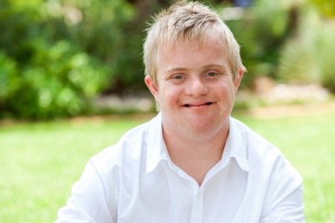
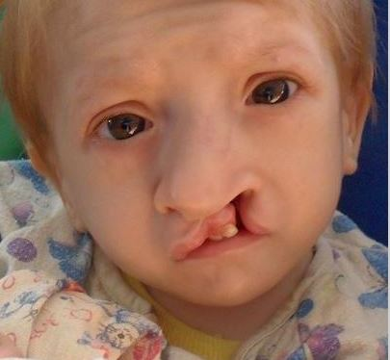
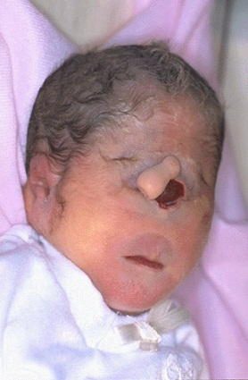
Objective 3a: Understand the common numerical autosomal disorders: trisomies 21, 13, 18
NUMERICAL CHROMOSOMAL ANOMALIES
"Numerical anomalies in autosomes"
Down syndrome, Trisomy 21
Edward's syndrome, Trisomy 18
Patau syndrome, Trisomy 13

Slide 13
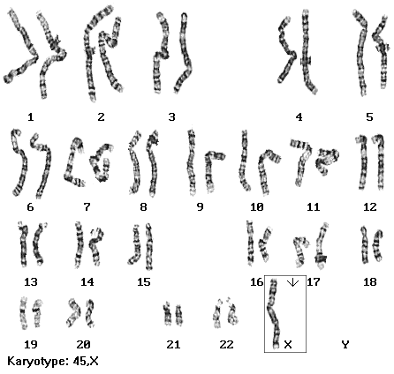
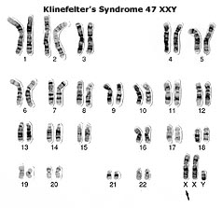
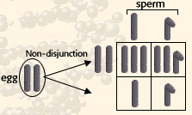
Objective 3b: Understand the common numerical sex chromosome disorders: Turner`s & Klinefelter`s syndromes
NUMERICAL CHROMOSOMAL ANOMALIES
"Numerical anomalies in Sex chromosomes "
Turner’s syndrome (Monosomy X (أحادي الصبغة
Karyotype: 45,XO, females
Klinefelter Syndrome
Karyotype: 47,XXY males
Occurring in 1 in 4000 phenotypic females.
As a result of paternal meiotic nondisjunction.
The only viable"قابل للحياة" monosomy in humans.
Characteristics: Webbed"قصيرة وعريضة" neck, Individuals are genetically female, not mature sexually, Sterile"عقيم", Short stature"قصير القامة", Broad chest, Low hairline, Streak ovaries, Normal intelligence, Normal life span.
1/600 males, due to nondisjunction of X chromosomes during meiosis I in females. (maternal)
Male sex organs; unusually small testes which fail to produce normal levels of testosterone→ breast enlargement (gynaecomastia "تثدي الرجل") and other feminine body characteristic.
Patients are taller and thinner than average and may have a slight reduction in IQ but generally they have normal intelligence.
No spermatogenesis → sterile
The dominant of this abnormality is the paternal genetic material(most of the time), so it may be maternal sometimes.
This one is caused by the mother.
فقط موجود
Xكروموسوم

Slide 14
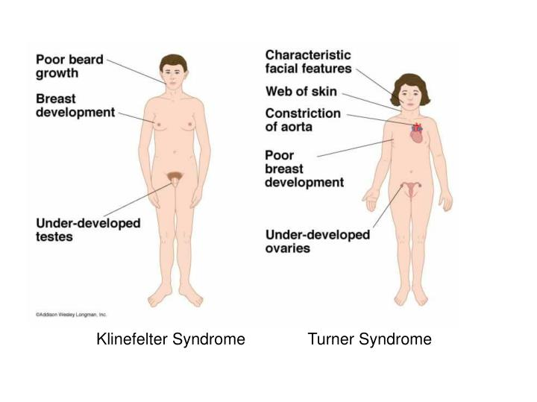
Objective 3b: Understand the common numerical sex chromosome disorders: Turner`s & Klinefelter`s syndromes
NUMERICAL CHROMOSOMAL ANOMALIES
"Numerical anomalies in Sex chromosomes "
*ممكن يعطونك الكاريو تايب و يسألونك عن أي أبنورمال أو العكس، يعني يعطونك السيندروم و يقولون لك اختر الكاريوتايب تبع هذا السيندروم.
او ما الطرف المسبب للأبنورمالِتي الفلاني ؟ (الام او الاب)

Slide 15
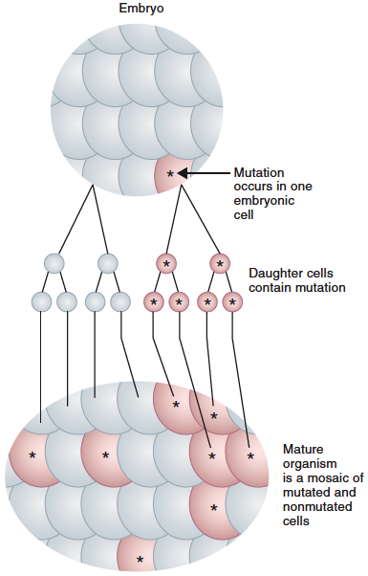
Objective 3: Classify chromosomal abnormalities: Numerical
MOSAICISM
The presence of more than one genetically distinct cell line in the body.
A mosaic individual is made of 2 (or more) cell populations, coming from only 1 zygote.
Is denoted by a slash between the various clones observed "كيف يكتب الكاريوتايب" e.g.(46, XY / 47, XY, +21).
Numerical mosaic anomaly is usually due to a mitotic non-disjunction.
A mosaic must not be confused with a chimeras.
Chimerism is the presence in an individual of two or more genetically distinct cell lines derive from more than one zygote (e.g. 2 sperms fertilize 2 ova → 2 zygotes that fuse to form 1 embryo.)
What’s the difference between mosaicism and the chimerism?
This abnormality (mosaicism) well develop after fertilization as a non-disjunction abnormality in the zygote. While in chimerism there’s two normal zygotes are fused together.
Chimerism isn’t important for us (in exam) but it’s mentioned to let us know the deference between them.

Slide 16
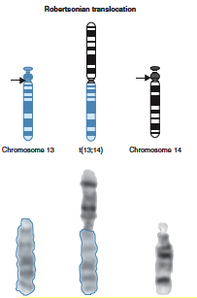
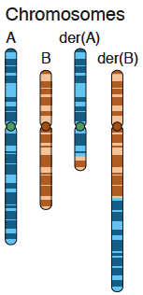
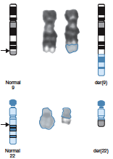
Objective 3c: Recognize the main structural anomalies in chromosomes
STRUCTURAL CHROMOSOMAL ANOMALIES “Translocation”
• Robertsonian translocation | • Reciprocal translocation
- Short arms of two non homologous chromosomes are lost and the long arms fuse at the centromere to form a single chromosome - Confined to the acrocentric chromosomes(13, 14, 15, 21, and 22) Although carriers have only 45 chromosomes in each cell, they are phenotypically unaffected | - Reciprocal translocation between chromosome 22 and the long arm of chromosome 9 (the Philadelphia chromosome). - The occurrence of this translocation in hematopoietic cells can produce chronic myelogenous leukemia (CML)

Slide 17
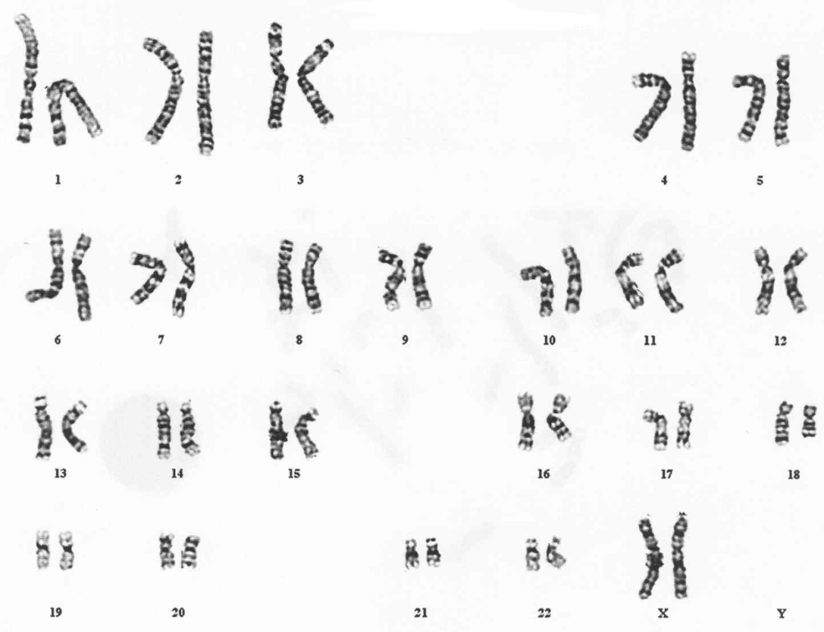
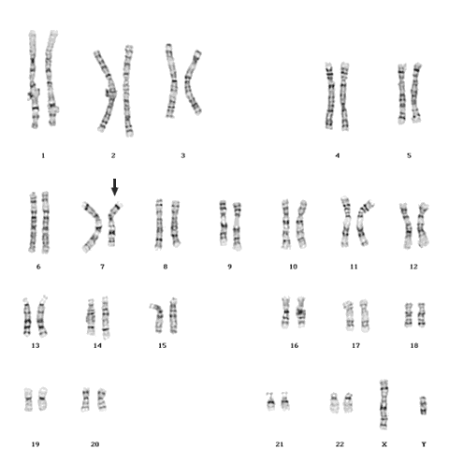
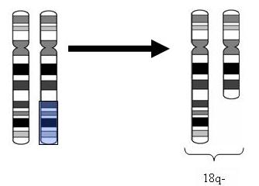
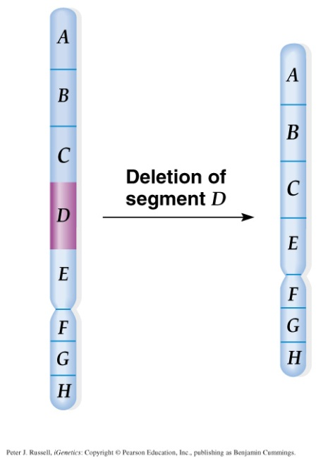
Objective 3c: Recognize the main structural anomalies in chromosomes
3c Recognize the main structural anomalies in chromosomes
STRUCTURAL CHROMOSOMAL ANOMALIES “Deletion”
Interstitial deletion | Terminal deletion
Deletion
• Loss of a segment from a chromosome, either terminal or interstitial
• Invariably, but not always, results in the loss of important genetic material
• Deletion is therefore an unbalanced rearrangement.
• Indicated in nomenclature del
Sample karyogram of Terminal deletion
Sample karyogram of Interstitial deletion
⬇
⬇
46,XX,del(18)(q21.3)
46,XY,del(7)(q11.23q21.2)
karyotype description is as follows:
- 46: the total number of chromosomes.
- XY: the sex chromosomes (male).
- del(7): deletion in chromosome 7.
- (q11.23q21.2): breakpoints of the deleted segment.

Slide 18
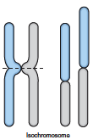
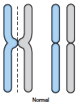
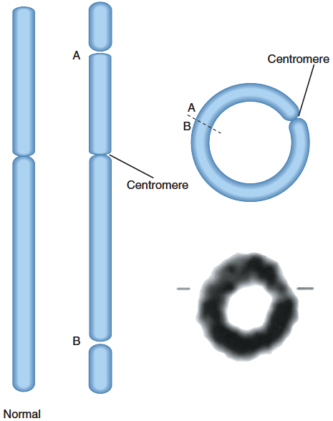
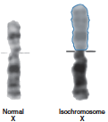
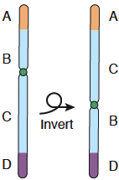
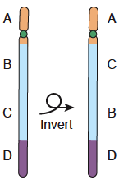
Objective 3c: Recognize the main structural anomalies in chromosomes
3c Recognize the main structural anomalies in chromosomes
STRUCTURAL CHROMOSOMAL ANOMALIES “Inversion, isochromosome, and ring chromosome ”
• Ring formation(Ring chromosome) | • Isochromosome | • Inversion
- A break on each arm of a chromosome - Two sticky ends - Reunion of the ends as a ring loss of the 2 distal chromosomal fragments - Ring chromosomes are often unstable in mitosis | The most probable explanation for isochromosome is that the centromere has divided transversely rather than longitudinally | - Occurs when a segment of chromosome breaks, and rejoining within the chromosome effectively. - Written in nomenclature as inv. - Only large inversions are normally detected. They are balance rearrangements that rarely cause problems in carriers
Normal
Isochromosome
Pericentric
Paracentric
Normal
Isochromosome

Slide 19
TAKE HOME MESSAGES
• Chromosome abnormalities can be numerical or structural.
• Normal meiotic division result in four haploid gametes
• In trisomy, a single extra chromosome is present, usually as a result of non-disjunction in the 1st or 2nd meiotic division.
• Mosaicism arise from one zygote while Chimera from the fusion of two fertilized eggs
• Structural abnormalities include translocations (balanced or unbalanced), inversions, deletions, isochromosome & rings.

Slide 20
MCQ
1- During which phase of the cell cycle DNA is replicated?
A- G1
B- S
C- G2
D- none of the above
2- Nuclear membrane dissolves at…
A- Prophase
B- Telophase
C- Metaphase
D- Prometaphase
3- Non disjunction in second division produces…
A- 2 unbalanced gametes
B- 2 normal gametes
C- 2 unbalanced gametes and 2 normal gametes
D- 4 unbalanced gametes
4- Which syndrome is known as Trisomy 18?
A- Down Syndrome
B- Patau Syndrome
C- Edward Syndrome
D- Klinefelter Syndrome
5- Fail to produce normal levels of testosterone is a characteristic of
A- Turnur’s Syndrome
B- Klinefelter Syndrome
C- Edward Syndrome
D- Patau Syndrome
6- Which of the following chromosome abnormalities is known as
Turner Syndrome?
A- 47, XXY
B- 44, XO
C- Trisomy 18
D- Trisomy 21

Slide 21
MCQ
9 - Presence of an abnormal number of chromosomes in
a cell known as
A- Aneuploidy
B- Mosaicism
C- Chimerism
D- None of the above
10- ……… is a result of maternal non-disjunction.
A- Turner’s Syndrome
B- Klinefelter Syndrome
C- Edward Syndrome
D- none of the above
11- Meiosis result in
A- 2 haploid daughter cells
B- 2 diploid daughter cells
C- 4 haploid daughter cells
D- 4 diploid daughter cells
7- Occurs when a segment of chromosome breaks,
and rejoining within the chromosome effectively:
A- Inversion
B- Isochromosome
C- Ring Formation
D- Deletion
8- Loss of a segment from a chromosome, either terminal or interstitial
A- Inversion
B- Isochromosome
C- Ring Formation
D- Deletion
1 B
2 D
3 C
4 C
5 B
6 B
7 A
8 D
9 A
10 B
11 C

Slide 22
Team leaders: Abdulmajeed Alwardi Haifa Alessa
تمّ بحمدِ الله
GIRLS TEAM:
Ghaida Alsanad
Munira Alhadlg
Batoul Alruhaimi
Dimah Alaraifi
Arjuwana Alaqeel
Marwah Alkhalil
BOYS TEAM:
Abdullah Alzahrani
Abdulaziz Aljohani
Adel Alzahrani
Hamdan Aldossri
نسعدُ باستقبالِ اقتراحاتكم و ملاحظاتكم على البريد الإلكتروني:
GeneticsTeam437@gmail.com

