Slide 1
HUMAN GENETICS
Color index:
Important
Slides
Drs’ notes
Explanation
New terminology
LECTURE : 3
Mode of inheritance
EDITION FILE

Slide 2
OBJECTIVES
By the end of this lecture, students should be able to:
Assess Mendel’s laws of inheritance.
Understand the bases of Mendelian inheritance.
Define various patterns of single gene inheritance using family pedigree and Punnett square.

Slide 3
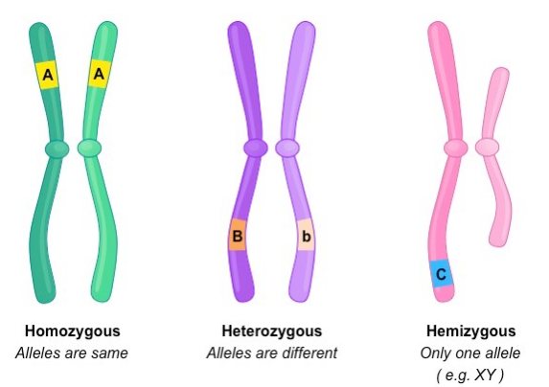
Interpreting the outcomes of Mendel’s breeding experiments:
The plant characteristics being studied were each controlled by a pair of FACTORS (allels) , one of which was inherited from each parent.
The pure-bred plants, with two identical genes, used in the initial cross.
The hybrid F1 plants, each of which has one gene for tallness and one for shortness.
The genes responsible for these contrasting characteristics are referred to as allelomorphs, or ALLELES for short.
Homozygous
Heterozygous
The same allele different alleles

Slide 4
Punnett Square
Each parent can only contribute one allele per gene.
These genes are found on the chromosomes of gametes of parents.
Offspring will inherit 2 alleles to express that gene.
A Punnett Square Can Be Used to Predict the Outcome of simple genetic crosses. A Punnett square illustrates how alleles combine in offspring, To construct a Punnett square, you must know the genotypes of the parents. With this information, the Punnett square enables you to predict the types of offspring the parents are expected to produce and in what proportions.
Allele: one of a pair of genes that appear at a particular location on a particular chromosome and control the same characteristic, such as blood type or colorblindness

Slide 5
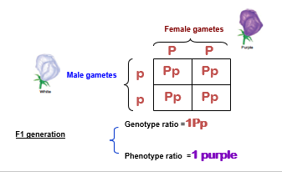
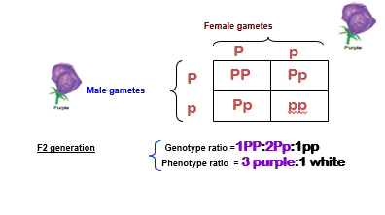
Law of Dominance or Uniformity & Law of segregation
Law of segregation | Law of Dominance or Uniformity
RECALL MENDEL’S 2nd EXPERIMENT | COMPLETE DOMINANCE - one allele is dominant to another allele. RECALL MENDEL’S 1st EXPERIMENT
CROSS: Two F1 generation offspring with each other | CROSS: Pure bred purple female x White male
P1 generation = Pp x Pp | P1 generation = PP x pp
Q1: Mixing the homozygous will result as ….?
• all heterozygous
Q2: Mixing the heterozygous will result as…..?
• half of offspring homozygous and the other half is heterozygous

Slide 6
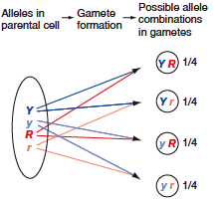
Law of independent assortment
During gamete formation, different pairs of alleles segregate independently of each other.
In a dihybrid cross, each pair of alleles assorts independently during gamete formation. In the
gametes, Y is equally likely to be found with R or r (that is, Y R = Y r ) the same is true for y
(that is, y R = y r ).
As a result, all four possible types of gametes ( Y R , Y r , y R , and y r ) are produced in equal frequency among a large population.

Slide 7
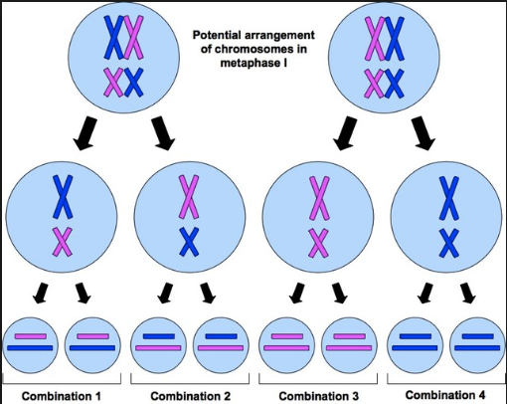
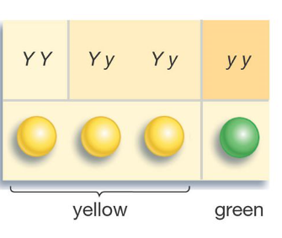
هذي السلايد للشرح فقط وليست موجودة في المحاضرة
Mendel’s law of segregation states:
The two copies of a gene segregate (or separate) from each other during transmission from parent to offspring.
Therefore, only one copy of each gene is found in a gamete. At fertilization, two gametes combine randomly, potentially producing different allelic combinations
Mendel law of dominance:
• There are recessive and dominant alleles
•In a cross of parents that are pure for contrasting traits, only one form of the trait will appear in the next generation
All offspring will be heterozygous and express only the dominant trait.
Mendel law of independent assortment :
The inheritance pattern of trait will not effect the inheritance pattern of another

Slide 8
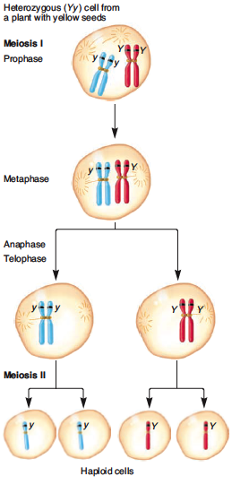
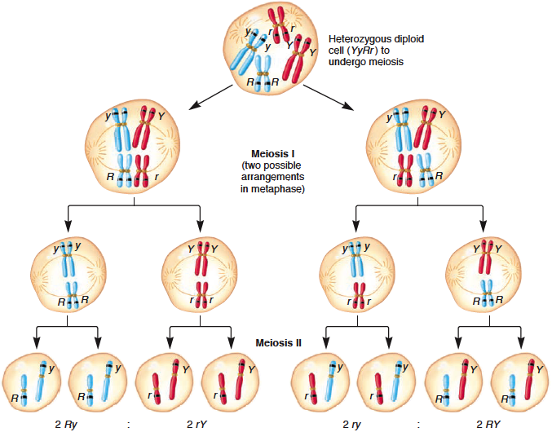
THE CHROMOSOME THEORy OF INHERITANCE AND Sex CHROMOSOMES
How chromosomal transmission is related to the patterns of inheritance observed by Mendel?
Mendel’s law of independent assortment can be explained by the random alignment of bivalents during metaphase of meiosis I | Mendel’s law of segregation can be explained by the segregation of homologs during meiosis
• The two copies of a gene are contained on homologous chromosomes.
• In this example using pea seed color, the two alleles are Y (yellow) and y (green).
• During meiosis, the homologous chromosomes segregate from each other, leading to segregation of the two alleles into separate gametes.
• This figure shows the assortment of two genes located on two different chromosomes, using pea seed color and shape as an example (YyRr).
• During metaphase of meiosis I, different possible arrangements of the homologs within bivalents can lead to different combinations of the alleles in the resulting gametes.
• For example, on the left, the dominant R allele has sorted with the recessive y allele; on the right, the dominant R allele has sorted with the dominant Y allele.

Slide 9
MODES OF INHEREITANCE FOR SINGLE GENE DISORDERS .
Important
Recessive
Recessive

Slide 10
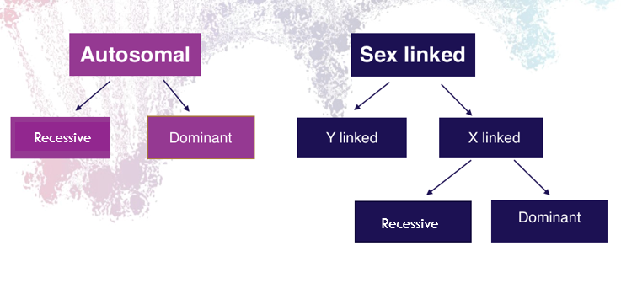
1- Autosomal dominant
Family tree of an autosomal dominant mode of inheritance
The trait (character, disease) appears in every generation.
Unaffected persons do not transmit the trait to their children.
Examples: Huntington disease, Myotonic dystrophy, Neurofibromatosis type 1, Marfan syndrome etc.
This pedigree is dominant because in EVERY generation there is effected individuals

Slide 11
2-Autosomal recessive
The trait (character, disease) is recessive
The trait expresses itself only in homozygous state
Unaffected persons (heterozygotes) may have affected children (if the other parent is heterozygote)
The parents of the affected child maybe related (consanguineous)
Males and female are equally affected
Examples: Cystic fibrosis, Phenyketonuria, Sickle cell anaemia, Thalassaemia etc.
(Family tree of an Autosomal recessive disorder
Sickle cell disease (SS )
father
S | A
AS | AA | A
SS | AS | S
mother

Slide 12
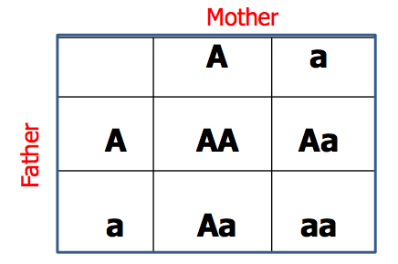
Punnett square showing autosomal recessive
1-) Both Parents Heterozygous:
• 25% offspring “affected Homozygous”
• 50% Trait “Heterozygous normal but carrier”
• 25% Normal
2-) One Parents Heterozygous:
• 50% normal but carrier
“heterozygous”
• 50% normal
3-) One Parents Homozygous:
• 100% offspring is carriers.

Slide 13
Sex- linked inheritance
This is the inheritance of a gene present on the sex chromosomes.
The Inheritance Pattern is different from the autosomal inheritance.
Inheritance differs in males from females.

Slide 14
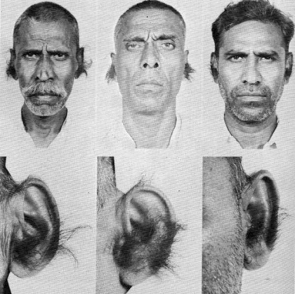
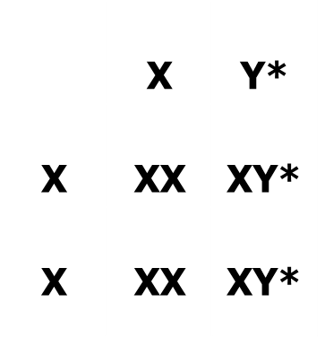
X-linked: • The gene is present on the X chromosome and the inheritance follows specific pattern. • Males have one X chromosome, and are hemizygous. Females have 2 X chromosomes, • they may be homozygous or heterozygous. |  | Y-linked
X-linked Dominant Inheritance: • The gene is on X Chromosome and is dominant. • The trait occurs at the same frequency in both males and females. Because both genders have X chromosome • Hemizygous male and heterozygous females express the disease. | X-linked Recessive Inheritance : • The incidence of the X-linked disease is higher in male than in female. Because males have only one X chromosome, so they can’t be healthy carriers, either effected or healthy. • The trait is passed from an affected man through all his daughters to half their sons. • The trait is never transmitted directly from father to sons. Because the father passes only his Y chromosome to all his sons, so he can’t pass the mutation to them. • An affected women has affected sons and carrier daughters. X - Linked Recessive Disorders: Albinism, Fragile X syndrome, Hemophilia, Muscular dystrophy, Retinitis pigmentosa. | • The gene is on the Y chromosomes • The gene is passed from fathers to sons only • Daughters are not affected Example :Hairy ears in India Male are Hemizygous, the condition exhibits itself whether dominant or recessive
Father
Mother

Slide 15
X – Linked Recessive Inheritance
(3) Homozygous female, normal male:
- All daughters carriers.
- All sons affected.
X* | X*
X*X | X*X | X
X*Y | X*Y | Y

Slide 16
X – Linked dominant Inheritance

Slide 17
Take home message:
An accurate determination of the family pedigree is an important part of the workup of every patient
Pedigrees for single-gene disorders may demonstrate a straightforward, typical mendelian inheritance pattern
These patterns depend on location of the gene locus on the chromosomal, which may be autosomal or sex chromosome-linked, and whether the phenotype is dominant or recessive

Slide 18
MCQ
1-the pure-bred plants, with two identical genes, Used in the initial cross would now
be referred To as: A. Homozygous B. Heterozygous C. Genetic twin 2-a person with these alleles ( TT ) is known to be: A. Homozygous recessive B. Homozygous dominant C. Heterozygous 3-the physical expression of a character is called: A. Phenotype B. Morphology C. Genotype
4-A trait or disorder determined by a gene on one of the sex chromosomes is said to be: a-autosomal inheritance b-recessive inheritance c-sex-linked inheritance 5-an individual inherits .... allele for each gene (character) A. 2 b. 3 c. 4
1- A
2-B
3- A
4- C
5- A

Slide 19
Team leaders: Abdulmajeed Alwardi Haifa Alessa
تمّ بحمدِ الله
GIRLS TEAM:
Ghaida Alsanad
Munira Alhadlg
Batoul Alruhaimi
Dimah Alaraifi
Arjuwana Alaqeel
Marwah Alkhalil
BOYS TEAM:
Abdullah Alzahrani
Abdulaziz Aljohani
Adel Alzahrani
Hamdan Aldossri
Khaled Aldosari
نسعدُ باستقبالِ اقتراحاتكم و ملاحظاتكم على البريد الإلكتروني:
GeneticsTeam437@gmail.com

