Slide 1
HUMAN GENETICS
Color index:
Important
Slides
Drs’ notes
Extra information
LECTURE 4
Atypical Mode of Inheritance
EDITION FILE

Slide 2
Objectives
By the end of this lecture, the students should be understand atypical patterns of inheritance with special emphasis on:
Codominant traits
Pseudodominant inheritance
The mitochondrial inheritance
Anticipation
Pleiotropy
Variable expressivity
New mutation
Complex trait: multifactorial/Polygenic
Non-Mendelian Genetics
we suggest you to watch this. It’d be helpful

Slide 3
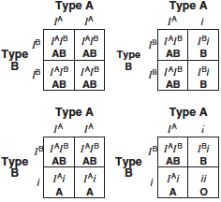
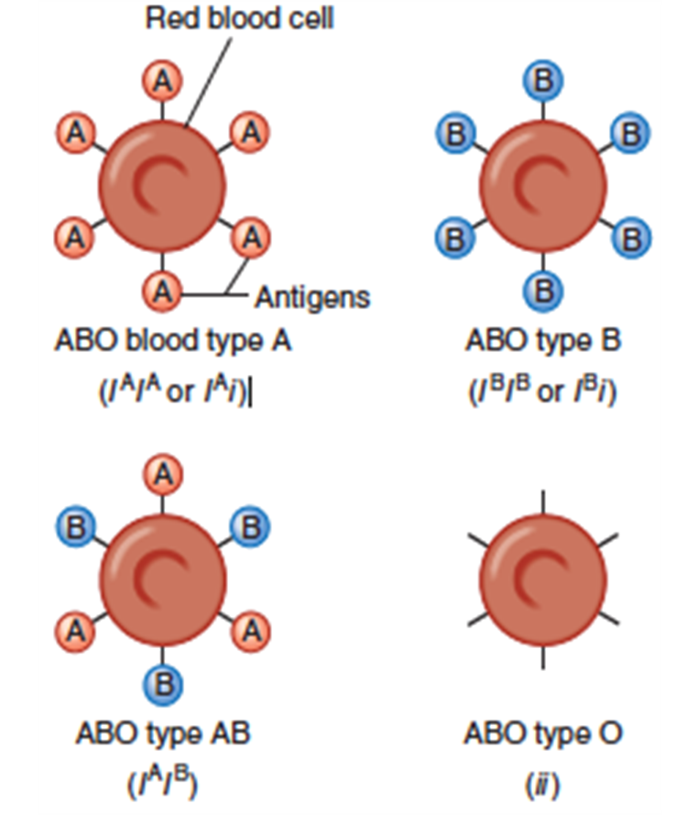
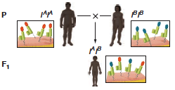
Codominant traits
Codominance Inheritance
- This pattern occurs when the heterozygote expresses both alleles simultaneously without forming an intermediate phenotype*.
For example,
in blood typing, an individual carrying the A and B alleles has an AB blood type.
- most genes exist in multiple alleles
Alleles of the ABO Blood Group Can Be Dominant, Recessive, or Codominant
*Both are dominant Both will occur.
e.g. Mother with blue eyes + Father with green eyes (both are dominant)
The child will have 1 green eye and 1 blue eye
Co-dominance Inheritance
Inheritance of Blood type

Slide 4
Possible genotypes, phenotypes & gametes formed from the four alleles: A1, A2, B, & O at the ABO locus
Genotype | Phenotype | Gamete
A1A1 | A1 | A1
A2A2 | A2 | A2
BB | B | B
OO | O | O
A1A2 | A1 | A1 or A2
A1B | A1B | A1 or B
A1O | A1 | A1 or O
A2B | A2B | A2 or B
A2O | A2 | A2 or O
BO | B | B or O
Read

Slide 5
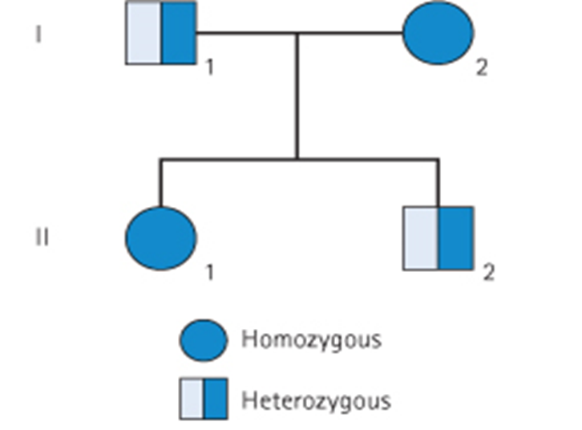
Pseudodominance inheritance
A Pedigree of
Pseudodominance inheritance
A woman homozygous for an autosomal recessive disorder whose husband is heterozygous for the same disorder.
Their children have a 1 in 2 (50%) chance of being affected (homozygous ) i.e. pseudodominant
is the situation in which the inheritance of a recessive* trait mimics "يقلّد"a dominant pattern.
It’s not dominant but it acts as it is.
*One copy of the gene but this copy is enough to show affected person

Slide 6
Atypical inheritance of single-gene disorders
What are the situations in which the inheritance of single-gene disorders diverges from typical mendelian patterns ?
Maternal inheritance of mitochondrial mutations
Anticipation
Atypical presentation for Autosomal Dominant defects:
Pleiotropy
Variable expressivity
Reduced penetrance
New mutation
Unusual inheritance patterns due to Genomic Imprinting
Mosaicism:
Somatic mosaicism
Germline mosaicism
The doctor has removed this one

Slide 7
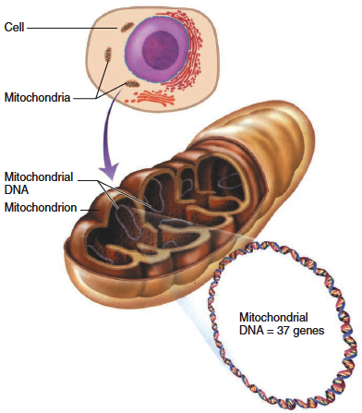
Mitochondrial inheritance
Homoplasmy vs. heteroplasmy
Homoplasmy = normally the mtDNA from different mitochondria is almost identical.
Heteroplasmy = the presence of two populations of mtDNA in a cell; the normal mtDNA & the mutant mtDNA.
The proportion of mutant mtDNA varies between cells & tissues
a range of phenotypic severity in mitochondrial inheritance.
Each cell contains thousands of copies of mitochondrial DNA with more being found in cells having high energy requirement (e.g. brain & muscle)
Mitochondria (& their DNA) are inherited from the mother (through ova)
mtDNA is a small circular double-stranded molecule containing 37 genes (coding for rRNA, tRNA, and some of the proteins of the mitochondrial electron transport chain)
Mitochondria contains genetic material, and it is circular DNA or chromosome

Slide 8
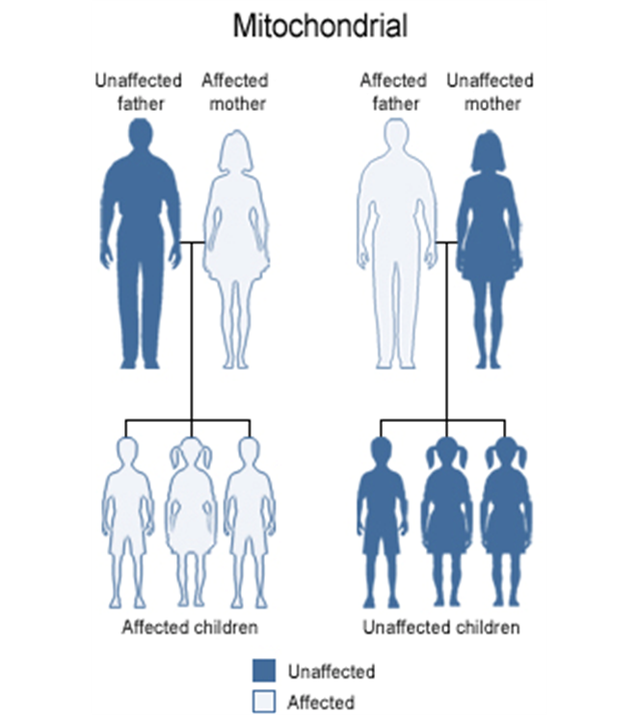
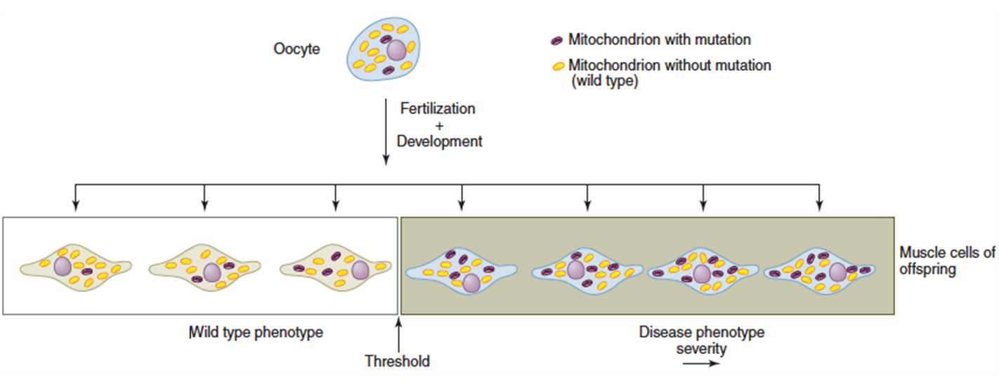
mitochondrial inheritance
Males do not transmit the disease as the cytoplasm is inherited only from the mother since the mitochondria are present in the cytoplasm.
The phenotype reflects the proportion of mitochondria bearing the mutation.
Cells have many mitochondria. If an oocyte is heteroplasmic, differing numbers of copies of a mitochondrial mutation may be transmitted.
Typical Example of Mitochondrial Disorders:
Leber hereditary optic neuropathy (LHON):
Mitochondria and their genes are passed only from the mother.
Rapid Optic nerve death → blindness in young adult life
Mitochondrial Inheritance
Mitochondrial Disease
The presence of 3 or less mutations in the mitochondria will not cause abnormality.
The presence of more than 3 mutations in the mitochondria will cause abnormality, And the more mutations the more severe is the abnormality

Slide 9
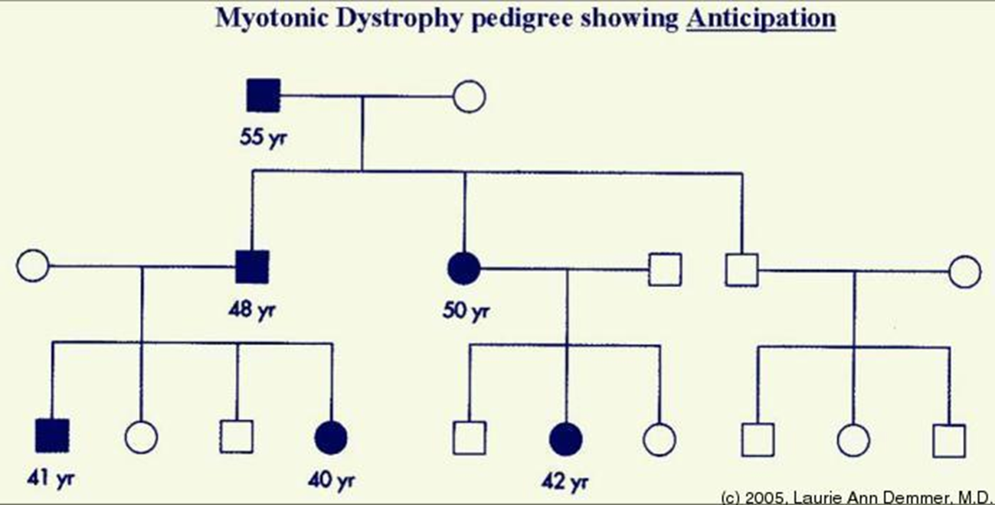
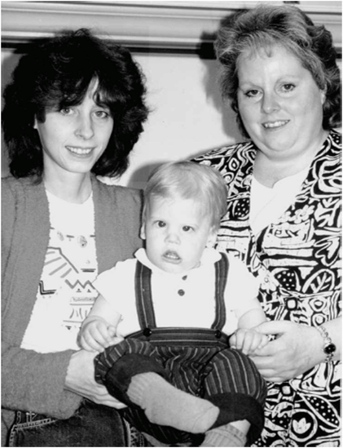
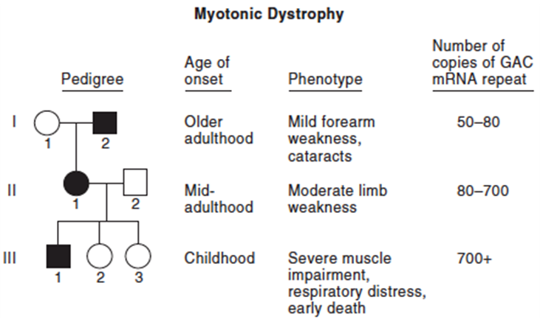
anticipation
Pedigree analysis for Myotonic dystrophy
A pattern of inheritance in which individuals in the most recent generations of a pedigree develop a disease at an earlier age or with greater severity than do those in earlier generation.
The reason might be the gradual expansion of trinucleotide repeat polymorphisms within or near a coding gene
Examples of diseases showing anticipation:
Huntington disease
Myotonic dystrophy
IMPORTANT
Myotonic dystrophy
*e.g. the grandmother had hypothyroidism at 60
The mother had the disease at 40
She get the disease at 30
So, in each generation the disease starts at earlier age
Huntington Disease
Severity increases as the number of GAC mRNA repeat increase
if this pedigree is without age, it will be “Autosomal dominant”
If it is with age
Then it will be “Autosomal dominant with anticipation”

Slide 10
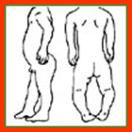
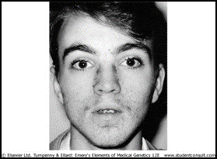
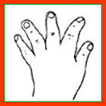
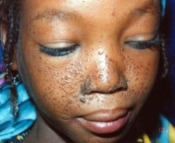
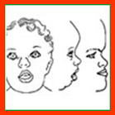
In autosomal dominant disorders; an affected person will usually have an affected parent.
However, this is not always the case and it is not unusual for a trait to appear in an individual when there is no family history of the disorder.
The sudden unexpected appearance of a condition arising as a result of a mistake occurring in the transmission of a gene is called a new mutation.
Appears suddenly
Pleiotropy
NEW mutations
One gene will cause multiple abnormalities
A single-gene disorder with many symptoms, or a gene that controls several functions or has more than one effect, is termed pleiotropic.
Causes autosomal dominant disorders
Example:
Tuberous sclerosis
affected individuals can present with either learning difficulties, Epilepsy, facial rashes , or all features
Important
An example of New Mutations
Achondroplasia
Pleiotropy
Achondroplasia
A form of short-limbed dwarfism, in which the parents usually have normal stature
Diagnosis/testing:
Molecular genetic tests: mutation in the FGFR3 gene on chromosome 4p16.3 (coding for fibroblast growth factor receptor 3)
The offspring of persons with Achondroplasia had a 50% chance of having Achondroplasia
What other possible explanations for the 'sudden' appearance of this disorder?
non-penetrance: One of the parents might be heterozygous for the mutant allele but so mildly affected that it has not previously been detected
Variable expressivity
the family relationships not being as stated, e.g. non-paternity
Characteristic clinical and radiographic finding

Slide 11
Variable expressivity
Penetrance & Expressivity
Reduced penetrance
Variable Expressivity & Incomplete Penetrance
The clinical features in autosomal dominant disorders can show striking variation from person to person, even in the same family.
Example:
Autosomal dominant polycystic kidney disease
Some affected individuals develop renal failure in early adulthood
Others have just a few renal cysts that do not significantly affect renal function
In some individuals heterozygous for gene mutations giving rise to certain autosomal dominant disorders there may be no abnormal clinical features, representing so-called reduced penetrance or 'skipping a generation’
Reduced penetrance might be due to:
modifying effects of other genes
interaction of the gene with environmental factors

Slide 12
Pedigree of a family with retinitis pigmentosa due to digenic inheritance
Complex traits
Complex Vs Mendelian traits
Complex traits are conditions which are likely to be due to the interaction of more than one gene.
The effects may be additive, one may be rate-limiting over the action of another, or one may enhance or multiply the effect of another.
e.g. Digenic inheritance: where a disorder has been shown to be due to the additive effects of heterozygous mutations at two different gene loci
In man one form of retinitis pigmentosa, a disorder of progressive visual impairment, is caused by double heterozygosity for mutations in two unlinked genes, which both encode proteins present in photoreceptors. Individuals with only one of these mutations are not affected.
Human characteristics such as height, skin color and intelligence could be determined by the interaction of many genes, each exerting a small additive effect.
This model of quantitative inheritance can explain the pattern of inheritance for many relatively common conditions including
congenital malformations such as:
late-onset conditions such as:
Hypertension, Diabetes mellitus, Alzheimer disease.
The prevailing view is that genes at several loci interact to generate a susceptibility to the effects of adverse environmental trigger factors.
cleft lip and palate

Slide 13
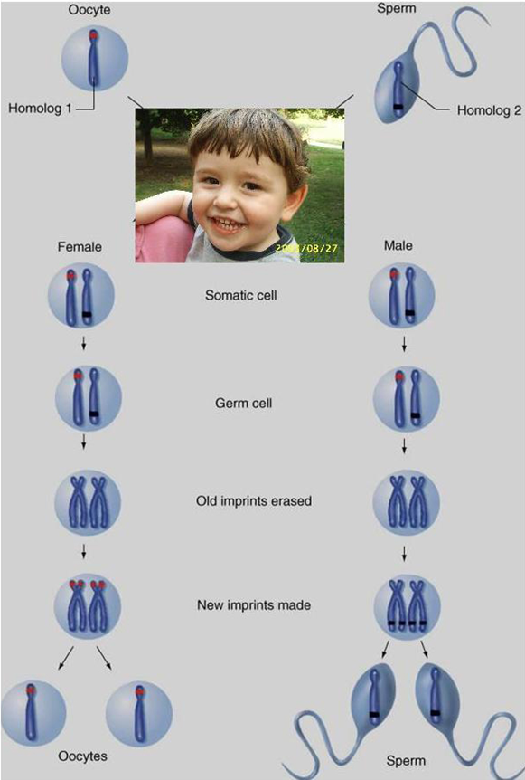
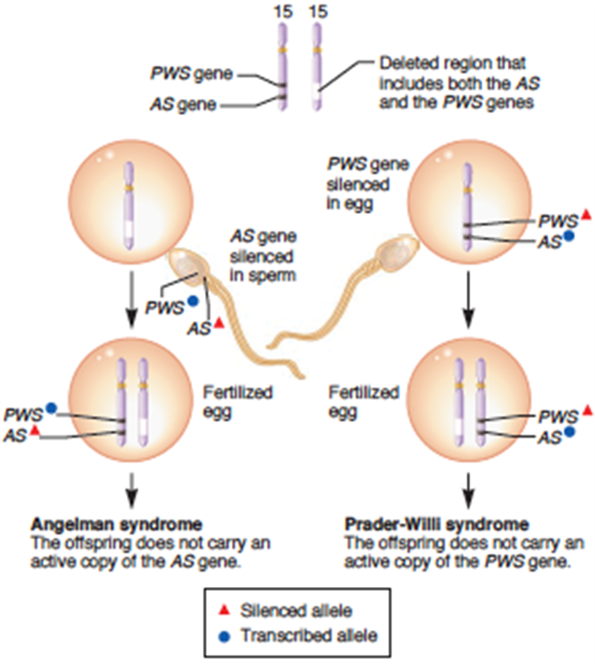
Genomic imprinting
The role of imprinting in the development of Angelman and Prader-Willi syndromes
An example of Non-Mendelian Inheritance
Certain chromosomes retain a memory or “imprint” of parental origin that influences whether genes are expressed or not during gametogenesis
Genomic Imprinting
A small region on chromosome 15 contains two different genes designated the AS gene and PWS gene in this figure.
If a chromosome 15 deletion is inherited from the mother, Angelman syndrome occurs because the offspring does not inherit an active copy of the AS gene (left).
Alternatively, the chromosome 15 deletion may be inherited from the father, leading to Prader-Willi syndrome. The phenotype of this syndrome occurs because the offspring does not inherit an active copy of the PWS gene (right).
Imprinting & Prader-Willi Vs. Angelman syndromes

Slide 14
Take home Messages:
An accurate determination of the family pedigree is an important part of the workup of every patient.
Exceptions to Mendelian inheritance do occur in single-gene disorders.
The inheritance pattern of an individual pedigree may be obscured by a number of other factors that may make the mode of inheritance difficult to interpret.
Some characteristics and many common familial disorders, do not usually follow a simple pattern of Mendelian inheritance.

Slide 15
MCQS
1-If the genotype is AO what is the phenotype? A. Blood group AB B.Blood group B C.Blood group O D.Blood group A
2-what is the phenotype for (A1B)? A. A1B B. A2B C. A D. B 3-Pseudodominant inheritance happens when there are: A. A heterozygous woman for an autosomal recessive disorder and a heterozygous man for the same disorder B. A homozygous woman for an autosomal dominant disorder and a heterozygous man for the same disorder C. A homozygous woman for an autosomal recessive disorder and a heterozygous man for the same disorder D. A heterozygous woman for an autosomal dominant disorder and a heterozygous man for the same disorder
4-Mitochondrial disorders are Transmitted from: A. Father to sons only B. Father to all children C. Mother to daughters only D. Mother to all children
5-A parent had Huntington disease at the age of 55 years old, her son and daughter developed the disease at an earlier age (almost 40 yr) with greater severity, this pattern of inheritance is: A. Anticipation B. Mitochondrial inheritance C. Pseudodominant inheritance D. Reduced penetrance
6-Myotonic dystrophy is an example of a disease showing: A. Pseudodominant inheritance B. Anticipation C. Pleiotropy D. New mutation

Slide 16
• 9-When an individual has a gene mutation which normally gives rise to autosomal dominant disorder. But in this particular individual, there are no abnormal clinical features. This condition is called: A. Pleiotropy B. Variable expressivity C. Codominance D. Reduced penetrance
• 10-The sudden unexpected appearance of a condition arising as a result of a mistake occurring in the transmission of a gene is called: A. Reduced penetrance B. New mutation C. Variable expressivity D. Pleiotropy
• 11-The offspring of persons with achondroplasia has a ……. chance of having achondroplasia. A. 100% B. 25% C. 50% D. 75%
• 12-This pattern occurs when the heterozygote expresses both alleles simultaneously without forming an intermediate phenotype: A. Codominant traits B. Achondroplasia C. COMPLEX TRAITS D. POLYGENIC DISORDERS • 13-Achondroplasia considered as: A. Codominant traits B. Anticipation C. New mutation D. Variable expressivity
• 7- The clinical features in autosomal dominant disorders can show striking variation from person to person, even in the same family: A. New mutations B. Variable expressivity C. Pleiotropy D. Reduced penetrance
• 8-interaction of the gene with environmental factors can be the reason for: A. Reduced penetrance B. New mutations C. Pleiotropy D. Variable expressivity
1- D
2- A
3- C
4- D
5- A
6-B
7-B
8-A
9-D
10-B
11-C
12-A
13-C

Slide 17
Team leaders: Abdulmajeed Alwardi Haifa Alessa
تمّ بحمدِ الله
GIRLS TEAM:
Ghaida Alsanad
Munira Alhadlg
Batoul Alruhaimi
Dimah Alaraifi
Arjuwana Alaqeel
BOYS TEAM:
Abdullah Alzahrani
Abdulaziz Aljohani
Adel Alzahrani
Hamdan Aldossri
Khaled Aldosari
نسعدُ باستقبالِ اقتراحاتكم و ملاحظاتكم على البريد الإلكتروني:
GeneticsTeam437@gmail.com

