Slide 1



Immunology teamwork 437
IMMUNOLOGY TEAM 437
Lecture (1):Introduction to Immunology & Lymphoid System
Color index :
IMPORTANT
Definition
Explanations + notes
extra

Slide 2
Objectives
To know the historical perspective of immunology
To be familiar with the basic terminology and definitions of immunology
To recognize immune response cells
To understand types of immune responses
To know about the lymphoid system
To understand T and B cell functions
Reference: kuby Immunology 7th Edition (chapter 1 pages 1-22 & chapter 2 pages 27-57)

Slide 3
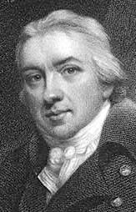
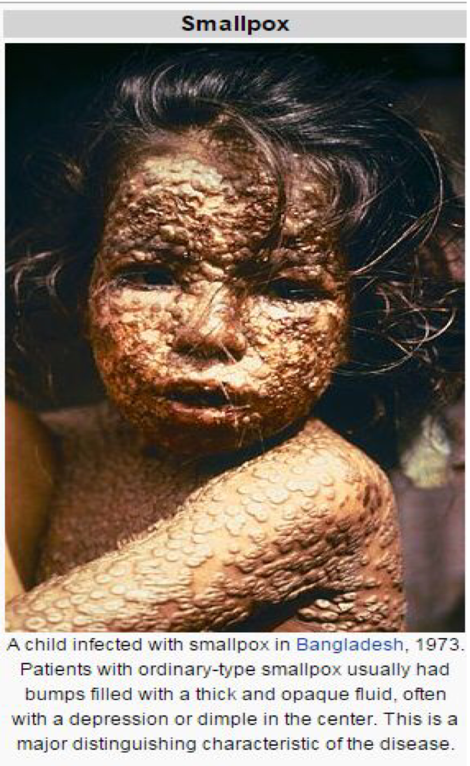
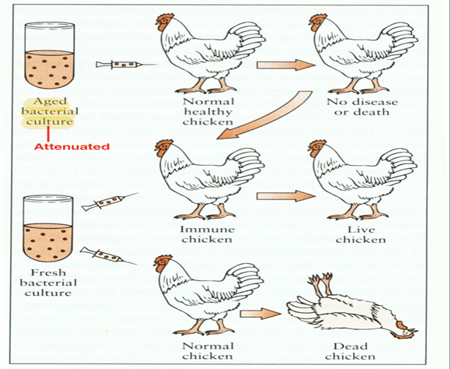
1798 Edward Jenner
Observation: Milkmaids who contracted cowpox (a mild disease) were subsequently immune to small pox
Symptoms of small pox: SCARRING BUMPS, BLINDNESS, LIMB DEFORMITIES
Profound results:
1-Jenner’s technique of inoculating with cowpox to protect against small pox spread quickly throughout Europe
2- Began the science of Immunology , the study of the body’s response to foreign substances.
Louis Pasteur’s Contributions
Determined through studies of cholera in chickens that the virulence of a pathogen weakens with age (chickens inoculated with old strains not only survive but become resistant)
Attenuated – weakened, non-virulent strain whose exposure can confer resistance to disease
Classical experiment➢ Heat attenuated anthrax bacillus and subsequent challenge with virulent Bacillus anthracis in sheep
Observation : Cholera

Slide 4
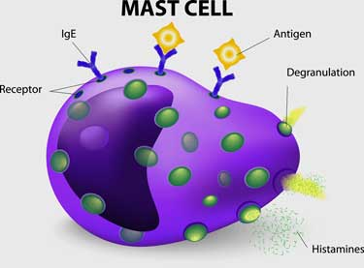
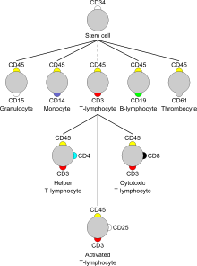
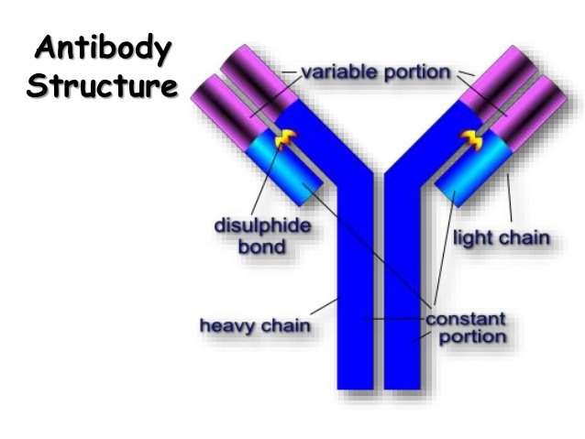
Definitions
Immune (Latin- “immunus”)
– To be free, exempt
– People survived ravages of epidemic diseases when faced with the same disease again
– Immunity: The state of protection from infectious disease
Also it’s :The study of mechanisms that humans and other animals use to defend their bodies from invading organisms such as bacteria, viruses , fungi, parasites and toxins
(CD) Cluster of Differentiation/Marker: molecule with a CD designation has a characteristic cell surface protein are often associated with the cells function.
CD(NUMBER)
“THEY ARE SURFACE MOLECULES , THEY CAN BE RECEPTORS OR PROITEINS TO IDENTIFY THE CELLS”
CELLULAR MARKER :EACH ONE OF THESE CELLS HAVE A SPECIAL MARKER
Antigen (Ag): any substance (usually foreign) that binds specifically to a component of the adaptive immunity.
Allergen: noninfectious antigens that induce hypersensitivity reactions, most commonly IgE-mediated type I reactions.
Immunoglobulin (Ig) or Antibodies:
- Secreted from plasma cell (B cell)
- Consists of a heavy and light polypeptide chains linked to each other via disulfide bonds.
Adaptive Immunity: Specific host defenses that are mediated by T & B cells following exposure to Ag.
Innate immunity: Nonspecific host defenses that exist prior to exposure to Ag.
Pathogen: a disease causing organism.
Vaccination: deliberate induction of protective immunity to a pathogen.
Where & what are antigens?
- Microorganisms & their related products
(proteins, polysaccharides, lipids)
- Environmental substances
- Drugs
-Organs, tissues, cells ( transplantation)
  Antigen Presenting Cells (APCs): Cells that process the antigen “breaking it down” into 13 – 15 amino acids and then present it on the surface to be contacted with T&B lymphocytes.
CD:-
هذا بروتين موجود ع سطح الخلية عن طريق ذا البروتين راح نقدر نتعرف على الخلية وعلى وظيفتها كمان زي مثلا
T and B lymphcytes هم متماثلين جدا تحت المايكروسكوب وماتقدر تفرقهم فصار العلماء يفرقونهم بذي البروتينات اللي موجوده في surface
وطبعا عددها كثير جدا يوصل ل 300 ولكن ال common قليل
For example you have a mast cell on the surface of the cell (IgE) and if there is an allergen(antigen) associated with it , it will become hypersensitivity reaction
mast cell يعني لو عندك
وعلى سطح ذي الخلية موجود
(IgE)
Allergen(antigen) وكان هناك
ربط فيها راح يصير
hypersensitivity reaction

Slide 5
Antigen Presenting Cells (APCs)
Macrophages
Dendritic Cells
B lymphocytes
T-lymphocytes are unable to recognize antigen they need to be presented by antigen presenting cells
Responding Cells
CD3 Positive T Lymphocytes
T Helper Lymphocyte (CD4)
T Cytotoxic Lymphocyte (CD8)
Natural Killer Cells
B Lymphocytes
T_{h2 (CD4)}
T_{h1(CD4)}
Types of Immunity
Innate immunity
  Shorter duration
  No memory
  Non specific
Adaptive immunity
  Response of a B and T lymphocytes to an antigen
  Exhibit immunological memory
  Specificity
  * Self / non-self recognition
N.B the innate and adaptive immunities are not working separately, they are overlapped and work in harmony
*Self = part of the body Non-self = foreign
Adaptive immunity
Divided into:
Humoral immunity
  Immunity that is mediated be antibodies (B cells)
Cell mediated immunity
  Immune response in which antigen specific T Cells dominate.

Slide 6
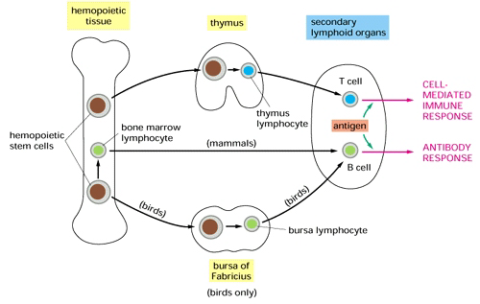
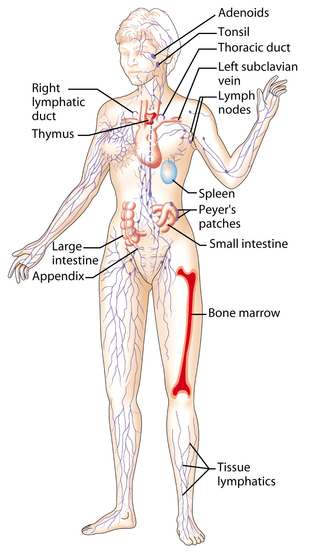
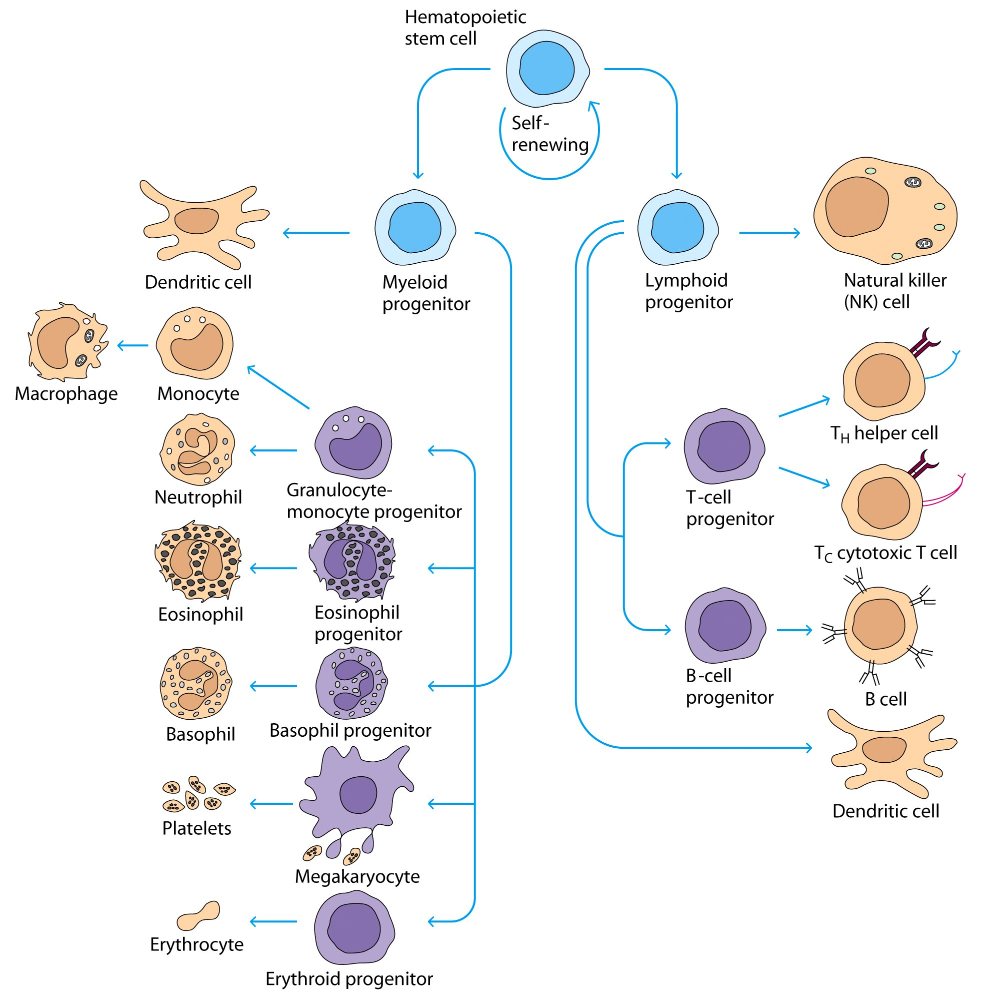
Lymphoid system
Consist of lymphatic vessels and lymphoid organs.
Primary lymphoid organs
  Bone marrow
  Thymus
responsible for development and differentiation of immune cells
Secondary lymphoid organs
“where the immune response occurs”
  Spleen
  Lymph nodes
  Tonsils
  MALT ( Mucosa Associated Lymphoid Tissue )
  Peyer’s patches
  Appendix
Lymphoid Series Comprise of Two main lymphocyte populations:
  T cells
  B cells

Slide 7
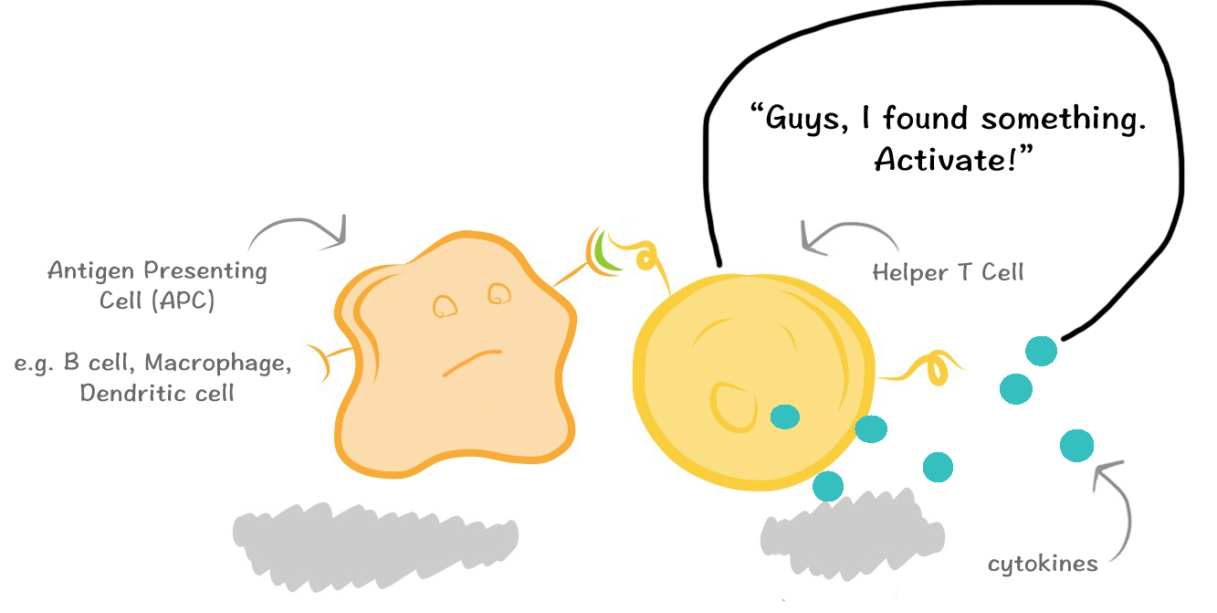
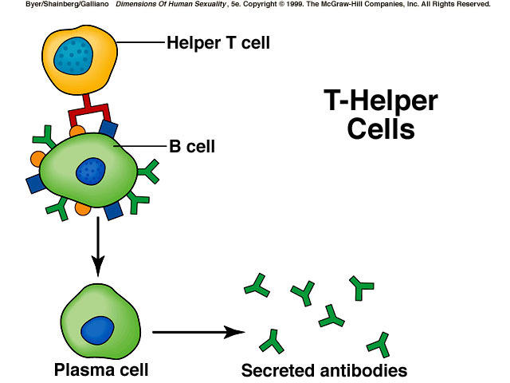
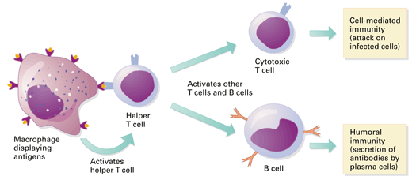
T-Lymphocyte Differentiation
T cells originate in Bone Marrow then migrate to Thymus for development.
T cell precursors differentiate into mature T cells in thymus
Stem cells lack antigen receptors and CD3, CD4, CD8 surface markers
During their passage through thymus they differentiate into T cells expressing either markers (CD4 or CD8)
T-Lymphocytes
All T cells have CD3 proteins on their cell surface
Mature T cells have either CD4 or CD8 proteins but not both
Functions of T Helper Lymphocytes
CD4 Lymphocytes (T helper 1 and 2: Th1 and Th2)
Functions
Help B cells to develop into antibody producing plasma cells (Th2)
Help CD8 cells to become activated cytotoxic T cells (Th1)
Help macrophages in cell mediated immunity (Th1) during inflammatory response.
CD8 positive cells (Cytotoxic T cells)
About 35% of peripheral blood T cells
Perform cytotoxic functions
They mediate the killing of:
Virus-infected cells
Tumors
Allograft cells (transplant)
B cells
Origin
During embryogenesis – fetal liver
Migrate to bone marrow – final destination
They do not require thymus for maturation
B cell progenitors like Pro-B cells, Pre-B cells and immature B cells are normally found in bone marrow and
Mature B cells are found circulating in body fluids and lymphoid organs.
Mature B cells display surface IgM and IgD which serves as antigen receptor
طبعا ال
B cells
غير موجودة في الدم نفسه , فإن كانت موجودة فيعتبر
lukemia

Slide 8
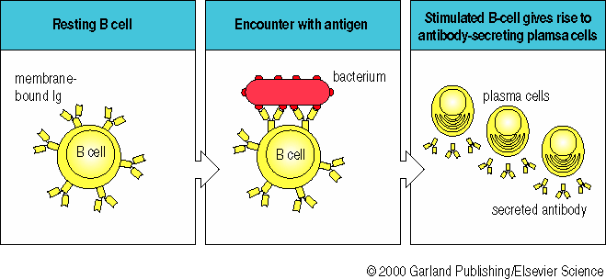
The Antibodies
Antibodies are also called Immunoglobulins
Immunoglobulins (Ig) are grouped into 5 classes:
IgG
IgM
IgA
IgD
IgE
Ig are glycoproteins
They differ in size, amount of CHO and biologic functions after binding to specific antigens

Slide 9
Immune system
Adaptive
(specific)
(third line of defense)
Humoral
Cell mediated immunity
(CMI)
Innate
(Non-specific)
First line of defense
Second line of defense
B-Lymphocytes
*Originated in fetal live During embryogenesis
T-Lymphocytes
*originated in Bone Marrow
*Matured in Thymus
CD4
CD8
Th1:
1-Help CD8 cells to become activated cytotoxic T cells.
2-Help macrophages in cell mediated immunity
during inflammatory response.
Th2:
*Helps B cells to develop into antibody producing plasma cells
Lymphoid System
Primary lymphoid organs
Bone marrow
Thymus
Secondary lymphoid organs
Spleen
Lymph node
Appendix
Tonsils
MALT( Mucosa Associated Lymphoid Tissue )
Peyer’s patches

Slide 10
Quiz
1-the state of protection from infectious disease is
A. Immunity B. Immunology C. pathology D. microbiology
2-antigen binds specifically to a component of the :
A. complementary system B. adaptive immunity C. innate immunity D. allergen
3- the light and heavy chains in the antibody are linked by
A. Hydrophobic interaction B. disulfide bond C. covalent bond D. hydrogen bond
4- Natural Killer cell originate from
A. Lymphoid progenitor B. myeloid progenitor C. A&B D. non
5-Humoral immunity is mediated by
A. Macrophages B. T lymphocytes C. B lymphocytes D.NK cells
6-all T cells have
A. CD18 B. CD4 C. CD8 D. CD3
7- origin of the B cells embryogenesis is
A.fetal spleen B.fetal liver C.bone marrow D.thymus
8- the immune response occur in the
A. bone marrow B. thymus C.-secondary lymphoid organ D. A&B
9-which Ig can be found in the surface of the B mature cells
A. IgG B.IgE C.IgM D.IgA
10- Ig are
A. Polypeptides B. proteoglycans C. glycoproteins D.CHO
1-A
2-B
3-B
4- A
5- C
6-D
7-B
8-C
9-C
10-C

Slide 11
https://www.youtube.com/watch?v=-wUhYRHstps what are antibodies?
https://www.youtube.com/watch?v=Nw27_jMWw10 شرح بطريقة ممتازة لو مافهمت
https://www.youtube.com/watch?v=RPIzIznmAO0 هذا الفيديو فيه الخلايا تحت المايكروسكوب أثناء حربها على المكيروبز تأمل فيه خلق الله سبحانه وتعالى.
Team members
1-زياد الخنيزان
2-عبدالإله الدوسري
3-عبدالله العمر
4-عبدالرحمن الطلاسي
5-عبدالعزيز الدخيل
6-عبدالرحمن الداوود
7-فيصل السيف
8-حسين علامي
9-صالح المعيقل
10-عبدالرحمن العوجان
11-محمد المعيوف
12-فهد الفايز
1- Lamyaa AlKuwaiz
2- AlAnoud AlMansour
3- Ghadah AlHaidari
4- Shirin Hammadi
5- AlAnoud AlMethem
6- Ghadah AlHenaki
Team leaders
Rahaf AlShammari عبدالعزيز الضرغام
For any concerns contact us at : immunology437@gmail.com

