Slide 1
Immunology Teamwork 437
IMMUNOLOGY TEAM 437
Lecture (3): Cell Mediated Immunity
Color index:
IMPORTANT
Definition
Explanations + notes
Extra (or gray)
Objectives
To describe antigen recognition by T cells.
To describe the pathways involved in processing endogenous and exogenous antigens.
To discuss self MHC restriction in Ag presentation to T cells.
To describe the induction of cell meditated immunity (Chronic Inflammation).
Reference
Kuby Immunology 7th Edition 2013
Chapter 8 Pages 270-276
Chapter 11 Pages 357-381
Note: there`s explanatory videos on some pictures

Slide 2
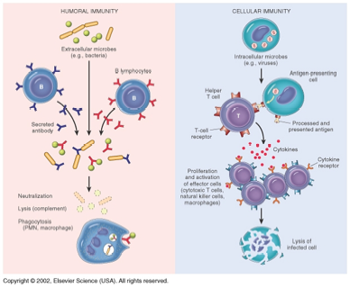
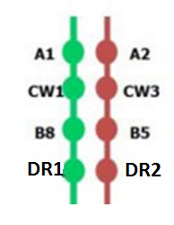
Antigen Presenting cells
Cell Mediated Immunity (CMI)
Monocytes: Peripheral blood.
Macrophages: Tissues.
Dendritic cells (Langerhans cells): Lymphoid tissue, skin.
B-cells: Lymphoid tissue, Blood.
Langerhans cells are dendritic cells (antigen-presenting immune cells) of the skin and mucosa, and contain organelles called Birbeck granules.
T cells (lymphocytes) through their receptors bind to the surface of other cells (Antigen Presenting Cells) that display the processed antigen and trigger a response.
Mononuclear cell inflammatory process usually associated with chronic inflammation.
Antigen + MHC
T-lymphocytes
Immune responses
Major Histocompatibility Complex (MHC)
Major histocompatibility complex (MHC) proteins were discovered for the first time when tissue transplantation started.
The success of tissue and organ transplantation depends upon the match of donor’s and recipient’s “human leukocyte antigens” (HLA) encoded by HLA genes.
Genes for HLA proteins are clustered in the MHC complex located on the short arm of chromosome 6.
Each individual has two “haplotypes” two sets of these genes one paternal and one maternal.
A haplotype (haploid genotype) is a group of genes in an organism that are inherited together from a single parent.
MHC Class I molecules are found on the surface of virtually all nucleated cells.
MHC Class II molecules are normally present of the surface of antigen presenting cells such as:
Macrophages
Dendritic cells
B cells

Slide 3
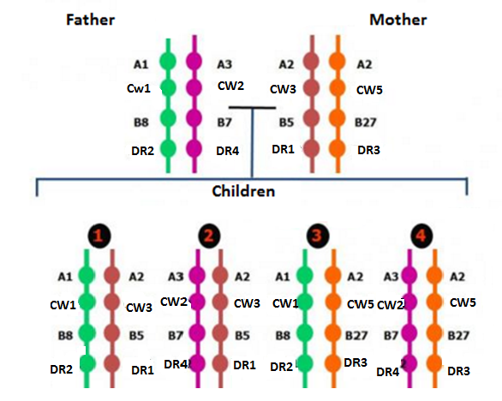
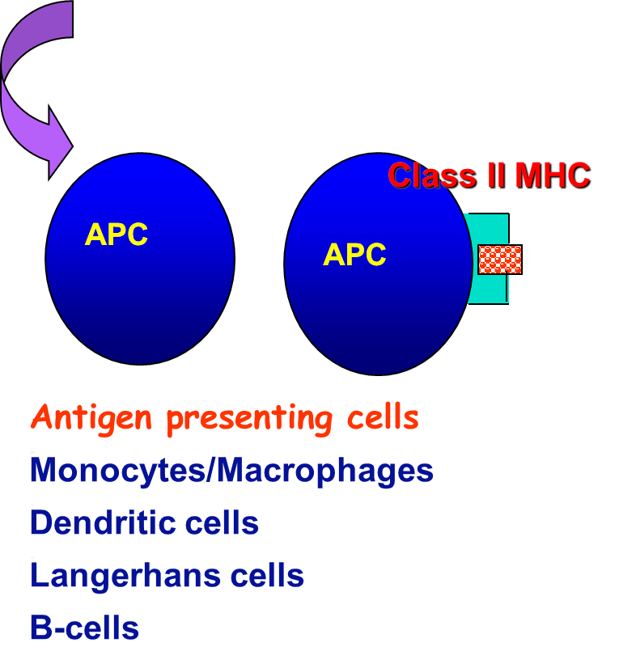
Biologic Importance of MHC
Antigen recognition
T cytotoxic (CD8) cells kill virus infected cells in association with class I MHC proteins.
T helper (CD4) cells recognize antigens in association with class II MHC proteins.
This is called MHC restriction
Transplantation
Success of organ transplant is determined by compatibility of the MHC genes.
Virus
Host cell
Endogenous antigen (Cytoplasm) e.g
Target cell
Viral protein
2. Exogenous antigen (Membrane Bound) e.g
Transcription
Translation
(Exogenous antigen entered the body and encountered the APC)
CMI (Cell Mediated Immunity)
T-lymphocytes(CD4+ cells)

Slide 4
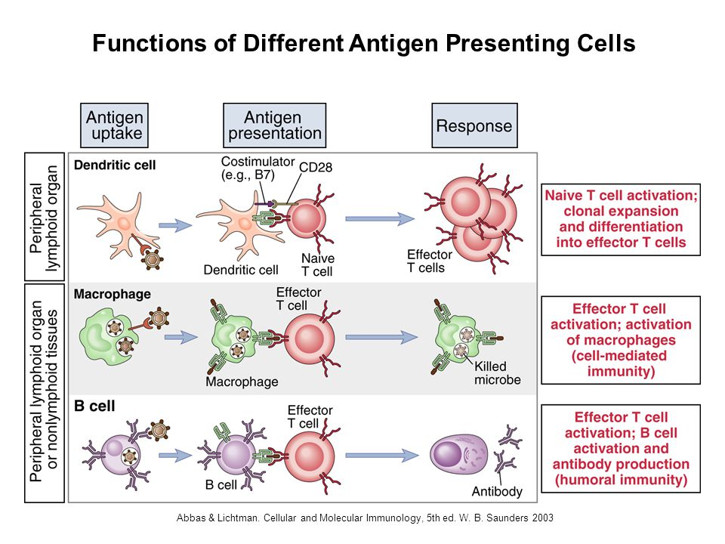
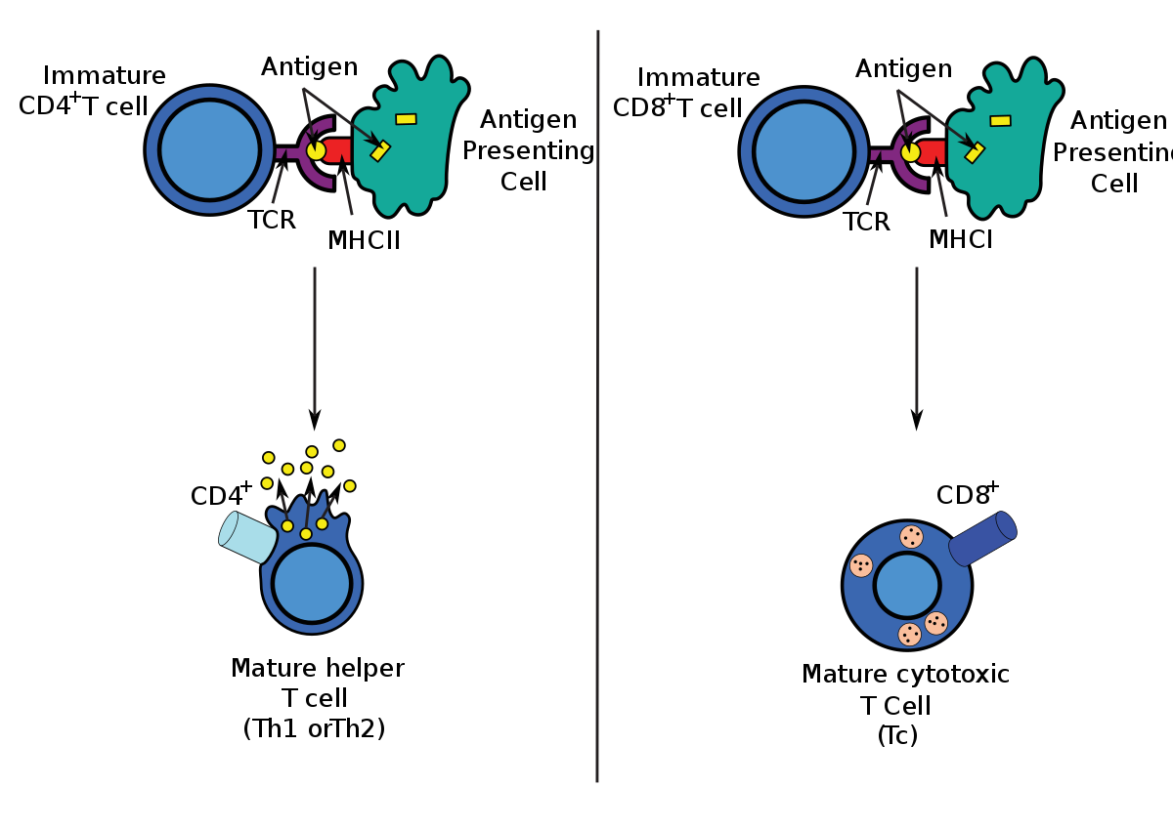
Antigen Presenting Cells
Dendritic cells and macrophages digest invading microbes and then present the antigen of the microbe to lymphocytes in lymphoid organs.

Slide 5
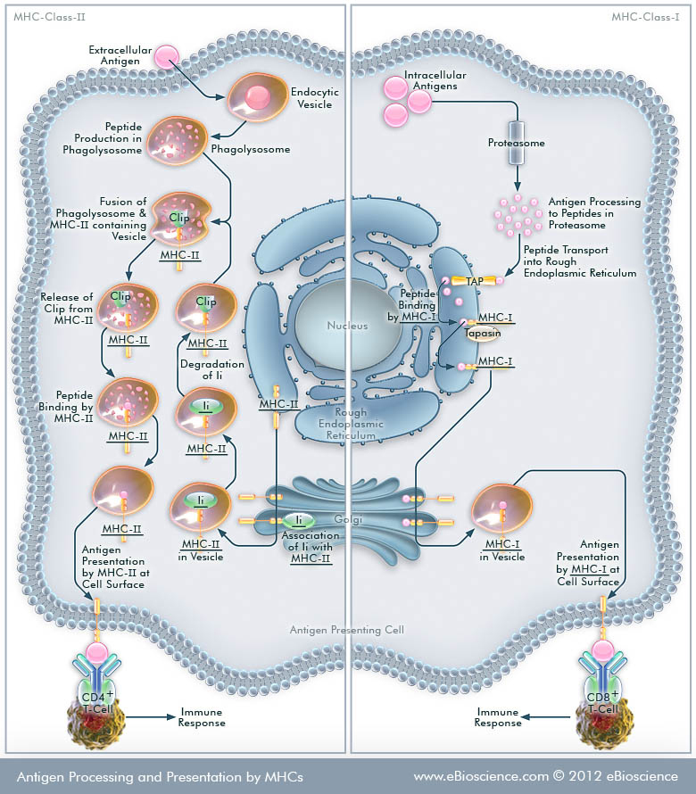
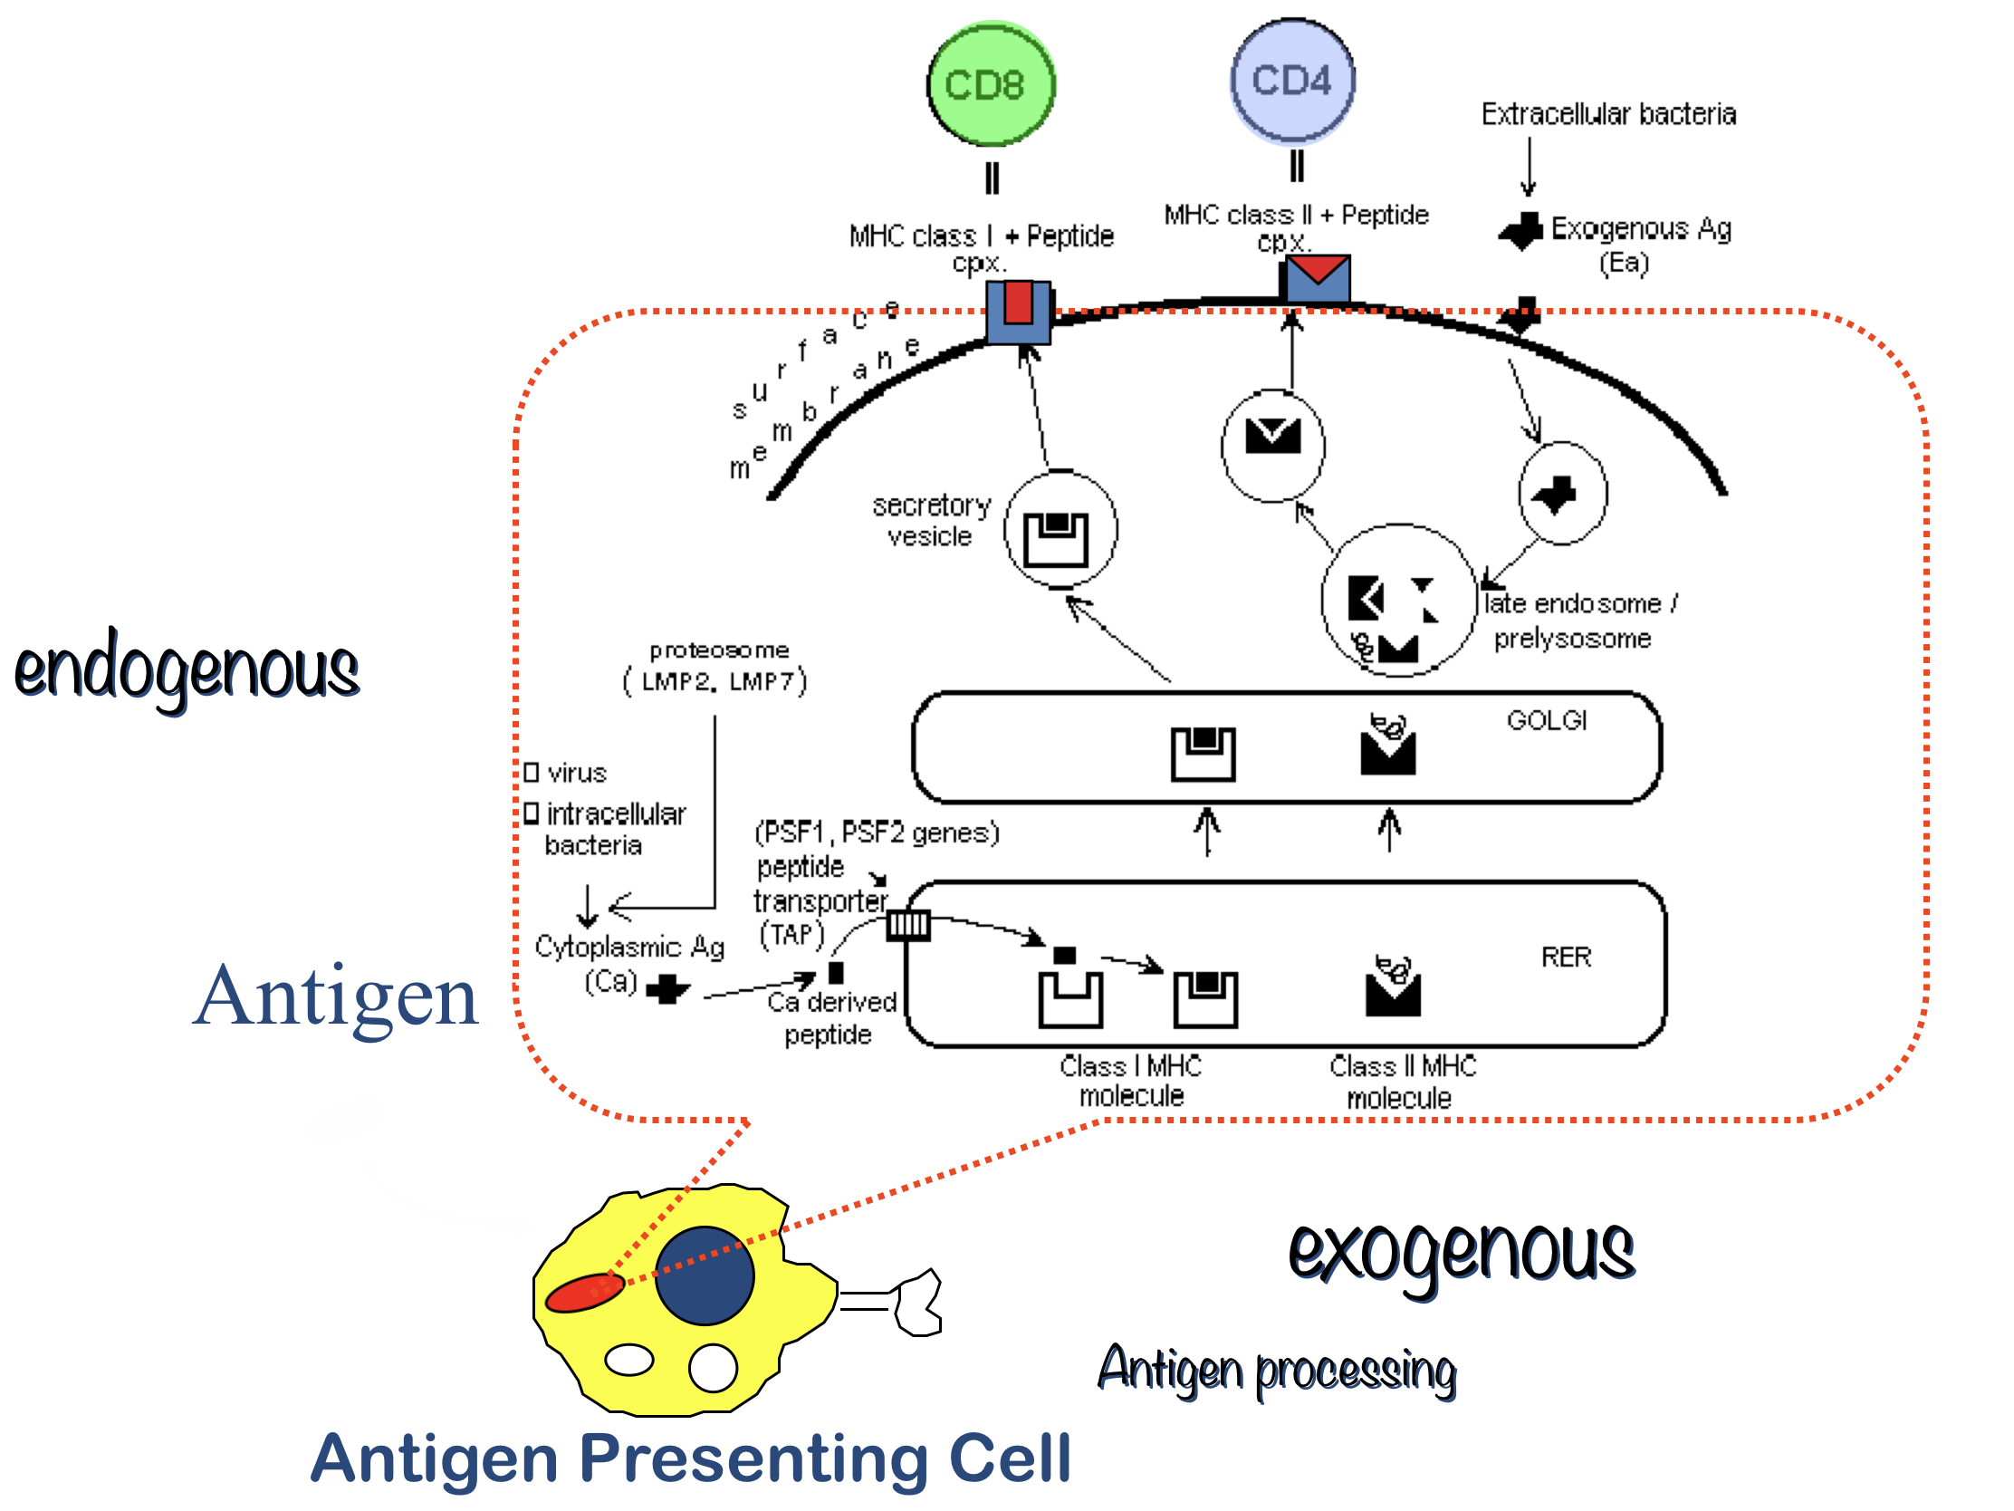
Endogenous & Exogenous antigen
This is the difference between endogenous and exogenous antigen:

Slide 6
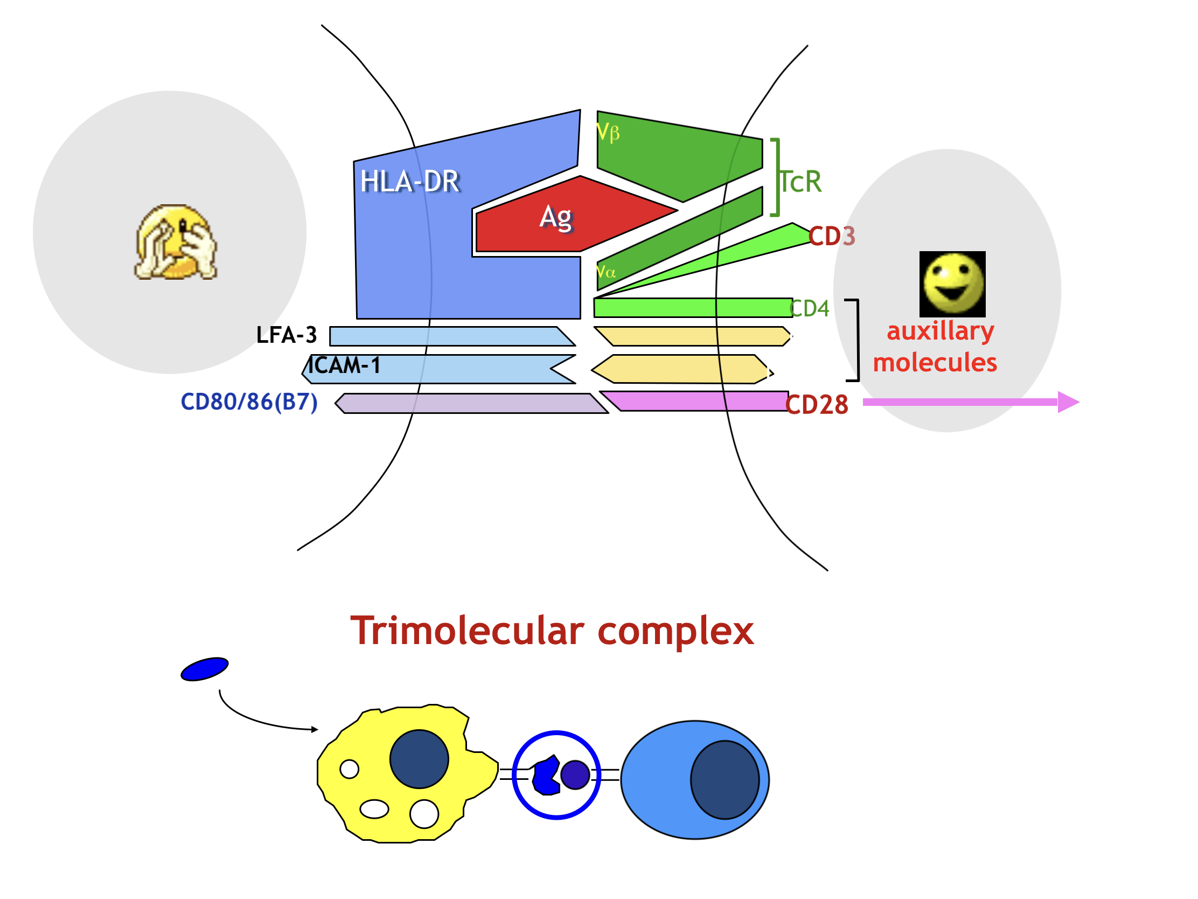
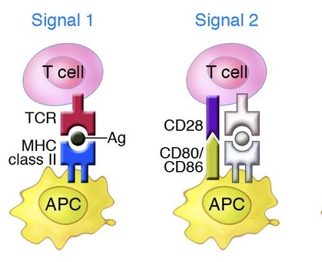
Two signals are required for the activation of T cells:
First signal:
Second signal (Costimulatory signal)
Class II MHC + antigen – TCR
IL-1, LFA-1 with ICAM
B7 on APC interacts with CD28 on lymphocyte
Doctor’s question:
Is there any possibility for T-cells to activate without the second signal?
Answer: Impossible

Slide 7
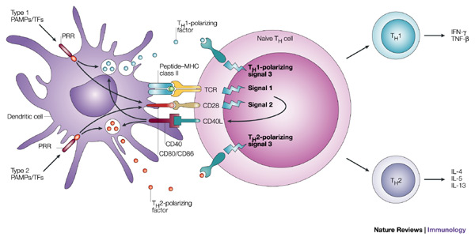
Illustrative Diagram:

Slide 8
T lymphocytes ("T cells"): CMI
Doctor’s note:
T-cells that enhance CMI are also called inflammatory T-cells (TH1).
T-cells that enhance production of antibodies are also called inflammatory T-cells (TH2).
IL2 is considered a cytokines and it's important in the regulation of the response action. It's also important in differentiation and maturation.
Interferons are important in fighting viral disease
Subsets include:
– CD4+ helper T cells enhance CMI and
production of antibodies by B cells
– CD8+ cytotoxic T lymphocytes (CTLs)
that kill virus-infected and tumor cells
Out come of T helper cell activation:
Production of IL-2 and its receptor
Effector and regulatory cells are produced along with
“memory” cells
IL-2 is also know as T cell growth factor
Production of Interferons
Proliferation of antigen specific T cells
IL-2 also stimulates CD8 cytotoxic cells
Enhances anti-microbial activity of macrophages

Slide 9
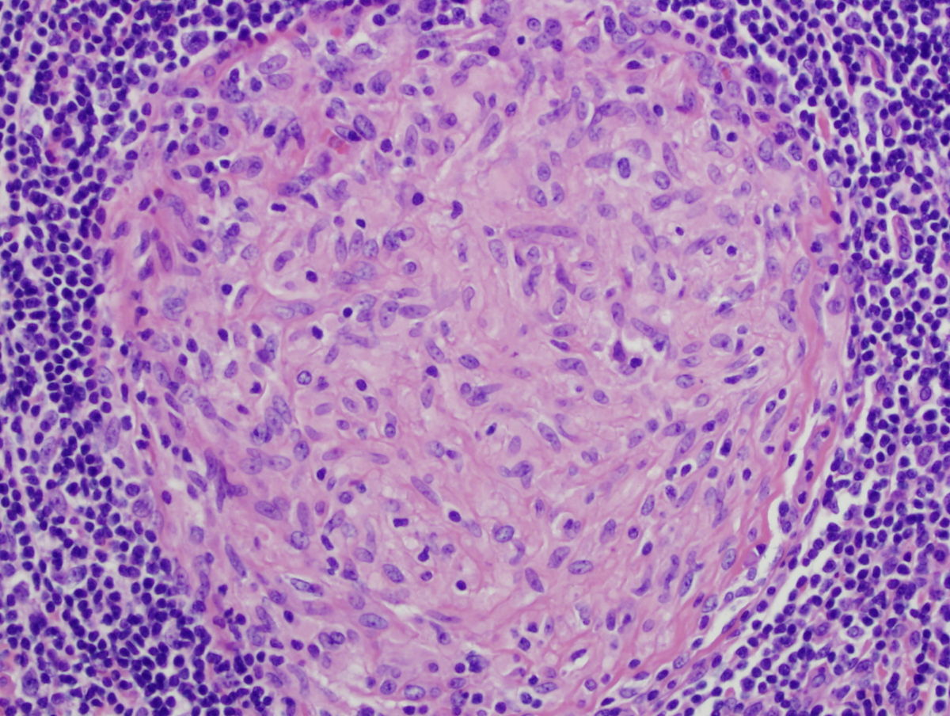
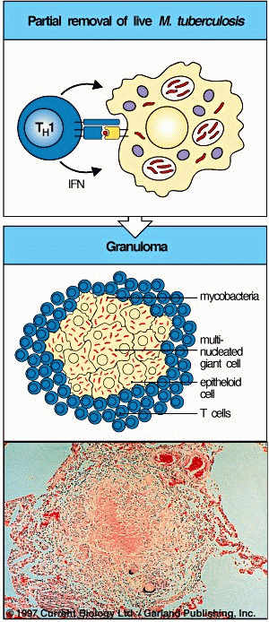
Granuloma Formation
(Chronic Inflammation, e.g. TB)
What you see is:
A group of microphages with macrobacteria inside it. Still propping response (inflammation), so it can get populated by Th1 that will form granulomas.
What is happening:
It’s an APC in an intracellular organism, and because it’s an APC, MHC class II will be exposed, that will lead to activation of T-helper cells (CD4).
since it’s Intracellular it will do a CMI response (Th1 inflammatory T-helper cell that will mediate chronic inflammation).
Outcome of T helper cell activation
Memory T cells
Respond rapidly for many years after initial exposure to antigen.
A large number of memory cells are produced so that the secondary response (future encounter with the same antigen) is greater than the primary.
Memory cells live for many years and have the capacity to multiply.
They are activated by smaller amounts of antigen.
They produce greater amounts of interleukins.

Slide 10
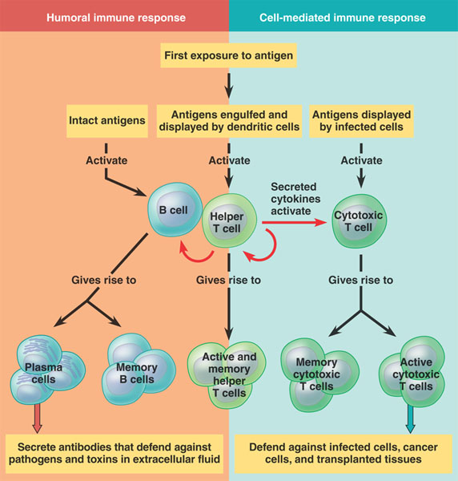
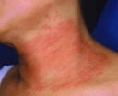
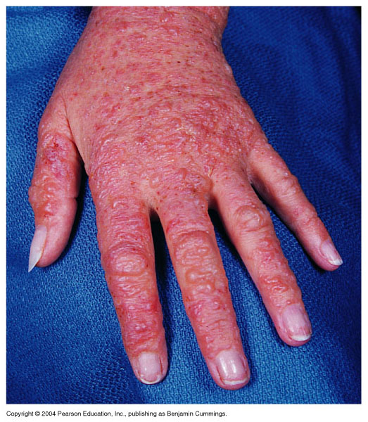
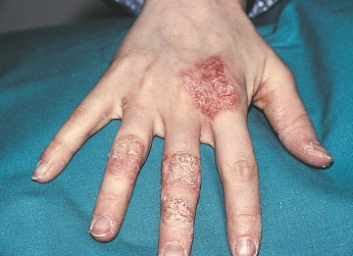
Necklace Rash
Contact Dermatitis
Examples of Cell Mediated Immunity
Delayed type of hypersensitivity (DTH) reaction:
Ex. the tuberculin test
Mediated by CD4+ T cells and takes about 72 hours to develop.
2. Contact hypersensitivity:
Many people develop rashes on their skin following contact with certain chemicals such as nickel, certain dyes, and poison ivy plant.
The response takes some 24 hours to occur and like DTH, is triggered by CD4+ T cells.

Slide 11
Take Home Message-SUMMARY
Cell mediated adaptive immune response is specific and develops after exposure to a pathogen (antigen).
Initial antigen exposure results in generation of memory cells for a stronger and quicker response against future exposures to the same pathogen.
It is usually associated with chronic infections.
Antibodies are not involved.
Quiz
1-The .......... Enhances anti-microbial activity of macrophages
A.TNS B.IL-2 C .interferon D. B7
2-the process in which B7 on APC interacts with CD28 on lymphocyte is called?
A. First signal B.Costimulatory signal C. the tuberculin test D.MHC restriction
3-Class II MHC interacts with ?
A. Th cell B. Tc cell C.B cell D. Eosinophil
4-An example for Delayed type of hypersensitivity is
A. nickel B. the tuberculin test C. certain dyes D. poison ivy plant
5-you can't find MHC Class I molecules in
A. macrophages B. neurons C. hepatic cells D.RBC
6- MHC complex located on the
A. short arm of chromosome 6
B. short arm of chromosome 9
C. long arm of chromosome 6
D. long arm of chromosome 9
7-the cell that kills virus-infected and tumour cells is
A. CD8+ B.CD4+ C. macrophages. D. B lymphocytes
8- the cell that produces IL-2 is
A. CD8+ B.CD4+ C. macrophages. D. B lymphocytes
9-Cell mediated adaptive immune response is specific and develops after exposure to a/an
A. antibody B. antigen. C. interferon. D.TNS
10- which of the following is not an Antigen Presenting cell
A. Monocytes. B. Dendritic cells. C. B lymphocytes D. Neutrophils
1-C
2-B
3-A
4-B
5-D
6-A
7-A
8-B
9-B
10-D

Slide 12
Team members
1-زياد الخنيزان
2-عبدالإله الدوسري
3-عبدالله العمر
4-عبدالرحمن الطلاسي
5-عبدالعزيز الدخيل
6-عبدالرحمن الداوود
7-فيصل السيف
8-حسين علامي
9-صالح المعيقل
10-عبدالرحمن العوجان
11-محمد المعيوف
12-فهد الفايز
1- Lamyaa AlKuwaiz
2- AlAnoud AlMansour
3- Ghadah AlHaidari
4- Shirin Hammadi
5- AlAnoud AlMethem
6- Ghadah AlHenaki
Team leaders
Rahaf AlShammari عبدالعزيز الضرغام
For any concerns contact us at : immunology437@gmail.com

