Slide 1
Immunology Teamwork 437
IMMUNOLOGY TEAM 437
Lecture (5): Hypersensitivity Reactions
Color index:
IMPORTANT
Definition
Explanations + notes
Extra (or gray)
Objectives
• To know that hypersensitivity reactions are over and excessive immune responses that can be harmful to the body in four different ways.
• To be familiar with inflammatory processes in Type I hypersensitivity reaction that mediates allergic inflammation.
• To recognize that Type II hypersensitivity deals with immune responses against antigens that are integral part of cell membrane and are usually associated with autoimmune disorders.
• To know that Type III hypersensitivity reactions are mediated by immune complexes and cause vasculitis.
• To describe Type IV hypersensitivity is a purely cell mediated immune response associated with chronic inflammation.
Reference
Kuby Immunology 7th Edition 2013
Chapter 15 Pages 485-510
Note: there are some explanatory videos on some pictures

Slide 2
What is hypersensitivity?
• Protective immunity: desirable reaction
• Hypersensitivity: undesirable reaction
• Undesirable responses can be mediated by:
Type I:
Immediate Hypersensitivity
Types of Hypersensitivity
Type II:
Cytotoxic Hypersensitivity
Anaphylactic reactions (allergies)
Caused by allergens (non-infectious foreign bodies)
Gel & Coombs Classification:
Ig Ab
Composed of:
Sensitization phase
Challenge phase
Anti-body mediated destruction of healthy cells
These antibodies are tissue specific
Gel & Coombs Classification:
IgG to tissue antigens
Involves activation of complement proteins
Antibody-Antigen binding:
(Types I-III)
Type III:
Immune Complex Hypersensitivity
Type IV:
Delayed Hypersensitivity
Cell-mediated reaction
(Type IIII)
Cell mediated immunity
Formation of abnormal tissue (Granuloma)
Gel & Coombs Classification:
Cell mediated (T_{helper} & T_{cytotoxic})
Composed of:
Sensitization phase
Challenge phase
Antibody reacts with soluble antigen to produce immune complex
Immune complex deposited in many types of tissues cause inflammation
Gel & Coombs Classification:
Ig immune complexes

Slide 3
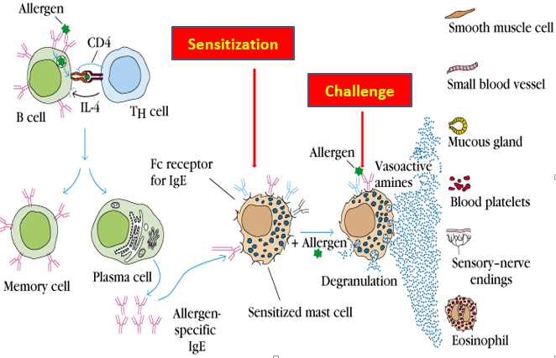
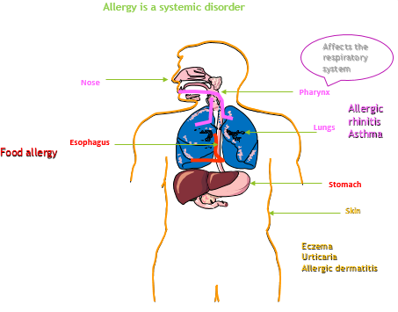
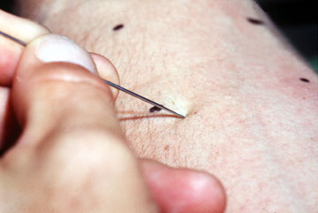
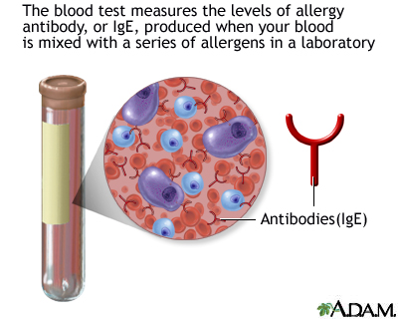
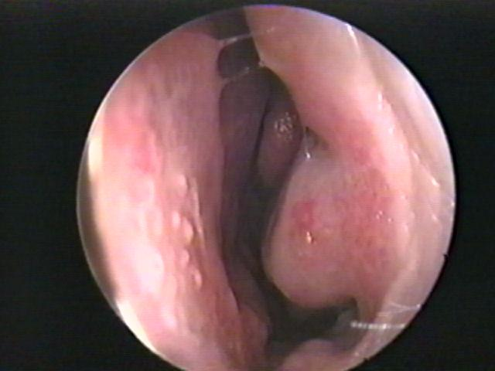
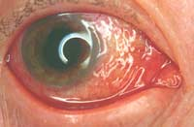
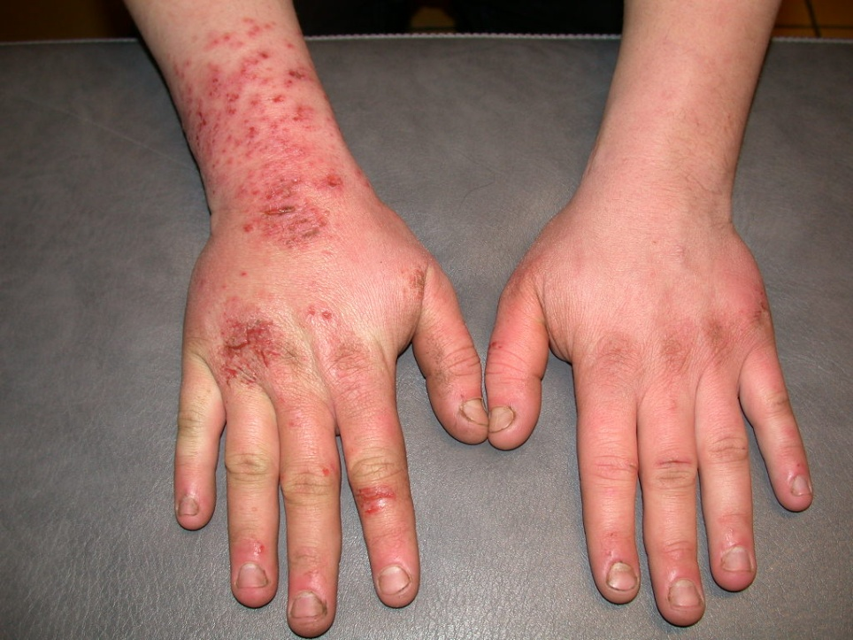
Features
Type I:
Immediate Hypersensitivity
Most people won’t react to these allergens
“Atopic individuals” respond by producing increased amounts of IgE
Non-allergic individuals respond by producing IgG
Mechanism
Components of Type I
Anti-body
IgE
Cellular components:
Mast cells
Basophils
Eosinophils
Antigens
Allergens: non-infectious agents that produce immune response
Low-molecular weight
Soluble
Allergic reaction
Anaphylactic reactions: severe & rapid forming systemic forms (life threatening)
Sensitization phase:
→ Allergen binds to B lymphocyte (APC)
→ B lymphocyte presents allergen to T_{helper} cell
→ Activation to Plasma cell
→ Production of anti-bodies (IgE) specific to antigen
→ Anti-bodies bind on surface of mast cells
2. Challenge phase:
→ Second exposure to allergen
→ Allergen binds with antibodies on mast cells
→ Mast cells stimulated to release histamine
→ Anaphylactic reaction (Allergy)
→ Results in many physiological changes
Allergens:
Dust mite
Pollen
Animal dander
Shellfish
Nuts
Drugs
Clinical examples
Diagnosis
Anaphylactic reaction:
Severe Type I reaction
Exposure to allergen
IgE mediated
Example: Hymenoptera (bee/wasp)
sting antigen
→Enters blood stream
→System inflammation
Life threatening
Anaphylactoid reaction:
Non-IgE mediated reaction
Produces same clinical expressions and symptoms of anaphylaxis
Caused by contrast media/local anesthetics
Results in direct degranulation of mast cells
NO sensitization/challenge phase or synthesis of antibodies
Skin-prick test:
Prick skin with small sample of allergen
Patients who are hypersensitive will develop rash & urticarial (immune response)
RAST(Radioallergosorbent test)
Specific IgE measurement
Measure amount of IgE antibodies which increase with allergies
Normal nose
Allergic rhinitis
Elimination/provocation test
Method to test out food tolerance
Used to identify food allergies
Eczema
Normal hand
Conjunctivitis

Slide 4
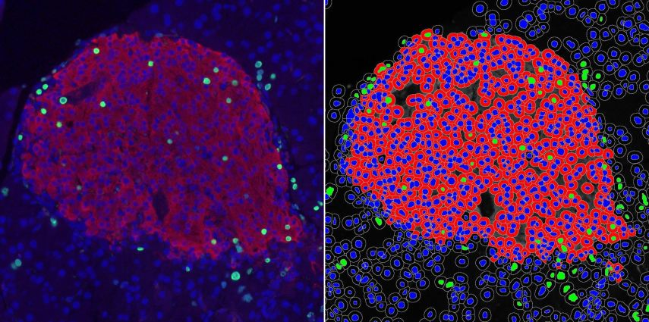
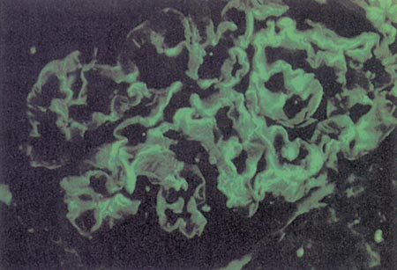
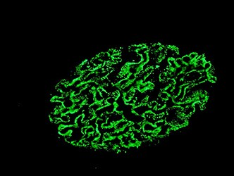
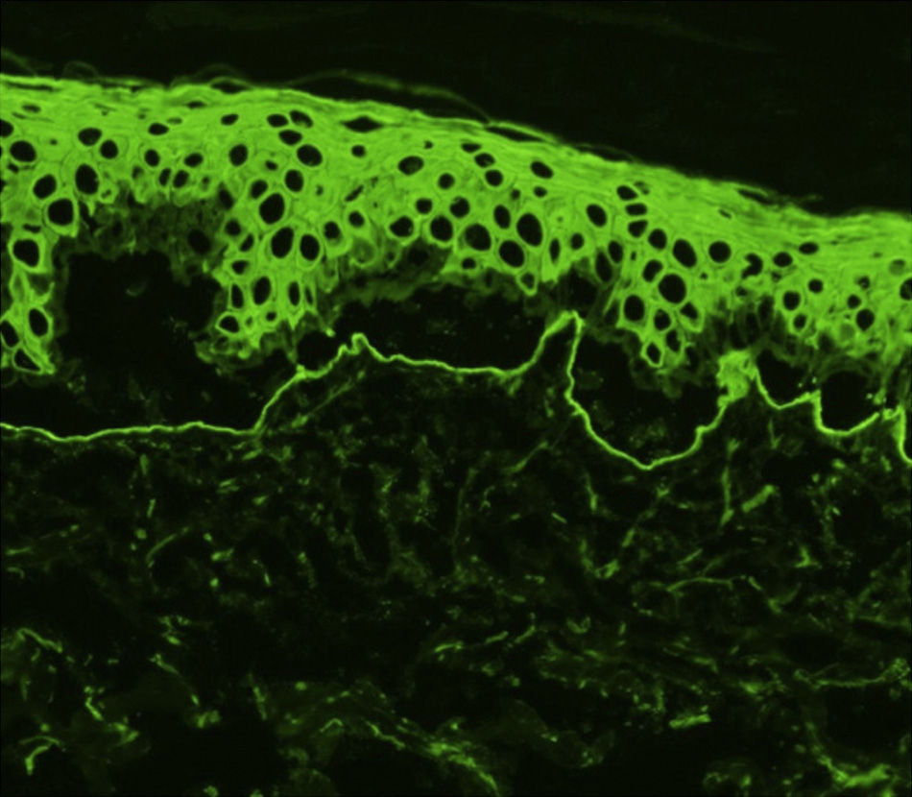
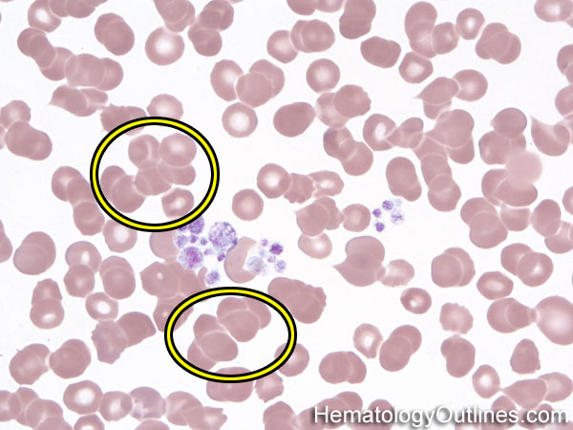
Features
Type II:
Cytotoxic Hypersensitivity
Mechanism
Antibodies bind to antigens on tissue surface.
IgG mediated process.
Involves activation of complement protein system.
Antibody (IgG) binds to antigen on cell membrane surface.
Activation of compliment protein system via classical pathway (antigen-antibody).
Result: Opsonization of antigen and chemotaxis of macrophages.
Frustrated phagocytosis resulting in some cell damage.
Antigens
Intrinsic:
Self antigens (in autoimmune disease)
Extrinsic
Exogenous antigens (microbial)
Diagnosis
Clinical examples
Detection of antibodies and antigens by Immunofluorescence in tissue biopsy specimen
Example:
1. Glomerulonephritis
caused by
Anti-Glomerular Basement membrane disease
Antibodies directly attack and bind to antigens on cell surface resulting in frustrated phagocytosis and cell damage
2. Mismatched blood transfusion:
Results of agglutination (clumping) of donor’s red blood cells by antibodies of recipient
Ultimately leads to hemolysis of donor RBCs
→Kidney
→Skin

Slide 5
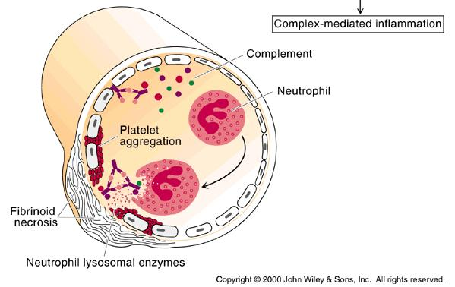
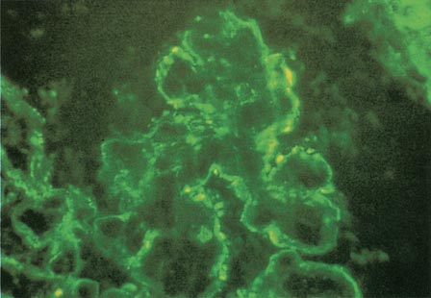
Features
Type III: Immune Complex Hypersensitivity
Mechanism
Features:
Antibody (IgG or IgM) + Antigen (soluble)
- Immune – Complex formation
- Complement activation (classical pathway)
- Attraction of inflammatory cells
When an antigen reacts with an antibody the product they form is called an immune complex which is capable of inducing an inflammatory response
Immune complexes are deposited in tissues like kidneys (nephritis), joints (arthritis) or blood vessels (vasculitis)
Antibodies attach to soluble antigens as opposed to antigens on cell surfaces (as seen in type 2 hypersensitivity).
Diagnosis
Clinical examples
Clinical examples:
Glomerulonephritis: Rheumatoid arthritis, SLE
Happened as consequences of deposition of the free antigen.
Systemic Lupus Erythematosus
Demonstration of specific immune complexes in the blood or tissues by: Immunofluorescence
Fibrinoid necrosis caused by type III hypersensitivity

Slide 6
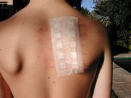
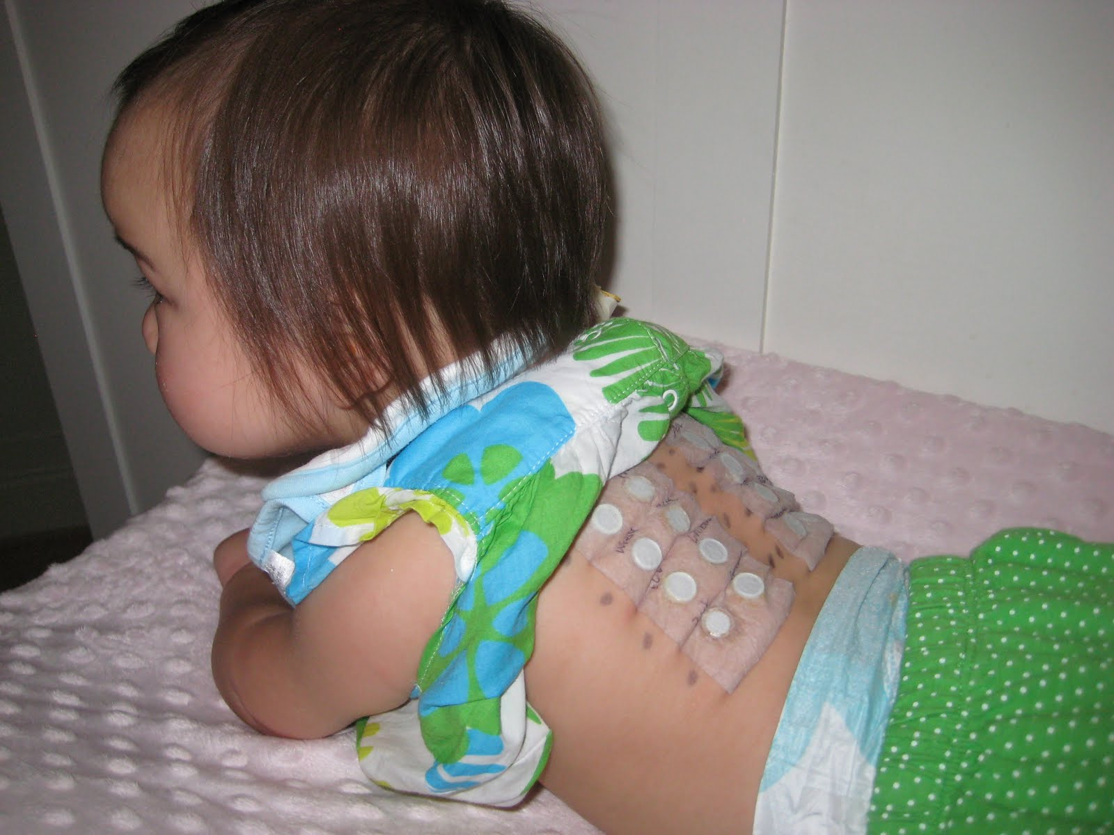
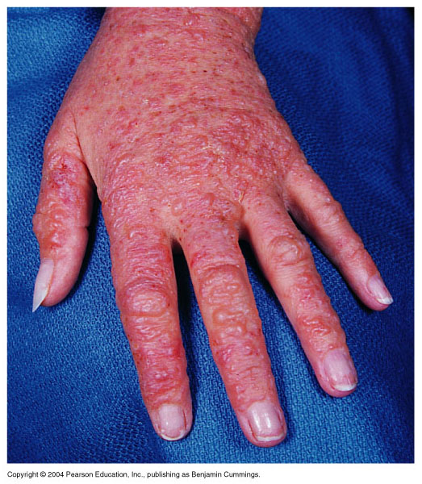
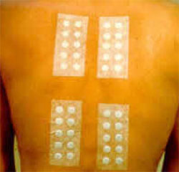
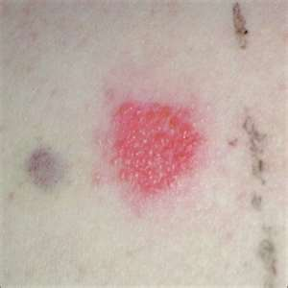
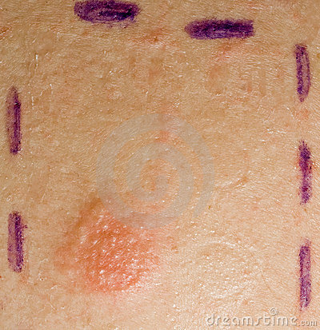
Features
Type IV: Delayed Hypersensitivity
Mechanism
Features :
Cell mediated immune response
- Antigen dependent T cell (CD4 generally and CD8 occasionally)
activation via MHC Class I (for CD8) or Class II (for CD4)
Activated macrophages
Delayed onset (2-4 days)
(this`s why we call it Delayed Hypersensitivity)
Abnormal cellular response
-(Granuloma formation)
Sensitization phase:
1-2 week period
(production of delayed hypersensitivity T lymphocyte that recognizing that antigen)
Effector phase:
24-72 hours
Effector cells
(activated macs)
act non-specifically
Diagnosis
Clinical examples
2. Patch test (Contact dermatitis)
Contact dermatitis
TB granuloma
(persistent antigen)
1. Delayed skin test (Mantoux test)
2. Patch test (Contact dermatitis)
3. Lymphocyte transformation test

Slide 7
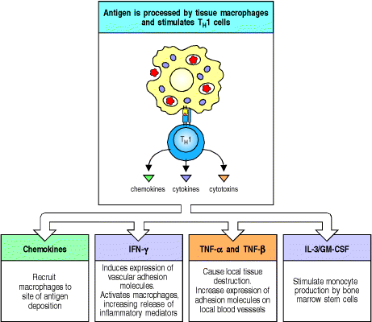
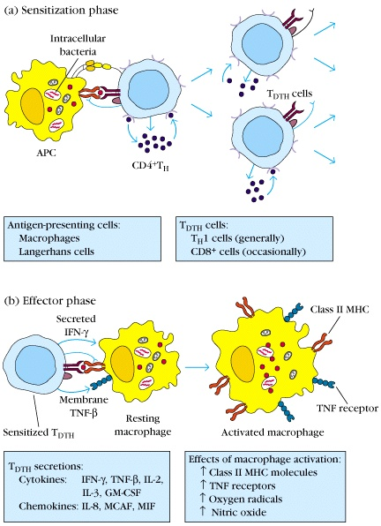
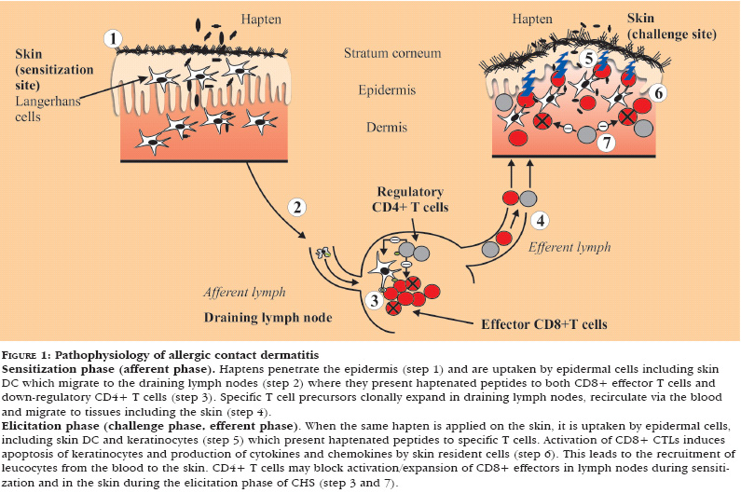
Mediators released by T_{DTH} cells:
Development of DTH Response:
Depends on APC :
If it is class I
(Cytotoxic T cell)
- If it is class II
(T helper cell)
Delayed type Hypersensitivity
*مهم تعرف النواتج و ايش يسوي كل واحد
INF: Interferon
TNF : tumor necrosis factor
IL: Interleukin
GM-CSF: Granulocyte-macrophage colony-stimulating factor
*الصورة مهمة
Pathophysiology of Contact dermatitis:

Slide 8
Test your knowledge!
1- Which type of Hypersensitivity includes cell mediated reaction?
A. I B. II C. III D. IV
2- Which type of Hypersensitivity responds by producing large amounts of IgE?
A. I B. II C. III D. IV
3- Which of the following is not a cellular component of type I hypersensitivity?
A. Mast cells B. Basophils C. Eosinophils D. Neutrophils
4- Anaphylactic reactions are considered in _______________
A. Type I hypersensitivity B. Type II hypersensitivity C. Type III hypersensitivity D. Type IV hypersensitivity
5- Immunofluorescence can be used to diagnose which type of hypersensitivity?
A. I B. II C. III D. B&C
6- Which type of Hypersensitivity can cause fibrinoid necrosis?
A. I B. II C. III D. IV
7- Allergic dermatitis is caused by?
A. I B. II C. III D. IV
8- Contact dermatitis is caused by?
A. I B. II C. III D. IV
9- Rheumatoid arthritis is a clinical example of?
A. I B. II C. III D. IV
10- Immediate Hypersensitivity is which type of hypersensitivity?
A. I B. II C. III D. IV
Answers: 1D 2A 3D 4A 5D 6C 7A 8D 9C 10A

Slide 9
Team members
1-زياد الخنيزان
2-عبدالإله الدوسري
3-عبدالله العمر
4-عبدالرحمن الطلاسي
5-عبدالعزيز الدخيل
6-عبدالرحمن الداوود
7-فيصل السيف
8-حسين علامي
9-صالح المعيقل
10-عبدالرحمن العوجان
11-محمد بن معيوف
12-فهد الفايز
1- Lamyaa AlKuwaiz
2- AlAnoud AlMansour
3- Ghadah AlHaidari
4- Shirin Hammadi
5- AlAnoud AlMethem
6- Ghadah AlHenaki
Team leaders
Rahaf AlShammari عبدالعزيز الضرغام
For any concerns contact us at : immunology437@gmail.com

