Slide 1

Microbiology – Lecture 1
Bacterial structure , Functions & Genetics

Slide 2
Objectives
Define the cellular organization of bacteria and know the differences between Eukaryotes and Prokaryotes.
Know major structures of bacteria and its function.
Know the structure of cell wall of bacteria including the differences between Gram positive and Gram negative bacteria and main functions.
Know the external structures of bacteria with and functions .
Know the cytosol and internal structures of bacteria .
Describe bacterial spores and its application in the practice of medicine.
Know basic information about bacterial genetics and replication of bacteria .
Describe plasmids , its origin , types and its importance in clinical practice.
Recalls genetics variations, including ; mutation and mechanisms of gene transfer and its implication on bacterial resistance to antimicrobial agents.

Slide 3
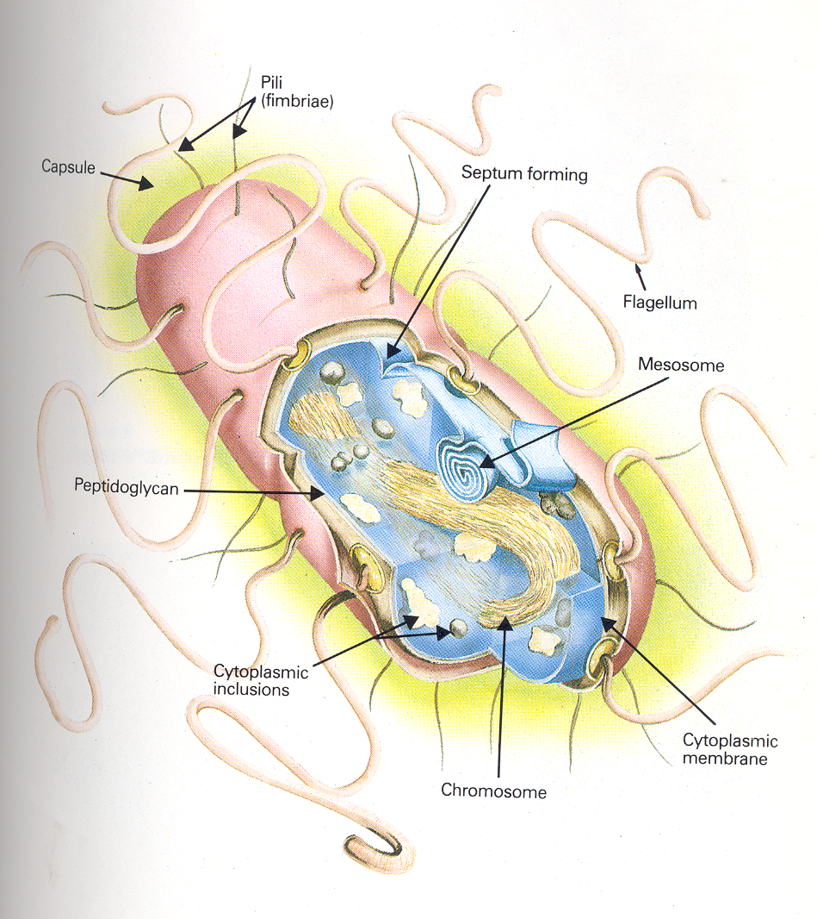
The Difference Between Prokaryotes and Eukaryotes
Eukaryotes | Prokaryotes
Nucleus | No nucleus
Multicellular organism | Unicellular organisms
Undergo mitosis | divide by binary fission
Membrane-bound organelles | No organelles
Ten times the size of prokaryotic cells. | Small
Similarities
They both have DNA as their genetic material.
They are both membrane bound
They both have ribosome

Slide 4
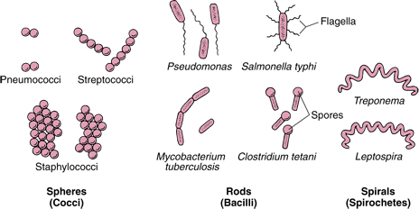
  Is a heterogeneous group of unicellular organisms , about 1-8 μm in diameter
Bacteria:
Arrangements of Bacteria:
Arrangements among Cocci:
Pairs Diplococci
Chains Streptococci
Clusters Staphylococci
In four Tetrad
Palisades Corynebacterium
Shapes:
Spherical / Oval , e.g. Cocci
Rods , e.g. Bacilli
Very short Bacilli , e.g. Coccobacilli
Tapered end , e.g. Fusiform
Club-shaped / Curved , e.g. Vibrio
Helical / Spiral , e.g. Spirochetes
Bacteria is a Prokaryote (has a primitive nucleus):
One chromosome
No nuclear membrane
No mitochondria
No sterols
Bacteria contain Plasmids: an extra piece of DNA.
For more information click here!

Slide 5
Major Bacterial Structure: Cell Wall
There is a difference between “cell wall” and
“cytoplasmic membrane” !! Cytoplasmic
membrane in pro –eukaryotes , while cell wall
in prokaryotes and plants and some kind of
animals
Two groups of bacteria depending on reaction to GRAM STAIN!
Definition:
It’s rigid, surrounds the cytoplasmic
membrane and internal structures.
Gram negative bacteria: stain red by Gram stain | Gram positive bacteria: stain blue/purple by Gram stain.
Thin peptidoglycan Outer membrane that contains: 1- Specific proteins (porins) important in the transport of hydrophilic molecules 2- Lipopolysaccharide & lipid (ENDOTOXIN) | Thick peptidoglycan. Closely associated with cytoplasmic membrane. Teichoic acid : anchors cell wall to cell membrane epithelial cell adhesion. Antigens: - polysaccharides (Lancefield) -protein (Griffith)
Function :
Rigidity
Protection
Shapes bacteria
Cell division
Porous: permeable to low molecular weight molecules
Antigenic determinants
Note from doctor: Mycoplasma naturally has no cell wall

Slide 6
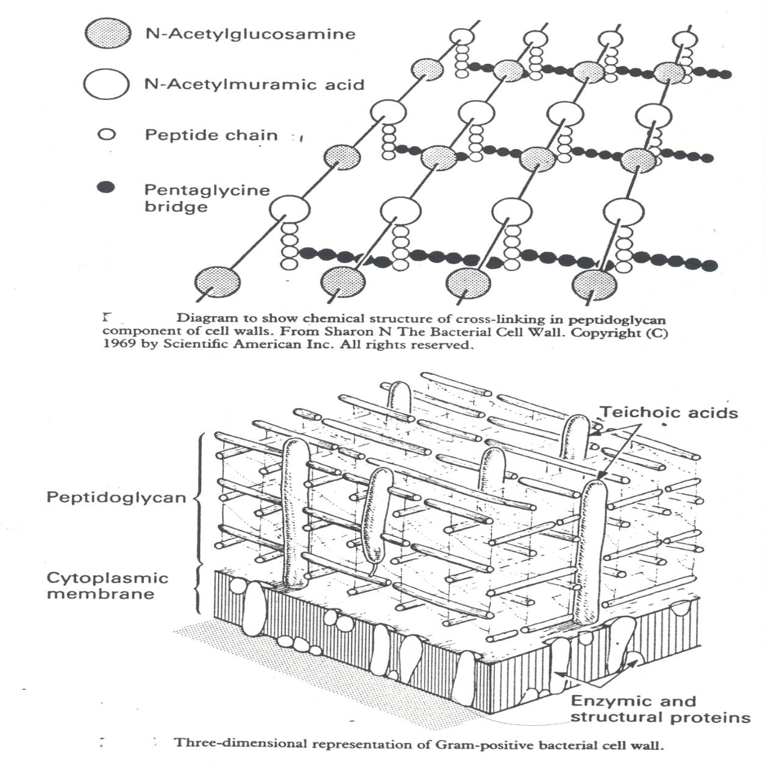
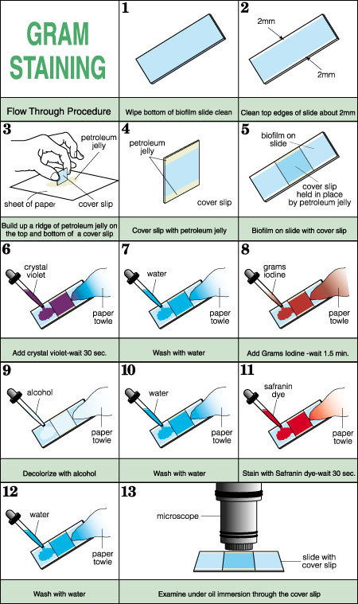
What is Peptidoglycan?
Chemical structure of bacterial cell wall is peptidoglycan the rigid part is mucopeptide composed of alternating strands of
N- acetyl muramic acid and N- acetyle glucosamine linked with peptide sub units.

Slide 7
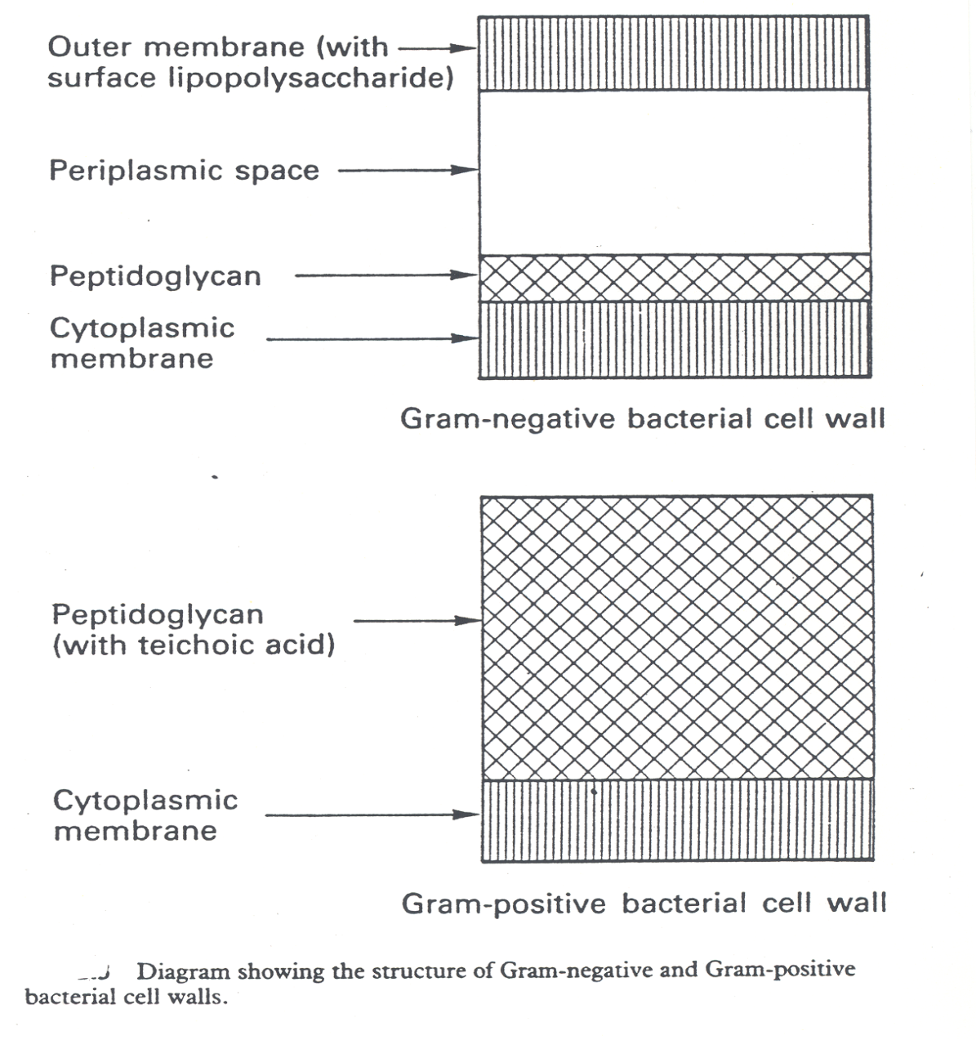
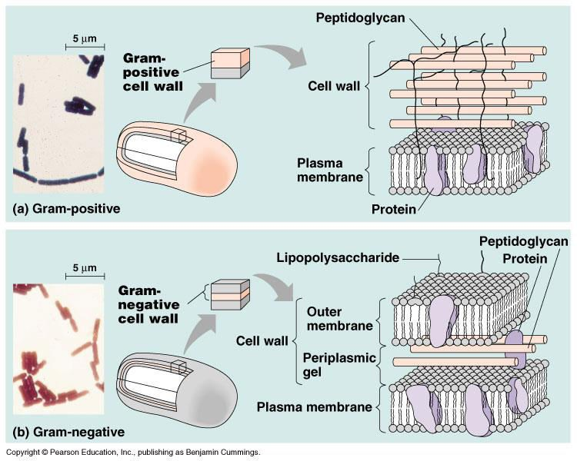
Thin!
Thick!

Slide 8
External Structures of Bacteria
Structure of flagella:
External protrude from the cell into the environment:
Flagella
Pili
Capsule
Basal Body: a protein arranged as rings on central rod
(4 ring in Gram negative, 2 ring in Gram positive).
1-outer pair of rings: only in Gram negative, pushed through outer membrane.
2-inner pair of rings : inserted into peptidoglycan & cytoplasmic membrane.
Flagella:
Helical filaments
Composed of protein FLAGELLIN.
Found in Gram positive & Gram negative bacteria.
Distribution:
- Peritrichous
- Monotrichous
- Lophotrichous
Chemotaxis is the movement of an organism in response to chemical stimuli
Hook: a bent structure , acts as a joint
Long Filament: a flagellin protein
Function of Flagella: motility & chemotaxis

Slide 9
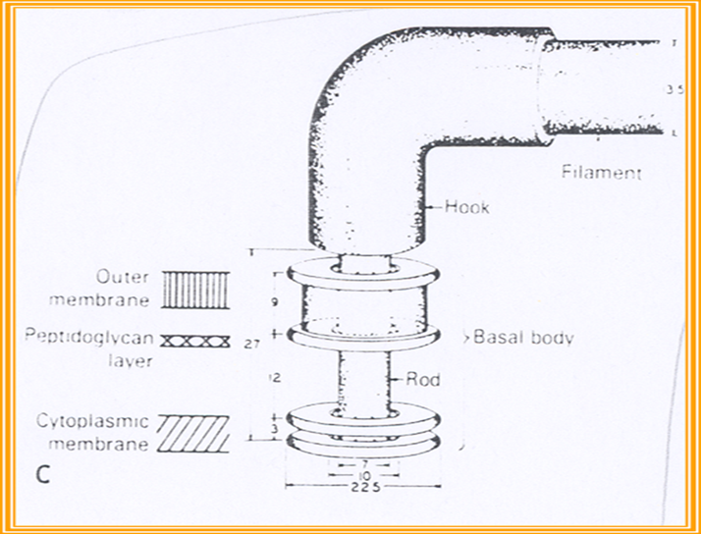
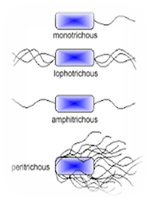
Structure of Flagella:

Slide 10
External Structures of Bacteria
Pili
Capsule
Cytoplasmic Membrane
Fine short filaments extruding from cytoplasmic membrane.
Found on the surface of many Gram negative & Gram positive bacteria.
Composed of protein Pilin.
Two classes:
Common pili (fimbriae): covers the surface— responsible for: adhesion & colonization
Sex pili : in some bacteria only, responsible for conjugation.
NOTE : GENE SHARING IS SEX PILI
Amorphous material surrounds bacteria.
Usually polysaccharide.
Occasionally protein.
Function:
  Inhibits phagocytosis.
  Acts as Virulence factor in some bacteria by assessing attachment to the surfaces.
Cytoplasmic membrane (cell membrane)
Double layered structure composed of phospholipid & protein.
Act as semi- permeable membrane (passive diffusion).
Site of numerous enzymes involved in active transport of nutrients and various metabolic processes.

Slide 11
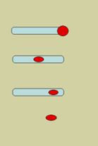
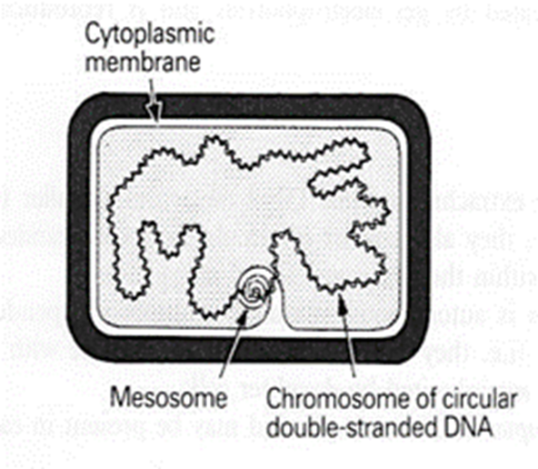
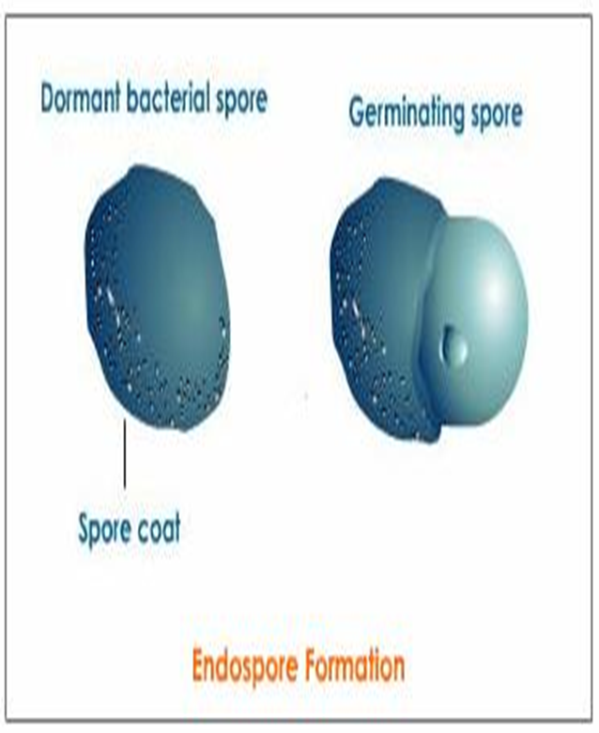
Internal Structures of Bacteria
Mesosomes : convoluted invaginations of cytoplasmic membrane.
Function:
Involved in DNA segregation during cell division & respiratory activity.
Contain receptors involved in chemotaxis.
Permeability barrier (active transport of solutes).
Spores of Bacteria
Small, dense, metabolically inactive, non- reproductive structures produced by Bacillus & Clostridium.
Enables the bacteria to survive adverse environmental conditions.
Contain high concentration of Calcium dipicolonate.
Resistant to heat, dissecation & disinfectants.
Often remain associated with the cell wall.
Spores are described as:
  Terminal spores
  Sub-terminal spores
  Central spores
Spores germinate when growth conditions become favorable to produce vegetative cells.
Application in medical practice :spore preparations used for checking the efficacy of Autoclaves, eg. Bacillus subtilis & Bacillus sterothermophilus.

Slide 12
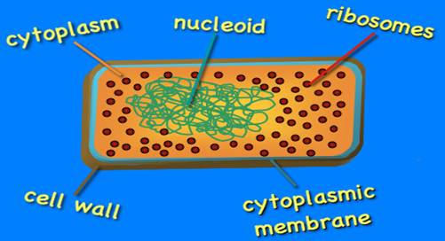
1- Cytoplasmic inclusions:
Are nutritional storage granules , examples:
volutin
Lipid
Starch / or Glycogen
The core of bacteria is composed of :
Cytoplasmic inclusions
Nucleoid ( nuclear body)
Ribosomes
2- Nucleoid ( Nuclear Body)
Circular single stranded chromosome (bacteria genome or DNA)
No nuclear membrane
DNA undergoes semi-conservative replication , bidirectional from a fixed point
3-Ribosomes of Bacteria:
Distributed throughout the cytoplasm
Site of protein synthesis
Composed of RNA and protein

Slide 13
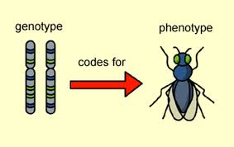
Bacterial Genetics:
Note:
البكتيريا تقدر تعيش بدون بلازميد، فهو يعطي البكتيريا صفات كمالية غير أساسية.
Types of DNA in bacteria
It is the study of inheritance and variation. And the
genetic information is encoded in DNA.
Function of genetic material:
1- Replication of the genome
2- Expression of DNA to mRNA then to protein.
Plasmids – extra chromosomal
Chromosomal
Extra chromosomal DNA composed of double stranded-DNA.
Found in most species of bacteria. (especially Gram negative bacteria)
Unknown orgin
Govern their own replication
Application :Genetic exchange, amplify genes
تستخدم في الهندسة الوراثية*
Transfer by conjugation.
Contains 3 types:
Haploid (1n), circular molecule of double stranded- DNA attached to cell membrane. No nuclear membrane .
DNA a double helical structure, genetic code in Purine and Pyrimidine bases of nucleotides that makes DNA strand.
3 bases comprise one code (codon), each triplet codon codes for one amino acid.
Replication is by binary fission.
Genotype: the complete set of genetic determinants of an organism.
Phenotype: expression of specific genetic material .
Wild type: reference (parent) strain
Mutant: progeny with mutation.
Col-plasmids: in Enterobacteria, codes for extracellular toxins.
(تقتل بكتيريا أخرى)
F-plasmids: (fertility) factor, transfer of chromosome during mating .
Notes:
Genotype: The genetic constitution (genome) النمط الجيني
Phenotype: Expressed features النمط الظاهري
R-plasmids: genes code for antibiotic resistance particularly Gram negative bacteria. (بكتيريا تكتسب مقاومة لمضادات حيوية من بكتيريا غيرها)

Slide 14
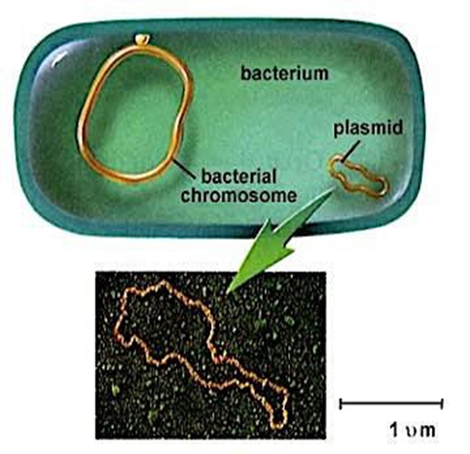
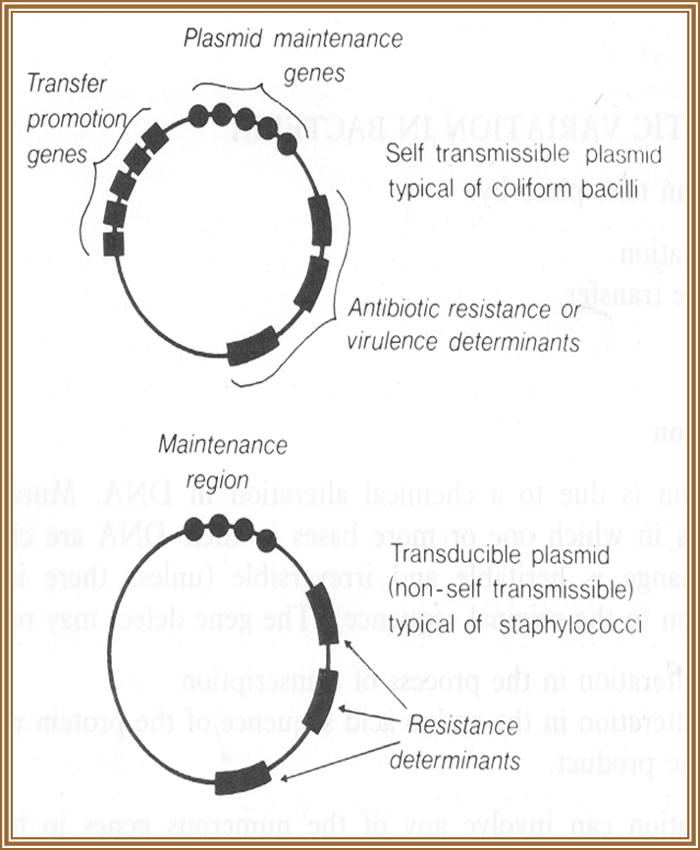
Plasmids

Slide 15
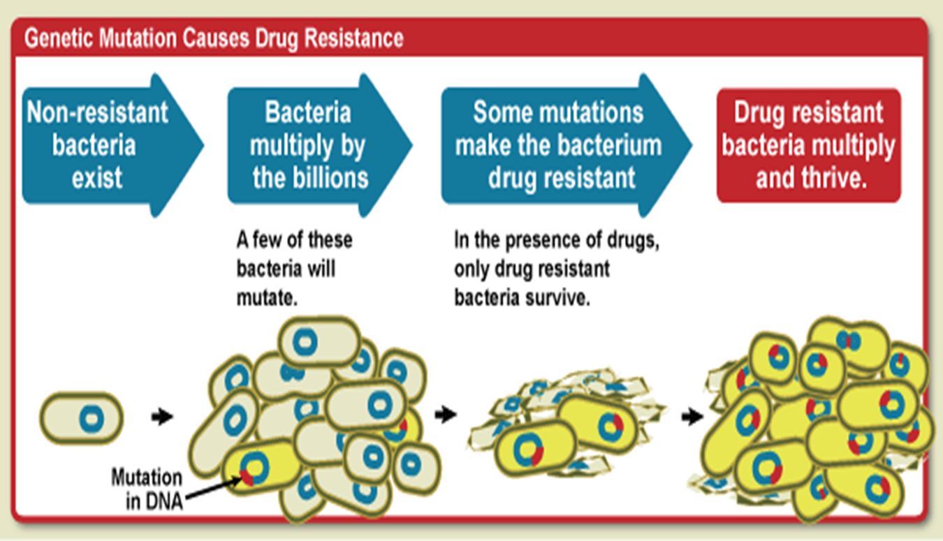
Genetic variation in bacteria -1- Mutation
Mutation
Inheritable changes in the structure of genes (DNA).
Chemical changes in one or more bases of DNA.
(so their characteristics change)
Mutation /gene defect leads to alteration in:
Transcription
Amino acid sequences
Function eg. Bacteria resistant to antibiotic.
Mutation Causes Antimicrobial Resistance
Depends on biological sequencing:
1- Resistance mutation: affect structure of cell protein. Main application in medical practice bacteria become resistant to antibiotics.
2- Auxotrophic mutation: affect biosynthetic enzyme resulting in a nutritional requirement of mutant cell.
3- Lethal mutation: leads to death of bacteria.

Slide 16
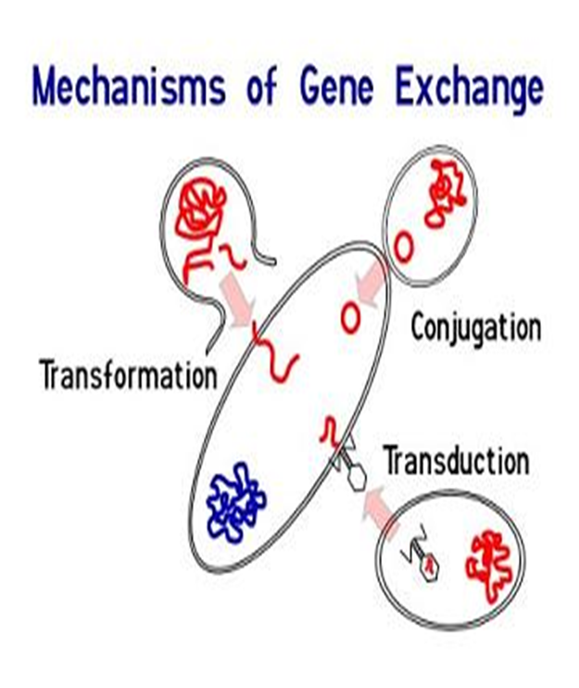
Genetic variation in bacteria -2- Gene transfer
Gene Transfer Among Bacteria
Three mechanisms:
1- Transformation
2- Transduction
3- Conjugation.
Transformation
A fragment of exogenous naked bacterial DNA are taken up and absorbed into recipient cells.
Common in Haemophilus influenzae & Streptococcus pneumoniae (they are very pathogenic especially in children). Bacteria become resistant to Ampicillin.
Transduction
Phage (a virus that infects/attacks bacteria) mediated transfer of genetic information from donor to recipient cells.
Example:
Beta – Lactamase production in Staphylococcus aureus :
Bacteria becomes resistant to penicillin.
Toxin production by Corynebacterium diphtheriae. (it gets the genes needed for the production of the toxin from the phage)
Conjugation is the common way of transfer of genes resistant to antibiotics among bacteria in hospitals.
1- Major way bacteria acquire additional genes. (mainly gram negative bacteria)
2- plasmid mediated (F factor -fertility)
cell contact required and genes reside in plasmid within
donor cells transfer to recipient cell (mating).
3- Gene encode changes in surface by producing a sex pilus .this facilitates capture of F- cells and the formation of a conjugation bridge through which DNA passes from F + into F-cells.

Slide 17
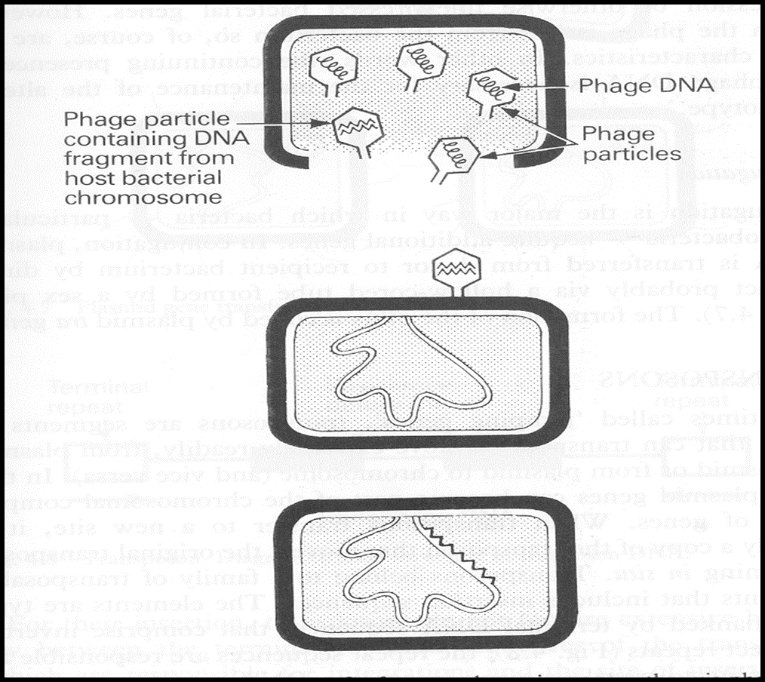
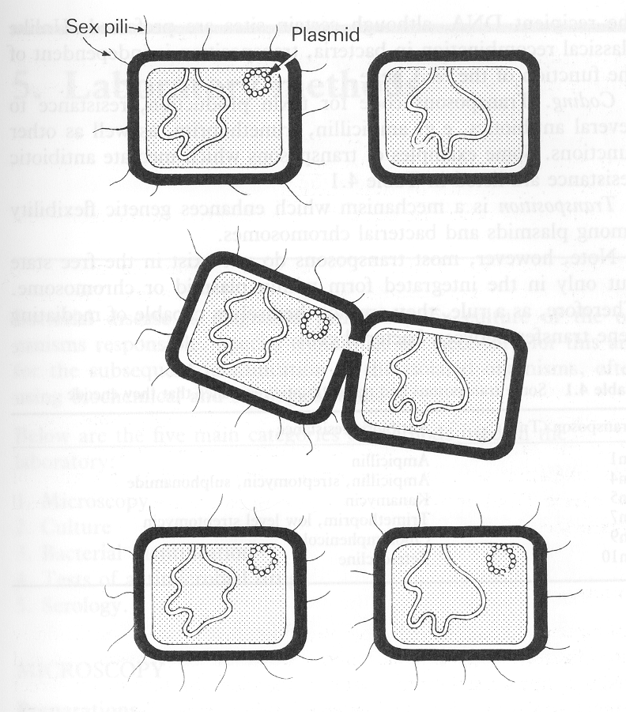
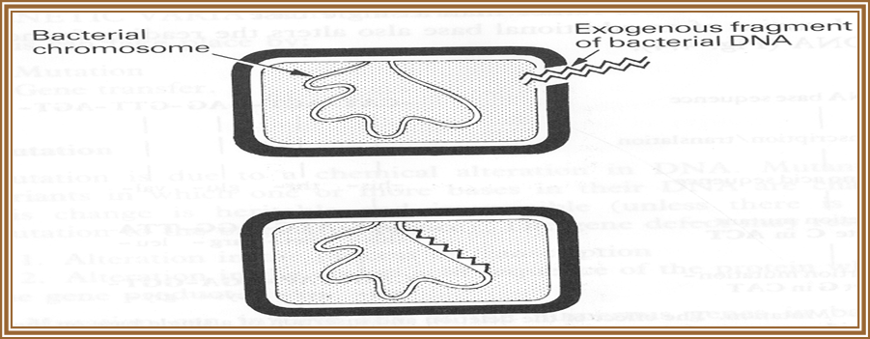
Transduction
Conjugation
Transformation

Slide 18
Genetic Recombination
After gene transfer, there are three possible fates:
1-Exogenous DNA degraded by nuclease.
2-Stabilized by circulization and become plasmid.
3- Form a partially hybrid chromosome (كروموسوم مهجن ) with segment derived from each source.
Transposable Elements
Genetic units capable of mediating own transfer from chromosome to another, from location to other on the same chromosome or between plasmid and chromosome or phage DNA
Types:
1- Transposons
2- Insertion sequence
NOTE
Transposable elements (TEs), also known as "jumping genes" or transposons, are sequences of DNA that move (or jump) from one location in the genome to another. Maize geneticist Barbara McClintock discovered TEs in the 1940s, and for decades thereafter, most scientists dismissedtransposons as useless or "junk" DNA.

Slide 19
Quiz and references
Sherries Medical Microbiology, an Introduction to Infectious Diseases.
Latest edition, Kenneth Ryan and George Ray. Publisher : McGraw Hill .
bacteria genetics explained skip to 4:15
https://www.onlinequizcreator.com/bacterial-structure-functions-genetics/quiz-312607

Slide 20

Team members:
Ghadah alHaidari
Noura AlKadi
Renad AlMogren
Esraa AlNzawi
Hadeel Awartani
Alaa AlSowigh
Elham AlAlmy
لايقوى الإنسان في الحياة على هذه الأرض من دون أن يعاونه النّاس ويقفوا معه.

