Slide 1
Microbiology – Lecture 2 Normal Flora
In this link, you will find any corrections or notes unmentioned in the team's work. Please check the link below frequently.
https://docs.google.com/presentation/d/1yIQt3G8UDFG6xYMRhXkTk-dS54NeTfhJaPe_y0M-kjk/edit?usp=sharing

Slide 2
Objectives
Define the terms: Normal Flora, Resident flora, Transient flora and carrier state
Know the origin of normal flora.
Know the importance of normal flora with examples, including importance as: Source of opportunistic infection., Immunostimulation, Nutrition: Vitamins production, Production of Carcinogens, Protection against external invaders.
Know areas of the body with normal flora (GIT, Urogenital tract, and skin) and most common types of organism in these areas and relation to pathogenicity of these organism.
Know sites of the body with no normal flora e.g. sterile body sites and the importance of this fact in relation to interpretation of culture results.

Slide 3
What is Normal flora?
They are a population of microorganisms that are frequently found on the skin ,mucous and other sites in a normal healthy individual.
Some are found in association with humans and animals. The Majority are bacteria.
Has symbolic relationship with the host.
Subject to constant changes.
Altered by antimicrobial agents.
Origin of Normal Flora:
1) Newborn is sterile in uterus.
2) After birth , newborn is exposed to flora of mother’s genital tract, skin, respiratory tract, flora of those handling him , and the organisms in the environment.
Normal flora
Beneficial Effects of Normal Flora
1- Immunostimulation (antibody production)
2- Exclusionary effect (vacuum effect ) and protection from external invaders. زي حرس الحدود
3- Antagonize other bacteria through the production of substances that inhibit or kill non-indigenous bacteria.
4-Production of essential nutrients (Vitamin K & B) by some normal intestinal flora eg. Eschericia coli ( E.coli).
Facts About Normal Flora
May be a source of opportunistic infections in patients with impaired defense mechanisms. eg. Staphylococcus epidermidis & E.coli. Found in skin
Some may cross react with normal tissue components ,eg. antibodies to various ABO group arise because of cross reaction between intestinal flora and the antigens of A & B blood substances.
Production of Carcinogens:
Some normal flora may modify through their enzymes chemicals in our diets into carcinogens. eg. artificial sweeteners may be enzymatically modified into bladder carcinogens.
Affected by antibiotics, tissue damage, mechanical procedures and diet change.
Especially to those who use them often

Slide 4
Types of Normal Flora
Note: they are subject to constant changes
Carrier flora potentially pathogenic and are present without symptoms because the person caring it has immunity
Transients
Carrier state
Transietes cont.
Exist temporarily for the following reasons:
they are washed by hand wash or bathing
competition by resident flora
killed by substances produced by resident flora
may not survive in acidic or alkaline PH of the body site
may be flushed away by bodily secretions like tears, sweat, oil urine,feces,..etc.
Consist of relatively fixed types of microorganisms . Regularly found in a given area at invariable period. If disturbed promptly re-establish itself .
Consist of nonpathogenic or potential pathogenic microorganisms that inhabit the skin or mucous membrane for hours or days. Establish itself briefly , excluded by host defense or competition from residents flora.
Microorganisms that have
natural relationship with the host. Found in
low number and has no benefit or harm .
Mainly associated with the GIT.
متعايشة
Residents
Potentially pathogenicthat are carried by the individual without
causing disease. However, it is the source of
infection to other susceptible (non-immune )
individual. , eg. Streptococcus pneumoniae, Neisseria meningetidis in throat of healthy individual
Commensals

Slide 5
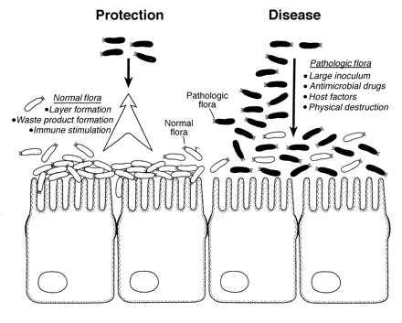
Normal Flora vs Pathogenic Flora

Slide 6
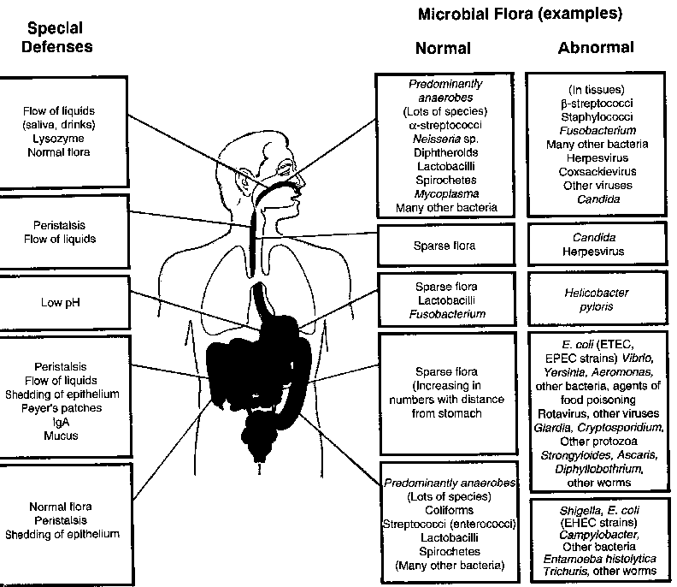
Distribution& Body Sites With Normal Flora
All external body sites contain normal flora. Each site having a predominant bacteria.
Gastro intestinal tract (GIT): mouth & large colon.
Team 436
Urogenital tract: vagina & distal one third of the urethra.
Skin: including external ear & conjunctiva.
Upper respiratory tract.
Internal organs are sterile at health “except the Gastrointestinal (alimentary)tract”.
Sterility maintained by :
Local defense mechanisms
Chemical substances in serum & tissues e.g.: complement, antibodies.
Phagocytic activity of (PMN) Polymorphonuclear Monocytes .
المهم في الصورة هو نعرف توزيع الفلورا في الجسم وكيف أنها تختلف كمية ونوعًا في كل منطقة، فمنطقة الفم والمرئ مليئة بالفلورا، بينما المعدة شبه معقمة، والأمعاء تتواجد فيها الفلورا لكن بشكل أقل من الجزء العلوى من الجهاز الهضمي.

Slide 7
Area | Sites | Normal Flora |  | Sterile Site | Information
Skin | Anaerobic organisms predominate in areas with sebaceous glands. | Main skin flora: 1) Corynebacteria. 2) Propionibacterium acnes. 3) Anaerobic cocci. 4) Staphylococcus epidermidis. 5) Coliforms {gram negative, moist skin often colonized by it}. | Potential pathogen: Less common: 1) Staphylococcus aureus. |  | * Skin has rich resident bacterial flora(10^4/cm^2). * Exist as microcolonies. * Fatty acid, lysozymes by sweat glands.
Eye | Conjunctival Sac. | 1) Corynebacterium xerosis. 2) Staphylococcus epidrmidis. |  | Internal eye.
Ear | External auditory meatus. | 1) S. epidermidis. 2) Corynebacteria. 3) Acid fast bacilli (AFB) {occasionally in wax}. Note ;Its normal non-pathogenic |  | Middle and inner ear.
435 note
Any skin has staph epidermidis and corynebacteria

Slide 8
Area | Site | Normal Flora |  | Sterile Site | Information
Respiratory Tract | Upper respiratory tract colonized by normal flora as in: 1) mouth. 2) nasopharynx. | Nose Flora: 1) Staphylococcus epidermidis. 2) Staphylococcus aurues 3) Corynebacteria. |  | Lower respiratory tract e.g.: lung.
Oropharynx |  | 1) Viridance streptococci. 2) Commensal neisseriae. 3) Corynebacteria. 4) Moraxella. 5) Bacteroides. 6) Fusobacteria. 7) Veillonella. 8) Actinomyces. 9) Spirochaetes. | Potiential pathogen: Most common: 1) Heamophilus inflenzea. 2) Pneumcoccus. Less common: 1) Streptococcus pyogenes. 2) Niesseria meningitidis. |  | Gram negative bacteria in hospitalize patient.
GIT | Mouth: * Saliva contains 10⁸ bacteria/ml. * Gingival margin debris & dental Plaque continually colonized by bacteria. Oesophagus: has normal flora similar to pharyngeal flora. Small Intestine: Duodenum, jejunum& upper ielium have scanty flora. Large intestine: heavily colonized by bacteria. |  |  | Empty stomach due to gastric acid. | Important: GIT contain mainly Anaerobic, gram–ve and enterococcus bacteria. (but it has 6 types we need to know). Note: GIT has Mostly Anaerobic bacteria (highest) because No oxygen in GIT.

Slide 9
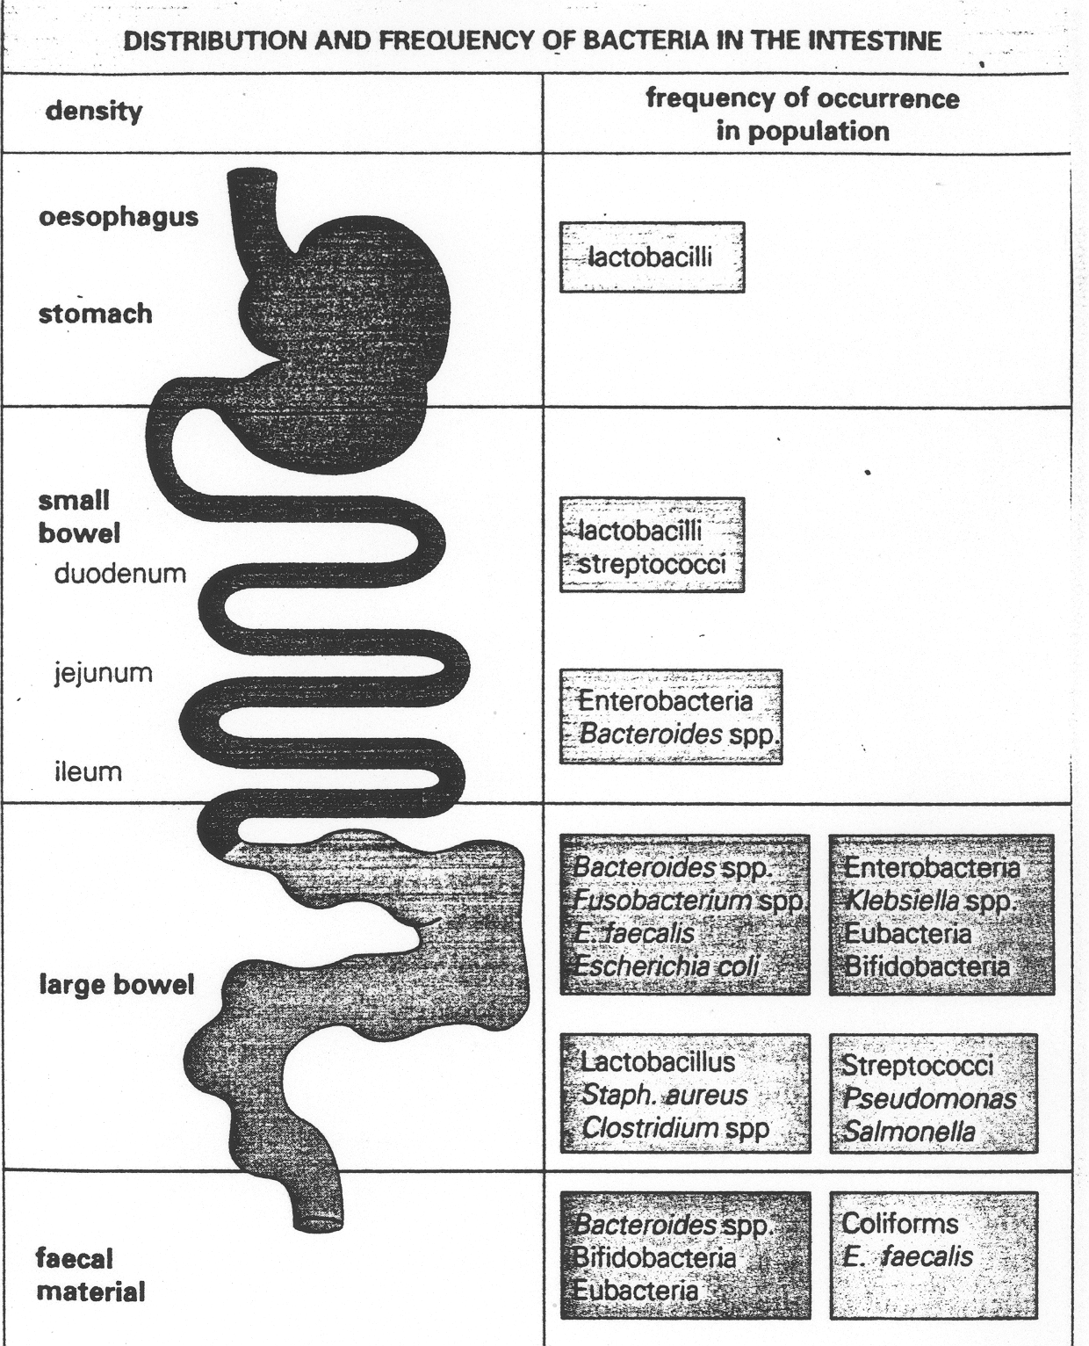
Empty stomach is sterile because of low ph
Area | Sites | Normal Flora |  | Sterile Site | Information
Feces(stool) Site with most normal flora |  | Anaerobics: Bacteroides fragilis group is the dominant anaerobes. 2) Bifidobacteria. 3) Lactobacill. Aerobics: 1) E.coli. 2) Proteus. |  |  | * 1/3 of feces weight is bacteria, mainly dead. * Living bacteria about 10¹⁰/gm. * 99% anaerobes. Anaerobic environment maintained by aerobic bacteria utilizing free O2. Less common aerobes.
Urinary tract |  |  |  | Kidney & bladder.

Slide 10
Area | Sites | Normal Flora |  | Sterile Site | Information
Genital Tract | In both sexs Distal urethra: | Mycobacterium smegmatis in (AFB) secretions which contaminate urine and leads to confusion /misdiagnosis. Distal urethra: 1) S.epidermidis. 2) Corynebacteria. 3) Mycoplasma species.
 | In Female: Vulva Vagina | Vulva: 1) S. epidermidis. 2) Corynebacteria. 3) E.coli. 4) coliforms. 5) Enterococcus faecalis. Vagina: 1) Lactobacillus (Doderlein’s bacilli). 2) Bacteroides melaninogenicus. 3) Enterococcus faecalis. 4) Corynebacteria. 5) Yeasts. 6) Mycoplasma. |  | Fallopian tube. | * Female genital tract heavily colonized, Why? - {Because it is short compared to the male genital tract. Also, the bacteria from the colon will come to colonize it. This is why we find that the flora in the genital tract is the same as in the colon.} * 10⁸/ml flora in normal vaginal secretion.

Slide 11
GIT flora similar with the oral cavity with 2 types of bacteria
Oral cavity differ then GIT with one type bacteria
GIT differ with Oral cavity by 4 different types
GIT = most contaminated with 6 types of bacteria
Female genital = least contaminated (only one type)
 | Staphylococcus aurous (Coagulase +) | Other Staph(Coagulase -) | Alph Hemolytic Streptococci (viridians Streptococci and strept pneumo | Enterococcus | Neisseria ,Moraxella and Heaomophilus | Corynebacteria (diphtheroid) Popionibacterium | Lactobacillus note: found in sexually active. i.e. 15 – 45 yrs | Gram Negative Bacteria (coliform ie E.coli) | Pseudomonas | Anaerobic bacteria (Bactericides, fusobacterium and clostridium )
Oral Cavity |  |  | +++ |  | +++ |  |  |  |  | +++
Skin |  | +++ |  |  |  | +++
Eye and ear |  | +++ |  |  |  | +++
Axilla, Groin and nose | +++ | +++ |  |  |  | +++
GIT |  |  | +++ | +++ |  |  | +++ | +++ | +++ | +++
female Genital |  |  |  |  |  |  | +++
Team 436
Only in skin!!

Slide 12
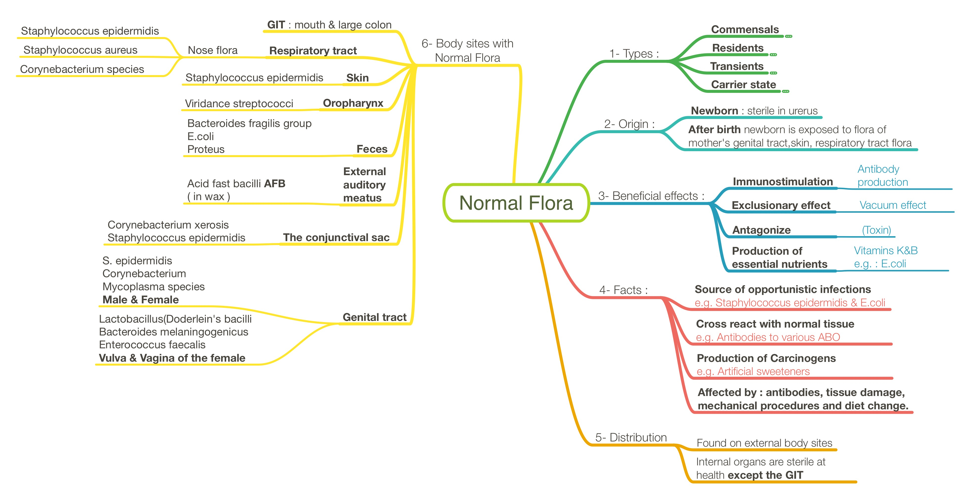

Slide 13
Quiz
1- Beneficial effects of normal flora includes:
A)Immunostimulation
B)Production of vitamins C and E by GI flora
C)Production of inhibiting or killing substances against foreign bacteria
D)A&C
2. A resident normal flora is:
a)iMicroorganisms that have natural relationship with the host
b)Regularly found in a given area at invariable period.
c)Consist of nonpathogenic or potential pathogenic microorganisms that inhabit the skin
4.Which one of the following is the most common bacteria in the skin?
A)Staphylococcus epidermidis
B)Coliforms
C)Proteus
D)E.coli
3. The type of relationship between normal flora and host is:
a)complicated
b)parasitic
c)symbolic
d)reversible

Slide 14
Quiz
5.Which one of the following is sterile?
A)jejunum
B)skin
C)vagina
D)peritoneum
8. Among the normal flora found in the vagina is?
a)E.coli
b)Lactobacillus
c)Enterococcus faecalis
6.Which of the following is not sterile?
a)Heart
b)uterus
c) GI Tract
d) liver
7. which is sterile?
a)Empty stomach
b)Inner ear
b)Internal eye
d)all of the above
Answer key:
d
b
c
a
d
c
d
b

Slide 15
لايقوى الإنسان في الحياة على هذه الأرض من دون أن يعاونه النّاس ويقفوا معه.
Team members:
داود إسماعيل
عمر الفوزان
عبدالله الزهراني
معن شكر
عبدالمجيد الوردي
محمد إبراهيم
عمر السحيباني
سيف المشاري
سعد العقيلي
فهد الشغيرثي
حسين علامي
الهام العلامي
الاء الصويغ رناد المقرن هديل عورتاني اسراء النزاوي لمياء القويز شوق القحطاني نورة القاضي افنان المصطفى رهف الشمري الهنوف الجلعود
فهد الفايز
سعد الهداب
خالد الدوسري
خالد المطيري
أنس السيف
عبدالجبار اليماني
عبدالله السرجاني
عبدالعزيز الدخيل
عادل العريني
محمد الدويغري
Team leaders:
غادة الحيدري ، علي الشحادة
For any corrections, suggestions or any useful information please contact us at: Micro.437@hotmail.com

