Slide 1
Microbiology – Lecture Host parasite relationship
In this link, you will find any corrections or notes unmentioned in the team's work. Please check the link below frequently.
https://docs.google.com/presentation/d/1yIQt3G8UDFG6xYMRhXkTk-dS54NeTfhJaPe_y0M-kjk/edit?usp=sharing

Slide 2
Objectives
1-Define core terms important in understanding host-parasite relationship: parasite, pathogen, pathogenicity, disease, infection.
2-Know host response to parasite invasion that include; nonspecific and specific defense mechanisms.
3-Name the important examples of primary pathogens and opportunistic pathogens.
4- Recognize the differences between virulence and pathogenicity and know how virulence is measured.
5- Recognize the transmissibility of pathogens.
6- Describe the attributes of pathogenicity and recalls examples, including:
a- Adherence
b- Survival of host natural defence mechanisms
C-Invasion (capsulated and non capsulated organisms)
d- Multiplication
e- Tissue destruction by toxins (the differences between endotoxins and exotoxins)
7- States Koch's postulates.

Slide 3
Host-Parasite Relationship
Human host is normally in contact with many microorganisms (normal flora), only a small number of these microorganism (primary and opportunistic pathogens) can cause disease.
Host-parasite relationships
Organism:
Fighting to invade body
Body:
defending itself by protective measures

Slide 4
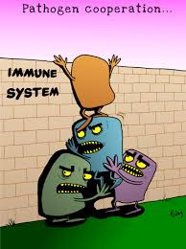
Definitions
Transmissibility: The ability to spread from one host to another. This enables the microorganism to maintain continuity of its species in the event of death of original host. | Disease: is the end product of an infectious process. | Pathogen: A microorganism having the capacity to cause disease in a particular host. | Pathogenicity: The ability of a microorganism to cause disease.
Disease in the host:
Resistance:
The ability of the host to prevent establishment of infection by using its defense mechanisms.
Susceptibility:
Lack of this resistance and establishment of disease.

Slide 5
Pathogens
Can be divided according to the degree of Pathogenecity into:
Cause disease in non- immune host to that organism(diseases). Can cause disease even with strong immune system. When the organism is able to produce disease even in an apparently healthy host it is referred to as primary pathogen Ex:
- Bordetella species
- Mycobacterium tuberculosis
Primary pathogens:
having low pathogenicity and infect people with low immunity. Only cause disease when the immune system is weak. When the organism causes disease only when the host’s defenses are impaired, it is called secondary pathogen (opportunistic pathogen).
Ex:
- Pseudomonas
Opportunistic pathogens:

Slide 6
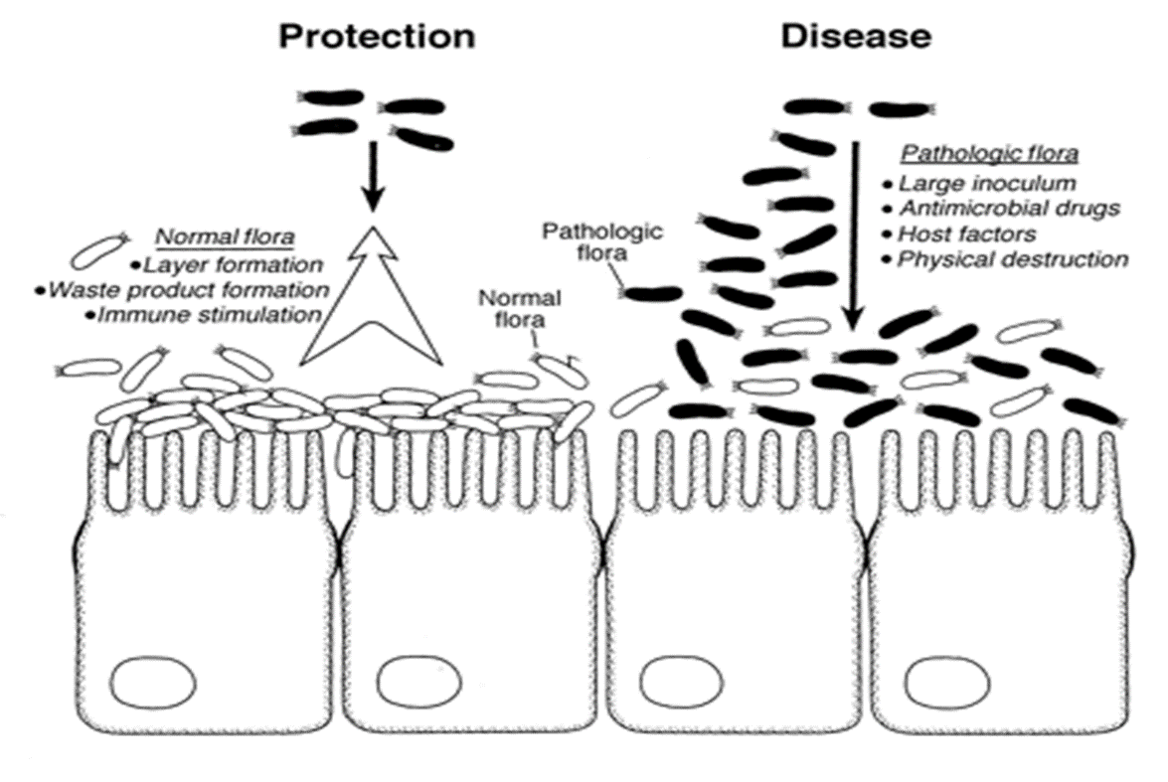
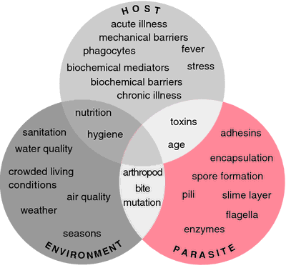
Infection and virulence
Infection:
is simply invasion of cells and multiplication by microorganisms without tissue destruction.
Virulence:
is an ability to invade and destroy tissue to produce disease.
Virulence is measured by the Lethal dose 50 (LD50) which is the number of organisms or mg. of toxins that will kill 50% of susceptible lab. animal ( usually mice ) when injected into such animal. When the LD 50 is small, the microorganism is considered highly virulent and when it is high the organism is said to be of low virulence.

Slide 7
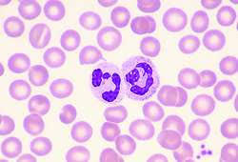
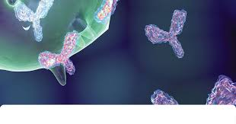
Pathogenicity : Host Resistance To Parasite Invasion
Non specific defense : is part of natural constitution of the host. Examples:
Skin mechanical barrier
ciliated epithelium of respiratory tract
Competition by normal flora
Low pH in the stomach
Cough
Peristalsis (movement of intestines)
Lysozymes (abundant in the eye)
Neutrophils (WBC)
specific defense : is acquired resistance to certain organism
formation of Antibodies

Slide 8
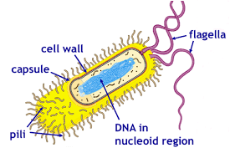
Determinants of Pathogenicity
Before causing disease, the microorganism should have the ability to:
b) Survive host natural defense mechanisms. | a) Adherence: the ability to attach firmly to host epithelial surface.
d) Tissue Destruction :the ability to overcome host defense , invade the tissues and cause destruction to produce clinical disease. | c) Multiply to large numbers.
Structures on host cells involved in adhesion include:
Adherence:
a) Fibronectin
By means of adhesins (attachment apparatus) found on bacterial surfaces.
examples:
a) Pili
b)Other protein surface structures
b)Proteins and Glycopeptide parts

Slide 9
Tissue destruction
Tissue destruction is produced by:
Invasion by: | Toxin production
Endotoxin سم داخلي: only found in gram negative bacteria.
Exotoxin sl ohv[d: produced outside the gram positive and gram negative bacteria.
Exotoxin can be:
A - B –exotoxins
A =Active Unit
B =Binding Unit for attachment
e.g. Cholera toxins
B) Membrane active exotoxin
e.g. Hemolysin of group A Streptococci
Capsulated organisms, bacterial capsules are all made of polysaccharide except that of B. anthracis (made of polypeptide).
Capsule prevent phagocytosis:
such organisms are readily killed once they are phagocytosed. So they’re called extracellular organisms
e.g. Pneumococcus
Non capsulated, organisms resist intracellular killing so they’re called intracellular organisms.
e.g.
- Mycobacterium tuberculosis
Salmonella typhi
Brucella species

Slide 10
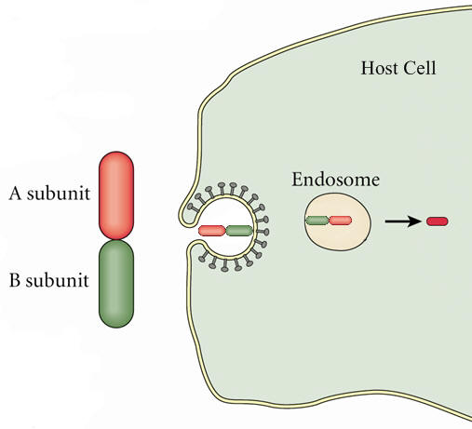
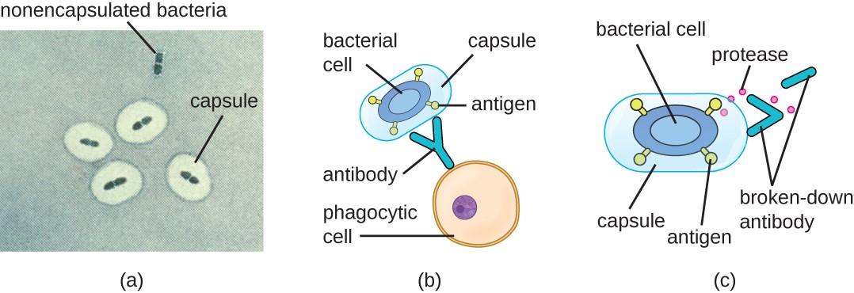
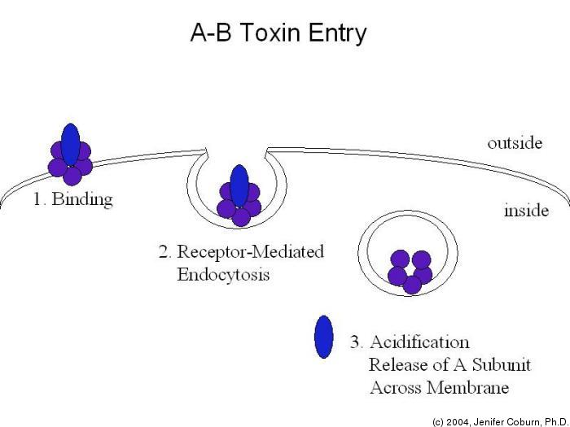
Tissue destruction
A: Active unit
B: Binding unit for attachment
A-B Toxin
Capsulated and non-capsulated bacteria

Slide 11
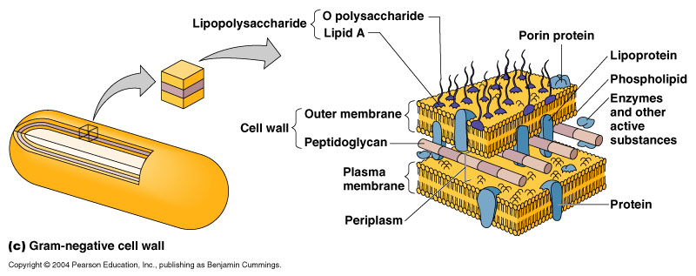
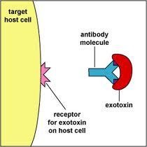
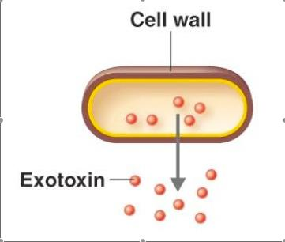
Exotoxin
Exotoxin versus Endotoxin
Endotoxin
Exotoxin
Endotoxin
1- Protein
Lipopolysaccharide
2- Soluble & Diffusible
Part of cell wall
3- Heat Labile
Heat stable
4- Pharmacologically specific action
Non-Specific
5- High Immunogenicity
Low Immunogenicity
6- Inactivated by Chemicals to toxoids
Do not form toxoids
7- No Fever
Induce Fever

Slide 12
Koch’s Postulates
a) The organism must be found in all cases of the disease and its distribution in the body must correspond to that of the lesions observed in the host.
c) The organisms should reproduce the disease in other susceptible animal hosts.
For a microorganism to be accepted as the cause of an infectious disease it must satisfy all or most of these criteria:
b) The organism should be cultured in pure culture from all cases of the disease.
N.B. Some organisms are yet to be cultured in the lab.
e.g. Treponema pallidum, M. leprae.
d) Antibodies to the disease usually develop in the course of the disease.

Slide 13
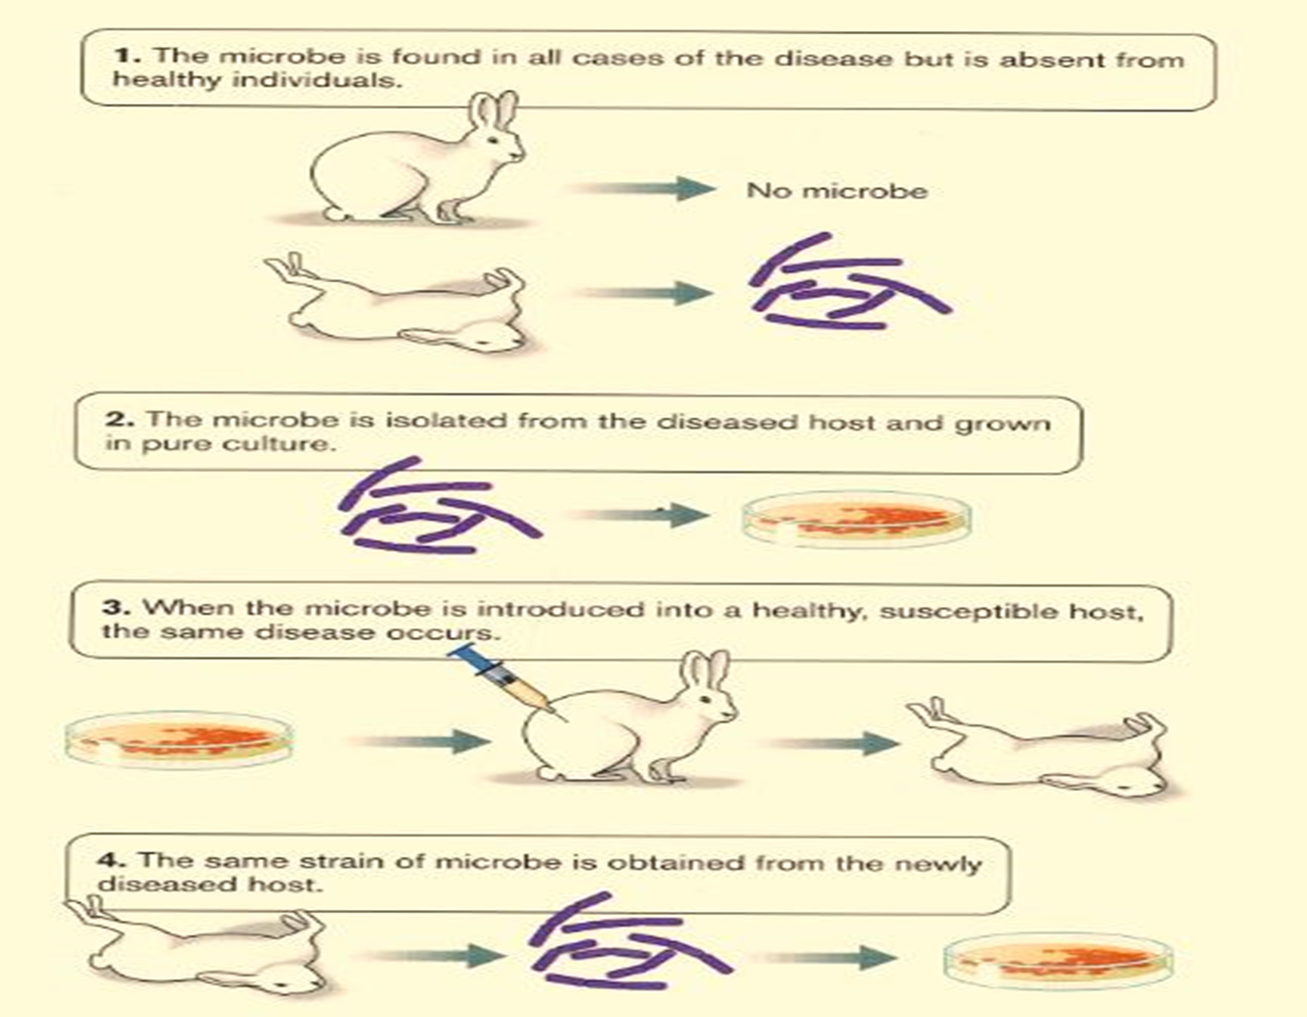
Koch’s Postulates

Slide 14
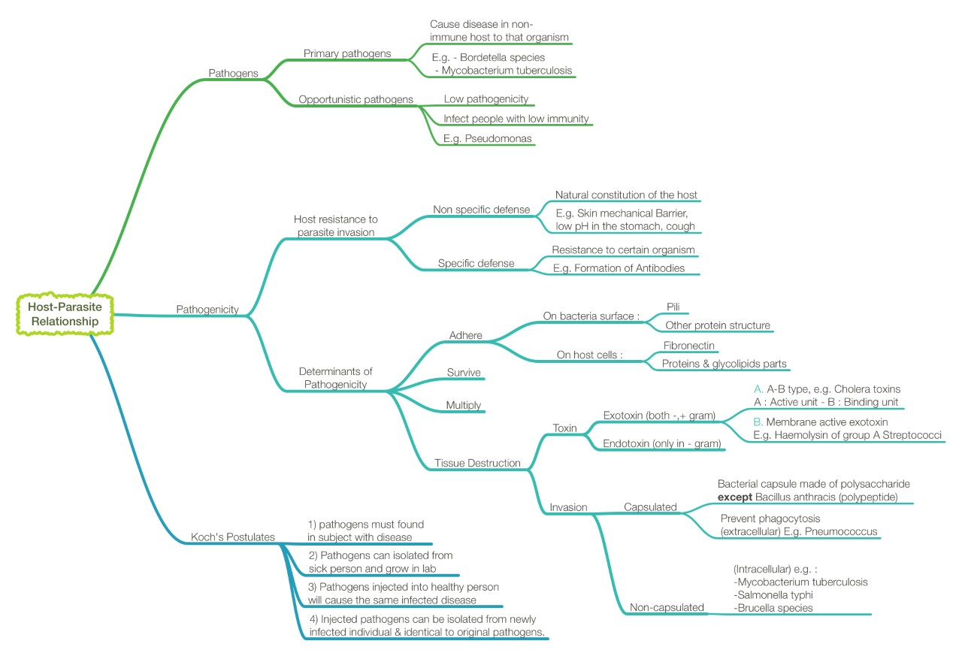

Slide 15
Questions
1-Refers to a microorganism having the capacity to cause disease in a particular host?
a) Antigen b) Infection c) Pathogen d)Flora
2- The ability of the host to prevent establishment of infection by using its defence mechanisms?
a) Resistance b) Susceptibility c)Pathogenicity d) Disease
3- An example of a primary pathogen?
a)Tuberculosis b) Pseudomonas c) Mycobacterium tuberculosis d)E.coli
4-An ability to invade and destroy tissue to produce disease is referred to as?
a) Infection b)Disease c) Virulence d) Pathogenicity

Slide 16
Questions and video
5-Example of endotoxin?
a) Protein b)Virus c) Bacteria d) Lipopolysaccharide
6- A determinant of pathogenicity?
a) Tissue Repair b) Inflammation c) Tissue Destruction d)Bacteria
7- The ability to spread from one host to another is transmissibility
a) True b) False
Useful video: https://youtu.be/nhj4I6YdVBo
1-C 2-A 3-C 4-C 5-D 6-C 7-A

Slide 17
لايقوى الإنسان في الحياة على هذه الأرض من دون أن يعاونه النّاس ويقفوا معه.
Team members:
فهد الفايز
سعد الهداب
خالد الدوسري
خالد المطيري
أنس السيف
عبدالجبار اليماني
عبدالله السرجاني
عبدالعزيز الدخيل
عادل العريني
محمد الدويغري
داود إسماعيل
عمر الفوزان
عبدالله الزهراني
معن شكر
عبدالمجيد الوردي
محمد إبراهيم
عمر السحيباني
سيف المشاري
سعد العقيلي
فهد الشغيرثي
حسين علامي
الهام العلامي
الاء الصويغ رناد المقرن هديل عورتاني اسراء النزاوي لمياء القويز شوق القحطاني نورة القاضي افنان المصطفى رهف الشمري الهنوف الجلعود
Team leaders:
غادة الحيدري ، علي الشحادة
For any corrections, suggestions or any useful information please contact us at: Micro.437@hotmail.com

