Slide 1
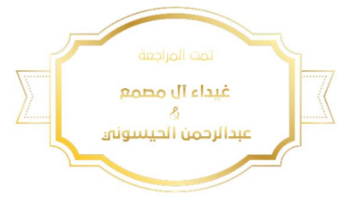
Microbiology – Lecture 3
Sterilization
In this link, you will find any corrections or notes unmentioned in the team's work. Please check the link below frequently.
https://docs.google.com/presentation/d/1yIQt3G8UDFG6xYMRhXkTk-dS54NeTfhJaPe_y0M-kjk/edit?usp=sharing

Slide 2
Objectives
1- Define the terms sterilization, disinfectant and antiseptic.
2- Classify the different methods of sterilization (physical and chemical methods).
3- Know and realizes that heat is the most important method of sterilization and its application in medical practice.
4- Know dry heat as applied in hot air Oven and moist heat as applied in autoclaves.
5- Know the principles of Autoclave function and monitoring methods of sterilization .
6- Know the importance of non heat sterilization methods and their use for sterilization of heat sensitive objects.
7-Know the difference between antiseptics and disinfectants.
8- Know types and scope of function of the disinfectants and antiseptics and factors affecting their functions.
9- Know the medical applications of different disinfections and antiseptics.

Slide 3
Definition and sterilization methods
Term | Definition
Sterilization | complete killing of all forms of microorganisms, including bacterial spores
Disinfection | killing or removing of harmful vegetative microorganisms.
Disinfectant | chemical substance used to achieve disinfection used on inanimate objects. Toxic to humans.
Antiseptic | disinfectant that can be safely used on living tissues.
Methods of Sterilization
Physical methods | Heat ( dry heat & moist heat), most important and should be used whenever possible. U.V. Light, ( ultra violet) Ionizing Radiation Filtration
Chemical method; used for heat sensitive equipment. | Ethylene Oxide Gluteraldehyde
Using very strong chemicals

Slide 4
1-Sterilization Monitor by physical, chemical or biological) | A-Physical | Heat | Dry Metals,Glassware,Ointment / Oils/ Waxes/Powder | 160˚C /60 mints
 |  |  | Moist heat | 121º C /15 mints or 134º C /10 mints
 |  |  | Pasteurization For milk | 74°C for 3-5 seconds or 62°C /30 mints
 |  | UV Light | TB lab | 254 nm waves
 |  | Ionizing Radiation | sterilization of disposable | X- rays, gamma rays & cosmic rays
 | B-Chemical (heat sensitive) | Ethylene Oxide (gas) | endoscopes | 55-60°C /4-6 hours.
 |  | Gluteraldehyde (Aldehydes) | Endoscopes anesthetic tubes | 2% 20 mints –TB 2 hrs
 |  | Filtration | For sera and antibiotics | 0.22-0.24 µm pores
2-Disinfectant |  | Phenolics fluids | Surfaces Surgical and neonal units | 1-2%
 |  | Gluteraldehyde | surfaces | 2%
 |  | Alcohole | Surfaces/thermometer
3-Antiseptic |  | Chlorhexidine | skin | 0.5%
 |  | Iodine (halogens) | skin | 10%
 |  | Alcohole | skin | 70%
Notes:
Quaternary ammonium compounds
Quaternary ammonium compounds (Quats), such as benzalkonium chloride, are a large group of related compounds. Some have been used as low level disinfectants. They are effective against bacteria, but not against some species of Pseudomonas bacteria or bacterial spores. Quats are biocides which also kill algae and are used as an additive in large-scale industrial water systems to minimize undesired biological growth. Quaternary ammonium compounds can also be effective disinfectants against enveloped viruses.
is another accepted liquid sterilizing agent. Household bleach, also used in hospitals and biological research laboratories, consists of 5.25% sodium hypochlorite. At this concentration it is most stable for storage, but not most active. According to the Beth Israel Deaconess Medical Center Biosafety Manual (2004 edition), in most cases, it should be diluted to 1/10 of its storage concentration immediately before use; however, it should be diluted only to 1/5 of the storage concentration to kill Mycobacterium tuberculosis. This dilution factor must take into account the volume of any liquid waste that it is being used to sterilize. Bleach will kill many organisms immediately, but should be allowed to incubate for 20 minutes for full sterilization. Bleach will kill many spores, but is ineffective against certain extremely resistant spores. It is highly corrosive, even causing rust of stainless steel surgical implements.

Slide 5
Level | uses | application | example
High-level disinfectants Kill all including spores | Used for items involved in invasive procedures but NOT withstand sterilization ( critical) | Endoscopes, Surgical instruments | Moist heat Gluteraldehyde Hydrogen peroxide Chlorine dioxide Formaldehyde Peracetic acid
Intermediate-level disinfectants Kill all including mycobacterium non-enveloped viruses fungus and bacteria | Used for cleaning surface or instruments without bacterial spores and highly resilient organism ( semicritical) | Laryngoscopes, Anesthesia breathing circuits…etc | Phenol compounds Alcohol Iodophor
Low-level disinfectants Enveloped viruses and bacteria | Used to treat noncritical instruments and devices, not penetrating into mucosa surfaces or sterile tissues (noncritical) | Hospital surfaces | Quaternary ammonium compounds

Slide 6
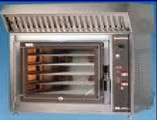
PHYSICAL METHODS
COMMON HEAT METHODS
1.Dry heat
2.Moist heat
Dry Heat- kills microorganisms by destroying their oxidative processes. At temperature of 160C for 1 hour.
Simplest method is exposing item to be sterilized to the naked flame e.g. Bunsen burner- for sterilizing bacteriological loops, knives, blades. Hot air oven expose items to 160 °C for 1 hour.
Has electric element in chamber as source of heat plus a fan to circulate air for even distribution of heat in chamber. Oven without fan is dangerous. Used for items that are lacking water such as:
Metals
Glassware
Ointment / Oils/ Waxes /Powder
Uses hot water. Moist heat kills microorganisms by denaturation proteins.
Autoclaving : The autoclave is a tough double walled chamber in which air is replaced by pure saturated steam under pressure.
standard sterilization method in hospitals.
The equipment is called Autoclave and it works under the same principle as the pressure cooker where water boils at increased atmosphere pressure i.e. because of increase pressure the boiling point of water is >100 °C.

Slide 7
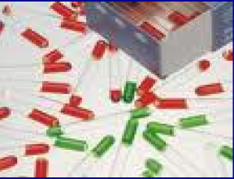
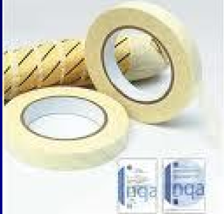
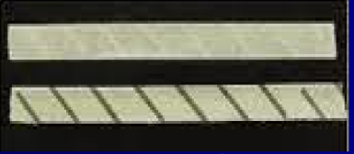
Autoclaving and how it works
1. Physical method: use of thermocouple to measure accurately the temperature.
2. Chemical method: it consists of heat sensitive chemical that changes color at the right temperature and exposure time. e.g:
a)- Autoclave tape
b)- Browne’s tube.
3. Biological method: where a spore-bearing organism is added during the sterilization process and then cultured later to ensure that it has been killed.
Monitoring of Autoclaves
Advantages of Autoclave
Spore test is a biological indicator
Temp. > 100 C therefore spores killed.
Condensation of steam generates extra heat.
The condensation also allows the steam to penetrate rapidly into porous materials.
Note: for all invasive procedures at operating room or clinics, autoclavable equipments should be used.
This is autoclave tape; it will have NO black stripes before sterilization.
Black stripes AFTER sterilization

Slide 8
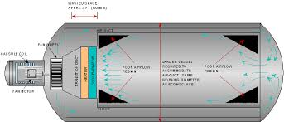
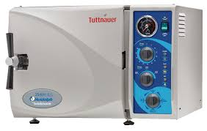
How does it work?
The air in the chamber is evacuated and filled with saturated steam. The chamber is closed tightly the steam keeps on filling into it and the pressure gradually increases. The items to be sterilized get completely surrounded by saturated steam (moist heat) which on contact with the surface of material to be sterilized condenses to release its latent heat of condensation which adds to already raised temperature of steam so that eventually all the microorganisms in what ever form are killed.
The usual temperature achieved is 121 °C , exposure time of only 15 minutes ( or 134 C for 10 minutes).

Slide 9
Moist heat: Other Applications
In short pasteurization :
Is the most effective way to sterilize.
-it requires high temperature and high pressure.
-it does the work at short time.
A) Pasteurization
B) Boiling
Used heat at temperatures sufficient to inactivate harmful organism in milk. The temperatures of sterilization is not achieved .
Temperature may be
74°C, for 3-5 seconds. ( Flash methods )
62°C for 30 minutes. ( Conventional method ).
Why do we pasteurize foods?
To prevent transmission of zoonotic diseases to humans, like :
Typhoid fever
Brucellosis
Tuberculosis
Q fever
quite common especially in domestic circumstances.
C) Steam Sterilizers
For babies’ bottles.

Slide 10
Other Physical Methods: Radiation
UV Light
Has limited sterilizing power because of poor penetration into most materials. Generally used in irradiation of air in certain areas such as operating rooms and tuberculosis labs.
Ionizing Radiation
e.g. Gamma radiation: has greater energy than U.V. light, therefore more effective. Used mainly in industrial facilities e.g. sterilization of disposable plastic syringes, gloves, specimens containers and Petri dishes.

Slide 11
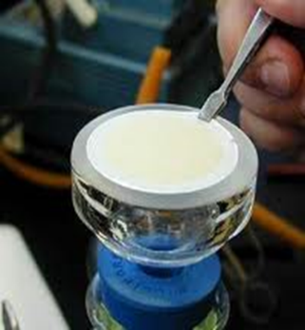
Other Physical Methods: Filtration
Use of membrane filter. Example; membrane filter made of cellulose acetate. Generally removes most bacteria but viruses and some small bacteria e.g. Chlamydia & Mycoplasma may pass through (require smaller pore size).
Thus filtration does not technically sterilize items but is adequate for circumstances under which is used.
Main use: for heat labile substances e.g. sera, antibiotics. Other use: AC of certain operating theatres.

Slide 12
Chemical Methods
Chemical Methods
Some strong chemical substances may be used to achieve sterilization (kill spores) e.g. Gluteraldehyde and Ethylene oxide. Used for heat sensitive equipment and materials e.g. lensed endoscopes and plastics.
Ethylene Oxide Chamber
Ethylene oxide alkylates DNA molecules and thereby inactivates microorganisms.
Temperature : 55-60°C and exposure period 4-6 hours.
Activated alkaline Gluteraldehyde 2%
Immerse item in solution for about 20 minutes.
If Mycobacterium tuberculosis or spores present then immersion period is 2-3 hours.
eg. phenolics, chlorhexidine, alcohol, iodine, etc..
Disinfectants /Antiseptics
Other uses: Hypochlorite (at certain concentrations) used for drinking water supply, house cleaning and swimming pools.
Note; Clorox is a tamer type of hypochlorite

Slide 13
Factors Influencing Activity of Disinfectants
1. Activity directly proportional to temperature.
2. Directly proportional to concentration up to an optimum concentration. After this level no advantage in further increases in concentration.
3. Disinfectants may be inactivated by:
A) Dirt
B) Organic matter: Proteins, Pus, Blood, Mucus and Feces.
C) Non organic: Cork, Hard water and Some plastics.
4. Time: Disinfectants need time to work.
5. Range of Action: Disinfectants not equally effective against the whole spectrum of microbes. e.g. Chlorhexidine less active against Gram negative bacteria than Gram positive cocci. Hypochlorite and Gluteraldehyde are more active against hepatitis viruses than most other disinfectants.
Note; it must be clean before disinfecting

Slide 14
Summary :Disinfectants & Antiseptics
Corrosive Action | Inactivated by |  | TB | Activity against |  | GPC | Disinfectants/ Antiseptics
 | Soap | Protein |  | Spores | GNB
+ | _ | + | + | _ | ++ | ++ | Phenolics Sudol
_ | _ | + | _ | _ | ++ | ++ | Izal
+ to + | _ | + | + | _ | ++ | ++ | Soluble Phenolic* e.g. clearsol
++ or +Φ (buffered Solution) | _ | ++ | + | ++ | ++ | ++ | Chlorine compound
_ | _ | + | + | + (Slow) | ++ | ++ | Lodophor
_ | _ | _ | _ | _ | + | ++ | Chlorhexidine (Hibitane)
_ | _ | ++ | + | _ | ++ | ++ | 70° alcohol
++ | _ | + | ++ | ++ (slow) | ++ | ++ | Formaldehyde
+ | _ | + | ++ | ++ | ++ | ++ | Gluteraldehyde (Cidex)

Slide 15
Hospital Disinfection Methods
Article:
Disinfectant:
Floors, walls
Phenolics fluids 1-2%
Surfaces tables
Hypochlorite, Alcohol
Skin:
Surgeons’ hands
Chlorhexidine, Iodine alcohol
Patient's skin
70% Alcohol, Iodine
_______
Endoscopes
Gluteraldehyde 2% (Cidex), sub-atmospheric steam
_______
Thermometers
70% Alcohol

Slide 16
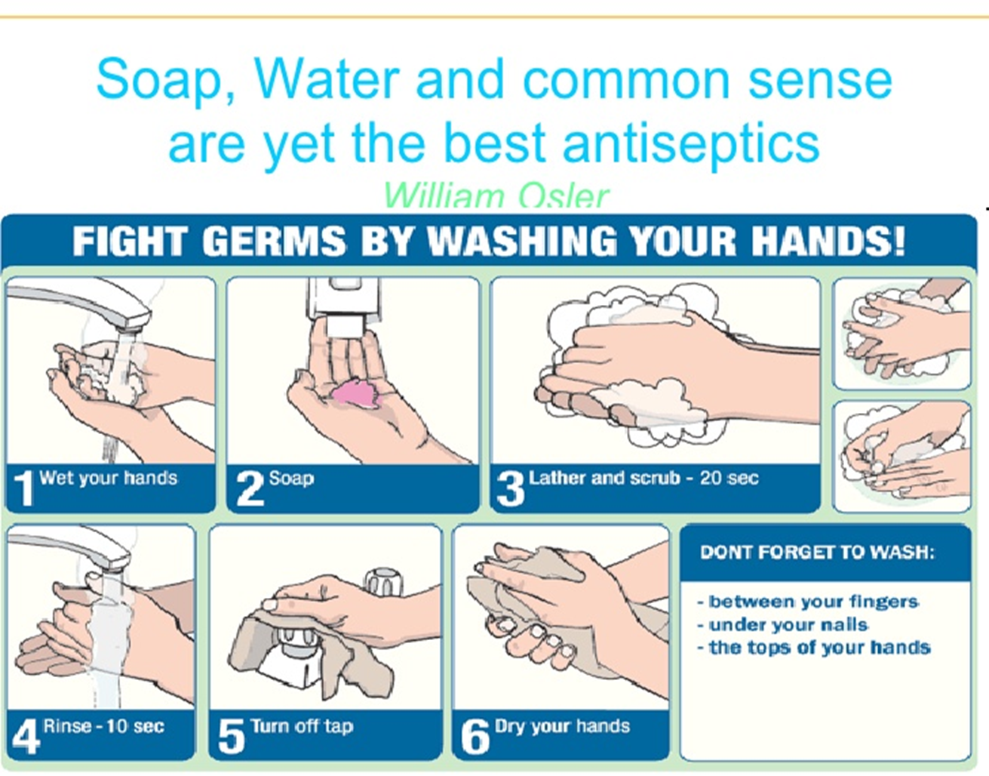
Important Points
Any instrument or item used for sterile body site should be sterile.
Any instrument or item used for non-sterile body site can be disinfected.

Slide 17
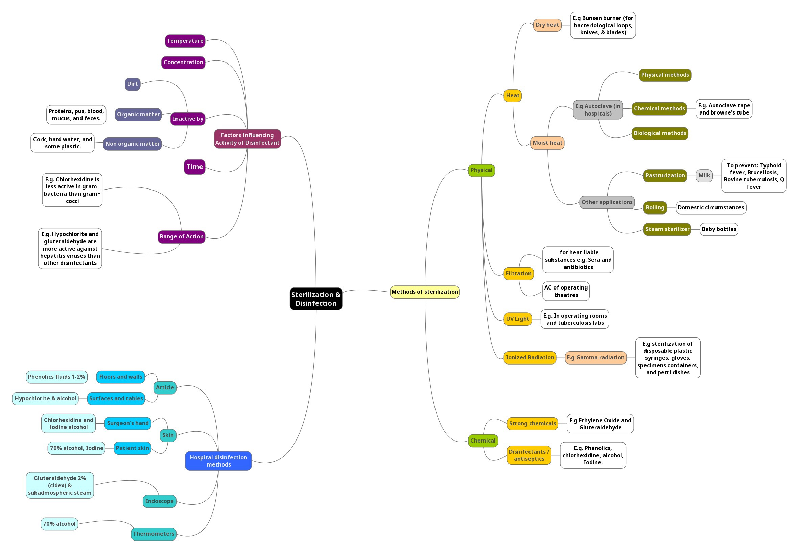

Slide 18
Quiz and references
1- killing or removing of harmful vegetative microorganisms, is:
A- sterilization b- disinfectant c- antiseptic d-disinfection
2- Disinfectants may be inactivated by :
A- water b-dirt c- soap d- washing
3-Gamma radiation: has greater energy than U.V. light, therefore more effective. Used mainly in :
A-industrial facilities b-tuberculosis labs c-Browne’s tube d-Patient's skin
4-We use pasteurization to prevent the transmission of which disease?
A-tuberculosis b-small pox c- hepatitis d-liver failure
5-Chlorhexidine less active against Gram:
A-positive b- negative
6- 74C, for 3-5 seconds is called:
A-frozen method b-conventional method c-flash method d-pasturized method
Answers
D
B
A
A
B
C
Sherries Medical Microbiology, an Introduction to Infectious Diseases.
Latest edition, Kenneth Ryan and George Ray. Publisher : McGraw Hill .

Slide 19
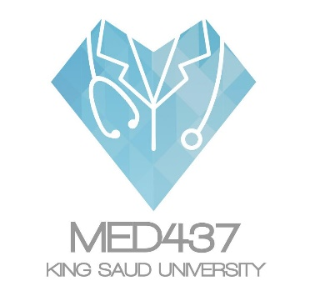
لايقوى الإنسان في الحياة على هذه الأرض من دون أن يعاونه النّاس ويقفوا معه.
Team members:
إلهام العلامي
رناد المقرن
هديل عورتاني
إسراء النزاوي
لمياء القويز
شوق القحطاني
نورة القاضي
أفنان المصطفى
رهف الشمري
الهنوف الجلعود
داود إسماعيل
عمر الفوزان
عبدالله الزهراني
معن شكر
عبدالمجيد الوردي
محمد إبراهيم
عمر السحيباني
سيف المشاري
سعد العقيلي
فهد الشغيرثي
حسين علامي
فهد الفايز
سعد الهداب
خالد الدوسري
خالد المطيري
أنس السيف
عبدالجبار اليماني
عبدالله السرجاني
عبدالعزيز الدخيل
عادل العريني
محمد الدويغري
Team leaders:
غادة الحيدري ، علي شحادة
For any corrections, suggestions or any useful information please contact us at: Micro.437@hotmail.com

